Slide 1

INVENTORY FORECAST DEMAND
Team Members :
Renu B -1RVU22CSE129
Karmishtha P-1RVU22CSE077
Radhika P-1RVU22CSE126

Slide 2
Overview
01
06
Outline
Experimental Results
02
07
Problem Statement
Result Analysis
03
08
Introduction
Future Work
04
09
Model and Methods
Conclusion
05
Dataset Details

Slide 3






Outline
Data preparation
Data Splitting
Model Development
Model Evaluation
Visualisation

Slide 4




Problem Statement
Efficient inventory management is essential for businesses to meet customer demand effectively while minimizing costs. However, accurately predicting inventory needs presents a significant challenge
Stockouts
Obsolete Inventory
Supply Chain Disruptions
Running out of products leads to lost sales & unhappy customers.
Products becoming outdated result in financial losses
Unexpected events like delays or transportation issues disrupt inventory flow, affecting customer satisfaction
Excess Inventory
Inaccurate Forecasts
Holding too much stock ties up money and space, increasing costs.
Poor predictions lead to inefficient ordering and mismatched inventory levels.

Slide 5






Introduction
Welcome to the Retail Sales Prediction presentation. Today, the focus is on analyzing sales data from 2010 to 2012 to forecast demand for Walmart, a major U.S. retail chain. This presentation will cover
Project Overview Understanding the goals.
Modeling Techniques Predicting sales methods.
Data Exploration & Preparation
Best Models and Analysis
Evaluating model performance.

Slide 6
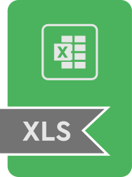






Methods & Models
Mount Drive
Import Libraries
Load Dataset
Print First 5 Rows
Data Visualization
Inference:
Best season - summer
TOTAL SALES IN EACH YR - 2011
TOTAL SALES IN EACH MONTH - july
TOTAL SALES IN EACH WEEK - week 51
HEAT MAP
Data Pre-Processing
Handling Missing values
Feature Engineering
EDA
Patterns+anomalies=Hypothesis

Slide 7
Methods & Models
After Data Visualization
Type Casting
Better Analysis
Copy code to df1
Numerical data to categorical (Explicit)
Store, holiday flag & week converted
Data Transformation
Data splitting
Numerical Features : ['Temperature', 'Fuel_Price', 'CPI', 'Unemployment']
Categorical Features:['Store','Holiday_Flag', 'week']

Slide 8



Methods & Models
After Detecting And Removing Outliers
Detecting & Removing
Outliers
Z-Score
Total outliers: 675 when threshold = 3
3 is standard deviation from mean is a common approach holding about 99.7% of data under a normal distribution
Hyperparameter Tuning(GRID SEARCH + RANDOMISED SEARCH)
Small dataset
Few hyperparameters
Grid search > Random search for accuracy
Cross Validation

Slide 9

Methods & Models
Supervised Learning
Linear
Regression
Polynomial Regression
Ridge
Regression
Lasso
Regression
Global estimator
Non-linear Relationship
Coefficient estimation
Predictive
Accuracy
Decision
Tree
Random
Forest
KNN
Regressor
XGB
Regressor
Individual predictions
Predictive accuracy
Local
estimation
Gradient
Boosting

Slide 10
Methods & Models
Unsupervised Learning
Deep Learning
K Means
Clustering
Hierachical
Clustering
Multi-Layer
Perceptron
Grouping unlabeled datasets
Organizing groups based on similarities
Interconnected neural network
Evaluation Metrics
Visualization
Supervised & Deep
Unsupervised
Distribution Plot
Mean Absolute Error (MAE)
Mean Squared Error (MSE)
Root Mean Squared Error (RMSE)
R Squared (R2)
Silhouette score
index

Slide 11
Dataset Details
Well-documented
Learning purpose
covers sales from 2010-02-05 to 2012-11-01
In the dataset,
Store - the store number
Date - the week of sales
Weekly_Sales - sales for the given store
Holiday_Flag - whether the week is a special holiday week 1 – Holiday week 0 – Non-holiday week
Temperature - Temperature on the day of sale
Fuel_Price - Cost of fuel in the region
CPI – Prevailing consumer price index
Unemployment - Prevailing unemployment rate
Holiday Events
Super Bowl: 12-Feb-10, 11-Feb-11, 10-Feb-12, 8-Feb-13
Labour Day: 10-Sep-10, 9-Sep-11, 7-Sep-12, 6-Sep-13
Thanksgiving: 26-Nov-10, 25-Nov-11, 23-Nov-12, 29-Nov-13
Christmas: 31-Dec-10, 30-Dec-11, 28-Dec-12, 27-Dec-13
One of the leading retail stores in the US, Walmart, would like to predict the sales and demand accurately. There are certain events and holidays which impact sales on each day. There are sales data available for 45 stores of Walmart. The business is facing a challenge due to unforeseen demands and runs out of stock some times

Slide 12
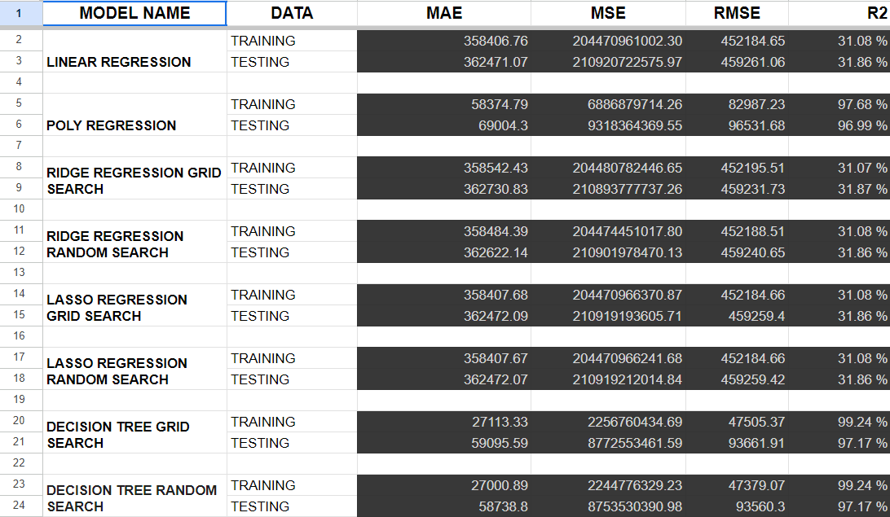
Experimental Results

Slide 13
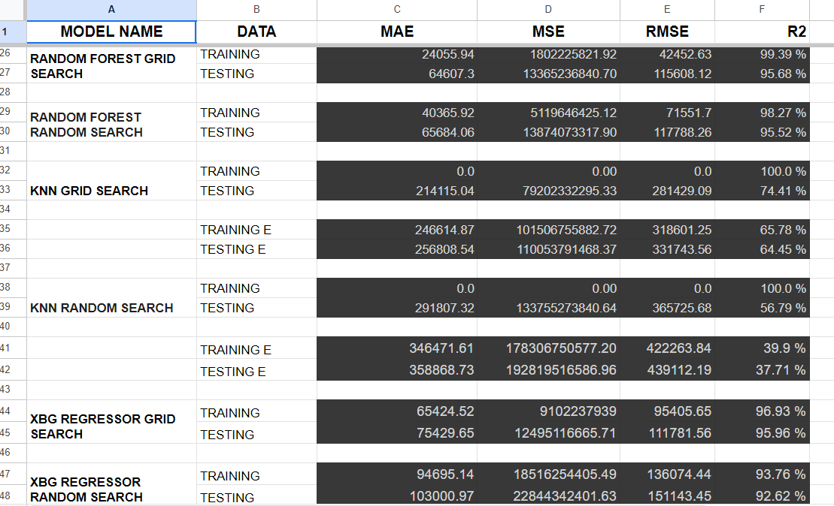
Experimental Results

Slide 14
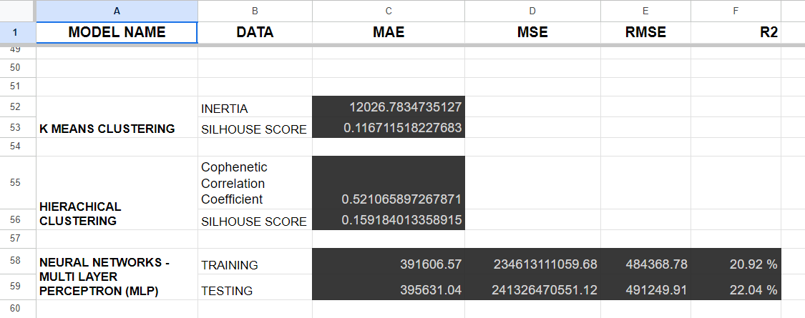
Experimental Results

Slide 15


Conclusion
Best Supervised Model
Decision Tree with Random Search or Random Forest with Grid Search
Low MAE, MSE, RMSE
High R2 scores on training and testing data
Best Unsupervised Model
Hierarchical clustering
Moderate cophenetic correlation
Higher silhouette score
Deep Learning Model (MLP)
High errors
Low R2 values
Model Analysis
Polynomial Regression, Random Forest, and XGB Regressor outperform others
Best scores
Generalization capability
Avoiding overfitting
Polynomial Regression achieves highest score

Slide 16

Future Works
Feature Engineering Refinement
Further exploration and engineering of features to capture more nuanced patterns and relationships in the data
Ensemble Methods Exploration
Investigate the effectiveness of ensemble methods such as stacking or blending to combine the strengths of multiple models and improve overall performance
Hyperparameter Fine-Tuning
Conduct thorough hyperparameter tuning for the selected models to optimize performance further and achieve even better results
Incorporate External Data
Explore the integration of additional external datasets, such as economic indicators or demographic information, to enhance the predictive capabilities of the models.
Deep Learning Architectures
Experiment with more complex deep learning architectures or pre-trained models to leverage the potential of neural networks for improved forecasting accuracy.

Slide 17
Thank You

