Slide 1


The Elastic Stack

Slide 2
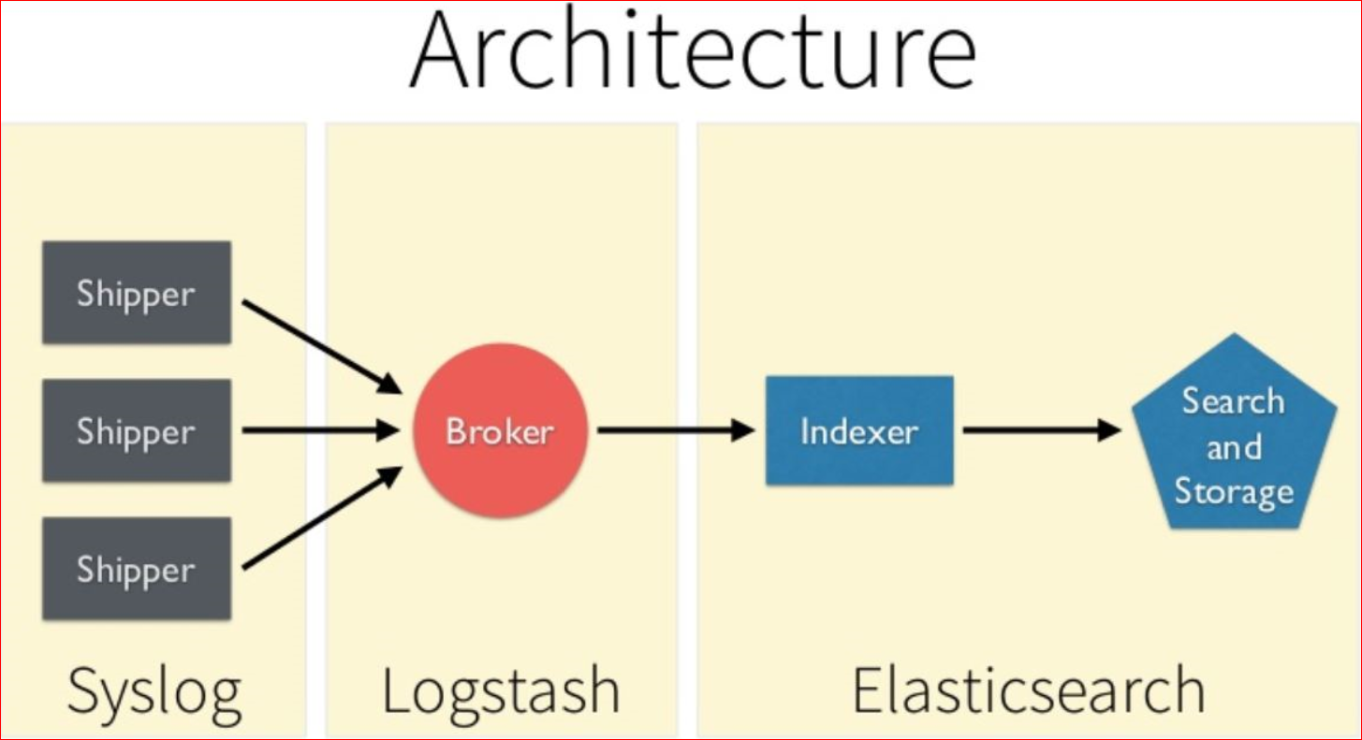
Existing ELK Model

Slide 3
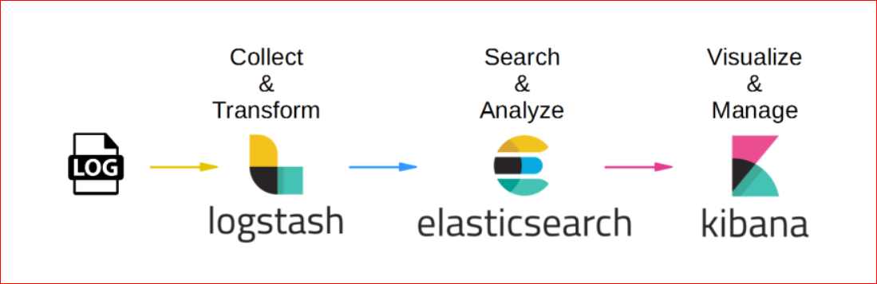
Log Analysis
Collective AIM:
Collect, transform, parse, analyze Various Unix System and N/W Logs.
Provide centralized access and search abilities to search Filter and aggregate the log data.
Related use case: Point in time Critical log searching based on desired Keywords or string patterns.

Slide 4
Elasticsearch The Search Engine
Schema-less
Distributed
REST-ful, Document-oriented, and Speaks JSON For searching and analytics
Highly scalable search index server
Based on Apache Lucene
Near real-time search and analysis capabilities
Document-oriented (structured) index entries which can (but must not) be associated with a schema
and more...

Slide 5

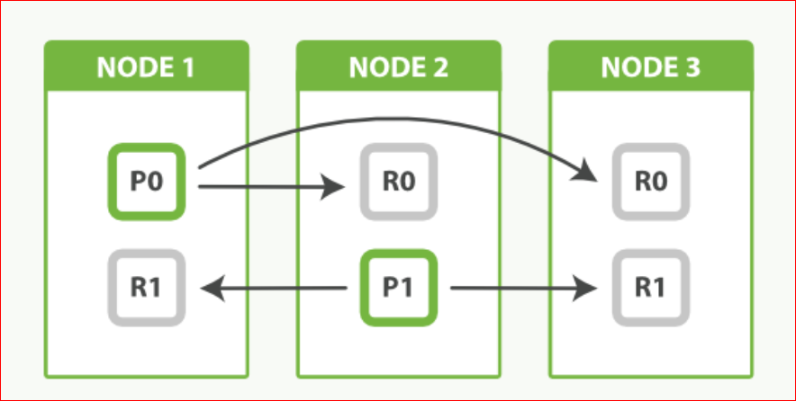
Scalability of Elasticsearch
Elasticsearch can run as one integrated application on multiple nodes of a cluster.
Indexes are stored in Lucene instances called “Shards” which can be distributed over several nodes.
There a two types of “Shards” Primary Shards & Replica.
Replicas of “Primary Shards” provide Failure tolerance and therefore protect data Make queries (search faster) faster

Slide 6
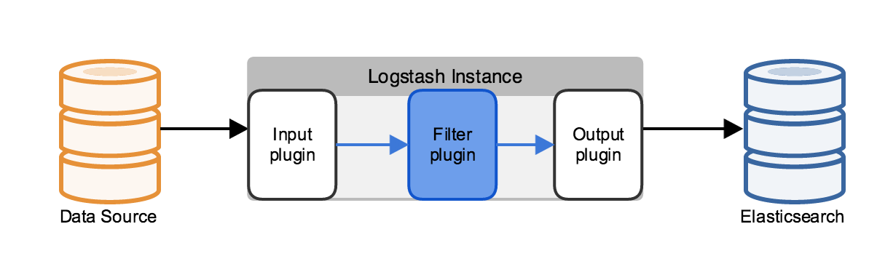
Logstash The Dataflow Engine
Open source software to collect, transform, filter and forward data (e.g. log data) from input sources to output sources (e.g. Elasticsearch)
Implemented in JRuby and runs on a JVM (Java Virtual Machine)
Simple message based architecture
Extendable by plugins (e.g. input, output, filter plugins)

Slide 7
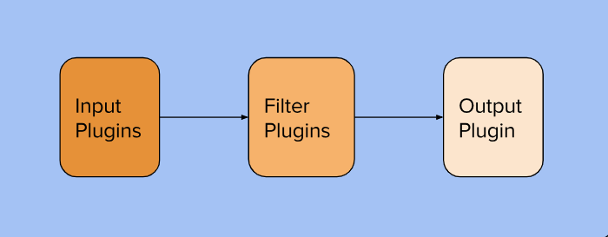
Logstash Internal architecture Logstash has a three-stage pipeline implemented in Jruby as Follows: Input: The input stage plugins extract data, This can be from logfiles, a TCP or UDP listener, one of several protocol-specific plugins such as syslog or IRC, or even queuing systems such as Redis etc. Filter: A filter plugin performs intermediary processing on an event which transforms and enrich the data by using various other plugins like grok etc. Output: The output stage plugins loads the processed events into something else, such as Elasticsearch or another document-database.

Slide 8
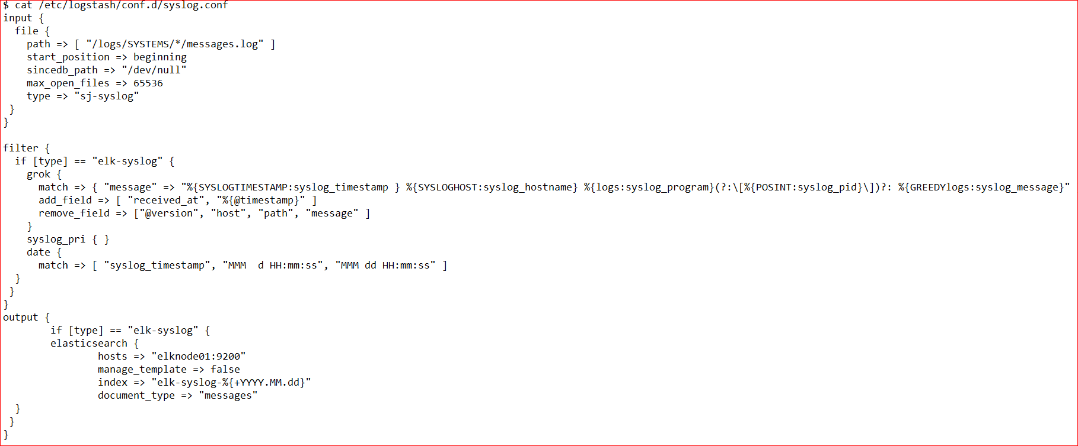
Configuration File
Multiple inputs of different types
Conditionally filter and transform data; some common formats are already known
Forward to multiple outputs

Slide 9
Kibana
Web-based application for exploring and visualizing data
Modern Browser-based interface (HTML5 + JavaScript)
Ships with its own web server for easy setup
Seamless integration with Elasticsearch.
Highly configurable/customizable, build panels with user defined charts, tables, etc.
Built on AngularJS

Slide 10
The Main ELK Configuration Files
The Kibana default configuration is stored kibana/config/kibana.yml.
/etc/kibana/kibana.yml
The Logstash configuration is stored in logstash/config/logstash.yml.
/etc/logstash/logstash.yml
The Logstash pipeline configuration is stored in logstash/pipeline/logstash.conf
/etc/logstash/conf.d/syslog.conf
The Elasticsearch configuration is stored in elasticsearch/config/elasticsearch.yml.
/etc/elasticsearch/elasticsearch.yml

Slide 11
Thanks!
Author: Karn Kumar

