Slide 1
DEPARTMENT OF ELECTRICAL AND ELECTRONICS ENGINEERING
18EEP202L-MINOR PROJECT
FINAL REVIEW
AUTOMATIC STREET LIGHTING
YEAR/ SEMESTER – II/IV
BATCH NUMBER :13
DATE : 22 /05/2024
GUIDED BY:
Dr.S.BANUMATHI PROFESSOR/EEE
PRESENTED BY: S.ATHIKESAVAN (927622BEE009)
P.S.CHARMITHA (927622BEE015)
S.KARNA (927622BEE051)

Slide 2
LIST OF CONTENTS
Problem Statement
Abstract
Problem Description
Components Used
Block Diagram
Hardware components
Working
Cost Estimation
Conclusion

Slide 3
PROBLEM STATEMENT
Street lights are continuously on even when there is sufficient amount of light is present. Existing light system needs man power, High Power consumption of electricity. Manual hectic operation due to change in season and climate. Street light are also on in the presence of sunlight. Due to carelessness of user large amount of power is consumed and thus energy is wasted. IR sensors are insensitive to very slow motion of the object.

Slide 4
ABSTRACT
In today's world,more amount of electricity is consumed due to street light.
This is due to continuous operation of lighting during the night time.
In order to reduce the electricity consumption and wastage of energy, the system that has to combine the existing network with intelligence to think it self.
This newly developed concept will be enabled in the street light to adjust automatically based on the real time traffic conditions and change according to naturalistic condition.
This paper is concerned with the development and implementation of low cost sensor based street light.
It helps to reduce the energy consumption .It consists of IR sensor ,low cost embedded controller and store device

Slide 5
DESCRIPTION
Street light comprises of a main power supply for providing power to the system, sensor for detecting the presence of an object, a light dependent resistor (LDR) for detecting the presence of light, a microcontroller for receiving the signal from both the sensors and control the system accordingly. A dual power supply unit for providing power to integrated chip embedded inside the micro controller and LEDs. As the vehicle passes on the road it can be sensed by the IR sensor. The system can adjust the intensity of light to provide brighter illumination in the movement of vehicles, When there is no movement of vehicles it automatically reduces the intensity of light. By implementing this system we can adjust the brightness of the light. It can Reduce the electrical power consumption around 35% to 40% of electricity.

Slide 6
COMPONENTS USED
Arduino
LDR
IR Sensor
Microcontroller
Resistor
LED Light

Slide 7
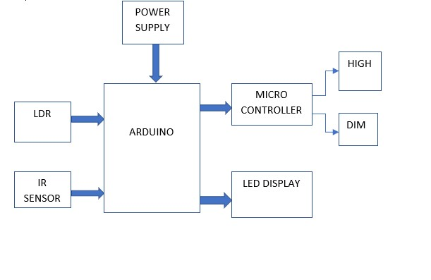
BLOCK DIAGRAM

Slide 8
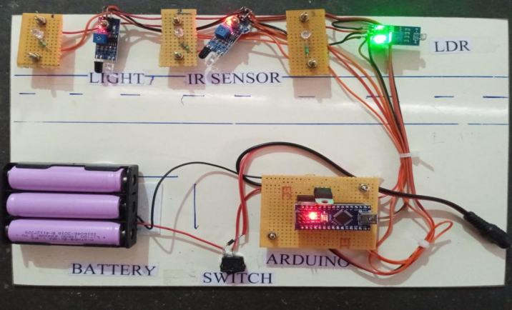

Slide 9
HARDWARE COMPONENTS
1.Battery.
The batteries will store the electricity and provide the energy to the street light during the lighting condition. The life cycle of the battery is very important to the lifetime of the light and the capacity of the battery will affect the backup days of the lights.
2.Switch.
Switch is used as circuit breaker. It is a special type of resistance whose value depends on the brightness of light which falling on it. It can be used to turn ON/OFF the light during the lighting operation of the light. When the switch is turn ON the light can be glows and the switch is in OFF condition the light cannot be glows.

Slide 10
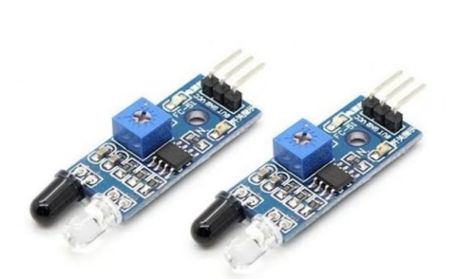
3.IR sensor.
We are using three sensors with the three lights. If any persons or any persons comes in front of the sensor then light will turn on. The sensor will connect respectively with the light. Such as the first sensor connect with first light, the second sensor connect with the second light, and the third sensor connect with the third light.
If someone comes in front of the sensor the sensor will notify the Arduino. Arduino, send the instruction the light to turn ON the light and when the person passes, the light will turn OFF.

Slide 11
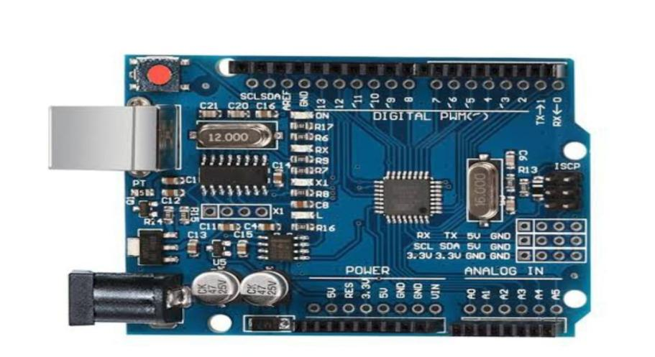
4.Arduino.
Street lights are made with Arduino have become increasingly popular due to their impressive efficiency. They are designed using a combination of sensors, microcontrollers and LED bulbs that can detect the presence of vehicles or pedestrians in order optimize lighting level as needed.

Slide 12
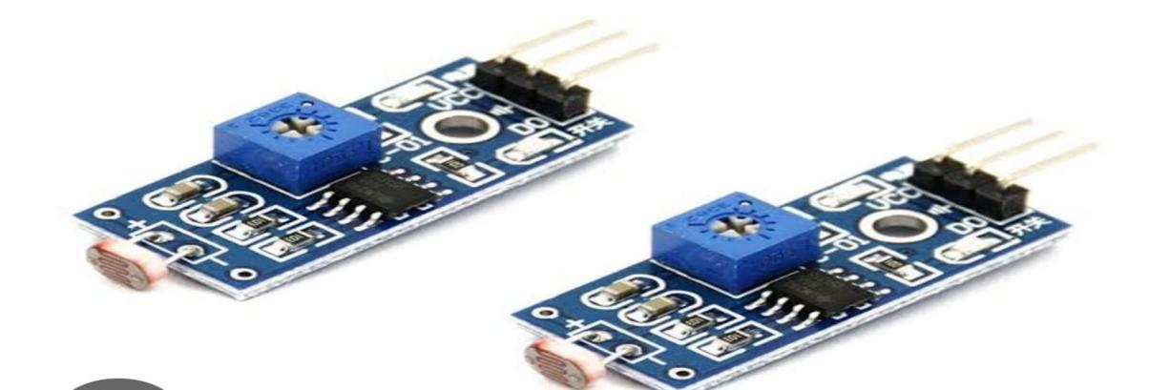
5.LDR.
LDR is a Light Dependent Resistor that changes its resistance when different amounts of light fall on it. They work on the principle of photo conductivity where it gives less resistance in high light intensity and high resistance in low light intensity. In other words, it gives high resistance at night and low resistance in day.
LDRs are made from semiconductor materials like cadmium sulphide, which help the lights to have their light sensitive properties. LDR sensor used for detecting the presence of surrounding light so that during the day time when sun is bright, the street light is switched off automatically. During the night time when there is no light, the LDR sends signal to microcontroller to turn on the street light.

Slide 13
5.LED LIGHT.
An LED street light is an integrated light that uses light emitting diodes (LED) as it light source. Different types of LED lights are used for the lighting operation of the street light. Either few high-power LEDs or many low-power LEDs may be used. The primary appeal of LED street lighting is energy efficiency compared to conventional street lighting fixture technologies such as high pressure sodium (HPS) and metal halide (MH). Research continues to improve the efficiency of newer models of LED street lights.

Slide 14
WORKING
Automatic street light intensity control systems are designed to adjust the brightness of street lights based on various factors such as ambient light levels, time of day, weather conditions, and pedestrian or vehicular traffic. This not only enhances energy efficiency but also ensures adequate lighting for safety. During daytime, light sensors detect high ambient light levels and keep the street lights off.
As ambient light levels decrease during dusk, the sensors signal the microcontroller to turn the lights on. After the lights are turned on, their intensity can be adjusted based on the level of ambient light detected. For example, during cloudy evenings or nights with bright moonlight, the lights can be dimmed to save energy. Motion sensors detect the presence of vehicles or pedestrians. When motion is detected, the microcontroller increases the brightness of the lights to maximum or a pre-set level to ensure safety.

Slide 15
WORKING
If no motion is detected for a certain period, the lights are dimmed to a lower intensity to conserve energy. The system can be programmed with a schedule to adjust the light intensity at different times of the night. For instance, lights can be set to dim after midnight when traffic is typically lower. Advanced systems can integrate data from weather forecasts and traffic flow sensors.
During adverse weather conditions (e.g., fog, rain), the light intensity can be increased. Higher traffic areas can have consistently higher light levels compared to less frequented streets. The communication module allows for real-time monitoring and remote control. Operators can adjust settings, monitor energy consumption, and receive alerts for maintenance.

Slide 16
PROJECT TOTAL COST ESTIMATION
S.NO | COMPONENT DESCRIPTION | QUANTITY | COST
01 | ARDUINO | 01 | 1500
02 | LDR | 01 | 100
03 | IR SENSOR | 02 | 200
04 | LED LIGHT | 03 | 30
05 | OTHERS | - | 300
 |  | TOTAL | 2130

Slide 17
CONCLUSION
Automatic street lighting systems offer numerous benefits, ranging from energy efficiency and cost savings to enhanced safety and security. By leveraging sensors and smart technologies, these systems intelligently adjust lighting levels based on environmental conditions and human presence, thereby reducing energy wastage and light pollution. Additionally, automatic street lighting contributes to safer roads and pedestrian pathways by ensuring adequate illumination when needed, while also minimizing the risk of accidents and criminal activities in poorly lit areas. Overall, the implementation of automatic street lighting represents a significant step towards creating more sustainable, safer, and smarter urban environments.

