Slide 1

SmartFlow
I N T E L L I G E N T U R B A N M O B I L I T Y / 2 02 6
Next-Generation Traffic
Management System
AI-Powered Smart Traffic Management for Urban Mobility
Presented by [Your Name] • September 11, 2026

Slide 2
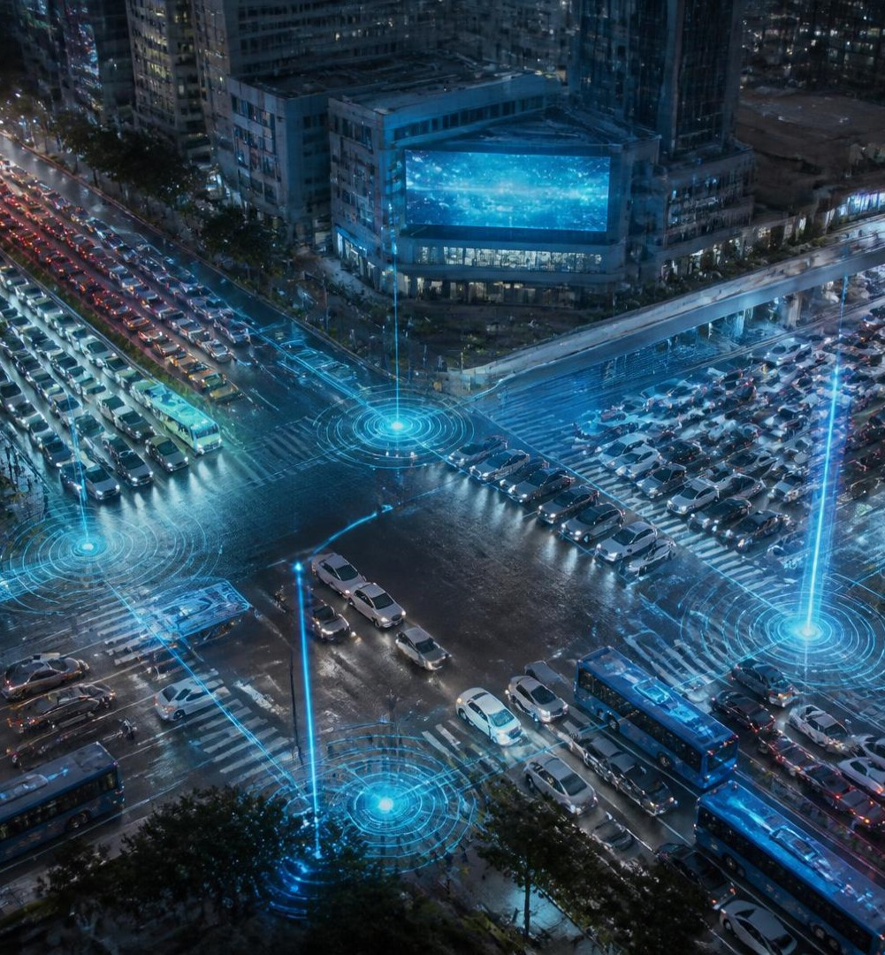
Urban mobility is under pressure
S M A R T F L O W / 01
Hours lost
Congestion compounds delays and emissions.
01
Slow response
Accidents escalate before teams arrive.
02
Blind signals
Static timing ignores live road conditions.
03
No foresight
Cities react instead of anticipating demand.
04

Slide 3
One intelligent control layer
S M A R T F L O W / 02
CAMERAS
GPS + MOBILE
WEATHER
ROAD SENSORS
AI / ML PREDICTION ENGINE
DYNAMIC SIGNALS EMERGENCY RESPONSE LIVE DASHBOARD
Cloud-based processing turns fragmented inputs into coordinated, real-time action.

Slide 4
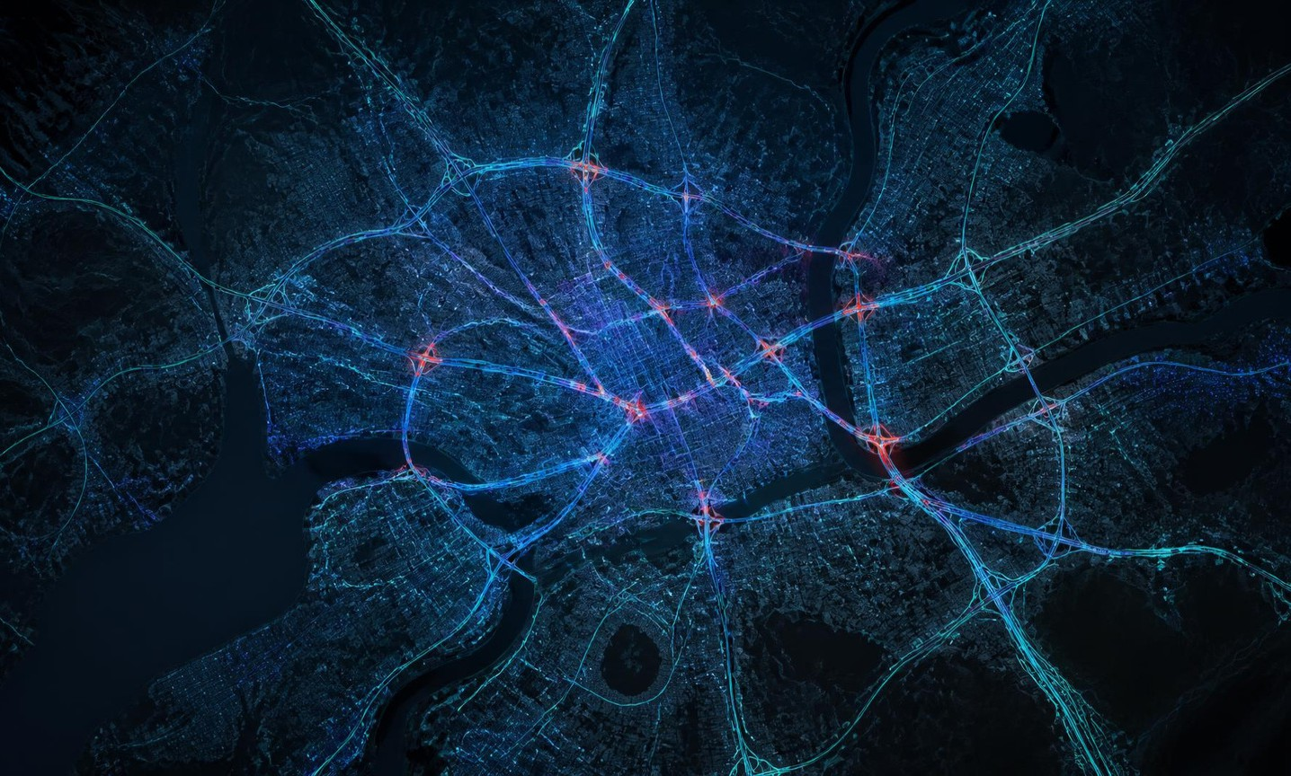
A live operating picture
S M A R T F L O W / 03
42 km/h
A V G S P E E D
07
A C T I V E A L E R T S
86%
N E T W O R K F L O W

Slide 5
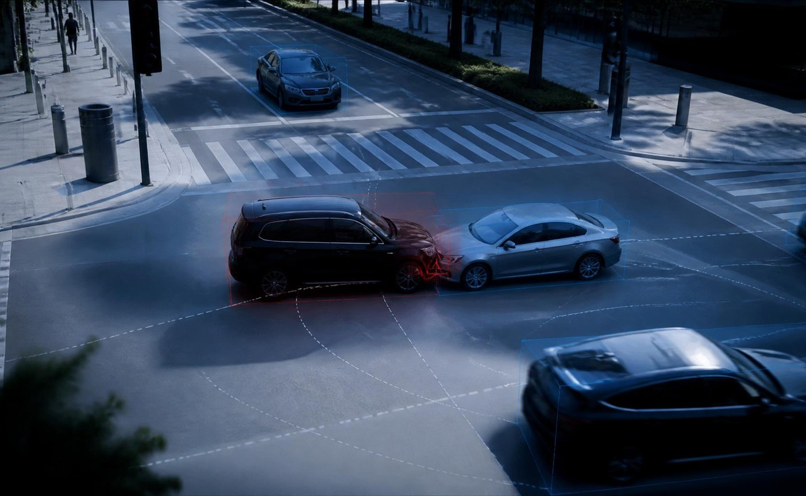
See incidents the moment they happen
S M A R T F L O W / 04
L I V E / C A M 1 2
Computer vision detects crashes, stopped vehicles and abnormal road behavior.
Verified alerts reach the control center immediately — reducing the gap between incident and response.

Slide 6



Predict the jam before it forms
S M A R T F L O W / 05
Morning corridor congestion
Actual congestion AI prediction
30 min
E A R L Y W A R N I N G W I N D O W
100%
80%
60%
Historical patterns + live signals reveal emerging hotspots and trigger proactive signal plans.
40%
20%
0%
06:00
07:00
08:00
09:00
10:00
11:00

Slide 7


From static timing to adaptive flow
S M A R T F L O W / 06
→
B E F O R E / S T A T I C
A F T E R / A D A P T I V E

Slide 8
Detection to dispatch — without delay
S M A R T F L O W / 07
INCIDENT DETECTED
AI VERIFICATION
NEAREST UNIT IDENTIFIED
FASTEST ROUTE CALCULATED
ALERTS SENT
Responders and citizens receive coordinated, real-time routing updates.

Slide 9


Patterns become planning decisions
S M A R T F L O W / 08
Accident frequency by corridor
Congestion intensity by hour
Weekday Weekend
35
100%
30
25
80%
20
60%
15
40%
10
20%
5
0
North
Central
East
Ring
South
0%
06
08
10
12
14
16
18
20

Slide 10
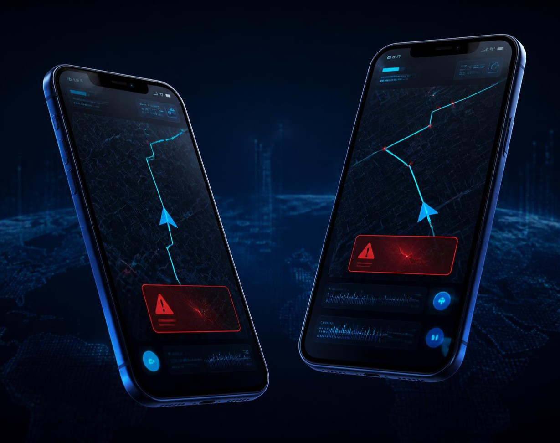
Traffic intelligence, in every pocket
S M A R T F L O W / 09
Know sooner.
Move smarter.
Live congestion updates, accident warnings, alternative routes and reliable arrival estimates
— designed for faster everyday decisions.
R E A L - T I M E • P E R S O N A L • A C T I O N A B L E

Slide 11
Modular by design. Scalable by default.
S M A R T F L O W / 1 0
DATA SOURCES
EDGE COLLECTION
CLOUD STORAGE
AI / ML ENGINE
ANALYTICS
TRAFFIC DASHBOARD
AUTHORITIES
+ CITIZENS
S E C U R E C L O U D F A B R I C
A P I - F I R S T
H O R I Z O N T A L L Y S C A L A B L E
Each layer can evolve independently while the full platform operates as one trusted mobility system.

Slide 12
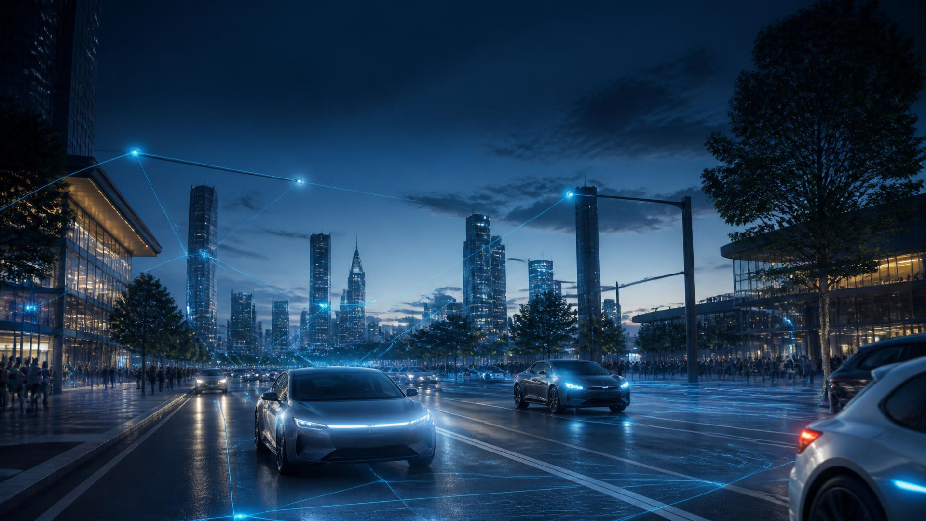
Reactive → Predictive
T H E R O A D A H E A D
Digital twins. Connected and autonomous vehicles. V2X communication. One intelligence layer for safer, smoother, smarter urban travel.
Transforming urban mobility with AI-powered intelligence
S M A R T F L O W / I N T E L L I G E N T U R B A N M O B I L I T Y

