Slide 1



Garbage Classification

Slide 2

Learning Objectives
By this Project, you will be able to: ✅ Understand the importance of automated garbage classification in waste management ✅ Describe the dataset and preprocessing steps used for training the model ✅ Explain the architecture of the deep learning model (EfficientNetV2B2 + custom layers) ✅ Analyze the model performance using evaluation metrics and confusion matrix ✅ Explore how Gradio can be used to build an interactive image classification interface
GOAL
Source :
www.freepik.com/

Slide 3
Tools and Technology used
. Programming Language:
Python
. Libraries & Frameworks:
TensorFlow / Keras: For building and training deep learning models
EfficientNetV2B2: Pre-trained CNN model used for transfer learning
Scikit-learn: For evaluation (confusion matrix, classification report)
Matplotlib / Seaborn: For data visualization and plotting results
Gradio: To create an interactive web-based interface for model inference
. Development Environment:
Jupyter Notebook
. Dataset:
Trash Type Image Dataset (custom directory structure loaded using image_dataset_from_directory)

Slide 4
Methodology
1 Data Loading & Preprocessing
Loaded images using image_dataset_from_directory with an 80-20 train-validation split
Resized all images to 124×124 pixels
Applied shuffling, caching, and prefetching for efficient data loading
2 Model Design
Used EfficientNetV2B2 as a base model with pre-trained weights
Added custom layers: Dropout, Dense layers for classification
3 Training Configuration
Optimizer: Adam
Loss: Categorical Crossentropy
Metrics: Accuracy
Callbacks: EarlyStopping, ReduceLROnPlateau for better generalization
4 Evaluation
Computed confusion matrix and classification report
Visualized performance using seaborn heatmaps
5 Deployment (Optional)
Built an interactive Gradio interface for real-time image classification

Slide 5
Problem Statement:
Manual waste segregation is time-consuming, error-prone, and inefficient. With the rise in urban waste generation, there is an urgent need for an
automated system that can classify different types of garbage to aid in recycling
and proper disposal.
. This project aims to: Develop a deep learning-based model to automatically classify images of
garbage into their respective categories. Support smarter waste management practices by reducing human effort and
improving accuracy in segregation.

Slide 6
Solution:
We propose a deep learning-based image classification model that:
Uses EfficientNetV2B2, a powerful pre-trained convolutional neural network (CNN), as the feature
extractor
Adds custom layers for classification tailored to trash types
. The model is trained on a labeled garbage image dataset to learn features that distinguish between different trash categories
. The system:
Automatically classifies input images into garbage types (e.g., plastic, paper, metal, etc.)
Provides real-time predictions using an interactive Gradio interface
. Helps enable faster, more accurate waste segregation, supporting better recycling and disposal processes

Slide 7
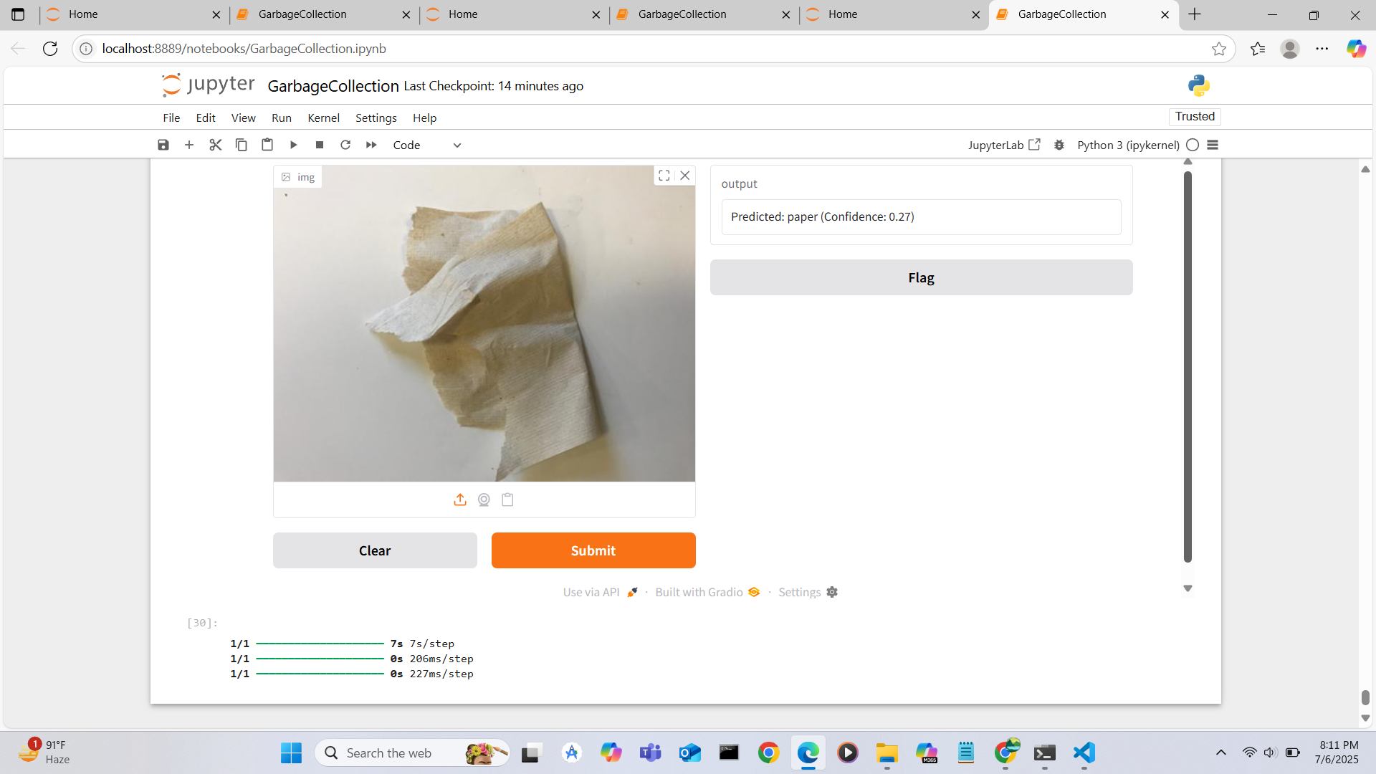
Screenshot of Output:

Slide 8
Conclusion:
. This project demonstrates how deep learning models can effectively automate the task of garbage
classification.
. The use of EfficientNetV2B2 with custom layers enables high accuracy in distinguishing different types
of trash.
. The system supports real-time classification via a user-friendly Gradio interface, making it practical for
deployment in waste management systems.
. Such automated solutions can significantly contribute to efficient recycling processes and sustainable
waste management in urban areas.
GitHub Link:
https://github.com/Karnaelango/garbageclassification_project

