Slide 1
Superstore Sales Performance Dashboard
An Interactive Power BI Dashboard for Sales and Profit Analysis
Title: Superstore Sales Dashboard Subtitle: Interactive Business Performance Analysis using Power BI Your Name: Karnakanti Varsha Role: Data Analyst / Power BI Developer Date: October

Slide 2
Objective of the Project
Design an interactive Power BI dashboard to analyze Total Sales, Total Profit, and Profit Margin (%)
Help management identify trends and top-performing areas
Enable data-driven decision-making

Slide 3
Dataset Description
Dataset: Sample Superstore Dataset (Kaggle)
File Type: CSV
Records: ~10,000+
Key Columns:
Order ID, Order Date, Ship Date
Sales, Quantity, Discount, Profit
Category, Sub-Category, Region, State, City

Slide 4
Data Cleaning & Transformation
Steps performed using Power Query:
1. Removed blank or duplicate rows
2. Corrected data types
3. Renamed columns
4. Created calculated fields and DAX measures

Slide 5
DAX Measures
Total Sales = SUM(train[Sales])
Total Profit = SUM(train[Profit])
Profit Margin % = DIVIDE([Total Profit], [Total Sales], 0)
Sales LY = CALCULATE([Total Sales], SAMEPERIODLASTYEAR(train[Order Date]))
Sales Growth % = DIVIDE([Total Sales] - [Sales LY], [Sales LY])

Slide 6
Dashboard Layout
Top Section: KPI Cards – Total Sales, Total Profit, Profit Margin %
Middle Section: Line Chart (Sales Over Time), Bar Chart (Sales by Category), Map (Sales by Region)
Bottom Section: Table – Top Products (Sales, Profit, Margin %)
Slicers: Year, Region, Category

Slide 7
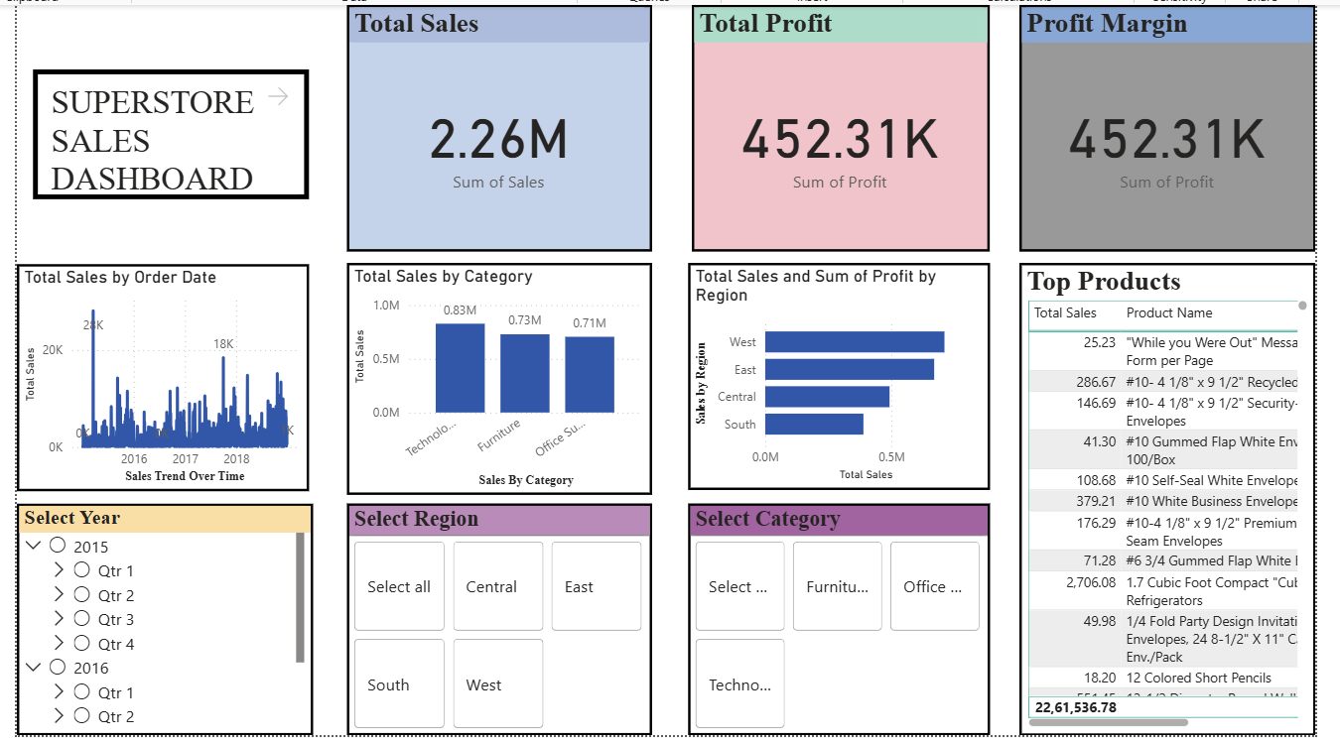
Visuals Used
Card (KPI): Display totals
Line Chart: Show sales trend
Bar Chart: Compare categories
Bar Chart: Analyze regions
Table: Top Products
Slicers: Interactivity

Slide 8
Key Insights
Technology category generates the highest sales and profit margin
West region performs best
Furniture shows low margins
Sales spike in Nov–Dec
Focus on low-performing regions

Slide 9
Tools Used
Power BI Desktop – Dashboard creation
Power Query – Data cleaning
DAX – Calculated measures
Excel/Kaggle – Source data

Slide 10
Conclusion
Power BI enables clear visualization of business KPIs
Dashboard provides insights into sales and profit performance
Supports strategic, data-driven decisions
Future Scope: Forecasting, real-time data connection

Slide 11
Acknowledgment
Thanks to mentors, faculty, and peers for guidance and support.
Special thanks to the institution for providing learning opportunities.

Slide 12
References
Kaggle Dataset: Sample Superstore
Power BI Docs: https://learn.microsoft.com/power-bi
Power BI Tips: https://powerbi.tips

