Slide 1
Fundamentals of Data Engineering (24DEA3101)
Real-Time Hospital Data Engineering Pipeline
Team members
K. Maheshwar Reddy – 2420090020
M. Sai Shashank – 2420030210
P. Venkata Sai Charan – 2420030339
Group Number:15 Section: 7
Under the guidance of
Dr. N. Shirisha

Slide 2

Objectives
Centralized Data Storage: Integrate healthcare data from multiple hospital departments — patient registration, laboratory, pharmacy, billing, and appointments — into a single data warehouse.
Data Consistency: Remove duplicate records and standardize healthcare data using ETL (Extract, Transform, Load) processes.
Improved Decision Making: Enable hospital administrators to generate reports for better operational and financial decisions.
Efficient Data Analysis: Support analytical queries for patient statistics, doctor performance, hospital occupancy, and revenue analysis.
Historical Data Management: Store historical healthcare data to support trend analysis and future planning.
Faster Query Performance: Design the warehouse using a Star Schema to improve query execution and reporting speed.
Business Intelligence Support: Provide reliable data for dashboards, visualization, and healthcare analytics.

Slide 3
Literature Survey
Authors | Title of the Paper | Methodology | Inferences | Limitation/Future work
Zhou et al. [3] | Development of traditional Chinese medicine clinical data warehouse for medical knowledge discovery and decision support, Artificial Intelligence in Medicine, 2010 | • Developed a clinical warehouse integrating inpatient and outpatient Traditional Chinese Medicine records; used structured data integration and OLAP reporting. | Integration of clinical records supported 400+ OLAP reports and medical knowledge discovery. | Architecture targets Traditional Chinese Medicine; applicability to a general multi-department hospital needs further study.
Bocquet et al. [2] | The Challenges of Implementing Comprehensive Clinical Data Warehouses in Hospitals, IJERPH, 2022 | • Examined comprehensive clinical data warehouse implementation, including heterogeneous hospital-data integration, governance and organizational requirements. . | Centralized clinical data can support research and quality evaluation when accompanied by reliable governance | • Requires substantial resources and sustained institutional support; simpler modular deployment needs exploration
Knezevic Ivanovski et al. [3] | Building a Healthcare Data Warehouse: Considerations, Opportunities, and Challenges, Frontiers in Digital Health, 2025 | • Discussed healthcare warehouse architecture, centralized clinical-data integration, ETL considerations and analytics opportunities. | • Consistent ETL and centralized storage can support healthcare analytics and business intelligence. | • Primarily a considerations/challenges paper; a specific implementation needs quantitative benchmarking.

Slide 4
Literature Survey (contd.)
Authors | Title of the Paper | Methodology | Inferences | Limitation/Future work
Denney et al. [4] | Validating the Extract, Transform, Load Process Used to Populate a Large Clinical Research Database, International Journal of Medical Informatics, 2016 | • Validated the ETL pipeline for a large clinical research database by comparing a sample of 498 repository observations against source EHR records. | • Discrepancy investigation supported validation of the repository's accuracy relative to source systems. | • Sample-based validation does not establish continuous ingestion performance; larger-scale and latency testing remain future work.
Visweswaran et al. [5] | An atomic approach to the design and implementation of a research data warehouse, Journal of the American Medical Informatics Association, 2022 | • Designed Neptune as an atomic research data warehouse integrating longitudinal information from EHRs, health plans and research studies. | • Atomic integration enabled reuse of data for more than five million patients across multiple research sources. | • Research-oriented architecture does not itself establish real-time operational analytics across all hospital departments.
Johns et al. [6] | Tracking provenance in clinical data warehouses for quality management, International Journal of Medical Informatics, 2025 | • Used provenance tracking in clinical warehouse ETL processes and a quality dashboard to trace recurring errors to their source and transformation stages. | • Lineage visibility helped identify error patterns and support ongoing data-quality management. | • Provenance increased ETL loading time; evaluation covered three ETL processes in an i2b2 setting.

Slide 5
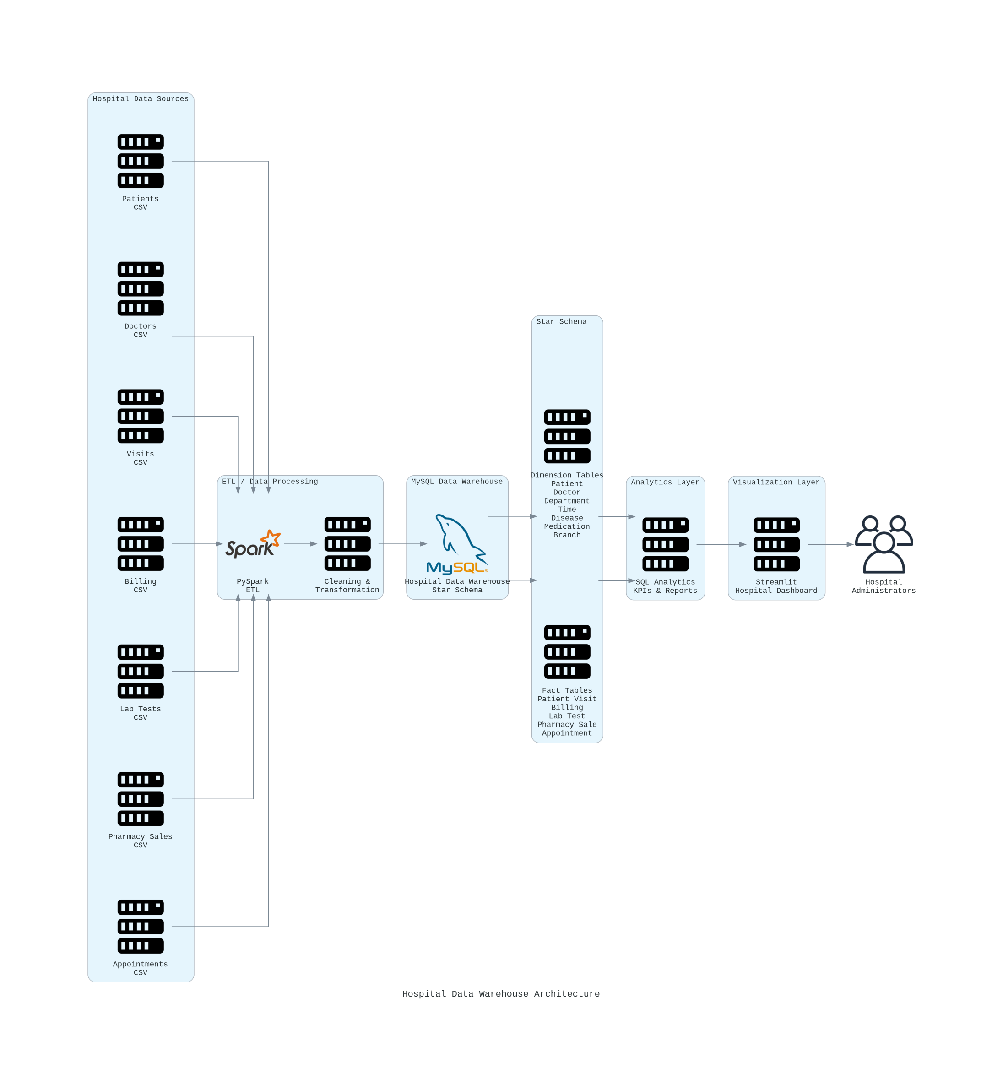

Slide 6
Proposed Method
Data Collection: Gather healthcare data from patient registration, laboratory, pharmacy, billing, and appointment systems across hospital departments.
Extraction: Extract operational data from these different source databases into a staging area.
Cleaning & Transformation: Clean inconsistent records, remove duplicate entries, handle missing values, and transform data into a standardized format using ETL techniques.
Loading: Load the transformed data into the centralized Hospital Data Warehouse.
Dimensional Modeling: Design the warehouse using a Star Schema consisting of Fact tables (patient visits, billing, lab tests, pharmacy sales) and Dimension tables (patient, doctor, department, time, disease, medication, hospital branch).
Analysis & Reporting: Execute SQL queries on the warehouse to generate reports and analytical insights for hospital administrators.
Flow: Hospital Systems → Extract → Clean & Transform (ETL) → Star Schema Warehouse → SQL Queries / Reports → Decision Making

