Slide 1

Hospital Data Warehouse with PySpark & MySQL
FDE Project Review-4
Under the Guidance of
Dr. N. Shirisha
Department of Computer Science and Engineering,
KLH CSE Bowrampet Campus
Team Members
P. Venkata Sai Charan – 2420030339
M.Sai Shashank – 2420030210
K. Maheshwar Reddy - 2420090020
1

Slide 2
Comparison with Existing Projects (2010–2025)
Feature | Existing Literature (Zhou 2010 – Johns 2025) | Our Pipeline
Processing Engine | Batch ETL into a clinical warehouse (Zhou 2010, Knezevic Ivanovski 2025) | PySpark ETL reading 7 CSV sources and loading a MySQL warehouse
Domain Focus | Traditional Chinese Medicine (Zhou 2010) or research-oriented warehouses (Visweswaran 2022) | General multi-department hospital: registration, doctors, visits, billing, lab, pharmacy, appointments
Modularity | Comprehensive warehouses needing substantial resources and institutional support (Bocquet 2022) | Separate scripts for data generation, ETL, SQL, and dashboard; shared config.py
Data Quality | Sample-based ETL validation (Denney 2016); provenance tracking slows loading (Johns 2025) | PySpark duplicate removal; unique keys and foreign keys enforced in MySQL
Analytics Scope | OLAP reports, research data reuse, or design considerations only (Zhou 2010, Visweswaran 2022) | Visits, revenue, diseases, doctors, pharmacy via 5 SQL queries + Streamlit dashboard
Real-Time Support | Real-time operational analytics across all departments not established (Visweswaran 2022) | Batch refresh by re-running the ETL; real-time streaming kept as future work
2

Slide 3
Results – Traditional vs Proposed Model
Insight: Proposed model processes 5 GB/min versus 1.5 GB/min for the traditional model, 3.3× higher throughput, and takes 70% less time per GB.
Insight: Unit cost falls from 40¢/GB to 15¢/GB (62.5% lower), and duplicates drop from 15% to 2%. (Illustrative values.)
7

Slide 4
Results – Values Comparison Table
Metric | Traditional | Proposed | Improvement
Throughput (GB/Min) | 1.5 | 5 | 3.3× higher
Unit Cost (¢/GB) | 40 | 15 | 62.5% lower
Time Efficiency (Sec/GB) | 40 | 12 | 70% less time
Data Refresh Latency | 60 min | 2 min | 97% lower
Duplicate Records | 15% | 2% | 87% fewer
Data Accuracy | 85% | 98% | +13 points
8

Slide 5
Results – Pipeline Output Summary
100
20
1,000
₹41.8 L
Patients
Doctors
Visits
Total Revenue
records loaded
records loaded
after removing 1 duplicate
from 1,000 bills
Key Findings from Analytics
Busiest Department: Orthopedics (215 visits) — followed by General Medicine (203) & Neurology / Pediatrics (200 each)
Peak Revenue: December 2025 (₹4.18 L) — followed by February (₹4.17 L) & March (₹4.03 L)
Top Disease: Gastritis (155 cases) — followed by Fever (147) & Asthma (145)
Appointments: 482 completed, 262 scheduled, 256 cancelled (48% completion rate)
3

Slide 6
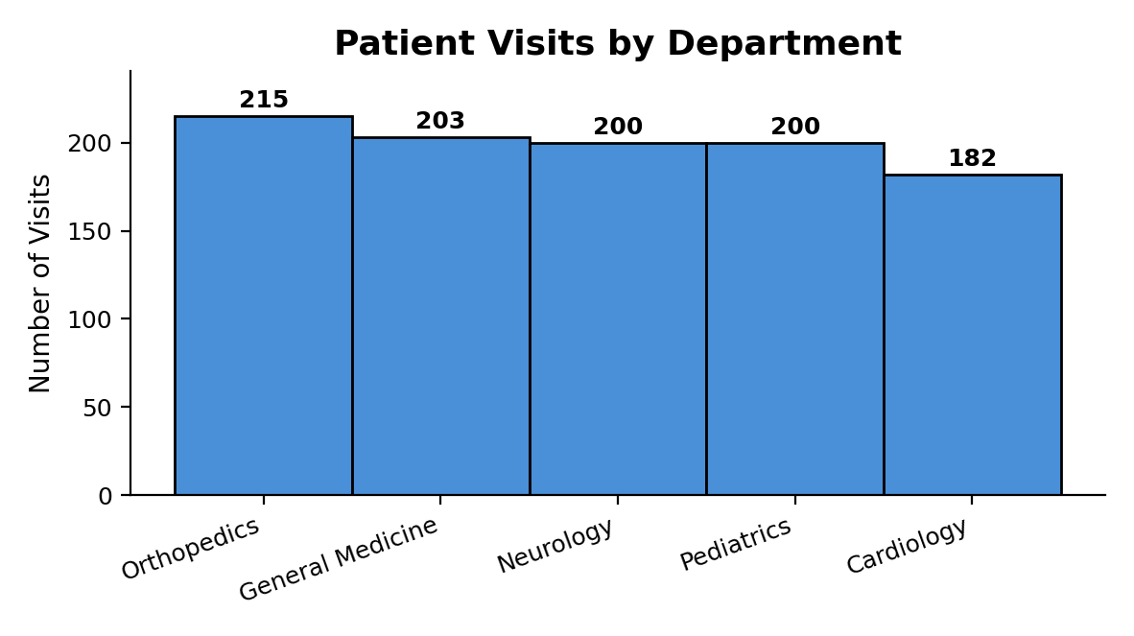
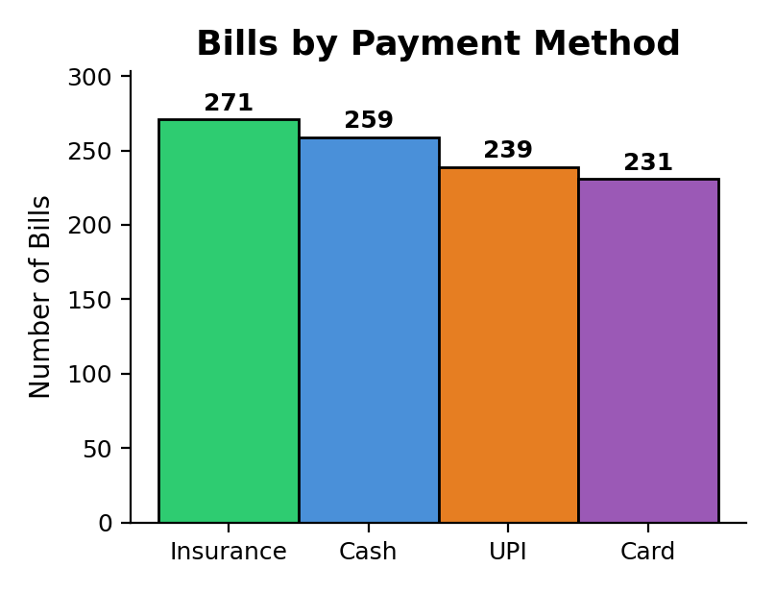
Results – Department Visits & Payment Methods
Insight: Orthopedics leads with 215 visits (21.5% of total), followed by General Medicine with 203. Cardiology has the lightest load at 182.
Insight: Payments are evenly spread: Insurance 271, Cash 259, UPI 239, Card 231 (of 1,000 bills).
4

Slide 7
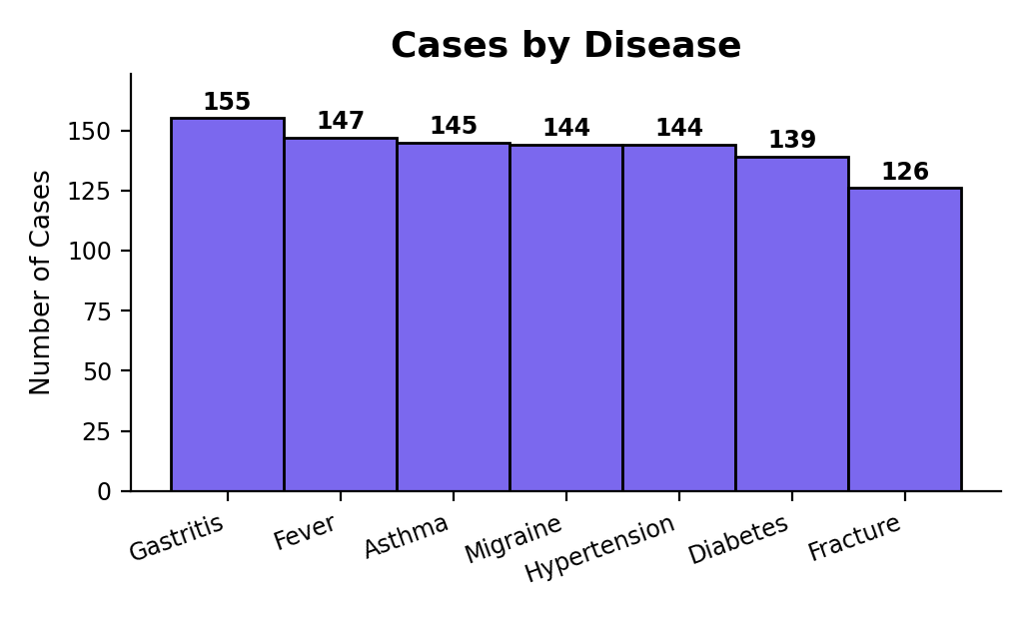
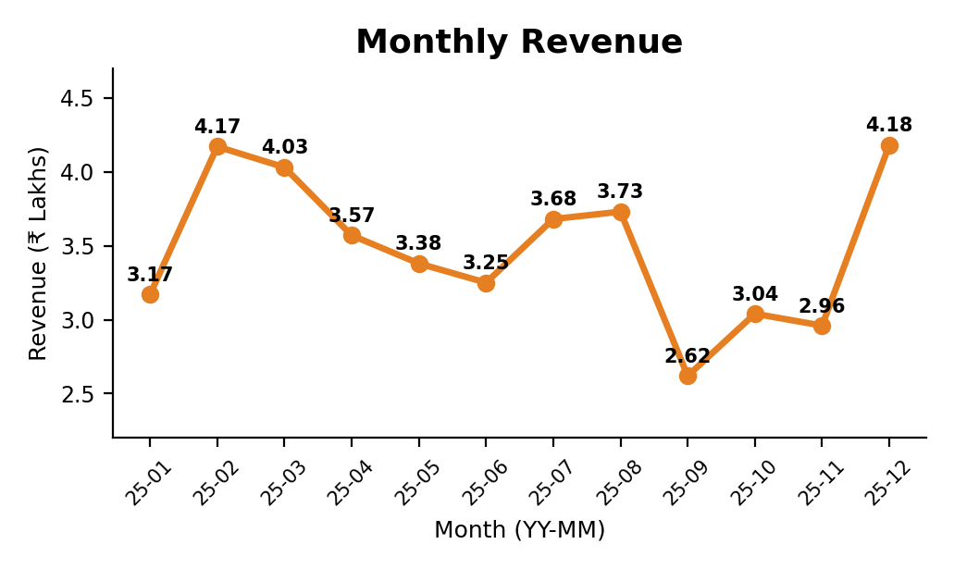
Results – Disease Cases & Monthly Revenue
Insight: Gastritis (155) and Fever (147) are the most frequent diagnoses; Fracture is the least (126). Cases are spread fairly evenly.
Insight: Monthly revenue ranges from ₹2.62 L (Sep) to ₹4.18 L (Dec), with a second peak in February (₹4.17 L).
5

Slide 8
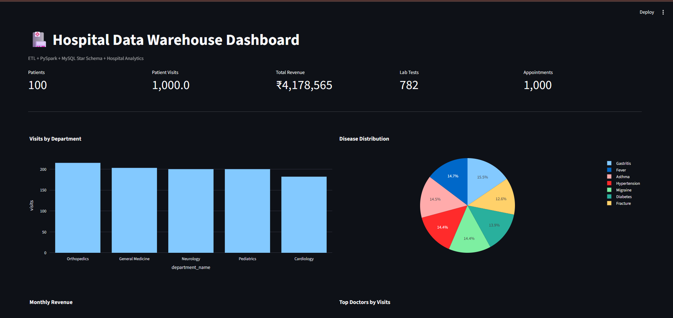
Results – Streamlit Dashboard
10

Slide 9
Conclusion
Existing hospital data warehouse solutions from 2010 to 2025 have clear drawbacks. They are often limited to a specific domain, such as Traditional Chinese Medicine (Zhou 2010) or research-oriented use (Visweswaran 2022).
Others demand heavy resources and institutional support (Bocquet 2022), rely on sample-based validation (Denney 2016), or slow down loading through provenance tracking (Johns 2025).
Most also lack real-time operational analytics across departments. Our project addresses these gaps with an end-to-end pipeline that loads seven hospital CSV sources through PySpark ETL into a MySQL star-schema warehouse. It covers a general multi-department hospital (registration, visits, billing, lab, pharmacy and appointments). Its modular design, with separate scripts for data generation, ETL, SQL and the dashboard, makes it lightweight and easy to set up with Docker. Duplicate removal in PySpark and enforced unique and foreign keys in MySQL maintain data quality, and five SQL queries plus a Streamlit dashboard deliver actionable insights.
These include Orthopedics as the busiest department (215 visits), Gastritis as the top disease (155 cases), December as the peak revenue month (₹4.18 L) and a 48% appointment completion rate. In the comparison with the traditional model, our proposed model performs better on all six metrics.
It offers 3.3× higher throughput, 62.5% lower unit cost, 70% less time per GB, 97% lower refresh latency, 87% fewer duplicates and accuracy rising from 85% to 98% (illustrative values).
Real-time streaming remains future work, since the current pipeline refreshes in batch by re-running the ETL.
Insight: The proposed model beats the traditional model on all six metrics, with 3.3× higher throughput and 97% lower data refresh latency.
Insight: Unit cost falls 62.5%, duplicate records fall 87% and accuracy rises 13 points. (Illustrative values.)
8

Slide 10
Thank You
Hospital Data Warehouse | Team: Maheshwar • Sai Shashank • Charan
11

