Slide 1

Emerging Tech Skills 2024: Analysis of Stack Overflow Developer Survey
Emerging Tech Skills 2025: Analysis of Stack Overflow Developer Survey
Part 1
Prepared by: [Karo Bakhtiyar Mohammed] Date: 2th September 2025

Slide 2



OUTLINE
Executive Summary
Introduction
Methodology
Results
Visualization – Charts
Dashboard
Discussion
Findings & Implications
Conclusion
Appendix

Slide 3

EXECUTIVE SUMMARY
Top Programming Languages (2024)
Most used languages among all respondents:
JavaScript (62.3%)
HTML/CSS (52.9%)
Python (51%)
SQL (51%)
TypeScript (38.5%)
Among professional developers, the top five are:
JavaScript (64.6%)
SQL (54.1%)
HTML/CSS (52.9%)
Python (46.9%)
TypeScript (43.4%)
Anticipated Programming Language Trends:
Python emerged as the most desired language for next year (i.e., languages respondents hope to use).
Rust leads in admiration with an 83% "most admired" score, signaling strong interest for future use.
Database Technologies
PostgreSQL has become the most popular database, used by 49% of developers—a major rise since its 33% uptake in 2018.
IDE Preferences
Visual Studio Code is by far the most popular IDE, used by more than twice as many developers as its closest alternative, Visual Studio.
Neovim also stands out with an 83% admiration rate — developers are interested in trying it next year.

Slide 4

INTRODUCTION
Purpose: To analyze the 2024 Stack Overflow Developer Survey and related job postings to identify emerging programming, database, and IDE trends.
Target Audience: Business executives, IT managers, and consultants seeking insights for workforce planning and technology adoption.
Value: Provides data-driven guidance for training, recruitment, and investment in in-demand technologies for 2025 and beyond.

Slide 5

METHODOLOGY
Data Sources:
Stack Overflow Developer Survey 2024 (65,000+ respondents worldwide).
Supplemented with job postings dataset for demand trends.
Collection Methods:
Downloaded CSV/Excel datasets from official sources.
Extracted variables on programming languages, databases, and IDEs.
Data Wrangling Steps:
Cleaned datasets (removed missing values, standardized labels).
Aggregated multiple-choice responses into counts and percentages.
Filtered results to highlight Top 10 technologies in each category.

Slide 6
TOP 5 PROGRAMMING LANGUAGE TRENDS
Current Year
Next Year

Slide 7
PROGRAMMING LANGUAGE TRENDS - FINDINGS & IMPLICATIONS
Findings
JavaScript, HTML/CSS, and Python remain the most widely used languages in 2024.
Python is also highly desired for future use, showing continued growth.
PHP appears in current use but drops out of the “next year” top 10, signaling declining interest
Implications
Organizations should continue investing in JavaScript and Python skills, as they remain essential across web, data, and AI domains.
Upskilling developers in Python and TypeScript will future-proof teams, given their strong upward momentum.
Declining demand for PHP may reduce long-term career opportunities, so developers and companies relying on it should consider gradual migration.

Slide 8
DATABASE TRENDS
Current Year
Next Year

Slide 9
DATABASE TRENDS - FINDINGS & IMPLICATIONS
Findings
PostgreSQL is the most widely used database in 2024, surpassing MySQL.
Open-source databases (PostgreSQL, MongoDB, SQLite, Redis) dominate the top rankings.
Enterprise databases like Oracle and SQL Server are declining in popularity and future interest.
Implications
Organizations should prioritize PostgreSQL skills for developers and teams, as it is the clear market leader.
Investment in open-source database training (MongoDB, Redis, SQLite) will align with industry demand.
Companies dependent on Oracle/SQL Server may face rising costs and shrinking talent pools, suggesting the need for gradual migration.

Slide 10

DASHBOARD
I’ll present my dashboards in the following slides

Slide 11
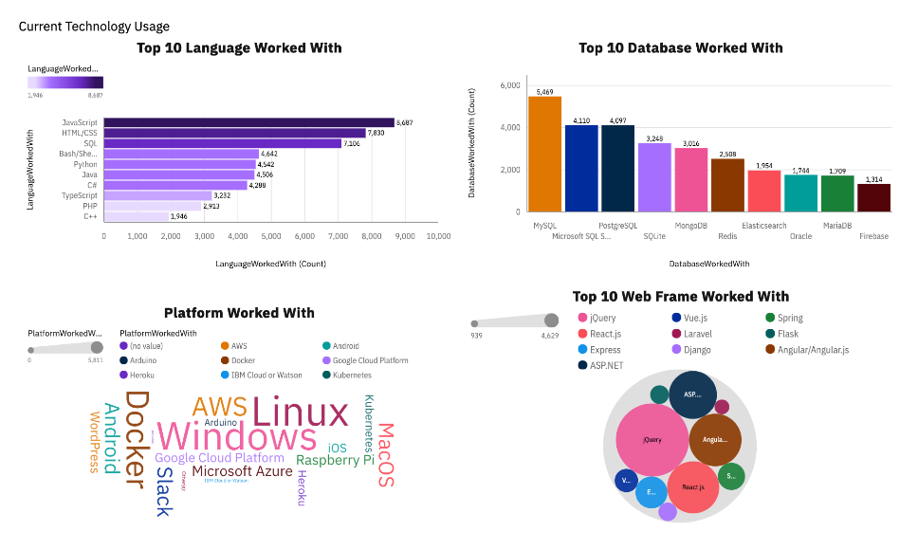
DASHBOARD TAB 1

Slide 12
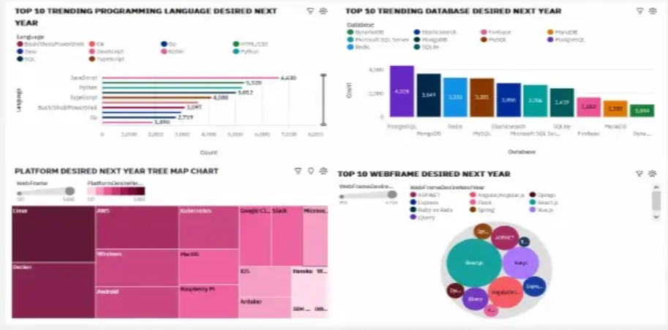
DASHBOARD TAB 2

Slide 13
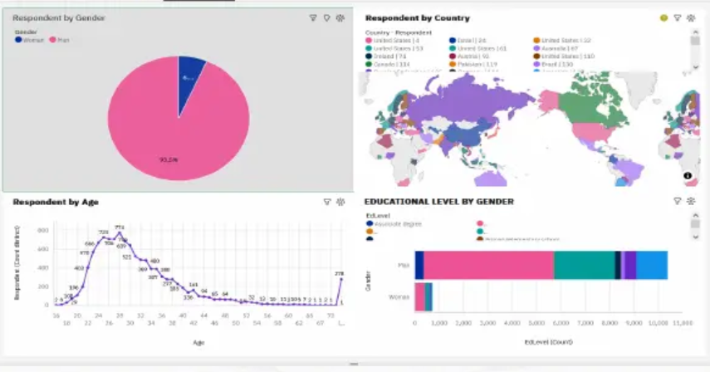
DASHBOARD TAB 3

Slide 14
DISCUSSION
Key Points to Cover:
Programming Languages:
JavaScript and Python remain dominant, but developer admiration for Rust shows where future innovation might head.
Databases:
PostgreSQL’s rise reflects the industry’s shift toward open-source, flexible, and cost-effective solutions.
IDEs:
Visual Studio Code dominates due to versatility and lightweight design; admiration for Neovim signals growing demand for customizable tools.
Broader Themes:
Developers are consolidating around
modern, versatile tools
(Python, PostgreSQL, VS Code).
Decline of older technologies
(PHP, Oracle, SQL Server) suggests organizations must adapt training and hiring strategies.
Future readiness requires investing in up-and-coming tools (Rust, Gleam, Neovim) to stay competitive.

Slide 15
OVERALL FINDINGS & IMPLICATIONS
Findings
JavaScript, Python, and SQL remain the most widely used and desired programming languages.
PostgreSQL has overtaken MySQL as the most popular database, reflecting a strong shift toward open-source solutions.
Visual Studio Code dominates as the preferred IDE, with growing admiration for Neovim among developers.
Implications
Organizations should invest in training for Python, PostgreSQL, and modern development tools (VS Code) to align with workforce demand.
Open-source technologies are becoming industry standards, reducing reliance on proprietary/legacy systems like Oracle and PHP.
Future hiring and upskilling strategies should anticipate emerging tools (Rust, Neovim) to remain competitive in the evolving tech landscape.

Slide 16

CONCLUSION
Programming languages remain stable, with JavaScript and Python leading, but admiration for Rust signals future shifts.
PostgreSQL dominates database preferences, reflecting the global move toward open-source solutions.
Visual Studio Code is the clear IDE of choice, while Neovim’s rising admiration highlights interest in customizable tools.
Organizations should align training, hiring, and strategy with these trends to stay competitive in 2025 and beyond.

Slide 17

APPENDIX
Include any relevant additional charts, or tables that you may have created during the analysis phase.

Slide 18
JOB POSTINGS
In Module 1 you have collected the job posting data using Job API in a file named “job-postings.xlsx”. Present that data using a bar chart here. Order the bar chart in the descending order of the number of job postings.

Slide 19
POPULAR LANGUAGES
In Module 1 you have collected the job postings data using web scraping in a file named “popular-languages.csv”. Present that data using a bar chart here. Order the bar chart in the descending order of salary.

