Slide 1
Midterm Presentation of Bachelor Thesis: Design and Implementation of a Privacy Assessment Framework for Synthetic Data Generation with Machine Learning
By Karoline Siarsky
Supervised by: Weijie Niu, Dr. Alberto Huertas Celdran
Date: 15.07.2024
Notes:
Welcome to my midterm presentation about my bachelor thesis regarding the topic “Design and Implementation of a Privacy Assessment Framework for Synthetic Data Generation with Machine Learning “.

Slide 2
Overview
Introduction/ Background
Related Work
Privacy Metrics (Design)
Goals/ Objectives
Notes:
We will first have a look at the background information needed for this thesis, then we will have a look at 3 papers I chose regarding the related work and
then, I will describe the metrics we are considering including in the framework and briefly talk about what we aim to achieve with it.

Slide 3
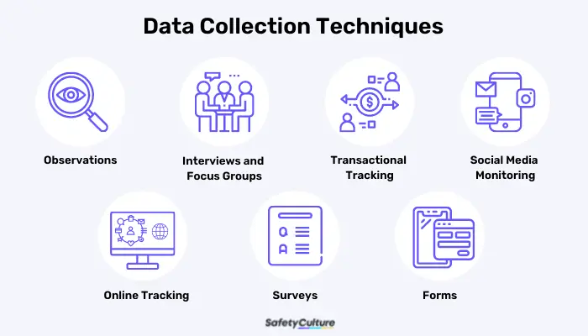
Introduction and Background:
In the rapidly evolving landscape of machine learning and artificial intelligence, our research focuses on data privacy and synthetic data generation.
AI applications depend heavily on vast training datasets, posing challenges in data collection.
https://help4study.online/paper/data-analysis-in-research-tools
Notes:
In the rapidly evolving landscape of machine learning and artificial intelligence, our research lies at the intersection of data privacy and synthetic data generation.
As AI applications spread across various sectors, the implementation of these technologies often depend on access to vast amounts of training data.

Slide 4
Challenges in Data Collection
Data Scarcity: Certain domains face challenges in obtaining sufficient high-quality data due to limited availability and incomplete information.
Cost of Data Collection: Gathering and storing large datasets, especially sensitive information, can be prohibitively expensive.
Privacy Concerns: Use of real-world datasets in AI raises significant privacy issues, necessitating robust protection measures.
Notes:
However, this need for large datasets introduces several challenges:
Data Scarcity:
In certain domains, collecting sufficient, high-quality data can be challenging due to limited availability. And missing or incomplete information affects algorithm accuracy.
Cost of Data Collection:
Also, gathering and storing large datasets can be expensive, especially when dealing with sensitive information.
Privacy Concerns:
And with the use of real-world datasets in AI, which often contain sensitive information, preserving privacy becomes a growing problem.
Privacy refers to the protection of individuals' sensitive information from unauthorized access or use, ensuring that data cannot be traced back to specific individuals.

Slide 5
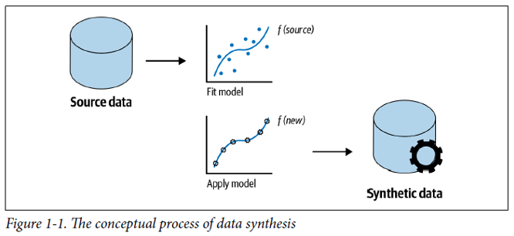
Solution: Synthetic Data Generation
Synthetic data generation with machine learning addresses these challenges by leveraging AI capabilities while preserving privacy.
Synthetic data mimics real-world data without direct collection from individuals, maintaining statistical properties like variance and correlations.
It breaks 1-1 mapping to prevent easy identification of specific individuals.
→ Learn the probability distribution of the dataset and draw samples from it
Source Picture: https://www.tnpconsultants.com/en/all-you-need-to-know-about-synthetic-data/
Notes:
So to address these challenges, synthetic data generation with machine learning has emerged as a promising solution. Researchers can use synthetic data to leverage the capabilities of machine learning and AI while preserving privacy.
So what is synthetic data generation exactly:
Synthetic data refers to artificially created information that mimics real-world data without being directly collected from actual events or individuals.
Researchers use synthetic data to extend their datasets which helps to address data shortages, especially when obtaining large, high-quality real-world datasets is challenging.
It’s designed to have the same key characteristics as actual data, even though it’s entirely computer-generated.
It involves training a model to replicate the statistical properties of real data, such as variance, mean, shape, and correlations among attributes, while ensuring that no direct links to real individuals are preserved. The model then generates random samples to create the synthetic dataset.
So unlike traditional anonymization (such as pseudonymization), where each real record corresponds to a modified version, synthetic data generates entirely new records. This prevents easy identification of specific individuals and tries to break the 1- on 1 mapping between real individuals and the synthetic data records.

Slide 6
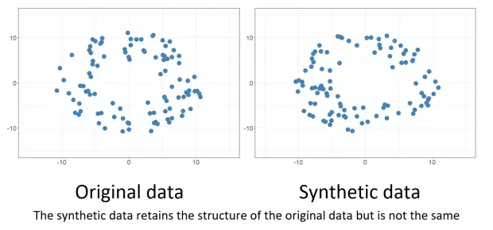
Risks of Synthetic Data
Synthetic data, while promising, poses risks of being too similar to real data, as seen in incidents like unauthorized use of voice data.
Example: Unauthorized use of Scarlett Johansson's voice highlighted ethical and privacy concerns.
https://www.labellerr.com/blog/synthetic-data-vs-real-data-which-is-a-better-option-for-your-projects-2/
Notes:
Risks of Synthetic Data:
However, there are risks associated with synthetic data being too similar to the real data.
For instance, an incident a few months ago involved the unauthorized use of Scarlett Johansson's voice.
AI models were trained using her voice data, generating synthetic speech that closely mimicked her real voice.
This raised significant privacy and ethical concerns, as the synthetic voice was used without her consent, highlighting the potential for synthetic data to infringe on individual privacy and the importance of implementing robust safeguards.

Slide 7
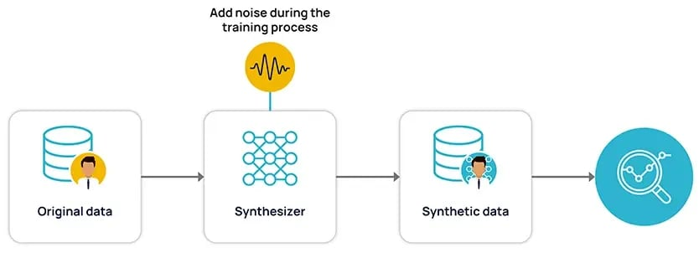
Enhancing Privacy with Differential Privacy
Differential privacy adds noise to original data to enhance privacy, ensuring data analysis remains unchanged with individual data additions or removals.
Despite enhancements, challenges like linkability attacks persist, compromising data privacy.
https://www.anonos.com/blog/what-is-differential-privacy-definition-mechanisms-examples
Notes:
Enhancing Privacy with Differential Privacy:
To enhance data privacy, original data can be modified using techniques like differential privacy, which involves adding noise to the data.
Differential privacy aims to provide strong privacy guarantees by ensuring that the output of a data analysis does not significantly change when any single individual's data is added or removed.
Despite these enhancements, privacy challenges such as linkability attacks and inference attacks persist.
For example, the Netflix Prize dataset, which was anonymized by adding noise, still faced privacy breaches through linkage attacks where researchers were able to re-identify individuals by correlating the dataset with other publicly available data.
This illustrates that even with noise addition, a one-to-one mapping can still occur, compromising data privacy.

Slide 8
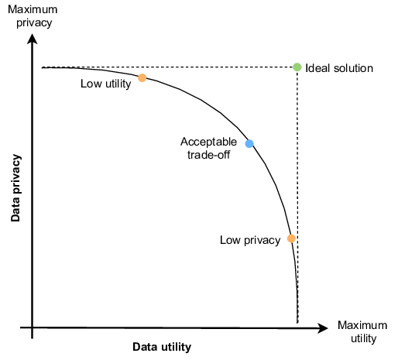
Balancing Privacy and Utility
It’s crucial to balance privacy and utility in synthetic data generation to ensure usefulness for various applications.
Utility measures the usefulness of synthetic data for analysis while preserving essential characteristics of the original data.
Synthetic data may not achieve complete privacy, necessitating a nuanced approach to privacy metrics.
https://www.researchgate.net/figure/Trade-off-between-privacy-level-and-utility-level-of-data_fig1_357987903
Notes:
Balancing Privacy and Utility:
While privacy-preserving techniques are crucial, it is equally important to ensure that the generated synthetic data remains useful for its intended applications. Utility measures the usefulness of synthetic data for various applications, ensuring that it retains essential characteristics and insights of the original data. Finding a balance between privacy and utility is essential.
Synthetic data is often considered to technically better preserve privacy. However, the reality is more nuanced. Synthetic data can still pose risks and may not achieve complete privacy protection, which remains controversial. There is a significant research gap regarding the extent to which synthetic data can effectively preserve privacy, a gap our research aims to address.
Many existing studies predominantly rely on traditional privacy metrics, raising concerns about their adequacy in assessing privacy in diverse contexts. Some papers have proposed new metrics, yet they often come with limitations such as focusing solely on specific types of metrics or neglecting considerations of data utility.

Slide 9
Review of Existing Approaches
Observations: Most papers emphasize the importance of privacy preservation without quantitative measurement.
Methods: Differential privacy (DP) is commonly used to add noise to original data. Others employ k-anonymity and t-closeness on the original dataset.
Privacy Metrics: Basic distance-based metrics like Distance of Closest Record (DCR) and Nearest Neighbor Distance Ratio (NNDR) are prevalent in comparing machine learning models.
Limitations: Many studies overlook utility metrics of synthetic data, focusing primarily on privacy aspects.
Selection: From this review, three key papers were selected for their insights into privacy metrics and synthetic data, yet they present limitations our research aims to address.
Notes:
I have reviewed numerous papers to understand their approaches, but most have merely stated that privacy preservation is important without quantitatively measuring it.
Many papers have used differential privacy to add noise to the original data before generating synthetic data, while others have measured for example k-anonymity and t-closeness, which are applied to the original data. Most have measured privacy using basic distance-based privacy metrics like Distance of Closest Record (DCR) and Nearest Neighbor Distance Ratio (NNDR) to compare different machine learning models for generating synthetic data. However, these studies often overlook the utility of their synthetic data.
From this extensive review, I selected three key papers that highlight significant aspects of privacy metrics and synthetic data but also present clear limitations that our research aims to address:

Slide 10
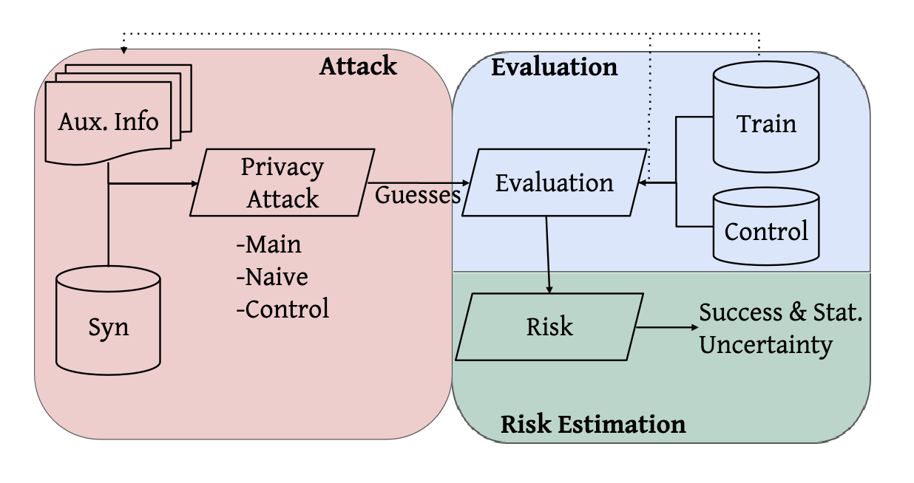
Related Work – Paper 1
Paper 1: “A Unified Framework for Quantifying Privacy Risk in Synthetic Data”:
Introduces Anonymeter to quantify privacy risks in synthetic datasets, emphasizing residual risks post-anonymization.
Methodology includes attack, evaluation, and risk estimation phases to evaluate singling out, linkability, and inference risks.
Conclusion: Proposes a framework focusing on privacy metrics from an attacker's perspective but lacks distance-based metrics.
https://arxiv.org/abs/2211.10459
Notes:
Paper 1: “A Unified Framework for Quantifying Privacy Risk in Synthetic Data”:
This paper introduces a framework called Anonymeter that quantifies privacy risks in synthetic tabular datasets. They emphasize that residual privacy risks remain even after anonymization, advocating for awareness and appropriate action.
Methodology: The framework evaluates privacy risks in three phases: the attack phase, evaluation phase, and risk estimation phase. In the attack phase, the attacker has full access to the synthetic dataset and additional information about a set of targets from the original dataset, generating guesses that evaluate to true or false to estimate overall risk.
Privacy Metrics Evaluated:
So there are 3 metrics they evaluated:
Singling Out Risk: The likelihood of identifying an individual from synthetic data.
Linkability Risk: The risk of linking synthetic records to real-world identities.
Inference Risk: The risk of inferring sensitive information from synthetic data.
Conclusions:
Theri conclusions were that Privacy risks scale linearly with privacy leakage in data. Synthetic data mitigates linkability risks, as one-to-one relationships are not preserved intuitively.
So overall, they propose a framework focusing on the 3 privacy metrics from an attacker’s perspective including utility, but it lacks other distance-based privacy metrics.

Slide 11
Related Work – Paper 2
Paper 2: “Generation and Evaluation of Privacy Preserving Synthetic Health Data”:
Introduces HealthGAN framework for generating synthetic health data balancing privacy, utility, and resemblance to real data.
Proposes Nearest Neighbor Adversarial Accuracy metric for evaluating privacy and resemblance.
Conclusion: Outperforms baseline methods in privacy preservation and computational efficiency, while maintaining high utility and resemblance.
https://www.sciencedirect.com/science/article/abs/pii/S0925231220305117
Notes:
Paper 2: “Generation and Evaluation of Privacy Preserving Synthetic Health Data”:
In the second paper, titled “Generation and Evaluation of Privacy Preserving Synthetic Health Data,” the authors propose a framework for creating synthetic health data that balances privacy, utility, and resemblance to real data. Their goal is to generate synthetic health data suitable for education and research while preserving privacy.
Key Points:
Privacy-Preserving Metric: They propose a new metric, Nearest Neighbor Adversarial Accuracy, to assess the resemblance and privacy of synthetic data compared to the original dataset.
Methodology: Their approach involves training a generative adversarial network (GAN) model, termed HealthGAN, in a secure environment. External users utilize HealthGAN to generate synthetic data without the need for de-identification,
which is the process of removing or altering personally identifiable information from data,
ensuring privacy is maintained throughout the data generation process.
Evaluation: The authors compare HealthGAN against five baseline methods and demonstrate better performance in terms of privacy preservation and computational efficiency, while maintaining high utility and resemblance to real health data.
Focus Area:
Proposed Metric: Our focus will be on understanding and possibly integrating the Nearest Neighbor Adversarial Accuracy metric into our framework. This metric plays a crucial role in quantifying both the privacy and resemblance aspects of synthetic health data

Slide 12
Related Work – Paper 3
Paper 3: “Practical Privacy Metrics for Synthetic Data”:
Extends synthpop package in R to calculate RepU (Replicated Uniques, % of unique identities replicated in the synthetic dataset )
and DiSCO metrics (Disclosive in Synthetic Correct Original, comparing how well synthetic data maintains the distribution of attributes) for identity and attribute disclosure risks in synthetic data.
Metrics compare replication of unique identities and attribute distributions between synthetic and original datasets.
Conclusion: Focuses on disclosure risks but lacks utility metrics.
https://arxiv.org/abs/2406.16826
Notes:
Paper 3: “Practical Privacy Metrics for Synthetic Data”:
In the third paper, titled “Practical Privacy Metrics for Synthetic Data,” the authors extend the synthpop package in R to calculate measures of disclosure risk for synthetic data. They introduce two primary metrics:
Key Metrics:
RepU (Replicated Uniques): This metric measures identity disclosure risk in synthetic data. It quantifies the percentage of unique identities replicated in the synthetic dataset compared to the original data. A higher percentage indicates a higher risk of identity disclosure.
DiSCO (Disclosive in Synthetic Correct Original): DiSCO measures attribute disclosure risk by comparing how well synthetic data maintains the distribution of attributes from the original dataset. It evaluates the percentage similarity between synthetic and original data attributes.
Methodology: The authors build upon the synthpop package to implement these metrics, enabling users to calculate and compare disclosure risks between synthetic and original datasets directly within R.
Use Case: Both metrics are expressed as percentages relative to the original records, allowing for straightforward comparison and evaluation of disclosure risks in synthetic data generation.
However, this paper does not discuss utility metrics, focusing primarily on privacy aspects.
Integration into Framework: Our research will explore the integration of RepU and DiSCO metrics into our framework. These metrics provide valuable insights into identity and attribute disclosure risks, enhancing the evaluation of synthetic data privacy alongside other metrics.
Representation of RepU and DiSCO metrics (e.g., a chart comparing original and synthetic data attributes).

Slide 13
Our Research Contribution
There’s a need for a unified framework integrating privacy and utility metrics to assess synthetic data effectively.
Our research aims to develop a comprehensive platform measuring privacy with distance-based and attacker's-point-of-view metrics alongside utility measurements.
Notes:
So there is a need for a unified framework that includes as many privacy metrics as possible and incorporates utility measurements.
This would allow researchers to better assess the privacy preservation level and utility of synthetic data.
Our research aims to fill this gap by proposing a comprehensive framework that balances privacy and utility, ensuring robust privacy while maintaining data usability.
We design and implement a platform for privacy assessment in synthetic data generation, which measures privacy using various distance-based and attacker’s-point-of-view metrics, along with utility measurements.

Slide 14
Privacy Metrics for Synthetic Data
Metric | Description
Singling Out Risk | Assess the risk of revealing specific individuals.
Linkability Risk | Evaluate the likelihood of connecting real and synthetic data records.
Inference Risk | Measure the risk of inferring sensitive information.
DiSCO (Disclosive in Synthetic Correct Original) | Measures attribute disclosure risk by comparing the distribution of attributes in synthetic data to the original data.
repU (Replicated Uniques) | Measures identity disclosure risk by identifying the proportion of unique records in the original data that are replicated in the synthetic data. (Unique records: A record in the original dataset with a combination of attribute values that doesn't match any other record.)
Notes:
Here are the privacy metrics that we might consider in our implementation:
Singling Out:
Singling Out assesses the risk of revealing specific individuals in synthetic data.
It focuses on scenarios where an attacker can uniquely identify someone based on their attributes.
Linkability:
Linkability evaluates the likelihood of connecting real and synthetic data records.
It considers how easily an attacker can link synthetic records to their corresponding real-world individuals.
Inference:
Inference risk measures the likelihood of sensitive information being inferred from synthetic data.
It accounts for indirect information leakage that might reveal sensitive attributes.
DiSCO (Disclosive in Synthetic Correct Original):
DiSCO measures the risk of attribute disclosure in synthetic data by comparing the distribution of attributes in synthetic data compared to the original data.
repU (Replicated Uniques):
(Replicated Uniques) is a privacy metric designed to assess identity disclosure risks in synthetic data.
It is calculated as the proportion of unique records in the original data that also appear in the synthetic data. Higher RepU values indicate a higher risk of identity disclosure since the presence of unique records in both datasets suggests that synthetic data might be revealing identifiable information.
A unique record in the original dataset (GT) is defined as a record with a combination of attribute values that does not match any other record in the dataset.
These 5 metrics can be seen as a measure of privacy from an attacker’s point of view.

Slide 15
Privacy Metrics for Synthetic Data
Metric | Description
NNDR (Nearest Neighbor Distance Ratio) | Evaluates proximity to outliers in the original dataset. ¥
DCR (Distance of Closest Record) | Quantifies privacy preservation in synthetic data. Defined as the minimum distance between synthetic records and original individuals. (Euclidean, Manhattan, Hamming Distance)
Nearest Neighbor Adversarial Accuracy | Resemblance and privacy; compares the original and synthetic data using nearest neighbor relationships.
Goal: Develop a Python library incorporating these metrics and utility measures (f.e. Wasserstein Distance) for robust privacy while maintaining data usability.
Notes:
NNDR (Nearest Neighbor Distance Ratio):
The other 3 metrics are the Nearest Neighbor Distance Ratio which calculates the ratio of the distance to the nearest neighbor and the second nearest neighbor. A higher NNDR indicates better privacy preservation.
DCR (Distance of Closest Record):
It measures the minimum distance between synthetic records and original individuals using various distance metrics (such as Euclidean, Manhattan, or Hamming Distance), to quantify privacy preservation in synthetic data.
Nearest Neighbor Adversarial Accuracy:
Nearest Neighbor Adversarial Accuracy allows an attacker to evaluate the success rate of attributing synthetic data to specific individuals using nearest neighbor relationships
These 3 metrics can be seen more as distance-based metrics where the synthetic data is compared to actual original data points.
Our goal is to create a framework, likely implemented as a Python library, that includes all of these privacy metrics as well as utility metrics, which we have not specifically defined yet, but one possible utility metric could be the Wasserstein Distance which compares two probability distributions.
So the main difference between comparing individual data points and probability distributions, is, that the similarity of distributions measures how closely the overall statistical properties of two datasets match. And the similarity of data samples measures how closely individual data points in two datasets match.
Both approaches are complementary and important for evaluating synthetic data, ensuring it replicates both the overall structure and the detailed attributes of the original data.
This will help researchers ensure robust privacy while maintaining the utility of synthetic data, making it useful for various applications and retaining essential characteristics and insights of the original data.

Slide 16
Conclusion and Future Work
Synthetic data offers solutions for data privacy but requires comprehensive privacy metrics.
Future work focuses on refining our framework to ensure safe and useful synthetic data for diverse applications.
 | KW 16 | KW 17 | KW 18 | KW 19 | KW 20 | KW 21 | KW 22 | KW 23 | KW 24 | KW 25 | KW 26 | KW 27 | KW 28 | KW 29 | KW 30 | KW 31 | KW 32 | KW 33 | KW 34 | KW 35 | KW 36 | KW 37 | KW 38 | KW 39 | KW 40 | KW 41 | KW 42
Background
Related Work
Design |  |  |  |  |  |  |  |  |  |  |  |  |  | Midterm pres.
Implementation
Testing
Writing (Finishing)
Notes:
In conclusion, while synthetic data offers promising solutions for data privacy, it is not without its risks.
So as you can see, we are currently in calendar week 29, so our next step will be to start with the implementation of the framework while we will finish the design. And afterwards, we will evaluate the framework and finish up the remaining thesis text.
To wrap up, our research highlights the need for more comprehensive privacy metrics and a balanced approach to assess both privacy and utility.
Future work will focus on developing and refining this unified framework, helping researchers ensure that synthetic data is both safe and useful.

Slide 17
Thanks for your attention! Any Questions?

