Slide 1
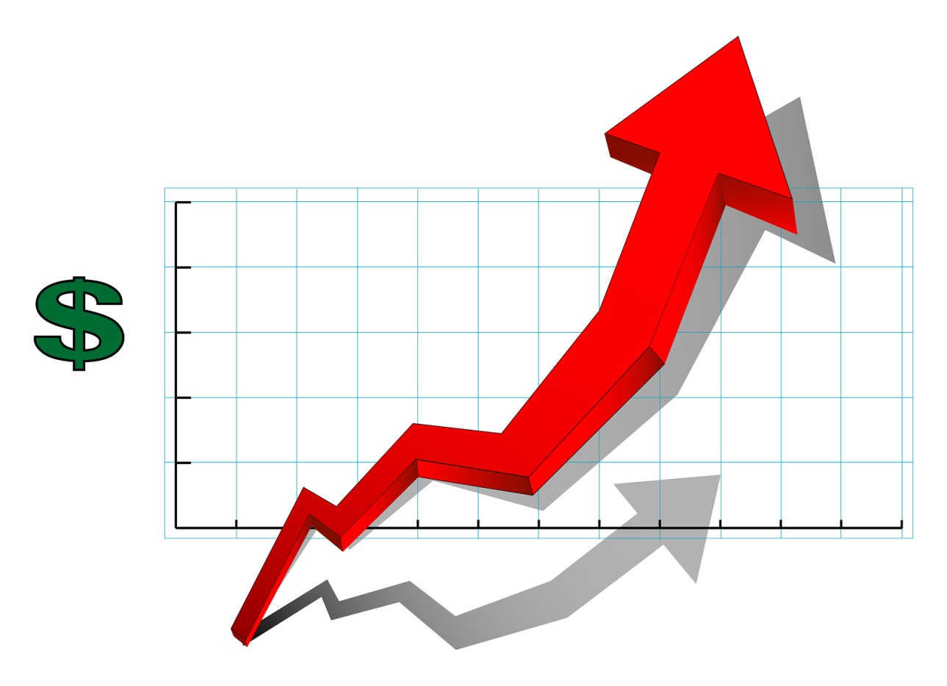
Mierniki predykcyjności i stabilności modelu
Credit Scoring i Makroprogramowanie w SAS

Slide 2
Dwie drogi
1. Wykorzystując współczynniki determinacji i kryteria informacyjne:
Adjusted R2
Akaike Information
Bayes Information
1. Inne mierniki dopasowania:
Confusion Matrix, Brier Score, Population Stability Index, Kolmogorov-Smirnov Statistic
Lorenz Curve and Gini Index, ROC Curve, CAP Curve, Lift Curve, Gain curve

Slide 3
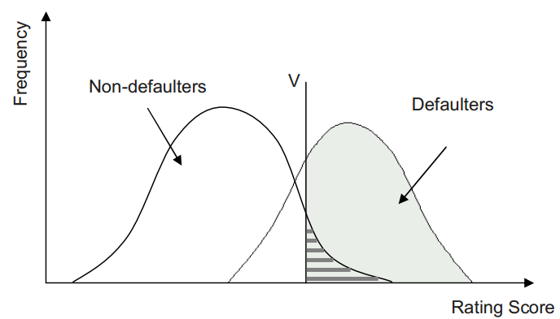
Rating Score distribution for defaulters and non-defaulters
For a perfect credit scoring model the distributions of defaulters and non-defaulters should be distinguished, but in the real world, perfect discrimination in general is not possible. Then both distributions will overlap as shown below. V is a cut-off value which provides a simple decision rule to divide the clients into potential defaulters and non-defaulters.
Then four scenarios can occur which are presented by the Confusion Matrix

Slide 4
Confusion matrix
Confusion matrix shows the number of correct and incorrect predictions made by the classification model compared to the actual outcomes in the data.
Confusion matrix |  | Observed
 |  | T | F
Predicted | T | True Positive | False Positive
 | F | False Negative | True Negative
TP + FN = P (observed positive)
TN + FP = N (observed negative)
TP + FP = PP (predicted positive)
TN + FN = PN (predicted negative)

Slide 5
Confusion matrix
Confusion matrix |  | Observed
 |  | T | F
Predicted | T | TP | FP | Positive Predictive Value | = TP / (TP + FP)
 | F | FN | TN | Negative Predictive Value | = TN / (FN + TN)
 |  | Sensitivity - czułość | Specificity – false alarm rate | Accuracy = (TP + TN) / (TP + TN + FP + FN)
 |  | = TP / (TP + FN) | = TN / (FP + TN)

Slide 6
Confusion matrix
Measure | Formula | Intuitive Meaning
Accuracy (PCC) | (TP + TN) / (TP + TN + FP + FN) | The proportion of the total number of predictions that were correct
Precision = Positive Predicted Value (PV+) | TP / (TP + FP) | The proportion of positive cases that were correctly identified
Negative Predicted Value (PV-) | TN / (TN + FN) | The proportion of negative cases that were correctly identified
Specificity | TN / (TN + FP) | The proportion of actual negative cases which were correctly identified.
TP-rate / Recall / Sensitivity | TP / (TP + FN) | The proportion of actual positive cases which were correctly identified.
FP-rate | FP / (TP + FN ) | The proportion of positive cases that were not correctly identified

Slide 7
Percentage correctly classified (PCC, Accuracy)
It’s the most straightforward method for assessing how well the model predicts good/bad behaviour
PCC = (TP + TN) / (TP + TN + FP + FN)
If two competing scores are being compared, the one with the highest PCC is considered to be the best

Slide 8



Brier Score
It’s a proper score function that measures the accuracy of probabilistic predictions
Brier score (~Mean Square Error):
Low Brier score indicates a good rating system

Slide 9

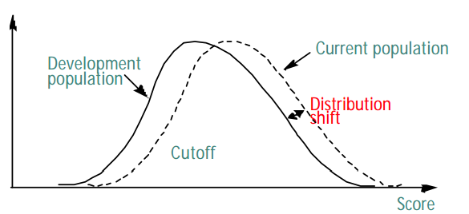
Population Stability Index (PSI)
PSI tells us how much the population has changed over time. The PSI can be applied at a score level, by binning the scores. This will tell us whether the population as a whole has shifted over time. Alternatively, the PSI can be applied at an individual variable level.
PSI allows finding the differences between expected and actual population
PSI
<0,1 | No meaningful changes
0,1-0,25 | Slight insignificant changes
>0,25 | Significant changes
Number of clients

Slide 10



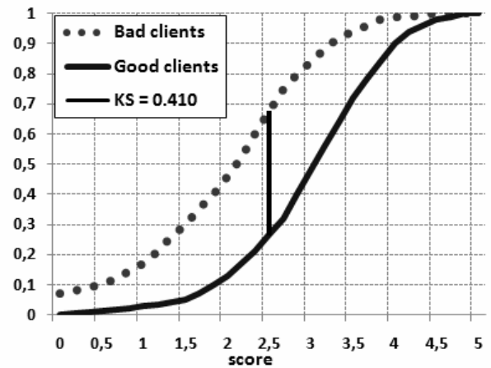

Kołmogorov-Smirnov statistic
– the cumulative distribution function among the goods
– the cumulative distribution function among the bads
– L is the minimum value of a given score, H is the maximum value
Kolmogorov-Smirnov statistic (KS):
describes the quality of the model
Score of around 2.5 or smaller has a population including around approximately 30% od good clients and 70% of bad clients

Slide 11


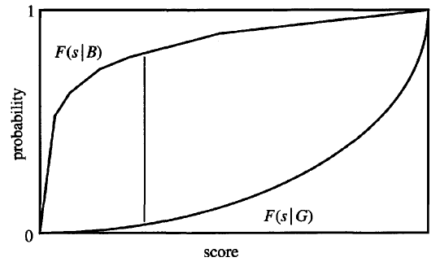
Kołmogorov-Smirnov statistic (2)
– cut-off (split)
– the cumulative distribution function among the Goods
– the cumulative distribution function among the Bads

Slide 12



Kołmogorov-Smirnov statistic (2)
– cut-off (split)
– the cumulative distribution function among the Goods
– the cumulative distribution function among the Bads
– the debt incurred by misclassifying a bad as a good
– the lost profit caused by misclassifying a good as a bad
Bads have a greater propensity for low values of score than the goods
The set of applitacation answers should be split on the value which minimazes:

Slide 13
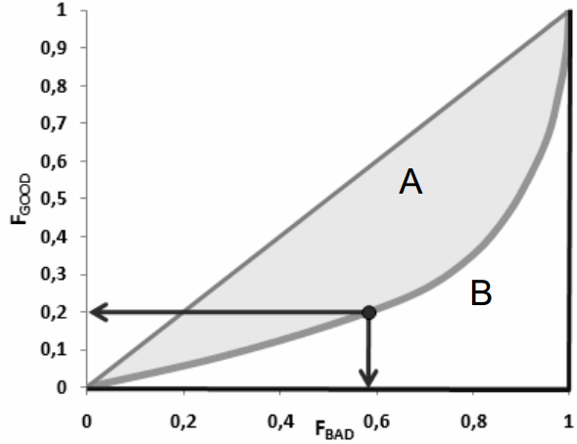


Lorenz Curve & Gini Index
– the cumulative distribution function among the goods
– the cumulative distribution function among the bads,
Each point on the curve represents some value of a given score (can be assumed as cut-off)
GINI INDEX:
The actual calculation:
By rejecting 20% of good clients, almost 60% of bad clients are rejected as well
Lorenz Curve
Line of perfect equality

Slide 14
ROC Curve
ROC → Receiver operating characteristic. The curve is obtained by plotting cumulated percentages of the non-defaulted and defaulted clients. It shows sensitivity ( TP / (TP + FN) ) on the X axis and specifity (TN / (FP + TN) ) on the Y axis
The area under the ROC curve called AUROC provides a measure of the model’s discriminatory power. For a random model without discriminatory power , AUROC = 0.5, and for a perfect model (it would exactly separate defaults and non-defaults) AUROC = 1. A model with greater discriminatory power has larger AUROC.
Difference between the current and development populations: Estimate AUROC for the current and development population. Then, apply the significance test on the difference between the current and development statistic. Depending on the result of this test, you may accept or reject the hypothesis that the difference is 0.

Slide 15
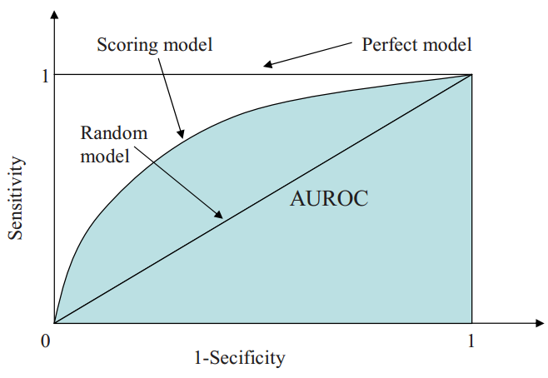
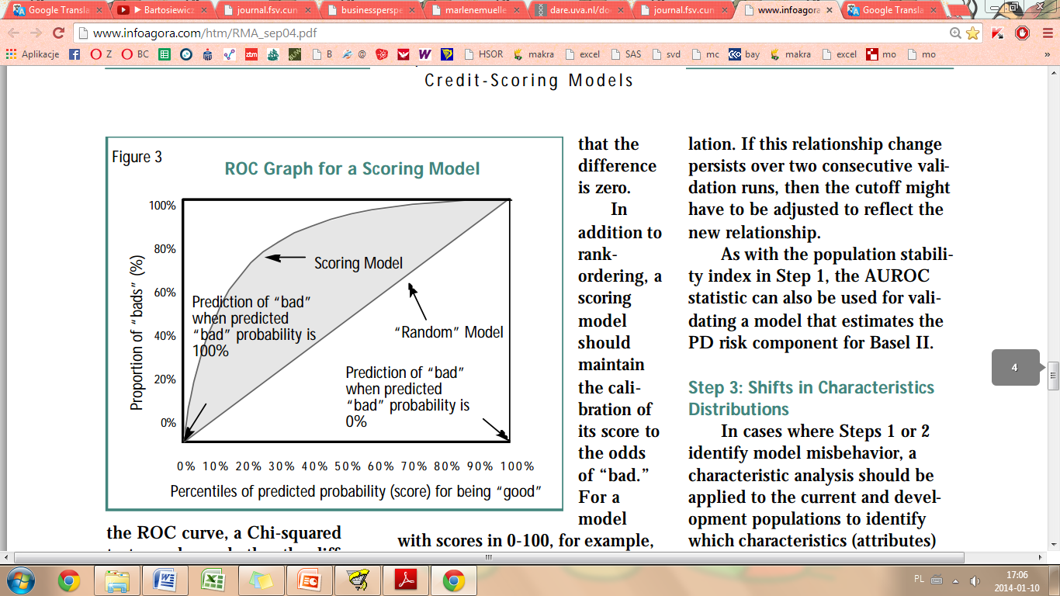
ROC Curve
Prediction of „bad” when predicted „bad” probability is 100%
Prediction of „bad” when predicted „bad” probability is 0%

Slide 16
KS statictic vs AUROC
It is worth pointing out, that the KS statistic is the maximum distance between the ROC curve and the X-axis. However, this maximum distance may occur at any point in the ROC curve. It is better if it occurs at the low scores, where most of the bads should be, than at the high scores. The KS statistics has the limitation that it does not refer to where the maximum distance occurs. That is why the statistics for AUROC is more general and so is better than the KS statistic.
KS statistics
ROC curve

Slide 17


CAP curve
CAP → Cumulative Accuracy Profile provides the assessment of the model’s quality.
The CAP curve shows the proportion of all clients (FALL) on the X axis and the proportion of bad clients (FBAD) on the Y axis. (skumulowany udział BAD przyporządkowany skumulowanemu udziałowi z całej próby)
The proportion of rejected bads vs. the proportion of all rejected can be easily read.
Accuracy Rate AR (stopień dopasowania):
Lorentz curve, ROC curve and CAP curve are not equivalent, but for any scoring model (AUROC – area under ROC curve) :

Slide 18
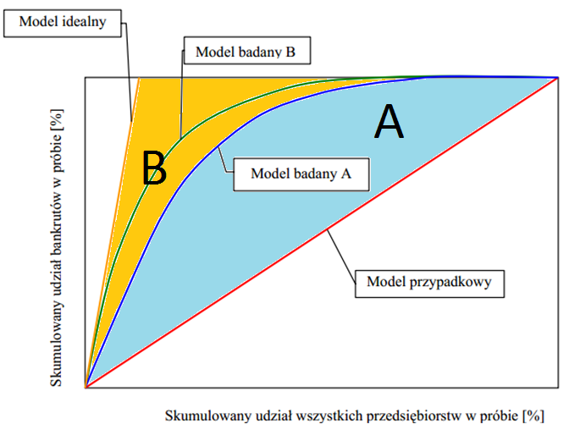
CAP curve
Dla modelu A:
AR = A / (A+B)

Slide 19
Krzywe koncentracji – CAP vs ROC
Na podstawie krzywej CAP można uzyskać odpowiedź na pytanie:
Ile procent klientów, przy wykorzystaniu wyników osiągniętych za pomocą danego modelu trzeba wyłączyć z całej badanej grupy, aby wyłączyć określoną liczbę bankrutów?
Natomiast krzywa ROC dostarcza odpowiedzi na pytanie:
Ile procent klientów zdrowych, przy wykorzystaniu wyników osiągniętych za pomocą danego modelu trzeba wyłączyć z grupy jednostek niezagrożonych upadkiem, aby wyłączyć określoną liczbę bankrutów?
Z obydwu krzywych można bezpośrednio dla danego punktu pośredniego (cut off point) modelu odczytać odpowiednie wartości sprawności lub błędów. Przy czym z krzywej ROC można odczytać zarówno sprawność jak i błędy I (specifity ~false positive rate) i II stopnia (sensitivity ~false negative rate), a dla krzywej CAP jedynie sprawność i błędy I stopnia (dla danych cut off’ów)

Slide 20






Lift chart and Cumulative Gain
The measure of the effectiveness of a predictive model calculated as the ratio between the results obtained with and without predictive model. Cumulative gains and lift charts consist of a lift curve and a baseline. The greater is the area between the lift curve and the baseline, the better is the model.
Cumulative Gains:
Lift Chart:
Where:

Slide 21
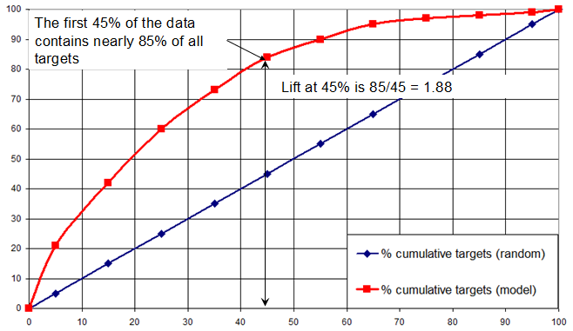
Cumulative Gain
Krzywa LIFT: na podstawie prognoz modelu liczymy procent pozytywnie zakwalifikowanych jako default względem wszystkich zakwalifikowanych jako default
PV+
Lift curve
Depth

Slide 22
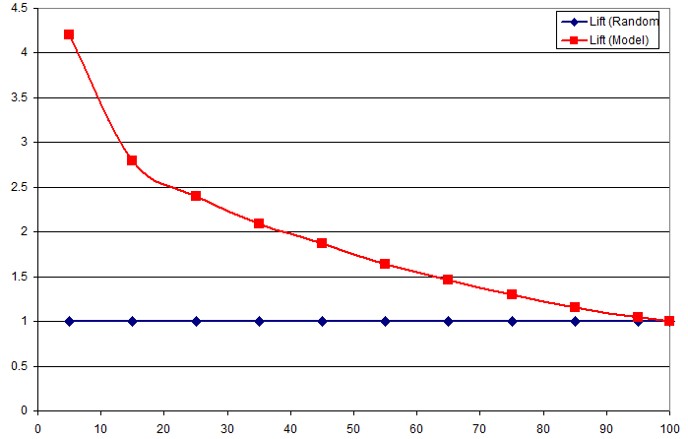
Lift chart – shows the actual lift
Dla danej wartości Depth krzywa Lift to odpowiednia różnica pomiędzy wynikiem otrzymanym za pomocą modelu i wynikiem otrzymanym „losowo”
PV+ / Rho1
Lift curve
Depth

