Slide 1
Generative AI

Slide 2
W2 Agenda
Introduction to working with LLMs
Prompt engineering
General rules
Retrieval Augmented Generation
Vector search
Hybrid search
How to leverage classic ML to make LLMs work better
Named Entity Recognition
CrossEncoders / Rerankers

Slide 3
Introduction to working with LLMs

Slide 4
Prompt Engineering

Slide 5
How can you communicate with any LLM? What can be included in LLM call?

Slide 6
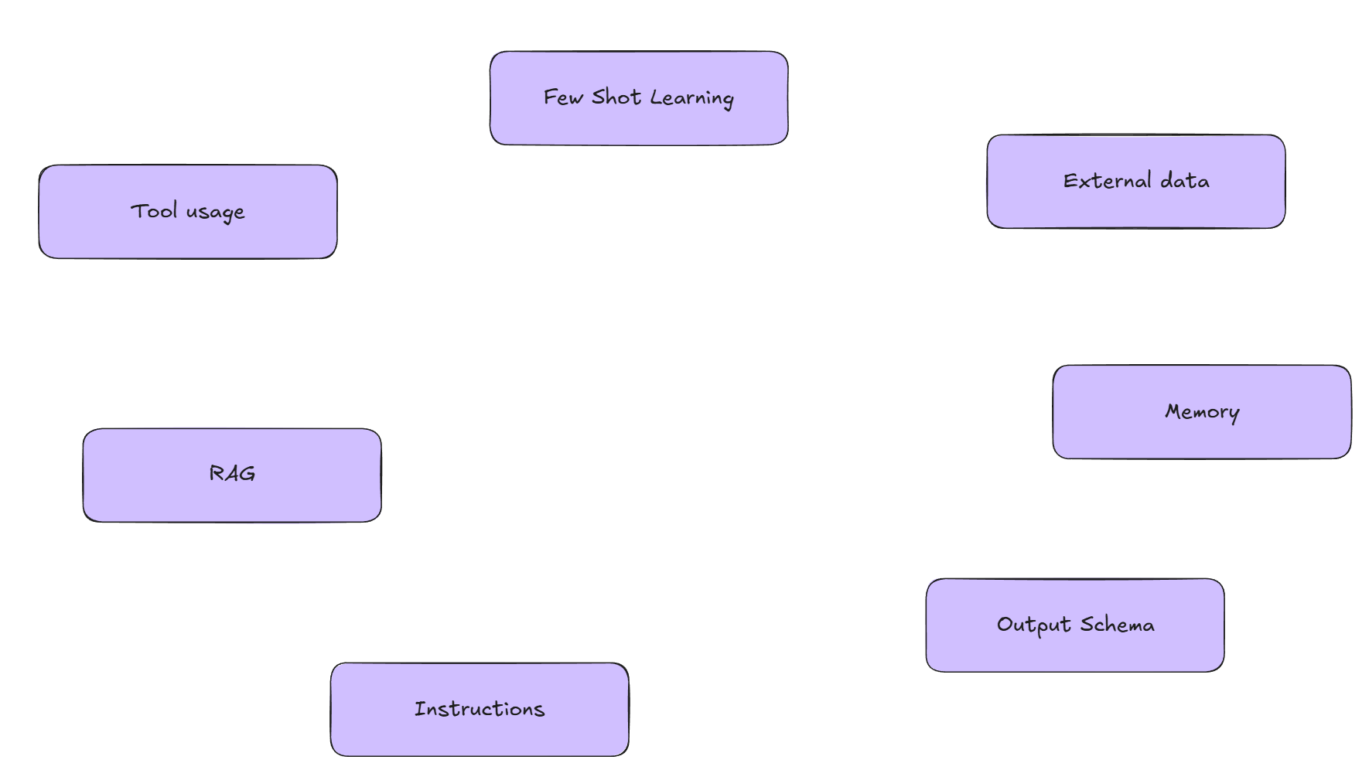
How can you communicate with any LLM? What can be included in LLM call?

Slide 7
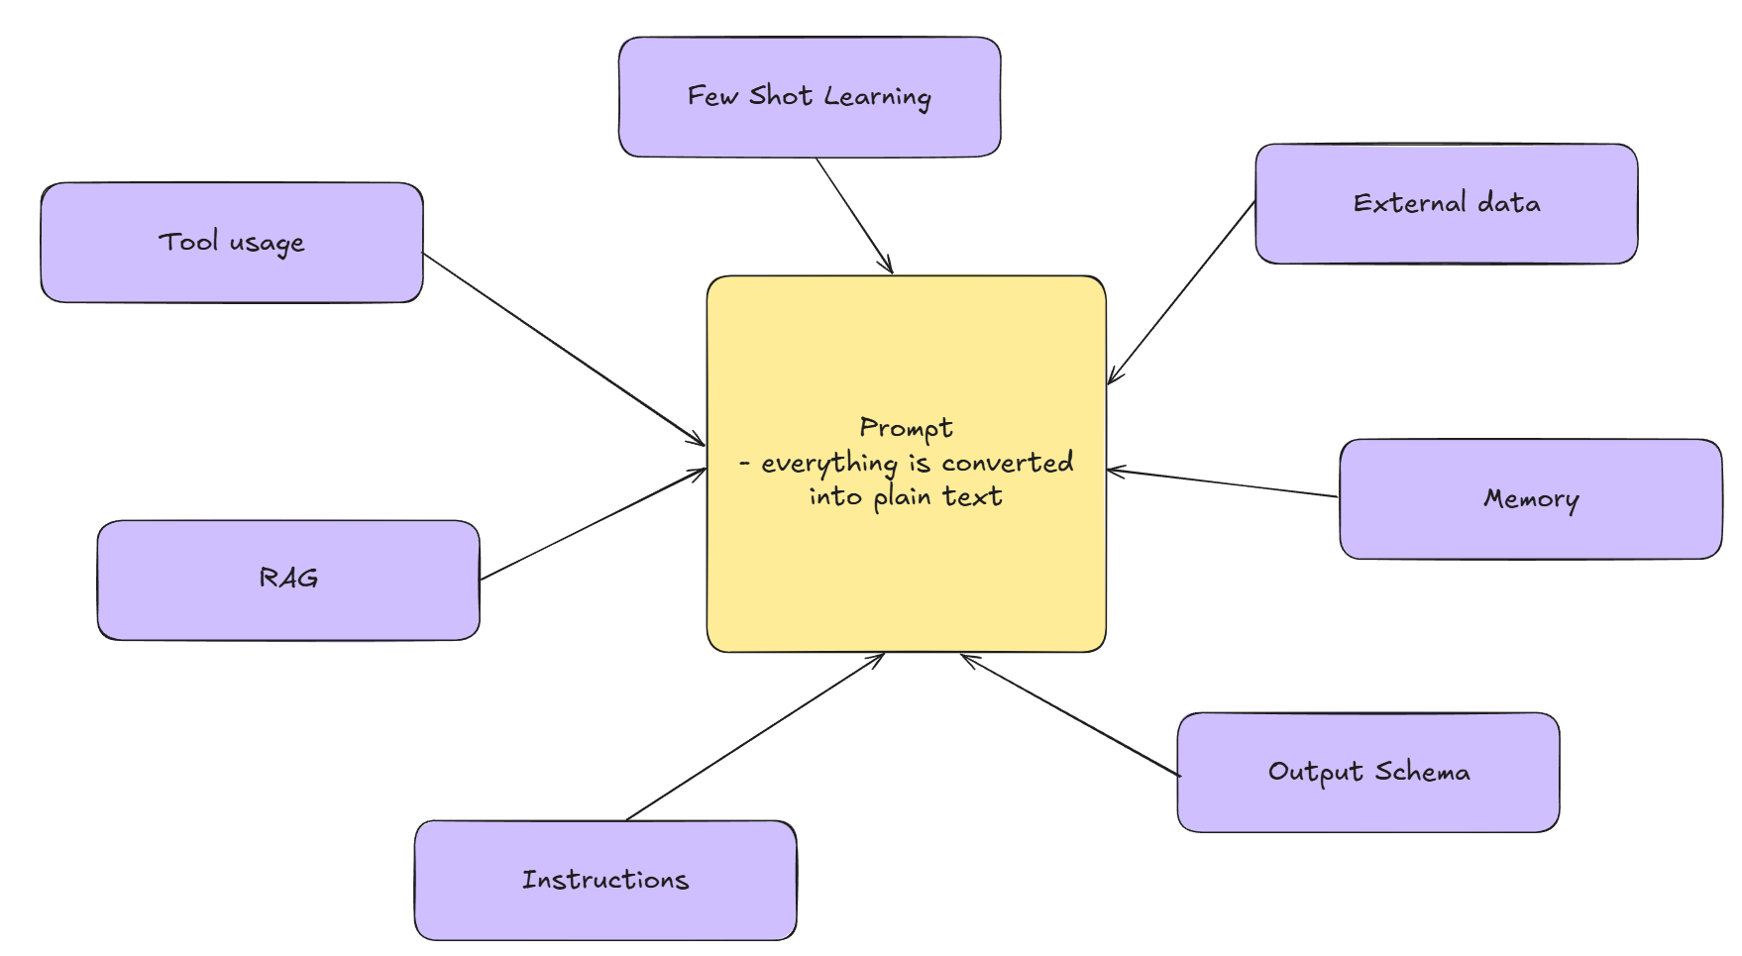
All non-image data is converted to text, no matter how complex the process might seem

Slide 8
What is a prompt?
Prompt text is the key model input for LLMs - it contains all the instructions together with conversation history and any additional context such as RAG
Despite being dominated by Natural Language prompt can implement coded structures such as html like syntax
While designing a prompt you should provide as detailed instructions and context as possible
Prompt does not need to be equal to what we see in the chat window, additional elements can be appended such as:
initial model instructions
domain information from RAG
conversation history
In context learning allows to help format model outputs by few-show-learning through prompting

Slide 9


https://chat.openai.com/c/507051a7-dc8a-4789-864c-e87fcfb2b1b2
Popular prompting templates
Question + Instruction
Instructions + Input data (zero-shot learning example)

Slide 10
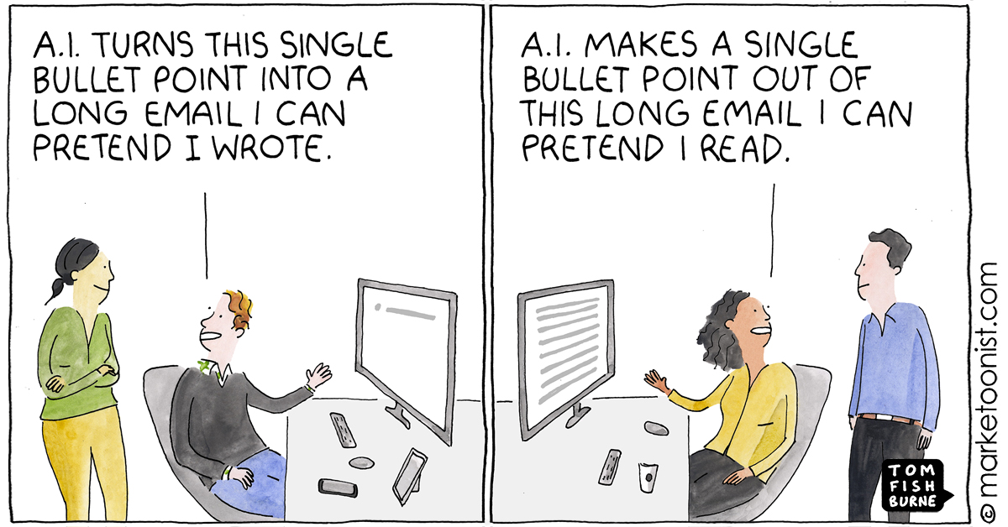

Slide 11

Popular prompting templates
Question + Examples

Slide 12
What is Prompt engineering
Prompt engineering aims to create prompts in a more programmatic, reproducible way
It involves carefully designing and structuring the input given to the model to effectively guide it towards generating the desired output or response.
Temperature is one of the key hyperparams controlling how varied and creative each models response is - even with the exact same prompt
Prompt Engineering can be more structured by leveraging libraries such as LangChain

Slide 13
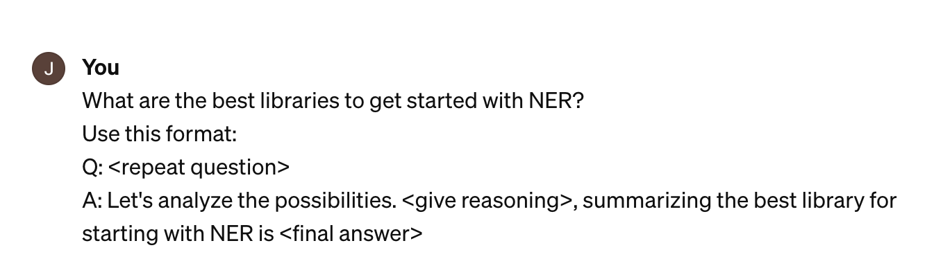
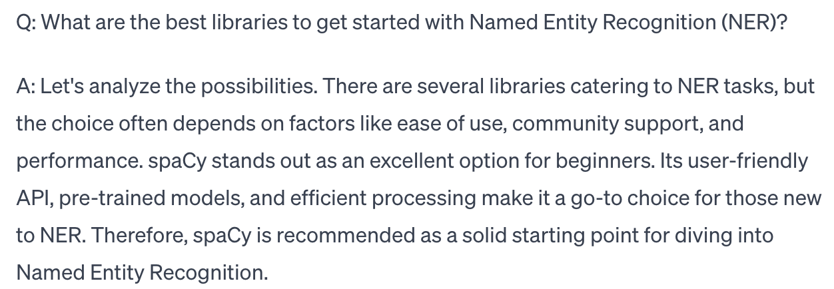
Chain-of-thought reasoning
Chain-of-thought prompting: Encourages model to be factual and precise by explaining its reasoning

Slide 14
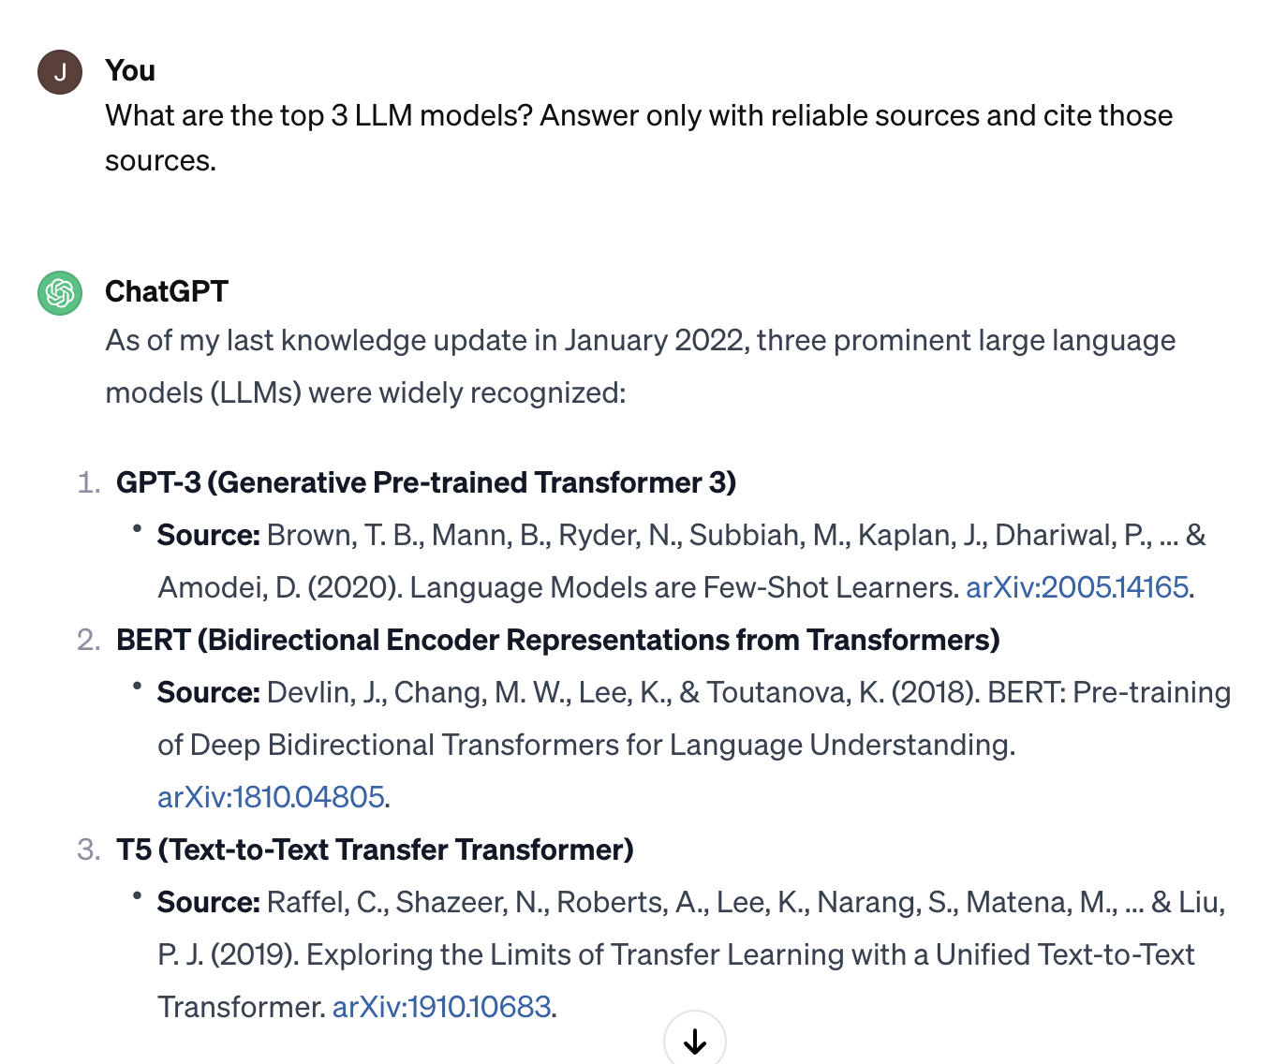
Citing sources
Warning!
LLM can still make up sources, but at least you can check if they exists

Slide 15
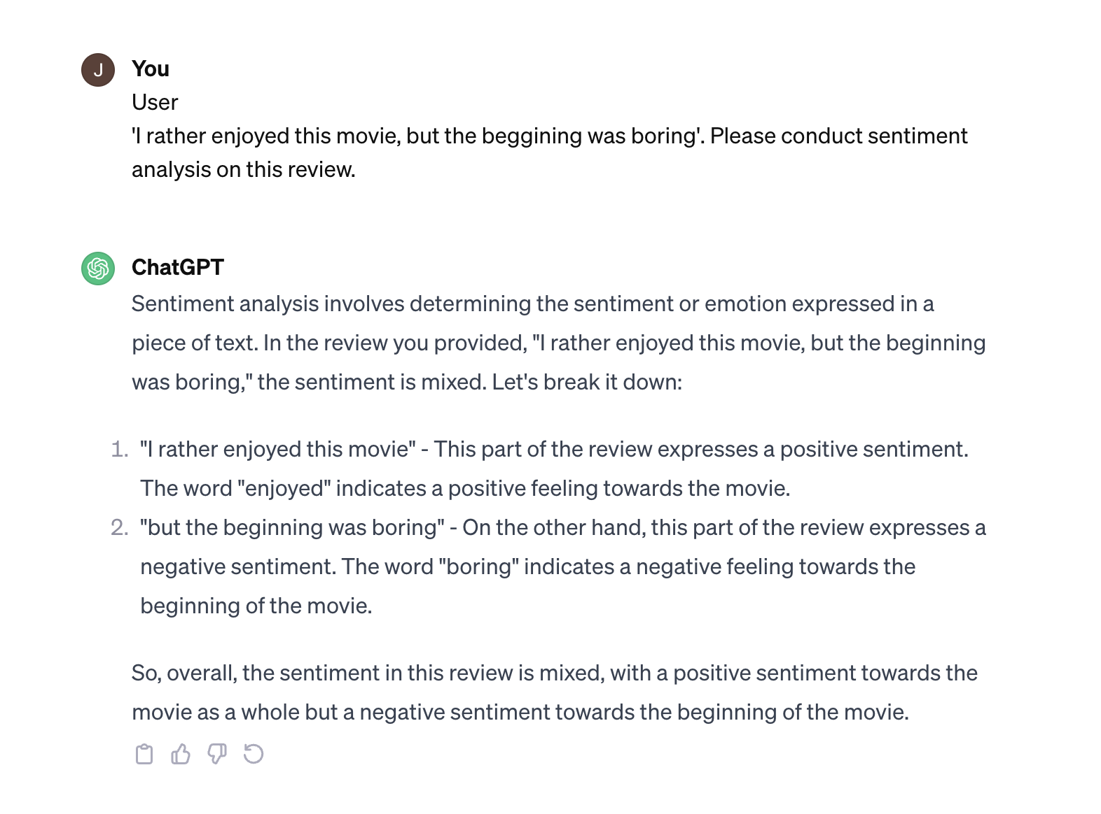
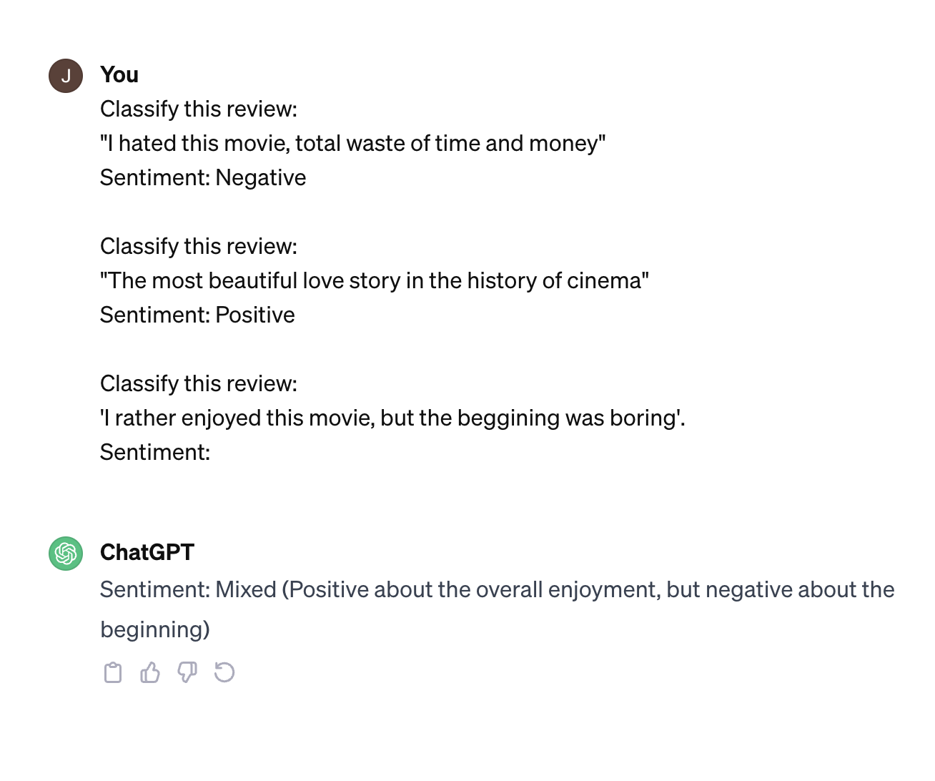
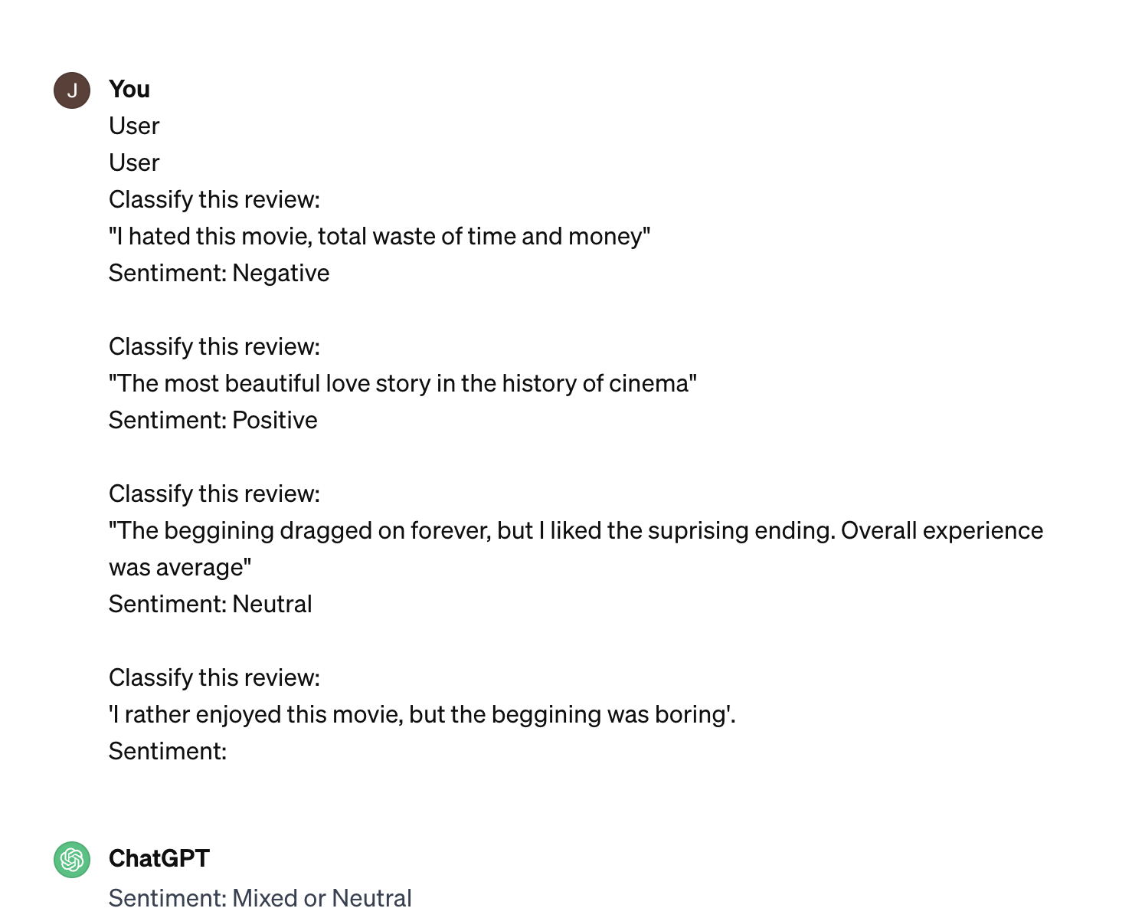
Few shot learning
Zero-shot
Two-shot
Three-shot

Slide 16
Few shot learning
Zero-shot
Two-shot
Three-shot

Slide 17
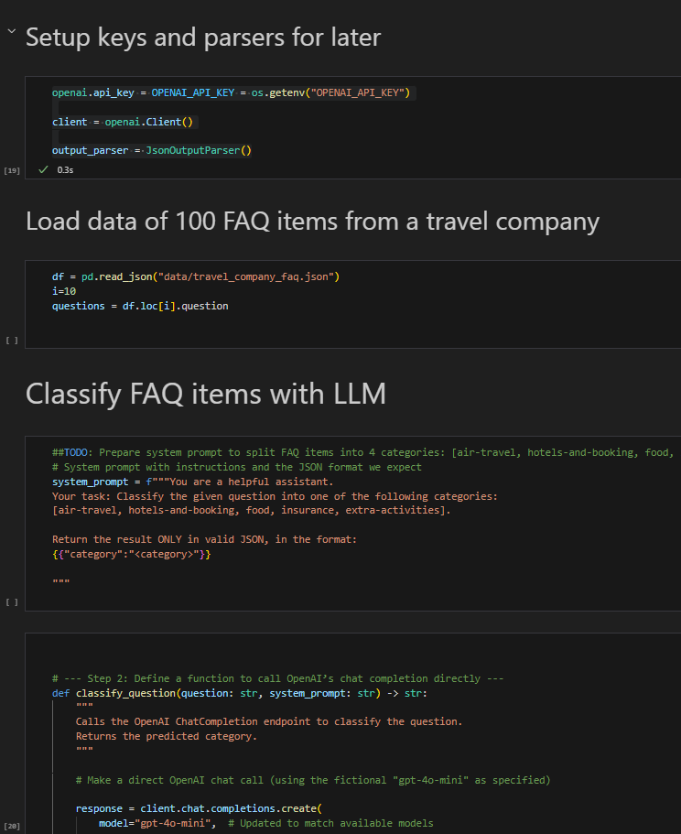
Jupyter exercise Few shot learning
Proceed to notebook W2-llm-calling-and-vector-search

Slide 18
General Tips

Slide 19


DOs and DONTs
Single, clear task per each call
Concise instructions, which can be followed as a human
Leverage markdown, html and system prompt for clear segmentation between input, instructions, few-shot examples and any other arguments
Complex tasks should be split into several, serial prompt calls
Asking for a score or exmplanation can improve results, even if the scores are not reliable
Chain-of-thouth framework can improve logical capabilities
Don’t flood LLMs with too much info, even if they have 1M tokens window
LLMs are pretty bad at numerical scoring
Be carefull with too many / too extreme examples as they might steer answers in unexpected directions
It is hard to tell LLM NOT TO DO something
LLMs are not designed for counting – it might be more reliable to extract values and summarize them programatically
Don’t overkill simple tasks with LLMs – many of them can be solved more efficiently with classic ML

Slide 20

It is harder to instruct LLM not to do something
Generated by author with gpt-4o, 2025-03-04

Slide 21
Retrieval Augmented Generation (RAG)

Slide 22
What is RAG?
Retrieval augmented generation (RAG) allows us to improve LLM performance by enriching our calls with some selected context
I allows expanding and updating model knowledge with external data, which improves information accuracy and relevance grounding its answers
Most popular forms of RAG rely on finding sections of documents, which are most similar to asked questions and integrating them to LLM call for better context
This approach can be used to feed real time or internal data to guide LLM answers, without need for retraining

Slide 23
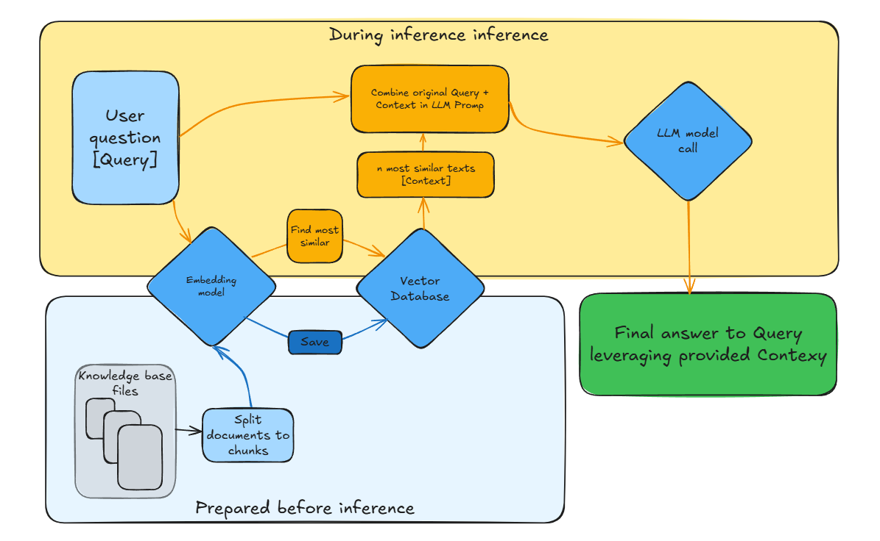
Vector RAG diagram
Source: image by author

Slide 24
RAG benefits
Grounding model answers with controlled context, which can reduce hallucinations
Ability to provide specified, real-time data to LLM e.g. fast changing promotions or product availability
Well-defined, specialized RAG can get good performance with smaller LLMs

Slide 25
RAG does NOT reason – key pitfalls
Despite being closely associated with LLMs, RAG relies mainly on vector search
It DOES NOT have any reasoning or logical abilities and can be easily misled
Purely vector based RAG carries many shortcoming of semantic similarity -> it will not perform well with complex questions and numbers
Feeding bad context to LLM call can increase risk of bad answers as LLM will be more likely to use this information

Slide 26
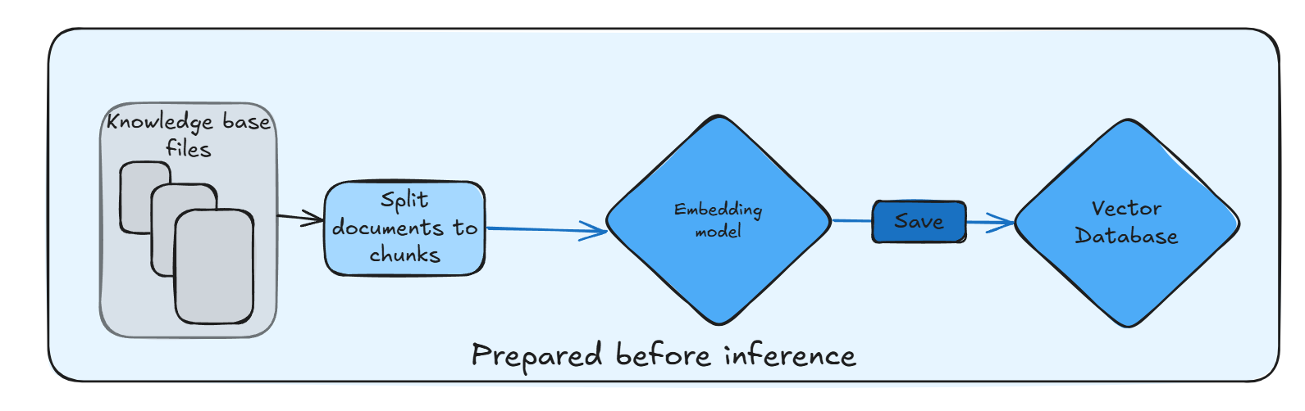
Creating and calling Vector database
1. Gather files for Knowledge base
2. Split files into smaller chunks within a few hundred tokens
3. Embed each chunk as a vector
4. Save each chunk’s text, vector, metadata and metadata to DB

Slide 27

Jupyter exercise Vector DB
Continue in notebook W2-llm-calling-and-vector-search

Slide 28
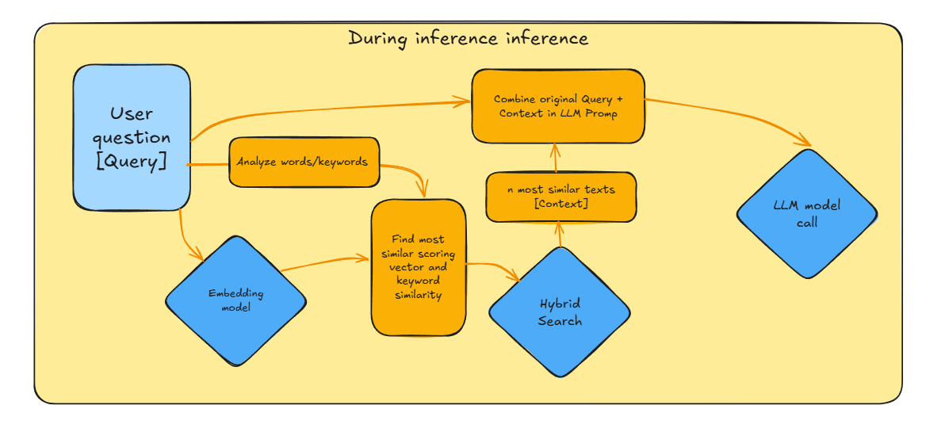
Hybrid search – combining vectors and keywords

Slide 29
Hybrid search – combining vectors and keywords
Hybrid search combines vector similarity with classic keyword-based searches
BM25 is a popular keyword search leveraging TF-IDF (Term Frequency-Inverse Document Frequency) algorithm
Keywords can also be used for hard filtering within document text (like in SQL) or metadata (if we want to limit our search to categories or documents)

Slide 30
Improving LLM results with classic ML

Slide 31
Why is it worth using classic ML when we have LLMs
LLMs are extremely flexible, but some tasks can be still completed with better speed and accuracy with pretrained NLP models e.g. Bert-based
They are significantly cheaper, faster and easier to deploy
Training/Finetuning can provide predictable results within specific domains if we have the data
Validation with classic ML can reduce LLM hallucinations
They give us to better control LLMs context and answers
Can serve for evaluation of LLMs

Slide 32
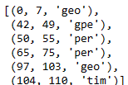

Named Entity Recognition summary
We use NER when we want to extract specific information from text
NER extract structured data from text
Single NER entity e.g. person can have thousands of instances
Position of the entity itself is important, which makes data annotation as well as processing especially challenging
geo
gpe
per
per
geo
tim
org
per
tim

Slide 33
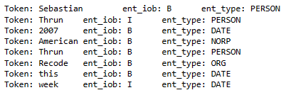
Under-the-hood NER is classifying tokens by their relations to specific entities
B
I
B
When Sebastian Thrun started working on self-driving cars at Google in 2007, few people outside of the company took him seriously. I can tell you very senior CEOs of major American car companies would shake my hand and turn away because I wasn’t worth talking to, said Thrun, in an interview with Recode earlier this week.
Spacy uses BIO labeling by default, where each token in analyzed text can get assigned the following values:
"B": Beginning of an entity
"I": Inside an entity
"O": Outside of any entity
Together with the label it also gets assigned an entity class.
From model perspective we are conducting multilabel classification for each token.
B
B
B
B
B
I

Slide 34
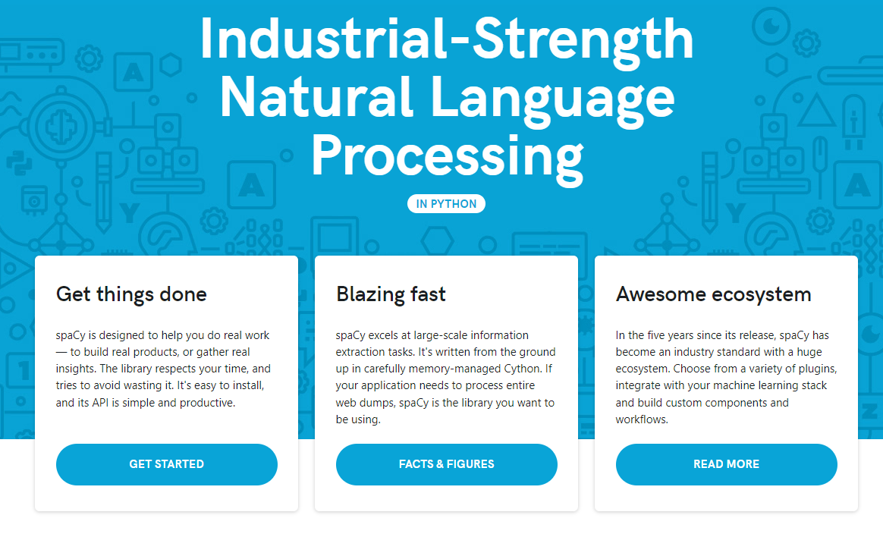
What is Spacy
Spacy is one of the most popular libraries for NLP
It has a low barier of entry
You can build models within a few dozens lines of code in a notebook
CLI interface great for building production models and replicability

Slide 35
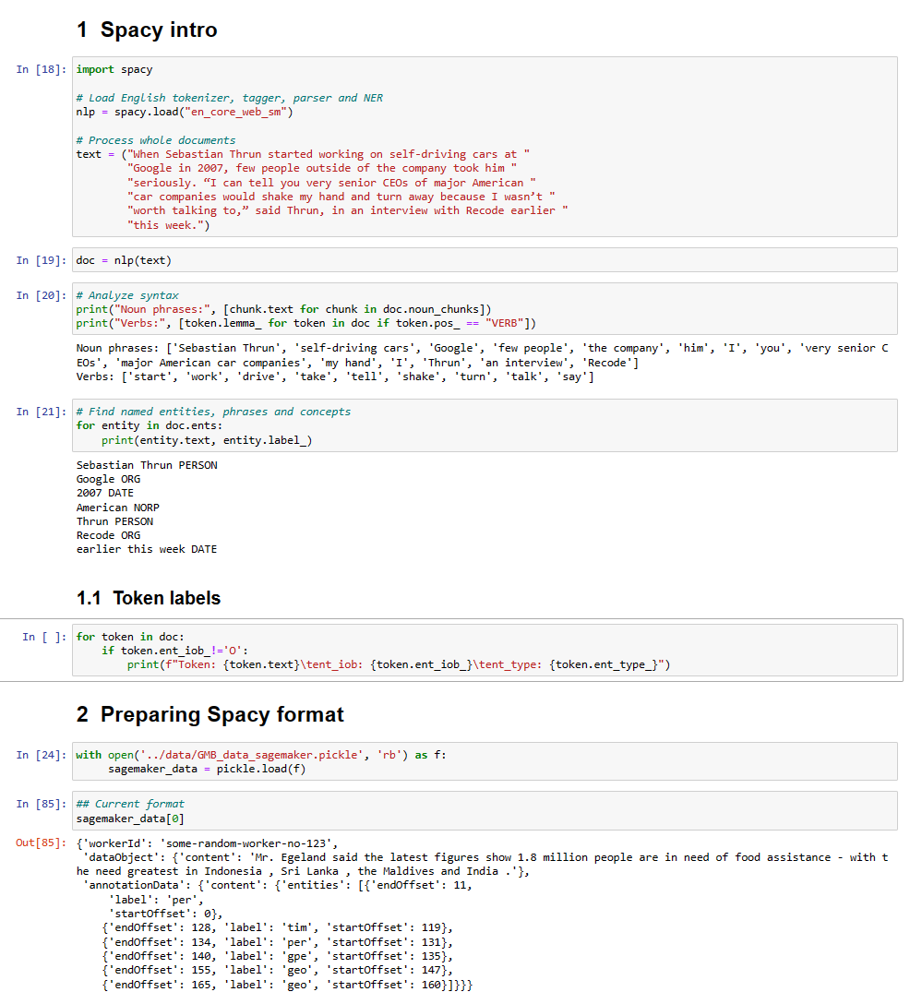
Jupyter exercise NER:
Proceed to notebook W2-NER-Intro-BLANK

Slide 36
Introduction to CrossEncoders
Crossencoders are a type of neural network used for ranking tasks – They take a pair of inputs (e.g., a query and a document) and jointly encode them into a single representation before making a relevance prediction.
They can be fine-tuned to perform multiple tasks e.g. similarity detection, answer releveance. We can tailor training data to fit our specific needs.
Under the hood they are based on encoder only transformer with additional neural network layers for regression task, outputting a single number according to they training goal
Pre-trained X-encoders are widely used for reranking of retrieval tasks.
They can also be used for evaluating logical similarity to evaluate LLM answers

Slide 37
CrossEncoders as rerankers – most common use case in RAG
As semantic similarity can be misleading, it is worth pulling more records than needed and then reranking most relevant using a more steerable and stronger model
Evaluating query<-> context pairs fit with cross-encoders can be much more accurate than vector similarity and much cheaper than LLMs
We can also fine-tune to X-encoders for our own goals e.g. answers following company specific rules such as different approach to different products/services/segments

Slide 38

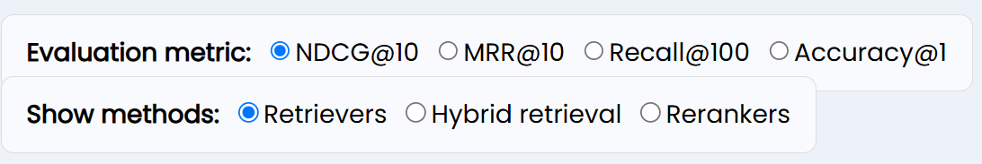
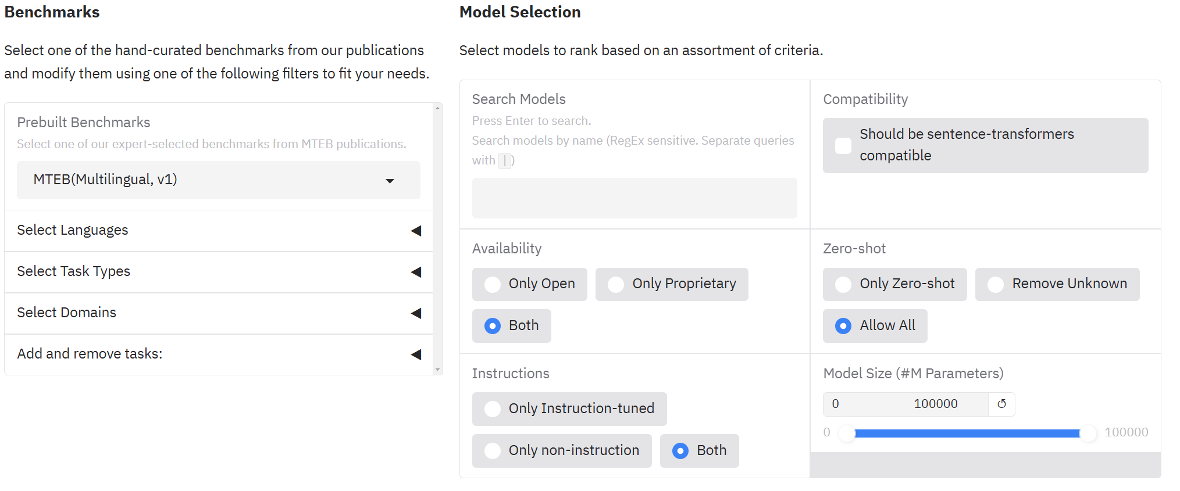
How to choose best model
Finding best model yourself is next to impossible – luckily, we have HF benchmarks focused on specific tasks and languages
Especially when working with non-English text most popular models might not perform best
Find relevant benchmark and choose best model within the size (params count) that you can use
Polish retrieval/reranking benchmark
Mutli-lingual embedding benchmark

Slide 39
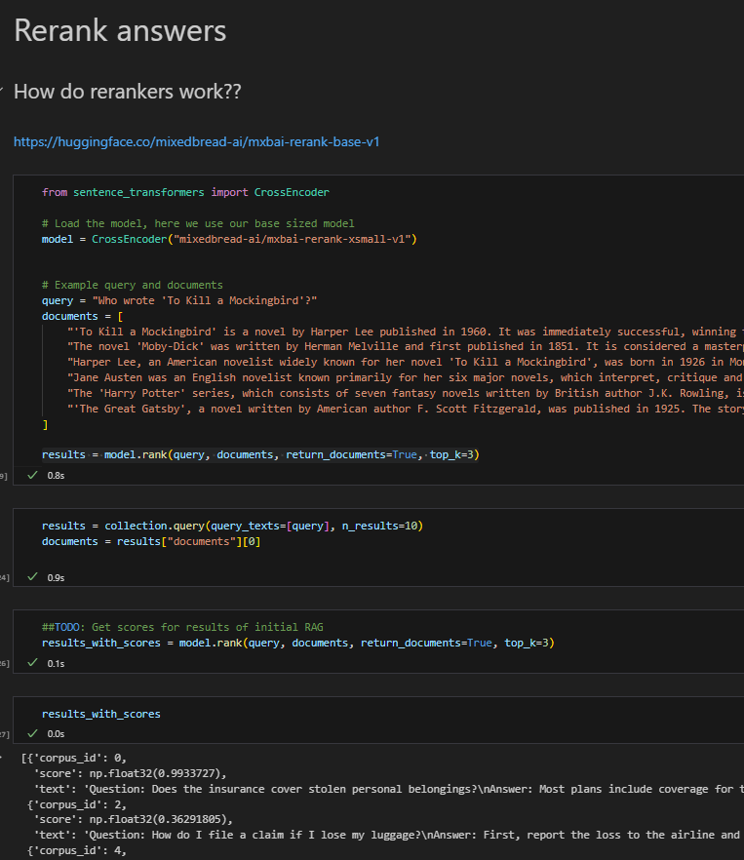
Jupyter exercise Reranking
Continue in notebook W2-llm-calling-and-vector-search

