Slide 1
Azure DevOps
Boards

Slide 2
Agile

Slide 3
Agile
Agile is a term used to describe approaches to software development emphasizing incremental delivery, team collaboration, continual planning, and continual learning.
The term “Agile” was coined in 2001 in the Agile Manifesto. The manifesto set out to establish principles to guide a better approach to software development. At its core, the manifesto declares 4 value statements representing the foundation of the agile movement. As written, the manifesto states…
We have come to value:
Individuals and interactions over processes and tools
Working software over comprehensive documentation
Customer collaboration over contract negotiation
Responding to change over following a plan
This does not imply the items on the right side of these statements aren’t important or needed; rather, items on the left are simply more valued.
https://docs.microsoft.com/en-us/azure/devops/learn/agile/what-is-agile

Slide 4
Agile Development
Agile development is a term used to describe iterative software development. Iterative software development shortens the software development lifecycle.
Agile development teams execute the entire software development lifecycle in smaller increments, usually called sprints.
Sprints are typically 1-4 weeks long. Agile development is often contrasted with traditional or waterfall development, where larger projects are planned up front and executed against that plan.
https://docs.microsoft.com/en-us/azure/devops/learn/agile/what-is-agile-development

Slide 5
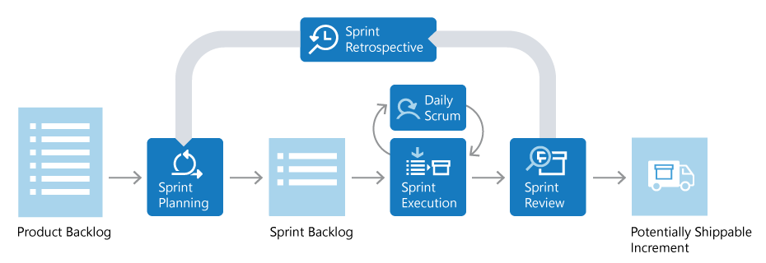
Scrum
Scrum is a framework used by teams to manage their work. Scrum implements the principles of Agile as a concrete set of artifacts, practices, and roles.
The following diagram details the Scrum lifecycle. Scrum is iterative. The entire lifecycle is completed in fixed time-period called a Sprint. A Sprint is typically 2-4 weeks long.
https://docs.microsoft.com/en-us/azure/devops/learn/agile/what-is-scrum

Slide 6
Scrum roles
Product Owner
Responsible for what the team is building, and why they’re building it. The product owner is responsible for keeping the backlog up-to-date and in priority order.
Scrum Master
Responsible to ensure the scrum process is followed by the team. Scrum masters are continually on the lookout for how the team can improve, while also resolving impediments (blocking issues) that arise during the sprint. Scrum masters are part coach, part team member, and part cheerleader.
Scrum Team
These are the individuals that actually build the product. The team owns the engineering of the product, and the quality that goes with it.

Slide 7
Scrum
Product Backlog
The Product Backlog is a prioritized list of value the team can deliver. The Product Owner owns the backlog and adds, changes, and reprioritizes as needed.
Sprint Planning and Sprint Backlog
In Sprint Planning, the team chooses the backlog items they will work on in the upcoming sprint. The team chooses backlog items based on priority and what they believe they can complete in the sprint. The Sprint Backlog is the list of items the team plans to deliver in the sprint. Often, each item on the Sprint Backlog is broken down into tasks.
Sprint Execution and Daily Scrum
Once the Sprint starts, the team executes on the Sprint Backlog. Scrum does not specify how the team should execute. That is left for the team to decide.

Slide 8
Scrum
Sprint Review
The team demonstrates what they’ve accomplished to stakeholders. They demo the software and show its value.
Sprint Retrospective
The team takes time to reflect on what went well and which areas need improvement. The outcome of the retrospective are actions for next sprint.
Increment
The product of a Sprint is called the “Increment” or “Potentially Shippable Increment”. Regardless the term, a Sprint’s output should be of shippable quality, even if it’s part of something bigger and can’t ship by itself. It should meet all the quality criteria set by the team and Product Owner.

Slide 9
Kanban
Kanban is a Japanese term meaning signboard or billboard. An industrial engineer named Taiichi Ohno is credited with having developed Kanban at Toyota Motor Corporation to improve manufacturing efficiency
Key Kanban principles:
Pull-model
Visualize work
Limit work in progress
Continuous improvement
https://docs.microsoft.com/en-us/azure/devops/learn/agile/what-is-kanban

Slide 10
Kanban: Pull-model
Software development teams historically have had work pushed on them as stakeholders request more functionality.
This is often accompanied by tight deadlines. A common side effect of this behaviour is that quality suffers as the team is forced to take shortcuts necessary to deliver the functionality within the timeframe.
Kanban helps a team focus on maintaining an agreed upon level of quality that must be met before the team can claim a piece of work as done. Stakeholders add requests to a backlog and then the team “pulls” work into their workflow as capacity becomes available.

Slide 11
Kanban: Visualize work
Understanding the status of a software development team in terms of both process and progress can be challenging. People can more easily understand the current state of work if it is shown using a visual representation rather than a large list of work items, or a document describing the work being done.
Visualization of work is a key Kanban principle.
Kanban addresses this visualization using Kanban boards. Visualizing the work to be done as cards on a board, in different states, allows you to easily see the “big picture” of where the project currently stands, as well as identify potential bottlenecks that could affect productivity.

Slide 12
Kanban: Limit work in progress
Teams that try to work on too many things often suffer from reduced productivity due to frequent and costly context switching. The team is busy but work just doesn’t seem to be getting done resulting in unacceptably high lead times.
To address this, limiting the number of backlog items a team is working on at any given time helps increase focus while reducing context switching.
The maximum number of items a team decides to work on at any point in time is known as the WIP limit. A well-disciplined team will work to ensure they are not exceeding their WIP limit. Should this occur, the team will investigate the reason, and work to solve the root cause for the issue.

Slide 13
Continuous improvement
For software development teams to continuously improve, they need ways to measure their team’s effectiveness and throughput. Kanban, through the use of the Kanban board, provides a dynamic view of the state of work in a workflow.
This allows the team to experiment with different processes and evaluate the impact on the flow of work more easily. Teams that practice Kanban often utilize measurements such as lead times and cycle times and generally embrace the benefits offered for continuous improvement.

Slide 14
Azure Boards

Slide 15
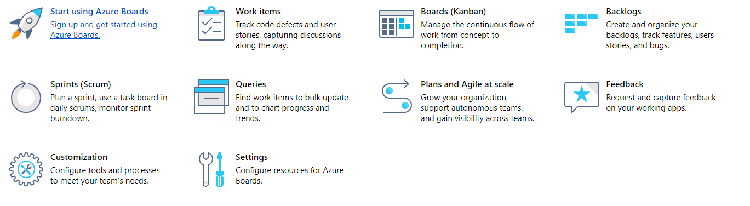
Azure Boards
Azure Boards provides a suite of interactive Agile tools with which you can plan and track work, bugs, and issues. Azure Boards is available from Azure DevOps Services and Team Foundation Server (TFS).
The set of Agile tools that Azure Boards provides are designed to support teams working with Agile methodologies, such as Kanban and Scrum.
https://docs.microsoft.com/en-us/azure/devops/boards/index?view=vsts

Slide 16
Work Items
You can use work items to track anything you need to track. Each work item represents an object stored in the work item data store. Each work item is based on a work item type and is assigned an identifier which is unique within an organization or project collection.
The work item types available to you are based on the process used when your project was created.
https://docs.microsoft.com/en-us/azure/devops/boards/work-items

Slide 17
Work Items
You use different work item types (WITs) to track different types of information, such as user stories, bugs, and tasks
You update the work item form to add information, update status, reassign to another project member or sprint, and to link work items, attach files, and add comments
You can add and modify work items using the web portal and other supported clients
You can assign a work item to one and only one project member
You assign work items to a sprint via the iteration path
You can use adhoc search or queries to find or list work items
Teams can choose how they track bugs, either as requirements or as tasks
To add or modify work items, you need to be a project member with Contributor permissions and Basic or Stakeholder access.

Slide 18
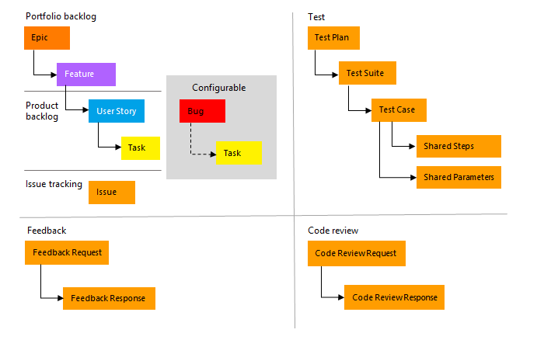
Work Item Types (WIT)
To track different types of work, different WITs are defined. The WITs available to you differ depending on the process or process template used to create your project.

Slide 19
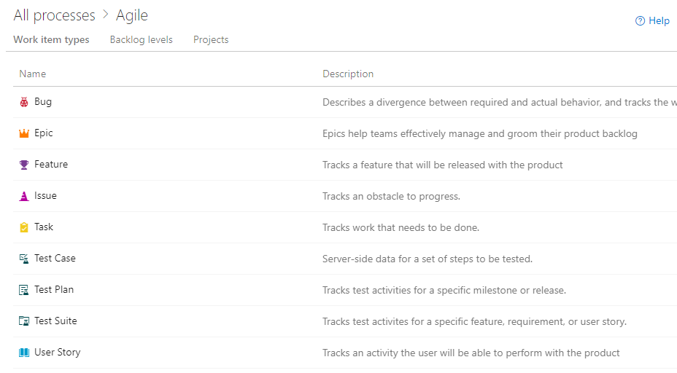
Agile Process
https://docs.microsoft.com/en-us/azure/devops/boards/work-items/guidance/agile-process-workflow

Slide 20
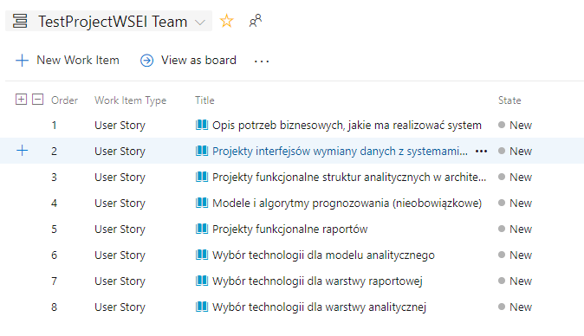
User Story
User stories define the applications, requirements, and elements that teams need to create. Product owners typically define and stack rank user stories. The team then estimates the effort and work to deliver the highest priority items.
https://en.wikipedia.org/wiki/User_story

Slide 21
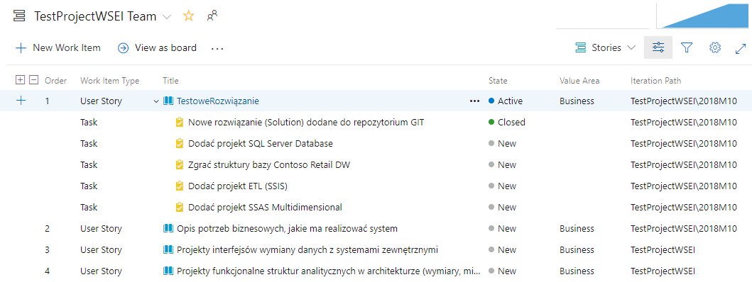
Task
When your team manages their work in sprints, they can use the sprint backlog page to break down the work to be accomplished into distinct tasks.

Slide 22
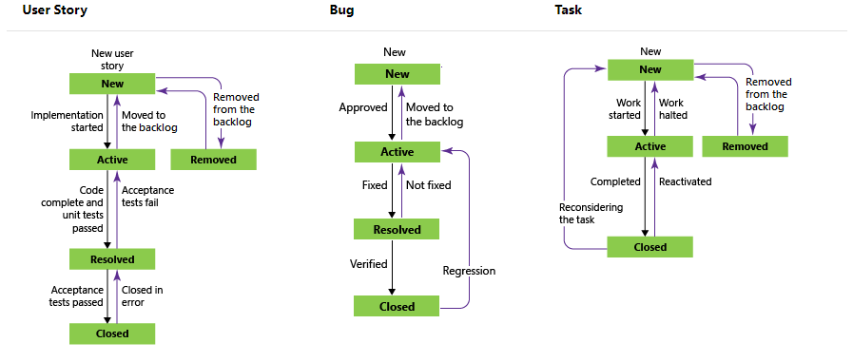
Workflow states
A typical workflow progression for a user story follows:
The product owner creates a user story in the New state with the default reason, New user story
The team updates the status to Active when they decide to complete the work during the sprint
A user story is moved to Resolved when the team has completed all its associated tasks and unit tests for the story pass
A user story is moved to the Closed state when the product owner agrees that the story has been implemented according to the Acceptance Criteria and acceptance tests pass.

Slide 23
Backlogs
An agile development team works off of a backlog of requirements, often called “user stories”. The backlog is prioritized so the most important user stories are at the top. The product owner owns the backlog and adds, changes, and reprioritizes user stories based on the customer’s needs.
One of the biggest drags on an agile team’s productivity is a poorly defined backlog. A team cannot be expected to consistently deliver high quality software each sprint unless they have clearly defined requirements.
The product owner’s job is to ensure that every sprint, the engineers have clearly defined user stories to work with. The user stories at the top of the backlog should always be ready for the team to execute on. This is called backlog refinement. Keeping a backlog ready for an agile development team takes an incredible amount of effort and discipline.

Slide 24
Backlogs
Refining user stories is often a long-lead activity
Elegant user interfaces, beautiful screen designs, and customer delighting solutions all take time and energy to create. Diligent product owners refine user stories 2-3 sprints in advance. They account for design iterations and customer reviews. They work to ensure every user story is something the agile team is proud to deliver to the customer.
A user story is not refined unless the team says it is
The team needs to review the user story, and agree it’s ready to work on. If a team has not seen the user story until day 1 of a sprint, that’s a big red flag.
User stories further down the backlog can remain ambiguous
Don’t waste time refining lower priority items. Stay intently focused on the top of the backlog.

Slide 25
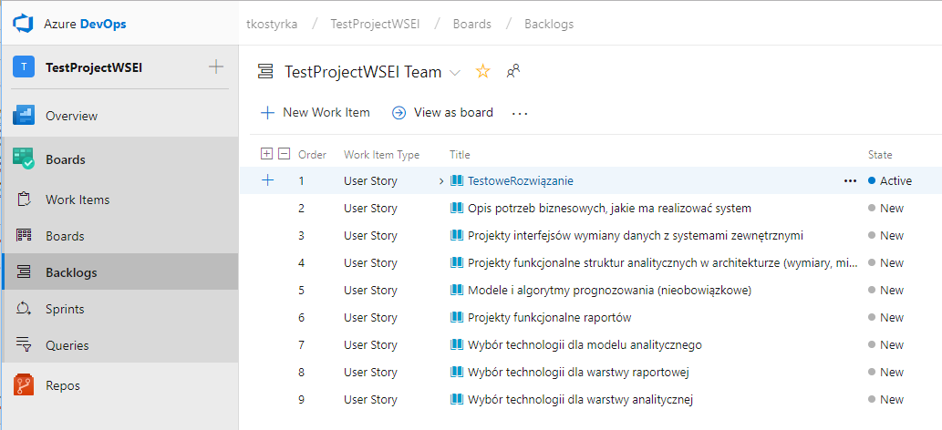
Backlog
https://docs.microsoft.com/en-us/azure/devops/boards/backlogs/

Slide 26
Sprints
With Scrum, teams plan and track work at regular time intervals, referred to as a sprint cadence. You define sprints to correspond to the cadence your team uses.
Many teams choose a two or three week cadence. However, you can specify shorter or longer sprint cycles. Also, you can create a release schedule which encompasses several sprints.
Scheduling sprints (tutorial):
https://docs.microsoft.com/en-us/azure/devops/boards/sprints/define-sprints?view=vsts&tabs=new-nav
Assign to sprint (tutorial):
https://docs.microsoft.com/en-us/azure/devops/boards/sprints/assign-work-sprint?view=vsts&tabs=new-nav
https://docs.microsoft.com/en-us/azure/devops/boards/sprints/scrum-overview?view=vsts&tabs=new-nav

Slide 27
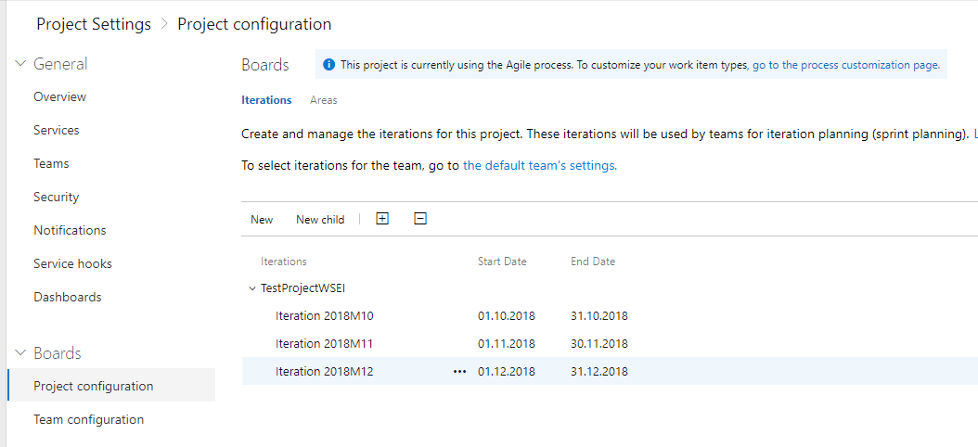
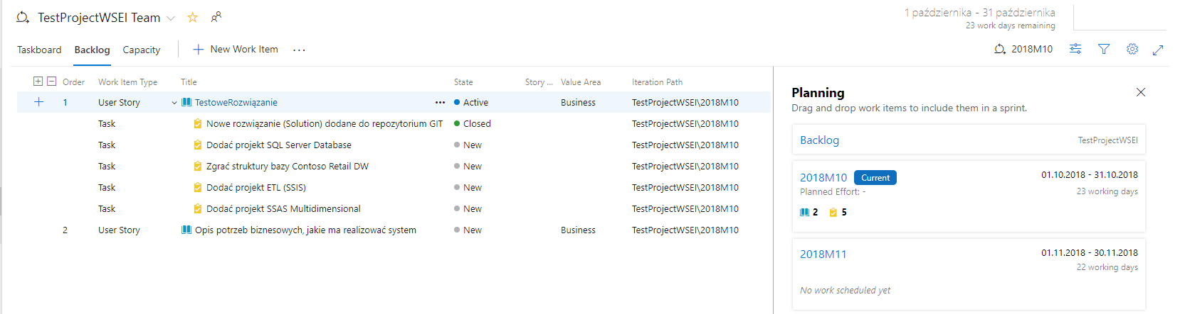
Sprints

Slide 28
Boards
Your Kanban board provides you with a visual interactive space for you and your team to plan and show progress. With it, your team can track the critical information they need by seeing which work items are in progress, where the bottlenecks are, who work is assigned to, and more.
Boards present work items as cards and support quick status updates through drag-and-drop, similar to sticky notes on a physical whiteboard.
A Kanban board can be a physical board or a software application that shows cards arranged into columns. Typical column names may include To-do, Doing and Done but teams can customize this to suit the states in their workflow. For example; New, Development, Testing, UAT, Done.
Software based Kanban boards can display cards corresponding to Product Backlog Items and include links to things such as tasks and test cases.
On a Kanban board, a WIP limit is applied to all “in-progress” columns. The first and last columns on a Kanban board do not have WIP limits.

Slide 29
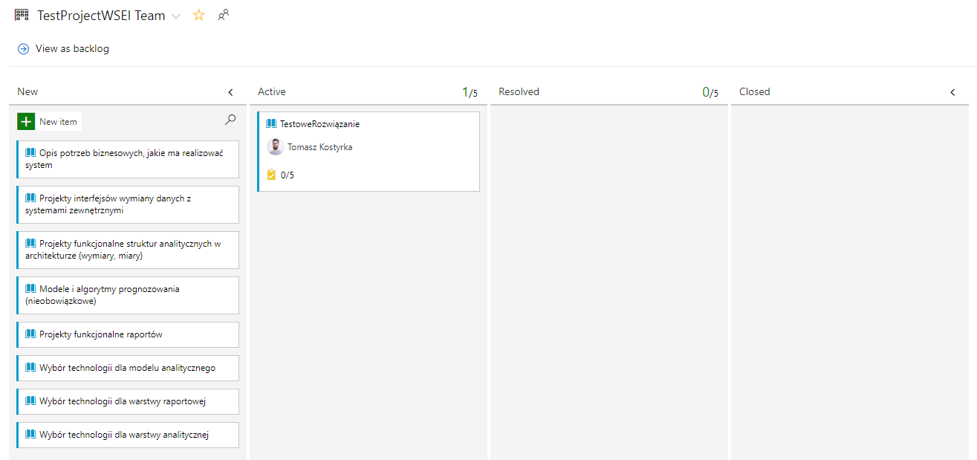
StoryBoard

Slide 30
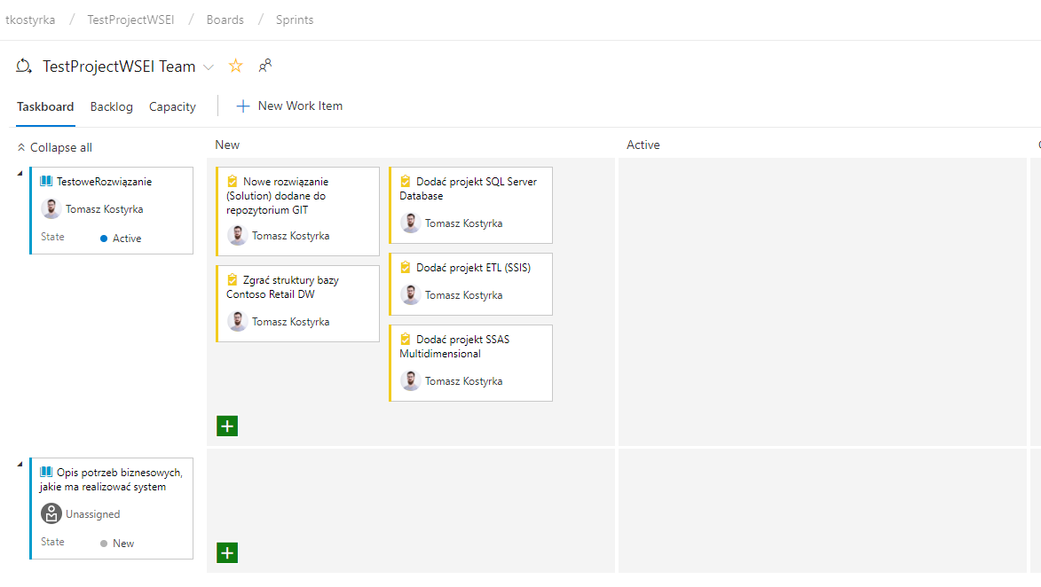
TaskBoard

Slide 31
Backlog vs. Boards
Backlogs display work items as a list and boards display them as cards
You use your product backlog to quickly plan and prioritize your work
Each backlog is associated with a board, changes to priority order you make in one are reflected in its corresponding board
With list backlogs you can quickly develop your project plan; group and prioritize work; and perform bulk updates on selected work items. With boards, you can quickly update status and fields displayed for each work item.
You access your backlogs and boards from a web portal. When you work from the Stories (Agile) or Backlog items (Scrum) pages, you have access to the product backlog and Kanban board. When you work from a sprint page, you have access to the sprint backlog and taskboard.

