Slide 1
Azure DevOps
GIT

Slide 2
links
https://docs.microsoft.com/en-us/azure/devops/repos/git/?view=vsts
https://docs.microsoft.com/en-us/azure/devops/repos/git/git-branching-guidance
https://www.youtube.com/watch?v=t_4lLR6F_yk

Slide 3
Basics

Slide 4
Branching

Slide 5
Understand branch history
https://www.atlassian.com/git/tutorials/syncing/git-fetch
Clone, add, commit
Fetch, push, pull

Slide 6
Understand branch history
Keep your branch strategy simple by building your strategy from these three concepts:
Use feature branches for all new features and bug fixes.
Merge feature branches into the master branch using pull requests.
Keep a high quality, up-to-date master branch.
A strategy that extends these concepts and avoids contradictions will result in a version control workflow for your team that is consistent and easy to follow.

Slide 7
Keep your branch strategy simple
Keep your branch strategy simple by building your strategy from these three concepts:
Use feature branches for all new features and bug fixes.
Merge feature branches into the master branch using pull requests.
Keep a high quality, up-to-date master branch.
A strategy that extends these concepts and avoids contradictions will result in a version control workflow for your team that is consistent and easy to follow.

Slide 8
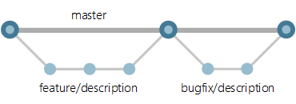
Use feature branches for your work
Develop your features and fix bugs in feature branches (also known as topic branches) based off your master branch. Feature branches isolate work in progress from the completed work in the master branch. Git branches are inexpensive to create and maintain, so even small fixes and changes should have their own feature branch.
Creating feature branches for all your changes makes reviewing history very simple. Look at the commits made in the branch and look at the pull request that merged the branch.

Slide 9
Name your feature branches by convention
Use a consistent naming convention for your feature branches to identify the work done in the branch. You can also include other information in the branch name, such as who created the branch.
Some suggestions for naming your feature branches:
users/username/description
users/username/workitem
bugfix/description
features/feature-name
features/feature-area/feature-name
hotfix/description

Slide 10
Manage releases
Use release branches to coordinate and stabilize changes in a release of your code. This branch is long-lived and isn't merged back into the master branch in a pull request, unlike the feature branches. Create as many release branches as you need, but keep in mind that each active release branch represents another version of the code you'll need to support. Lock release branches when you're ready to stop supporting a particular release.

Slide 11
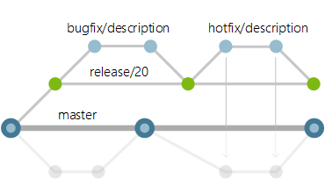
Use release branches
Create a release branch from the master branch as you get close to your release or other milestone, such as the end of a sprint. Give this branch a clear name associating it with the release, for example release/20.
Create branches to fix bugs from the release branch and merge them back into the release branch in a pull request.

Slide 12
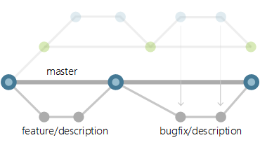
Port changes back to the master branch
Bring over changes made in your release branch into your master branch to prevent regression in your code. Port your changes from your release branch into a new feature branch to bring them back into the master branch. Use cherry-picking instead of merging so that you have exact control over which commits are ported back to the master branch. Merging the feature branch into the master branch can bring over release-specific changes you don't want in the master branch.
Update the master branch with a change made in the release branch with these steps:
Create a new feature branch off the master branch to port the changes.
Cherry-pick the changes from the release branch to your new feature branch.
Merge the feature branch back into the master branch in a second pull request.
image of release branch workflows
This release branch workflow keeps the pillars of the basic workflow intact: feature branches, pull requests, and a strong master branch that always has the latest version of the code.

Slide 13
Forks

Slide 14
A fork is a complete copy of a repository, including all files, commits, and (optionally) branches. Forks are a great way to support an Inner Source workflow: you can create a fork to suggest changes to a project when you don't have permissions to write to the original project directly. Once you're ready to share those changes, it's easy to contribute them back using pull requests.
A fork starts with all the contents of its upstream (original) repository. When you create a fork, you can choose whether to include all branches or limit to only the default branch. None of the permissions, policies, or build pipelines are applied. The new fork acts as if someone cloned the original repository, then pushed to a new, empty repository. After a fork has been created, new files, folders, and branches are not shared between the repositories unless a PR carries them along.

