Slide 1
Azure DevOps
GIT Demo

Slide 2
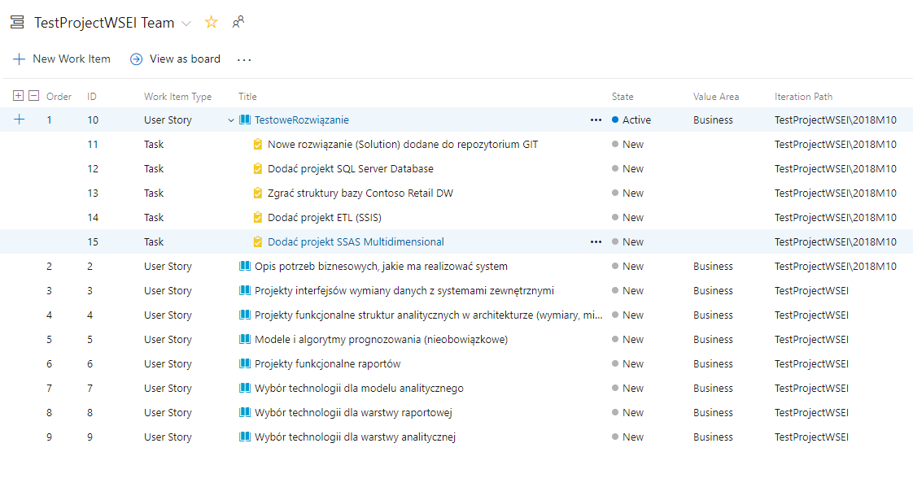
Check backlog

Slide 3
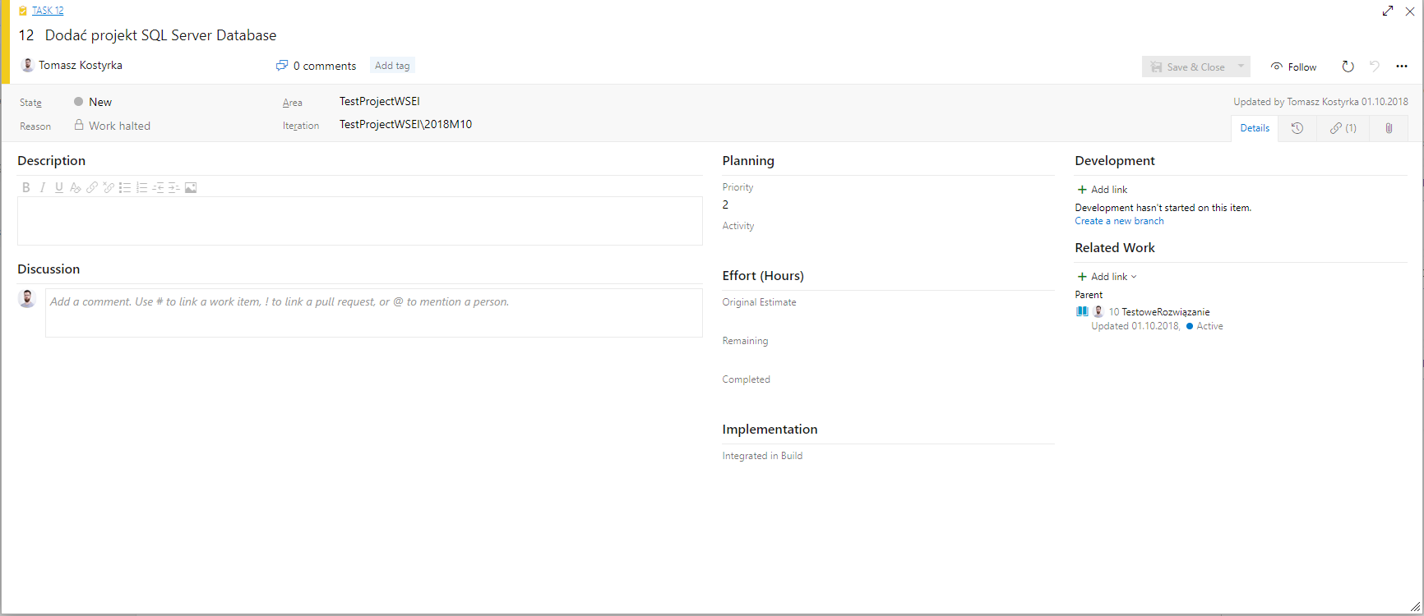
Analyze WIT form.

Slide 4
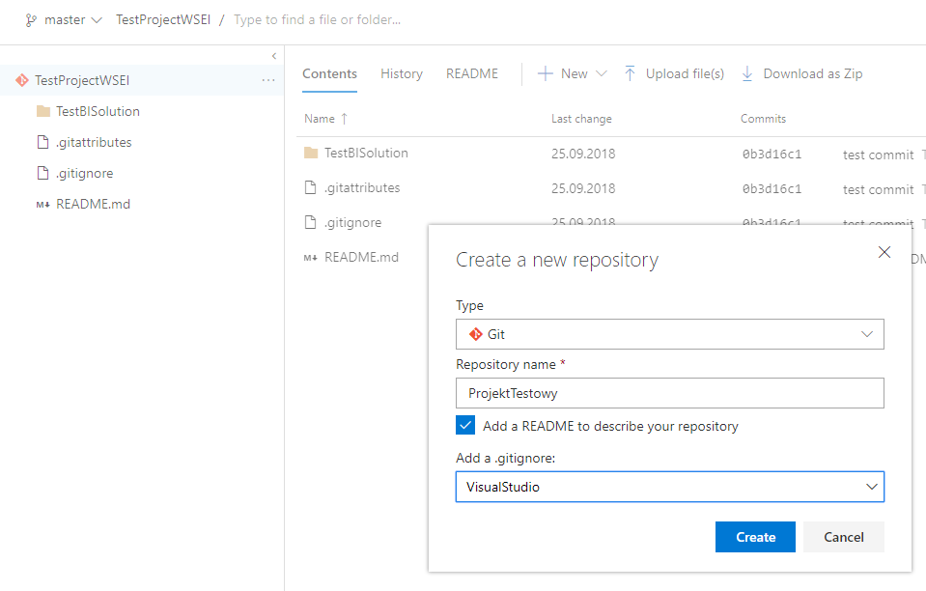
Create Repository. Add VisualStudio .gitignore file and README file.

Slide 5
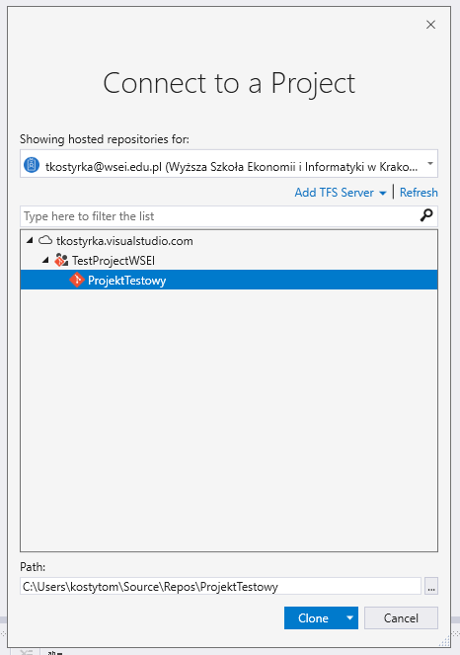
Clone repository.

Slide 6
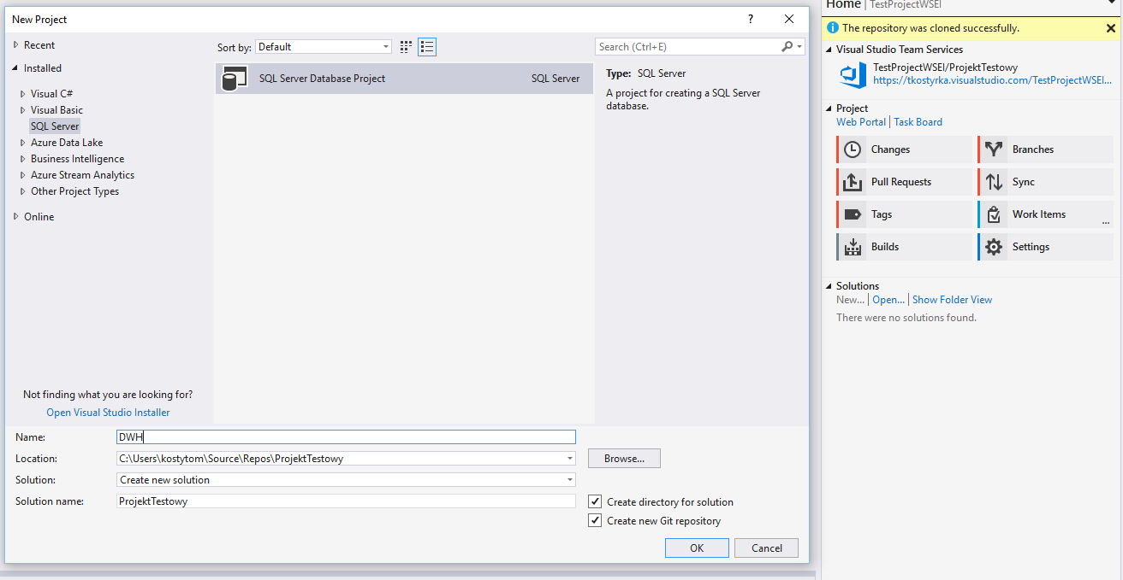
Add new solution with SQL/S project.

Slide 7
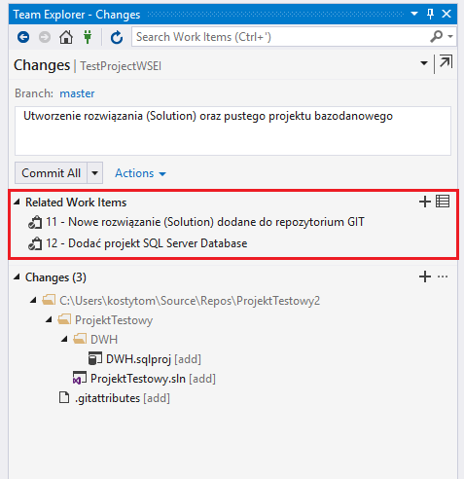
Commit. Add appropriate comment and related Work Items.

Slide 8
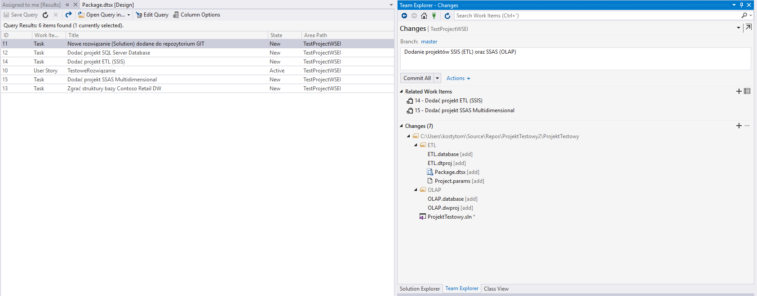
Add SSIS and SSAS projects. Add comment, related WITs and commit.

Slide 9
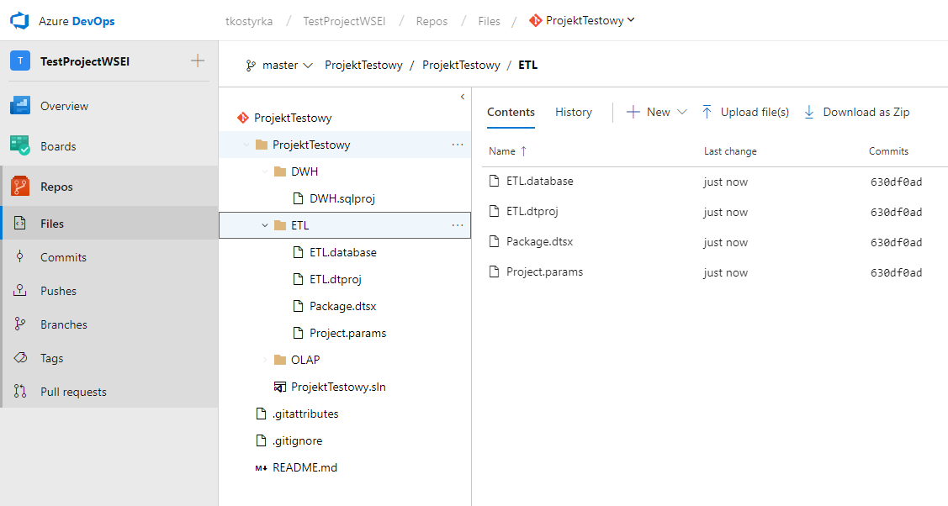
Push. Check repo in AzureDevOps.

Slide 10
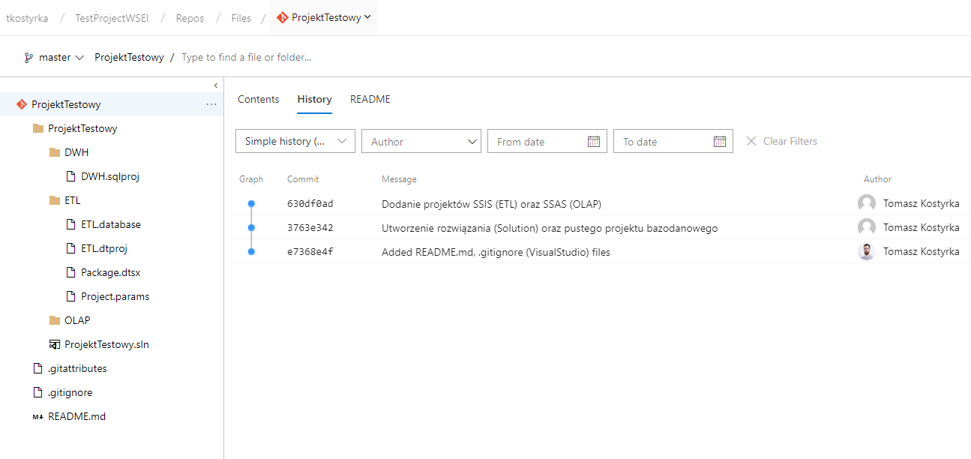
Check History in AzureDevOps (list of commits).

Slide 11
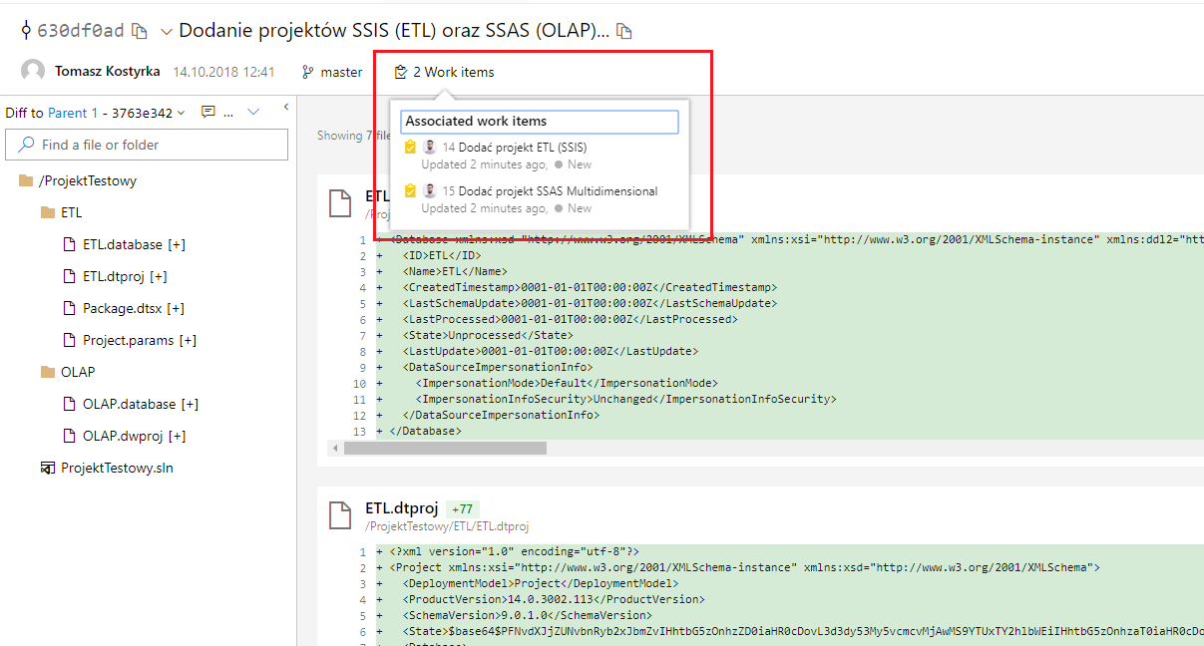
Check commit content.

Slide 12
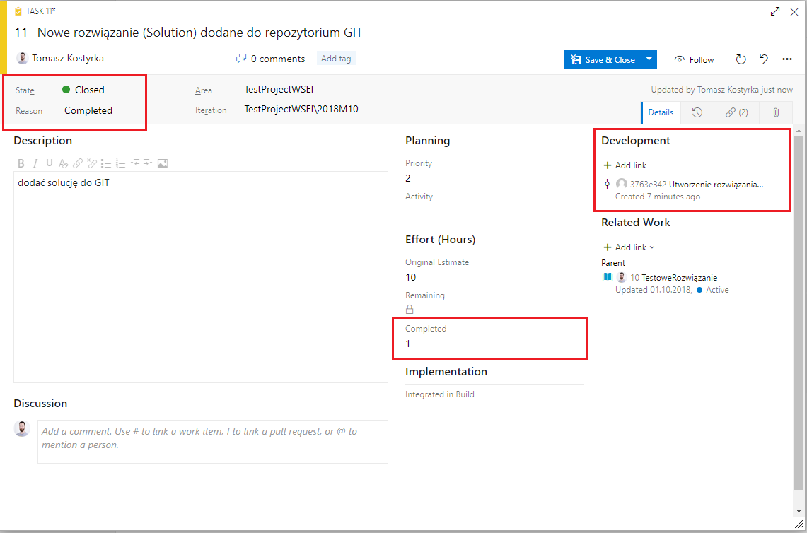
Check WIT form. Close task, fill completed hours, check if WIT is related to commit.

Slide 13
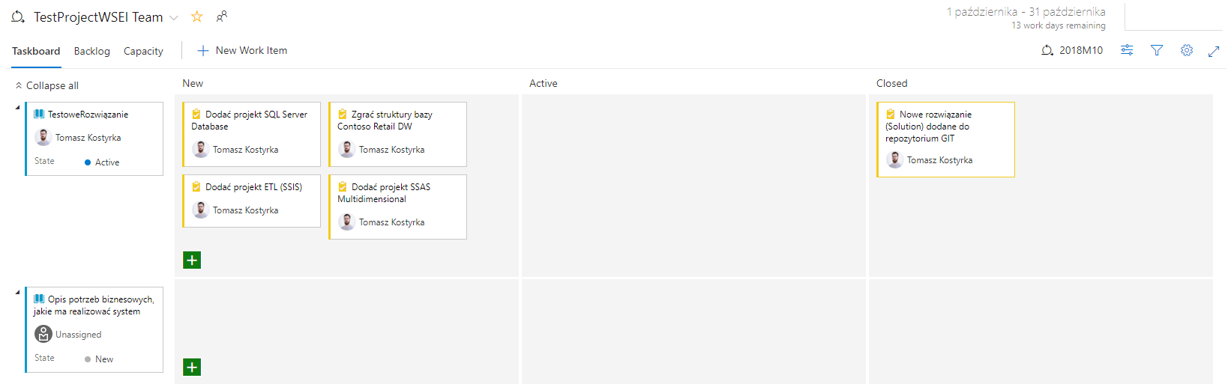
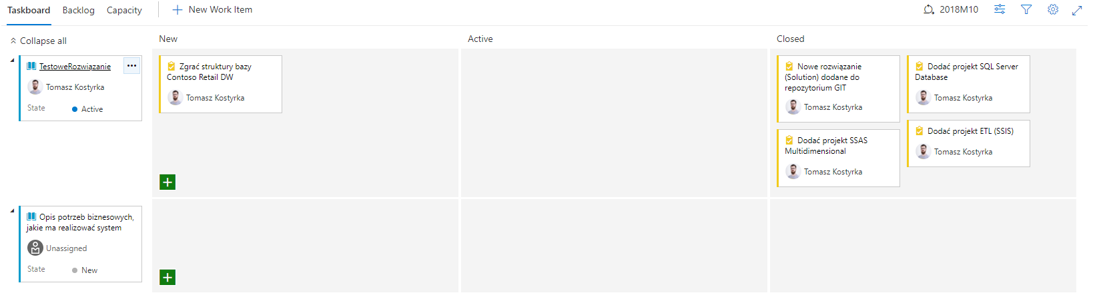
Close remaining taks (using Taskboard).

Slide 14
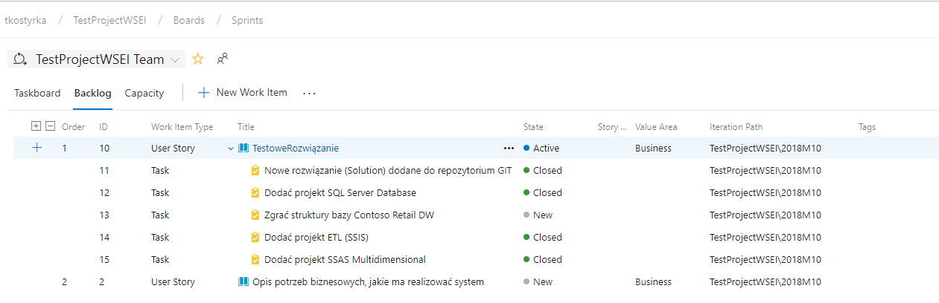
Chech WIT statusses in backlog.

Slide 15
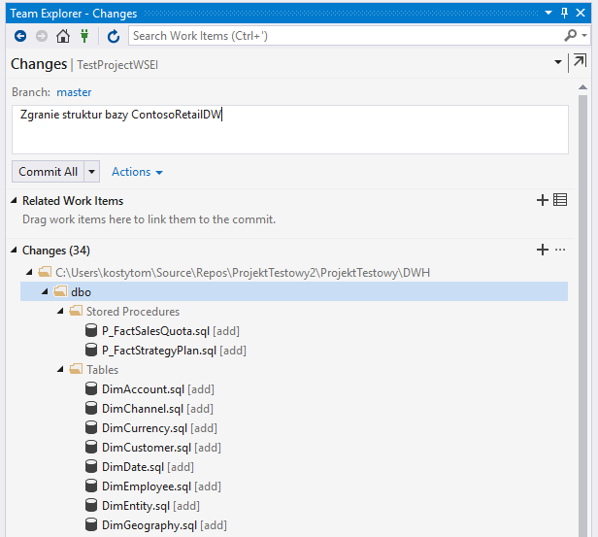
Add DB structures, commit (do not add related WIT), Push.

Slide 16
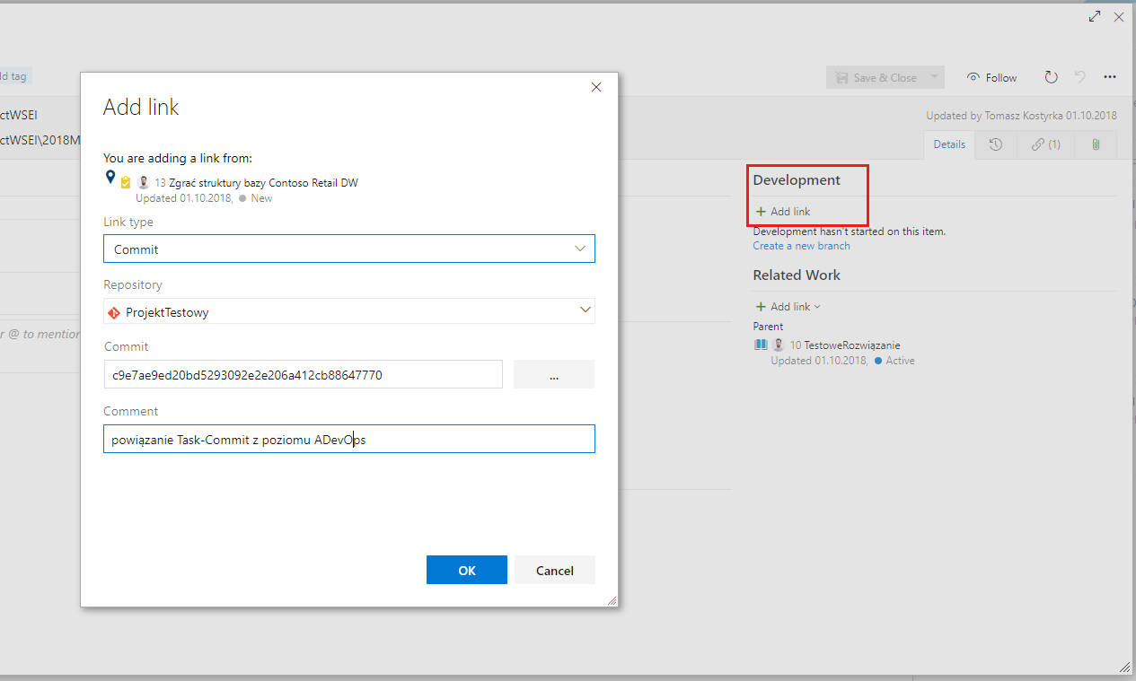
Add related commit to WIT in AzureDevOps (WIT form). Close the task.

Slide 17
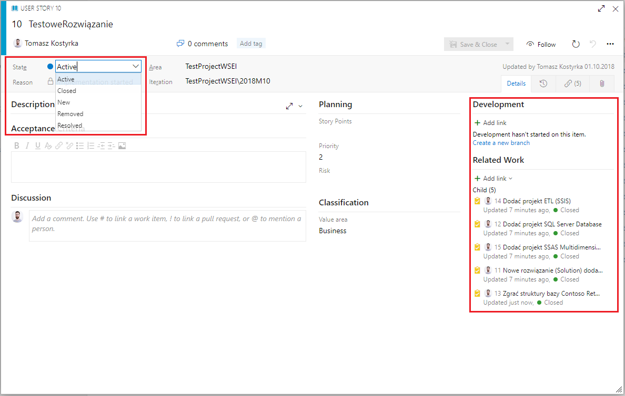
Close User Story (PBI).

Slide 18
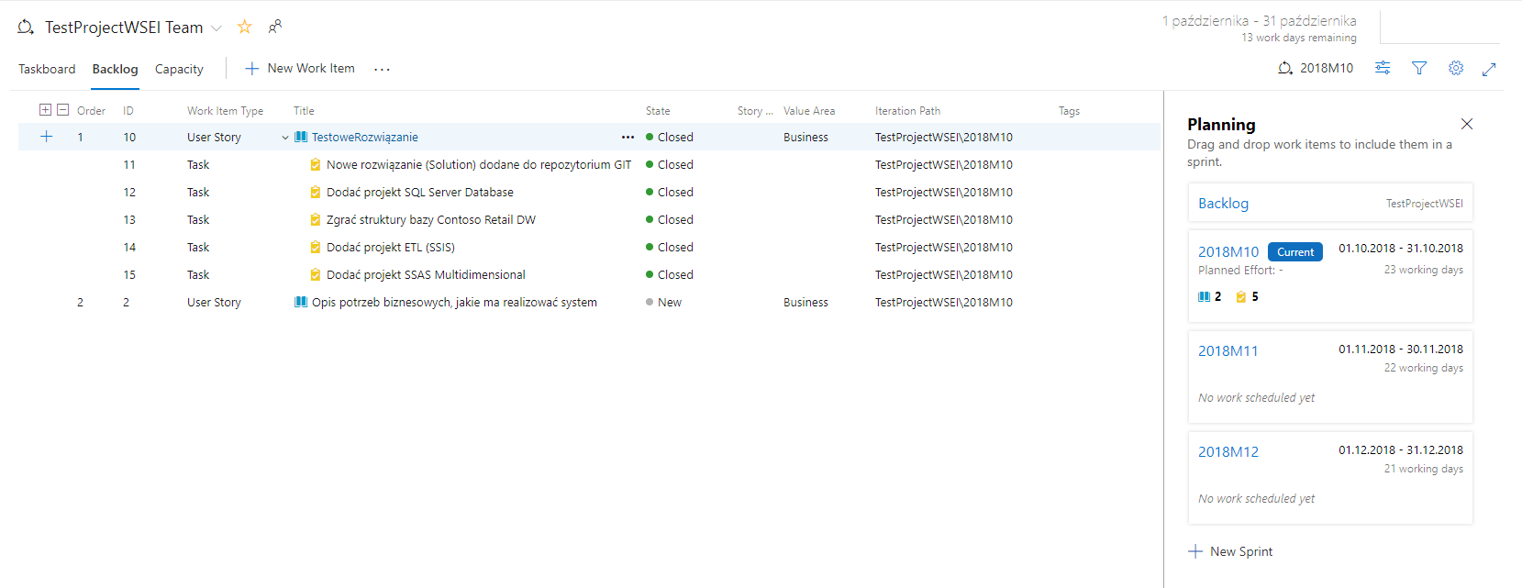
Check the backlog.

