Slide 1
Azure DevOps
First steps

Slide 2
Azure DevOps
Azure DevOps Services is a cloud service for collaborating on code development. It provides an integrated set of features that you access through your web browser or IDE client, including the following:
Git repositories for source control of your code
Build and release management to support continuous integration and delivery of your apps
Agile tools to support planning and tracking your work, code defects, and issues using Kanban and Scrum methods
A variety of tools to test your apps, including manual/exploratory testing, load testing, and continuous testing
Highly customizable dashboards for sharing progress and trends
Built-in wiki for sharing information with your team

Slide 3
Azure DevOps
Pipelines
CI/CD that works with any language, platform, and cloud. Connect to GitHub or any Git repository and deploy continuously.
Azure Boards
Powerful work tracking with Kanban boards, backlogs, team dashboards, and custom reporting.
Azure Artifacts
Maven, npm, and NuGet package feeds from public and private sources.
Azure Repos
Unlimited cloud-hosted private Git repos for your project. Collaborative pull requests, advanced file management, and more.
Azure Test Plans
All in one planned and exploratory testing solution.

Slide 4
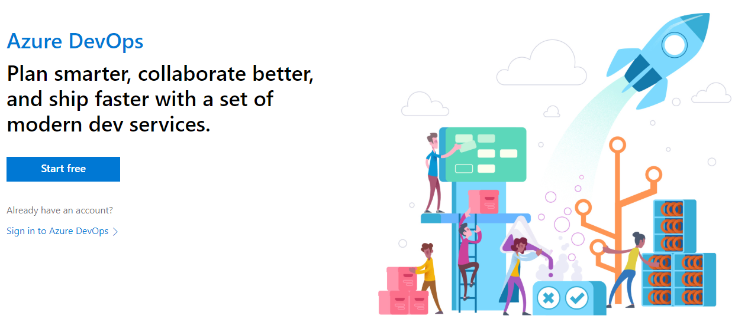
Azure DevOps
https://visualstudio.microsoft.com/team-services/
https://azure.microsoft.com/en-us/services/devops/
https://azure.microsoft.com/en-us/services/devops/git-repos/
https://channel9.msdn.com/Events/Microsoft-Azure/Azure-DevOps-Launch-2018

Slide 5
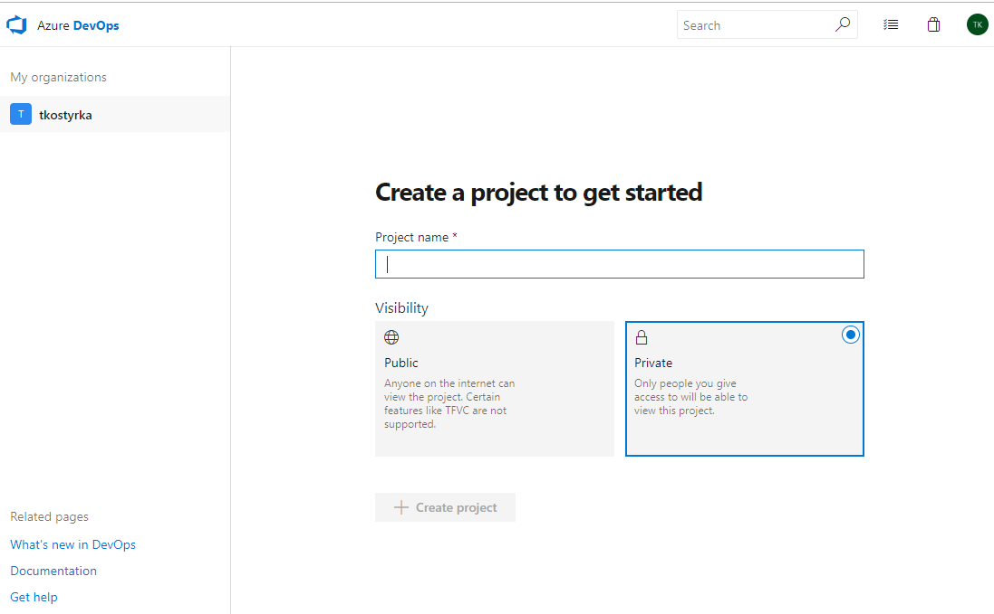
Create Project #1

Slide 6
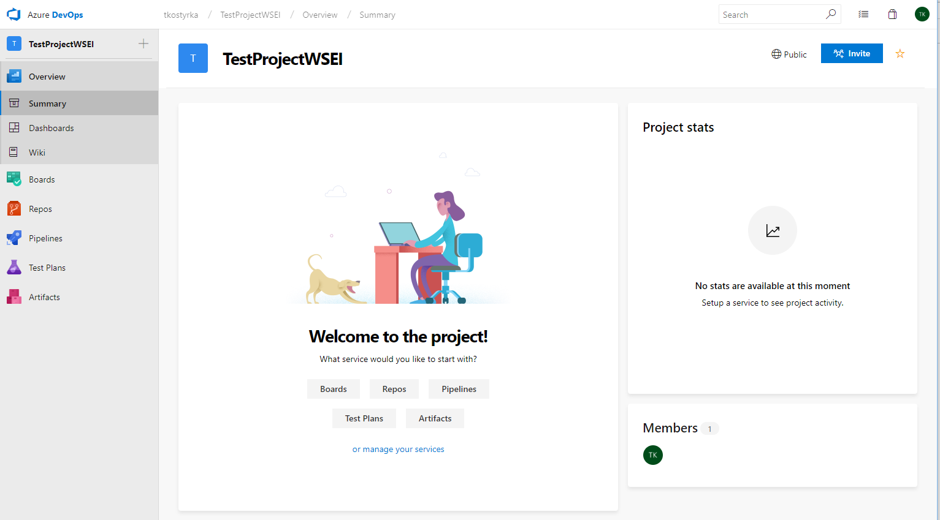
Create Project #2

Slide 7
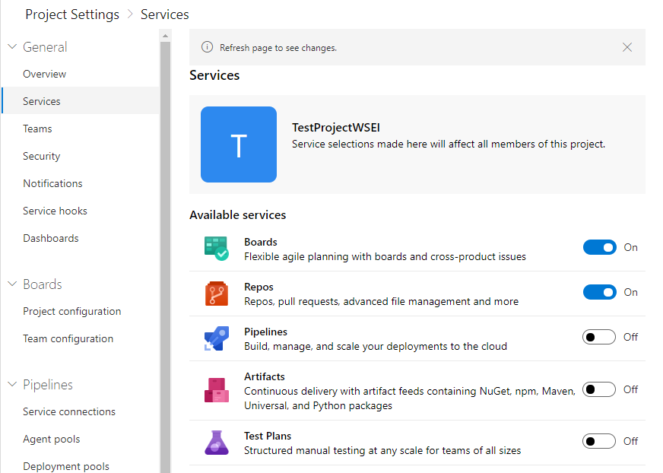
Create Project #3

Slide 8
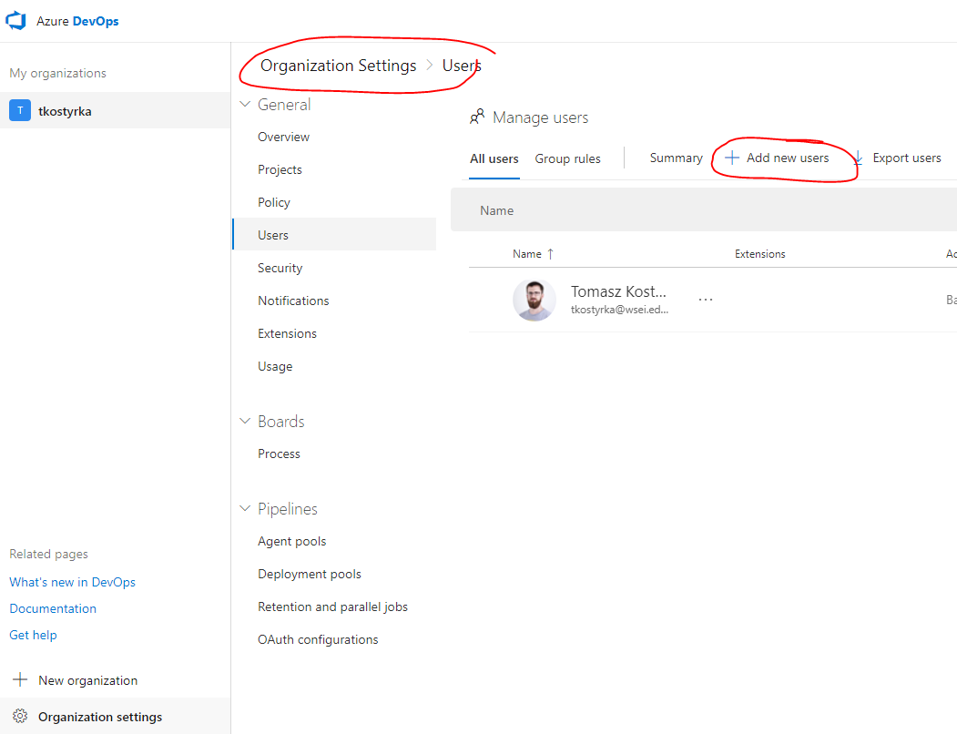
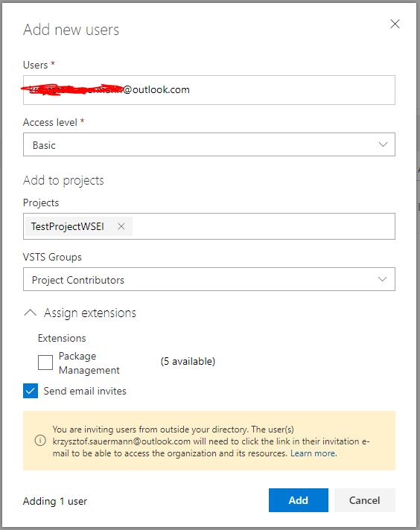
Add User to Organization

Slide 9
Add Repo #1 – Git vs. TFS
Azure DevOps Services and TFS provide two models of version control:
Git, which is distributed version control, and
Team Foundation Version Control (TFVC), which is centralized version control.
Git is the default version control provider for new projects. You should use Git for version control in your projects unless you have a specific need for centralized version control features in TFVC.
You can use TFVC repos with Git in the same Project so it's easy to add TFVC later if you need centralized version control.
https://docs.microsoft.com/en-us/azure/devops/repos/tfvc/comparison-git-tfvc?view=vsts

Slide 10
Add Repo #2 - Git
Git is a distributed version control system. Each developer has a copy of the source repository on their dev machine.
Developers can commit each set of changes on their dev machine and perform version control operations such as history and compare without a network connection. Branches are lightweight.
When you need to switch contexts, you can create a private local branch. You can quickly switch from one branch to another to pivot among different variations of your codebase. Later, you can merge, publish, or dispose of the branch.
https://git-scm.com/book/en/v2/Getting-Started-Git-Basics

Slide 11
Add Repo #3 - TFS
Team Foundation Version Control (TFVC) is a centralized version control system. Typically, team members have only one version of each file on their dev machines. Historical data is maintained only on the server. Branches are path-based and created on the server.
TFVC has two workflow models:
Server workspaces - Before making changes, team members publicly check out files. Most operations require developers to be connected to the server. This system facilitates locking workflows. Other systems that work this way include Visual Source Safe, Perforce, and CVS. With server workspaces, you can scale up to very large codebases with millions of files per branch and large binary files.
Local workspaces - Each team member takes a copy of the latest version of the codebase with them and works offline as needed. Developers check in their changes and resolve conflicts as necessary. Another system that works this way is Subversion.

Slide 12
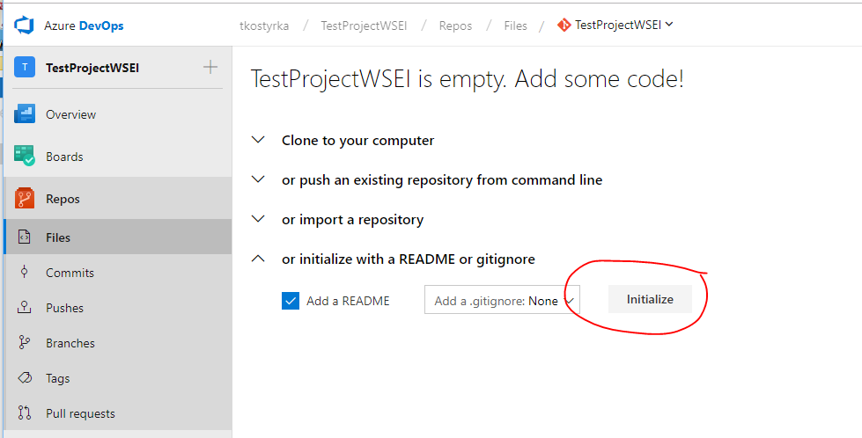
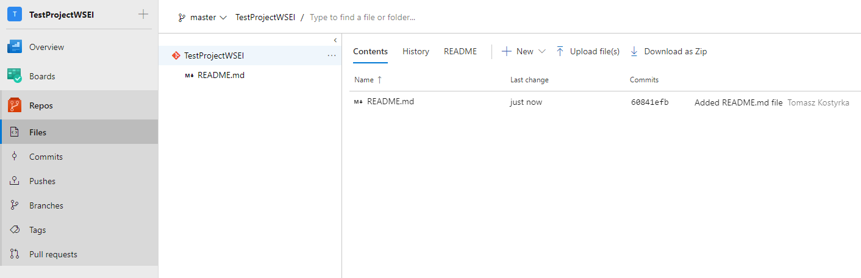
Add Repo #4

Slide 13
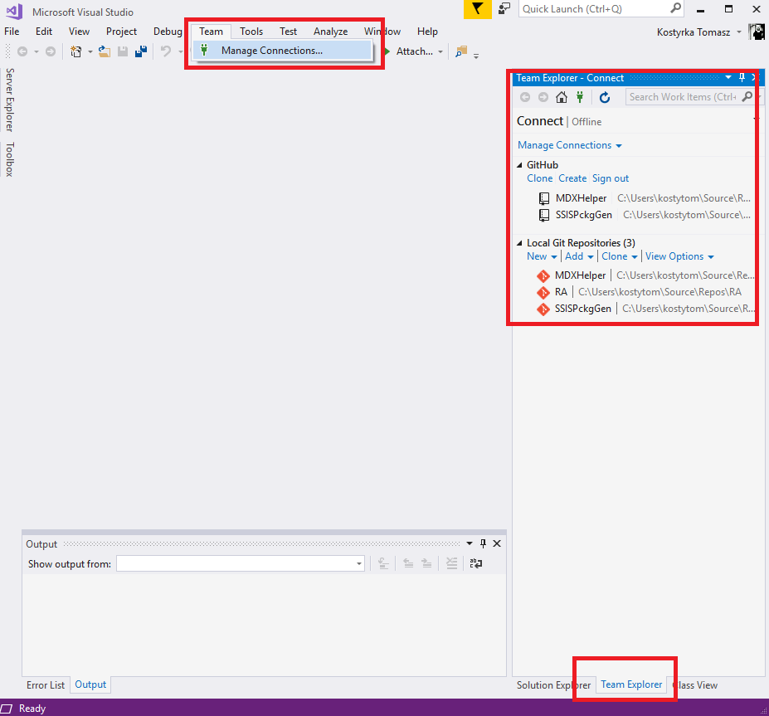
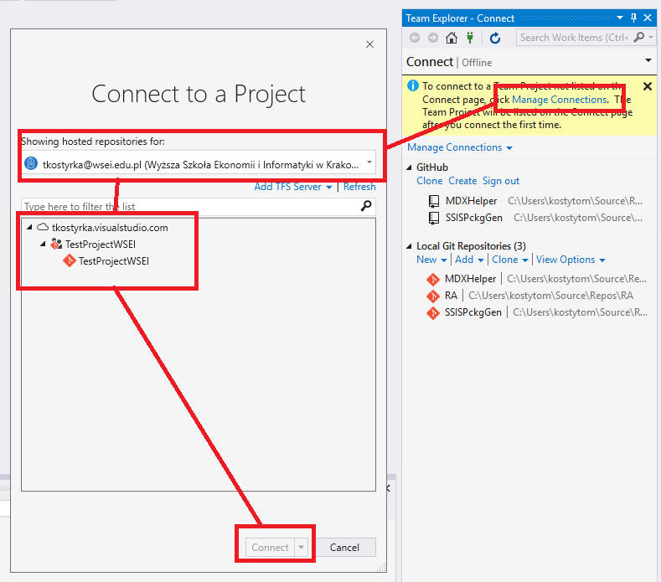
Connect using VS2017

Slide 14
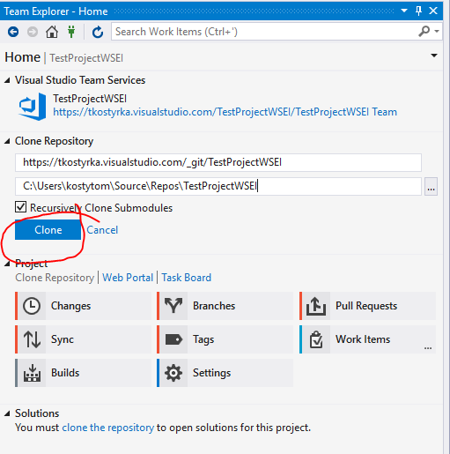
Clone Repo
If you want to get a copy of an existing Git repository — for example, a project you’d like to contribute to — the command you need is git clone.
If you’re familiar with other VCS systems such as Subversion, you’ll notice that the command is "clone" and not "checkout". This is an important distinction — instead of getting just a working copy, Git receives a full copy of nearly all data that the server has.
Every version of every file for the history of the project is pulled down by default when you run git clone. In fact, if your server disk gets corrupted, you can often use nearly any of the clones on any client to set the server back to the state it was in when it was cloned.

Slide 15
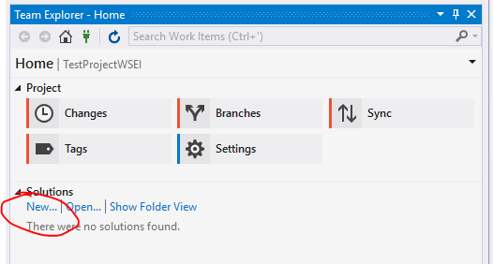
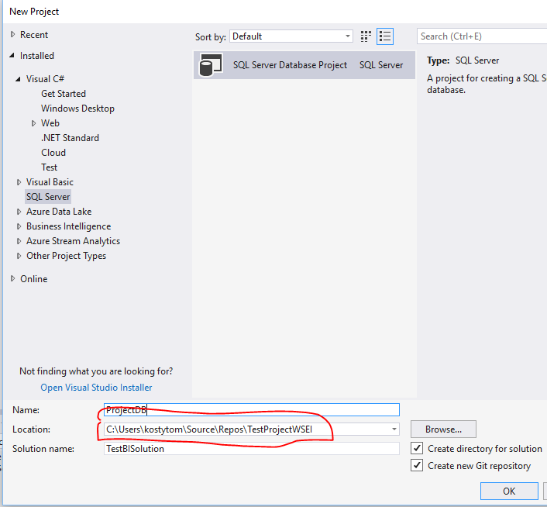
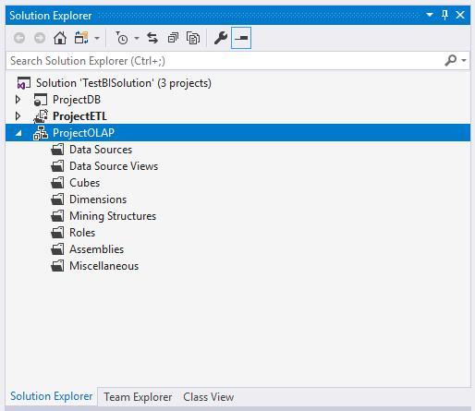
Create Solution, Add Projects

Slide 16
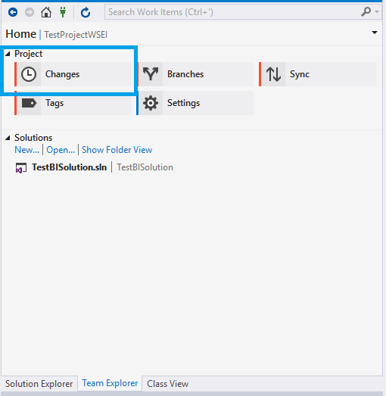
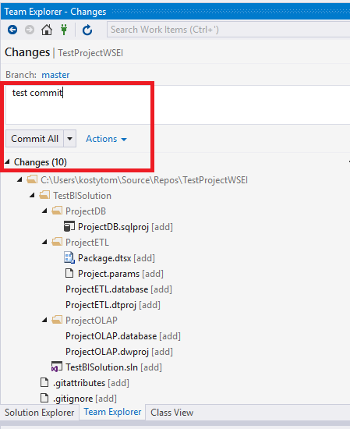
Commit

Slide 17
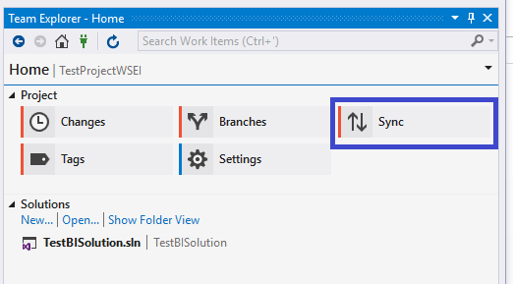
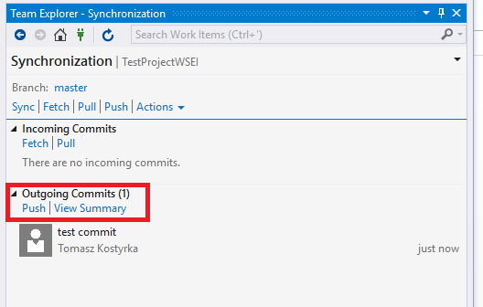
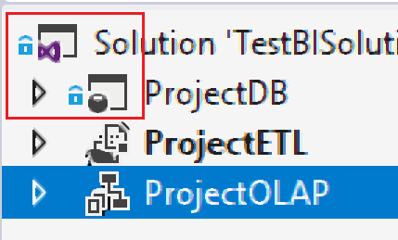
Push

Slide 18
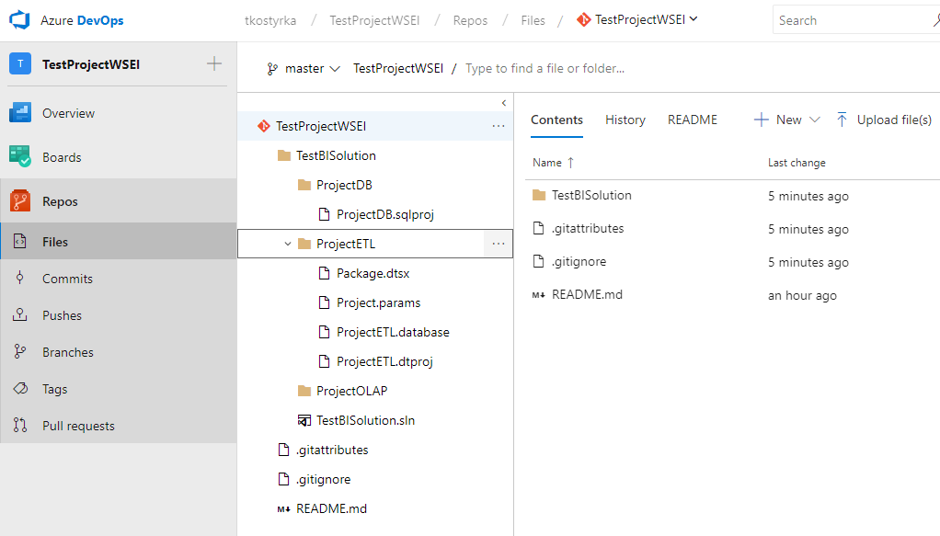
Portal

Slide 19
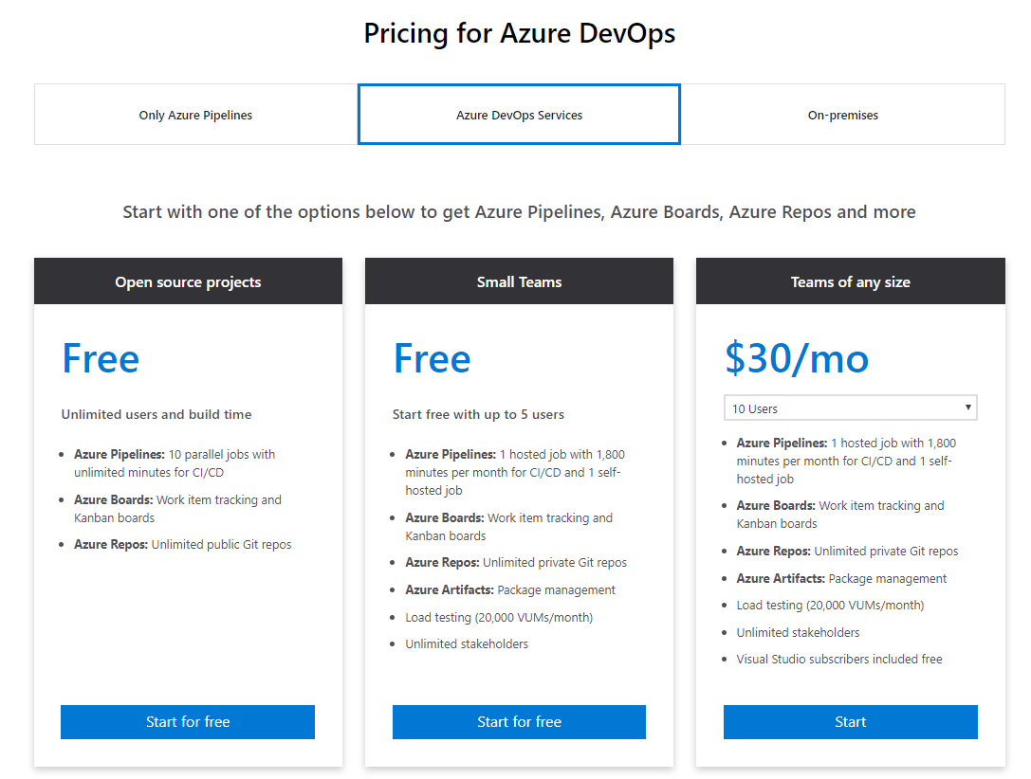
Pricing

