Slide 1
Azure DevOps
GIT

Slide 2
Version Control

Slide 3
What is Version Control
Version control systems are a category of software tools that help a software team manage changes to source code over time.
Version control software keeps track of every modification to the code in a special kind of database. If a mistake is made, developers can turn back the clock and compare earlier versions of the code to help fix the mistake while minimizing disruption to all team members.
Software teams that do not use any form of version control often run into problems like:
not knowing which changes that have been made are available to users
creation of incompatible changes between two unrelated pieces of work that must then be painstakingly untangled and reworked.
If you're a developer who has never used version control you may have added versions to your files, perhaps with suffixes like "final" or "latest" and then had to later deal with a new final version.

Slide 4
What is Version Control
Primary benefits you should expect from version control are as follows:
A complete long-term change history of every file.
Branching and merging.
Traceability. Being able to trace each change made to the software and connect it to project management and bug tracking software.

Slide 5
Git

Slide 6
What is Git
By far, the most widely used modern version control system in the world today is Git.
Git is a mature, actively maintained open source project originally developed in 2005 by Linus Torvalds, the famous creator of the Linux operating system kernel.

Slide 7
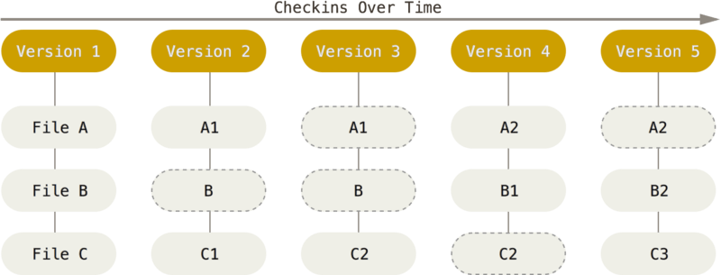
What is Git
With Git, every time you commit, or save the state of your project, Git basically takes a picture of what all your files look like at that moment and stores a reference to that snapshot.
To be efficient, if files have not changed, Git doesn’t store the file again, just a link to the previous identical file it has already stored.

Slide 8
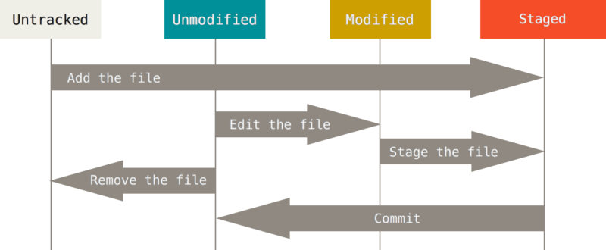
What is Git
Remember that each file in your working directory can be in one of two states: tracked or untracked.
Tracked files are files that were in the last snapshot; they can be unmodified, modified, or staged. In short, tracked files are files that Git knows about.

Slide 9
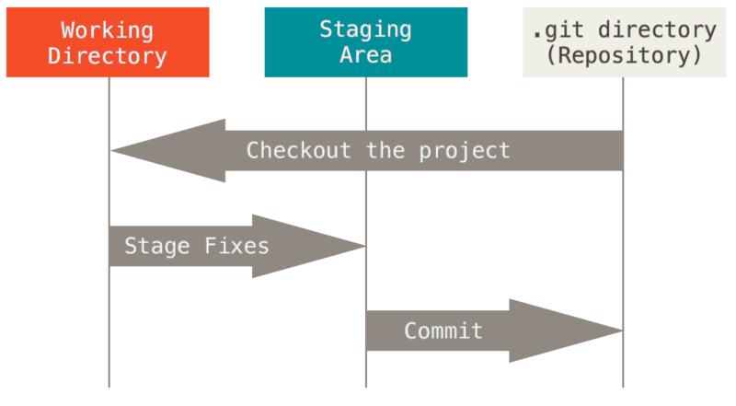
What is Git
Git has three main states that your files can reside in: committed, modified, and staged:
Modified means that you have changed the file but have not committed it to your database yet.
Staged means that you have marked a modified file in its current version to go into your next commit snapshot.
Committed means that the data is safely stored in your local database.

Slide 10
What is Git
The basic Git workflow goes something like this:
You modify files in your working tree.
You selectively stage just those changes you want to be part of your next commit, which adds only those changes to the staging area.
You do a commit, which takes the files as they are in the staging area and stores that snapshot permanently to your Git directory.

Slide 11
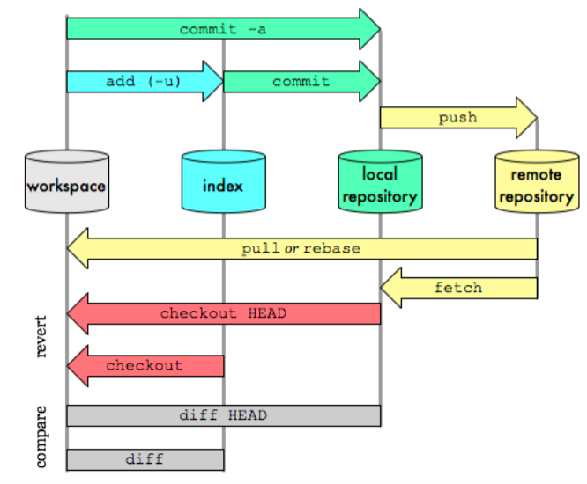
Git Workflow

Slide 12
Basics

Slide 13
Init/Clone
The git init command creates a new Git repository. It can be used to convert an existing, unversioned project to a Git repository or initialize a new, empty repository. Most other Git commands are not available outside of an initialized repository, so this is usually the first command you'll run in a new project.
clone is a Git command line utility which is used to target an existing repository and create a clone, or copy of the target repository.
git clone is primarily used to point to an existing repo and make a clone or copy of that repo at in a new directory, at another location. The original repository can be located on the local filesystem or on remote machine accessible supported protocols.

Slide 14
Init/Clone
git init vs. git clone
git init and git clone can be easily confused. At a high level, they can both be used to "initialize a new git repository."
However, git clone is dependent on git init.
git clone is used to create a copy of an existing repository. Internally, git clone first calls git init to create a new repository. It then copies the data from the existing repository, and checks out a new set of working files.

Slide 15
Add/Commit/Push
The git add and git commit commands compose the fundamental Git workflow. These are the two commands that every Git user needs to understand, regardless of their team’s collaboration model. They are the means to record versions of a project into the repository’s history.
Developing a project revolves around the basic edit/stage/commit pattern. First, you edit your files in the working directory. When you’re ready to save a copy of the current state of the project, you stage changes with git add. After you’re happy with the staged snapshot, you commit it to the project history with git commit.
In addition to git add and git commit, a third command git push is essential for a complete collaborative Git workflow. git push is utilized to send the committed changes to remote repositories for collaboration. This enables other team members to access a set of saved changes.

Slide 16
Fetch/Pull
The git fetch command downloads commits, files, and refs from a remote repository into your local repo. Fetching is what you do when you want to see what everybody else has been working on.
Git isolates fetched content as a from existing local content, it has absolutely no effect on your local development work.

Slide 17
Branching

Slide 18
Understand branch history
Keep your branch strategy simple by building your strategy from these three concepts:
Use feature branches for all new features and bug fixes.
Merge feature branches into the master branch using pull requests.
Keep a high quality, up-to-date master branch.
A strategy that extends these concepts and avoids contradictions will result in a version control workflow for your team that is consistent and easy to follow.

Slide 19
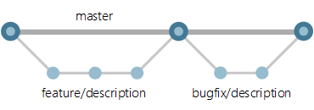
Use feature branches for your work
Develop your features and fix bugs in feature branches (also known as topic branches) based off your master branch.
Feature branches isolate work in progress from the completed work in the master branch. Git branches are inexpensive to create and maintain, so even small fixes and changes should have their own feature branch.
Creating feature branches for all your changes makes reviewing history very simple. Look at the commits made in the branch and look at the pull request that merged the branch.

Slide 20
Naming convention
Use a consistent naming convention for your feature branches to identify the work done in the branch. You can also include other information in the branch name, such as who created the branch.
Some suggestions for naming your feature branches:
users/username/description
users/username/workitem
bugfix/description
features/feature-name
features/feature-area/feature-name
hotfix/description

Slide 21
Manage releases
Use release branches to coordinate and stabilize changes in a release of your code.
This branch is long-lived and isn't merged back into the master branch in a pull request, unlike the feature branches. Create as many release branches as you need, but keep in mind that each active release branch represents another version of the code you'll need to support.
Lock release branches when you're ready to stop supporting a particular release.

Slide 22
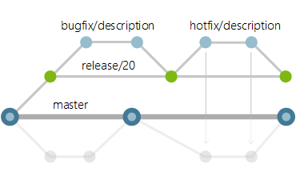
Use release branches
Create a release branch from the master branch as you get close to your release or other milestone, such as the end of a sprint. Give this branch a clear name associating it with the release, for example release/20.
Create branches to fix bugs from the release branch and merge them back into the release branch in a pull request.

Slide 23
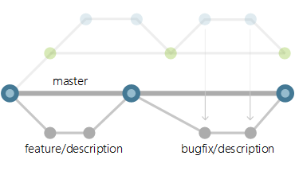
Port changes back to the master branch
Bring over changes made in your release branch into your master branch to prevent regression in your code. Port your changes from your release branch into a new feature branch to bring them back into the master branch. Use cherry-picking instead of merging so that you have exact control over which commits are ported back to the master branch. Merging the feature branch into the master branch can bring over release-specific changes you don't want in the master branch.
Update the master branch with a change made in the release branch with these steps:
Create a new feature branch off the master branch to port the changes.
Cherry-pick the changes from the release branch to your new feature branch.
Merge the feature branch back into the master branch in a second pull request.
image of release branch workflows
This release branch workflow keeps the pillars of the basic workflow intact: feature branches, pull requests, and a strong master branch that always has the latest version of the code.

Slide 24
Other

Slide 25
Fork
A fork is a complete copy of a repository, including all files, commits, and (optionally) branches. Forks are a great way to support an Inner Source workflow: you can create a fork to suggest changes to a project when you don't have permissions to write to the original project directly. Once you're ready to share those changes, it's easy to contribute them back using pull requests.
A fork starts with all the contents of its upstream (original) repository. When you create a fork, you can choose whether to include all branches or limit to only the default branch. None of the permissions, policies, or build pipelines are applied. The new fork acts as if someone cloned the original repository, then pushed to a new, empty repository. After a fork has been created, new files, folders, and branches are not shared between the repositories unless a PR carries them along.

Slide 26
links
https://docs.microsoft.com/en-us/azure/devops/repos/git/?view=vsts
https://docs.microsoft.com/en-us/azure/devops/repos/git/git-branching-guidance
https://www.youtube.com/watch?v=t_4lLR6F_yk
https://www.atlassian.com/git/tutorials/what-is-version-control
https://www.atlassian.com/git/tutorials/what-is-git
https://www.atlassian.com/git/tutorials/why-git
https://kosiorowski.usermd.net/2013/11/22/git-cherry-pick/
http://krishnaiitd.github.io/gitcommands/git-workflow/
https://lukaszprogramista.pl/praktyczny-kurs-git-dla-zielonych-cz-3-konflikty-gitignore-i-pull-requesty/

