Slide 1
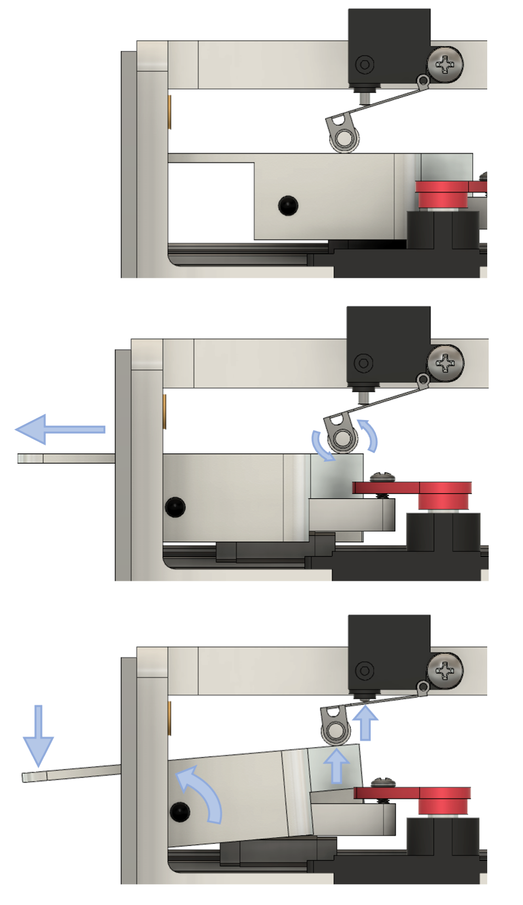
retracted
as the stage extends, the limit switch arm rolls along the lever surface
pressing down on the lever front causes the lever back to rise and actuate the limit switch

