Slide 1
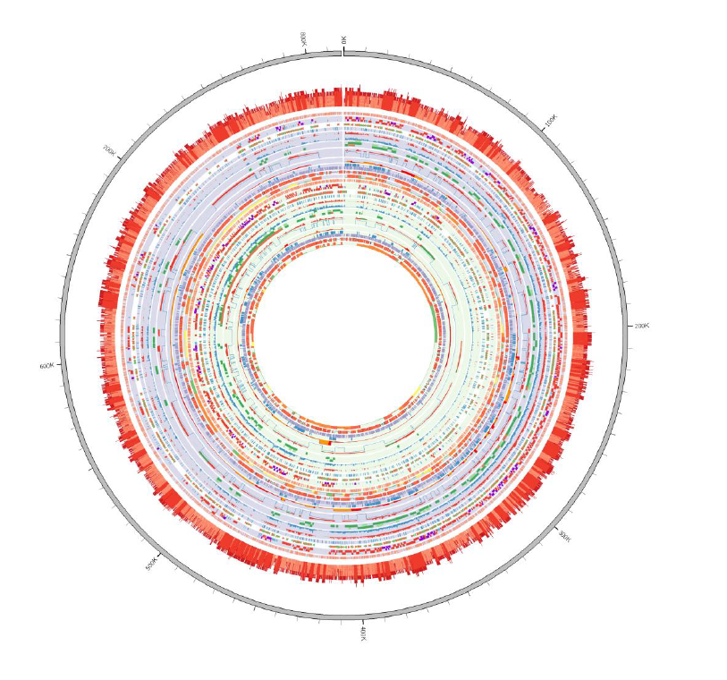
Metabolic
fluxes by NMR,
GC-MS
Cell cycle
Transcriptomics:
Chips, Pull-down
Metabolite
quantification:
MS
Protein
quantification:
MS
Protein complex
characterization:
TAP
Mathematical
Modeling
Engineering
& Tool
Development
Structural
reconstruction:
EM
Bioinformatic
analyses &
database dev.

