Slide 1
SkinSense Project
Machine Learning 2 – 15-minute presentation
Notes:
Hello everyone. My name is Hayder Karim Kaher and today I'll present my machine learning project called SkinSense. Initially, my goal was to solve electricity problems in Iraq using AI, but I pivoted to building a machine learning system that could help people understand their skin and beauty routines.

Slide 2
Problem
Many people are unsure of their skin type and appropriate skincare routine.
Confusing marketing messages lead to poor product choices.
Goal: Provide a simple and transparent tool to guide beginners.
Notes:
Problem statement: Many people struggle to determine their skin type and choose appropriate skincare products. Misinformation and marketing make it confusing. I wanted to create a tool that simplifies this process using a rule-based system.

Slide 3
Target Users & Value
Target users: Students and young adults (16–30), beginners in skincare.
Value: Quick self-assessment, personalised routine, less trial and error.
Notes:
Target users are students and young adults starting skincare routines and anyone with acne, dryness, or sensitivity. The value is saving time and money by giving clear, personalized recommendations.

Slide 4
Methods
Questionnaire with 8 questions covering dryness, oiliness, acne risk, sensitivity, barrier health and habits.
Weighted scoring model calculates dryness, oiliness, acne risk, barrier support and sensitivity scores.
Logic determines skin type and top concerns based on thresholds.
Notes:
Methods: We built a questionnaire with over 10 questions. Each answer contributes to scores for dryness, oiliness, acne risk, barrier support, and sensitivity. A rule-based scoring engine determines your skin type and suggests a routine. It's transparent and easy to explain, unlike black-box models.

Slide 5
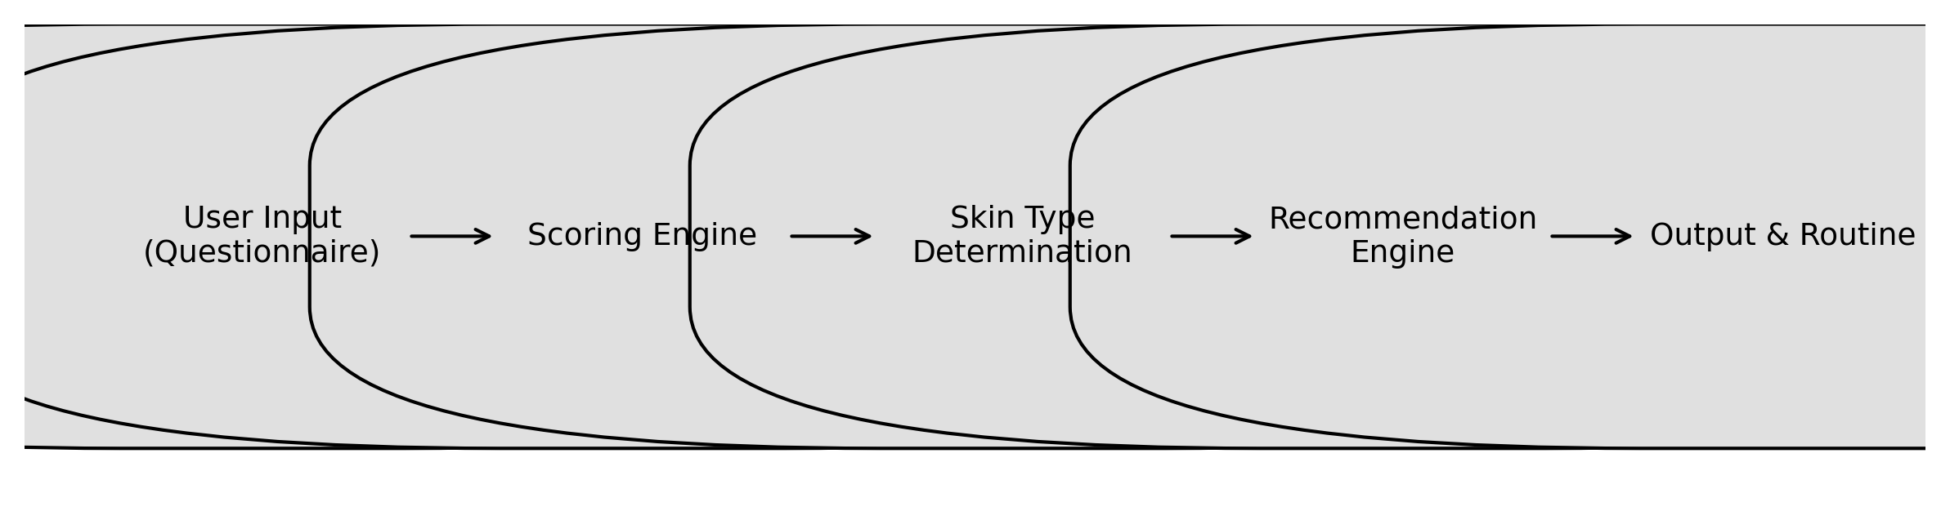
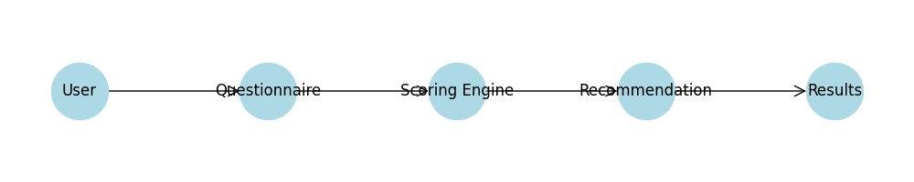
System Architecture
Notes:
System architecture: The user interacts with a Streamlit web app. Inputs go to a scoring engine, which calculates scores, determines skin type, and passes it to a recommendation engine to output the routine. This pipeline is simple, explainable, and implemented in Python.

Slide 6
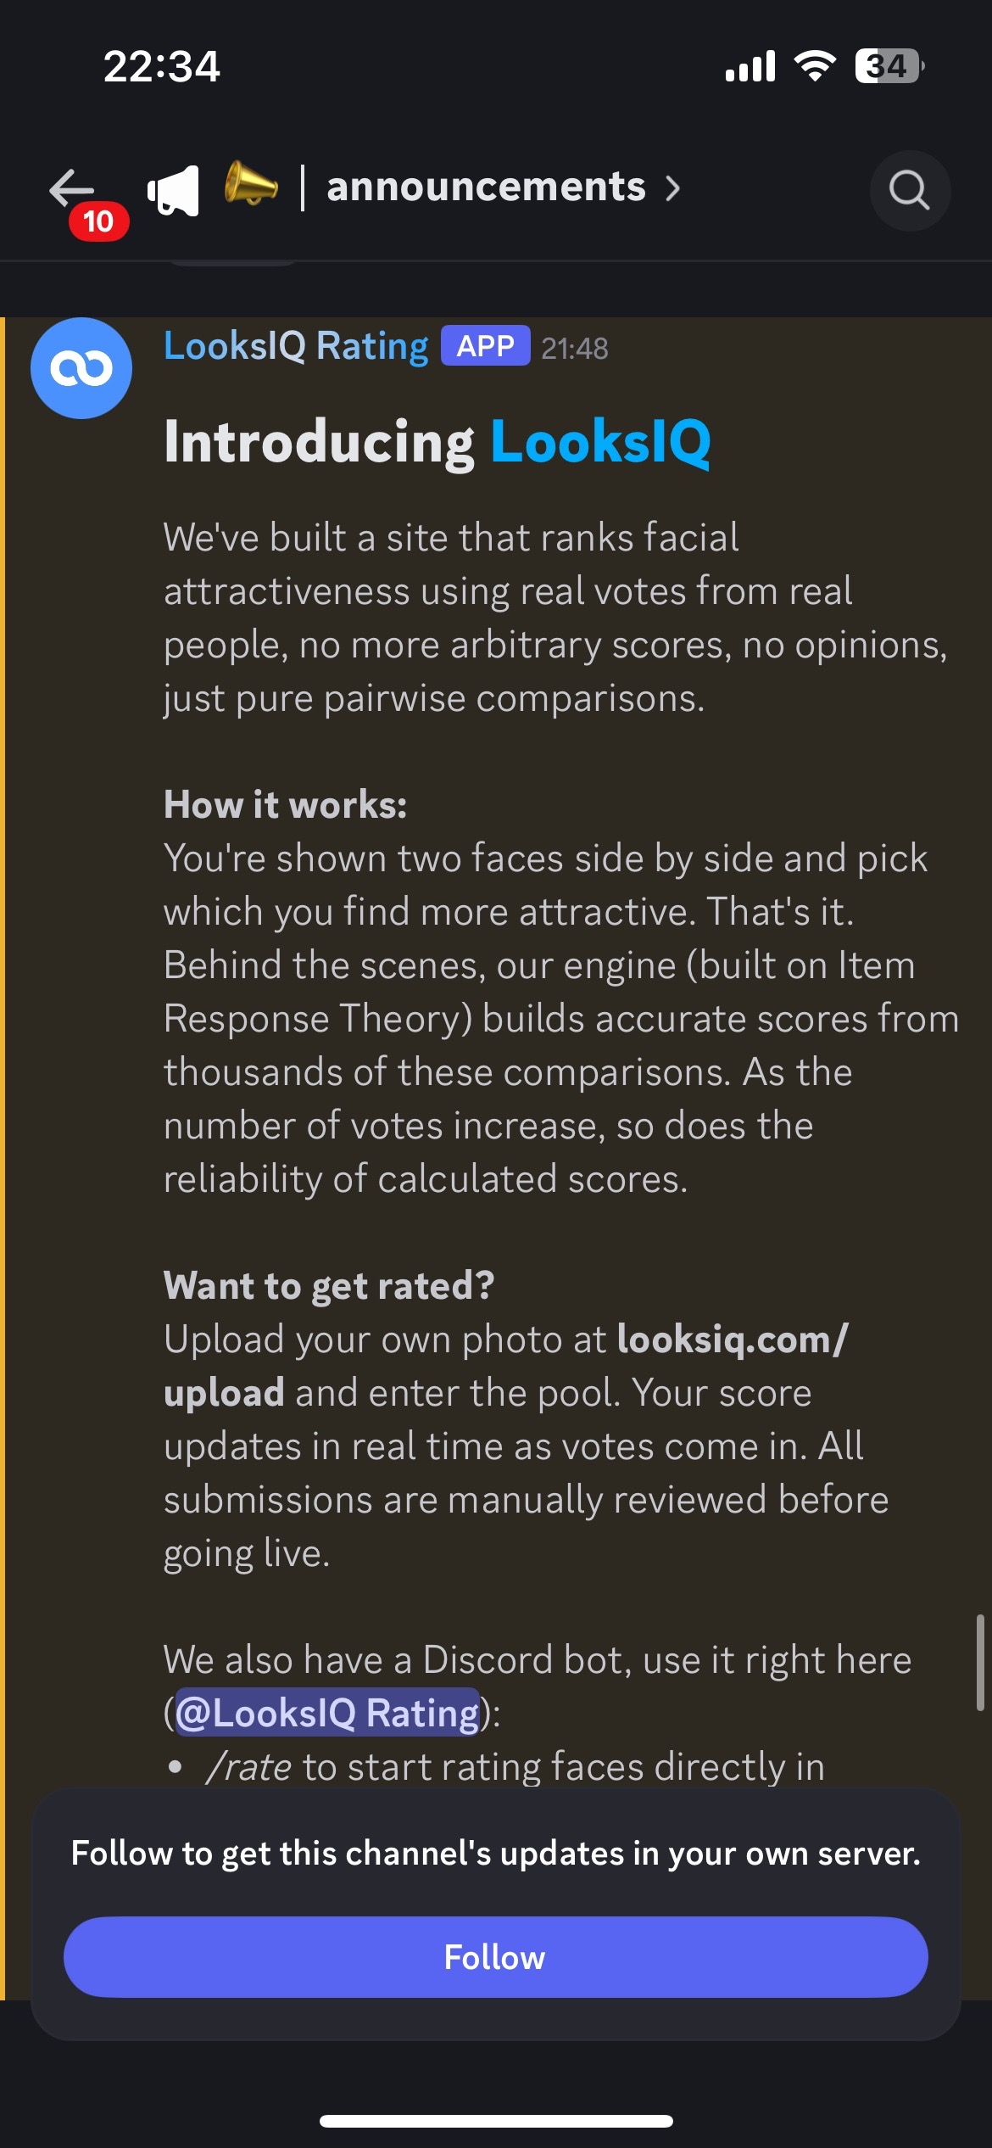
Results & Demo
The app outputs a skin type, top concerns and a simple routine.
Users can download the routine as a text file.
Notes:
Results & Demo: The app runs on Streamlit. Users answer questions and get a skin type and routine. During development we also started a separate project called LooksIQ, which ranks faces using pairwise comparisons and Item Response Theory, shown in this slide.

Slide 7
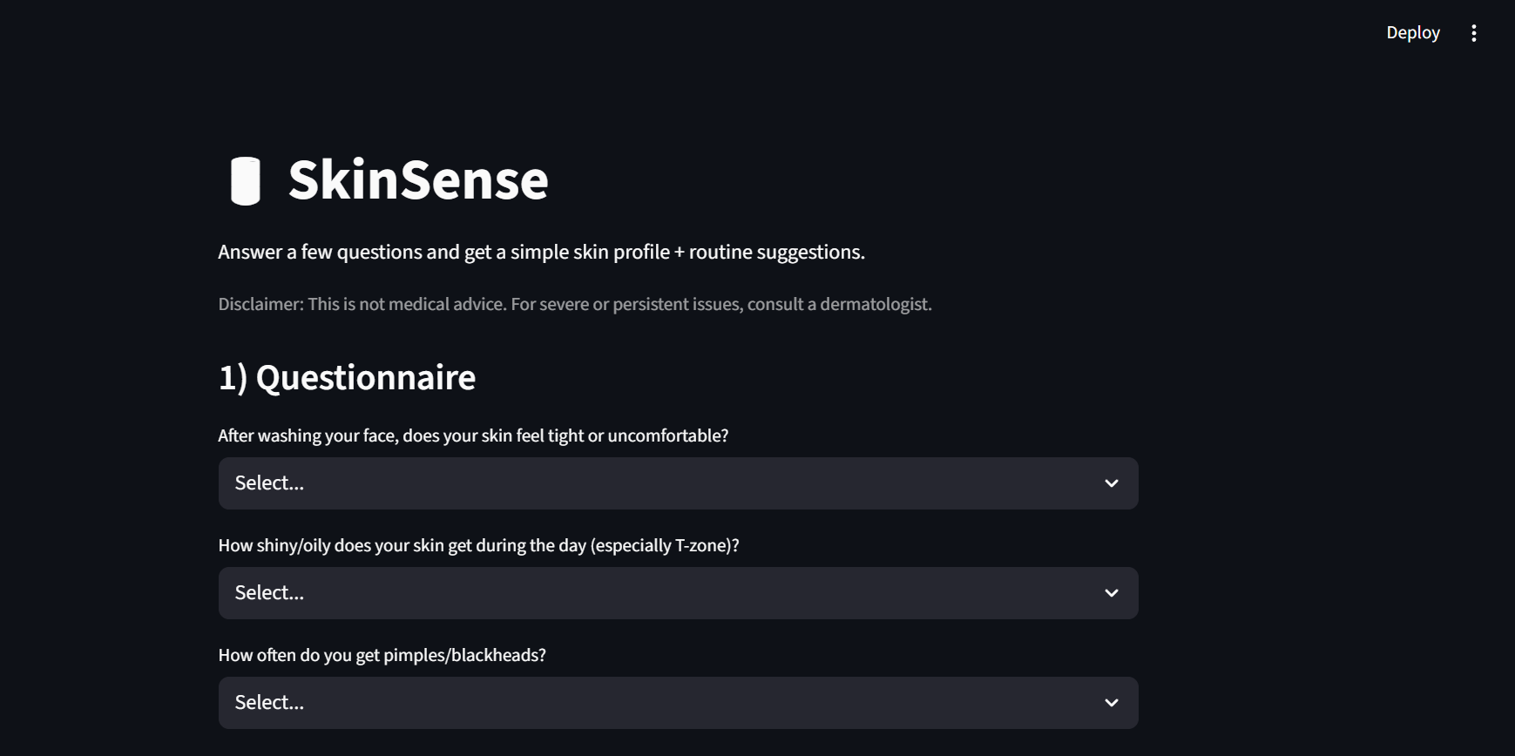
App Interface
Notes:
App interface: This screenshot shows the SkinSense UI built with Streamlit. Users select answers from dropdowns and view the results immediately. The dark mode design is clear and simple.

Slide 8
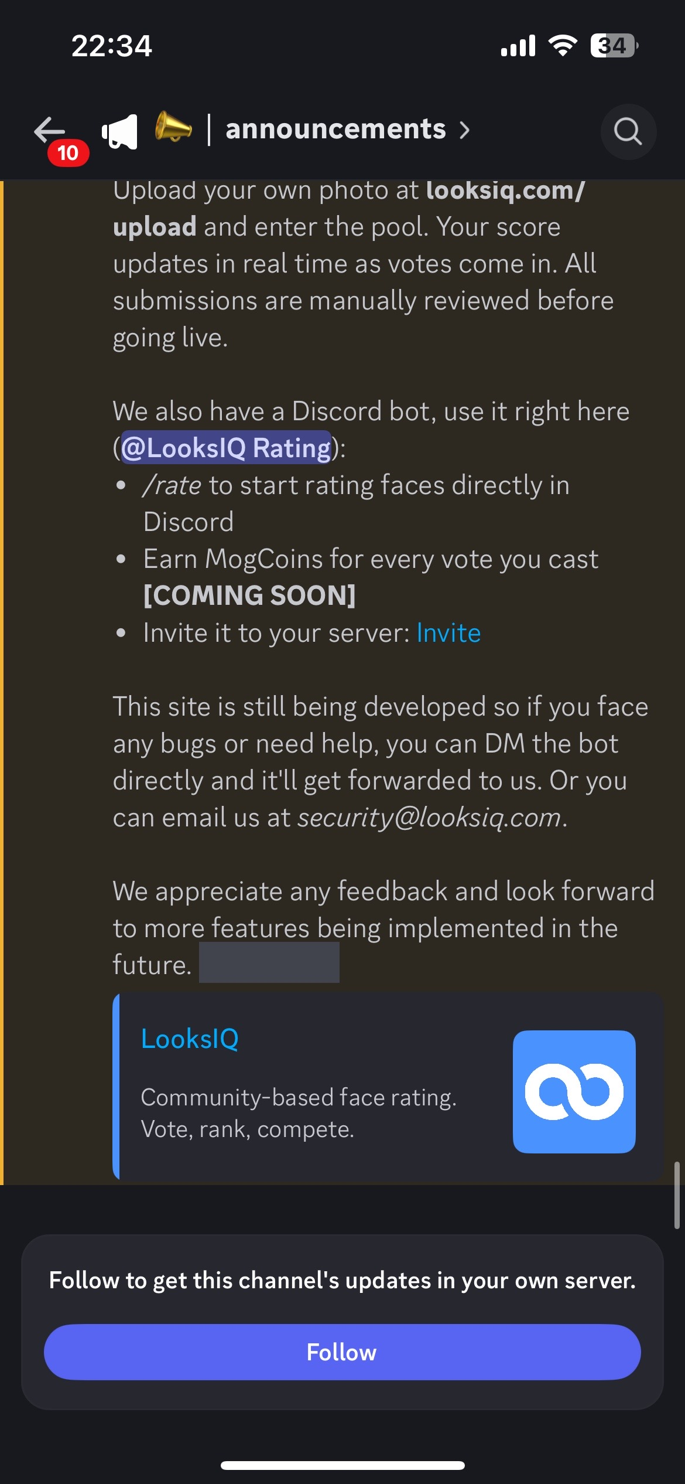
Challenges & Lessons
Balancing scoring weights and thresholds required iterative testing.
Time management was critical to compress the project into four weeks.
I learned to write clear documentation and consider ethical implications.
Notes:
Challenges & lessons: Working in a group initially caused misalignment. We split the group and I pivoted from the original electricity project due to lack of data. I learned to manage time, implement rule-based logic, and integrate feedback. A friend helped with debugging and brainstorming.

Slide 9
Future Work
Expand the questionnaire and refine scoring for more nuanced outputs.
Integrate image analysis or machine learning for project 2.
Collect user feedback to improve recommendations.
Notes:
Future work: Extend SkinSense with image-based analysis using CNNs to detect skin features from selfies. Integrate with LooksIQ and deploy on mobile. Collect more data to refine the scoring and recommendation logic.

Slide 10
Conclusion
SkinSense offers a transparent, rule-based skincare assessment tool.
It helps beginners understand their skin and build a routine.
Thank you for listening.
Notes:
Conclusion: SkinSense shows how simple ML systems can provide real value. I learned about rule-based models, project management, and AI ethics. Thanks for listening. I welcome any questions.

