Slide 1

SQL Training Session #1
TIGERRISK PARTNERS

Slide 2
Agenda – SQL Session #1
What is SQL?
How to use SQL?
Getting data into SQL
Queries & Subqueries
Requesting information
Filtering
Stacking tables/views
Case statements
Aggregating
This is a crash course in SQL, so utilize the internet to look up
Syntax
New ways & different ways to query
Sample queries for more complicated requests/edits (e.g., loops)
When using pre-made scripts
Do not blindly execute scripts
Know that there might be mistakes
There might be a better way

Slide 3
What is SQL?
What is SQL?
SQL – Structured queried language
SSMS – SQL Server Management Studio
Made up of databases
Databases are made up of Tables
Tables are made up of columns/rows of information
Query - a question or request for information
Action query: Performs additional operations on data such as insertion, updating, deleting, etc.
Select query: Retrieves data
Basic Language Rules
Not case sensitive
Brackets on Columns with spaces in name
[Policy ID] vs Policy_ID or PolicyID
Columns have data types
Int
Float
varchar
Alias – is a new name for a column or table. These are usually required when executing sub-queries/nested queries

Slide 4
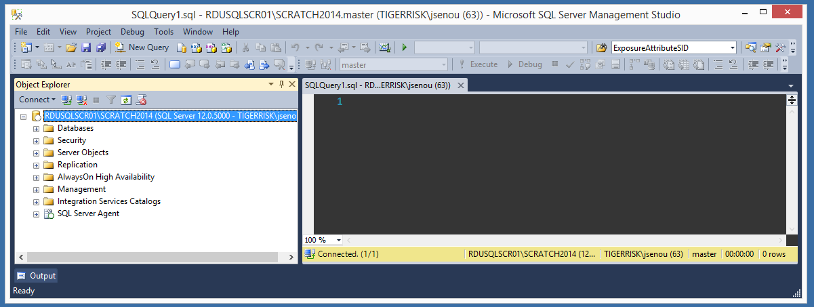
How to use SQL? Demo
How to use SQL?
Open
Connect
New Query
Anatomy of SSMS
Object explorer
Query/script
Info

Slide 5
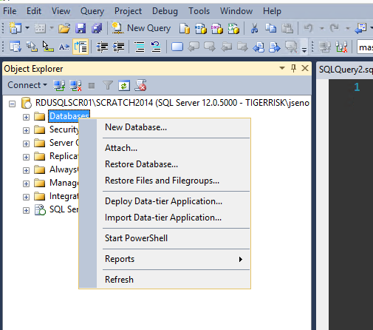
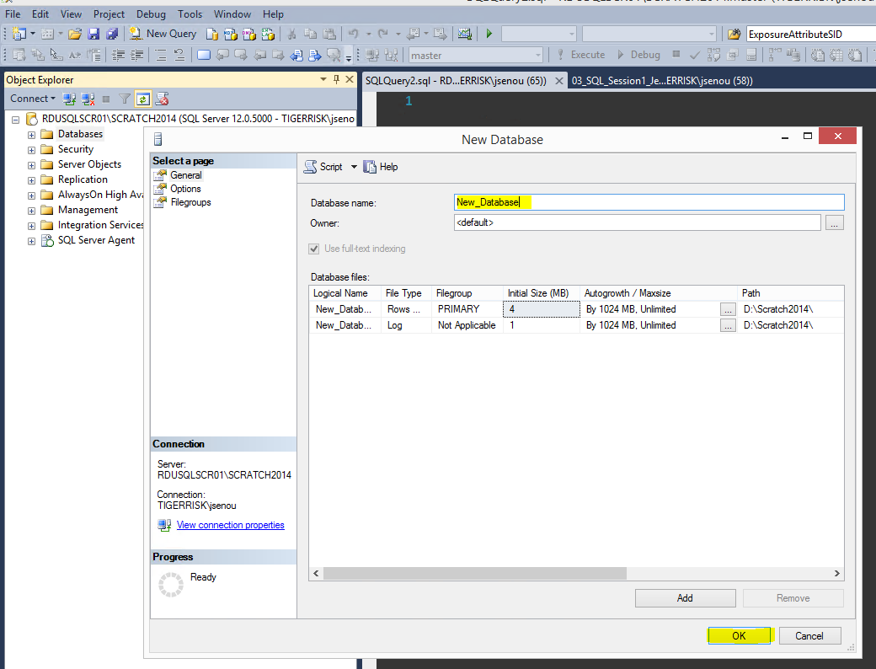
How to use SQL? Demo of Section 1.0
Creating a new database (on scratch servers)
Right click on Database and select New Database
Name the database appropriately and click ok
Right click on Database and select Refresh
Expand Database and navigate to the database; it will be in alphabetical order

Slide 6
Importing Data Demo of Section 1.0
From Flat File Outside of SQL Databases
Right Click DB where data is to be imported and, under Tasks select Import
Choose Flat File and browse to location of file and select it
In advanced you can change data type or rename columns if needed
Click next once will send you to the destination page where you can check or change the DB where the data is imported
Clicking Next again identifies the source and imported table name (change the name as you please here, but leave the [dbo] scheme )
Finish
From Table/View from another SQL Databases
Right Click DB where data is to be imported and, under Tasks select Import
Choose SQL Server Native Client 11.0 then choose the server name and the database within that server where the data is
Click next once will send you to the destination page where you can check or change the DB where the data is imported
Clicking Next again asks if you want to copy 1 or more tables/view or write a query (I always use the first option)
Clicking next will take you to a list of all the tables/views in the source DB and just click (and rename if you like) the ones you want
Finish

Slide 7
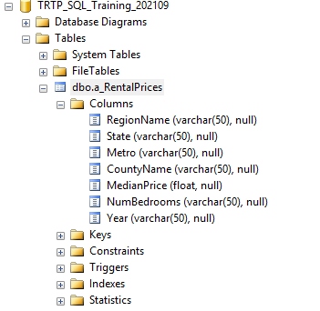
Using SQL Demo
Quick look at data by right clicking table and choose to “select top 1000 rows”
Execute query by highlighting it and pressing F5 or click on the execute button
Expand columns for a table to see & grab column names & type
Open premade script for SQL session 1 and save your own copy to work along with
Section 1.0
Create a new database
Importing data into a database
Deleting tables (CAUTION cannot be undone)
Section 1.1
Use [Database Name] – point to where your working
Comments – use them they will save yourself and others headaches and time
Make scripts easy to read via indenting, white space, comments, etc.
Section 1.2
Displaying, filtering, ordering
Aggregating data
Section 1.3
Nested query / sub-query
Stacking data
Case statements

Slide 8


Slide 9
SQL Training Session #2
TIGERRISK PARTNERS

Slide 10
Agenda – SQL Session #2
Joins
Editing queries
Select into
Create table
Insert into
Alter
Update
Delete/Drop
Miscellaneous
Functions
Len()
Right() & Left() & substring()
Replace()
Convert()
Concat()
Data Types
Int Identity (1,1)
Row_Number() Over()
Renaming columns
Take caution execution CANNOT BE UNDONE
First typing a select query to emulate what you want to do for your update/delete/drop statements

Slide 11
Demo
Open premade script for SQL session 2 and save your own copy to work along with
Section 2.1 – Joins
Common errors include
Obtain too many records (usually duplicates)
This is where control totals will come in handy (session on common data errors edits and assumptions docs)
Not joining on the right columns or not enough of the columns
Join misses some records because of slight differences in the column values
Section 2.2 – Editing
Caution when deleting or dropping anything.
Section 2.3 – Miscellaneous
Resources
Internet
Other people’s client and working folders
R:\01_REFERENCES\SQLSCRIPT

Slide 12
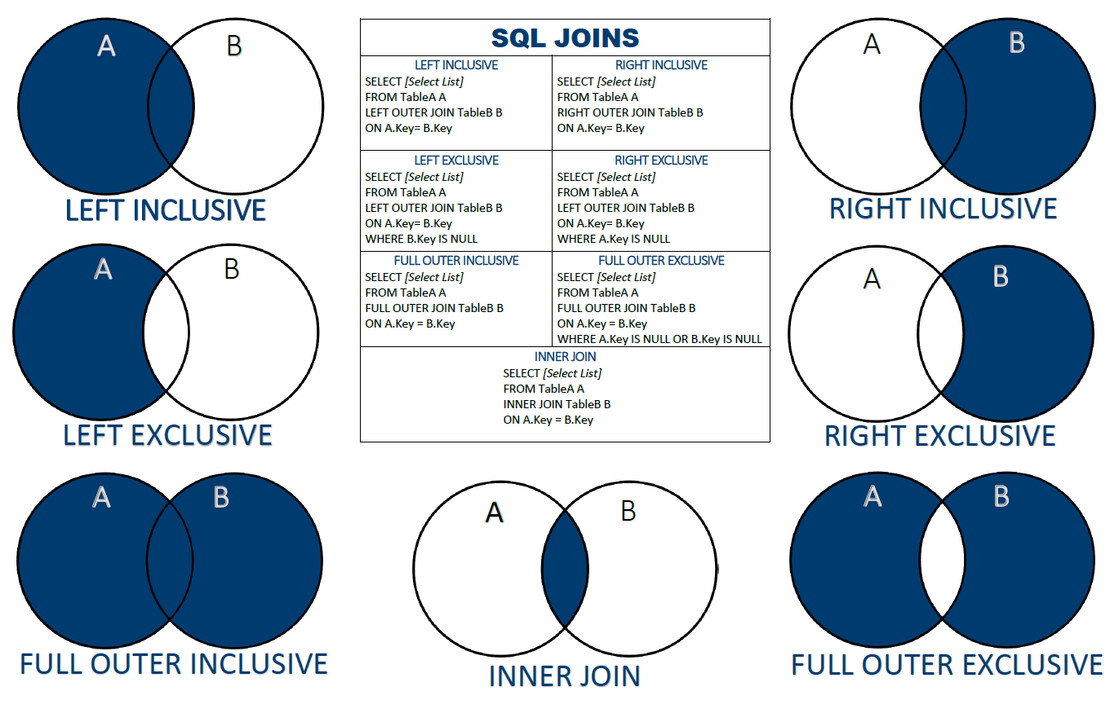
Joins

