Slide 1
RMS Background Tables
TIGERRISK PARTNERS

Slide 2
RMS Background Tables
Intro to background tables
EDM tables
Practice
RDM tables
Practice

Slide 3
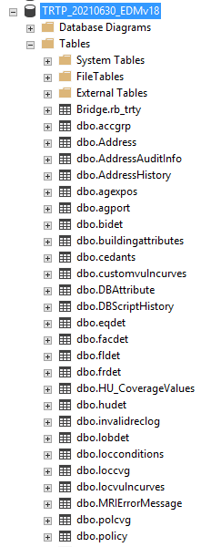
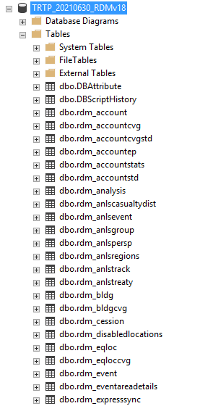
What are the “background tables”?
When you import your contract and location data into an EDM, the data gets parsed between many different tables in the model’s SQL structure
RMS has its own specific way of organizing loss results in the RDM
Each model vendor has their own “database schema”
Tables contain a combination of user supplied data and model generated data
Models generate their own unique identifiers for specific contracts / locations / loss results / etc that can be used to tie across tables

Slide 4
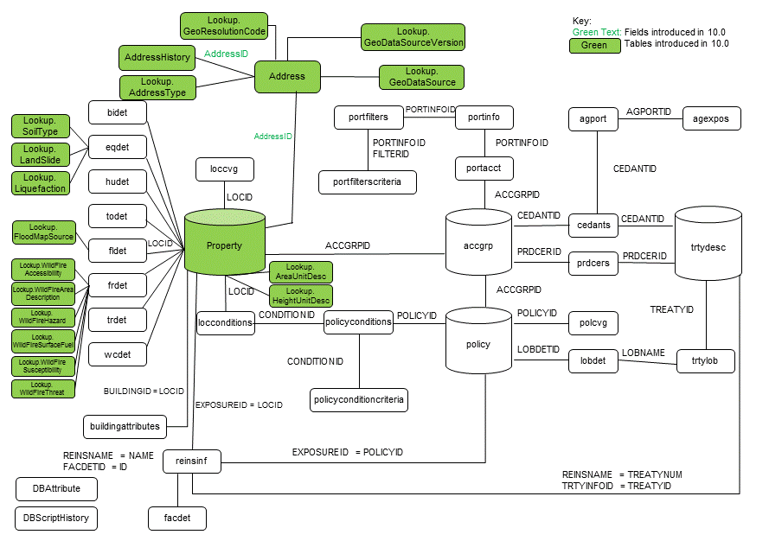
RMS EDM Database Schema

Slide 5
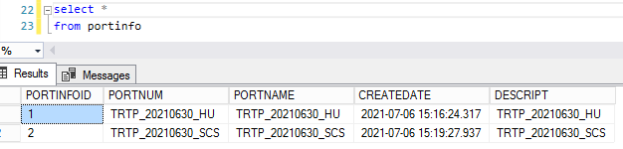
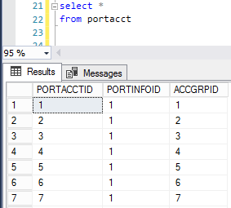
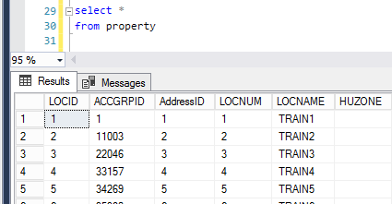
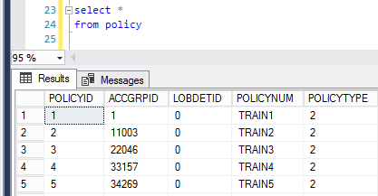
EDM Tables – Portfolio Identification
When you import a portfolio, it gets saved in the “portinfo” table
This “portinfoid” can be used to tie to other exposure tables, such as “portacct”
The accgrpid can be used to tie to a number of other tables, such as the policy table and the property tables
NOTE: When trying to isolate exposures based on the portfolio they are in, join your exposures back to the portacct table and filter on the appropriate portinfoID!

Slide 6
EDM Tables – Location Information
Location Identifiers: LocID (RMS generated), Locnum (Imported), Locname (Imported)
Property Table:
Exposure Identifiers: LOCID, Accgrpid, AddressID, Locnum, Locname
Table information: Primary risk characteristics
Loccvg Table:
Exposure Identifiers: LoccvgID, LocID
Table information: Location level coverage information (coverage A/B/C/D, location deductibles, etc)
HUDET/TODET/etc tables:
Exposure Identifiers: Xxdet ID, LocID
Table information: Site-level coverage information (site deductible, etc), peril-specific secondary modifiers
Address Table:
Exposure Identifiers: AddressID
Table information: Location / geographic information
NOTE: the “loc” view is a view that combines a number of different location exposure tables and can be a useful resource when profiling locations / exposure data.

Slide 7
EDM Tables – Policy Information
Policy Identifiers: PolicyID, PolicyNum, AccgrpID, AccgrpNum, AccgrpName
Accgrp Table:
Exposure identifiers: AccgrpID, AccgrpNum, AccgrpName
Table information: Account identifiers and UDFs
Policy Table:
Exposure identifiers: PolicyID, AccgrpID, PolicyNum
Table information: Policy info (LOB, type, etc) and policy-level coverage information
Multiple policy types per one account

Slide 8
EDM Tables – Profiling Examples
In SQL!

Slide 9
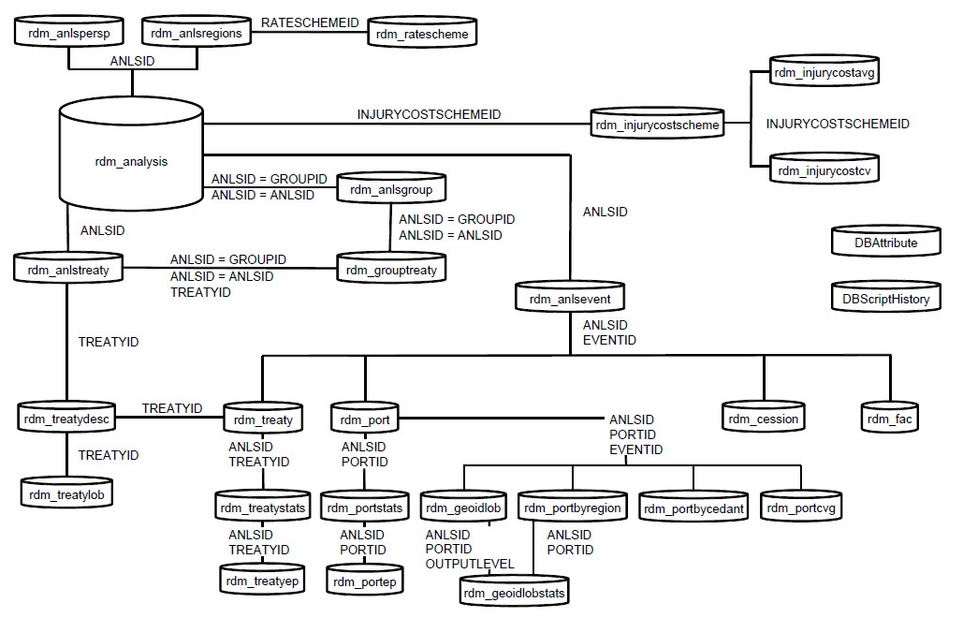
RMS RDM Database Schema

Slide 10
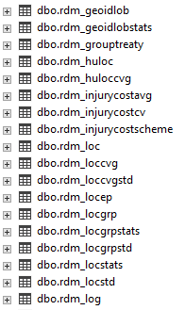
RDM Tables – Identifying Analyses
Similar to identifying a portfolio, need to be able to filter on an analysis
Identify which analysis you are looking at using the rdm_analysis table
Can use the analysis ID to tie to table containing detailed loss information
Results are organized based on level of event detail and level of AAL detail
The part of the name after the rdm_ indicates the level of detail – here, it is by geography and LOB. This table contains your event losses by geography, by LOB.
Tables that end in “stats” refer to AAL level of detail. This table contains AAL by geography, by LOB.
This table contains event losses by location
NOTE: If you save event losses ONLY by state LOB, RMS will only populate the rdm_geoidLOB table for that analysisID. If you thought you ran an analysis event by location, but the rdm_loc table is empty, then you should double check your DLM settings!
This table contains AAL by location

Slide 11
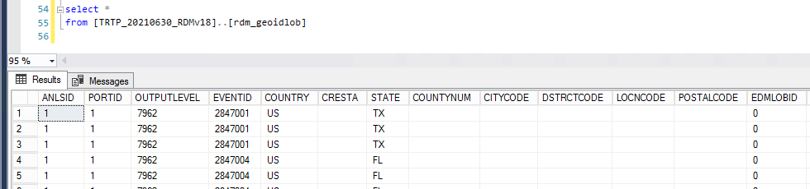
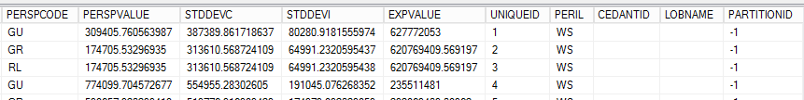
RDM Tables – Column Names – Event Tables
Tables with losses saved by event have several columns in common
Anlsid: Identifies which analysis the loss is tied to
PortID: Identifies the portfolio that was run for this analysis
Outputlevel: Level of granularity saved – for example, by state by LOB, or by county by LOB, etc.
EventID: The unique ID of the event
Perspcode: The financial perspective (ground up, gross, net pre cat, etc)
Perspvalue: The given loss for that event, financial perspective, and LOB/geography/etc
STDDEVC: The correlated portion of the standard deviation (around the event loss)
STDDEVI: The independent portion of the standard deviation (around the event loss)
EXPVALUE: The exposed value to that event

Slide 12
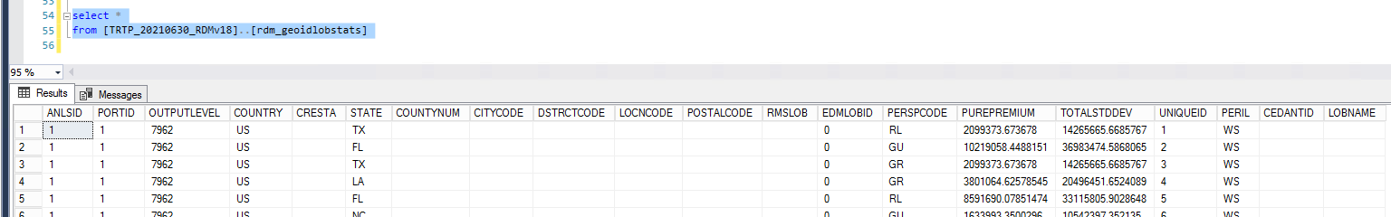
RDM Tables – Column Names – AAL Tables
Tables with AAL statistics have several column names in common
Perspcode: Financial perspective (ground up, gross, net pre cat)
PurePremium: The AAL for that event / level of detail
TotalSTDDEV: Total standard deviation around the AAL

Slide 13
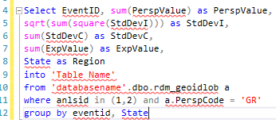
RDM Tables - ELTs
ELT = Event Loss Table
Event losses are used to calculate the exceedance probabilities
Can be used to import into Tiger Eye, can be altered to reflect a company's “view of risk”, can be used for other investigations
For TE import, must have EventID, PerspValue, StdDevI, StdDevC, and ExpValue
Region and LineOfBusiness are optional but usually also included
This is a sample ELT script which is pulling event losses by state, so we are pulling from the geoidLOB table
In order to combine analyses (or roll up to a more granular level), we must transform Perspvalue, StdDevI, StdDevC and ExpValue
We must filter on a few items, including anlsid, perspcode and sometimes outputlevel

Slide 14
RDM Tables – Loss Examples
In SQL!

Slide 15


