Slide 1
Database Basics
Cat Modeling Training, January 4th, 2024

Slide 2
Overview
What you should know already
How to create databases (RMS, AIR, raw data)
How to name the databases (naming convention)
Today’s Focus
Attaching / detaching / moving databases
Renaming databases
Copying databases
Retrieving archived data
Upgrading databases
Downgrading a database to a lower SQL version

Slide 3
Detaching a Database
Detaching a database disconnects it from SQL
Detaching a database allows you copy/move/archive it.
Two Methods: in the interface or via script
It is not always necessary to take a database offline
Shrinking a database reduces its size by eliminating unused space
DBCC SHRINKDATABASE('DatabaseName')
GO
alter database [DatabaseName] SET OFFLINE WITH ROLLBACK IMMEDIATE
GO
sp_detach_db 'DatabaseName'
GO
Disconnects active connections
This action is not necessary for some servers
Completely disconnects the database from SQL control
Note – skip taking a database offline for the following servers:
RMS v22 and newer
TS v10 and newer
Scratch 2019 and newer

Slide 4
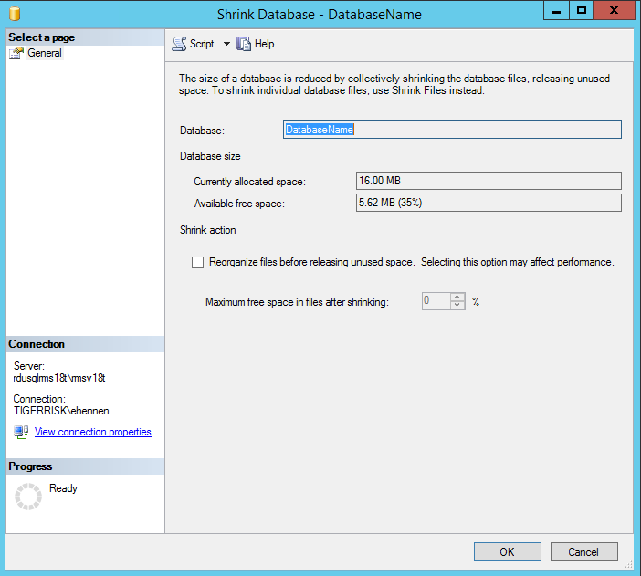
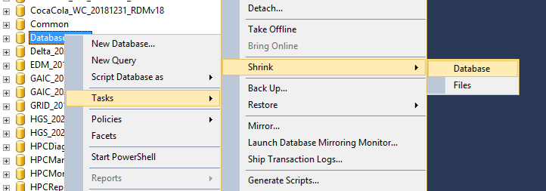
Detaching a Database
Shrinking a database reduces its size by eliminating unused space
Right click on database name
2
3
1
4

Slide 5
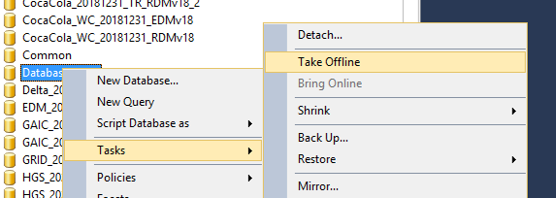
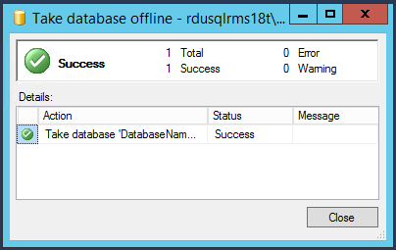
Detaching a Database
Taking offline disconnects active connections
Right click on database name
2
1
3
Note – skip taking a database offline for the following servers:
RMS v22 and newer
TS v10 and newer
Scratch 2019 and newer

Slide 6
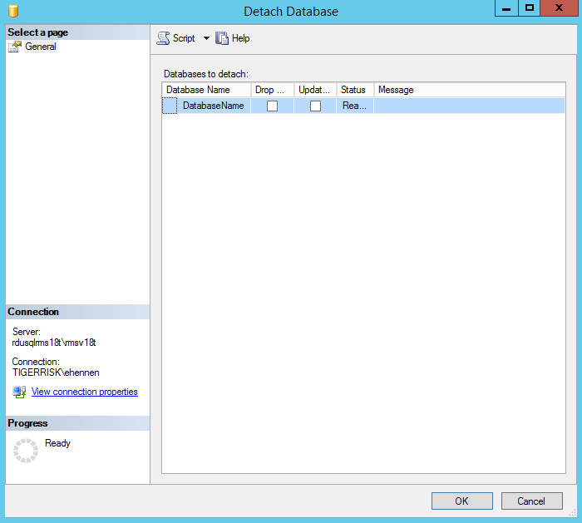
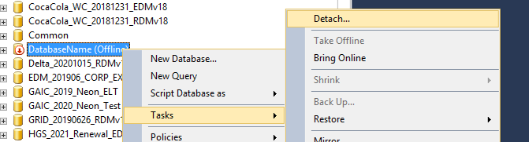
Detaching a Database
Completely disconnects the database from SQL control
Right click on database name
2
1
3

Slide 7
Attaching a File
Move the .mdf to the appropriate SQL directory on the SQL Server (e.g. D:\RMSv18T)
Do NOT create additional folders on any of the D drives
Change the File Name to Follow Naming Convention
SQL Databases should always follow a naming convention similar to the following Client_DataAsOf_OptionalDescription_FileTypeWithVersion
RMS Example:
LMG_201601_HU_EDMv15
LMG_201601_HU_RDMv15
AIR Example:
Farmers_20151231_EQ_CEDEv3
Farmers_20151231_EQ_LOSSv3
Data Edits/Raw Data Example:
Anchor_20160630_RawData

Slide 8
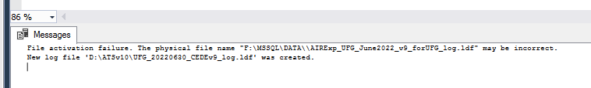
Attaching a File, cont.
The SQL database name and the file name MUST be the same
SQL 2017 and Prior Using SQL Management Studio
If you have both the mdf and ldf file:
If you only have the mdf file:
You will sometimes get the below error. SQL will create a log file if you don’t have one, so you can ignore this error.
CREATE DATABASE [CLIENT_20190701_EDMv18] ON
( FILENAME = N'D:\RMSv18T\CLIENT_20190701_EDMv18.mdf' ),
( FILENAME = N'D:\RMSv18T\CLIENT_20190701_EDMv18_log.ldf' )
FOR ATTACH
GO
CREATE DATABASE [CLIENT_20190701_EDMv18] ON
( FILENAME = N'D:\RMSv18T\CLIENT_20190701_EDMv18.mdf' )
FOR ATTACH
GO
Point to the correct D drive

Slide 9
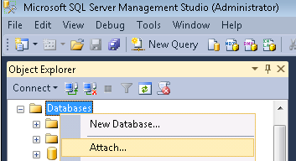
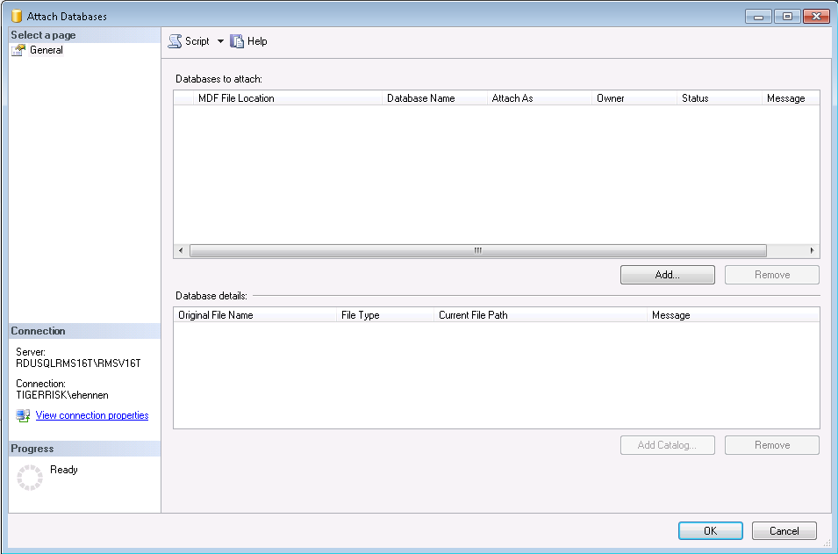
Attaching a File, cont.
SQL 2014 and Prior
In SQL Management Studio
Right Click – Attach
Add
Find File
1
2

Slide 10
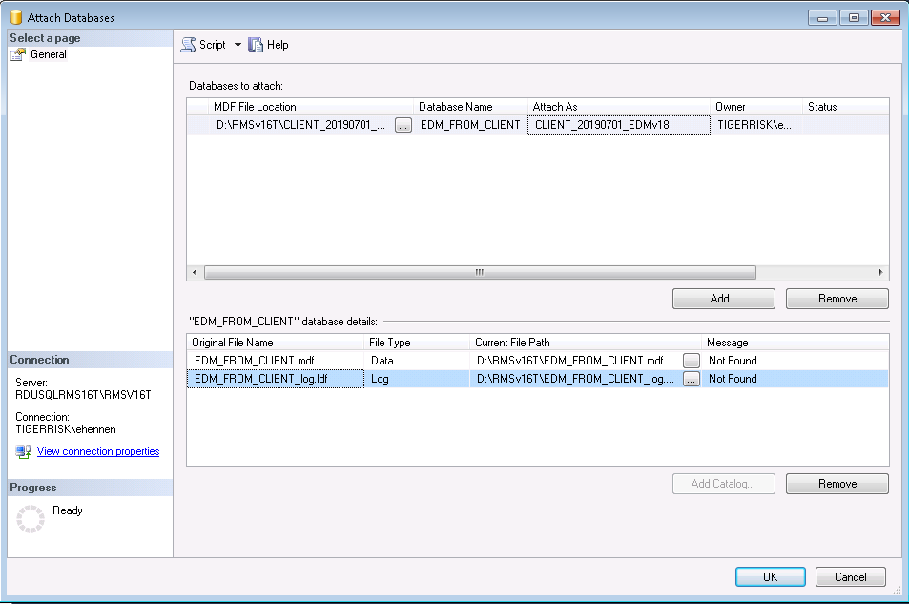
Attaching a File, cont.
SQL 2014 and Prior
In SQL Management Studio
Change
Attach As Name
Current File Path for mdf
Current File Path for ldf if you have the log file
If you don’t have the log file, remove the Log entry
Click OK
4a
4b
4c
4d
5

Slide 11
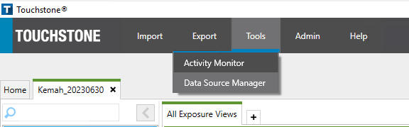
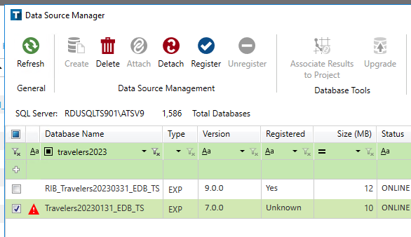
Registering & Upgrading Databases – Verisk
After attaching your database in SQL
In Touchstone
Open the Data Source Manager
Search for your Database
Check the box next to your database
Click Register
You may have to upgrade your database
Check the box next to your database again
Click Upgrade at the top of the Data Source Manager (Step 5)
1
4
5
2
3

Slide 12
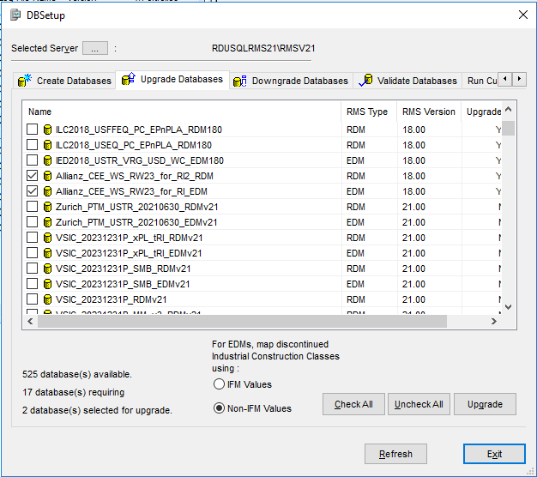
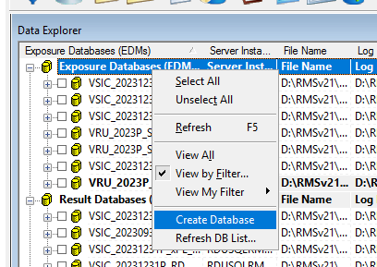
Upgrading Databases - RMS
In RiskLink
Right Click Exposure Databases (EDMs)
Click Create Database
Select Upgrade Databases ribbon
Click Uncheck All then Check the box(es) next to your database(s)
Click Upgrade
Exit
2
3
3
4
1
5

Slide 13
Moving a Database / Copying a Database
Steps for moving a database
Detach the database
Move the mdf and ldf to the new location
Attach the database
Steps for copying a database
Take database offline
Detach the database
Copy and paste the mdf and ldf files
Rename the copied files appropriately
Attach original database
Attach copied database
Retrieving archived data
Find file \\RDUTRFS02\Archive
Move the zipped file to the SQL server drive
Unzip the file
Attach the database

Slide 14
Moving Data to an Older Version of SQL
Ask for help if you’re unsure
Do data checks after the transfer to make sure all the data transferred.
Situation: Someone sends you an EDM/CEDE in a newer SQL version than what’s installed on the modeling server (e.g. receive a SQL2017 file but our RMSv18 environment only has SQL2016)
Steps
Attach the EDM/CEDE on a server with an appropriate SQL version (i.e. the version received or newer)
Create an empty EDM/CEDE on the modeling environment where the data is needed in order to run (using DBSetup (RMS) or Data Source Manager (AIR))
RMS:
Follow the detailed instructions starting on page 103 to export the data to the empty database
R:\01_REFERENCES\Documentation\RMS\v23\RiskLink System Administration Guide.pdf
AIR:
AIR’s process doesn’t always work…
R:\01_REFERENCES\Documentation\AIR\Database Downgrade\AIR_CEDE_Data_Transformation_Utility_for_SQL_2012_Instructions.pdf
Alternative Process: Use SQL scripts to transfer the data. BE CAREFUL and check that there aren’t any missing columns in the script (e.g. due to new fields added for newer versions of AIR, etc.)
R:\01_REFERENCES\Documentation\AIR\Database Downgrade\02_Transfer_AIR7.sql

Slide 15
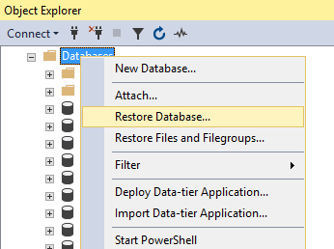
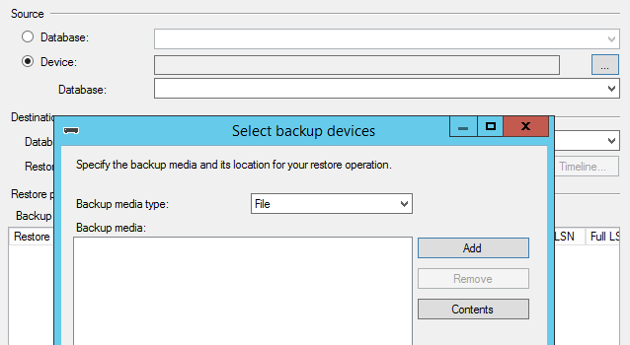
Backup Files
Sometimes we will need to bring in databases saved as .bak files instead of .mdf files
Save these files under the […]-Backups folder in the D drive of the server you need your database on
In SQL Management Studio
Right click Databases and select Restore Database…
Select Device
Click the … box to the right
Select Add and navigate to your file
Hit OK at the bottom
1
2
3
4

