Slide 1
Using the RMS Interface
TIGERRISK PARTNERS

Slide 2
Using the RMS Interface – Where are the Servers
Log into the appropriate remote Server
Before you log in you need to confirm that there are no other users using the specific Client Server. RMS can not handle concurrent users.
Below are the current RMS RiskLink Instances, but for future reference see the below document.
R:\01_REFERENCES\00_TIGER_MODELING_SERVERS.xlsx
Open RiskLink

Slide 3
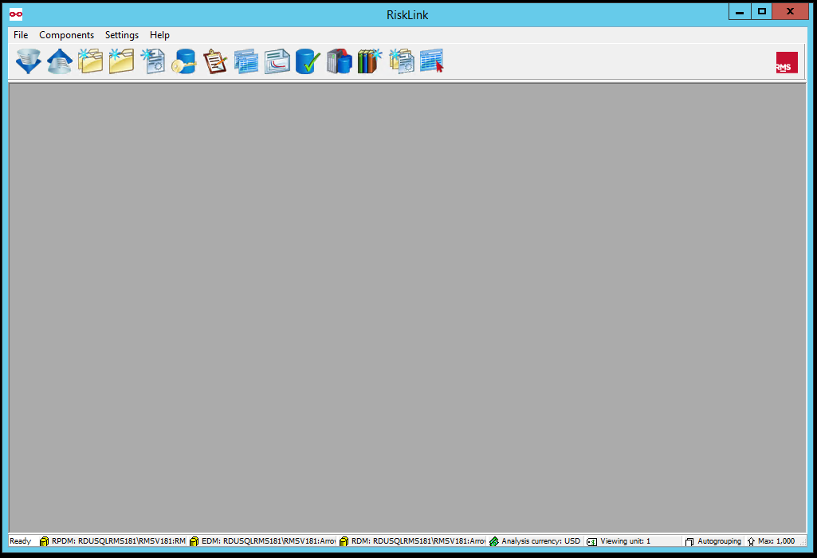
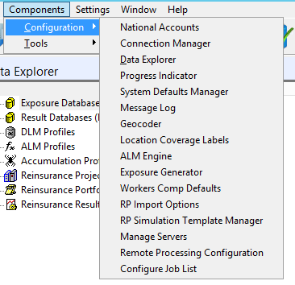
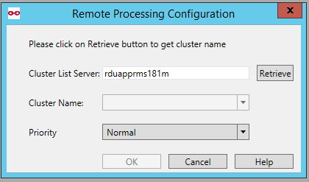
Using the RMS Interface – Brief Tour
Open Data Explorer to View Databases
Show Analysis Queue
Import Data
The first time you connect to an RMS server you will need to Set up Remote Processing. Which is done by going to
Components
Configuration
Remote Processing Configuration
Retrieve
OK
Create Portfolio
Set up Remote Processing
Currently Connected EDM and RDM

Slide 4
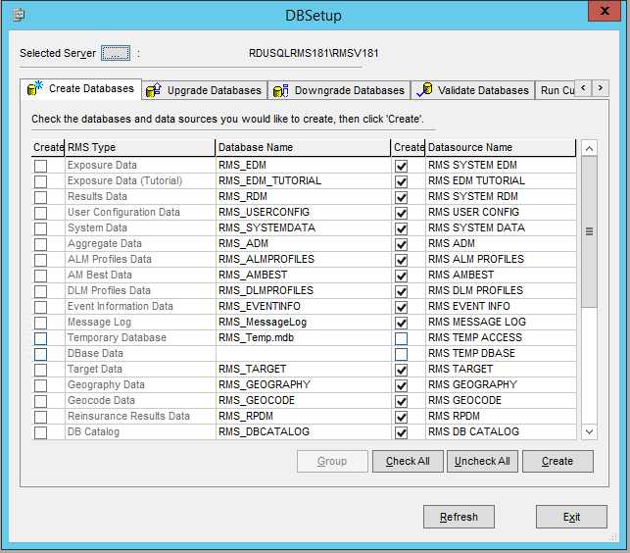
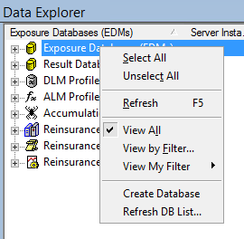
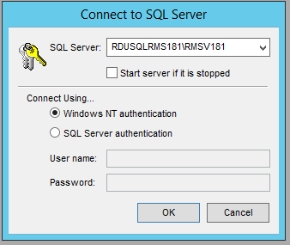
Using the RMS Interface – Creating a Database
1. Right Click on Exposure/Result Database
3. Select SQL Server (RDUSQLRMSXXX\RMSvXXX)
2. Click on Create Database
1
6
3
4
7
2
4. Select Windows NT authentication
8
5. Uncheck All
5
Creating a Database Best Practices?
In order to import data into the software, or generate modeled losses, we need a database to send this data into. For each client new data dates and new projects should have their own EDM/RDM and should have names like the following:
ClientName_Date_OptionalDescription_EDMvXXX
ClientName_Date_OptionalDescription _RDMvXXX
6. Check Exposure Data and Provide DB Name
7. Check Results Data and Provide DB Name
8. Create

Slide 5
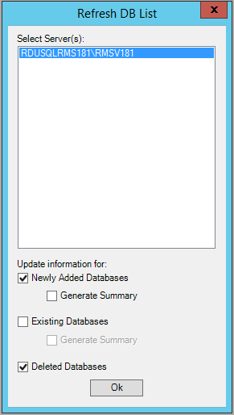
Using the RMS Interface – Creating a Database (continued)
3
1. Right Click on Exposure/Result Database
2. Click on Refresh DB List…
1
3. Select SQL Server
4. OK
2
4

Slide 6
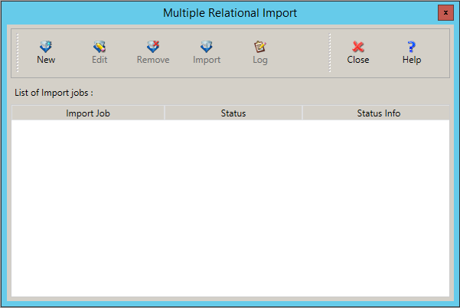
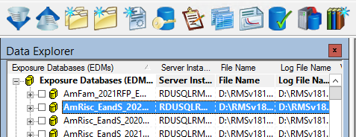
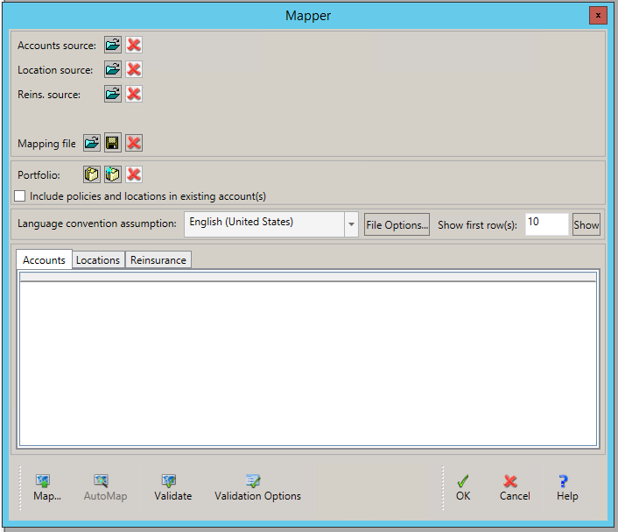
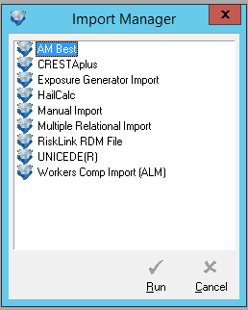
Using the RMS Interface – Importing Data
5
2
14
13
5. New
6. Open Account File
1
7. Run Auto Map
6
8. Open Location File
9. Run Auto Map
8
1. Select Active EDM in Data Explorer
10. Name Portfolio
10
11. Run Validator (See common errors later)
2. Import Data
3
12. OK. You will then be prompted to make a mapping file, just create a new file name and hit save.
3. Multiple Relational Import
4. Run
13. Import
14. View Log If Errors
7
12
4
9
11

Slide 7
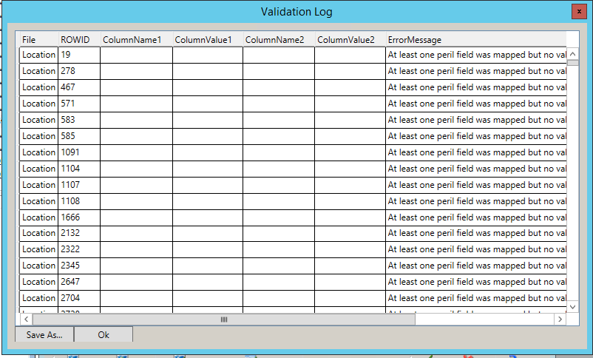
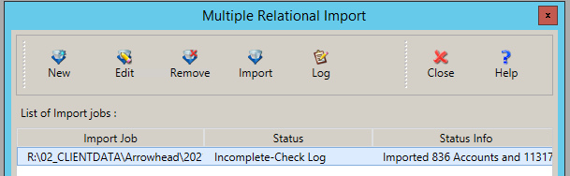
Using the RMS Interface – Troubleshooting Imports
When you validate your import, you will get a window like this one that provides you with some error messaging. Some Common errors are caused by:
Rogue Delimiters (e.g. commas in text values when your file is saved as a .csv).
Invalid Year built – RMS does not allow for any years of construction prior to 1753.
Negative Values – RMS will throw errors if unexpected columns have negative values. (e.g. Number of Stories, Deductibles, Coverage Values)
Non-unique identifiers – if account or location identifiers are non-unique then it can cause issues on import.
If you import without validating, you can get a similar error log by opening the log after import. But the post import log is not always as helpful as the Validation Log. See below.

Slide 8
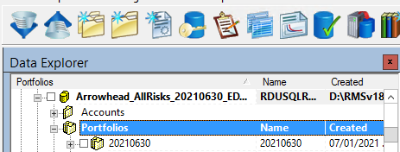
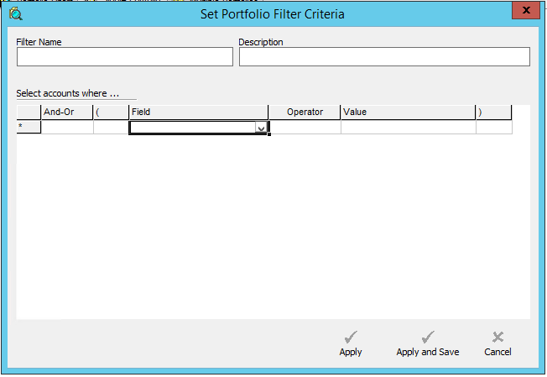
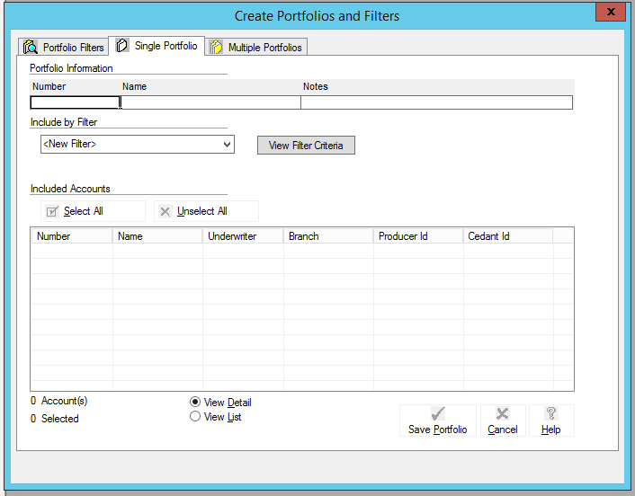
Using the RMS Interface – Creating Portfolios
1
4
2
5b
5
3b
3
1. After selecting your active EDM, click Create Portfolio
5. Apply
2. Give your Portfolio a Number and Name.
5b. If you want to be able to reuse the filter give it a Name and hit Apply and Save.
3. Define Filter Criteria
6. Wait for RMS to add all Accounts that fit the logic to the portfolio and check that the number of accounts matches your expectation.
6
7
3b. You can use this drop down to either Select All Accounts in the Database or use an existing defined filter.
7. Save Portfolio
4. Define Portfolio Filter Logic by selecting appropriate fields, operators, values and logic.

Slide 9
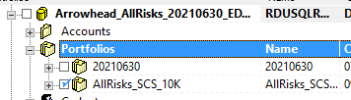
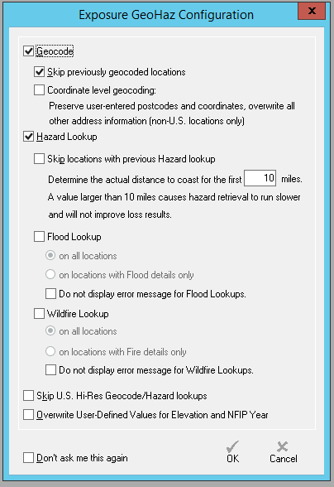
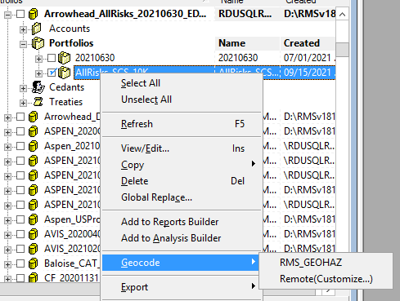
Using the RMS Interface – Geocoding Exposures
1. Select the portfolio(s) that you would like to be geocoded. Note that if some of your portfolios are subsets of other portfolios you only need to Geocode the larger portfolio.
1
3
2. Right click and click Geocode -> RMS_GEOHAZ. If RMS_GEOHAZ isn’t displayed, then you will need to re-set up Remote Processing (slide 3)
4
3. Enable Geocode (if the data is previously geocoded and you don’t want to overwrite that then check Skip previously geocoded locations)
4. Enable Hazard Lookup
5. OK
2
5

Slide 10
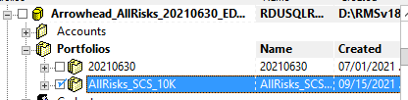
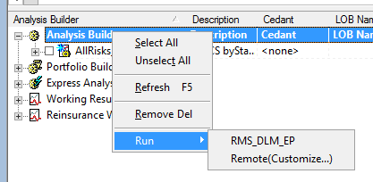
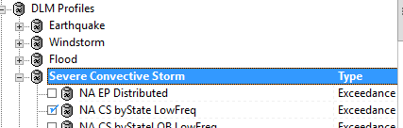
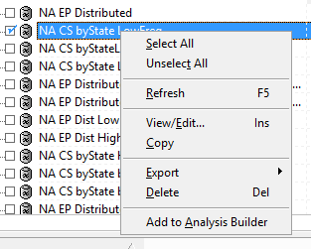
Using the RMS Interface – Submitting an Analysis
1
4
2
1. Select the Portfolio(s) that you would like to be run with the same analysis settings.
2. Expand the DLM Profiles and select the appropriate peril and setting profile(s). (see next slide for creating a new DLM Profile)
3. Right click and Add to Analysis Builder
Repeat until you have all your analyses submitted to the analysis builder.
4. Right click in the Analysis Builder -> Run -> RMS_DLM_EP
3

Slide 11
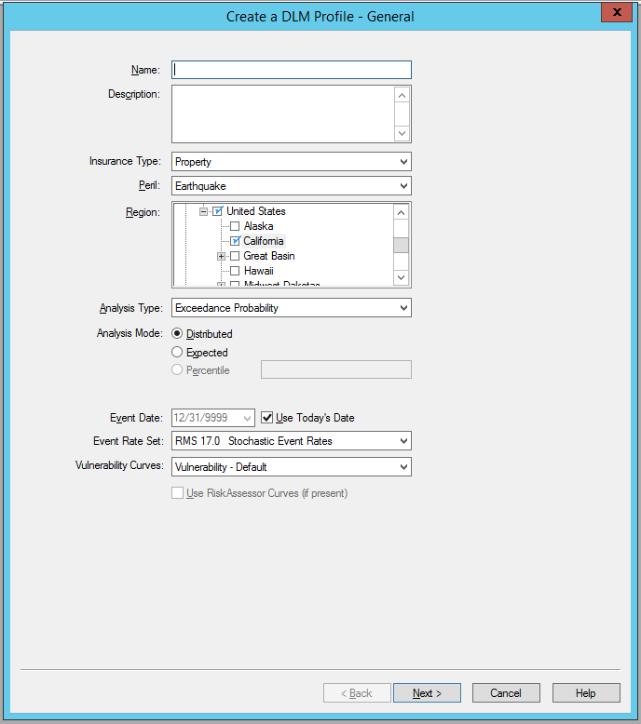
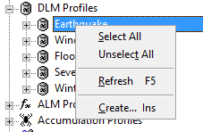
Using the RMS Interface – Creating a New DLM
Creating a DLM (page 1)
Name: Provide the DLM Profile with a Name that will inform others what the settings are something like:
Region EP Distributed Peril Subperil DS? Output type
Description: Optionally add a description
Insurance Type: Select between Property and Workers Comp
Peril: Select Peril
Region: Select the appropriate Region for the DLM. Most commonly North America.
Analysis Type: Almost always use Exceedance Probability
Analysis Mode: Almost always use Distributed
Event Date: Leave as Use Today’s Date
Event Rate Set: Choose the appropriate Event Rates.
For Hurricane Historical = Long Term, Stochastic = Near Term
For other perils you will generally use the most recent Stochastic Event Set.
Vulnerability Curves: Generally left on Default, but may change depend on your clients view.
1
1. Select the appropriate peril in the DLM Profiles section, right click -> Create…

Slide 12
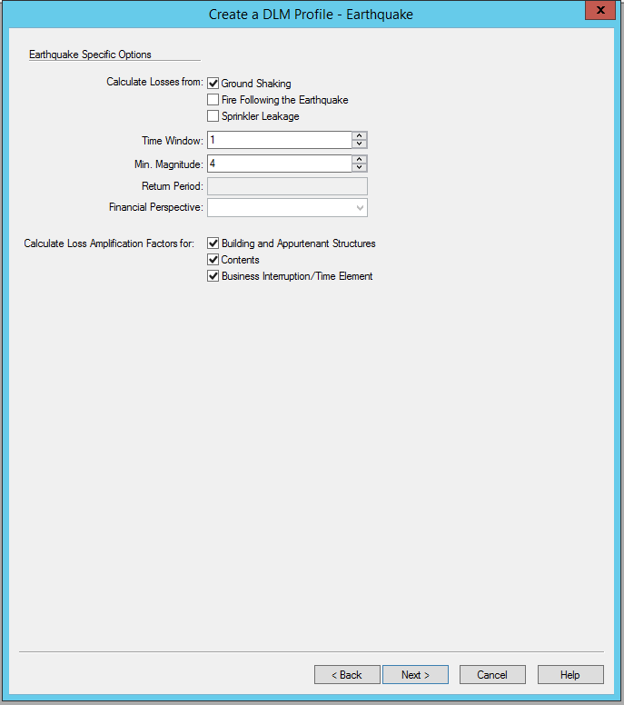
Using the RMS Interface – Creating a New DLM (continued)
Creating a DLM (page 2)
This page is peril specific and will include the subperils that you want to include and what you want to calculate Loss Amplification on.
Loss Amplification is almost always calculated for all three or not at all.

Slide 13
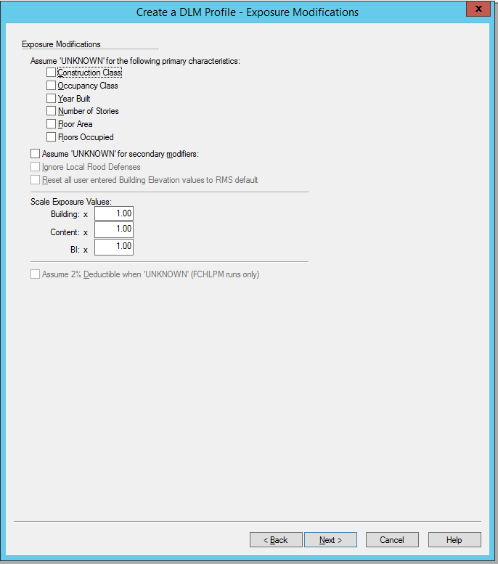
Using the RMS Interface – Creating a New DLM (continued)
Creating a DLM (page 3)
This page allows you to make bulk exposure modification assumptions. It is not generally utilized, but you can force certain modifiers to be unknown and you can scale exposure values across the entire portfolio.

Slide 14
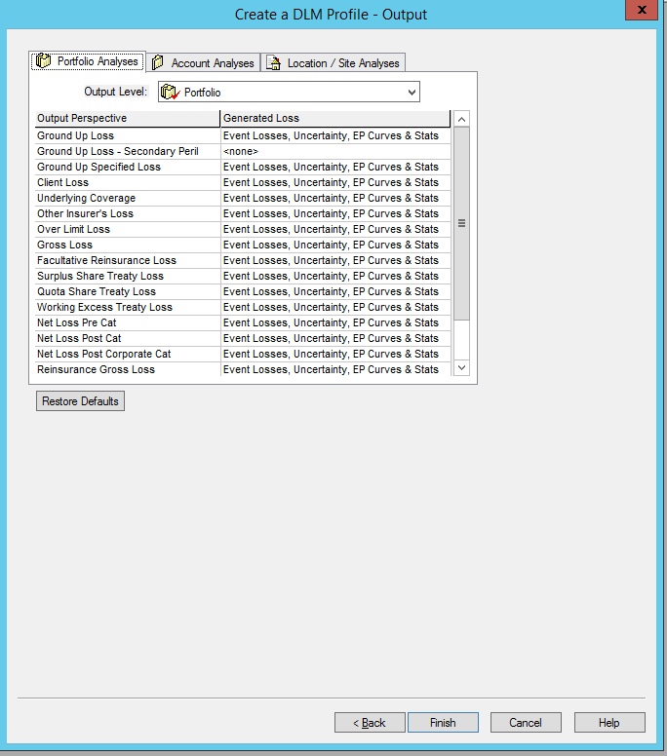
Using the RMS Interface – Creating a New DLM (continued)
Creating a DLM (page 4)
This page is where you set all the output for the analysis. You will use the Output Level drop down to select the output resolution and what results are saved for that resolution. Output is usually some combination of Geography, Line Of Business and Cedant.
Available Geographies are Postal Code, District, City, County, CRESTA, State, Country.
There are several options of Generated Losses for an output level, but you will almost always select either “Pure Premium” which will save AAL for that resolution, or “Event Losses, Pure Premium, & Uncertainty” which will save all loss information by event for that resolution. You will make this selection for each perspective and will generally want to include it for Ground Up, Gross and Net.
In addition to Portfolio level losses, you can also save losses by Account, Policy and/or Location.

Slide 15
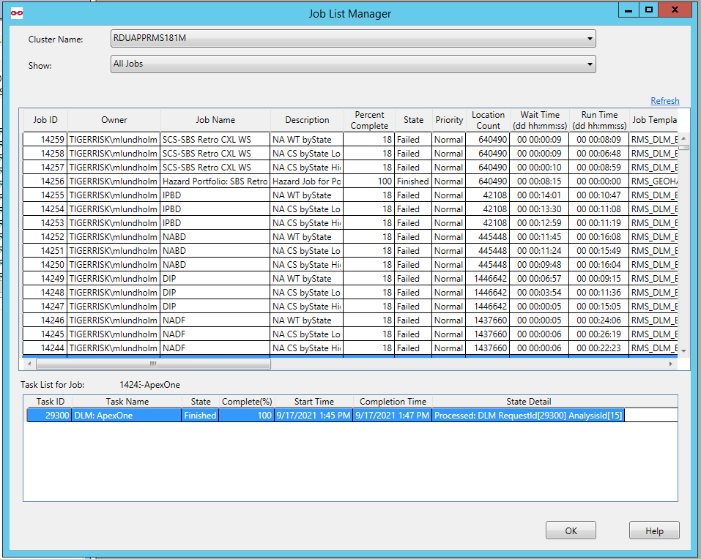
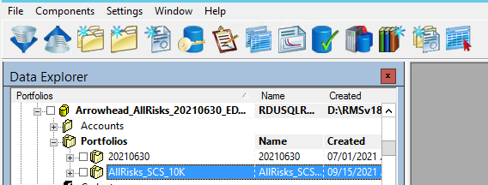
Using the RMS Interface – Checking the Queue
1
2
3
1. Click Job List Manager
2. Filter Job List Manager
3. Check Job Progress
4. For Additional information right click on the Task -> View Details
4

Slide 16
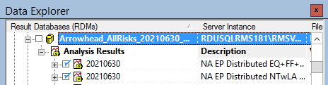
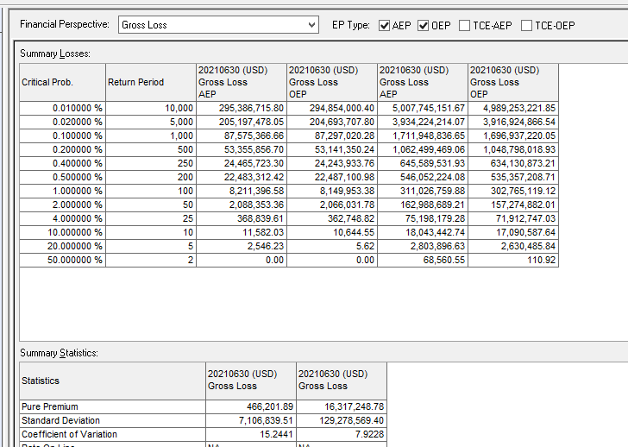
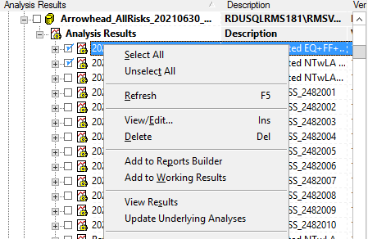
Using the RMS Interface – Viewing Results in the Interface
3
4
1
5
2
1. Select the Analyses that you would like to see results for.
3. Select the Financial Perspective that you would like to see (usually Gross Loss)
5. Return Periods can be customized by entering any value in each of these rows.
2. Right click -> View Results
4. Select AEP and/or OEP

Slide 17


