Slide 1
How do Cat Models Work? ELTs and YELTs
TIGERRISK PARTNERS

Slide 2
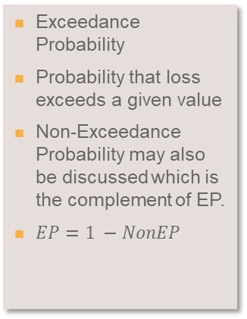
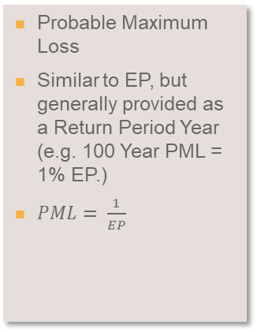
Common Terms (Review)
These terms will become very familiar…….
Expected Loss/AAL
STDEV
EP
PML
OEP/AEP
Average Annual Loss
This is interpreted as the amount of a loss a company can expect each year
RMS=sum of PERSPVALUE*Rate
AIR=sum of Loss / # of Years in Simulation (Typically 10K)
Standard Deviation of Loss
RMS generates correlated and independent standard deviations for every event to calculate loss
Exceedance Probability
Probability that loss exceeds a given value
Non-Exceedance Probability may also be discussed which is the complement of EP.
$EP=1 −NonEP$
Probable Maximum Loss
Similar to EP, but generally provided as a Return Period Year (e.g. 100 Year PML = 1% EP.)
$PML= \frac{1}{EP}$
Occurrence/Aggregate Exceedance Probability
OEP is the probability that the largest event in any given year exceeds some amount
AEP is the probability that the total of all events in a year exceeds some amount

Slide 3
Common Terms Continued (Review)
These terms will become very familiar…….
TVAR
ELT
YELT/Loss File
(Often referred to as a YLT)
YLT
EP Summary
Tail Value At Risk
This value represents the maximum loss that can be expected if a given loss occurs
Example – If a loss of at least $XXX occurs, then we could expect losses to be $XXX
Event Loss Table
Modeled output from RMS is an ELT
Contains all relevant loss information (Expected Loss, StdDev, Max Loss)
ELTs do not contain a Year so to simplify post model computations, we simulate Years and Events in TigerEye to be used in analyses
Year Event Loss Table
Modeled output from AIR is a YELT
Contains Loss information by event for each year
Can be loaded directly in to TigerEye, which is why it is often referred to as a Loss File internally.
Year Loss Table
Not usually used or seen but will commonly be used in place of YELT
Contains totals loss information by year
A report that summarizes return time losses along with AAL and Standard Deviation.
Can be generated for a Portfolio, Line of Business, Region or even Policy.

Slide 4
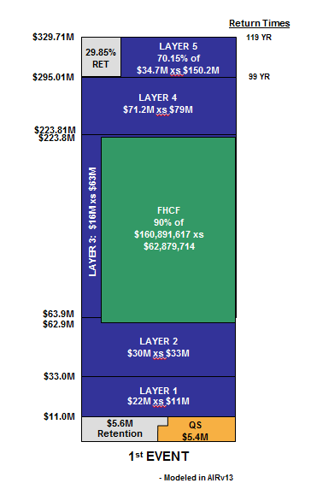
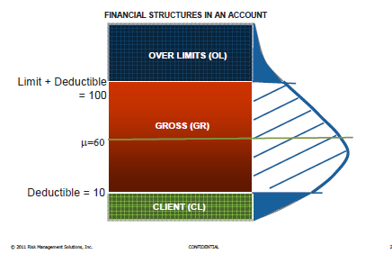
Financial Perspectives (Review)
RMS Code | Meaning | AIR Equivalent
GU | Ground Up Loss | GroundUpLoss
CL | Client Loss | RetainedLoss
GR | Gross Loss | GrossLoss
OL | Over Limit Loss
RL | Net of Pre-Cat | NetOfPreCATLoss
RP | Net of Post Cat | PostCATNetLoss
RC | Net of Post Corporate Cat
 |  | PreLayerGrossLoss
Policy Structure
Value of Risk
Policy Limit, Participation, Deductible
Reinsurance

Slide 5
Year Event Loss Tables (AIR Modeled Output)
Required
Year
EventID
Loss Amount
Optional
Region Qualifier
Line of Business Qualifier
Day of Year
Peril Identifier
Model Identifier
How to Combine Multiple YELTs
To combine multiple YELTs in to a single YELT you can sum the Loss Amount while controlling for Year, EventID and any optional qualifiers
e.g. Select Year, EventID, sum(Loss) as Loss from All_YELTs group by Year, EventID
How to obtain a YELT from AIR through SQL.
Select YearID as Year, ModelCode * 10000000 + EventID as EventID, GrossLoss as Loss from t#_LOSS_byEvent where CatalogTypeCode = ‘STC’
Example of a Generic YELT
Year | Event | Loss
1 | 1 | 79,174,641
1 | 2 | 49,618,930
2 | 1 | 108,232,547
3 | 1 | 84,831,222
4 | 1 | 88,941,571
4 | 2 | 58,683,481
5 | 1 | 82,725,542
6 | 1 | 78,922,946
8 | 1 | 105,084,355
8 | 2 | 50,503,169
10 | 1 | 72,730,101

Slide 6
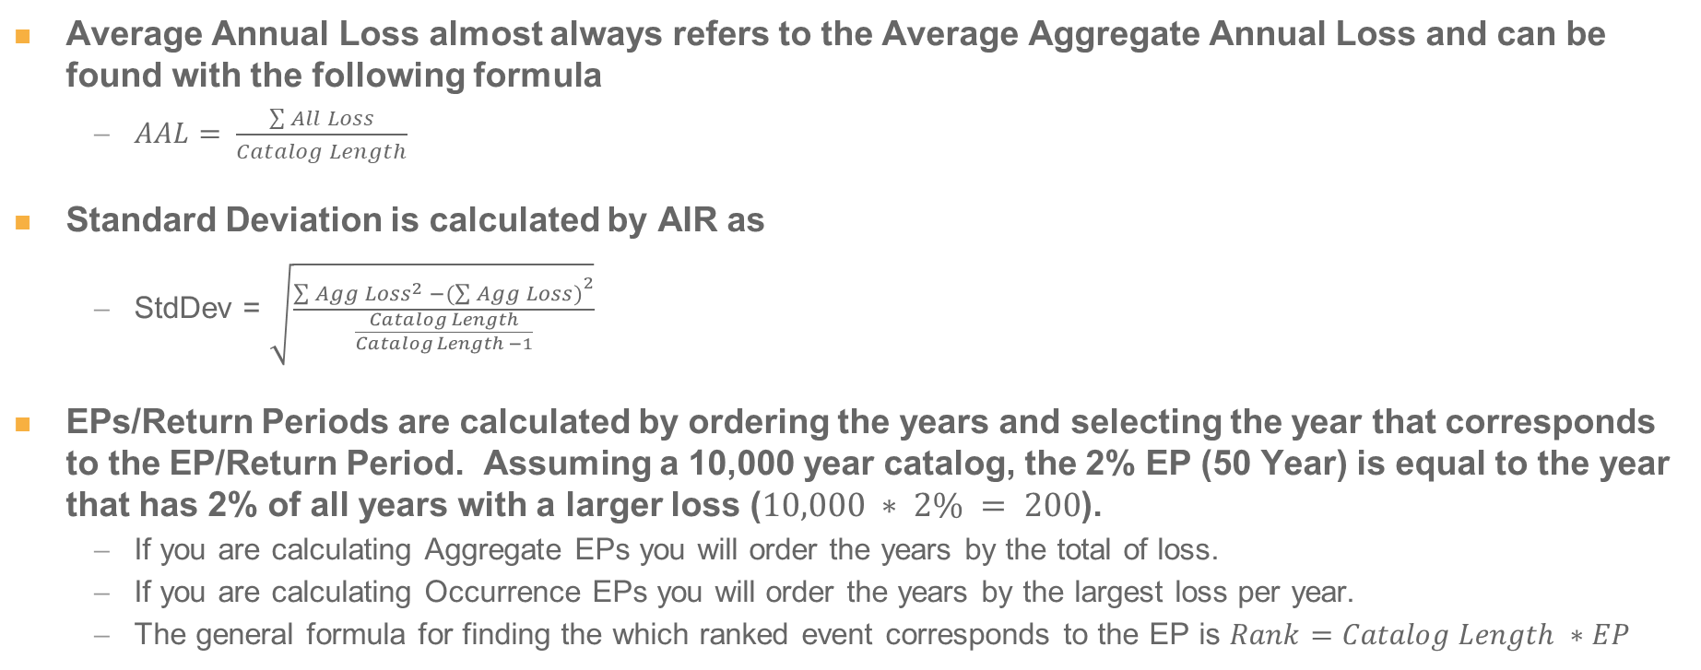
Creating an EP Summary from a YELT
Average Annual Loss almost always refers to the Average Aggregate Annual Loss and can be found with the following formula
$AAL= \frac{\sum{All Loss}}{Catalog Length}$
Standard Deviation is calculated by AIR as
StdDev = $\sqrt{\frac{\sum{{Agg Loss}^{2} −{(\sum{Agg Loss)}}^{2}}}{\frac{Catalog Length}{Catalog Length −1}}}$
EPs/Return Periods are calculated by ordering the years and selecting the year that corresponds to the EP/Return Period. Assuming a 10,000 year catalog, the 2% EP (50 Year) is equal to the year that has 2% of all years with a larger loss ($10,000 ∗ 2\% = 200$).
If you are calculating Aggregate EPs you will order the years by the total of loss.
If you are calculating Occurrence EPs you will order the years by the largest loss per year.
The general formula for finding the which ranked event corresponds to the EP is $Rank=Catalog Length ∗EP$

Slide 7
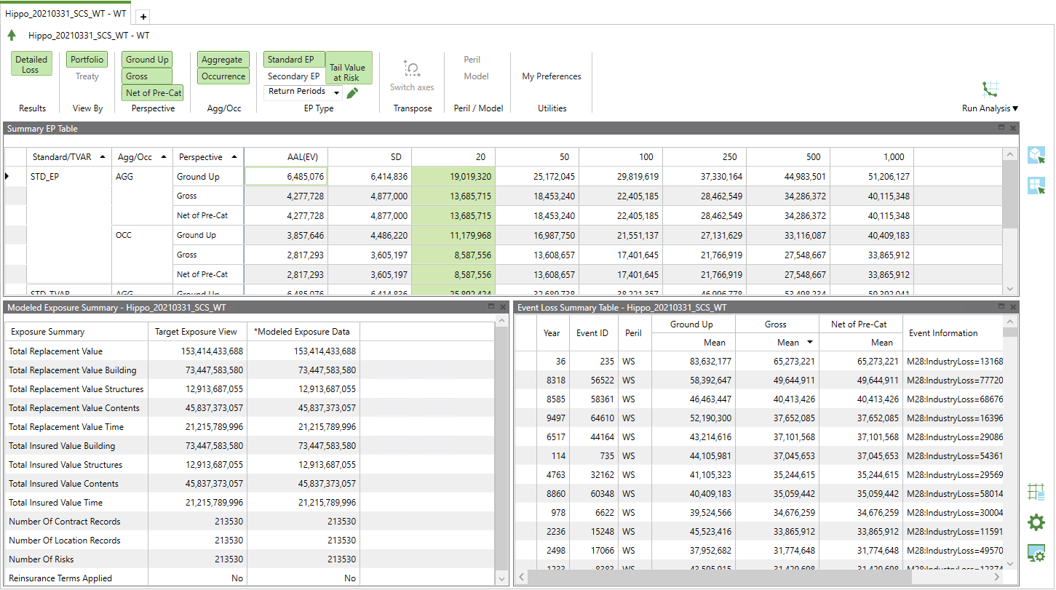
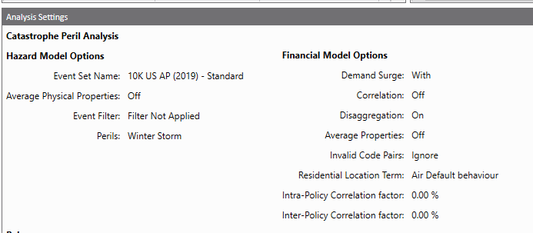
Using the AIR Interface – Viewing Results in the AIR Interface (Review)
You can adjust the PML settings that are displayed in the table below
Here are the PML Summaries (based on the settings you selected above). When you import your YELT into TigerEye, you should make sure your PMLs tie to what is shown here in the AIR interface
Selecting this will give you the analysis settings of this model run (what event set you ran, was demand surge included, etc.)
Can add return periods by selecting this

Slide 8
Event Loss Tables (RMS Modeled Output)
Required
EventID
Event Rate
Expected Loss Amount
Standard Deviation
Max Exposed Value
Optional
Region Qualifier
Line of Business Qualifier
Peril Identifier
Model Identifier
How to Combine Multiple ELTs
To combine multiple ELTs in to a single ELT you can sum the Loss, StdDev, and Max Exposed Value respectively while controlling for EventID and any optional qualifiers.
In RMS the Independent and Correlated StdDev are handled differently (See below example).
Select EventID, sum(PerspValue), sqrt(sum(square(StdDevI))), sum(StdDevC), sum(ExpValue) from All_ELTs group by EventID
How to obtain an ELT from RMS through SQL.
Select EventID, PerspValue, StdDevI, StdDevC, ExpValue from rdm_port where Anlsid = # and PerspCode = ‘GR’
Example of a Generic ELT
Event | Event Rate | Expected Loss | Std Dev | Max Loss
1 | 0.01 | 1,500,000 | 800,000 | 5,500,000
2 | 0.01 | 3,000,000 | 2,000,000 | 15,000,000
3 | 0.02 | 6,500,000 | 5,000,000 | 50,000,000
4 | 0.03 | 8,000,000 | 6,000,000 | 90,000,000
5 | 0.03 | 10,000,000 | 7,000,000 | 95,000,000

Slide 9
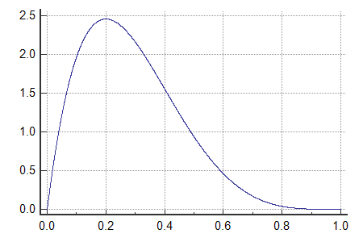
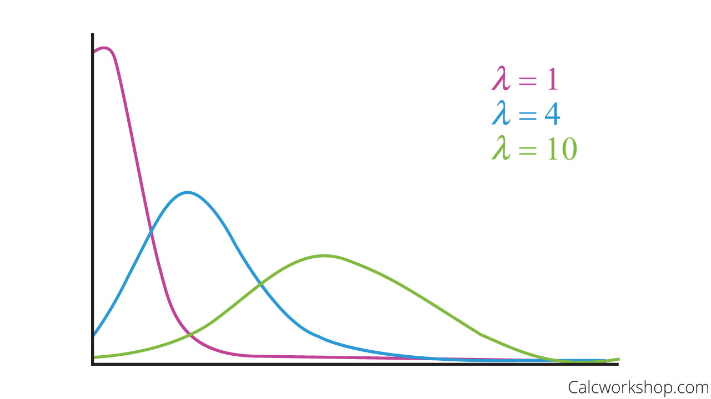
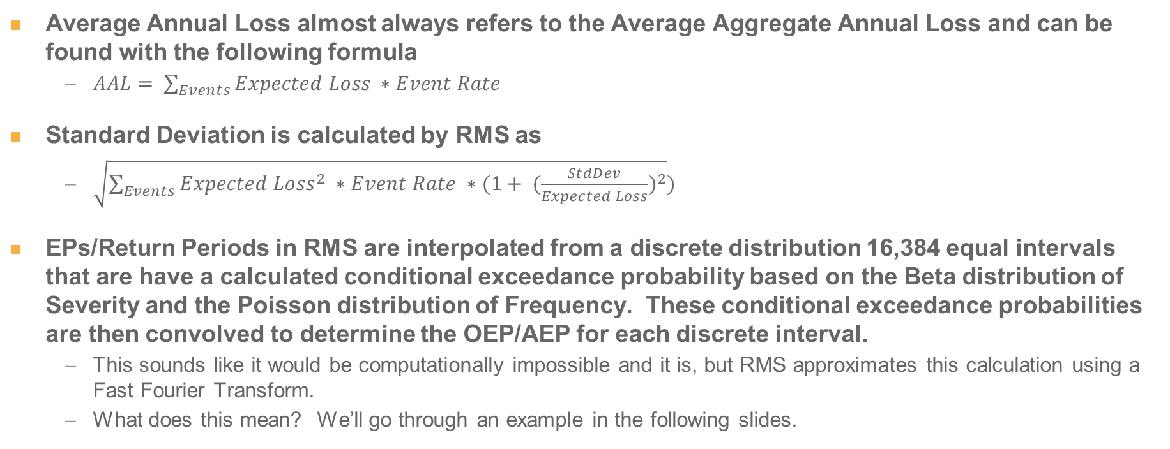
Creating an EP Summary from an ELT
Average Annual Loss almost always refers to the Average Aggregate Annual Loss and can be found with the following formula
$AAL= \sum_{Events}{Expected Loss ∗Event Rate}$
Standard Deviation is calculated by RMS as
$\sqrt{\sum_{Events}{{Expected Loss}^{2} ∗Event Rate ∗(1+ {(\frac{StdDev}{Expected Loss})}^{2}}})$
EPs/Return Periods in RMS are interpolated from a discrete distribution 16,384 equal intervals that are have a calculated conditional exceedance probability based on the Beta distribution of Severity and the Poisson distribution of Frequency. These conditional exceedance probabilities are then convolved to determine the OEP/AEP for each discrete interval.
This sounds like it would be computationally impossible and it is, but RMS approximates this calculation using a Fast Fourier Transform.
What does this mean? We’ll go through an example in the following slides.
Beta Dist
Poisson Dist

Slide 10
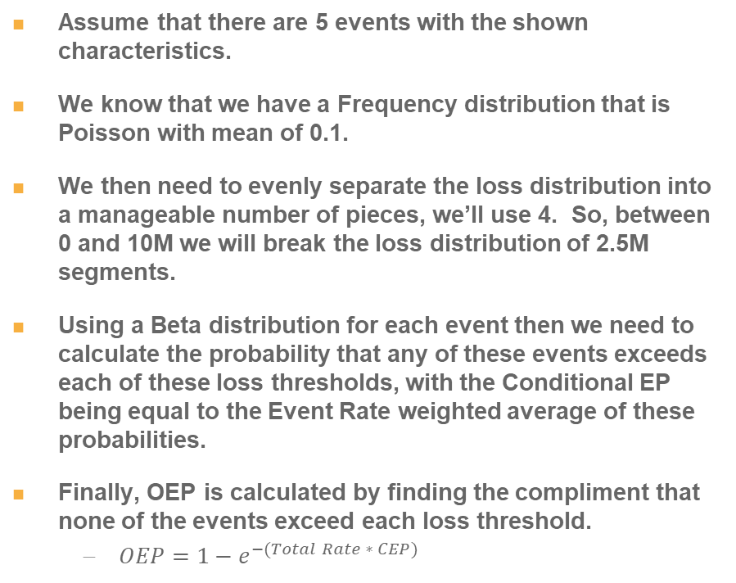
Creating an EP Summary from an ELT – Example OEP
Assume that there are 5 events with the shown characteristics.
We know that we have a Frequency distribution that is Poisson with mean of 0.1.
We then need to evenly separate the loss distribution into a manageable number of pieces, we’ll use 4. So, between 0 and 10M we will break the loss distribution of 2.5M segments.
Using a Beta distribution for each event then we need to calculate the probability that any of these events exceeds each of these loss thresholds, with the Conditional EP being equal to the Event Rate weighted average of these probabilities.
Finally, OEP is calculated by finding the compliment that none of the events exceed each loss threshold.
$OEP=1−e^{−(Total Rate ∗ CEP)}$

Slide 11
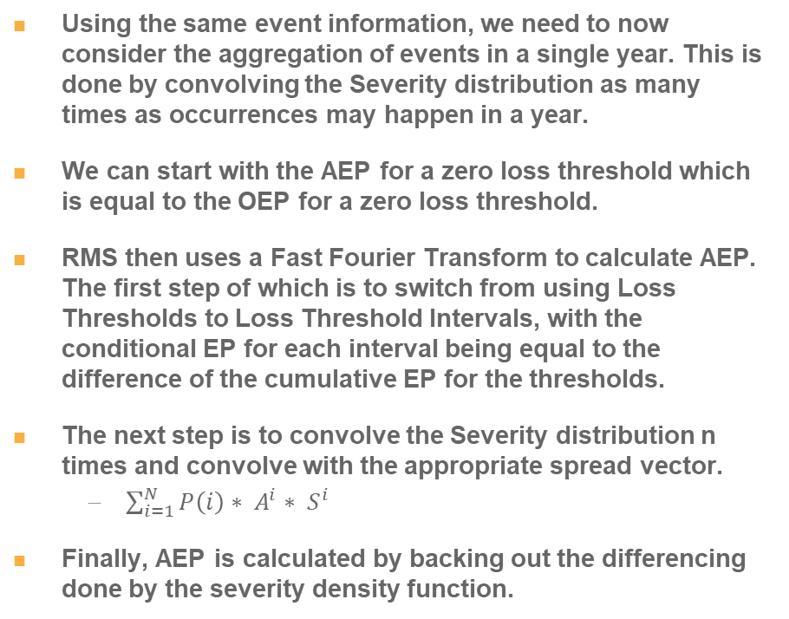
Creating an EP Summary from an ELT – Example AEP
Using the same event information, we need to now consider the aggregation of events in a single year. This is done by convolving the Severity distribution as many times as occurrences may happen in a year.
We can start with the AEP for a zero loss threshold which is equal to the OEP for a zero loss threshold.
RMS then uses a Fast Fourier Transform to calculate AEP. The first step of which is to switch from using Loss Thresholds to Loss Threshold Intervals, with the conditional EP for each interval being equal to the difference of the cumulative EP for the thresholds.
The next step is to convolve the Severity distribution n times and convolve with the appropriate spread vector.
$\sum_{i=1}^{N}{P\left(i\right)∗ A^{i}∗ S^{i}}$
Finally, AEP is calculated by backing out the differencing done by the severity density function.

Slide 12
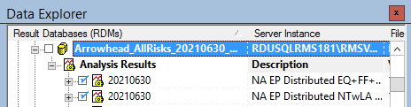
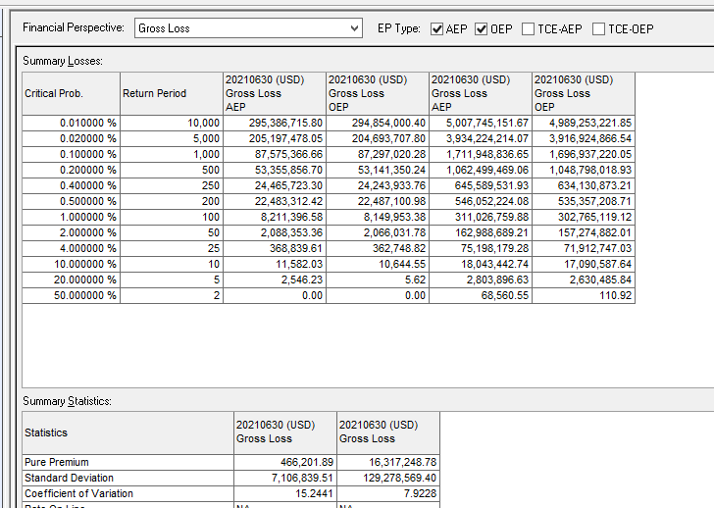
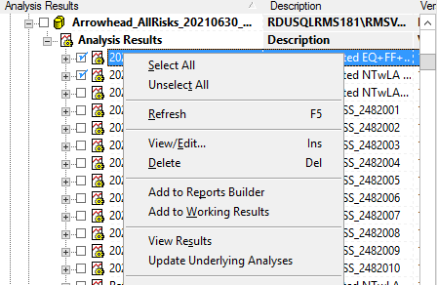
Using the RMS Interface – Viewing Results in the Interface (Review)
3
4
1
5
2
1. Select the Analyses that you would like to see results for.
3. Select the Financial Perspective that you would like to see (usually Gross Loss)
5. Return Periods can be customized by entering any value in each of these rows.
2. Right click -> View Results
4. Select AEP and/or OEP

Slide 13
Creating an EP Summary from an ELT – Simulated Estimate
The easiest and most common method to work with an ELT is to simulate the ELT in to a YELT using TigerEye’s simulated catalogs.
TigerEye uses defined catalogs of severity Beta selections for each event for each year.
This process allows us to work with ELT outputs in a manner that is consistent across all clients and datasets.
This is a simulation that is generally very good, but you will see deviations from the arithmetic OEP/AEP results that have been laid out in the previous slides.
TigerEye’s simulation error is generally within 5%, but for events with very low rates you can see larger differences.

Slide 14
References
RMS OEP and AEP detailed example
https://support.rms.com/documents/10192/0/EP_Methodology.pdf/c23b6df3-d87c-4811-b5ad-f3da3316e592

