Slide 1
HOWDEN TIGER PCS Training Guide

Slide 2
Agenda
Property Claims Services Introduction
What PCS Provides
PCS Loss Development
PCS Website
PCS Loss Listings
Cat Report
Trending Factors
International Events: CRESTA CLIX Website
Other Tiger PCS Uses
Loss Development
Live Event Reporting
Estimates by County

Slide 3


Property Claims Services Introduction
The PCS Catastrophe Loss Bulletins quantify the estimated loss of insured properties resulting from catastrophes impacting the United States
PCS gives expected losses, number of claims, and average claim loss, separated by state and line of business for every U.S. Cat event with losses over $25 million since 1980, with events since 1998 having greater detail
Most events have multiple estimates released over time as insurers refine their estimation of loss and claims mature
Estimates are based on surveying insurers for their estimate of ultimate loss
Estimates are meant to reflect the total insured payment for private personal and commercial property lines of insurance

Slide 4
What PCS Provides
PCS Does include:
PCS Does NOT include:
Estimated insured property losses from catastrophes in the United States, Puerto Rico, and the U.S. Virgin Islands.
Since January 1998
For catastrophes resulting in estimated losses of $25M or more
ALAE – Allocated Loss Adjustment Expenses
Losses that accumulate outside of the insured property damage
Included in the loss bulletins, not in the loss totals
Estimates reflecting their best judgement of the total insured payment for private personal and commercial property lines of insurance covering:
Fixed property
Personal property
Time element losses
Vehicles, boats, and other related property items
Estimates by county for large events since 2017
Loss involving uninsured property
Publicly owned property and utilities
Agricultural
Aircraft
Ocean marine
Property insured under the National Flood Insurance Program or the Write-Your-Own Flood Insurance Program
Catastrophes below the $25M threshold
Estimates by county for events prior to 2017

Slide 5

PCS Loss Development
Some events develop due to a combination of an increase in claims and average loss per claim, but it is difficult to pinpoint the development with an accurate model due to high variability
However, we have been able to observe:
Events below $250M in losses rarely develop
The second estimate of an event tends to be the most accurate
Hurricanes have the highest development overall
Commercial losses tend to develop more than personal or auto
Most events show little to no development from the initial estimates.
The second estimate of losses for a developing event, which on average is a 4% increase from the first estimate, tends to be the most accurate.
Average development depends on peril and event size.

Slide 6
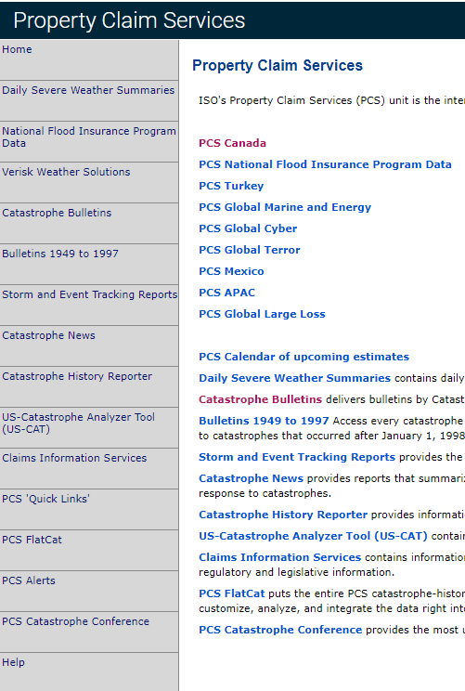
PCS Guide
https://pcs.iso.com/pcs/app/start.do
NFIP – National Flood Insurance Program
Includes NFIP loss estimates for major hurricanes
Used for one section of the PCS Loss Listing
Cat Bulletins
Estimate summary reports for each event
ALAE (Allocated Loss Adjustment Expenses) figures found here
PCS Calendar
Useful for planning and live event reporting
FlatCat Files
Summary files that are used to create PCS Loss Listings and the Monthly Cat Report
The “pcscat” file includes the most recent loss by state for each event since 1985
The “pcscat_est” file includes every iteration of loss by state for events since 1998, including loss by LOB and claim count
Loss estimates by county are available here for major events since 2017

Slide 7
Loss Listings
S:\PCS Loss History
FOR INTERNAL USE ONLY
Tiger licenses PCS, so it can be shared to other Tigers, but not all clients have it
Before sharing PCS information with clients, confirm that they have the licensing as well
We can provide summarized, non-granular information (rounded loss ranges, etc.) to those without a license
Updated reports are released at the middle and end of each month
An Excel tool automates the bulk of this process
Includes organized tables of PCS losses since 1998
By state, line of business, and peril
Tiger-generated trending factors are included
Interactive graphs and pivot tables
A go-to source for brokers and other teams at Tiger

Slide 8

Cat Report
Updated reports are released at the middle of each month
Distributed via the TigerAlert email companywide, as well as posted on the Jungle Website
Summarizes PCS events throughout the year, sorted by peril/hazard
Provides high level trends
Forecast Development
Peril seasonality
Monthly activity

Slide 9
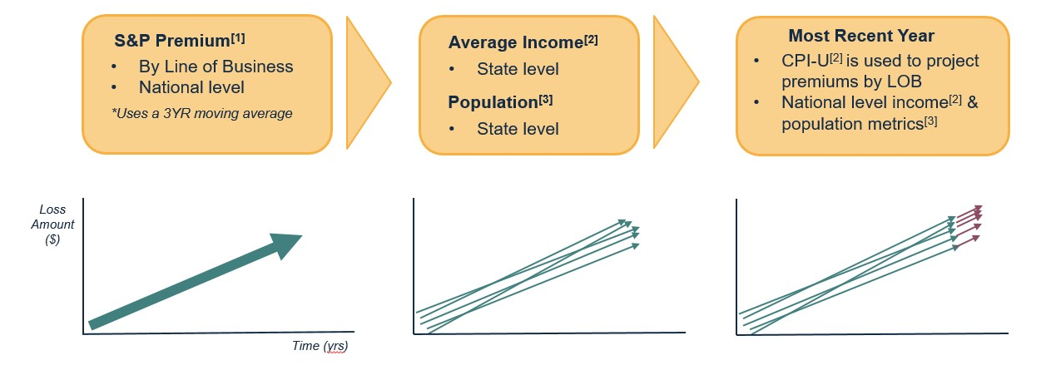
Trending Factors
We include our own Trending Factors in the Loss Listings, Cat Report, and custom View of Risk/ Claims Analysis projects to account for exposure growth and inflation.
Factors are applied by Year, State, and Line Of Business
LOBs included are Personal, Commercial, and Auto
We use the following metrics to calculate our trend factors:
Updated on a yearly basis
1. S&P Global
2. U.S. Bureau of Labor Statistics
3. U.S. Census

Slide 10


CRESTA CLIX – International Events
https://clix.cresta.org/
Provides loss estimates for catastrophic events outside of the United States
Updated Quarterly
Used for both the Tiger Loss Listings as well as the Monthly Cat Report

Slide 11
PCS in R&D Projects
PCS Loss Development
Industry Market Share Tool
View of Risk
Live Event Reporting
By County Estimates
Broker requests
Trending Factors
Claims Studies

