Slide 1
Cat Modeling Training Program Modeling Project Overview
TIGERRISK PARTNERS

Slide 2
Training Project
The next two weeks of training are focused on the cat modeling process
Receive Data
Data Checks and profiles
Data Assumptions
Data Edits and Profiles
Import files, modeling in AIR and RMS
Pull and review results
Provide results to client / broker / project lead
Raw Data
EDM/RDM
Cede Databases
Import Files
Need to make sure you interpret data correctly
Gut checks and sense checks
Double check all edits applied to data
Make sure to receive sign off from client and brokers/project leads on edits being made
DOCUMENT EVERYTHING
After data has been edited, pull import files by model and peril
Can include pulling ELTs/YLTS
Populating EP summaries or TMR
Sense check results
When providing results, must also provide commentary and a story around the results
AND BEYOND...
Tiger CQ, reinsurance cost allocation / policy ranking, rate filings, exposure management, market files, pro forma / projections…

Slide 3
Training Project Overview
Work through a LION Insurance Company client data set as you progress through your sessions
Copy over client data folder into your working folder: R:\01_REFERENCES\TrainingMaterials\NewHire_Training\CatModelingTraining_202311\03_PracticeProject
This folder is how client folders should be organized when receiving client data
Take some time to look through the folders - there are items in there to help aid you through the modeling process
Raw data from the LION insurance company can be found here: R:\01_REFERENCES\TrainingMaterials\NewHire_Training\CatModelingTraining_202311\03_PracticeProject\20210630\DATA\01_RAWORIG

Slide 4
Training Project Deliverables
Data profiles – Monday, 12/11
Assumptions document – Wednesday, 12/13
Data edits – No official deadline, remember to follow assumptions document exactly!
Import files – No official deliverable, aim to have exposures December 14th
EP Summaries – Interface: 12/15, TigerEye: 12/19
Final presentation! – Tuesday 12/26

Slide 5
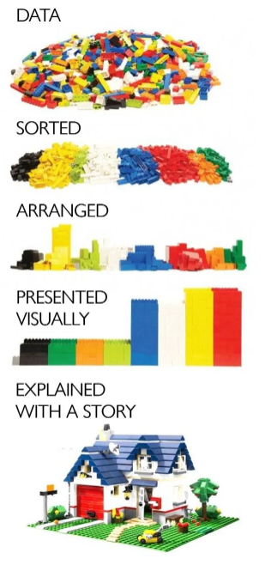
Training Project Final Presentation
The first section of the training project is focused on modeling the 6/30/2021 data set
After EP summary validation on/after 12/19, you will be provided with loss results and exposures from the 12/31/2020 data set
You will put together a short cat modeling presentation directed to the CRO (chief risk officer) at LION insurance company
Items to cover in your presentation:
What does the current portfolio look like?
What are the current losses?
How have exposures changed?
How have losses changed?
WHY
Will deliver the presentation to me and Anna as if we work for the LION Insurance Company
Should be about 5 to 7 minutes

Slide 6
Training Project Resources
Sample templates for powerpoints, etc can be found on the Jungle: https://jungle.tigerrisk.com/Interact/Pages/Section/Default.aspx?section=3175
All the work completed should be your own
Final deliverables should be only your work
However, please use each other and ask questions along the way!
Training check in meetings are the time for you to ask questions about the project
Outside of the training check ins, please reach out to me or other session instructors with questions

Slide 7


