Slide 1
RMS Import Files & RMS Codes
TIGERRISK PARTNERS

Slide 2
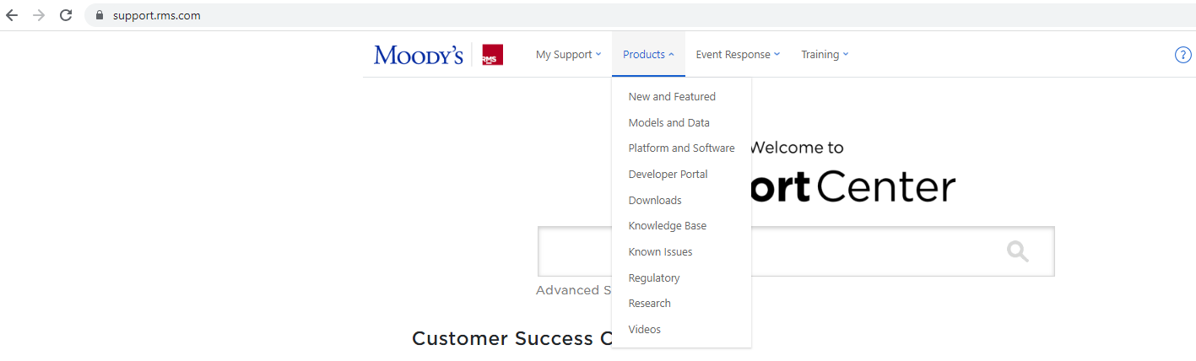
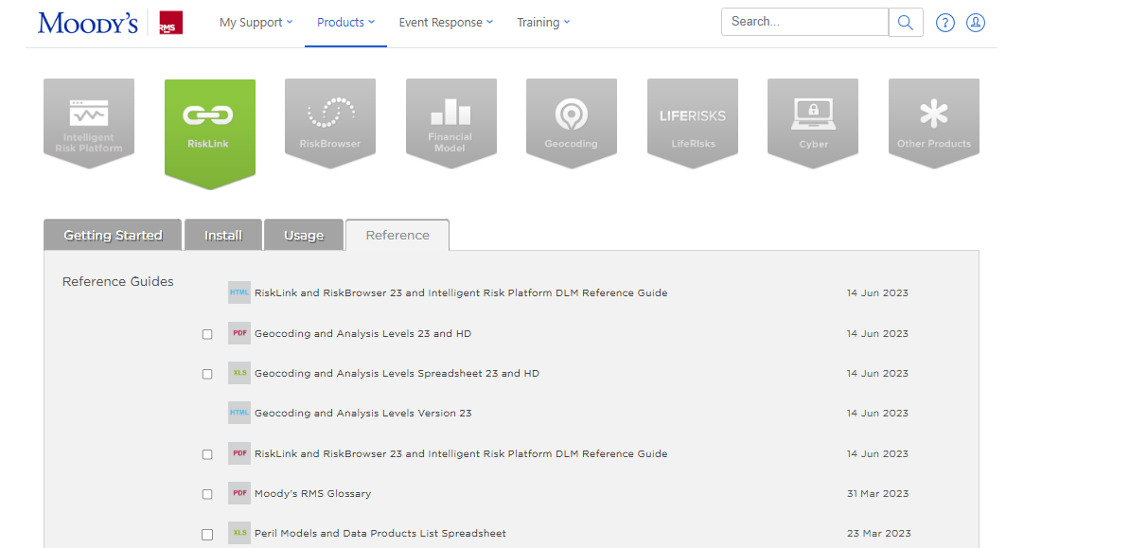
RMS Import Files & Codes – Where to Find Documentation?
DLM Reference Guide – provides material necessary to use RMS products effectively. Includes:
Import File Structure Details
Construction Classes
Occupancy Types
Country Information

Slide 3
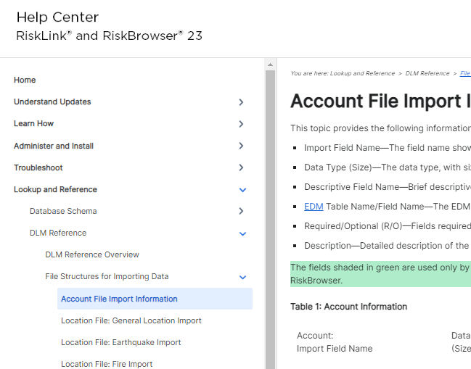
RMS Import Files
ACCOUNT FILE:
Contains Policy Terms & Line of Business details of the exposure
2 Fields ALWAYS Required in an Account File:
ACCOUNT NUMBER (ACCNTNUM) – *This will be the field that joins the Account File and the Location File together*
POLICY TYPE (POLICYTYPE)– This specifies the peril type to be applied to your policy (Policy type codes within the DLM Reference Guide)
POLICY TERMS (if applicable)
Limits, deductibles, attachment points, etc.
Multiple policies can be associated with a single account (i.e. $50M xs $50M HU Policy, $50M xs $10M All Other Peril), or there can just be a single policy associated with a single account, or there may not be policy terms (meaning location terms are only utilized)

Slide 4
RMS Import Files
LOCATION FILE: Contains the geography information, risk characteristics, and location terms of the exposure
ALWAYS Required Fields to Import:
ACCOUNT NUMBER (ACCNTNUM) - *This field is used as the key between the Account File and the Location File*
STATE (STATECODE)
COUNTY (COUNTY)
COUNTRY SCHEME (CNTRYSCHEME) –The scheme used for importing country codes (typically always ISO2A)
COUNTRY CODE (CNTRYCODE )– The country code of the location from the matching country code scheme (US)
BUILDING CLASS (BLDCLASS) – Construction Type
BUILDING SCHEME (BLDGSCHEME) – typically always choose “RMS”
OCCUPANCY TYPE (OCCTYPE) – Occupancy Type
OCCUPANCY SCHEME (OCCSCHEME) – typically always choose “ATC”
LOCATION TERMS
COVERAGE VALUES – The full replacement cost associated with the coverage type.
(XXCV1VAL) – Building
(XXCV2VAL) – Contents
(XXCV3VAL) – Business Interruption
(XXCV4VAL) – Coverage A
(XXCV5VAL) – Coverage B
(XXCV6VAL) – Coverage C
(XXCV7VAL) – Coverage D
LIMITS
(XXSITELIM) – site limit
(XXCVXLIMIT) – coverage limits
DEDUCTIBLES
(XXSITEDED) – site deductible
(XXCVXDED) – coverage deductibles
Parentheses are RMS import file field header names
Specify policy type (WS for hurricane, EQ for Earthquake, TO for Severe Thunderstorm / Winter Storm, etc.)
Use for Homeowners risks
Sometimes, deductibles will be received as percentages. If this is the case, generally we’d multiply that deductible percentage against Coverage A – but that is something you’ll want to confirm in your assumptions document with the client.

Slide 5
RMS Import Files
BEST PRACTICES
Include ALL applicable risk details and characteristics to your import files
Create Separate Import Files for each peril (HU, SCS/WT, & EQ-FF)
ADDITIONAL GOOD TO HAVE LOCATION FILE FIELDS:
DETAILED GEOGRAPHY INFORMATION
(STREETNAME) – address number and street name of the location (do not use punctuation)
(CITY)
(POSTALCODE)
(LATITUDE/LONGITUDE)
YEARBUILT
NUMBER OF STORIES (NUMSTORIES)
SQUARE FOOTAGE (FLOORAREA)
LOCATION IDENTIFIER (LOCNUM) – Best practice to make sure all risks in your portfolio have a unique ID, which is what we use the LOCNUM field for.
If you do not have multiple locations per account, you can also just set this to the account number since the account number is already unique
This field is required if you have any facultative reinsurance.
SECONDARY MODIFIERS / ADDITIONAL RISK CHARACTERISTICS
Roof Covering (ROOFSYS)
Roof Geometry (ROOFGEOM)
Roof Age (ROOFAGE)
Roof Anchor (ROOFANCH)
Roof Sheathing Attachment (CLADRATE)
Foundation System (FOUNDSYS)
Opening Protection (RESISTOPEN)
Cladding Type (CLADSYS)
Etc.

Slide 6
RMS Codes
DLM Reference Guide:
Contains Import file structures, construction classes, occupancy types, and country information
Secondary Modifiers Applicability: Reference Guide:
Contains secondary modifier applicability and mapping details for each RMS model
https://support.rms.com/group/rms/peril-models
OCCUPANCY
CONSTRUCTION
YEAR BUILT
NUMBER OF STORIES
To code your Occupancy and Construction data, you will need to assign these fields both a “Scheme” and then that Scheme’s respective “code” for the risk’s description
For Occupancy, most common to utilize “ATC” Occupancy Scheme
For Construction, most common to utilize “RMS” Construction Scheme
If your construction type is coded as “brick veneer”, you should set “bldgclass” = 1, and add a RMS field “cladsys”, and set that to 1.
Needs to be in date format (MM/DD/YYYY). So if the year built is 2000, can enter as 12/31/2000. If unknown, set to 12/31/9999. If left blank in import file, will automatically set to 12/31/9999
Needs to be a single digit. If unknown, should set to 0.
***Secondary modifiers only applicable if all primary modifiers are known***
Roof Covering (RoofSys)
Roof Age (RoofAge)
Roof Anchorage (RoofAnch)
Roof Sheathing Attachment (Cladrate)
Roof Geometry (RoofGeom)
These are some examples of secondary modifiers in the North Atlantic Windstorm and US Severe Thunderstorm Models
Secondary Modifiers will vary by peril

Slide 7


