Slide 1
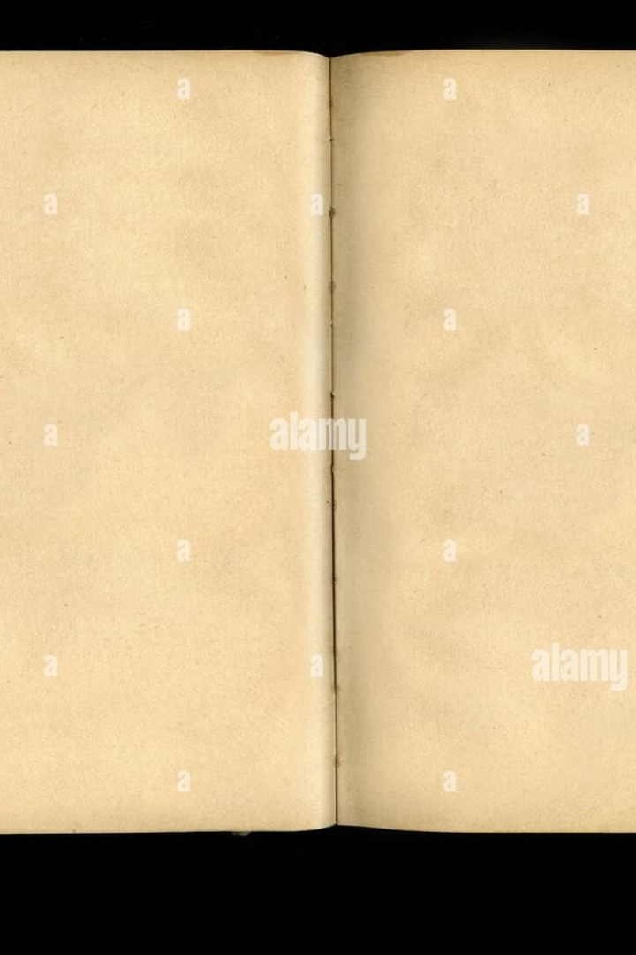
Enhancing Readability of Historical Manuscripts Using Image Processing
This presentation explores a comprehensive approach to enhancing the readability of historical manuscripts using image processing techniques. We'll delve into the challenges posed by degraded documents, the framework we employ to address these issues, and the metrics used to evaluate the effectiveness of our approach.

Slide 2
Problem Statement
Faded Ink
Noise and Artifacts
Low Contrast
Over time, ink can fade, making it difficult to decipher text.
Damaged paper, stains, and other imperfections can obscure the text.
Poor lighting conditions and variations in ink density can make it hard to distinguish characters.

Slide 3





Framework: Image Processing Pipeline
Noise Reduction (Gaussian Blur)
Contrast Enhancement (CLAHE)
Adaptive Thresholding
Converts the image to a binary format by applying a threshold to each pixel.
Reduces noise and smooths out irregularities in the image.
Improves overall contrast by enhancing local regions of the image.
Morphological Cleaning
Sharpening and Normalization
Removes small artifacts and irregularities to clean up the binary image.
Enhances edges and improves the clarity of characters.

Slide 4
Steps Involved
Load Image
1
Read the image from the file system.
2
Convert to Grayscale
Convert the image to grayscale for better processing.
Gaussian Blur
3
Apply a Gaussian filter to reduce noise and smooth the image.
4
Apply CLAHE
Enhance contrast using the Contrast Limited Adaptive Histogram Equalization (CLAHE) method.
Adaptive Thresholding
5
Apply a threshold to each pixel to create a binary image.
6
Morphological Cleaning
Remove small artifacts and irregularities from the image.
Sharpening & Normalization
7
Sharpen edges and normalize the image to improve character clarity.

Slide 5
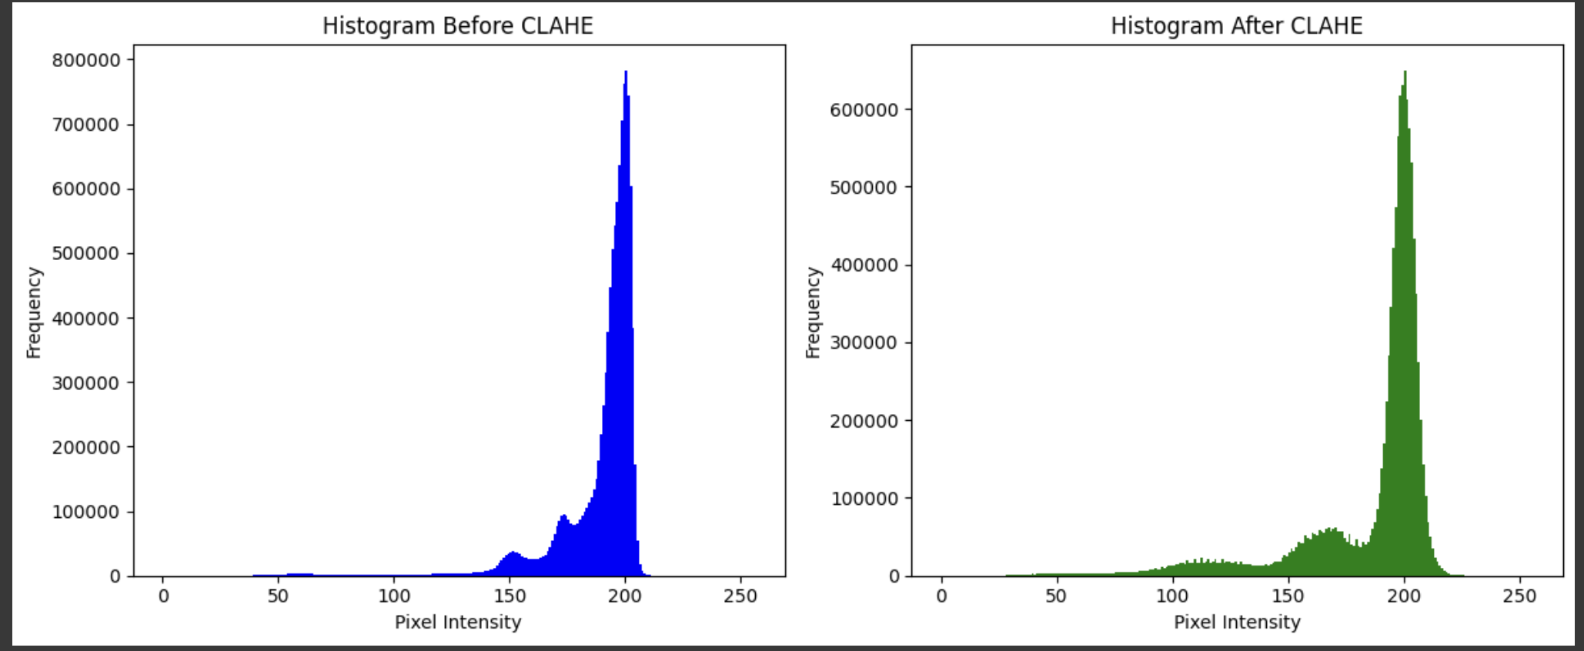
Histogram Analysis
Before Processing
After Processing
Original image histogram shows low contrast and spread of pixel values, indicative of degraded quality.
Enhanced image histogram shows a wider distribution of pixel values, resulting in higher contrast and better readability.

Slide 6
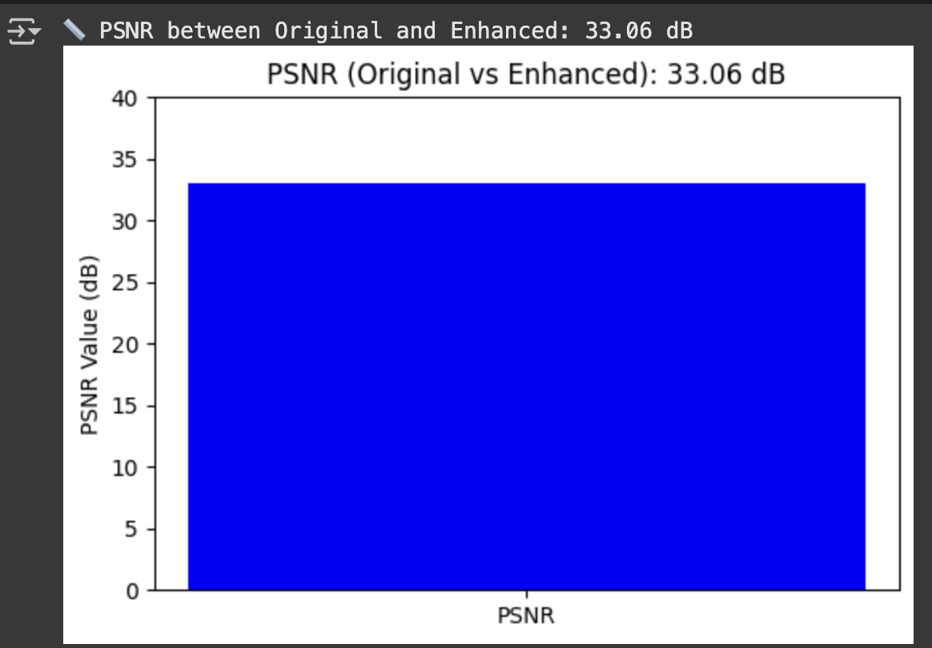
Peak Signal-to-Noise Ratio (PSNR)
PSNR is a measure of the quality of reconstructed images compared to the original image. Higher PSNR values indicate a better quality image with less noise and distortion.

Slide 7
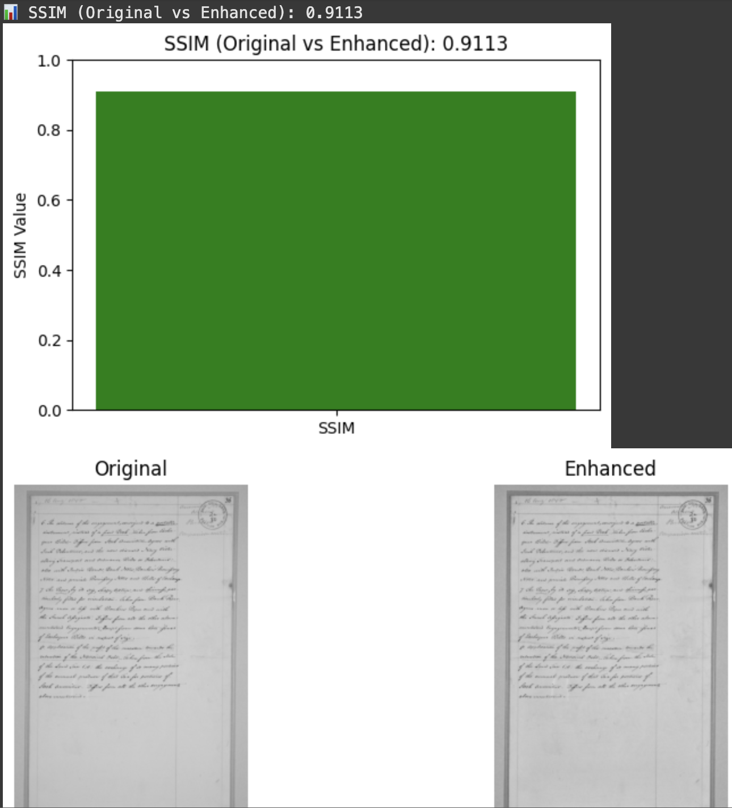
Structural Similarity Index (SSIM)
SSIM evaluates the structural similarity between two images, taking into account luminance, contrast, and structure. An SSIM value close to 1 indicates high similarity between the enhanced and original images, signifying successful preservation of structural information.

Slide 8
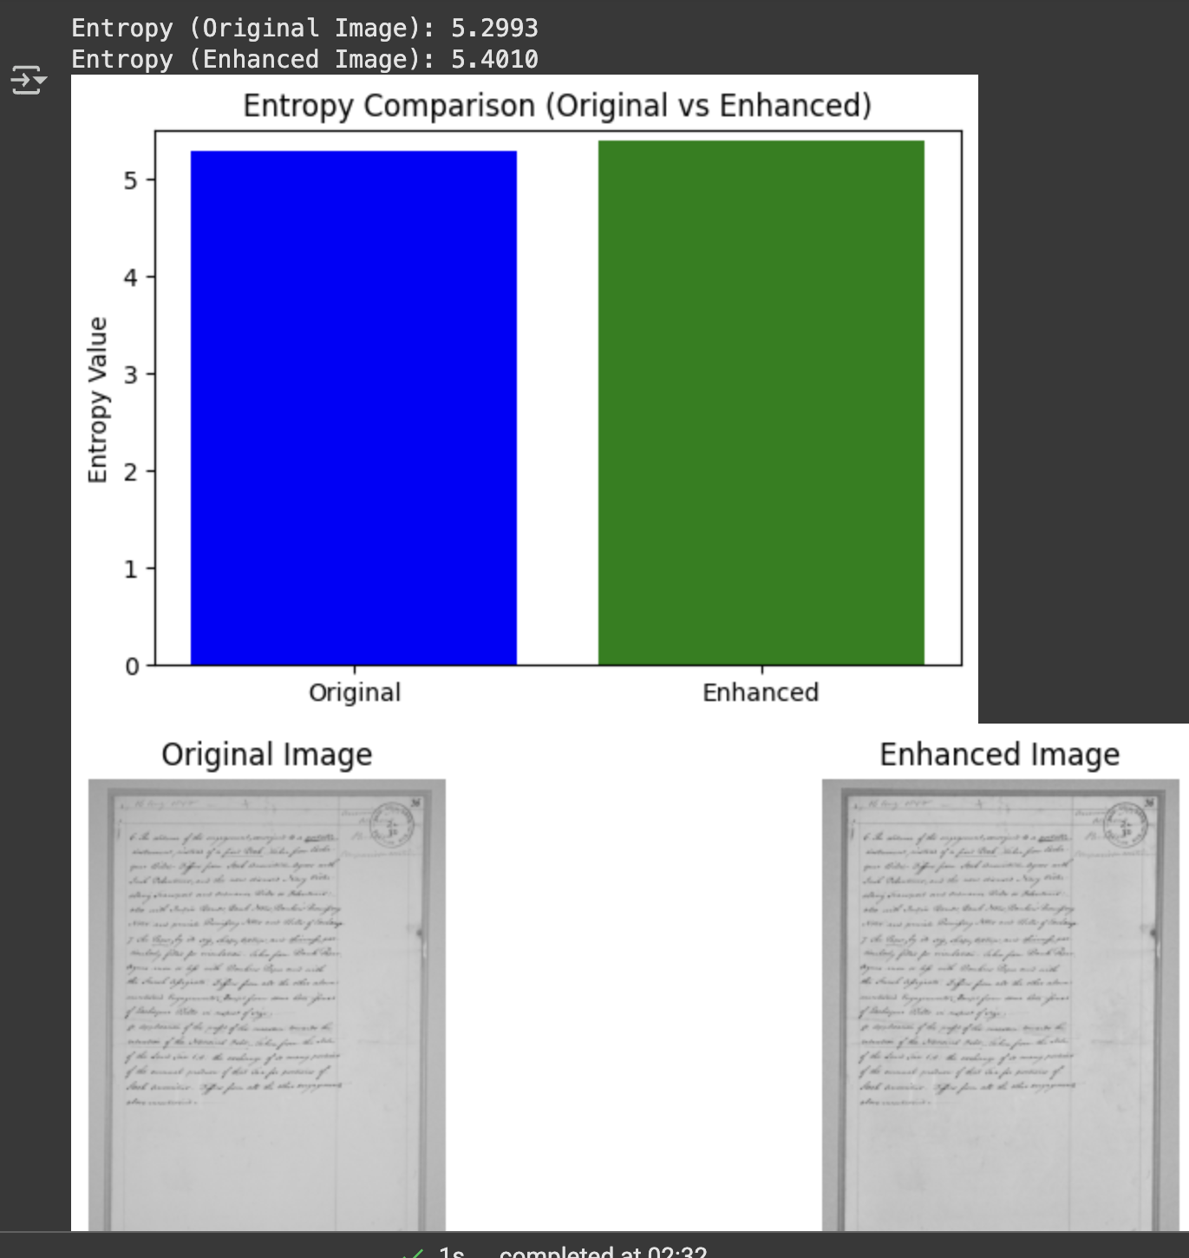
Entropy: Information Content
Entropy measures the randomness or complexity of an image. Higher entropy values indicate a greater amount of information contained within the image, demonstrating the effectiveness of our approach in preserving and enhancing details.

Slide 9
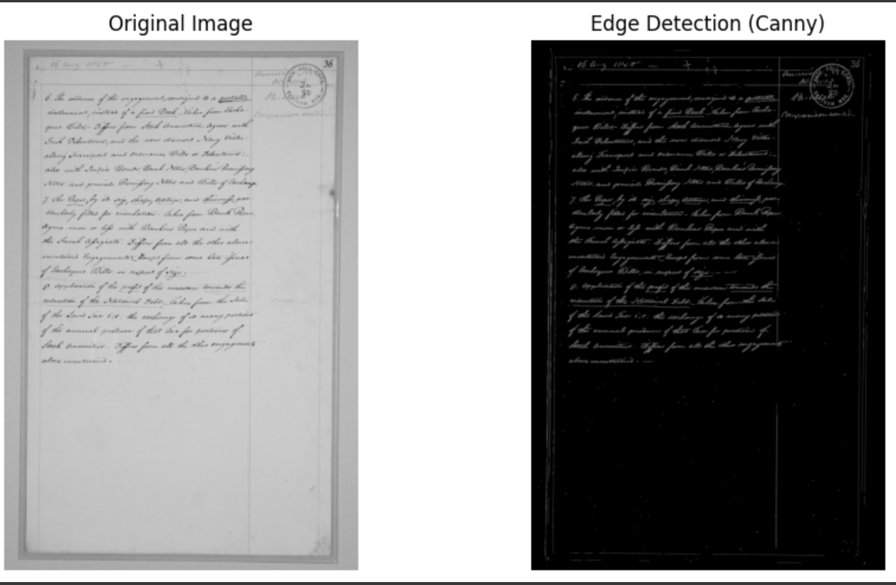
Edge Detection: Character Recognition
Edge detection is a crucial step in character recognition. By highlighting edges, we can effectively segment characters from the background, enabling accurate recognition and transcription of the text.

Slide 10
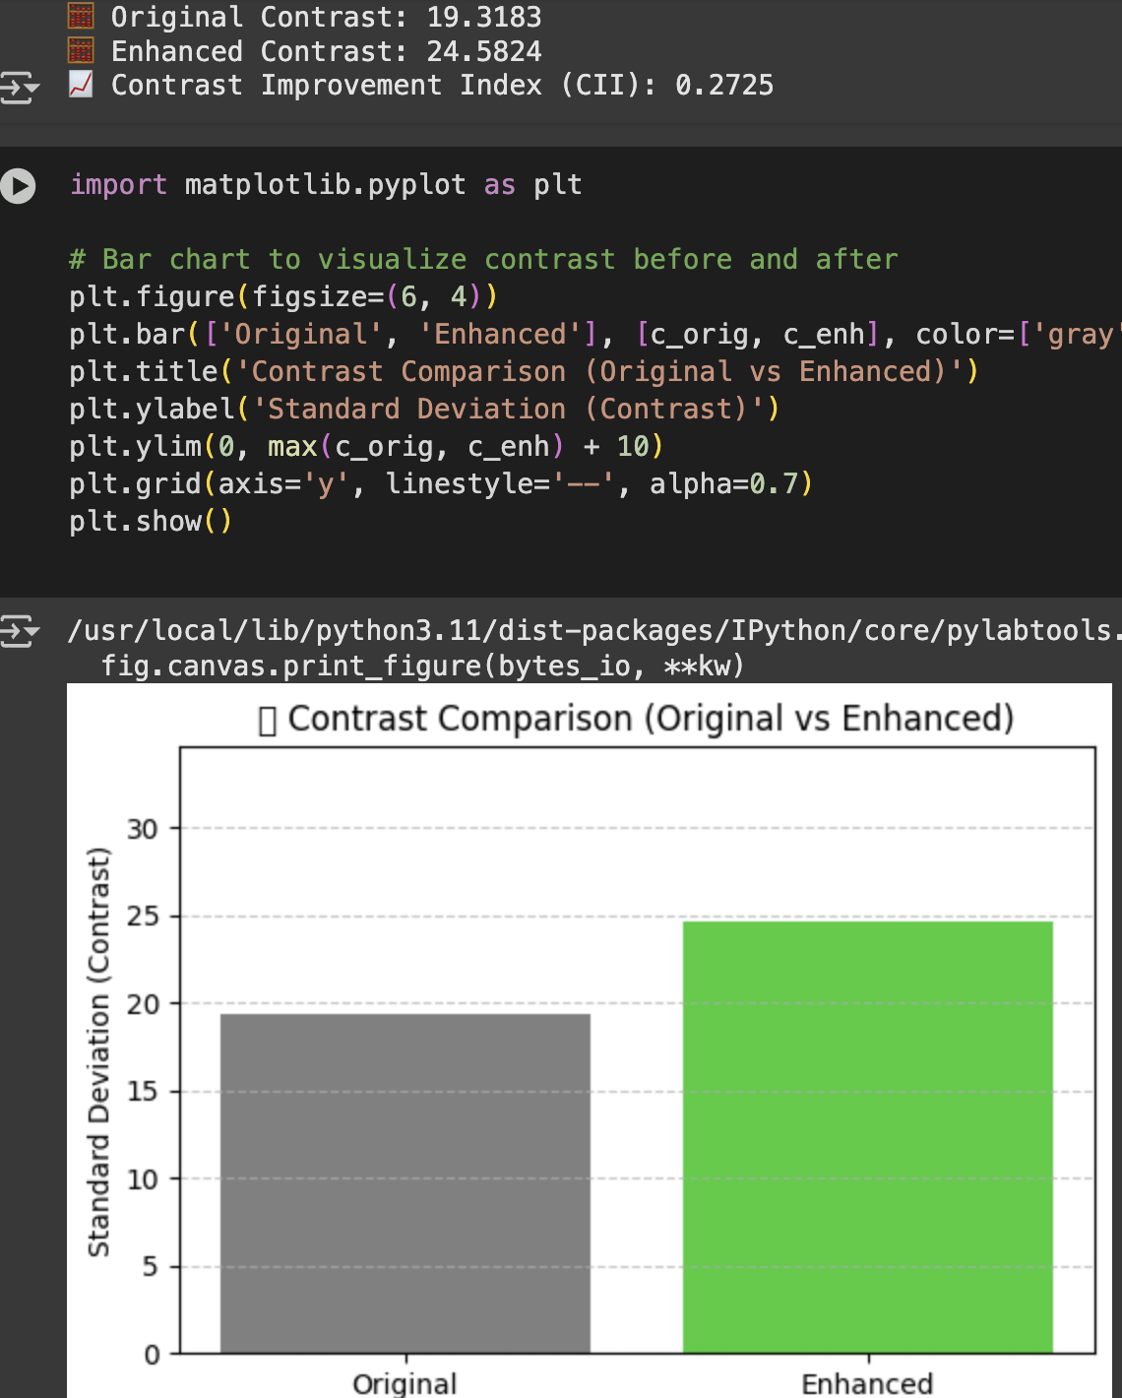
Contrast Improvement Index (CII)
CII quantifies the improvement in contrast achieved by our image processing methods. Higher CII values indicate a greater degree of contrast enhancement, leading to more readable text.

