Slide 1





Data Versioning and reproducible ML in Jupyter Notebook using DVC, Feast, Papermill and MLflow

Slide 2
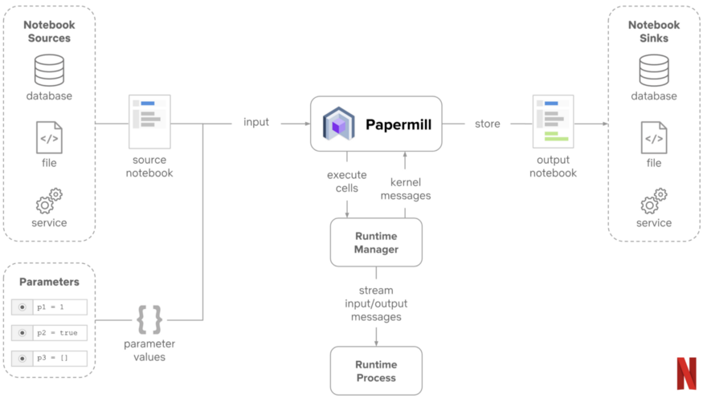
Papermill is a library for parameterizing, executing, and analyzing Jupyter notebooks. With it, you can spawn multiple notebooks with different parameter sets and execute them concurrently. Papermill can also help collect and summarize metrics from a collection of notebooks.
A parameterized notebook is a notebook which allows you to specify parameters in your code and accept input values at runtime. This provides an excellent mechanism for users to define notebooks as reusable templates.
Papermill doesn’t modify the source notebook, we get a functional property added to our definition of work
Sample Executor:
Papermill
//input/notebook/location/notebook_file.ipynb
//output/notebook/location/${timestamp}_notebook_file_fr.ipynb
-p param1 value1
Reference: https://netflixtechblog.com/scheduling-notebooks-348e6c14cfd6

Slide 3
ML Problem Statement
What we need to track in Data science project to be
able to reproduce the results
Data Versioning Usecase
Data Beyond Data Science
Dataset
Tabular
Images, Videos, Sound etc.
Code
Functionality, Hyper-parameter
Data pre-processing, modelling
Results
Metadata(metrics, params)
plots
Environment
Dependencies
Data engineering during data cleaning and data preparation.
Test data in software engineering to assure the functionality of the software.
Development and testing the database application.
Classical DV solution and there downsides
Classical Software engineering tools are not enough to solve Ml reproducibility crisis
GIT
GIT-LFS
External Storage

Slide 4
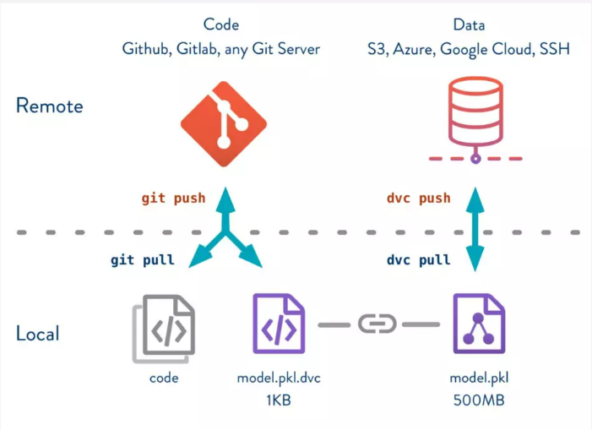
What is DVC?
Git like Data version control for ML Projects
dvc and git
git: version code, small files
dvc: version data, intermed results, models
dvc use git, w/o storing file content in repo.
Versioning and storing large files
dvc save info on data in special .dvc files
.dvc files can then be versioned using git.
actual storage happens w remote storage(S3, azure blob, Cloud storage etc.)
dvc supports many remote storage types
dvc main features
data versioning
data access
data pipelines

Slide 5
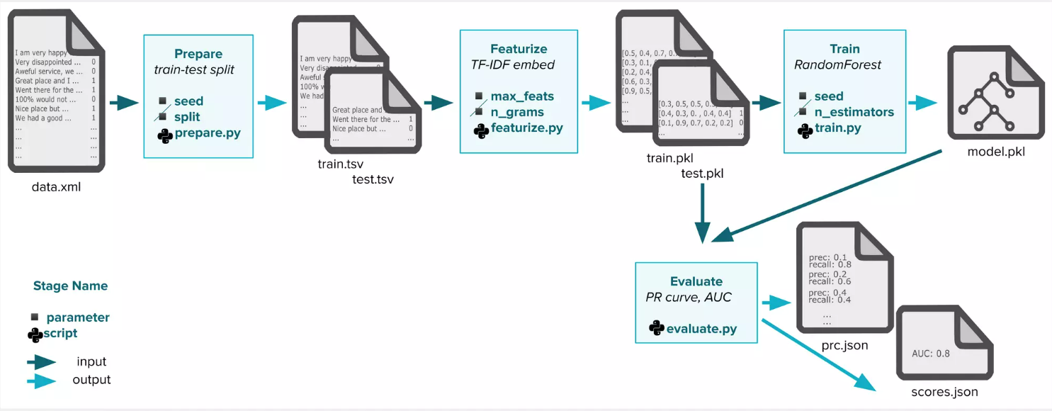
Data Pipeline:
How is data filtered, transformed, or used to train ML models?

Slide 6
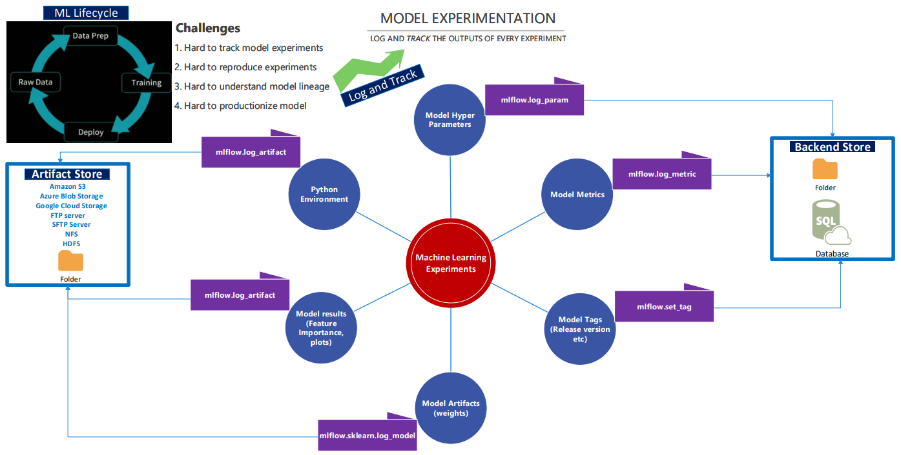
Mlflow-Model lifecycle management:
Model governance and experimentation

Slide 7


Feature difference between MLFLOW and DVC
Feature | MLFLOW | DVC
Versioning ML Model
Versioning dataset
Versioning ML Pipelines
Connecting data and code | Manual only
Tracking metrics |  | Final metric only
Visualise metrics
Model registry
UI
Dependencies | Model env dependencies (packages, etc)

Slide 8
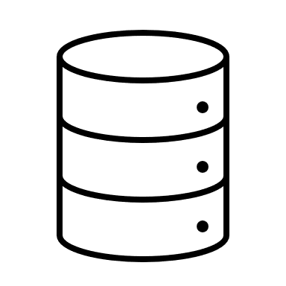
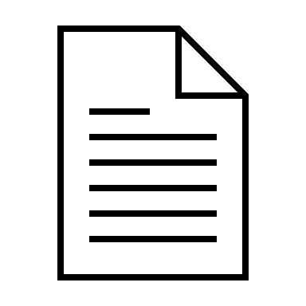
MLOPs: DVC-Papermill-Feast-Mlflow-Jupyter Notebook
1: dvc pipeline contains the dag details like cmd, input, output and dependencies.
2: papermill: it takes the parameters from params.yaml file and pass to notebook for its execution.
3: data ingestion: it takes the data from source location for processing.
4: Feature engineering & Feast: the feature are stored in feast with its record it and event timestamp.
5: Feast & modelling: the feature which is required for modelling is pulled and model is been trained.
6: Mlflow: All the meta data and artifacts and models are stored in mlflow in local for validation and comparison.
DVC Pipeline DAG
2
4
5
params.yaml
Data Ingestion
Feature engineering
Model Building
6
1
3
dvc.yaml
Metadata store

