Slide 1
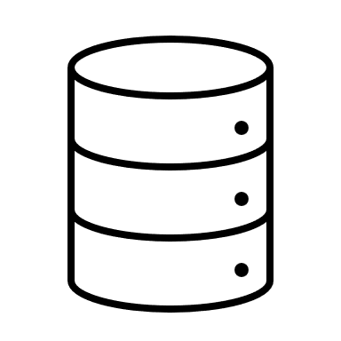

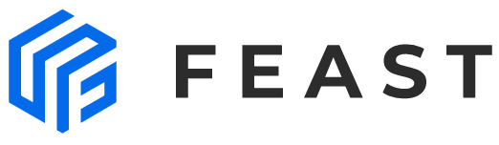
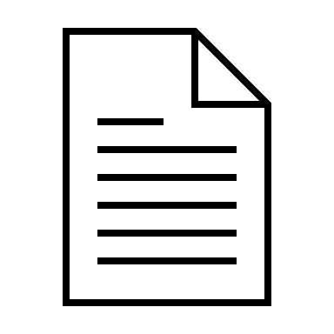



MLOPs: DVC-Papermill-Feast-Mlflow-Jupyter Notebook
1: dvc pipeline contains the dag details like cmd, input, output and dependencies.
2: papermill: it takes the parameters from params.yaml file and pass to notebook for its execution.
3: data ingestion: it takes the data from source location for processing.
4: Feature engineering & Feast: the feature are stored in feast with its record it and event timestamp.
5: Feast & modelling: the feature which is required for modelling is pulled and model is been trained.
6: Mlflow: All the meta data and artifacts and models are stored in mlflow in local for validation and comparison.
DVC Pipeline DAG
2
4
5
params.yaml
Data Ingestion
Feature engineering
Model Building
6
1
3
dvc.yaml
Metadata store

