Slide 1
Guiding Opinions on Regulating the Asset Management Business of Financial Institutions
Regulatory Principles
unified standard
behavioral regulation
look-through regulation
integrated statistics
non-retroactive
Regulatory Objects
Asset Management Business
off-balance sheet operations of financial institutions
Asset Management Product
funding method: public and private
investment nature: fixed income, equity, hybrid, etc.
mode of operation: open, closed
Regulatory Requirement
Remove Rigidity in Cash
broadly defined
ban on in-balance sheet asset management
investor suitability
net asset management
categorized penalties
complaints and reports
Remove Nesting
back to the essence of asset management
prohibition of multi-layer nesting
Licensing Management
franchising
intelligent investment
distributor qualifications
Deleveraging
debt leverage
graded leverage
prohibition of pledge financing
De-pooling
three-order requirement
duration management
prohibition of limits and mismatches

Slide 2
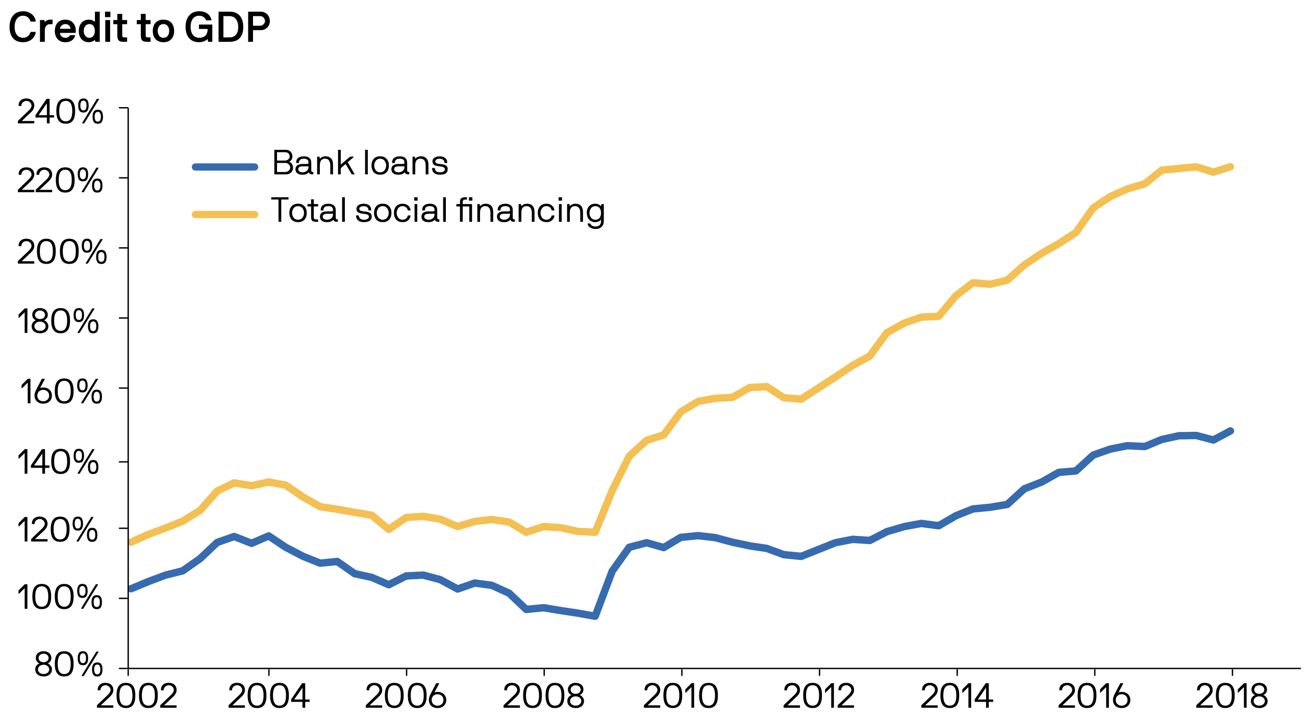
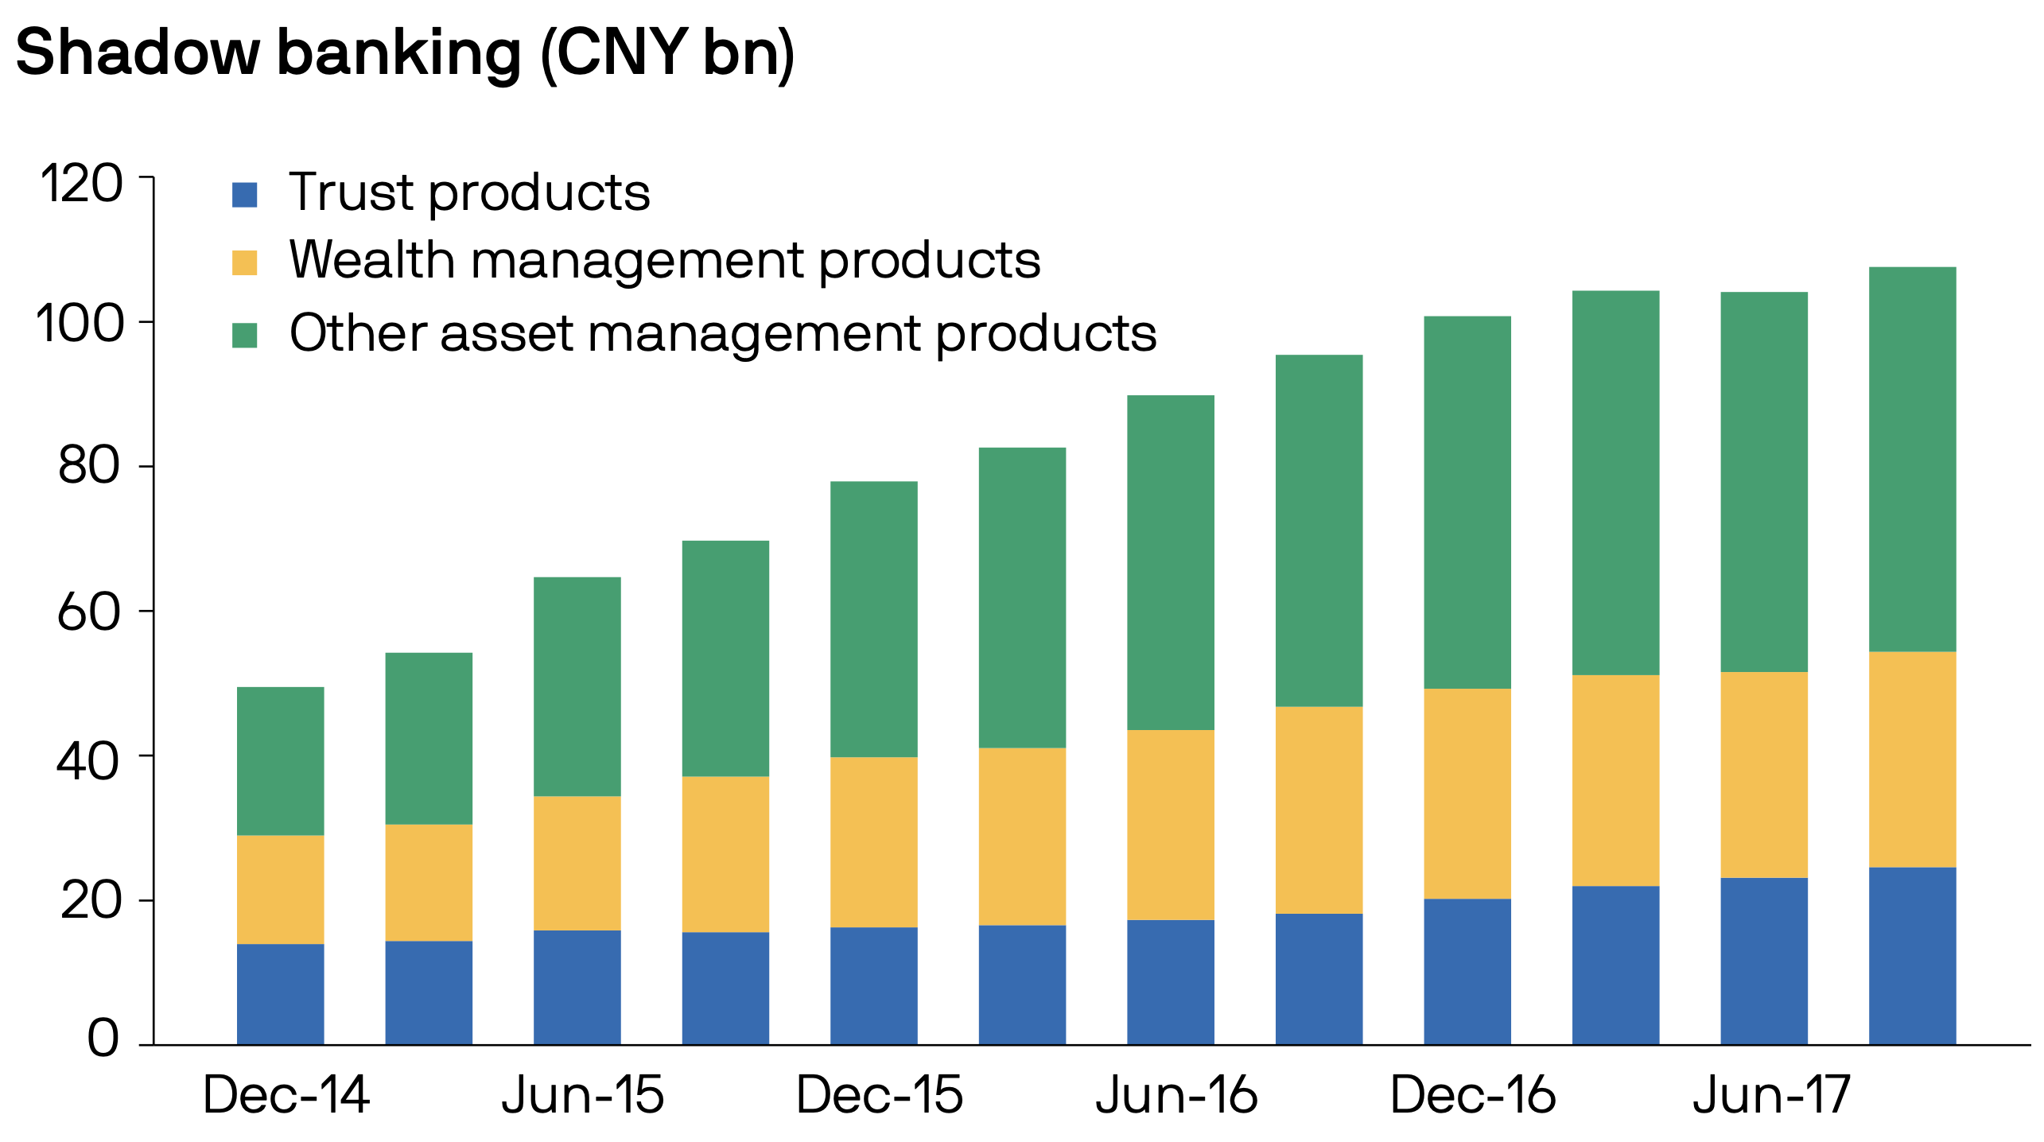

Slide 3
The Involving Way of Commercial Banks 🏦
Part 1. Transformation of financial products into net worth.
table returns
marketable disposals
new product takeovers
Part 2. Risk control and product system simplification.
Simplify the product system, reduce nesting, and enhance product penetration by the requirements of the new asset management regulations.
Part 3. Establishment of asset management subsidiary.
Transferring its stock of asset management business to asset management subsidiaries.
Bank wealth management subsidiaries also issued some new products, with stock transformation and new issuance going in parallel.

