Slide 1
Stock Market: Two Innovative Monetary Policy Tools 💵
SFISF: Supporting eligible institutions to obtain liquidity from the central bank through asset pledges, with an initial swap facility operation of 500 billion yuan.
(I will focus on analyzing this policy)
LFSBIS: Guiding commercial banks to provide loans to listed companies and major shareholders to support the repurchase and increase the shareholding of listed companies, with an initial amount of 300 billion yuan.
Money Market 💰
Real Estate Market 🏠
Volume Increase: RRR cut by 50 bp, releasing liquidity of around 1 trillion, with a possible second cut of 25-50 bp in 2024.
Price Decrease: 7-day reverse repo rate cut by 20bp to 1.5%, MLF rate cut by 30bp to 2.0%, LPR and deposit rate cut by 20~25bp.
Reducing interest rates on stock mortgages to near the rate for new originations, expected to average about 0.5%.
Lowering the minimum down payment ratio for second-suite loans from 25% to 15%.
The proportion of central bank funding support in the previously created 300 billion yuan guaranteed housing refinancing will be increased from 60% to 100%.
Extension of phased policies on the roll-over of inventory financing for real estate enterprises and loans for operating properties until the end of 2026.
PBOC Sept. 24th
Monetary Easing Package

Slide 2
Treasury bonds and central bank bills
Treasury bonds and central bank bills
PBOC
Securities, Funds and Insurance Companies
Secondary Market
Bonds, Stock ETFs and CSI 300 stocks
Special Funding 💰
Stock 💵
Special Funding 💰
Part 1. Swap Operation
Part 2. Institutional Financing
Part 3. Institutional Investment
Stock Market

Slide 3
PBOC
NBFIs: Securities, Funds and Insurance Companies
Secondary Market
Conversion 1: Pledge for high-quality and high-liquidity assets
Get Liquidity (500 Billion) and Buy Stock
Conversion 2: Repurchase access to special funding
Stock Market
Liquidity Effects
The first product created by the PBOC specifically for the development of asset capital markets.
The rapid implementation of SFISF shows positive signals, which is helpful to boost the confidence of the capital market.
Consolidating the bottom area of the capital market since 9.24.
Policy Effects

Slide 4
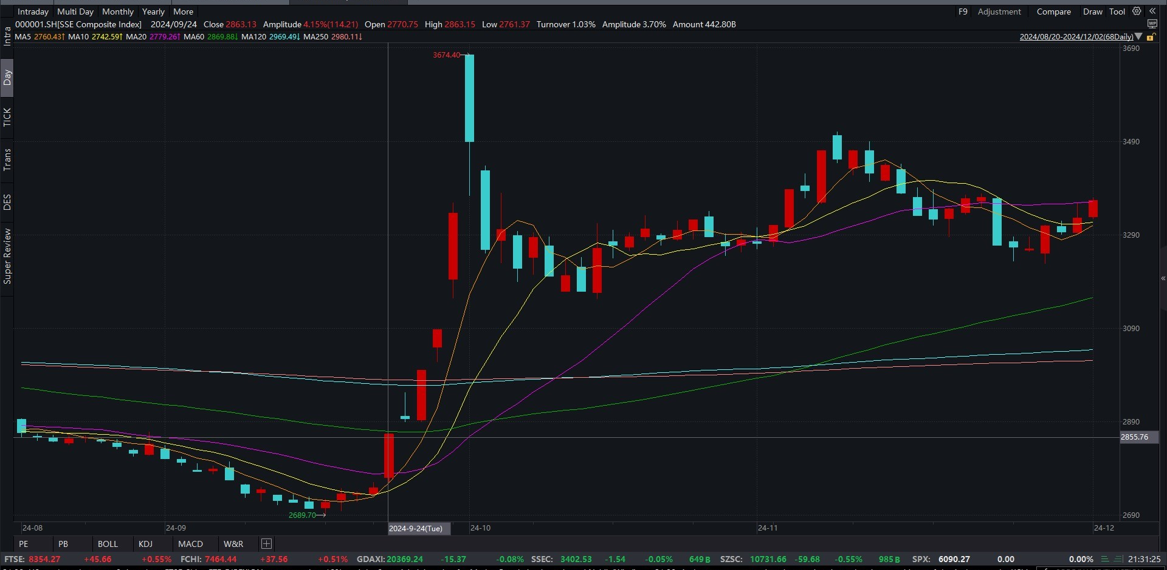
10.10 Creation of SFISF
10.22 & 23
First Operation Works
10.18 Issue a circular
9.24 Announcing Monetary
Easing Package
The market continued to be sluggish.
Short-term effects are clear.
Long-term effects remain to be seen.

