Slide 1
USD Billion
USD Billion

Slide 2
Q1. Details and evaluation of 2015 foreign exchange reforms
Details of 2015 foreign exchange reforms.
Some specific impacts of the reforms.
Analysis based on the first trade war.
Q3. Foreign exchange market regulation comparison
Compare the relevant policies and draw references from them. Especially focus on the strength of the US and HK, and the shortcoming of CHINA.
The Reforms Proposal
Q2. Changes for regulatory agencies: for PBOC, NFRA and the CSRC
Q4. Reforms for financial regulation
Q5. Reforms to make Chinese capital markets more efficient and safer

Slide 3
China’s Official Foreign Exchange Reserves
(USD Hundred Million)
Grew Steadily
Sharp Decline
Reserve Stabilized

Slide 4
Dollar Linked
Broad Depreciation
Broad Basket Peg

Slide 5
2016
2024

Slide 6
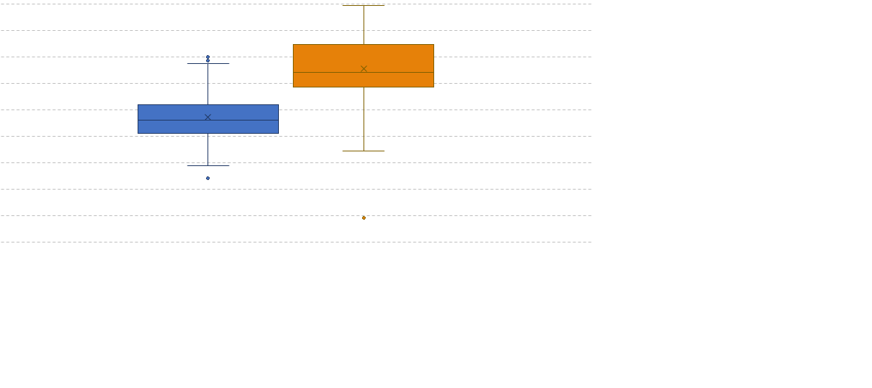
Trade balance (RMB hudred million)
Pre-2015 Policy
Post-2015 Policy

