Slide 1

1
INTRODUCTION TO FINANCIAL STATEMENTS
Financial Accounting, Sixth Edition

Slide 2
Study Objectives
Describe the primary forms of business organization.
Identify the users and uses of accounting information.
Explain the three principal types of business activity.
Describe the content and purpose of each of the financial statements.
Explain the meaning of assets, liabilities, and stockholders’ equity, and state the basic accounting equation.
Describe the components that supplement the financial statements in an annual report.

Slide 3

Introduction to Financial Statements
Forms of Business Organization
Users and Uses of Financial Information
Business Activities
Communicating with Users
Sole proprietorship
Partnership
Corporation
Internal users
External users
Ethics in financial reporting
Financing
Investing
Operating
Income statement
Retained earnings statement
Balance sheet
Statement of cash flows
Interrelationships of statements
Other elements of an annual report

Slide 4
Forms of Business Organization
Proprietorship
Partnership
Corporation
Generally owned by one person
Simple to establish
Owner controlled
Tax advantages
Simple to establish
Shared control
Broader skills and resources
Tax advantages
Easier to transfer ownership
Easier to raise funds
No personal liability
SO 1 Describe the primary forms of business organization.

Slide 5
Users and Uses of Financial Information
Who Uses Accounting Data
External Users
Internal Users
Human Resources
Taxing Authorities
Labor Unions
Finance
Management
Customers
Creditors
Marketing
Regulatory Agencies
Investors
SO 2 Identify the users and uses of accounting information.

Slide 6
Users and Uses of Financial Information
Questions Asked by Internal Users
User
1. Can we afford to give our employees a pay raise?
Human Resources
What price for our product will maximize net income?
Marketing
3. Which product line is most profitable?
Management
4. Is cash sufficient to pay dividends to the stockholders?
Finance
SO 2 Identify the users and uses of accounting information.

Slide 7
Users and Uses of Financial Information
Questions Asked by External Users
User
1. Is the company earning satisfactory income?
Investors
How does Disney compare in size and profitability with Time Warner?
Investors
Will United Airlines be able to pay its debts as they come due?
Creditors
SO 2 Identify the users and uses of accounting information.

Slide 8
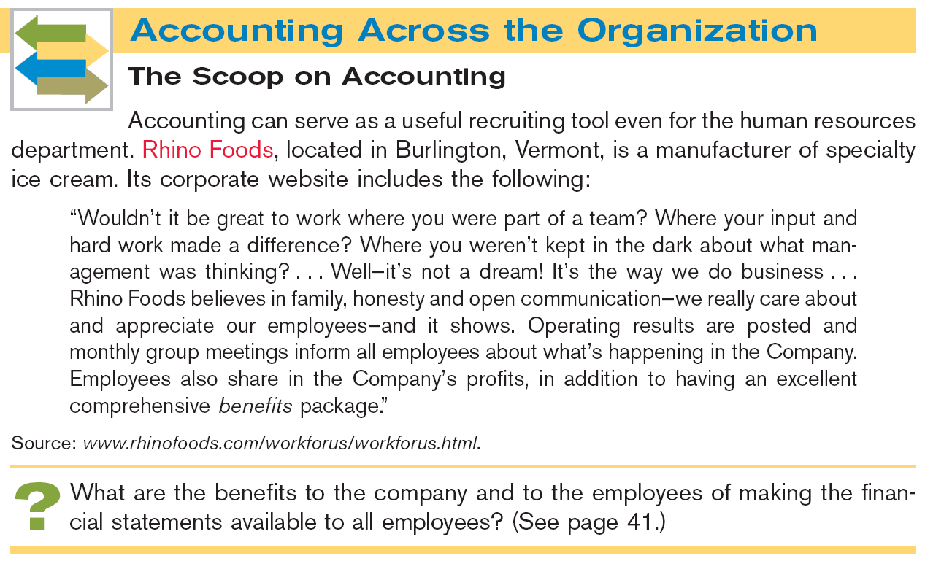


Slide 9
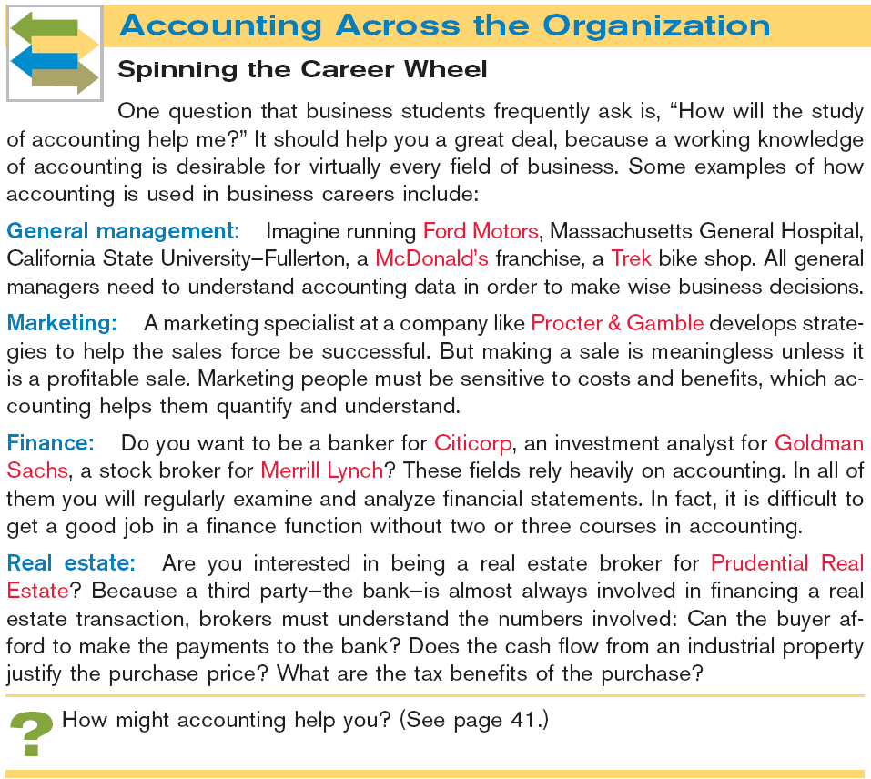

Slide 10
Users and Uses of Financial Information
Ethics In Financial Reporting
United States regulators and lawmakers were very concerned that the economy would suffer if investors lost confidence in corporate accounting because of unethical financial reporting.
  Recent financial scandals include: Enron, WorldCom, HealthSouth, AIG, and others.
  Congress passed Sarbanes-Oxley Act of 2002.
  Effective financial reporting depends on sound ethical behavior.
SO 2 Identify the users and uses of accounting information.

Slide 11
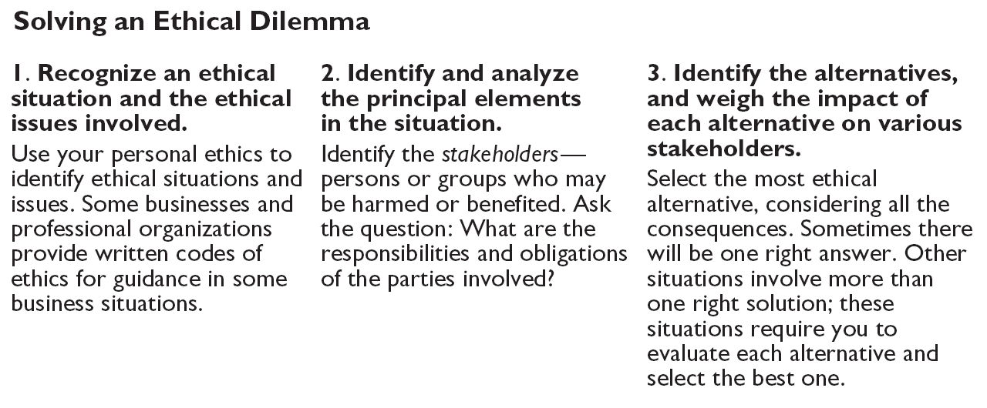
Users and Uses of Financial Information
Illustration 1-3
Steps in analyzing ethics cases
SO 2 Identify the users and uses of accounting information.

Slide 12
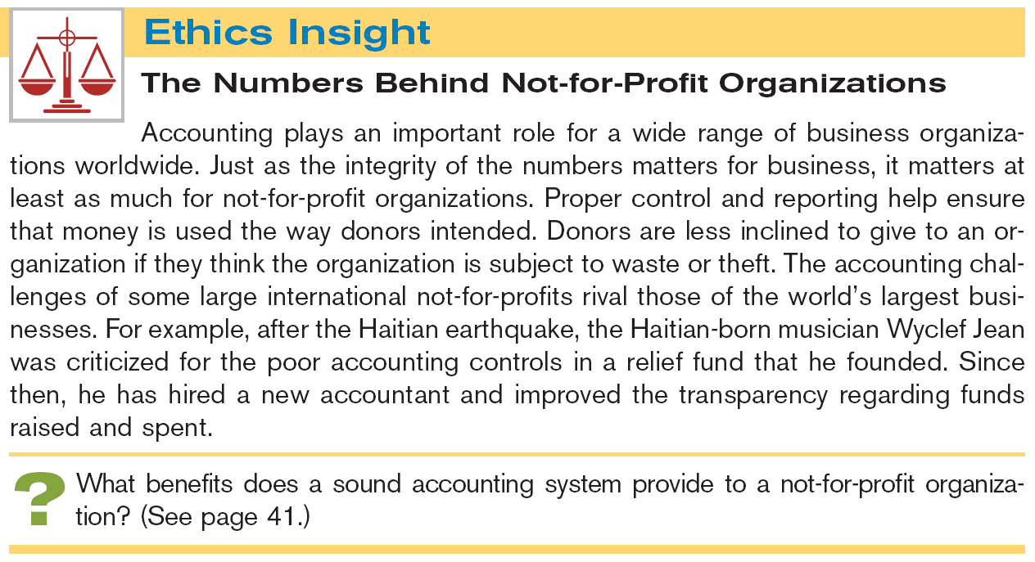


Slide 13
Users and Uses of Financial Information
Question
Which of the following did not result from the Sarbanes-Oxley Act?
  Top management must now certify the accuracy of financial information.
  Penalties for fraudulent activity increased.
  Independence of auditors increased.
  Tax rates on corporations increased.
SO 2 Identify the users and uses of accounting information.

Slide 14
Business Activities
All businesses are involved in three types of activity —
  financing,
  investing,
  and operating.
The accounting information system keeps track of the results of each of these business activities.
SO 3 Explain the three principal types of business activity.

Slide 15
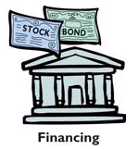
Business Activities
Financing Activities
Two primary sources of outside funds are:
  Borrowing money
    Amounts owed are called liabilities.
    Party to whom amounts are owed are creditors.
    Notes payable and bonds payable are different type of liabilities.
  Issuing shares of stock for cash.
    Payments to stockholders are called dividends.
SO 3 Explain the three principal types of business activity.

Slide 16
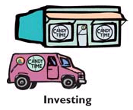
Business Activities
Investing Activities
Purchase of resources a company needs to operate.
  Computers, delivery trucks, furniture, buildings, etc.
  Resources owned by a business are called assets.
SO 3 Explain the three principal types of business activity.

Slide 17

Business Activities
Operating Activities
Once a business has the assets it needs, it can begin its operations.
  Revenues - Amounts earned from the sale of products (sales revenue, service revenue, and interest revenue).
  Inventory - Goods available for sale to customers.
  Accounts receivable - Right to receive money from a customer,in the future, as the result of a sale.
SO 3 Explain the three principal types of business activity.

Slide 18
Business Activities
Operating Activities
  Expenses - cost of assets consumed or services used. (cost of goods sold, selling, marketing, administrative, interest, and income taxes expense).
  Liabilities arising from expenses include accounts payable, interest payable, wages payable, sales taxes payable, and income taxes payable.
  Net income – when revenues exceed expenses.
  Net loss – when expenses exceed revenues.
SO 3 Explain the three principal types of business activity.

Slide 19
Communicating with Users
Companies prepare four financial statements from the summarized accounting data:
Balance Sheet
Income Statement
Retained Earnings Statement
Statement of Cash Flows
SO 4 Describe the content and purpose of each of the financial statements.

Slide 20
Communicating with Users
Review Question
Net income will result during a time period when:
  assets exceed liabilities.
  assets exceed revenues.
  expenses exceed revenues.
  revenues exceed expenses.
SO 4 Describe the content and purpose of each of the financial statements.

Slide 21
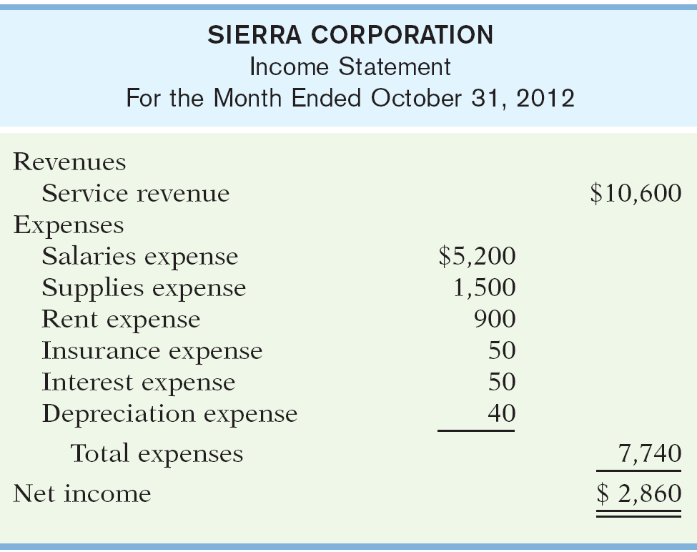
Communicating with Users
Income Statement
Reports revenues and expenses for a specific period of time.
Net income – revenues exceed expenses.
Net loss – expenses exceed revenues.
Past net income provides information for predicting future net income.
Illustration 1-4
SO 4 Describe the content and purpose of each of the financial statements.

Slide 22
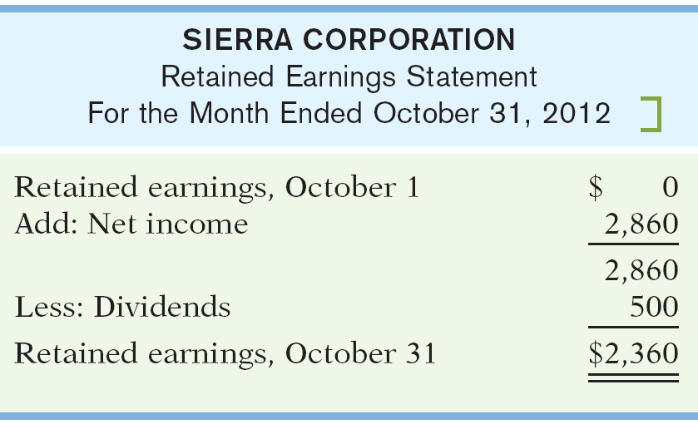
Communicating with Users
Retained Earnings Statement
Income Statement
Illustration 1-4
Illustration 1-5
Net income is needed to determine the ending balance in retained earnings.
SO 4 Describe the content and purpose of each of the financial statements.

Slide 23
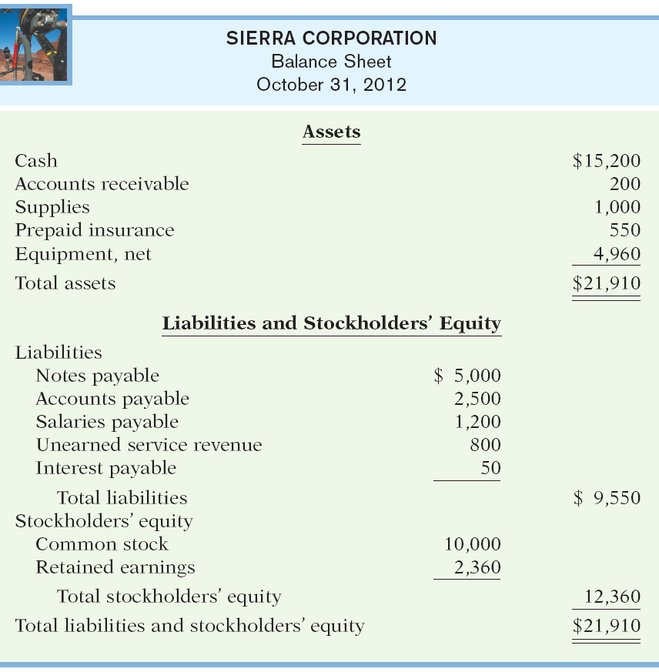

Slide 24
Communicating with Users
Retained Earnings Statement
Statement shows amounts and causes of changes in retained earnings during the period.
Time period is the same as that covered by the income statement.
Users can evaluate dividend payment practices.
Illustration 1-5
SO 4 Describe the content and purpose of each of the financial statements.

Slide 25
Communicating with Users
Balance Sheet
Retained Earnings Statement
Illustration 1-7
Illustration 1-5
Ending balance in retained earnings is needed in preparing the balance sheet.
SO 4 Describe the content and purpose of each of the financial statements.

Slide 26
Communicating with Users
Balance Sheet
Illustration 1-7
Reports assets and claims to assets at a specific point in time.
Assets = Liabilities + Stockholders’ Equity.
Lists assets first, followed by liabilities and stockholders’ equity.
SO 5 Explain the meaning of assets, liabilities, and stockholders’ equity, and state the basic accounting equation.

Slide 27
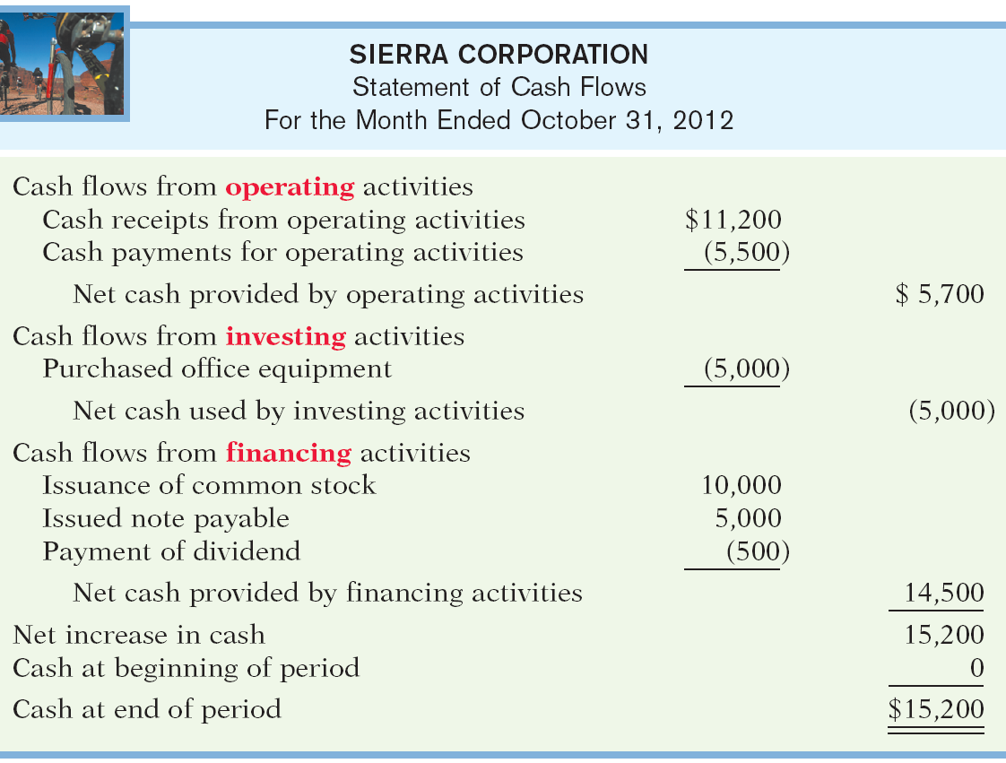
Communicating with Users
Balance Sheet
Statement of Cash Flows
Illustration 1-7
Illustration 1-8
SO 5 Explain the meaning of assets, liabilities, and stockholders’ equity, and state the basic accounting equation.

Slide 28
Communicating with Users
Statement of Cash Flows
Answers:
  Where did cash come from during the period?
  How was cash used during the period?
  What was the change in the cash balance during the period?
Illustration 1-8
SO 5 Explain the meaning of assets, liabilities, and stockholders’ equity, and state the basic accounting equation.

Slide 29
Communicating with Users
Review Question
Which of the following financial statements is prepared as of a specific date?
  Balance sheet.
  Income statement.
  Retained earnings statement.
  Statement of cash flows.
SO 5 Explain the meaning of assets, liabilities, and stockholders’ equity, and state the basic accounting equation.

Slide 30
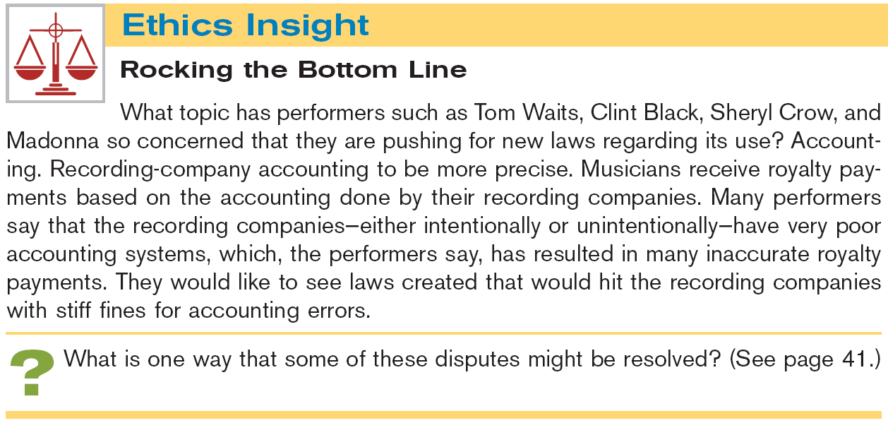


Slide 31
Other Elements of an Annual Report
U.S. companies that are publicly traded must provide shareholders with an annual report.
The annual report always includes:
  Financial statements.
  Management discussion and analysis.
  Notes to the financial statements.
  Independent auditor's report.
SO 6 Describe the components that supplement the financial statements in an annual report.

Slide 32
Other Elements of an Annual Report
Management’s Report
Management discussion and analysis (MD&A) covers the companies ability to pay near-term obligations, its ability to fund operations and expansion, and its results of operations.
Management must highlight favorable or unfavorable trends and identify significant events and uncertainties that affect these three factors.
SO 6 Describe the components that supplement the financial statements in an annual report.

Slide 33
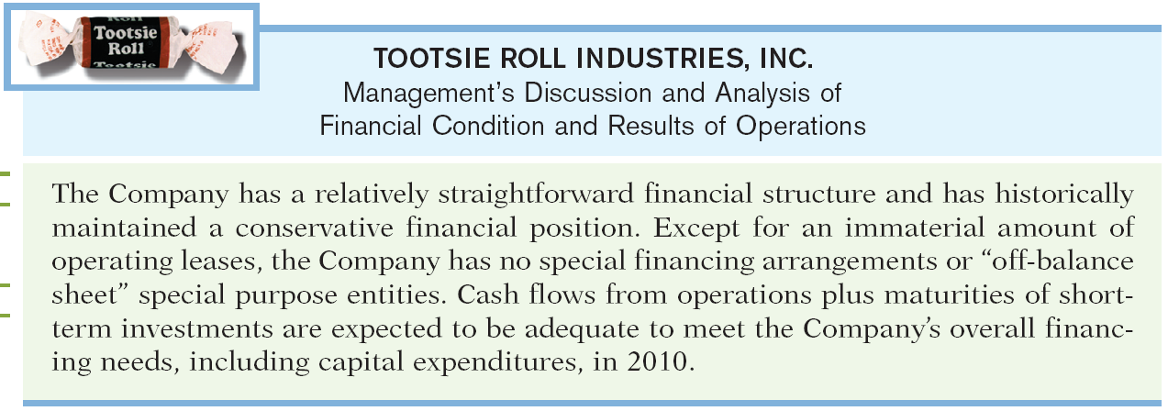
Other Elements of an Annual Report
Management’s Report
Illustration 1-10
SO 6 Describe the components that supplement the financial statements in an annual report.

Slide 34
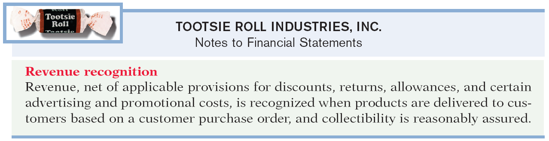
Other Elements of an Annual Report
Notes to the Financial Statements
  Clarify the financial statements.
  Provide additional detail.
Notes are essential to understanding a company’s operating performance and financial position.
Illustration 1-11
SO 6 Describe the components that supplement the financial statements in an annual report.

Slide 35
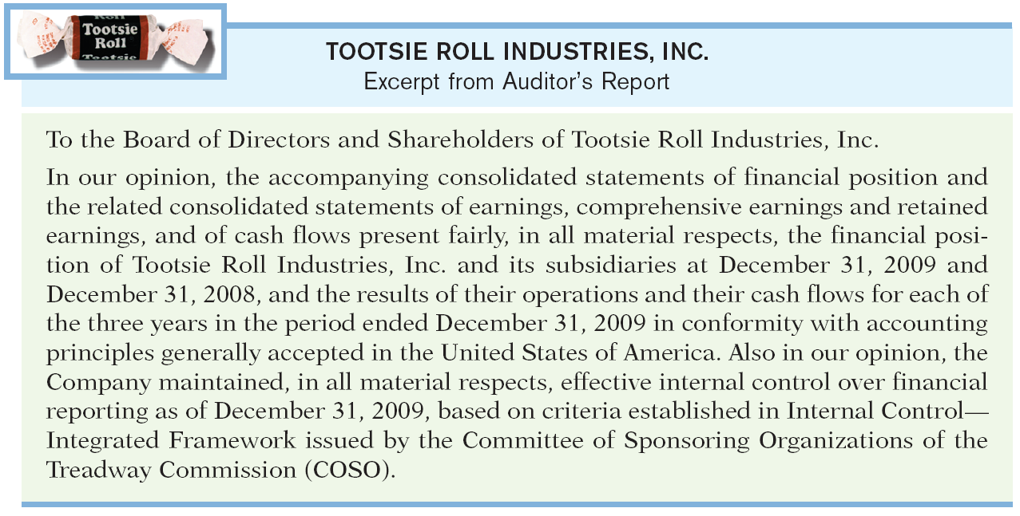
Other Elements of an Annual Report
Auditor’s Report
Auditor’s opinion as to the fairness of the presentation of the financial position and results of operations and their conformance with generally accepted accounting standards.
Illustration 1-12
SO 6

Slide 36

Other Elements of an Annual Report
State whether each of the following items is most closely associated with the management discussion and analysis (MD&A), the notes to the financial statements, or the auditor’s report.
Descriptions of significant accounting policies: Notes
Unqualified opinion: Auditor’s report
Explanations of uncertainties and contingencies: Notes
Description of ability to fund operations and expansion: MD&A
Description of results of operations: MD&A
Certified Public Accountant (CPA): Auditor’s report
SO 6 Describe the components that supplement the financial statements in an annual report.

Slide 37

Key Points
        International standards referred to as International Financial Reporting Standards (IFRS), are developed by the International Accounting Standards Board (IASB).
        The United States and the international standard-setting environment are primarily driven by meeting the needs of investors and creditors.
        The internal control standards applicable to Sarbanes-Oxley (SOX) apply only to large public companies listed on U.S. exchanges.

Slide 38
Key Points
        IFRS tends to be simpler in its accounting and disclosure requirements; some people say more “principles-based.” GAAP is more detailed; some people say more “rules-based.”
        U.S. regulators have recently eliminated the need for foreign companies that trade shares in U.S. markets to reconcile their accounting with GAAP.
        The three most common forms of business organization, proprietorships, partnerships, and corporations, are also found in countries that use IFRS.
        The conceptual framework that underlies IFRS is very similar to that used to develop GAAP.

Slide 39
Looking into the Future
        Both the IASB and the FASB are hard at work developing standards that will lead to the elimination of major differences in the way certain transactions are accounted for and reported. In fact, at one time the IASB stated that no new major standards would become effective until 2009. The major reason for this policy was to provide companies the time to translate and implement IFRS into practice, as much has happened in a very short period of time.

Slide 40
Which of the following is not a reason why a single set of high-quality international accounting standards would be beneficial?
  Mergers and acquisition activity.
  Financial markets.
  Multinational corporations.
  GAAP is widely considered to be a superior reporting system.

Slide 41
The Sarbanes-Oxley Act determines:
  international tax regulations.
  internal control standards as enforced by the IASB.
  internal control standards of U.S. publicly traded companies.
  U.S. tax regulations.

Slide 42
IFRS is considered to be more:
  principles-based and less rules-based than GAAP.
  rules-based and less principles-based than GAAP.
  detailed than GAAP.
  None of the above.

Slide 43
Copyright
“Copyright © 2011 John Wiley & Sons, Inc. All rights reserved. Reproduction or translation of this work beyond that permitted in Section 117 of the 1976 United States Copyright Act without the express written permission of the copyright owner is unlawful. Request for further information should be addressed to the Permissions Department, John Wiley & Sons, Inc. The purchaser may make back-up copies for his/her own use only and not for distribution or resale. The Publisher assumes no responsibility for errors, omissions, or damages, caused by the use of these programs or from the use of the information contained herein.”

