Slide 1

2
A FURTHER LOOK AT FINANCIAL STATEMENTS
Financial Accounting, Sixth Edition

Slide 2
Study Objectives
Identify the sections of a classified balance sheet.
Identify and compute ratios for analyzing a company’s profitability.
Explain the relationship between a retained earnings statement and a statement of stockholders’ equity.
Identify and compute ratios for analyzing a company’s liquidity and solvency using a balance sheet.
Use the statement of cash flows to evaluate solvency.
Explain the meaning of generally accepted accounting principles.
Discuss financial reporting concepts.

Slide 3

A Further Look At Financial Statements
The Classified Balance Sheet
Using the Financial Statements
Financial Reporting Concepts
Current assets
Long-term investments
Property, plant, and equipment
Intangible assets
Current liabilities
Long-term liabilities
Stockholders’ equity
Ratio analysis
Using the income statement
Using the statement of stockholders’ equity
Using a classified balance sheet
Using the statement of cash flows
The standard-setting environment
Qualities of useful information
Assumptions
Principles
Constraints

Slide 4
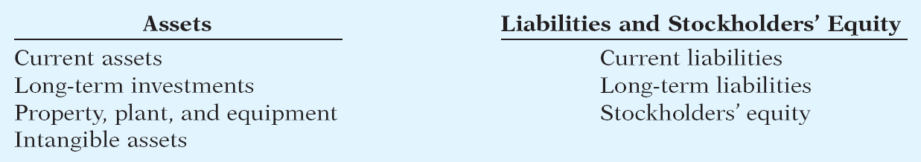
The Classified Balance Sheet
  Presents a snapshot at a point in time.
  To improve understanding, companies group similar assets and similar liabilities together.
Standard Classifications
Illustration 2-1
SO 1 Identify the sections of a classified balance sheet.

Slide 5
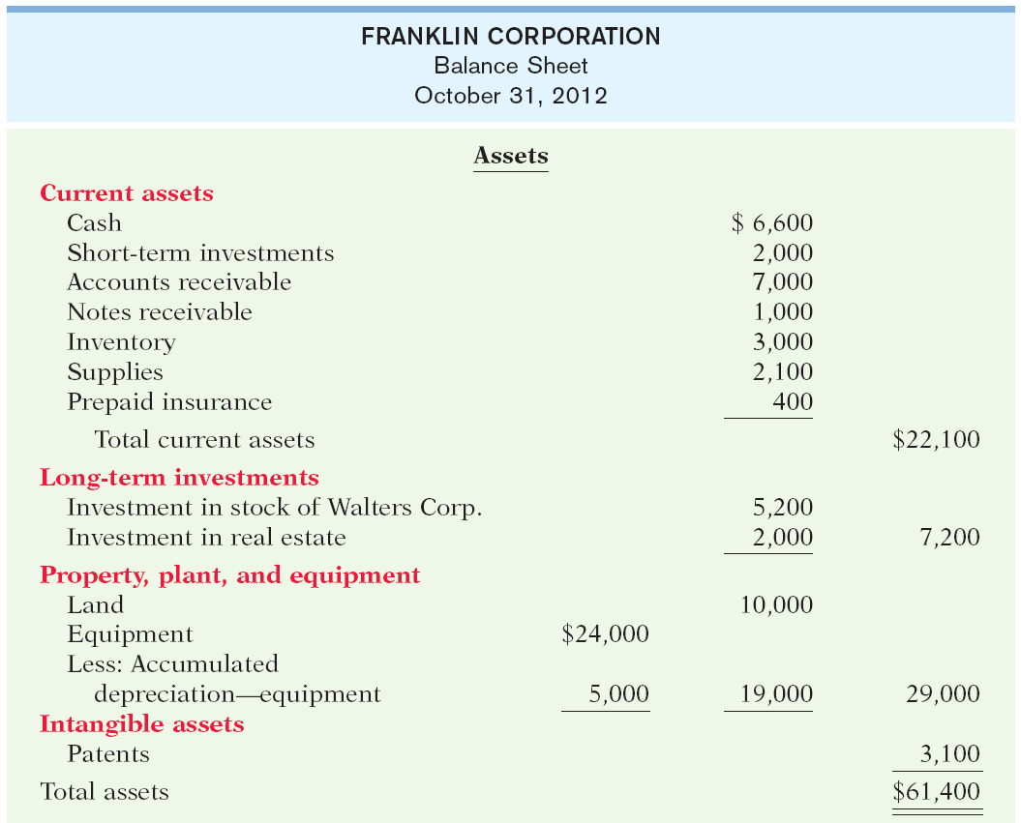
The Classified Balance Sheet
Illustration 2-2
SO 1

Slide 6
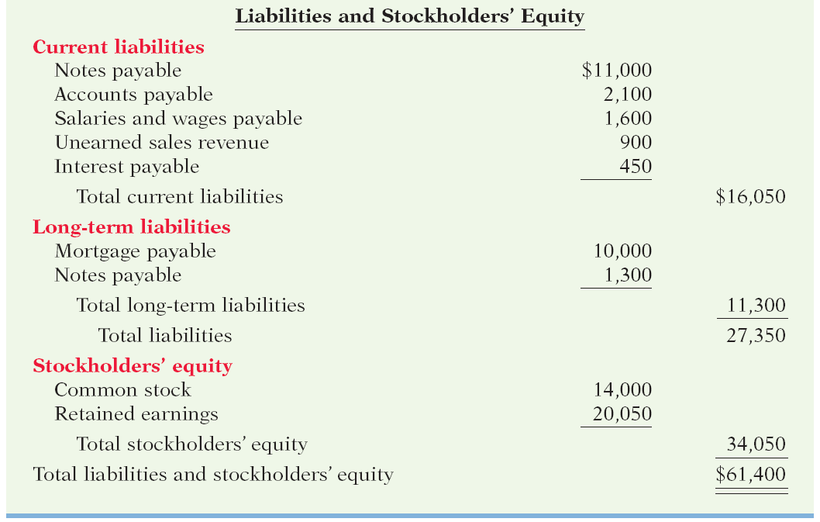
The Classified Balance Sheet
Illustration 2-2
SO 1

Slide 7
The Classified Balance Sheet
Current Assets
  Assets that a company expects to convert to cash or use up within one year or the operating cycle, whichever is longer.
  Operating cycle is the average time it takes from the purchase of inventory to the collection of cash from customers.
SO 1 Identify the sections of a classified balance sheet.

Slide 8
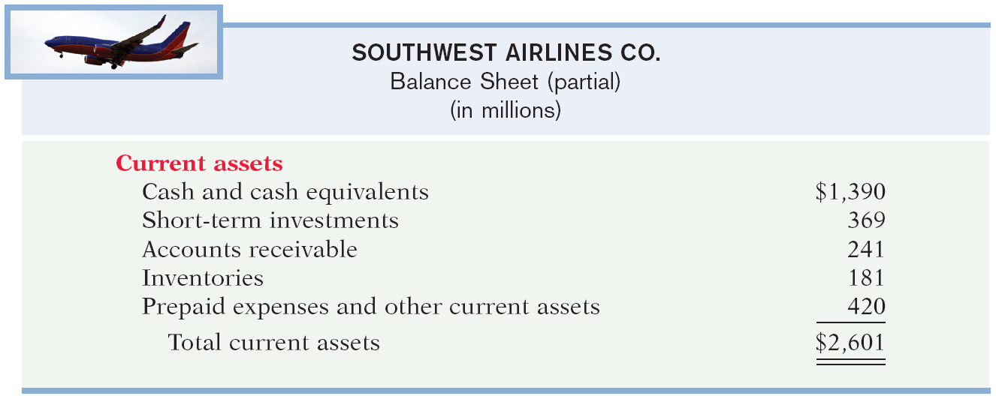
The Classified Balance Sheet
Current Assets
Illustration 2-3
  Companies list current asset accounts in the order they expect to convert them into cash.
SO 1 Identify the sections of a classified balance sheet.

Slide 9
The Classified Balance Sheet
Review Question
Cash, and other resources that are reasonably expected to be realized in cash or sold or consumed in the business within one year or the operating cycle, are called:
  Current assets.
  Intangible assets.
  Long-term investments.
  Property, plant, and equipment.
SO 1 Identify the sections of a classified balance sheet.

Slide 10
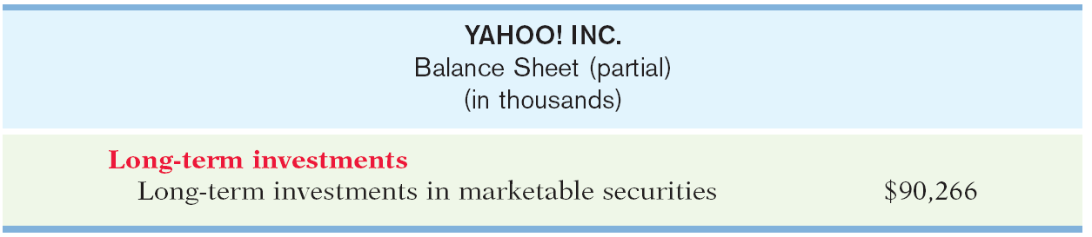
The Classified Balance Sheet
Long-Term Investments
  Investments in stocks and bonds of other companies that are held for more than one year.
  Investments in long-term assets such as land or buildings not currently being used in operating activities.
Illustration 2-4
SO 1 Identify the sections of a classified balance sheet.

Slide 11
The Classified Balance Sheet
Property, Plant, and Equipment
  Long useful lives.
  Currently used in operations.
  Depreciation - allocating the cost of assets to a number of years.
  Accumulated depreciation - total amount of depreciation expensed thus far in the asset’s life.
SO 1 Identify the sections of a classified balance sheet.

Slide 12
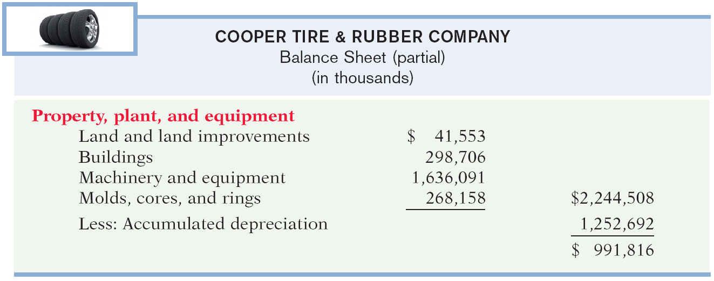
The Classified Balance Sheet
Property, Plant, and Equipment
Illustration 2-5
SO 1 Identify the sections of a classified balance sheet.

Slide 13
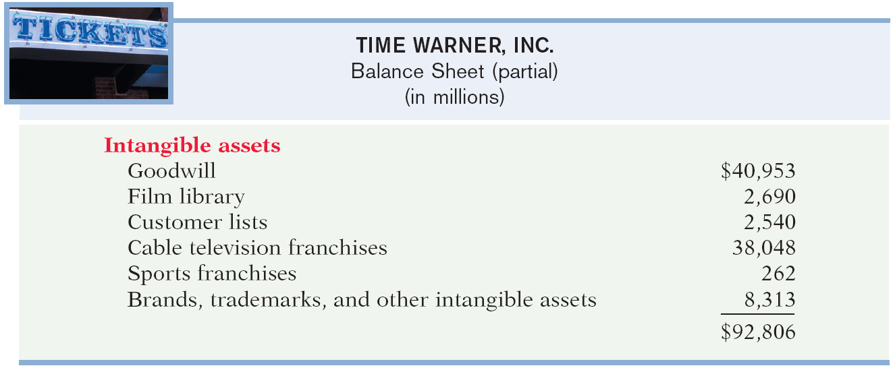
The Classified Balance Sheet
Intangible Assets
  Assets that do not have physical substance.
Illustration 2-6
SO 1 Identify the sections of a classified balance sheet.

Slide 14
The Classified Balance Sheet
Review Question
Patents and copyrights are
  Current assets.
  Intangible assets.
  Long-term investments.
  Property, plant, and equipment.
SO 1 Identify the sections of a classified balance sheet.

Slide 15
The Classified Balance Sheet
Current Liabilities
  Obligations the company is to pay within the coming year.
  Usually list notes payable first, followed by accounts payable.
  Other items follow in order of magnitude.
SO 1 Identify the sections of a classified balance sheet.

Slide 16
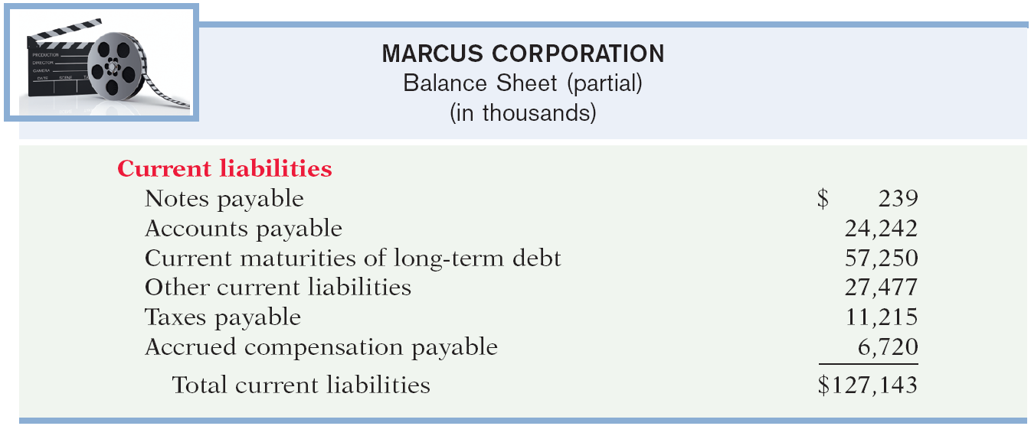
The Classified Balance Sheet
Current Liabilities
Illustration 2-7
SO 1 Identify the sections of a classified balance sheet.

Slide 17
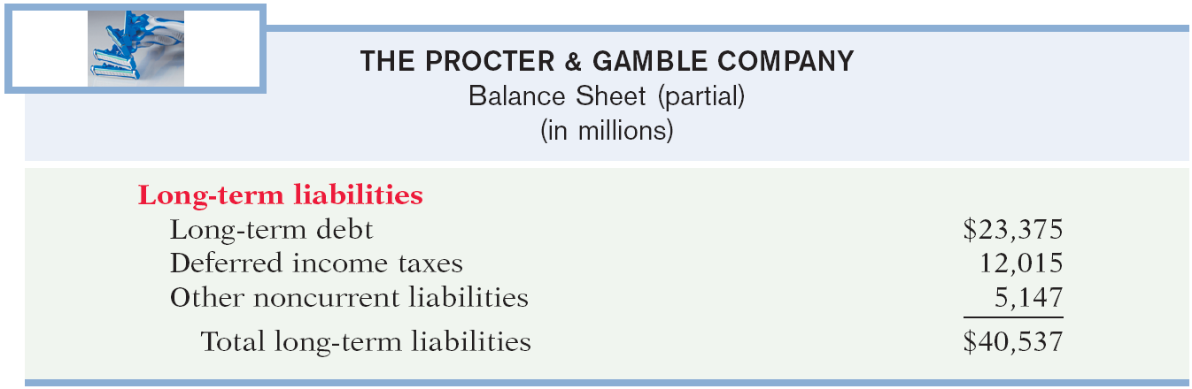
The Classified Balance Sheet
Long-Term Liabilities
  Obligations a company expects to pay after one year.
Illustration 2-8
SO 1 Identify the sections of a classified balance sheet.

Slide 18
The Classified Balance Sheet
Review Question
Which of the following is not a long-term liability?
  Bonds payable
  Current maturities of long-term obligations
  Long-term notes payable
  Mortgages payable
SO 1 Identify the sections of a classified balance sheet.

Slide 19
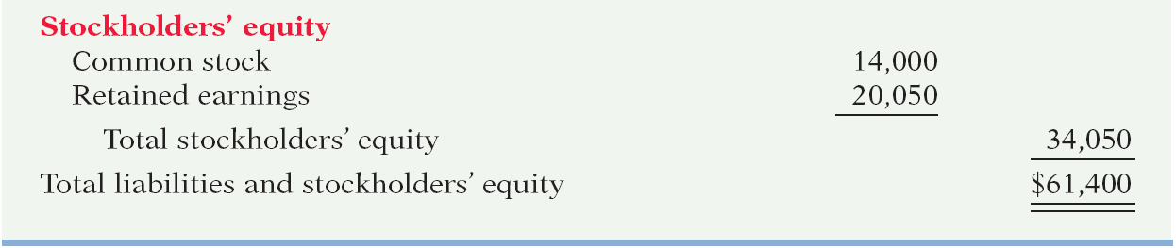
The Classified Balance Sheet
Stockholders’ Equity
Illustration 2-2
  Common stock - investments of assets into the business by the stockholders.
  Retained earnings - income retained for use in the business.
SO 1 Identify the sections of a classified balance sheet.

Slide 20

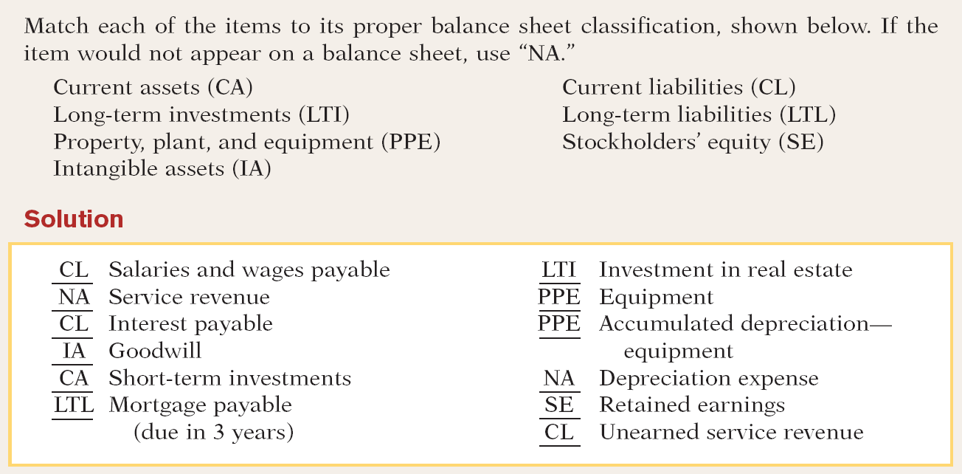
The Classified Balance Sheet
SO 1 Identify the sections of a classified balance sheet.

Slide 21
Using the Financial Statements
Ratio Analysis
  Ratio analysis expresses the relationship among selected items of financial statement data.
  A ratio expresses the mathematical relationship between one quantity and another.

Slide 22

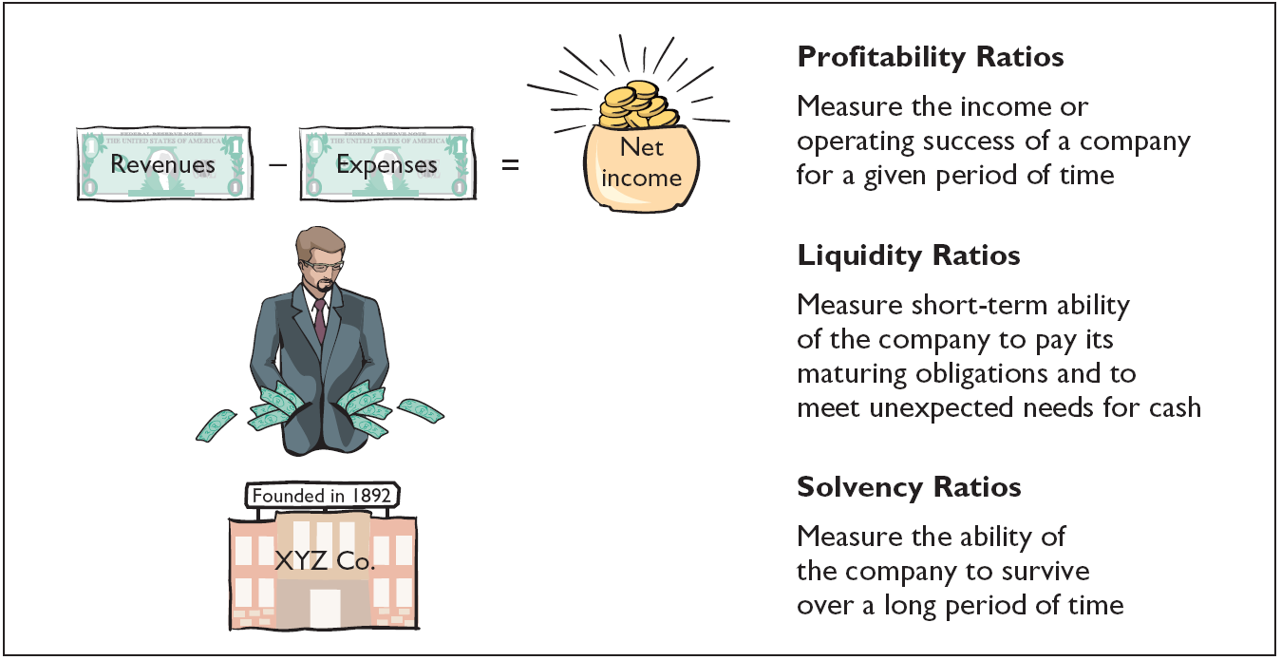
Using the Financial Statements

Slide 23
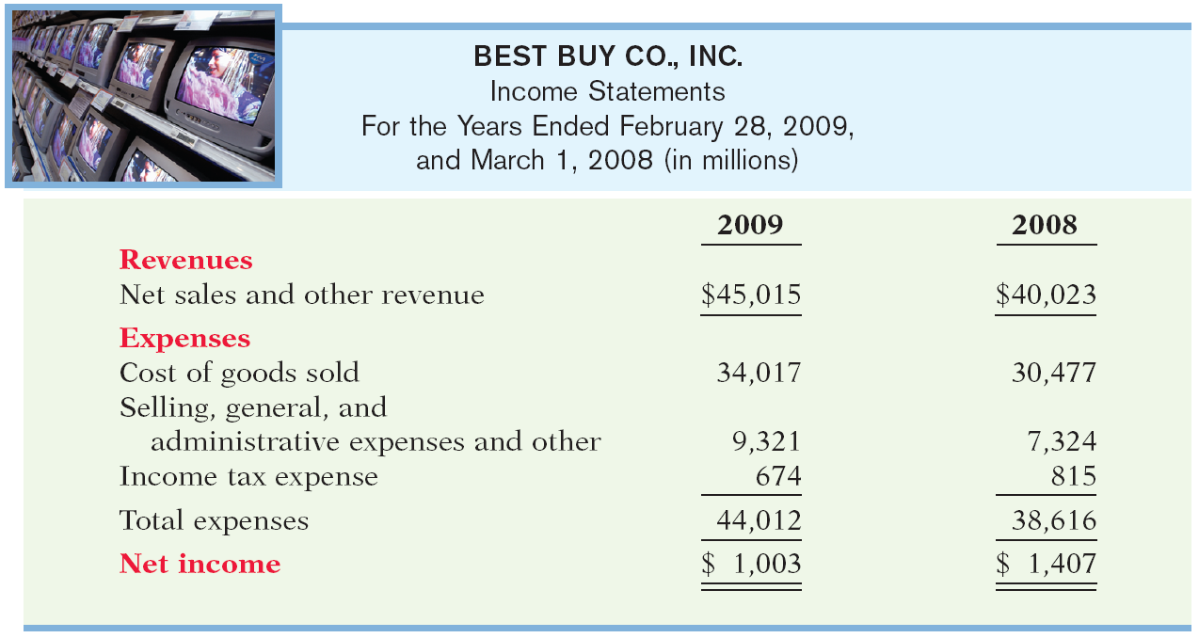
Using the Financial Statements
Using the Income Statement
Illustration 2-10
Profitability ratios measure the operating success of a company for a given period of time.
SO 2 Identify and compute ratios for analyzing a company’s profitability.

Slide 24
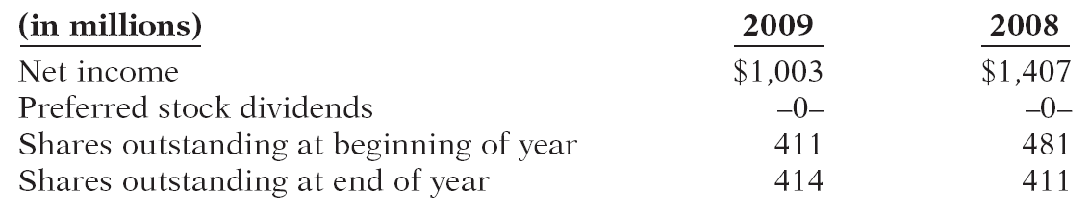
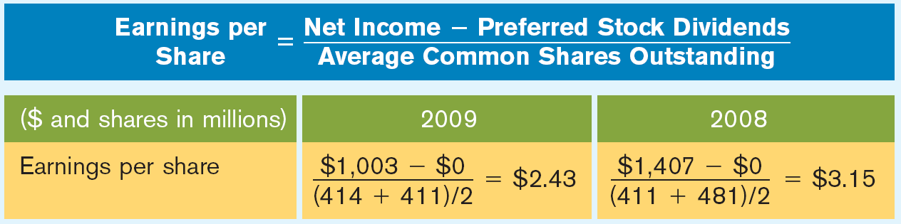

Using the Financial Statements
Profitability Ratio
Illustration: Earnings per share (EPS) measures the net income earned on each share of common stock.
Best Buy
Illustration 2-11
$1,003
- $0
$1,407
- $0
=
=
(414
+ 411)
2
(411
+ 481)
2
$2.43
$3.15

Slide 25
Using the Financial Statements
Review Question
For 2010 Stoneland Corporation reported net
income $26,000; net sales $400,000; and average shares outstanding 6,000. There were preferred stock dividends of $2,000. What was the 2010 earnings per share?
  $4.00
  $0.06
  $16.67
  $66.67
$26,000
- $2,000
= $4.00
6,000
SO 2 Identify and compute ratios for analyzing a company’s profitability.

Slide 26
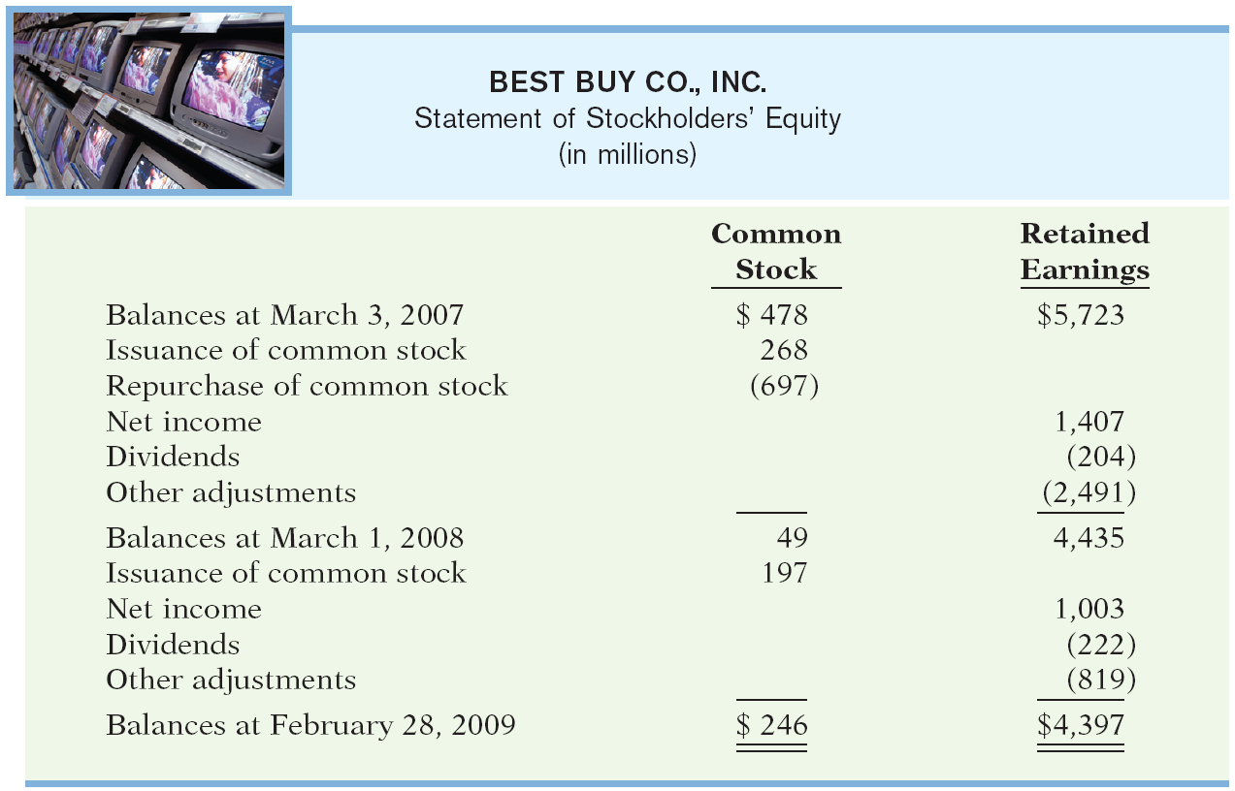
Using the Financial Statements
Using the Statement of Stockholders’ Equity
Most companies use a statement of stockholders’ equity, rather than a retained earnings statement, so that they can report all changes in stockholders’ equity accounts.
Illustration 2-12
SO 3 Explain the relationship between a retained earnings statement and a statement of stockholders’ equity.

Slide 27
Using the Financial Statements
Using the Statement of Stockholders’ Equity
Observations from this financial statement of Best Buy:
  Common stock decreased during the first year because the stock issuance was much smaller than the stock repurchase.
  Common stock increased in the second year as the result of an issuance of shares..
  Best Buy paid dividends each year.
  Prior to 2003, Best Buy did not pay dividends, even though it was profitable and could do so.
  Why didn’t Best Buy pay dividends prior to 2003?
SO 3 Explain the relationship between a retained earnings statement and a statement of stockholders’ equity.

Slide 28
Using the Financial Statements
Review Question
The balance in retained earnings is not affected by:
  net income
  net loss
  issuance of common stock
  dividends
SO 3 Explain the relationship between a retained earnings statement and a statement of stockholders’ equity.

Slide 29
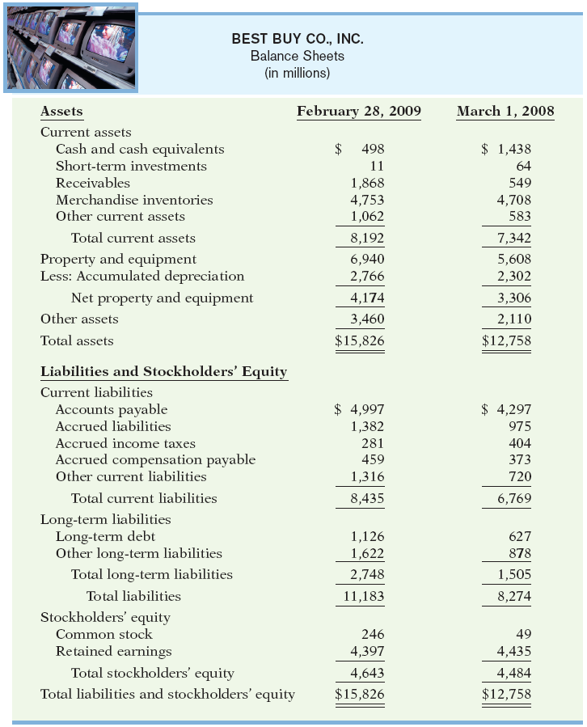
Using the Financial Statements
Illustration 2-13
Using a Classified Balance Sheet

Slide 30

Using the Financial Statements
Using a Classified Balance Sheet
Liquidity—the ability to pay obligations expected to become due within the next year or operating cycle.
Illustration 2-14
When working capital is positive, there is greater likelihood that the company will pay its liabilities.
Best Buy had a NEGATIVE working capital in 2009 of $243 million.
SO 4 Identify and compute ratios for analyzing a company’s liquidity and solvency using a balance sheet.

Slide 31
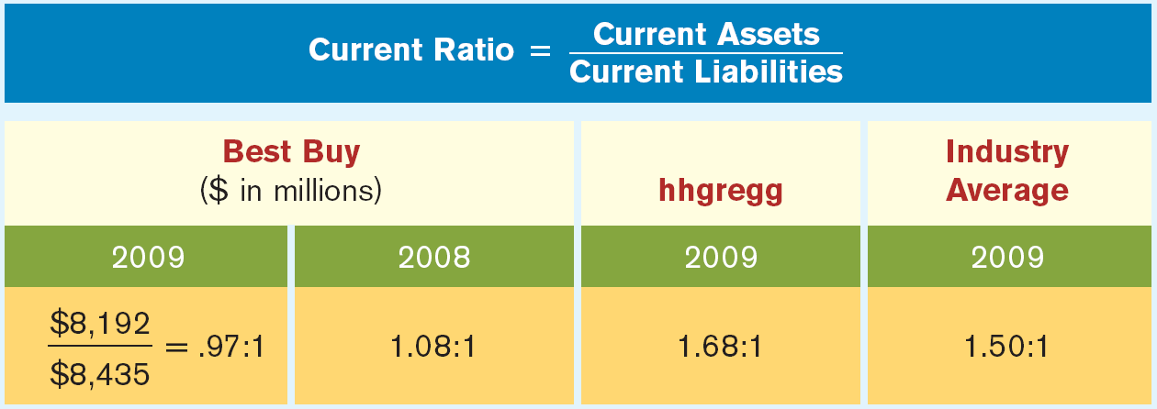
Using the Financial Statements
Liquidity Ratio
Liquidity ratios measure the short-term ability to pay maturing obligations and to meet unexpected needs for cash.
Illustration 2-15
For every dollar of current liabilities, Best Buy has $.97 of current assets
SO 4 Identify and compute ratios for analyzing a company’s liquidity and solvency using a balance sheet.

Slide 32
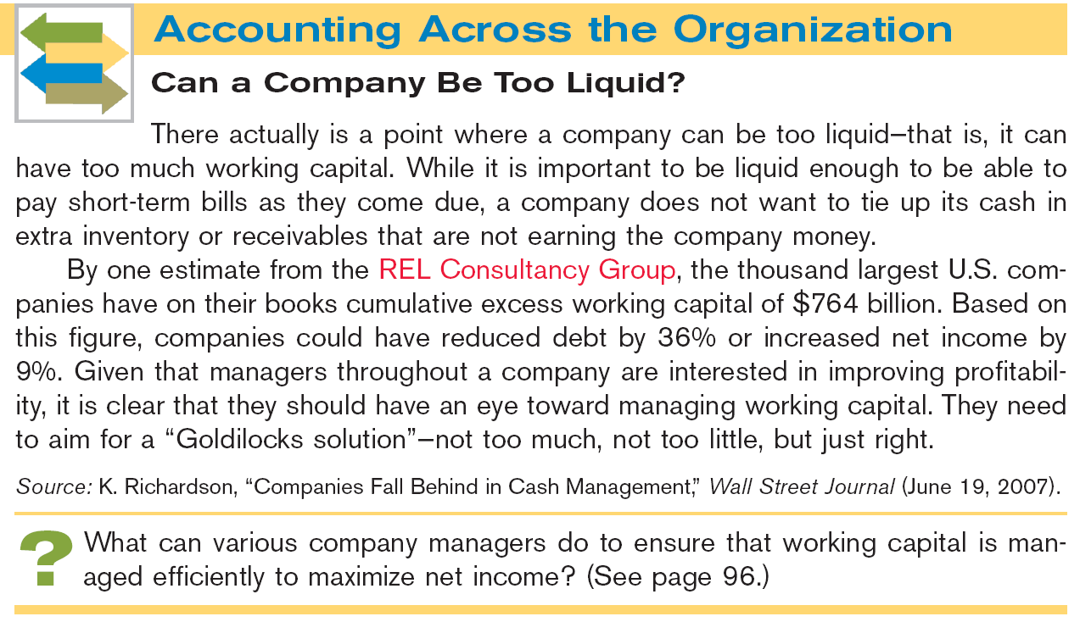


Slide 33
Using the Financial Statements
Using a Classified Balance Sheet
Solvency—the ability to pay interest as it comes due and to repay the balance of a debt due at its maturity.
Solvency ratios measure the ability of the company to survive over a long period of time.
SO 4 Identify and compute ratios for analyzing a company’s liquidity and solvency using a balance sheet.

Slide 34
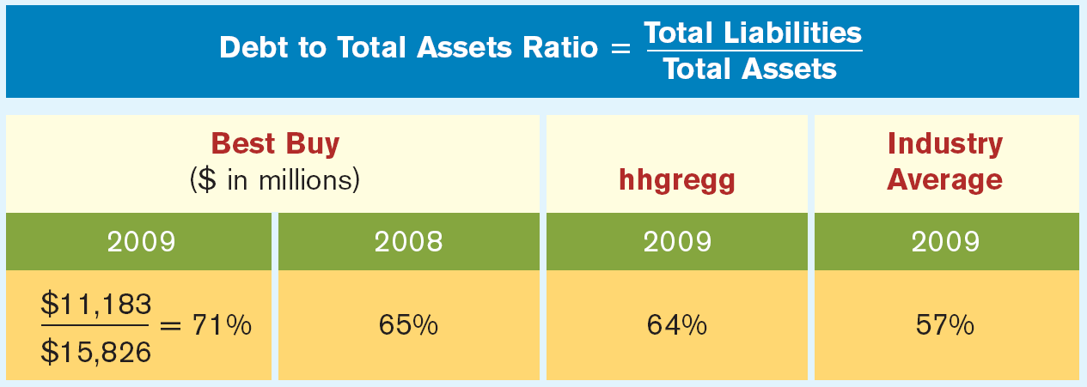
Using the Financial Statements
Solvency Ratio
Debt to total assets ratio measures the percentage of total financing provided by creditors rather than stockholders.
Illustration 2-16
The 2009 ratio means that every dollar of assets was financed by 71 cents of debt.
SO 4 Identify and compute ratios for analyzing a company’s liquidity and solvency using a balance sheet.

Slide 35
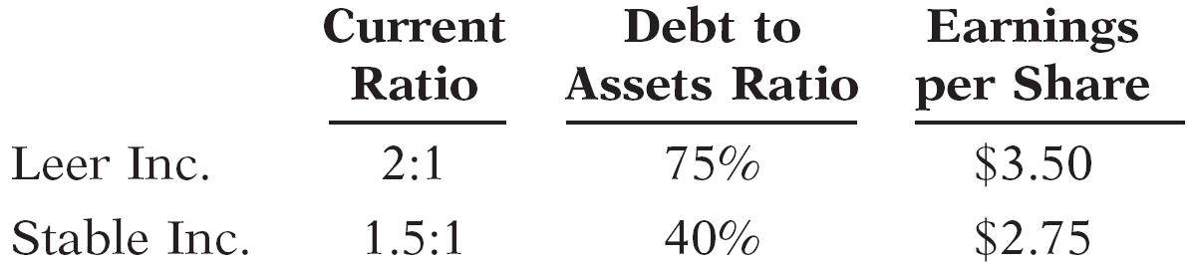
Using the Financial Statements
Review Question
The following ratios are available for Leer Inc. and Stable Inc.
Compared to Stable Inc., Leer Inc. has:
higher liquidity, higher solvency, and higher profitability.
lower liquidity, higher solvency, and higher profitability.
higher liquidity, lower solvency, and higher profitability.
higher liquidity and lower solvency, but profitability cannot be compared based on information provided.
SO 4

Slide 36
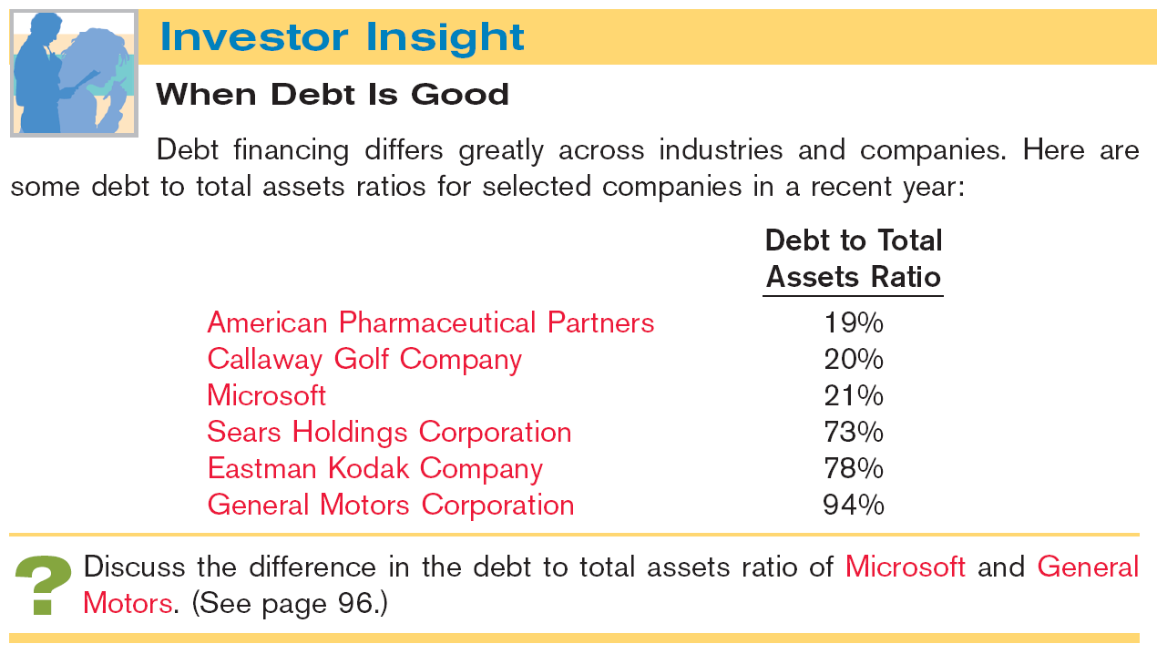
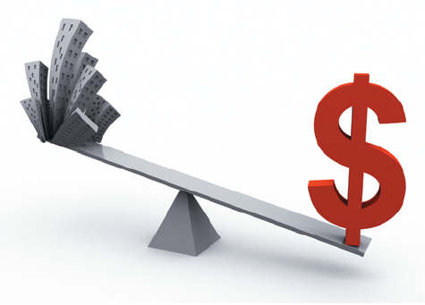

Slide 37


Using the Financial Statements
In the Statement of Cash Flows, cash provided by operating activities fails to take into account that a company must invest in new PP&E and must maintain dividends at current levels to satisfy investors.
Free cash flow is a measurement to provide additional insight regarding a company’s cash-generating ability.
SO 5 Use the statement of cash flows to evaluate solvency.

Slide 38
Using the Financial Statements
Illustration: MPC produced and sold 10,000 personal computers this year. It reported $100,000 cash provided by operating activities. In order to maintain production at 10,000 computers, MPC invested $15,000 in equipment. It chose to pay $5,000 in dividends. Calculate free cash flow.
Cash provided by operating activities $100,000
Less: Expenditures on property, plant, and equipment -15,000
Dividends paid 5,000
Free cash flow $ 80,000
SO 5 Use the statement of cash flows to evaluate solvency.

Slide 39
Financial Reports Concepts
The Standard-Setting Environment
Generally Accepted Accounting Principles (GAAP) - A set of rules and practices, having substantial authoritative support, that the accounting profession recognizes as a general guide for financial reporting purposes.
Standard-setting bodies determine these guidelines:
  Securities and Exchange Commission (SEC)
  Financial Accounting Standards Board (FASB)
  International Accounting Standards Board (IASB)
  Public Company Accounting Oversight Board (PCAOB)
SO 6 Explain the meaning of generally accepted accounting principles.

Slide 40
Financial Reports Concepts
Review Question
Generally accepted accounting principles are:
  a set of standards and rules that are recognized as a general guide for financial reporting.
  usually established by the Internal Revenue Service.
  the guidelines used to resolve ethical dilemmas.
  fundamental truths that can be derived from the laws of nature.
SO 6 Explain the meaning of generally accepted accounting principles.

Slide 41
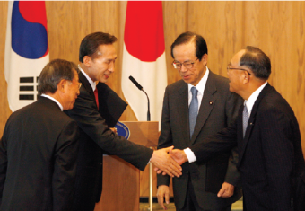
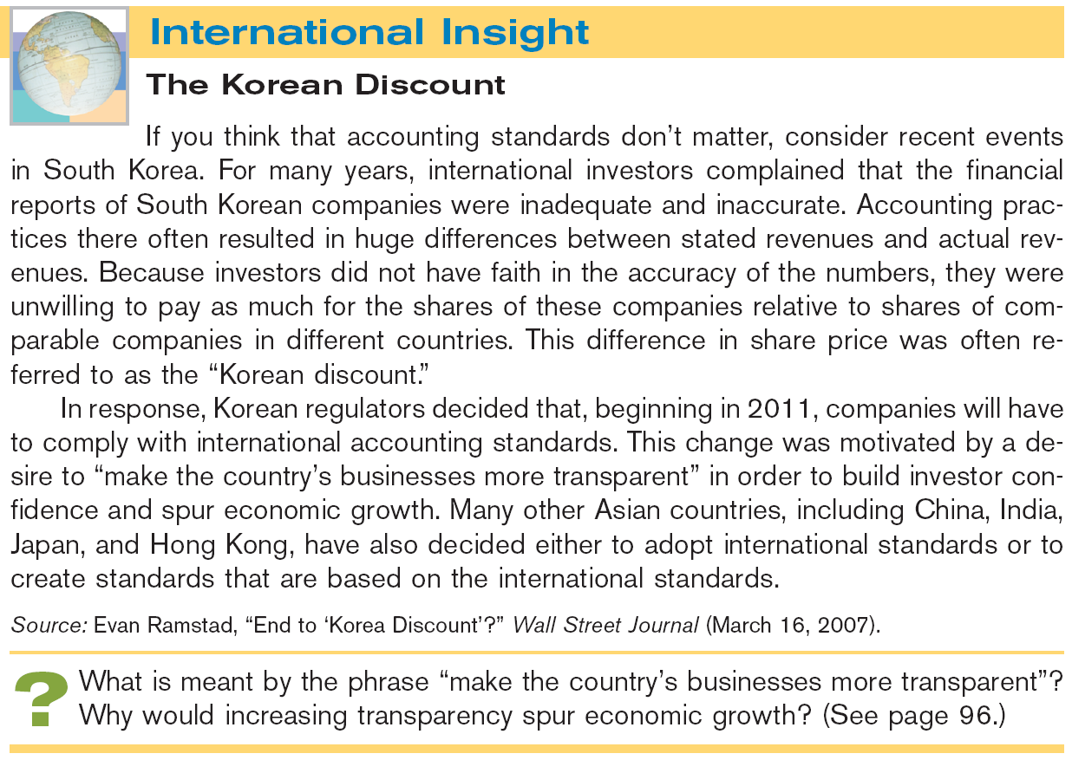

Slide 42
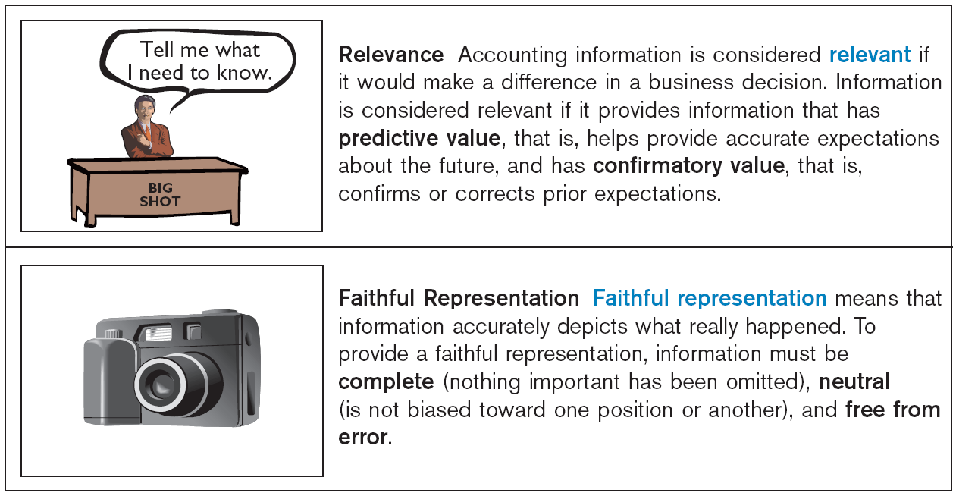
Financial Reports Concepts
Qualities of Useful Information
According to the FASB, useful information should possess two fundamental qualities, relevance and faithful representation.
Illustration 2-17
SO 7

Slide 43
Financial Reports Concepts
Qualities of Useful Information
Enhancing Qualities
Comparability results when different companies use the same accounting principles.
Information has the quality of understandability
if it is presented in a clear and concise fashion.
Information is verifiable if we are able to prove that it is free from error.
Consistency means that a company uses the same accounting
principles and methods from year to year.
For accounting information to be relevant, it must be timely.
SO 7 Discuss financial reporting concepts.

Slide 44
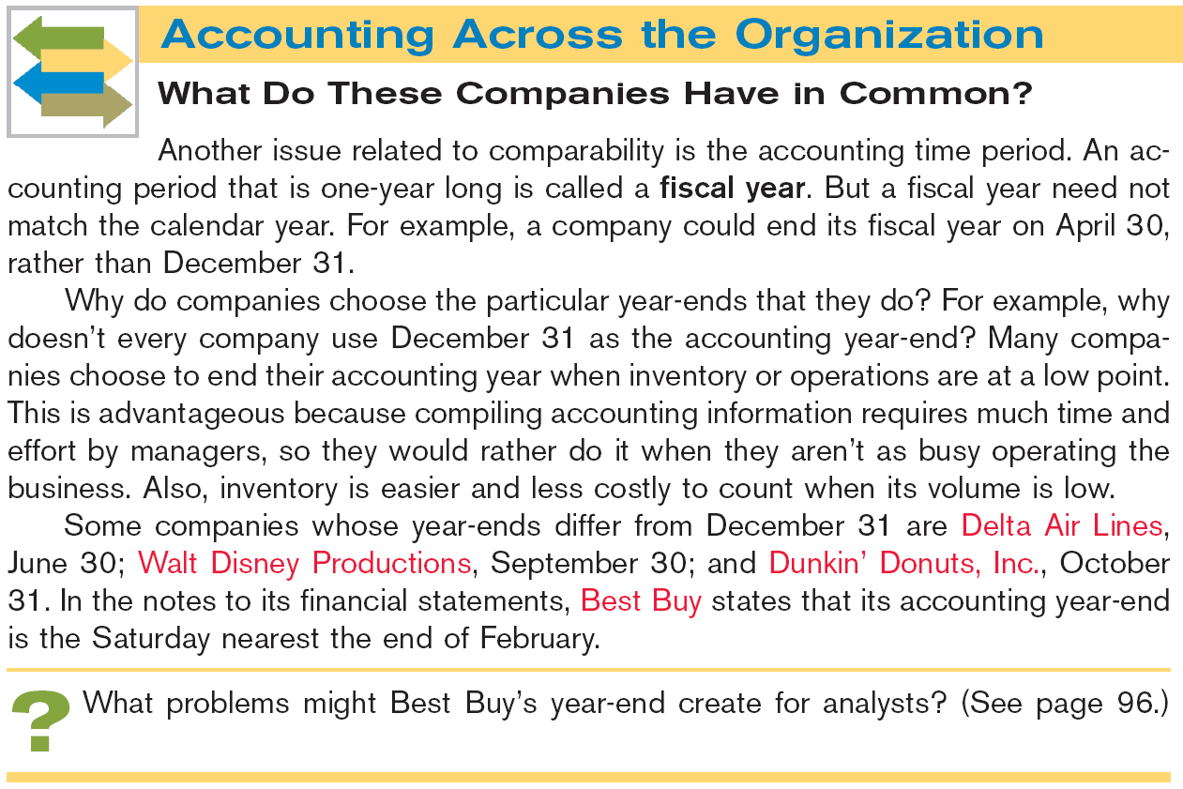
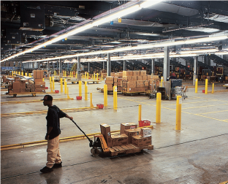

Slide 45
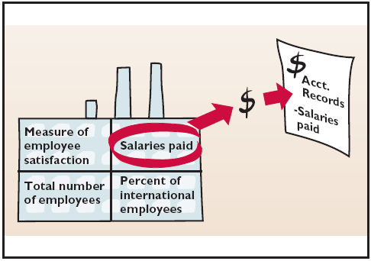
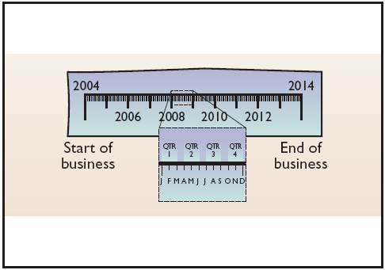
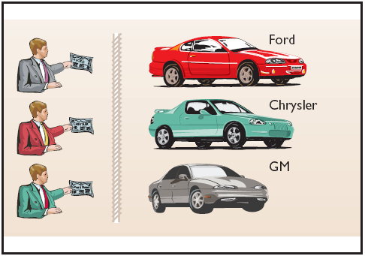
Financial Reports Concepts
Assumptions in Financial Reporting
Illustration 2-18
Economic Entity
States that every economic entity can be separately identified and accounted for.
Monetary Unit
Periodicity
Requires that only those things that can be expressed in money are included in the accounting records.
States that the life of a business can be divided into artificial time periods.
SO 7 Discuss financial reporting concepts.

Slide 46
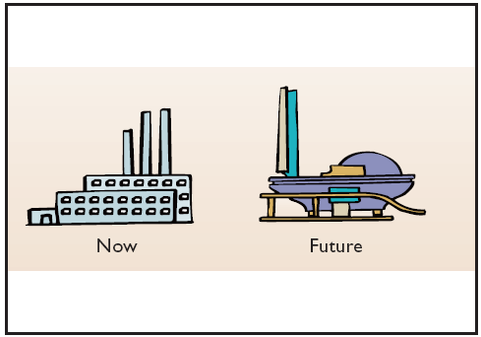
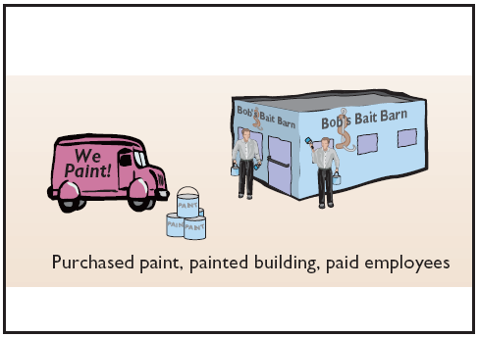
Financial Reports Concepts
Assumptions in Financial Reporting
Illustration 2-18
Going Concern
Accrual-Basis
The business will remain in operation for the foreseeable future.
Transactions are recorded in the periods in which the events occur.
SO 7 Discuss financial reporting concepts.

Slide 47
Financial Reports Concepts
Principles in Financial Reporting
Measurement Principles
Cost
Fair Value
Full disclosure
Or historical cost principle, dictates that companies record assets at their cost.
Indicates that assets and liabilities should be reported at fair value (the price received to sell an asset or settle
a liability).
Requires that companies disclose all circumstances
and events that would make a difference to financial statement users.
SO 7 Discuss financial reporting concepts.

Slide 48
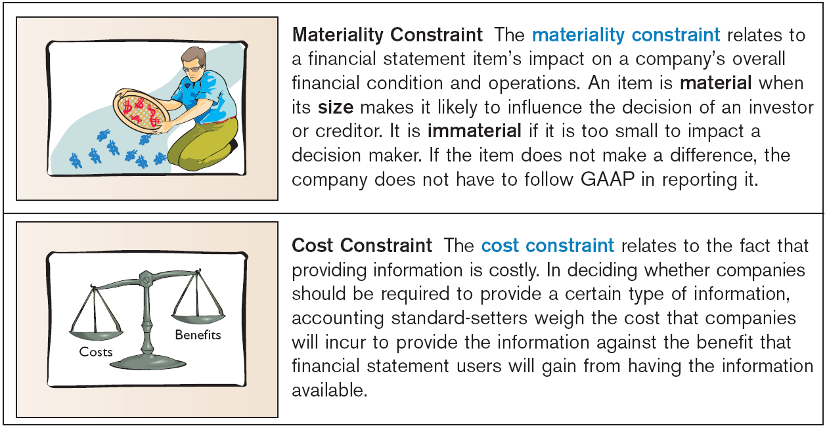
Financial Reports Concepts
Constraints in Financial Reporting
Illustration 2-19
Materiality Constraint
An item is material when its size makes it likely to influence the decision of an investor or creditor.
Cost Constraint
Accounting standard-setters weigh the cost that companies will incur to provide the information against the benefit that
financial statement users will gain.
SO 7

Slide 49
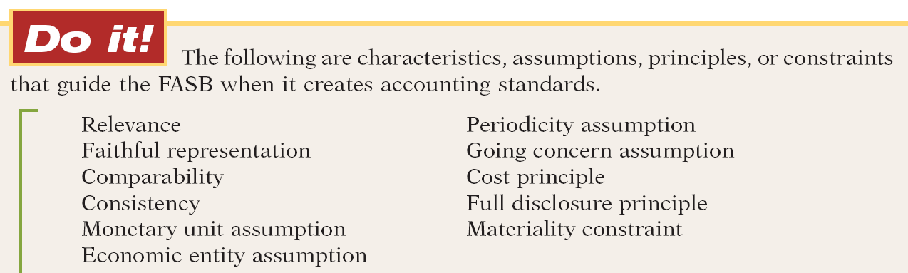

Financial Reports Concepts
Match each item above with a description below.
Ability to easily evaluate one company’s results relative to another’s.
Belief that a company will continue to operate for the foreseeable future.
The judgment concerning whether an item is large enough to matter to decision makers.
Comparability
Going concern
Materiality
SO 7 Discuss financial reporting concepts.

Slide 50
Financial Reports Concepts
The reporting of all information that would make a difference to financial statement users.
The practice of preparing financial statements at regular intervals.
The quality of information that indicates the information makes a difference in a decision.
Full disclosure
Periodicity
Relevance
SO 7 Discuss financial reporting concepts.

Slide 51
Financial Reports Concepts
Belief that items should be reported on the balance sheet at the price that was paid to acquire the item.
A company’s use of the same accounting principles and methods from year to year.
Tracing accounting events to particular companies.
Cost
Consistency
Economic entity
SO 7 Discuss financial reporting concepts.

Slide 52
Financial Reports Concepts
The desire to minimize errors and bias in financial statements.
Reporting only those things that can be measured in dollars.
Faithful representation
Monetary unit
SO 7 Discuss financial reporting concepts.

Slide 53
Financial Reports Concepts
Review Question
What is the primary criterion by which accounting information can be judged?
  Consistency.
  Predictive value.
  Usefulness for decision making.
  Comparability.
SO 7 Discuss financial reporting concepts.

Slide 54

Key Points
  IFRS recommends but does not require the use of the title “statement of financial position” rather than balance sheet.
  The format of statement of financial position information is often presented differently under IFRS. Most companies that follow IFRS present statement of financial position information in this order:
    Noncurrent assets
    Current assets
    Equity
    Noncurrent liabilities
    Current liabilities

Slide 55
Key Points
  IFRS requires a classified statement of financial position except in very limited situations. IFRS follows the same guidelines as this textbook for distinguishing between current and noncurrent assets and liabilities.
  Under IFRS, current assets are usually listed in the reverse order of liquidity.
  Some companies report the subtotal net assets, which equals total assets minus total liabilities.

Slide 56
Key Points
  IFRS has many differences in terminology. In the investment category stock is called shares, and common stock is called share capital–ordinary.
  Both IFRS and GAAP require disclosures about (1) accounting policies followed, (2) judgments that management has made in the process of applying the entity’s accounting policies, and (3) the key assumptions and estimation uncertainty that could result in a material adjustment to the carrying amounts of assets and liabilities within the next financial year.

Slide 57
Key Points
  Comparative prior-period information must be presented and financial statements must be prepared annually.
  Both GAAP and IFRS are increasing the use of fair value to report assets. As examples, under IFRS companies can apply fair value to property, plant, and equipment; natural resources; and in some cases intangible assets.
  Recently, the IASB and FASB completed the first phase of a jointly created conceptual framework.

Slide 58
Key Points
  The monetary unit assumption is part of each framework. However, the unit of measure will vary depending on the currency used (e.g., Chinese yuan, Japanese yen, and British pound).
  The economic entity assumption is also part of each framework although some cultural differences result in differences in its application. For example, in Japan many companies have formed alliances that are so strong that they act similar to related corporate divisions although they are not actually part of the same company.

Slide 59
Looking into the Future
The IASB and the FASB are working on a project to converge their standards related to financial statement presentation. A key feature of the proposed framework is that each of the statements will be organized in the same format, to separate an entity’s financing activities from its operating and investing activities and, further, to separate financing activities into transactions with owners and creditors.
The same classifications used in the statement of financial position would also be used in the income statement and the statement of cash flows.

Slide 60
Which of the following statements is false?
  The monetary unit assumption is used under IFRS.
  Under IFRS, companies sometimes net liabilities against assets to report “net assets.”
  The FASB and IASB are working on a joint conceptual framework project.
  Under IFRS, the statement of financial position is usually referred to as the statement of assets and equity.

Slide 61
A company has purchased a tract of land and expects to build a production plant on the land in approximately 5 years. During the 5 years before construction, the land will be idle. Under IFRS, the land should be reported as:
  land expense.
  property, plant, and equipment.
  an intangible asset.
  a long-term investment.

Slide 62
Current assets under IFRS are listed generally:
  by importance.
  in the reverse order of their expected conversion to cash.
  by longevity.
  alphabetically.

Slide 63
Copyright
Copyright © 2011 John Wiley & Sons, Inc. All rights reserved. Reproduction or translation of this work beyond that permitted in Section 117 of the 1976 United States Copyright Act without the express written permission of the copyright owner is unlawful. Request for further information should be addressed to the Permissions Department, John Wiley & Sons, Inc. The purchaser may make back-up copies for his/her own use only and not for distribution or resale. The Publisher assumes no responsibility for errors, omissions, or damages, caused by the use of these programs or from the use of the information contained herein.

