Slide 1

8
REPORTING AND ANALYZING RECEIVABLES
Financial Accounting, Sixth Edition

Slide 2
Study Objectives
Identify the different types of receivables.
Explain how accounts receivable are recognized in the accounts.
Describe the methods used to account for bad debts.
Compute the interest on notes receivable.
Describe the entries to record the disposition of notes receivable.
Explain the statement presentation of receivables.
Describe the principles of sound accounts receivable management.
Identify ratios to analyze a company’s receivables.
Describe methods to accelerate the receipt of cash from receivables.

Slide 3

Reporting and Analyzing Receivables
Types of Receivables
Accounts Receivable
Notes Receivable
Statement Presentation of Receivables
Managing Receivables
Accounts receivable
Notes receivable
Other receivables
Recognizing accounts receivable
Valuing accounts receivable
Determining maturity date
Computing interest
Recognizing notes receivable
Valuing notes receivable
Disposing of notes receivable
Balance sheet and notes
Income statement
Extending credit
Establishing a payment period
Monitoring collections
Evaluating liquidity of receivables
Accelerating cash receipts

Slide 4

Types of Receivables
Amounts due from individuals and other companies that are expected to be collected in cash.
Amounts owed by customers that result from the sale of goods and services.
Claims for which formal instruments of credit are issued
as proof of debt.
“Nontrade” (interest, loans to officers, advances to employees, and income taxes refundable).
Accounts Receivable
Notes Receivable
Other Receivables
SO 1 Identify the different types of receivables.

Slide 5
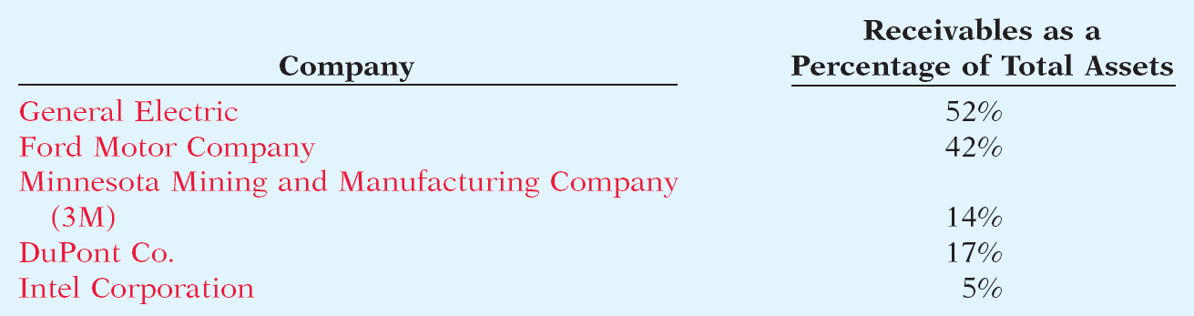
Types of Receivables
Amounts due from individuals and other companies that are expected to be collected in cash.
Illustration 8-1
SO 1 Identify the different types of receivables.

Slide 6
Accounts Receivable
Two accounting issues:
  Recognizing accounts receivable.
  Valuing accounts receivable.
Recognizing Accounts Receivable
Service organization - records a receivable when it provides service on account.
Merchandiser - records accounts receivable at the point of sale of merchandise on account.
SO 2 Explain how accounts receivable are recognized in the accounts.

Slide 7
Accounts Receivable
Illustration: Assume that Jordache Co. on July 1, 2012, sells merchandise on account to Polo Company for $1,000 terms 2/10, n/30. Prepare the journal entry to record this transaction on the books of Jordache Co.
Jul. 1
Accounts receivable 1,000
Sales revenue 1,000
SO 2 Explain how accounts receivable are recognized in the accounts.

Slide 8
Accounts Receivable
Illustration: On July 5, Polo returns merchandise worth $100 to Jordache Co.
Jul. 5
Sales returns and allowances 100
Accounts receivable 100
Illustration: On July 11, Jordache receives payment from
Polo Company for the balance due.
Jul. 11
Cash 882
Sales discounts ($900 x .02) 18
Accounts receivable 900
SO 2 Explain how accounts receivable are recognized in the accounts.

Slide 9
Accounts Receivable
Valuing Accounts Receivables
Current asset.
Valuation (net realizable value).
Uncollectible Accounts Receivable
Sales on account raise the possibility of accounts not being collected.
Seller records losses that result from extending credit as Bad Debts Expense.
SO 3 Describe the methods used to account for bad debts.

Slide 10
Valuing Accounts Receivable
Methods of Accounting for Uncollectible Accounts
Direct Write-Off
Theoretically undesirable:
  No matching.
  Receivable not stated at net realizable value.
  Not acceptable for financial reporting.
Allowance Method
Losses are estimated:
  Better matching.
  Receivable stated at net realizable value.
  Required by GAAP.
SO 3 Describe the methods used to account for bad debts.

Slide 11
Accounting for A/R and Bad Debts
How are these accounts presented on the Balance Sheet?
Allowance for Doubtful Accounts
Accounts Receivable
Beg. 500
25 Beg.
End. 500
25 End.

Slide 12
Assets
Current Assets:
Cash $ 346
Accounts receivable 500
Less allowance for doubtful accounts 25 475
Inventory 812
Prepaids _ 40
Total current assets 1,673
Fixed Assets:
Office equipment 5,679
Furniture & fixtures 6,600
Less: Accumulated depreciation (3,735)
Total fixed assets 8,544
Total Assets $10,217

Slide 13
Assets
Current Assets:
Cash $ 346
Accounts receivable, net of $25 allowance
for doubtful accounts 475
Inventory 812
Prepaids _ 40
Total current assets 1,673
Fixed Assets:
Office equipment 5,679
Furniture & fixtures 6,600
Less: Accumulated depreciation (3,735)
Total fixed assets 8,544
Total Assets $10,217

Slide 14
Accounting for A/R and Bad Debts
Journal entry for credit sale of $100?
Accounts receivable 100
Sales 100
Allowance for Doubtful Accounts
Accounts Receivable
Beg. 500
25 Beg.
End. 500
25 End.

Slide 15
Accounting for A/R and Bad Debts
Journal entry for credit sale of $100?
Accounts receivable 100
Sales 100
Allowance for Doubtful Accounts
Accounts Receivable
Beg. 500
25 Beg.
Sale 100
End. 600
25 End.

Slide 16
Accounting for A/R and Bad Debts
Collected of $333 on account?
Cash 333
Accounts receivable 333
Allowance for Doubtful Accounts
Accounts Receivable
Beg. 500
25 Beg.
Sale 100
End. 600
25 End.

Slide 17
Accounting for A/R and Bad Debts
Collected of $333 on account?
Cash 333
Accounts receivable 333
Allowance for Doubtful Accounts
Accounts Receivable
Beg. 500
25 Beg.
Sale 100
333 Coll.
End. 267
25 End.

Slide 18
Accounting for A/R and Bad Debts
Adjustment of $15 for estimated Bad-Debts?
Bad debt expense 15
Allowance for Doubtful Accounts 15
Allowance for Doubtful Accounts
Accounts Receivable
Beg. 500
25 Beg.
Sale 100
333 Coll.
End. 267
25 End.

Slide 19
Accounting for A/R and Bad Debts
Adjustment of $15 for estimated Bad-Debts?
Bad debt expense 15
Allowance for Doubtful Accounts 15
Allowance for Doubtful Accounts
Accounts Receivable
Beg. 500
25 Beg.
Sale 100
333 Coll.
15 Est.
End. 267
40 End.

Slide 20
Accounting for A/R and Bad Debts
Write-off of uncollectible accounts for $10?
Allowance for Doubtful accounts 10
Accounts receivable 10
Allowance for Doubtful Accounts
Accounts Receivable
Beg. 500
25 Beg.
Sale 100
333 Coll.
15 Est.
End. 267
40 End.

Slide 21
Accounting for A/R and Bad Debts
Write-off of uncollectible accounts for $10?
Allowance for Doubtful accounts 10
Accounts receivable 10
Allowance for Doubtful Accounts
Accounts Receivable
Beg. 500
25 Beg.
Sale 100
333 Coll.
15 Est.
10 W/O
W/O 10
End. 257
30 End.

Slide 22
Assets
Current Assets:
Cash $ 346
Accounts receivable, net of $30 allowance
for doubtful accounts 227
Inventory 812
Prepaids _ 40
Total current assets 1,425
Fixed Assets:
Office equipment 5,679
Furniture & fixtures 6,600
Less: Accumulated depreciation (3,735)
Total fixed assets 8,544
Total Assets $ 9,969

Slide 23
Valuing Accounts Receivable
Direct Write-off Method for Uncollectible Accounts
Illustration: Assume, for example, that Warden Co. writes off M. E. Doran’s $200 balance as uncollectible on December 12. Warden’s entry is:
Bad debts expense 200
Accounts receivable 200
SO 3 Describe the methods used to account for bad debts.

Slide 24
Valuing Accounts Receivable
Allowance Method for Uncollectible Accounts
Companies estimate uncollectible accounts receivable.
Debit Bad Debts Expense and credit Allowance for Doubtful Accounts (a contra-asset account).
Companies debit Allowance for Doubtful Accounts and credit Accounts Receivable at the time the specific account is written off as uncollectible.
SO 3 Describe the methods used to account for bad debts.

Slide 25
Valuing Accounts Receivable
Illustration: Hampson Furniture has credit sales of $1,200,000 in 2012, of which $200,000 remains uncollected at December 31. The credit manager estimates that $12,000 of these sales will prove uncollectible.
Dec. 31
Bad debts expense 12,000
Allowance for doubtful accounts 12,000
SO 3 Describe the methods used to account for bad debts.

Slide 26
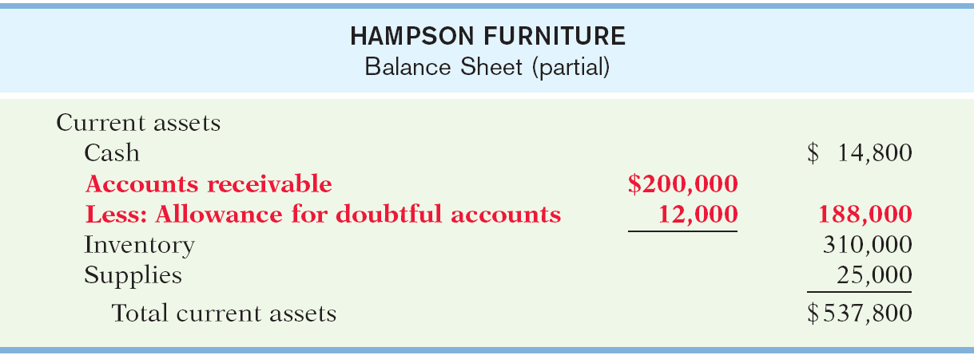
Valuing Accounts Receivable
Illustration 8-3
Presentation of allowance
for doubtful accounts
SO 3 Describe the methods used to account for bad debts.

Slide 27
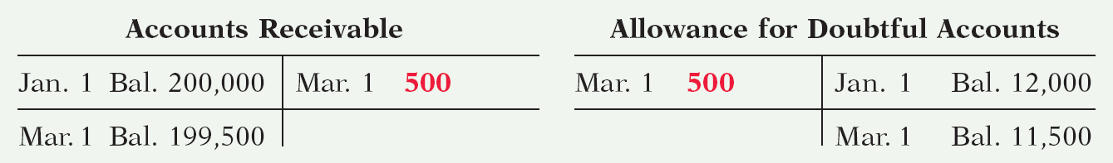
Valuing Accounts Receivable
Recording Write-Off of an Uncollectible Account
Illustration: The vice-president of finance of Hampson Furniture on March 1, 2013, authorizes a write-off of the $500 balance owed by R. A. Ware. The entry to record the write-off is:
Mar. 1
Allowance for doubtful accounts 500
Accounts receivable 500
Illustration 8-4
SO 3 Describe the methods used to account for bad debts.

Slide 28
Valuing Accounts Receivable
Recovery of an Uncollectible Account
Illustration: On July 1, R. A. Ware pays the $500 amount that Hampson Furniture had written off on March 1. Hampson makes these entries:
July 1
Accounts receivable 500
Allowance for doubtful accounts 500
1
Cash 500
Accounts receivable 500
SO 3 Describe the methods used to account for bad debts.

Slide 29
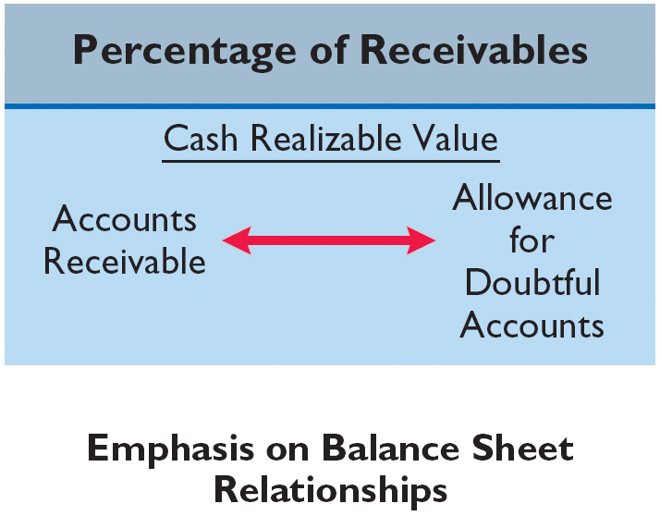
Valuing Accounts Receivable
Estimating the Allowance
Under the percentage of receivables basis, management establishes a percentage relationship between the amount of receivables and expected losses from uncollectible accounts.
SO 3 Describe the methods used to account for bad debts.

Slide 30
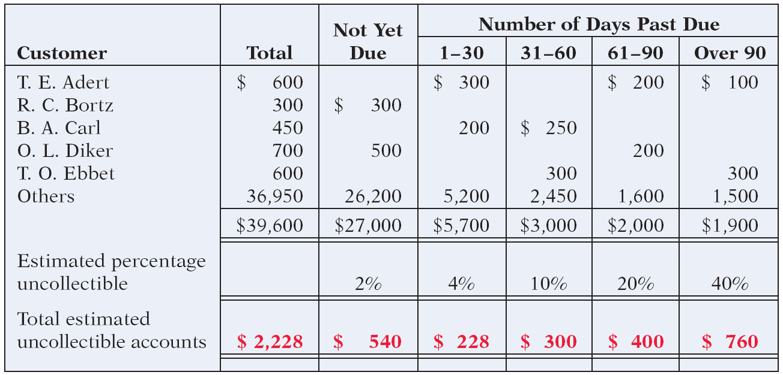
Valuing Accounts Receivable
Aging the accounts receivable - customer balances are classified by the length of time they have been unpaid.
Illustration 8-6
SO 3 Describe the methods used to account for bad debts.

Slide 31
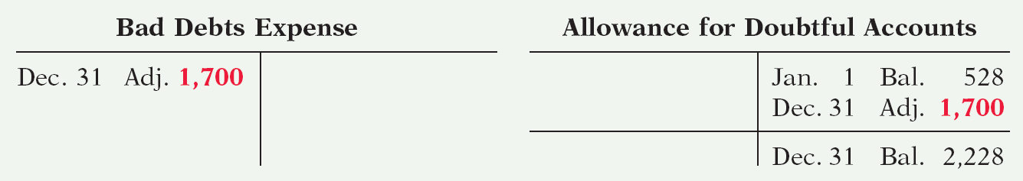
Valuing Accounts Receivable
Estimating the Allowance
Illustration: Assume the unadjusted trial balance shows Allowance for Doubtful Accounts with a credit balance of $528. Prepare the adjusting entry assuming $2,228 is the estimate of uncollectible receivables from the aging schedule.
Dec. 31
Bad debts expense 1,700
Allowance for doubtful accounts 1,700
Illustration 8-7 Bad debts accounts after posting

Slide 32
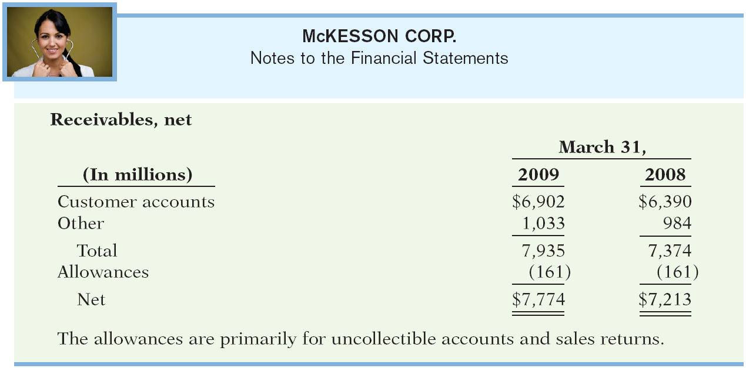
Valuing Accounts Receivable
Illustration 8-8
Note disclosure of accounts receivable
SO 3 Describe the methods used to account for bad debts.

Slide 33
Notes Receivable
Companies may grant credit in exchange for a promissory note. A promissory note is a written promise to pay a specified amount of money on demand or at a definite time.
Promissory notes may be used
  when individuals and companies lend or borrow money,
  when amount of transaction and credit period exceed normal limits, or
  in settlement of accounts receivable.

Slide 34
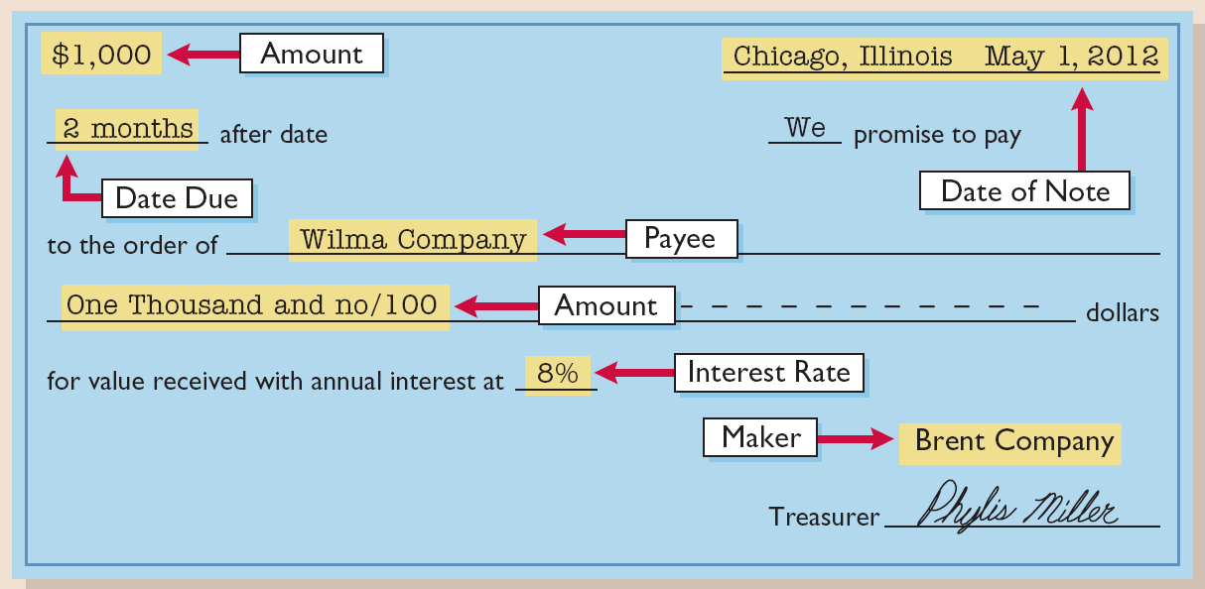
Notes Receivable
To the Payee, the promissory note is a note receivable.
To the Maker, the promissory note is a note payable.
Illustration 8-9

Slide 35

Notes Receivable
Determining the Maturity Date
Note expressed in terms of
  Months
  Days
Computing Interest
Illustration 8-10
SO 4 Compute the interest on notes receivable.

Slide 36
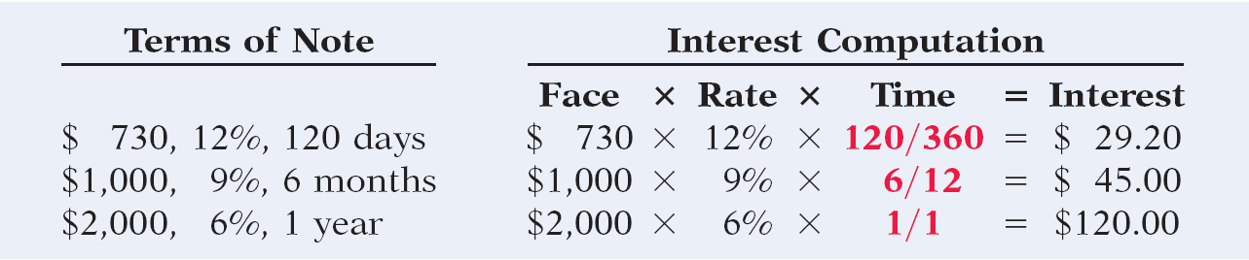
Notes Receivable
Computing Interest
When counting days, omit the date the note is issued, but include the due date.
Illustration 8-11
SO 4 Compute the interest on notes receivable.

Slide 37
Notes Receivable
Recognizing Notes Receivable
Illustration: Brent Company wrote a $1,000, two-month, 8% promissory note dated May 1, to settle an open account. Prepare entry would Wilma Company makes for the receipt of the note.
May 1
Notes receivable 1,000
Accounts receivable 1,000
SO 4 Compute the interest on notes receivable.

Slide 38
Notes Receivable
Valuing Notes Receivable
Report short-term notes receivable at their cash (net) realizable value.
Estimation of cash realizable value and bad debts expense are done similarly to accounts receivable.
Allowance for Doubtful Accounts is used.
SO 4 Compute the interest on notes receivable.

Slide 39
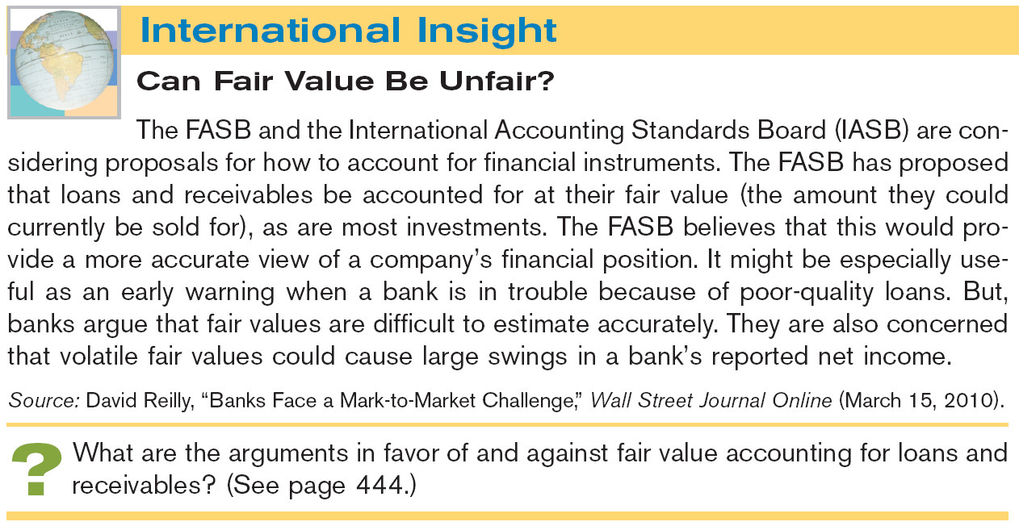


Slide 40
Notes Receivable
Disposing of Notes Receivable
Notes may be held to their maturity date.
Maker may default and payee must make an adjustment to the account.
Holder speeds up conversion to cash by selling the note receivable.
SO 5 Describe the entries to record the disposition of notes receivable.

Slide 41
Notes Receivable
Disposing of Notes Receivable
Honor of Notes Receivable
A note is honored when its maker pays it in full at its maturity date.
Dishonor of Notes Receivable
A dishonored note is not paid in full at maturity. Dishonored note receivable is no longer negotiable.
SO 5 Describe the entries to record the disposition of notes receivable.

Slide 42
Notes Receivable
Honor of Notes Receivable
Illustration: Wolder Co. lends Higley Inc. $10,000 on June 1, accepting a five-month, 9% interest note. If Wolder presents the note to Higley Inc. on November 1, the maturity date, Wolder’s entry to record the collection is:
Nov. 1
Cash 10,375
Notes receivable 10,000
Interest revenue 375
($10,000 x 9% x 5/12 = $ 375)
SO 5 Describe the entries to record the disposition of notes receivable.

Slide 43

Notes Receivable
Accrual of Interest
Illustration: Suppose instead that Wolder Co. prepares financial statements as of September 30. The adjusting entry by Wolder is for four months ending Sept. 30.
Illustration 8-12
Sept. 30
Interest receivable 300
Interest revenue 300
($10,000 x 9% x 4/12 = $ 300)
SO 5 Describe the entries to record the disposition of notes receivable.

Slide 44
Notes Receivable
Accrual of Interest
Illustration: Prepare the entry Wolder’s would make to
record the honoring of the Higley note on November 1.
Nov. 1
Cash 10,375
Notes receivable 10,000
Interest receivable 300
Interest revenue 75
SO 5 Describe the entries to record the disposition of notes receivable.

Slide 45
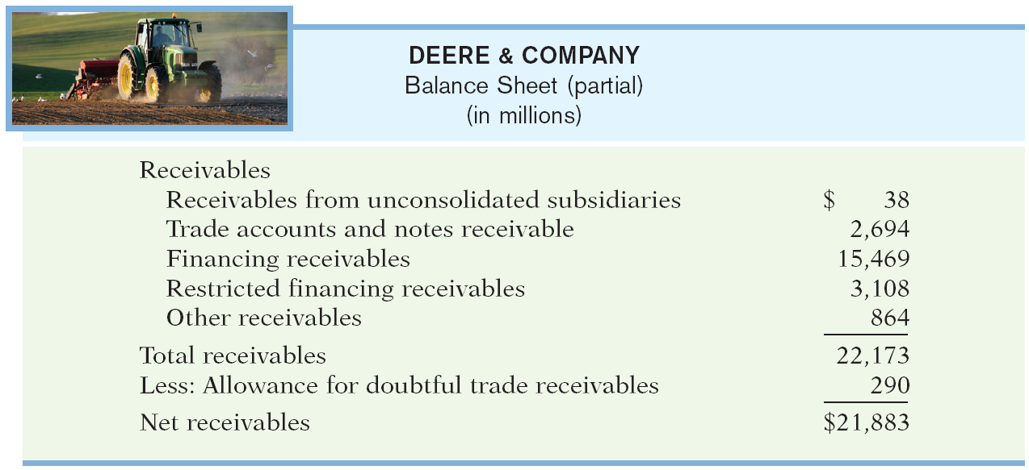
Financial Statement Presentation
Illustration 8-13
Balance sheet presentation
of receivables
SO 6 Explain the statement presentation of receivables.

Slide 46
Managing Receivables
Managing accounts receivable involves five steps:
  Determine to whom to extend credit.
  Establish a payment period.
  Monitor collections.
  Evaluate the liquidity of receivables.
  Accelerate cash receipts from receivables when necessary.
SO 7 Describe the principles of sound accounts receivable management.

Slide 47
Managing Receivables
Extending Credit
If the credit policy is too tight, you will lose sales.
If the credit policy is too loose, you may sell to customer who will pay either very late or not at all.
It is important to check references on potential new customers as well as periodically to check the financial health of continuing customers.
SO 7 Describe the principles of sound accounts receivable management.

Slide 48
Managing Receivables
Establishing a Payment Period
Companies should determine a required payment period and communicate that policy to their customers.
The payment period should be consistent with that of competitors.
SO 7 Describe the principles of sound accounts receivable management.

Slide 49
Managing Receivables
Monitoring Collections
Companies should prepare an accounts receivable aging schedule at least monthly.
Treasurer should prepare a cash budget.
Significant concentrations of credit risk must be discussed in the notes to its financial statements.
SO 7 Describe the principles of sound accounts receivable management.

Slide 50
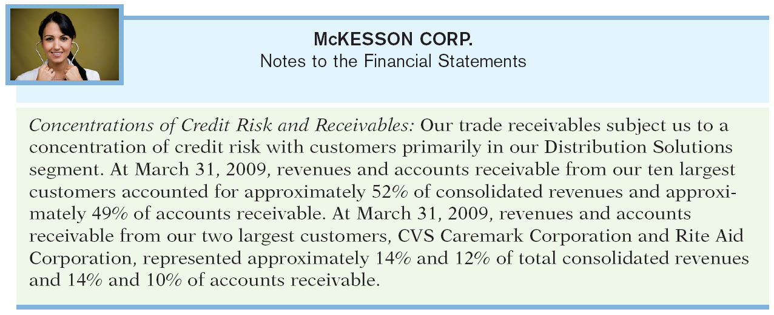
Illustration 8-14
Excerpt from note on concentration of credit risk

Slide 51
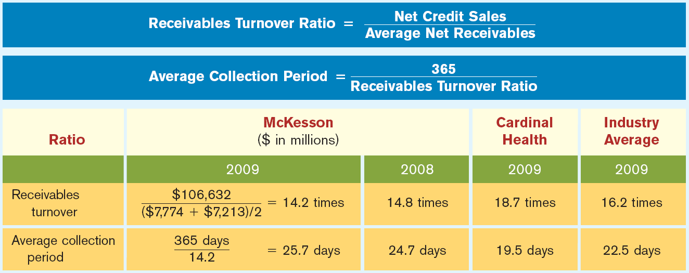
Financial Statement Presentation
Evaluating Liquidity of Receivables
Illustration 8-15
SO 8 Identify ratios to analyze a company’s receivables.

Slide 52
Financial Statement Presentation
Evaluating Liquidity of Receivables
Accounts Receivable Turnover:
  Assess the liquidity of the receivables.
  Measure the number of times, on average, a company collects receivables during the period.
Average collection period:
  Used to assess effectiveness of credit and collection policies.
  Collection period should not exceed credit term period.
SO 8 Identify ratios to analyze a company’s receivables.

Slide 53
Financial Statement Presentation
Accelerating Cash Receipts
Three reasons for the sale of receivables:
  Size.
  Companies may sell receivables because they may be the only reasonable source of cash.
  Billing and collection are often time-consuming and costly.
SO 9 Describe methods to accelerate the receipt of cash from receivables.

Slide 54
Financial Statement Presentation
National Credit Card Sales
Three parties involved when credit cards are used.
  credit card issuer,
  retailer, and
  customer.
The retailer pays the credit card issuer a fee of 2% to 4% of the invoice price for its services.
SO 9 Describe methods to accelerate the receipt of cash from receivables.

Slide 55
Financial Statement Presentation
National Credit Card Sales
Illustration: Morgan Marie purchases $1,000 of compact discs for her restaurant from Sondgeroth Music Co., and she charges this amount on her Visa First Bank Card. The service fee that First Bank charges Sondgeroth Music is 3%.
Cash 970
Service charge expense 30
Sales revenue 1,000
SO 9 Describe methods to accelerate the receipt of cash from receivables.

Slide 56
Financial Statement Presentation
Sale of Receivables to a Factor
A factor is a finance company or bank that buys receivables from businesses for a fee and then collects the payments directly from the customers.
Illustration: Assume that Hendredon Furniture factors $600,000 of receivables to Federal Factors, Inc. Federal Factors assesses a service charge of 2% of the amount of receivables sold.
Cash 588,000
Service charge expense 12,000
Accounts receivable 600,000
SO 9 Describe methods to accelerate the receipt of cash from receivables.

Slide 57
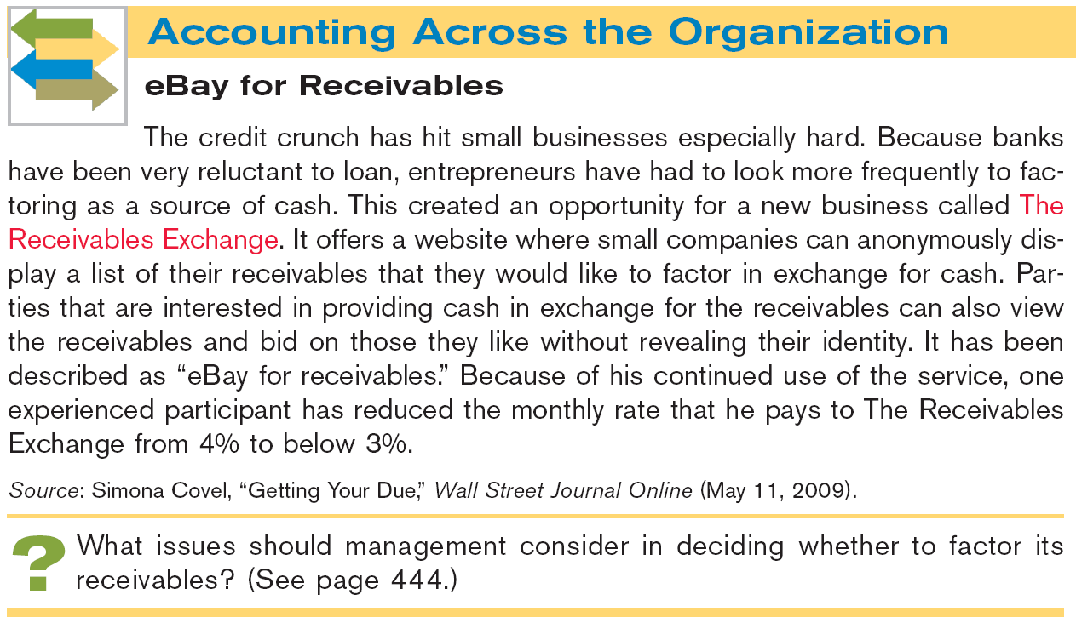


Slide 58
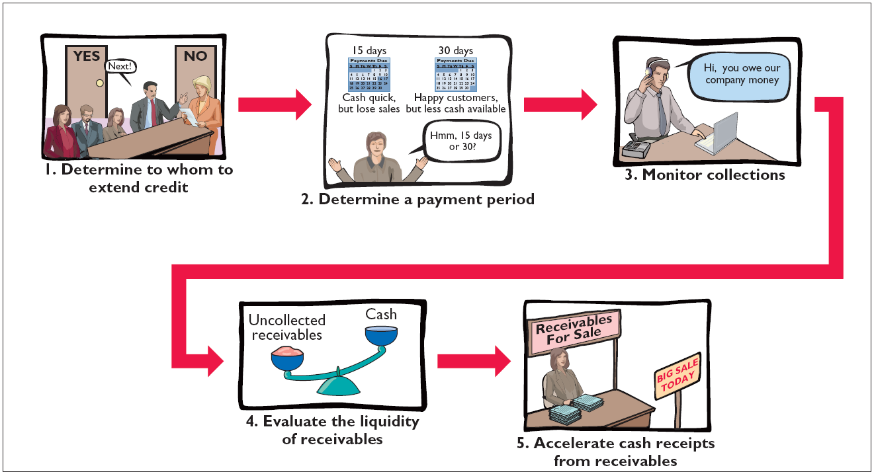
Financial Statement Presentation
Illustration 8-17
Managing receivables
SO 9 Describe methods to accelerate the receipt of cash from receivables.

Slide 59

Key Points
  IFRS requires that loans and receivables be accounted for at amortized cost, adjusted for allowances for doubtful accounts. IFRS sometimes refers to these allowances as provisions.
  Although IFRS implies that receivables with different characteristics should be reported separately, there is no standard that mandates this segregation.
  The FASB and IASB have worked to implement fair value measurement for financial instruments. The Boards have adopted a piecemeal approach; the first step is disclosure of fair value information in the notes. The second step is the fair value option, which permits, companies to record some financial instruments at fair values in the financial statements.

Slide 60
Key Points
  IFRS requires a two-tiered approach to test whether the value of loans and receivables are impaired. First, a company should look at specific loans and receivables to determine whether they are impaired. Then, the loans and receivables as a group should be evaluated for impairment. GAAP does not prescribe a similar two-tiered approach.
  IFRS and GAAP differ in the criteria used to derecognize (generally through a sale or factoring) a receivable. IFRS is a combination of an approach focused on risks and rewards and loss of control. GAAP uses loss of control as the primary criterion. In addition, IFRS permits partial derecognition; GAAP does not.

Slide 61
Looking into the Future
Both the IASB and the FASB have indicated that they believe that financial statements would be more transparent and understandable if companies recorded and reported all financial instruments at fair value. That said, in IFRS 9, which was issued in 2009, the IASB created a split model, where some financial instruments are recorded at fair value, but other financial assets, such as loans and receivables, can be accounted for at amortized cost if certain criteria are met. It has been suggested that IFRS 9 will likely be changed or replaced as the FASB and IASB continue to deliberate the best treatment for financial instruments.

Slide 62
Under IFRS, loans and receivables are to be reported on the balance sheet at:
  amortized cost.
  amortized cost adjusted for estimated loss provisions.
  historical cost.
  replacement cost.

Slide 63
Which of the following statements is false?
  Loans and receivables include equity securities purchased by the company.
  Loans and receivables include credit card receivables.
  Loans and receivables include amounts owed by employees as a result of company loans to employees.
  Loans and receivables include amounts resulting from transactions with customers.

Slide 64
In recording the derecognition of a receivable, for example, as the result of a factoring transaction:
  IFRS focuses on loss of control.
  GAAP focuses on loss of control and risks and rewards.
  IFRS and GAAP allow partial derecognition.
  IFRS allows partial derecognition

Slide 65
Copyright
“Copyright © 2011 John Wiley & Sons, Inc. All rights reserved. Reproduction or translation of this work beyond that permitted in Section 117 of the 1976 United States Copyright Act without the express written permission of the copyright owner is unlawful. Request for further information should be addressed to the Permissions Department, John Wiley & Sons, Inc. The purchaser may make back-up copies for his/her own use only and not for distribution or resale. The Publisher assumes no responsibility for errors, omissions, or damages, caused by the use of these programs or from the use of the information contained herein.”

