Slide 1


9
REPORTING AND ANALYZING LONG-LIVED ASSETS
Financial Accounting, Sixth Edition

Slide 2
Study Objectives
Describe how the cost principle applies to plant assets.
Explain the concept of depreciation.
Compute periodic depreciation using the straight-line method, and contrast its expense pattern with those of other methods.
Describe the procedure for revising periodic depreciation.
Explain how to account for the disposal of plant assets.
Describe methods for evaluating the use of plant assets.
Identify the basic issues related to reporting intangible assets.
Indicate how long-lived assets are reported in the financial statements.

Slide 3

Reporting and Analyzing Long-Lived Assets
Plant Assets
Intangible Assets
Determining the cost of plant assets
Accounting for plant assets
Analyzing plant assets
Accounting for intangibles assets
Types of intangibles assets
Financial statement presentation of long-lived assets

Slide 4
Plant Assets
Section One
Plant assets are resources that have
  physical substance (a definite size and shape),
  are used in the operations of a business,
  are not intended for sale to customers,
  are expected to provide service to the company for a number of years, except for land.
Referred to as property, plant, and equipment; plant and equipment; and fixed assets.

Slide 5
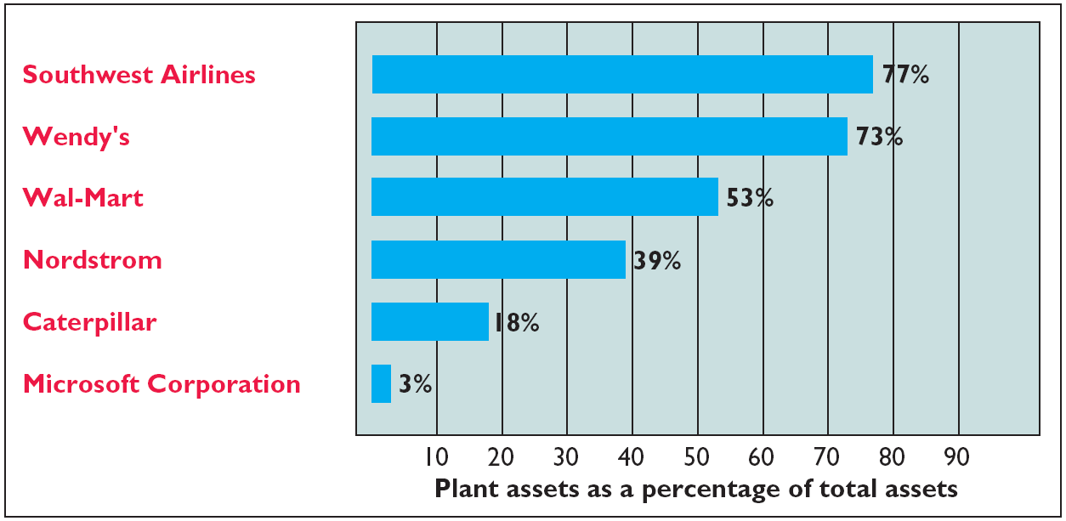
Plant Assets
Section One
Plant assets are critical to a company’s success
Illustration 9-1

Slide 6
Determining the Cost of Plant Assets
Cost Principle - requires that companies record plant assets at cost.
Cost consists of all expenditures necessary to acquire an asset and make it ready for its intended use.
Revenue expenditure – costs that are immediately charged against revenues as an expense.
Capital expenditures - costs included in a plant asset account.
SO 1 Describe how the cost principle applies to plant assets.

Slide 7
Determining the Cost of Plant Assets
Cost - cash paid in a cash transaction or the cash equivalent price paid.
Cash equivalent price is the
  fair value of the asset given up or
  fair value of the asset received,
  whichever is more clearly determinable.
SO 1 Describe how the cost principle applies to plant assets.

Slide 8
Determining the Cost of Plant Assets
Land
All necessary costs incurred in making land ready for its intended use increase (debit) the Land account.
  Costs typically include:
    cash purchase price,
    closing costs such as title and attorney’s fees,
    real estate brokers’ commissions, and
    accrued property taxes and other liens on the land assumed by the purchaser.
SO 1 Describe how the cost principle applies to plant assets.

Slide 9
Determining the Cost of Plant Assets
Illustration: Assume that Hayes Manufacturing Company acquires real estate at a cash cost of $100,000. The property contains an old warehouse that is razed at a net cost of $6,000 ($7,500 in costs less $1,500 proceeds from salvaged materials). Additional expenditures are the attorney’s fee, $1,000, and the real estate broker’s commission, $8,000.
Required: Determine the amount to be reported as the cost of the land.
SO 1 Describe how the cost principle applies to plant assets.

Slide 10
Determining the Cost of Plant Assets
Required: Determine amount to be reported as the cost of the land.
Land
Cash price of property ($100,000)
$100,000
Net removal cost of warehouse ($6,000)
6,000
Attorney's fees ($1,000)
1,000
Real estate broker’s commission ($8,000)
8,000
Cost of Land
$115,000
SO 1 Describe how the cost principle applies to plant assets.

Slide 11
Determining the Cost of Plant Assets
Land Improvements
Includes all expenditures necessary to make the improvements ready for their intended use.
Examples: driveways, parking lots, fences, landscaping, and underground sprinklers.
Limited useful lives.
Expense (depreciate) the cost of land improvements over their useful lives.
SO 1 Describe how the cost principle applies to plant assets.

Slide 12
Determining the Cost of Plant Assets
Buildings
Includes all costs related directly to purchase or construction.
Purchase costs:
  Purchase price, closing costs (attorney’s fees, title insurance, etc.) and real estate broker’s commission.
  Remodeling and replacing or repairing the roof, floors, electrical wiring, and plumbing.
Construction costs:
  Contract price plus payments for architects’ fees, building permits, and excavation costs.
SO 1 Describe how the cost principle applies to plant assets.

Slide 13
Determining the Cost of Plant Assets
Equipment
Include all costs incurred in acquiring the equipment and preparing it for use.
Costs typically include:
  Cash purchase price.
  Sales taxes.
  Freight charges.
  Insurance during transit paid by the purchaser.
  Expenditures required in assembling, installing, and testing the unit.
SO 1 Describe how the cost principle applies to plant assets.

Slide 14
Determining the Cost of Plant Assets
Illustration: Lenard Company purchases a delivery truck at a cash price of $22,000. Related expenditures are sales taxes $1,320, painting and lettering $500, motor vehicle license $80, and a three-year accident insurance policy $1,600. Compute the cost of the delivery truck.
Truck
Cash price
$22,000
Sales taxes
1,320
Painting and lettering
500
Cost of Delivery Truck
$23,820
SO 1 Describe how the cost principle applies to plant assets.

Slide 15
Determining the Cost of Plant Assets
Illustration: Lenard Company purchases a delivery truck at a cash price of $22,000. Related expenditures are sales taxes $1,320, painting and lettering $500, motor vehicle license $80, and a three-year accident insurance policy $1,600. Prepare the journal entry to record these costs.
Equipment 23,820
License expense 80
Prepaid insurance 1,600
Cash 25,500
SO 1 Describe how the cost principle applies to plant assets.

Slide 16
Determining the Cost of Plant Assets
To Buy or Lease?
A lease is a contractual agreement in which the owner of an asset (lessor) allows another party (lessee) to use the asset for a period of time at an agreed price.
Some advantages of leasing
  Reduced risk of obsolescence.
  Little or no down payment.
  Shared tax advantages.
  Assets and liabilities not reported.
Capital lease - lessees show the asset and liability on the balance sheet.
SO 1 Describe how the cost principle applies to plant assets.

Slide 17
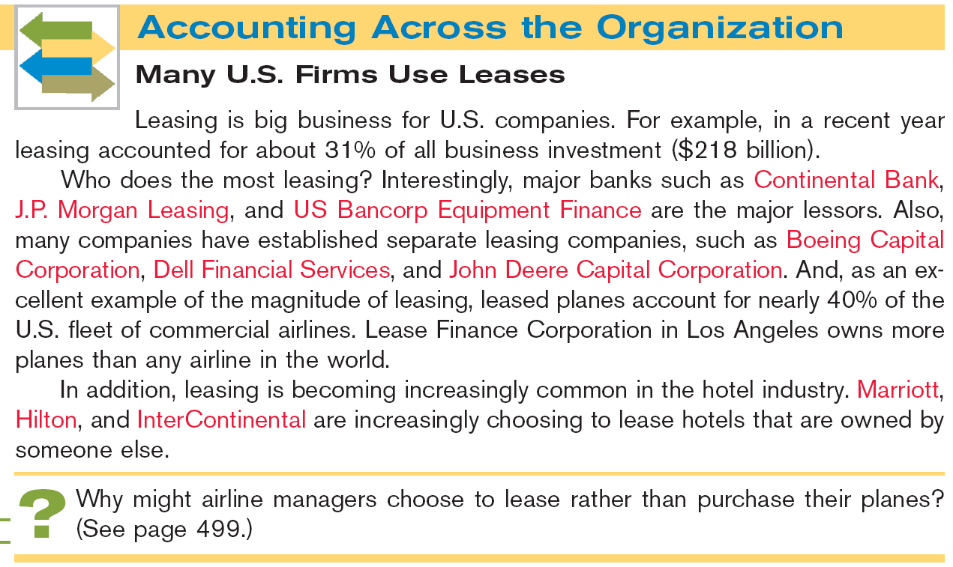
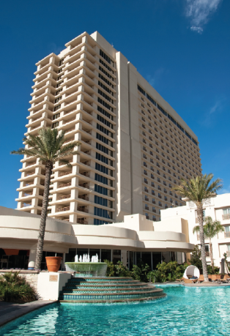

Slide 18
Accounting for Plant Assets
Depreciation
Process of allocating to expense the cost of a plant asset over its useful (service) life in a rational and systematic manner.
  Process of cost allocation, not asset valuation.
  Applies to land improvements, buildings, and equipment, not land.
  Depreciable, because the revenue-producing ability of asset will decline over the asset’s useful life.
SO 2 Explain the concept of depreciation.

Slide 19
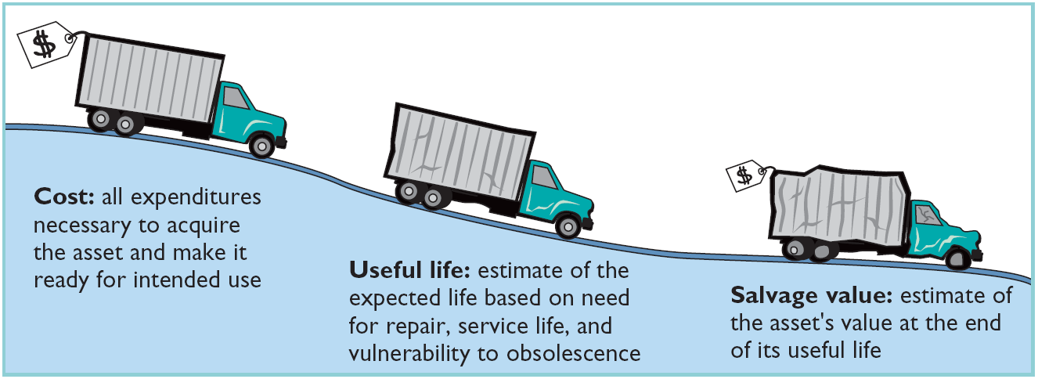
Accounting for Plant Assets
Factors in Computing Depreciation
Illustration 9-6
Cost
Useful Life
Salvage Value
SO 2 Explain the concept of depreciation.

Slide 20
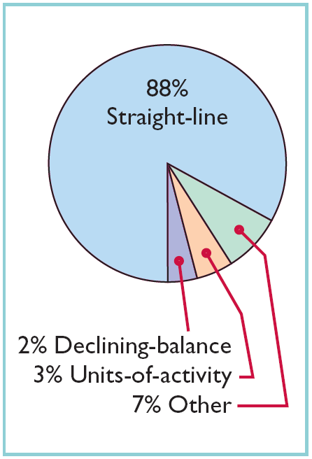
Accounting for Plant Assets
Depreciation Methods
Management selects the method it believes best measures an asset’s contribution to revenue over its useful life.
Examples include:
  Straight-line method.
  Declining-balance method.
  Units-of-activity method.
Illustration 9-7
Use of depreciation methods in major U.S. companies
SO 3

Slide 21
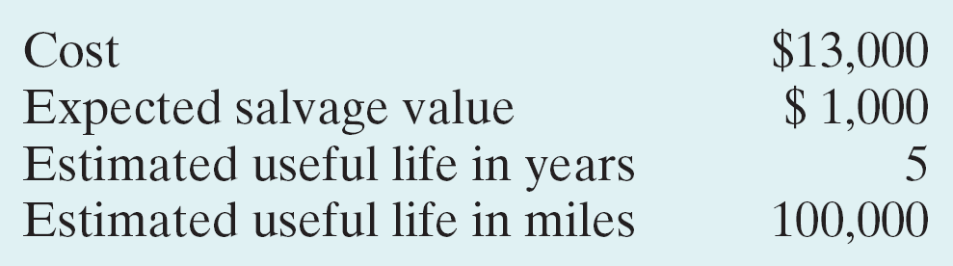
Accounting for Plant Assets
Illustration: Bill’s Pizzas purchased a small delivery truck on January 1, 2012.
Required: Compute depreciation using the following.
(a) Straight-Line. (b) Units-of-Activity. (c) Declining Balance.
SO 3 Compute periodic depreciation using the straight-line method, and contrast its expense pattern with those of other methods.

Slide 22
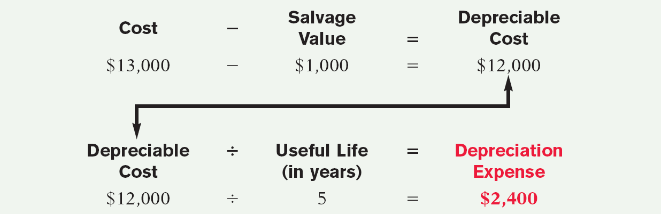
Accounting for Plant Assets
Straight-Line
Expense is same amount for each year.
Depreciable cost = Cost less salvage value.
Illustration 9-8
SO 3 Compute periodic depreciation using the straight-line method, and contrast its expense pattern with those of other methods.

Slide 23
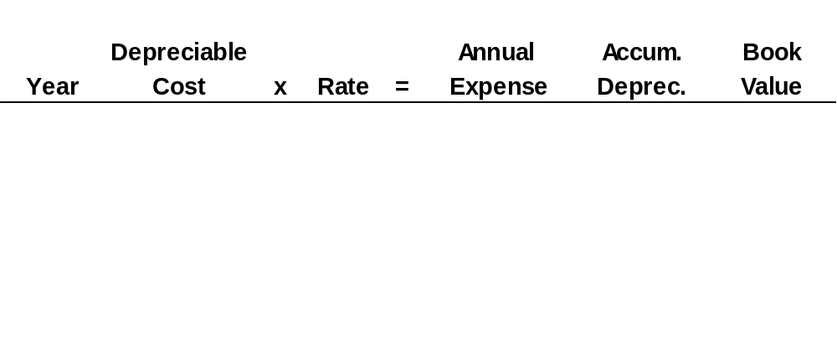
Accounting for Plant Assets
Illustration: (Straight-Line Method)
Illustration 9-9
2012
$ 12,000
20%
$ 2,400
$ 2,400
$ 10,600
2013
12,000
20
2,400
4,800
8,200
2014
12,000
20
2,400
7,200
5,800
2015
12,000
20
2,400
9,600
3,400
2016
12,000
20
2,400
12,000
1,000
2012 Journal Entry
Depreciation expense 2,400
Accumulated depreciation 2,400
SO 3 Compute periodic depreciation using the straight-line method, and contrast its expense pattern with those of other methods.

Slide 24
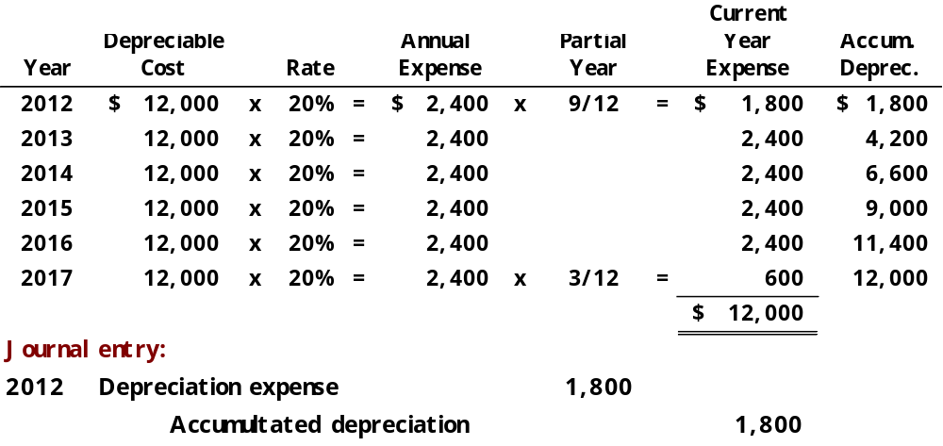
Accounting for Plant Assets
Partial Year
Illustration: (Straight-Line Method)
Assume the delivery truck was purchased on April 1, 2010.
SO 3

Slide 25
Accounting for Plant Assets
Declining-Balance
Accelerated method.
Decreasing annual depreciation expense over the asset’s useful life.
Double declining-balance rate is double the straight-line rate.
Rate applied to book value.
SO 3 Compute periodic depreciation using the straight-line method, and contrast its expense pattern with those of other methods.

Slide 26
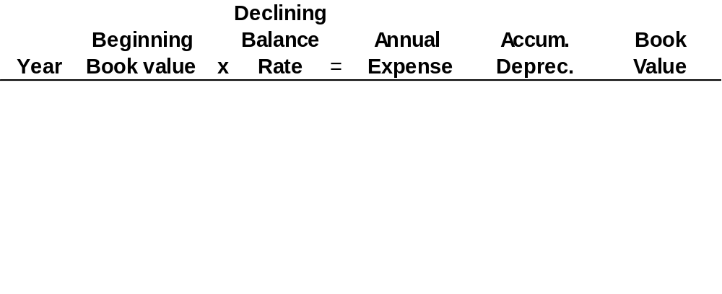
Accounting for Plant Assets
Illustration: (Declining-Balance Method)
Illustration 9A-2
2012
13,000
40%
$ 5,200
$ 5,200
$ 7,800
2013
7,800
40
3,120
8,320
4,680
2014
4,680
40
1,872
10,192
2,808
2015
2,808
40
1,123
11,315
1,685
2016
1,685
40
685*
12,000
1,000
2012 Journal Entry
Depreciation expense 5,200
Accumulated depreciation 5,200
* Computation of $674 ($1,685 x 40%) is adjusted to $685.
SO 3

Slide 27
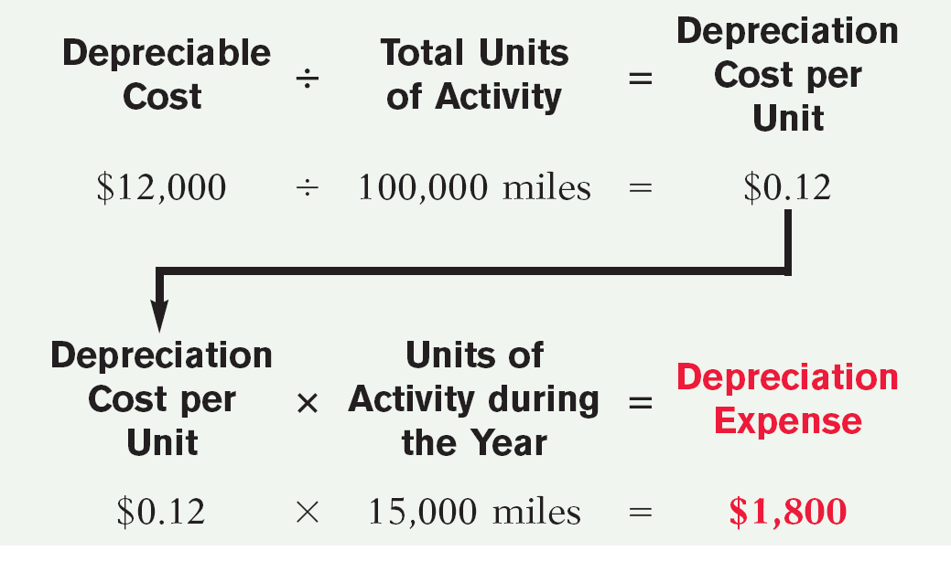
Accounting for Plant Assets
Units-of-Activity
Companies estimate total units of activity to calculate depreciation cost per unit.
Illustration 9A-3
Expense varies based on units of activity.
Depreciable cost is cost less salvage value.
SO 3 Compute periodic depreciation using the straight-line method, and contrast its expense pattern with those of other methods.

Slide 28
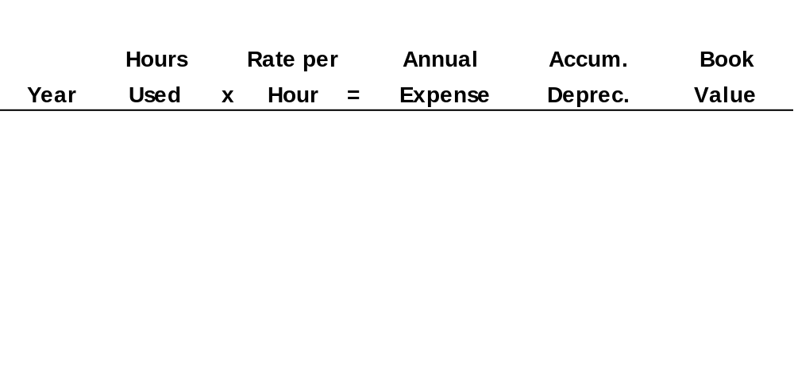
Accounting for Plant Assets
Illustration: (Units-of-Activity Method)
Illustration 9A-4
2012
15,000
$ 0.12
$ 1,800
$ 1,800
$ 11,200
2013
30,000
0.12
3,600
5,400
7,600
2014
20,000
0.12
2,400
7,800
5,200
2015
25,000
0.12
3,000
10,800
2,200
2016
10,000
0.12
1,200
12,000
1,000
2012 Journal Entry
Depreciation expense 1,800
Accumulated depreciation 1,800
SO 3 Compute periodic depreciation using the straight-line method, and contrast its expense pattern with those of other methods.

Slide 29
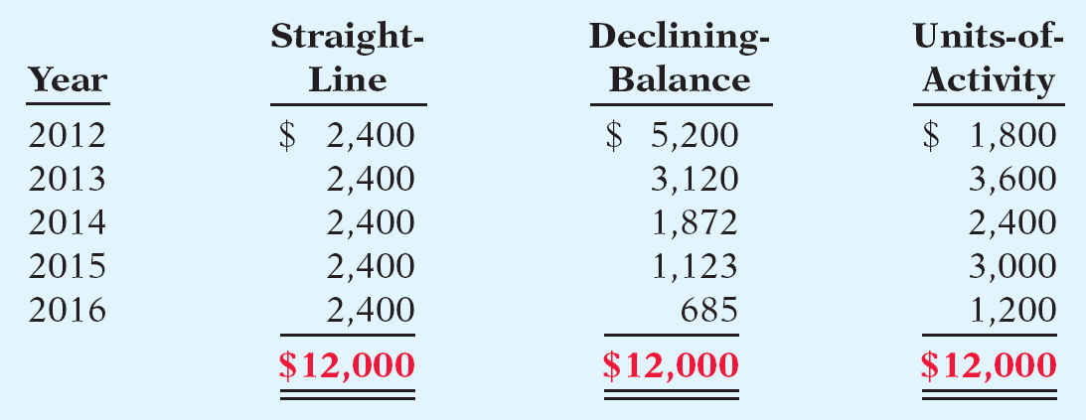
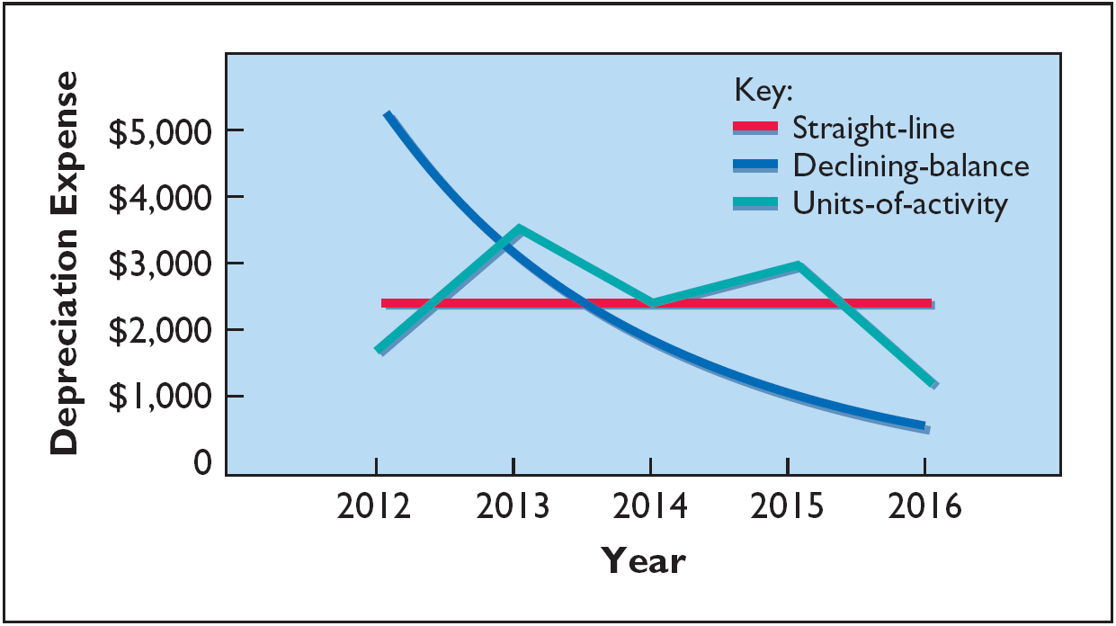
Accounting for Plant Assets
Illustration 9-12
Comparison of Depreciation Methods
Illustration 9-13
Each method is acceptable because each recognizes the decline in service potential of the asset
in a rational and systematic manner.
SO 3

Slide 30
Accounting for Plant Assets
Depreciation and Income Taxes
IRS does not require taxpayer to use the same depreciation method on the tax return that is used in preparing financial statements.
IRS requires the straight-line method or a special accelerated-depreciation method called the Modified Accelerated Cost Recovery System (MACRS).
MACRS is NOT acceptable under GAAP.
SO 3 Compute periodic depreciation using the straight-line method, and contrast its expense pattern with those of other methods.

Slide 31
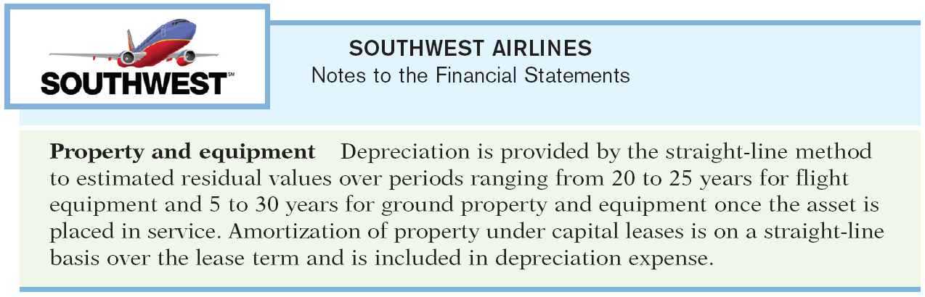
Accounting for Plant Assets
Depreciation Disclosure in the Notes
Illustration 9-14
SO 3 Compute periodic depreciation using the straight-line method, and contrast its expense pattern with those of other methods.

Slide 32
Accounting for Plant Assets
Revising Periodic Depreciation
Accounted for in the period of change and future periods (Change in Estimate).
Not handled retrospectively.
Not considered error.
SO 4 Describe the procedure for revising periodic depreciation.

Slide 33
Accounting for Plant Assets
Illustration: Arcadia HS, purchased equipment for $510,000 which was estimated to have a useful life of 10 years with a salvage value of $10,000 at the end of that time. Depreciation has been recorded for 7 years on a straight-line basis. In 2012 (year 8), it is determined that the total estimated life should be 15 years with a salvage value of $5,000 at the end of that time.
Questions:
  What is the journal entry to correct the prior years’ depreciation?
  Calculate the depreciation expense for 2012.
No Entry
Required
SO 4 Describe the procedure for revising periodic depreciation.

Slide 34
Accounting for Plant Assets
After 7 years
Equipment cost $510,000
Salvage value - 10,000
Depreciable base 500,000
Useful life (original) 10 years
Annual depreciation $ 50,000
First, establish NBV at date of change in estimate.
x 7 years = $350,000
Balance Sheet (Dec. 31, 2011)
Plant Assets:
Equipment
$510,000
Accumulated depreciation
350,000
Net book value (NBV)
$160,000
SO 4 Describe the procedure for revising periodic depreciation.

Slide 35
Accounting for Plant Assets
After 7 years
Net book value $160,000
Salvage value (new) 5,000
Depreciable base 155,000
Useful life remaining 8 years
Annual depreciation $ 19,375
Depreciation Expense calculation for 2012.
Journal entry for 2012 and future years.
Depreciation expense 19,375
Accumulated depreciation 19,375
SO 4 Describe the procedure for revising periodic depreciation.

Slide 36
Accounting for Plant Assets
Expenditure During Useful Life
Ordinary Repairs - expenditures to maintain the operating efficiency and productive life of the unit.
  Debit - Repair (or Maintenance) Expense.
Additions and Improvements - costs incurred to increase the operating efficiency, productive capacity, or useful life of a plant asset.
  Debit - the plant asset affected.
SO 4 Describe the procedure for revising periodic depreciation.

Slide 37

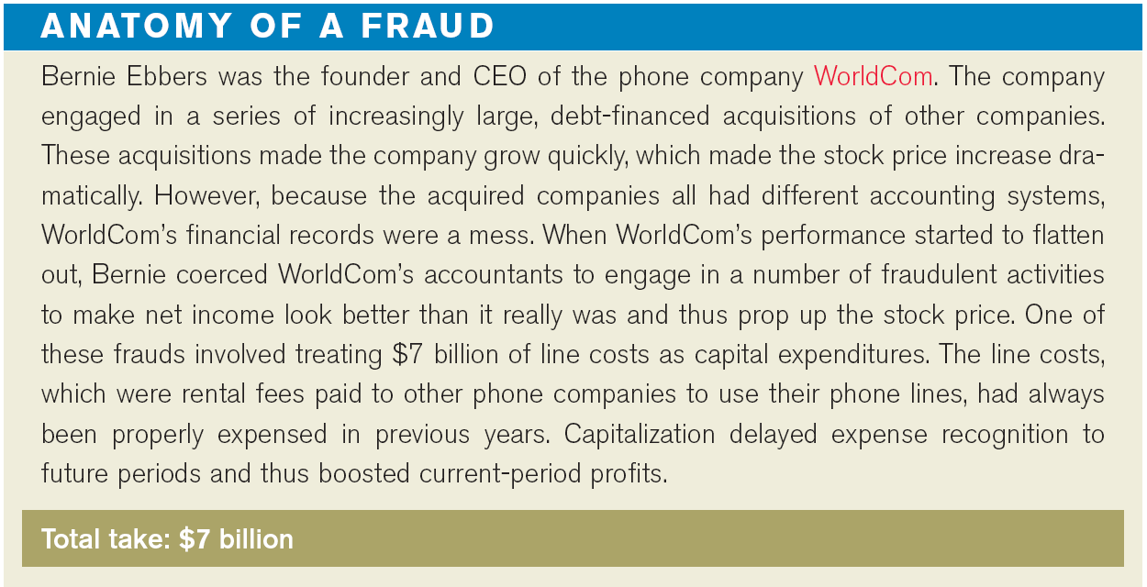

Slide 38
Accounting for Plant Assets
Impairments
Permanent decline in the fair value of an asset.
So as not to overstate the asset on the books, the company writes the asset down to its new fair value during the year in which the decline in value occurs.
SO 4 Describe the procedure for revising periodic depreciation.

Slide 39
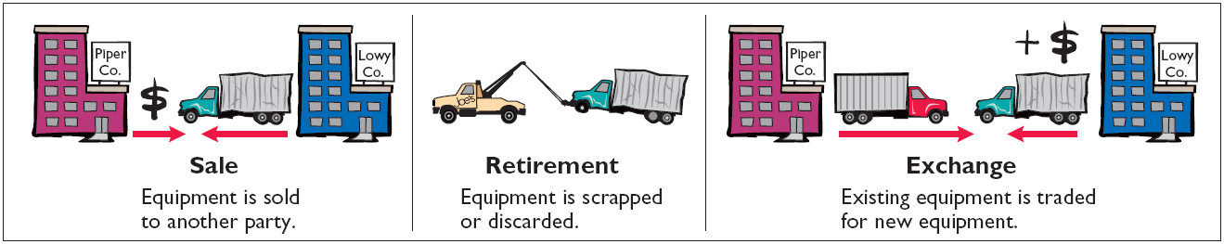
Accounting for Plant Assets
Plant Asset Disposals
Companies dispose of plant assets in three ways —Retirement, Sale, or Exchange (appendix).
Illustration 9-16
Record depreciation up to the date of disposal.
Eliminate asset by (1) debiting Accumulated Depreciation, and (2) crediting the asset account.
SO 5 Explain how to account for the disposal of a plant asset.

Slide 40
Plant Asset Disposals
Sale of Plant Assets
  Compare the book value of the asset with the proceeds received from the sale.
    If proceeds exceed the book value, a gain on disposal occurs.
    If proceeds are less than the book value, a loss on disposal occurs.
SO 5 Explain how to account for the disposal of a plant asset.

Slide 41
Plant Asset Disposals
Illustration: On July 1, 2012, Wright Company sells office furniture for $16,000 cash. The office furniture originally cost $60,000. As of January 1, 2012, it had accumulated depreciation of $41,000. Depreciation for the first six months of 2012 is $8,000. Prepare the journal entry to record depreciation expense up to the date of sale.
July 1
Depreciation expense 8,000
Accumulated depreciation 8,000
SO 5 Explain how to account for the disposal of a plant asset.

Slide 42
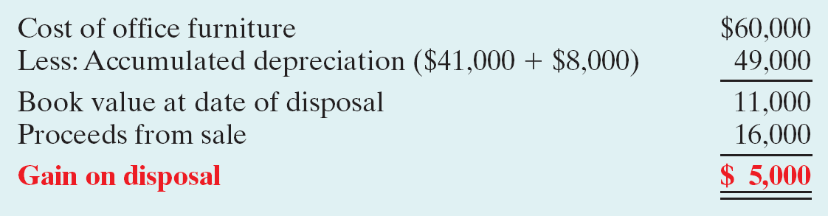
Plant Asset Disposals
Illustration 9-17
Computation of gain on disposal
Illustration: Wright records the sale as follows.
July 1
Cash 16,000
Accumulated depreciation 49,000
Equipment 60,000
Gain on disposal 5,000
SO 5 Explain how to account for the disposal of a plant asset.

Slide 43
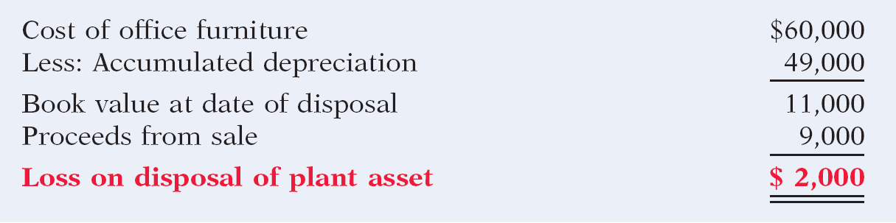
Plant Asset Disposals
Illustration: Assume that instead of selling the office furniture for $16,000, Wright sells it for $9,000.
Illustration 9-18
Computation of loss on disposal
July 1
Cash 9,000
Accumulated depreciation 49,000
Equipment 60,000
Loss on disposal 2,000
SO 5 Explain how to account for the disposal of a plant asset.

Slide 44
Plant Asset Disposals
Retirement of Plant Assets
No cash is received.
Decrease (debit) Accumulated Depreciation for the full amount of depreciation taken over the life of the asset.
Decrease (credit) the asset account for the original cost of the asset.
SO 5 Explain how to account for the disposal of a plant asset.

Slide 45
Plant Asset Disposals
Illustration: Assume that Hobart Enterprises retires
its computer printers, which cost $32,000. The accumulated depreciation on these printers is $32,000. The journal entry to record this retirement is?
Accumulated depreciation 32,000
Printing equipment 32,000
Question: What happens if a fully depreciated plant asset is still useful to the company?
SO 5 Explain how to account for the disposal of a plant asset.

Slide 46
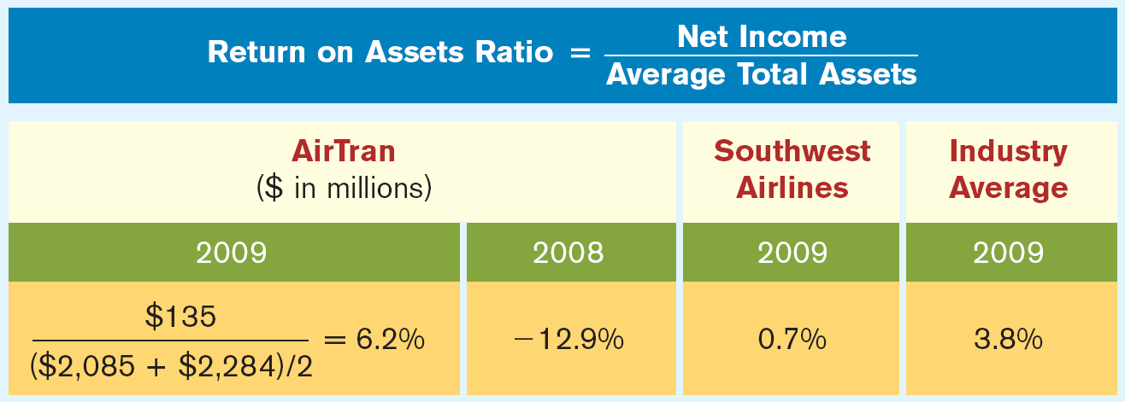
Analyzing Plant Assets
Return on Asset Ratio indicates the amount of net income generated by each dollar of assets.
Illustration 9-19
SO 6 Describe methods for evaluating the use of plant assets.

Slide 47
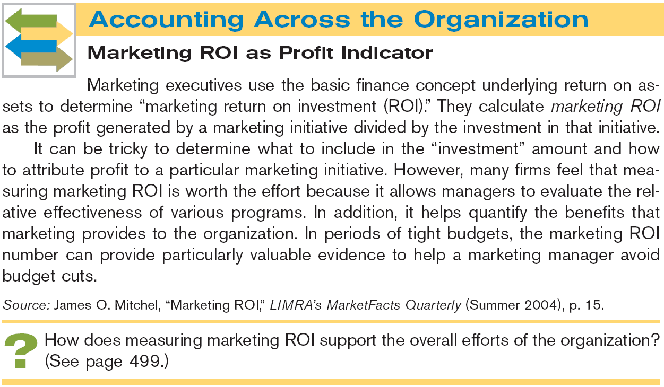


Slide 48
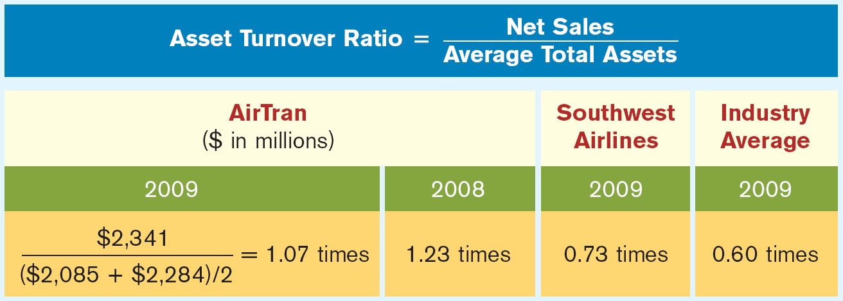
Analyzing Plant Assets
Asset Turnover Ratio indicates how efficiently a company uses its assets to generate sales.
Illustration 9-20
SO 6 Describe methods for evaluating the use of plant assets.

Slide 49
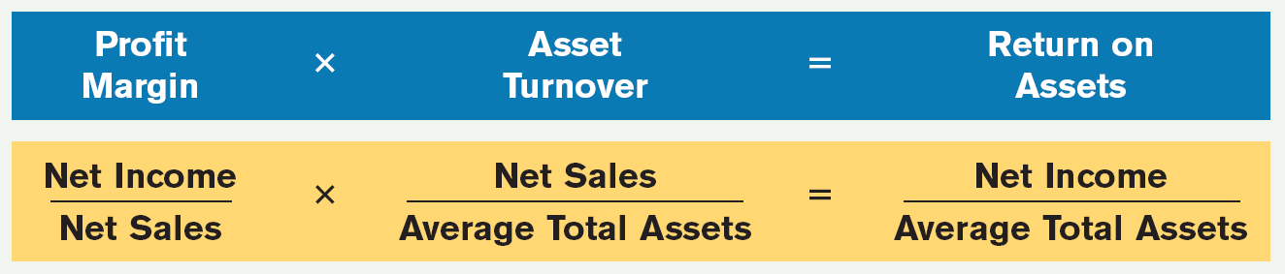
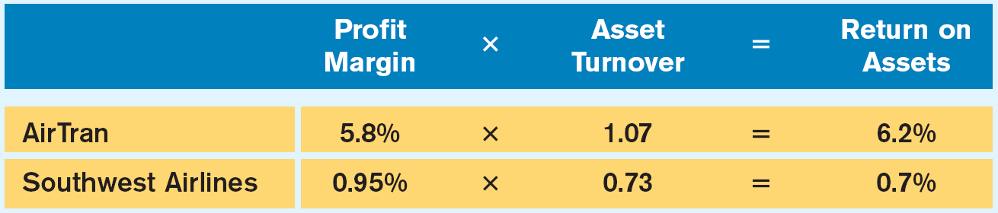
Analyzing Plant Assets
Profit Margin Ratio Revisited
Tells how effective a company is in turning its sales into income—that is, how much income each dollar of sales provides.
Illustration 9-21
Illustration 9-22
You can evaluate the return on assets ratio by evaluating its components.
SO 6 Describe methods for evaluating the use of plant assets.

Slide 50
Intangible Assets
Section Two
Intangible assets are rights, privileges, and competitive advantages that result from ownership of long-lived assets that do not possess physical substance.
Limited life or an indefinite life.
Common types of intangibles:
Patents
Copyrights
Franchises or licenses
Trademarks
Trade names
Goodwill
SO 7 Identify the basic issues related to reporting intangible assets.

Slide 51
Accounting for Intangible Assets
Amortization of Intangibles
Limited-Life Intangibles:
  Amortize to expense.
  Credit asset account.
Indefinite-Life Intangibles:
  No foreseeable limit on time the asset is expected to provide cash flows.
  No amortization.
SO 7 Identify the basic issues related to reporting intangible assets.

Slide 52
Types of Intangible Assets
Patents
Exclusive right to manufacture, sell, or otherwise control an invention for a period of 20 years from the date of the grant.
Capitalize costs of purchasing a patent and amortize over its 20-year life or its useful life, whichever is shorter.
Expense any R&D costs in developing a patent.
Legal fees incurred successfully defending a patent are capitalized to Patent account.
SO 7 Identify the basic issues related to reporting intangible assets.

Slide 53
Types of Intangible Assets
Illustration: National Labs purchases a patent at a cost of $60,000 on June 30. National estimates the useful life of the patent to be eight years. Prepare the journal entry to record the amortization for the six-month period ended December 31.
Cost $60,000
Useful life / 8
Annual expense $ 7,500
6 months x 6/12
Amortization $ 3,750
Dec. 31
Amortization expense 3,750
Patent 3,750
SO 7

Slide 54
Types of Intangible Assets
Research and Development Costs
Expenditures that may lead to
  patents,
  copyrights,
  new processes, and
  new products.
All R & D costs are expensed when incurred.
SO 7 Identify the basic issues related to reporting intangible assets.

Slide 55
Types of Intangible Assets
Copyrights
Give the owner the exclusive right to reproduce and sell an artistic or published work.
Granted for the life of the creator plus 70 years.
Capitalize costs of acquiring and defending it.
Amortized to expense over useful life.
SO 7 Identify the basic issues related to reporting intangible assets.

Slide 56
Types of Intangible Assets
Trademarks and Trade Names
  Word, phrase, jingle, or symbol that identifies a particular enterprise or product.
    Wheaties, Monopoly, Sunkist, Kleenex, Coca-Cola, Big Mac, and Jeep.
  Legal protection for indefinite number of 20 year renewal periods.
  Capitalize acquisition costs.
  No amortization.
SO 7 Identify the basic issues related to reporting intangible assets.

Slide 57
Types of Intangible Assets
Goodwill
Includes exceptional management, desirable location, good customer relations, skilled employees, high-quality products, etc.
Only recorded when an entire business is purchased.
Goodwill is recorded as the excess of ...
purchase price over the FMV of the identifiable net assets acquired.
Internally created goodwill should not be capitalized.
SO 7 Identify the basic issues related to reporting intangible assets.

Slide 58
Types of Intangible Assets
Franchises and Licenses
  Contractual arrangement between a franchisor and a franchisee.
    Toyota, Shell, Subway, and Marriott are franchises.
  Franchise (or license) with a limited life should be amortized to expense over the life of the franchise.
  Franchise with an indefinite life should be carried at cost and not amortized.
SO 7 Identify the basic issues related to reporting intangible assets.

Slide 59

Types of Intangible Assets
Illustration: Identify the term most directly associated with each statement.
1. The allocation to expense of the cost of an intangible asset over the asset’s useful life.
2. Rights, privileges, and competitive advantages that result from the ownership of long-lived assets that do not possess physical substance.
3. An exclusive right granted by the federal government to reproduce and sell an artistic or published work.
Amortization
Intangible Assets
Copyrights
SO 7 Identify the basic issues related to reporting intangible assets.

Slide 60
Types of Intangible Assets
Illustration: Identify the term most directly associated with each statement.
4. A right to sell certain products or services or to use certain trademarks or trade names within a designated geographic area.
5. Costs incurred by a company that often lead to patents or new products. These costs must be expensed as incurred.
Franchise
Research and Development Costs
SO 7 Identify the basic issues related to reporting intangible assets.

Slide 61
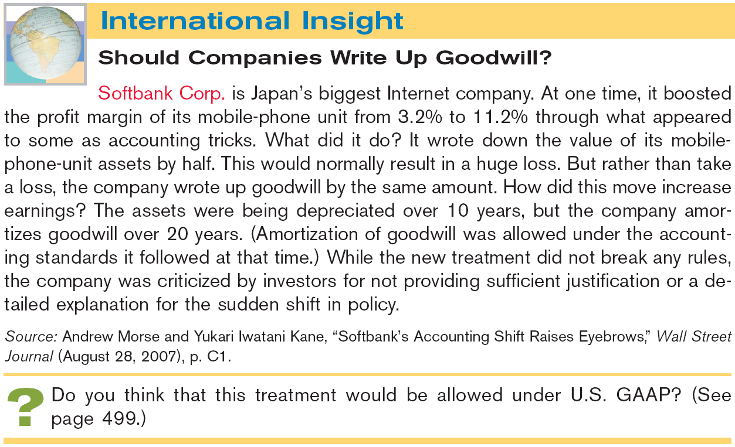


Slide 62
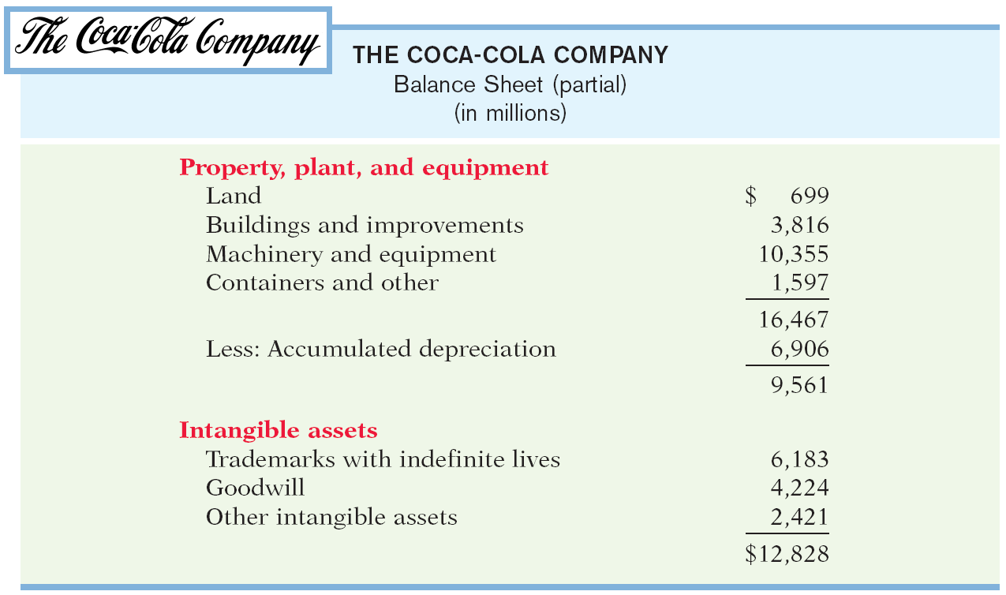
Statement Presentation of Long-Lived Assets
Illustration 9-23
SO 8 Indicate how long-lived assets are reported in the financial statements.

Slide 63
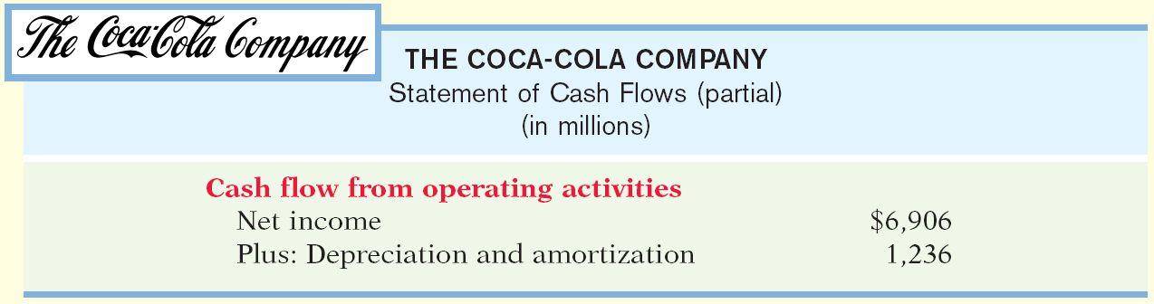
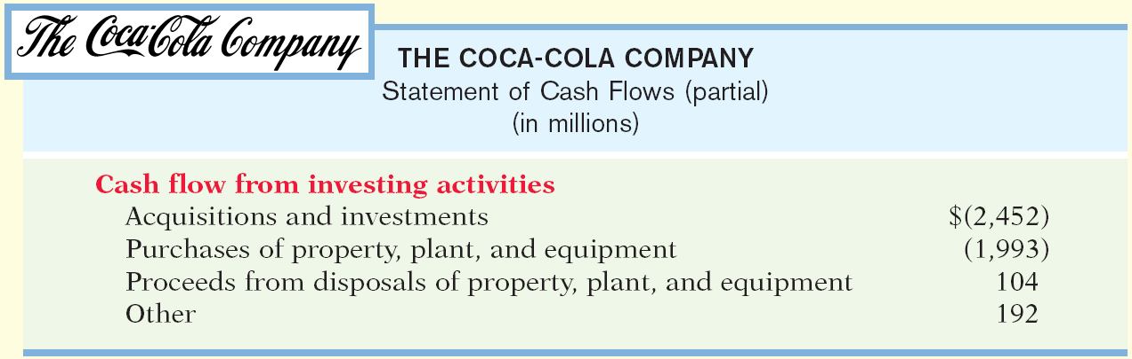
Statement Presentation of Long-Lived Assets
A difference between accrual-accounting net income and net cash provided by operating activities is caused by depreciation and amortization expense.
SO 8.

Slide 64
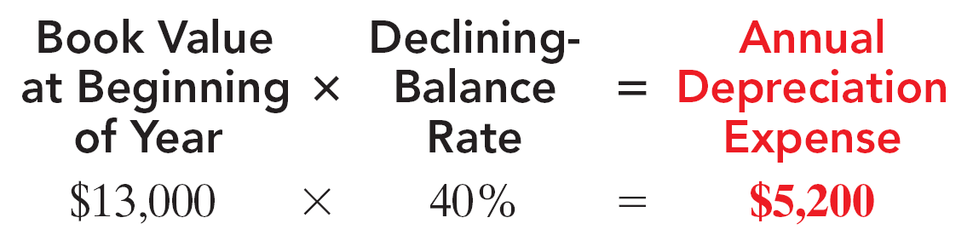
Calculation of Depreciation Using Other Methods
appendix 9A
Declining-Balance
Decreasing annual depreciation expense over the asset’s useful life.
Double declining-balance rate is double the straight-line rate.
Rate applied to book value.
Illustration 9-A1
SO 9 Compute periodic depreciation using the declining- balance method and the units-of-activity method.

Slide 65
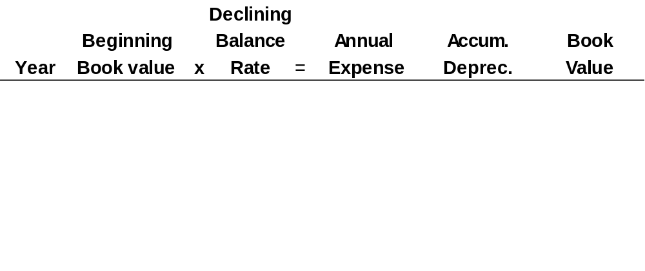
Calculation of Depreciation Using Other Methods
appendix 9A
Illustration: (Declining-Balance Method)
Illustration 9-A2
2012
13,000
40%
$ 5,200
$ 5,200
$ 7,800
2013
7,800
40
3,120
8,320
4,680
2014
4,680
40
1,872
10,192
2,808
2015
2,808
40
1,123
11,315
1,685
2016
1,685
40
685*
12,000
1,000
2012 Journal Entry
Depreciation expense 5,200
Accumulated depreciation 5,200
* Computation of $674 ($1,685 x 40%) is adjusted to $685.

Slide 66
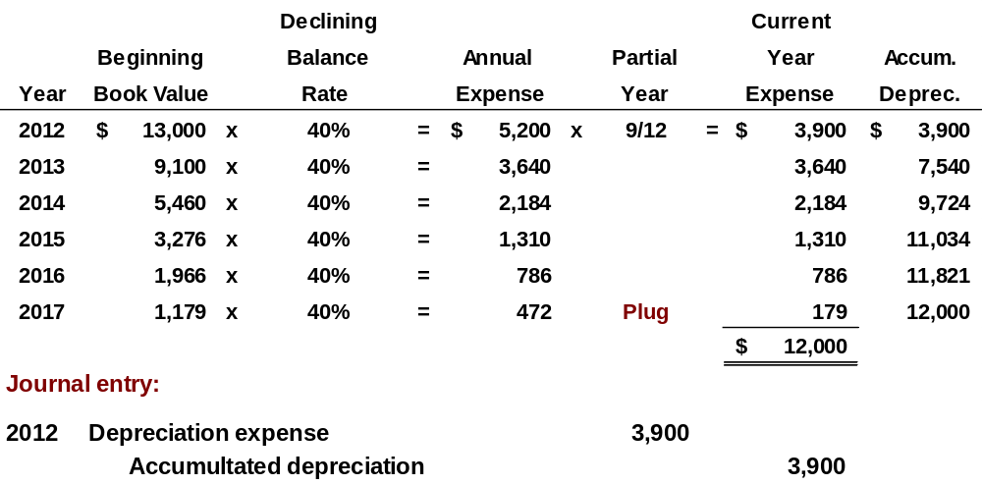
Partial Year
Purchased on 4/1/12
appendix 9A
Illustration: (Declining-Balance Method)
SO 9 Compute periodic depreciation using the declining- balance method and the units-of-activity method.

Slide 67
Calculation of Depreciation Using Other Methods
appendix 9A
Units-of-Activity
Suited to equipment whose activity can be measured in units of output, miles driven, or hours in use.
Calculate depreciation cost per unit.
Expense varies based on units of activity.
Depreciable cost is cost less salvage value.
Illustration 9A-3
SO 9 Compute periodic depreciation using the declining- balance method and the units-of-activity method.

Slide 68
Calculation of Depreciation Using Other Methods
appendix 9A
Illustration: (Units-of-Activity Method)
Illustration 9A-4
2012
15,000
$ 0.12
$ 1,800
$ 1,800
$ 11,200
2013
30,000
0.12
3,600
5,400
7,600
2014
20,000
0.12
2,400
7,800
5,200
2015
25,000
0.12
3,000
10,800
2,200
2016
10,000
0.12
1,200
12,000
1,000
2012 Journal Entry
Depreciation expense 1,800
Accumulated depreciation 1,800
SO 9 Compute periodic depreciation using the declining- balance method and the units-of-activity method.

Slide 69

Key Points
  The definition for plant assets for both IFRS and GAAP is essentially the same.
  Both international standards and GAAP follow the cost principle when accounting for property, plant, and equipment at date of acquisition.
  Under both IFRS and GAAP, interest costs incurred during construction are capitalized. Recently, IFRS converged to GAAP requirements in this area.
  IFRS, like GAAP, capitalizes all direct costs in self-constructed assets such as raw materials and labor. IFRS does not address the capitalization of fixed overhead.

Slide 70
Key Points
  IFRS also views depreciation as an allocation of cost over an asset’s useful life. IFRS permits the same depreciation methods (e.g., straight-line, accelerated, and units-of-activity) as GAAP. However, a major difference is that IFRS requires component depreciation. Component depreciation specifies that any significant parts of a depreciable asset that have different estimated useful lives should be separately depreciated. Component depreciation is allowed under GAAP but is seldom used.
  IFRS uses the term residual value, rather than salvage value.

Slide 71
Key Points
  IFRS allows companies to revalue plant assets to fair value at the reporting date. Companies that choose to use the revaluation framework must follow revaluation procedures. If revaluation is used, it must be applied to all assets in a class of assets. Assets that are experiencing rapid price changes must be revalued on an annual basis, otherwise less frequent revaluation is acceptable.
  Under both GAAP and IFRS, changes in the depreciation method used and changes in useful life are handled in current and future periods. Prior periods are not affected. GAAP recently conformed to international standards in the accounting for changes in depreciation methods.

Slide 72
Key Points
  The accounting for subsequent expenditures, such as ordinary repairs and additions, are essentially the same under IFRS and GAAP.
  The accounting for plant asset disposals is essentially the same under IFRS and GAAP.
  Initial costs to acquire natural resources are essentially the same under IFRS and GAAP.
  The definition of intangible assets is essentially the same under IFRS and GAAP.

Slide 73
Key Points
  Intangibles generally arise when a company buys another company. In this case, specific criteria are needed to separate goodwill from other intangibles. Both GAAP and IFRS follow the same approach to make this separation, that is, companies recognize an intangible asset separately from goodwill if the intangible represents contractual or legal rights or is capable of being separated or divided and sold, transferred, licensed, rented, or exchanged. In addition, under both GAAP and IFRS, companies recognize acquired in-process research and development (IPR&D) as a separate intangible asset if it meets the definition of an intangible asset and its fair value can be measured reliably.

Slide 74
Key Points
  As in GAAP, under IFRS the costs associated with research and development are segregated into the two components. Costs in the research phase are always expensed under both IFRS and GAAP. Under IFRS, however, costs in the development phase are capitalized as Development Costs once technological feasibility is achieved.
  IFRS permits revaluation of intangible assets (except for goodwill). GAAP prohibits revaluation of intangible assets.

Slide 75
Key Points
  IFRS requires an impairment test at each reporting date for plant assets and intangibles and records an impairment if the asset’s carrying amount exceeds its recoverable amount. The recoverable amount is the higher of the asset’s fair value less costs to sell or its value-in-use. Value-in-use is the future cash flows to be derived from the particular asset, discounted to present value. Under GAAP, impairment loss is measured as the excess of the carrying amount over the asset’s fair value.

Slide 76
Key Points
  IFRS allows reversal of impairment losses when there has been a change in economic conditions or in the expected use of the asset. Under GAAP, impairment losses cannot be reversed for assets to be held and used; the impairment loss results in a new cost basis for the asset. IFRS and GAAP are similar in the accounting for impairments of assets held for disposal.
  The accounting for exchanges of nonmonetary assets has recently converged between IFRS and GAAP. GAAP now requires that gains on exchanges of nonmonetary assets be recognized if the exchange has commercial substance. This is the same framework used in IFRS.

Slide 77
Looking into the Future
It is too early to say whether a converged conceptual framework will recommend fair value measurement (and revaluation accounting) for plant assets and intangibles. The IASB and FASB have identified a project that would consider expanded recognition of internally generated intangible assets. IFRS permits more recognition of intangibles compared to GAAP. Thus, it will be challenging to develop converged standards for intangible assets, given the long-standing prohibition on capitalizing internally generated intangible assets and research and development costs in GAAP.

Slide 78
Which of the following statements is correct?
  Both IFRS and GAAP permit revaluation of property, plant, and equipment and intangible assets (except for goodwill).
  IFRS permits revaluation of property, plant, and equipment and intangible assets (except for goodwill).
  Both IFRS and GAAP permit revaluation of property, plant, and equipment but not intangible assets.
  GAAP permits revaluation of property, plant, and equipment but not intangible assets.

Slide 79
Research and development costs are:
  expensed under GAAP.
  expensed under IFRS.
  expensed under both GAAP and IFRS.
  None of the above.

Slide 80
Under IFRS, value-in-use is defined as:
  net realizable value.
  fair value.
  future cash flows discounted to present value.
  total future undiscounted cash flows.

Slide 81
Copyright
“Copyright © 2011 John Wiley & Sons, Inc. All rights reserved. Reproduction or translation of this work beyond that permitted in Section 117 of the 1976 United States Copyright Act without the express written permission of the copyright owner is unlawful. Request for further information should be addressed to the Permissions Department, John Wiley & Sons, Inc. The purchaser may make back-up copies for his/her own use only and not for distribution or resale. The Publisher assumes no responsibility for errors, omissions, or damages, caused by the use of these programs or from the use of the information contained herein.”

