Slide 1

12
STATEMENT OF CASH FLOWS
Financial Accounting, Sixth Edition

Slide 2
Study Objectives
Indicate the usefulness of the statement of cash flows.
Distinguish among operating, investing, and financing activities.
Explain the impact of the product life cycle on a company’s cash flows.
Prepare a statement of cash flows using the indirect method.
Use the statement of cash flows to evaluate a company.

Slide 3

Statement of Cash Flows
The Statement of Cash Flows: Usefulness and Format
Preparing the Statement of Cash Flows—Indirect Method
Using Cash Flows to Evaluate a Company
Usefulness
Classifications
Significant noncash activities
Format
Corporate life cycle
Preparation
Indirect and direct methods
Step 1: Operating activities
Step 2: Investing and financing activities
Step 3: Net change in cash
Free cash flow
Assessing liquidity and solvency

Slide 4
Usefulness and Format
Usefulness of the Statement of Cash Flows
Provides information to help assess:
  Entity’s ability to generate future cash flows.
  Entity’s ability to pay dividends and obligations.
  Reasons for difference between net income and net cash provided (used) by operating activities.
  Cash investing and financing transactions during the period.
SO 1 Indicate the usefulness of the statement of cash flows.

Slide 5
Usefulness and Format
Classification of Cash Flows
Operating Activities
Investing Activities
Financing Activities
Income Statement Items
Changes in Investments and Long-Term Asset Items
Changes in Long-Term Liabilities and Stockholders’ Equity
SO 2 Distinguish among operating, investing, and financing activities.

Slide 6
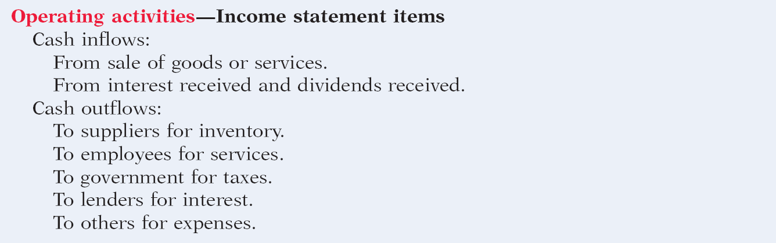
Usefulness and Format
Classification of Cash Flows
Illustration 12-1 Typical receipt and payment classifications
SO 2 Distinguish among operating, investing, and financing activities.

Slide 7
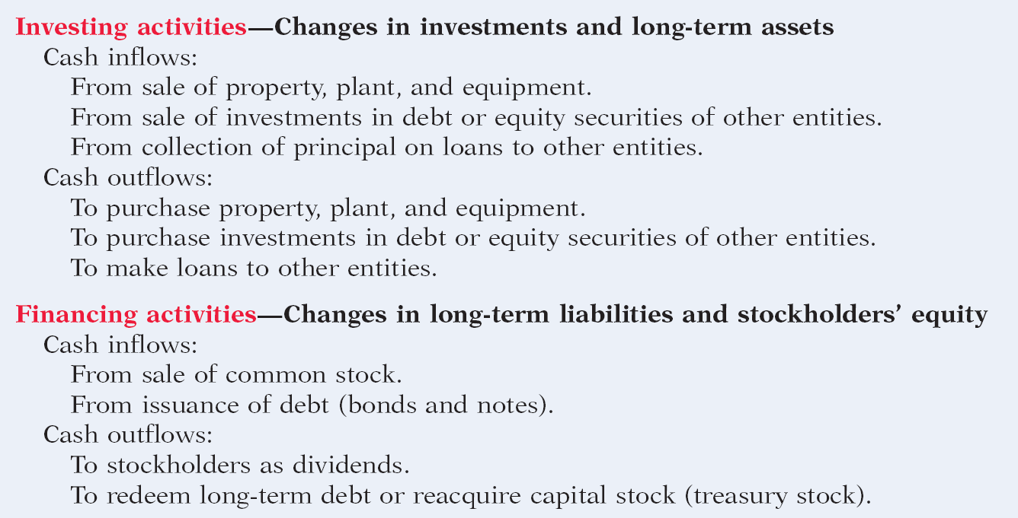
Usefulness and Format
Classification of Cash Flows
Illustration 12-1 Typical receipt and payment classifications
SO 2 Distinguish among operating, investing, and financing activities.

Slide 8
Usefulness and Format
Significant Noncash Activities
  Issuance of common stock to purchase assets.
  Conversion of bonds into common stock.
  Issuance of debt to purchase assets.
  Exchanges of plant assets.
Companies report noncash activities in either a
  separate schedule (bottom of the statement) or
  separate note to the financial statements.
SO 2 Distinguish among operating, investing, and financing activities.

Slide 9
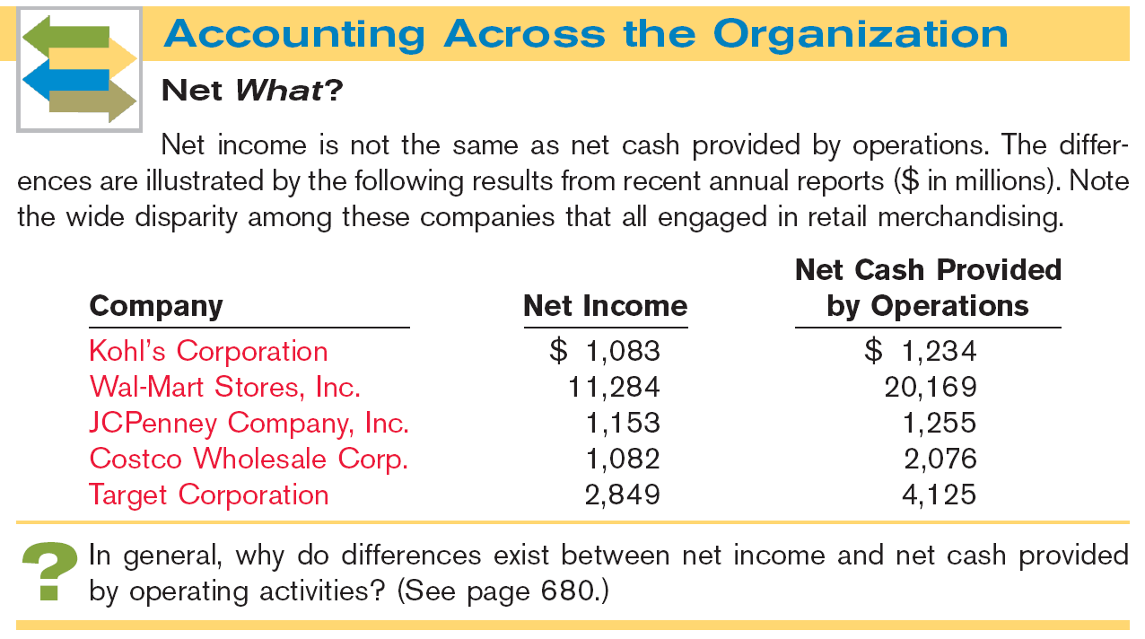


Slide 10
Usefulness and Format
Format of the Statement of Cash Flows
Order of Presentation:
  Operating activities.
  Investing activities.
  Financing activities.
Direct Method
Indirect Method
SO 2 Distinguish among operating, investing, and financing activities.

Slide 11
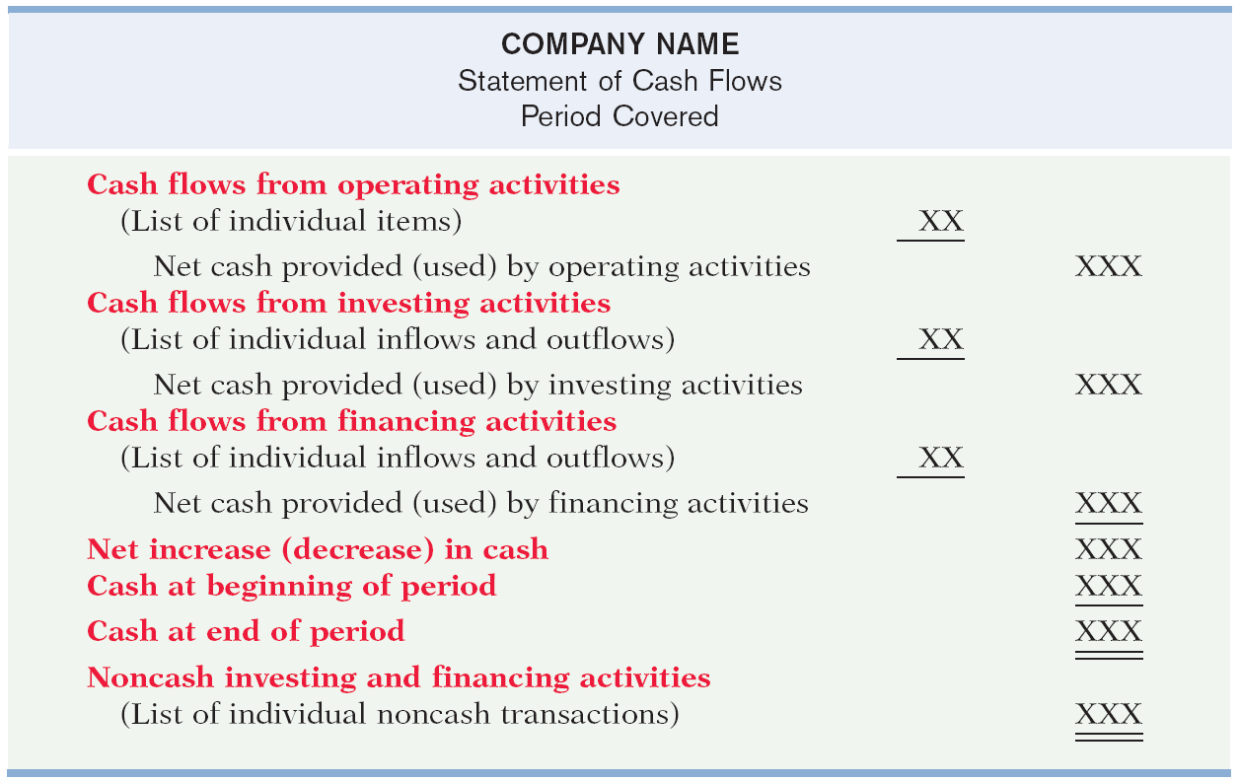
Format of the Statement of Cash Flows
Illustration 12-2
SO 2 Distinguish among operating, investing, and financing activities.

Slide 12

Format of the Statement of Cash Flows
Illustration: Classify each of these transactions by type of cash flow activity.
1. Issued 100,000 shares of $5 par value common stock for $800,000 cash.
2. Borrowed $200,000, signing a 5-year note bearing 8% interest.
3. Purchased two semi-trailer trucks for $170,000 cash.
4. Paid employees $12,000 for salaries and wages.
5. Collected $20,000 cash for services provided.
Financing
Financing
Investing
Operating
Operating
SO 2 Distinguish among operating, investing, and financing activities.

Slide 13
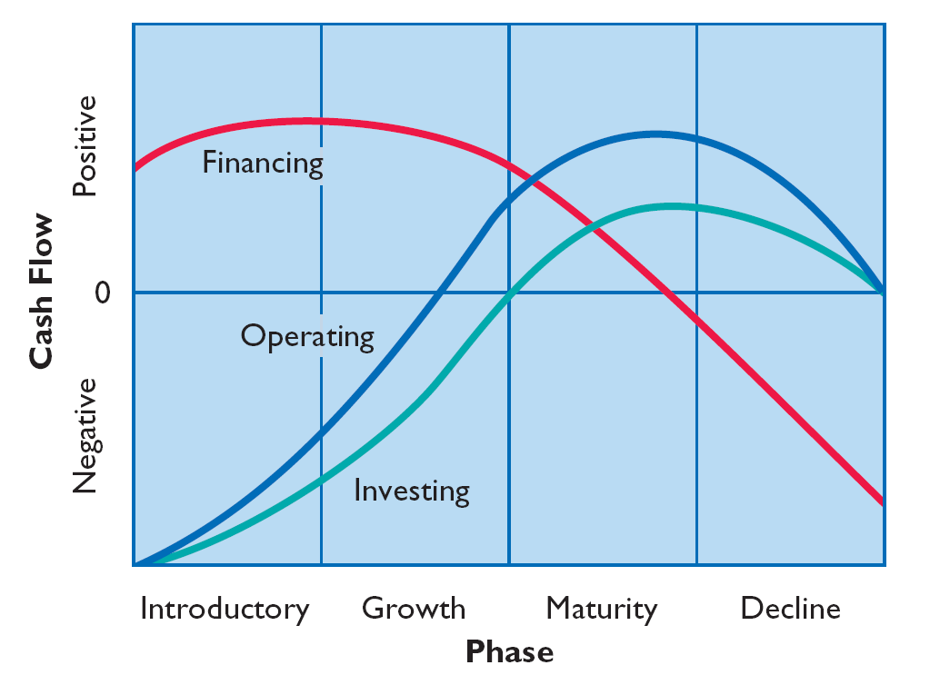
Usefulness and Format
The Corporate Life Cycle
Illustration 12-3
Impact
of product life cycle on
cash flows.
SO 3 Explain the impact of the product life cycle on a company’s cash flows.

Slide 14

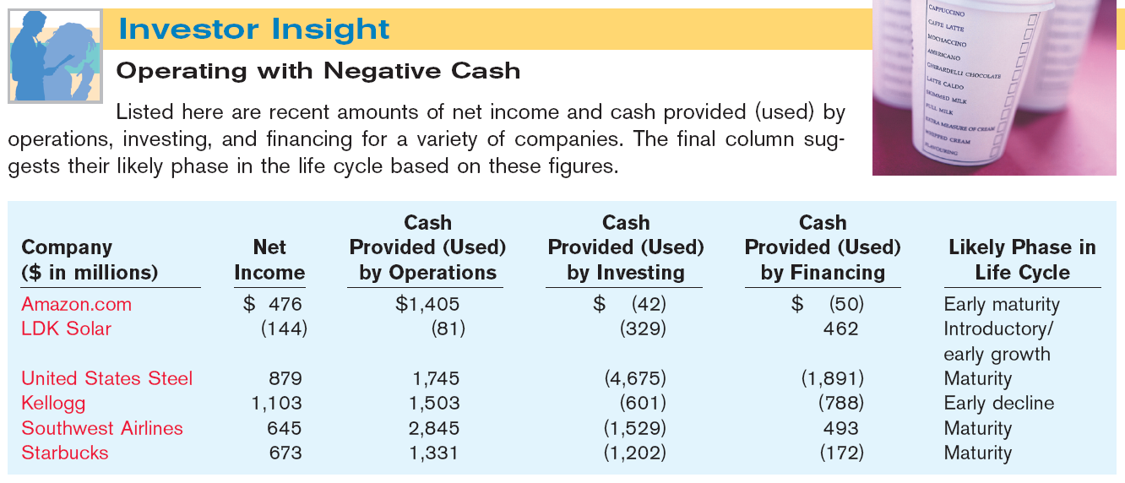

Slide 15
Usefulness and Format
Preparing the Statement of Cash Flows
Three Sources of Information:
  Comparative balance sheets
  Current income statement
  Additional information
SO 3 Explain the impact of the product life cycle on a company’s cash flows.

Slide 16
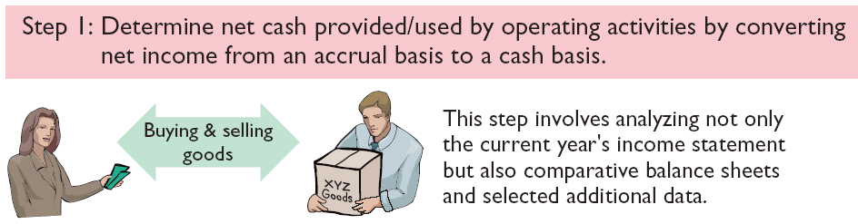
Usefulness and Format
Preparing the Statement of Cash Flows
Three Major Steps:
Illustration 12-4
SO 3 Explain the impact of the product life cycle on a company’s cash flows.

Slide 17
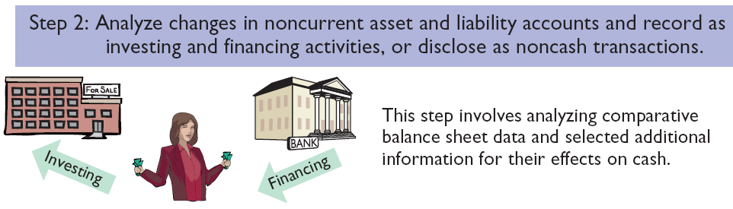
Usefulness and Format
Preparing the Statement of Cash Flows
Three Major Steps:
Illustration 12-4
SO 3 Explain the impact of the product life cycle on a company’s cash flows.

Slide 18
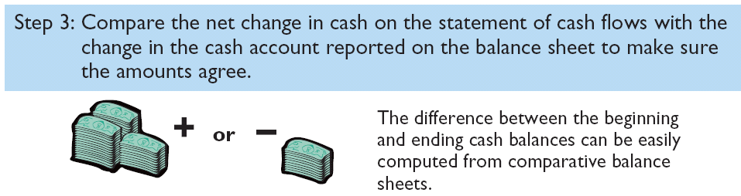
Usefulness and Format
Preparing the Statement of Cash Flows
Three Major Steps:
Illustration 12-4
SO 3 Explain the impact of the product life cycle on a company’s cash flows.

Slide 19
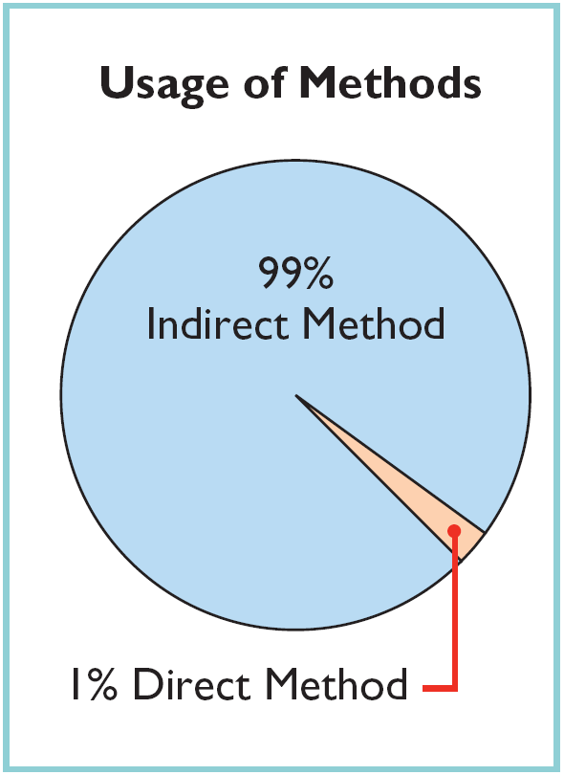
Usefulness and Format
Indirect and Direct Methods
Companies favor the indirect method for two reasons:
  Easier and less costly to prepare.
  Focuses on differences between net income and net cash flow from operating activities.
SO 3 Explain the impact of the product life cycle on a company’s cash flows.

Slide 20
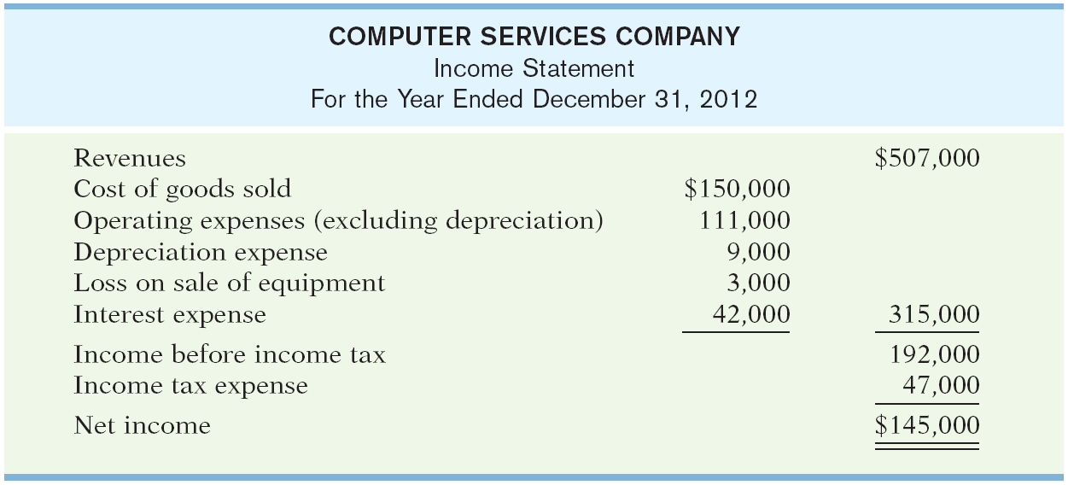
Preparing the Statement of Cash Flows
Illustration – Indirect Method
Illustration 12-5
SO 4 Prepare a statement of cash flows using the indirect method.

Slide 21
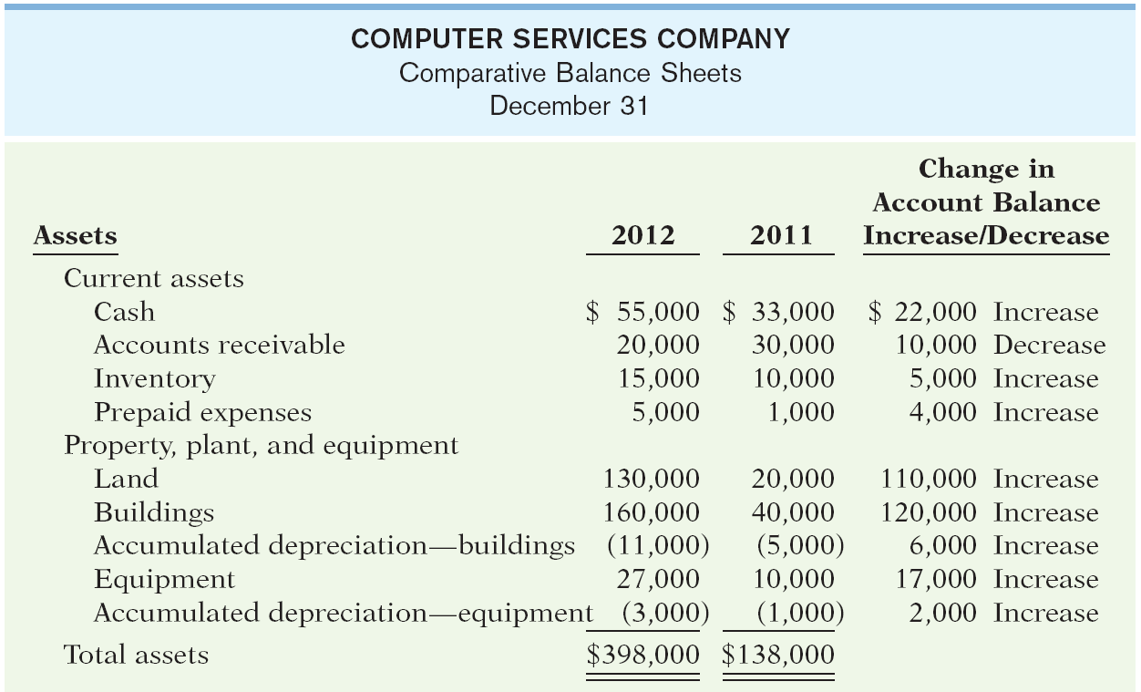
Preparing the Statement of Cash Flows
Illustration 12-5
SO 4 Prepare a statement of cash flows using the indirect method.

Slide 22
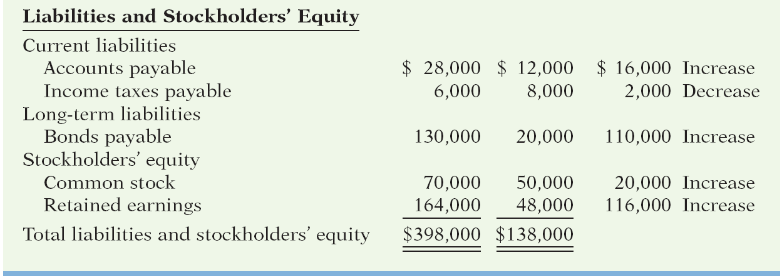
Preparing the Statement of Cash Flows
Illustration 12-5
Additional information for 2012:
Depreciation expense was comprised of $6,000 for building and $3,000 for equipment.
The company sold equipment with a book value of $7,000 (cost $8,000, less accumulated depreciation $1,000) for $4,000 cash.
Issued $110,000 of long-term bonds in direct exchange for land.
A building costing $120,000 was purchased for cash. Equipment costing $25,000 was also purchased for cash.
Issued common stock for $20,000 cash.
The company declared and paid a $29,000 cash dividend.
SO 4.

Slide 23
Preparation of the Statement of Cash Flows – Indirect Method
Step 1: Operating Activities
Determine net cash provided/used by operating activities by converting net income from accrual basis to cash basis.
Common adjustments to Net Income (Loss):
  Add back non-cash expenses (depreciation, amortization, or depletion expense).
  Deduct gains and add losses.
  Changes in noncash current assets and current liabilities.
SO 4 Prepare a statement of cash flows using the indirect method.

Slide 24
Step 1: Operating Activities
Question
Which is an example of a cash flow from an operating activity?
  Payment of cash to lenders for interest.
  Receipt of cash from the sale of capital stock.
  Payment of cash dividends to the company’s stockholders.
  None of the above.
SO 4 Prepare a statement of cash flows using the indirect method.

Slide 25
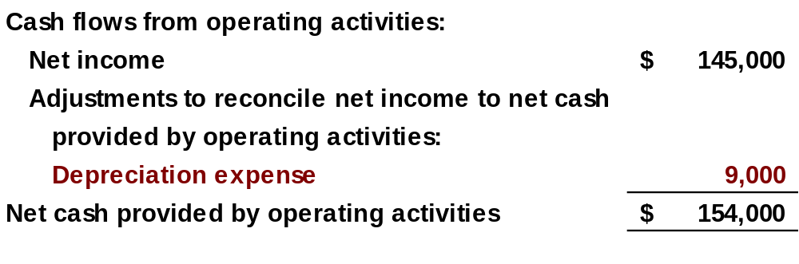
Step 1: Operating Activities
Depreciation Expense
Although depreciation expense reduces net income, it does not reduce cash. The company must add it back to net income.
Illustration 12-7
SO 4 Prepare a statement of cash flows using the indirect method.

Slide 26
Operating Activities
Loss on Sale of Equipment
Companies report as a source of cash in the investing activities section the actual amount of cash received from the sale.
  Any loss on sale is added to net income in the operating section.
  Any gain on sale is deducted from net income in the operating section.
SO 4 Prepare a statement of cash flows using the indirect method.

Slide 27
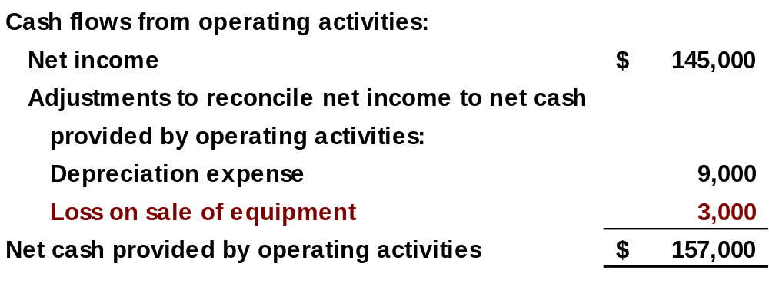
Operating Activities
Loss on Sale of Equipment
Illustration 12-8
SO 4 Prepare a statement of cash flows using the indirect method.

Slide 28
Operating Activities
Changes to Noncash Current Asset Accounts
When the Accounts Receivable balance decreases, cash receipts are higher than revenue earned under the accrual basis.
Illustration 12-9
Accounts Receivable
1/1/012 Balance 30,000
Receipts from customers 517,000
Revenues 507,000
12/31/12 Balance 20,000
Company adds to net income the amount of the decrease in accounts receivable.
SO 4 Prepare a statement of cash flows using the indirect method.

Slide 29
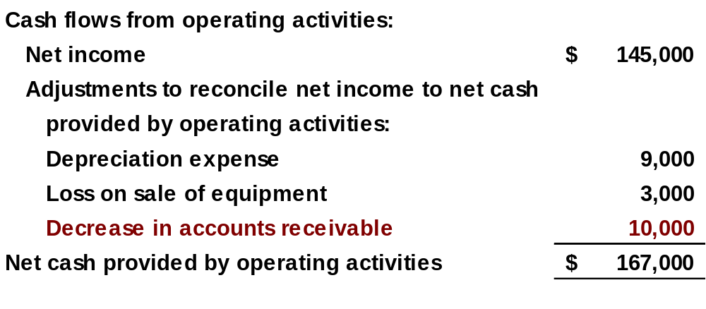
Operating Activities
Changes to Noncash Current Asset Accounts
Illustration 12-10
SO 4 Prepare a statement of cash flows using the indirect method.

Slide 30
Operating Activities
Changes to Noncash Current Asset Accounts
When the Inventory balance increases, the cost of merchandise purchased exceeds the cost of goods sold.
Inventory
1/1/12 Balance 10,000
Cost of goods sold 150,000
Purchases 155,000
12/31/12 Balance 15,000
Cost of goods sold does not reflect cash payments made for merchandise. The company deducts from net income this inventory increase.
SO 4 Prepare a statement of cash flows using the indirect method.

Slide 31
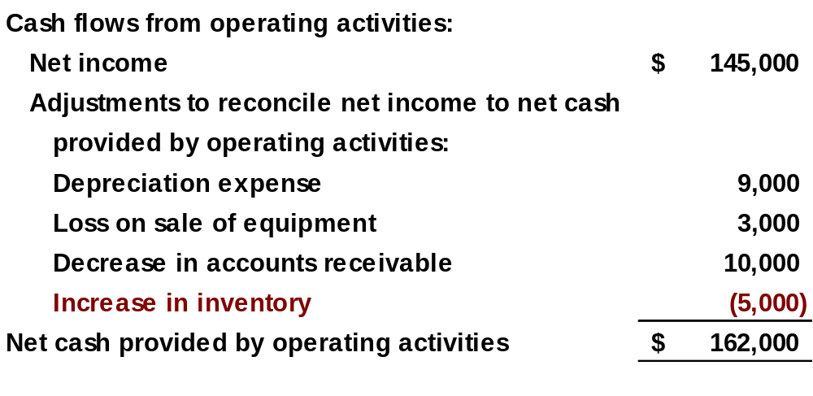
Operating Activities
Changes to Noncash Current Asset Accounts
Illustration 12-10
SO 4 Prepare a statement of cash flows using the indirect method.

Slide 32
Operating Activities
Changes to Noncash Current Asset Accounts
When the Prepaid Expense balance increases, cash paid for expenses is higher than expenses reported on an accrual basis. The company deducts the decrease from net income to arrive at net cash provided by operating activities.
If prepaid expenses decrease, reported expenses are higher than the expenses paid.
SO 4 Prepare a statement of cash flows using the indirect method.

Slide 33
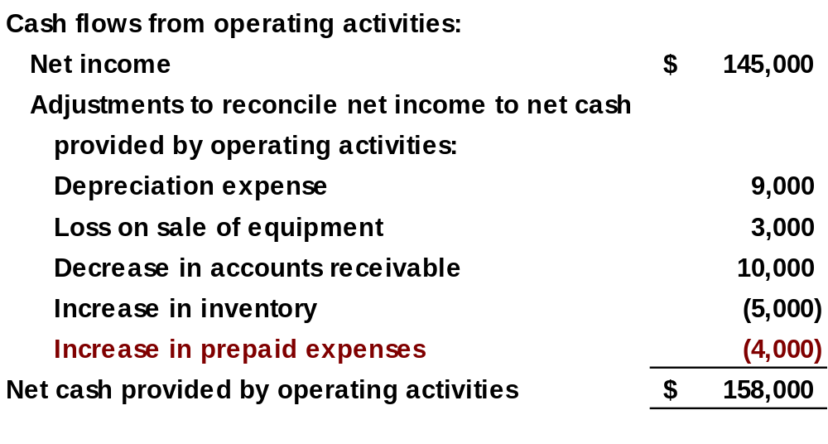
Operating Activities
Changes to Noncash Current Asset Accounts
Illustration 12-10
SO 4 Prepare a statement of cash flows using the indirect method.

Slide 34
Operating Activities
Changes to Noncash Current Liability Accounts
When Accounts Payable increases, the company received more in goods than it actually paid for. The increase is added to net income to determine net cash provided by operating activities.
When Income Tax Payable decreases, the income tax expense reported on the income statement was less than the amount of taxes paid during the period. The decrease is subtracted from net income to determine net cash provided by operating activities.
SO 4 Prepare a statement of cash flows using the indirect method.

Slide 35
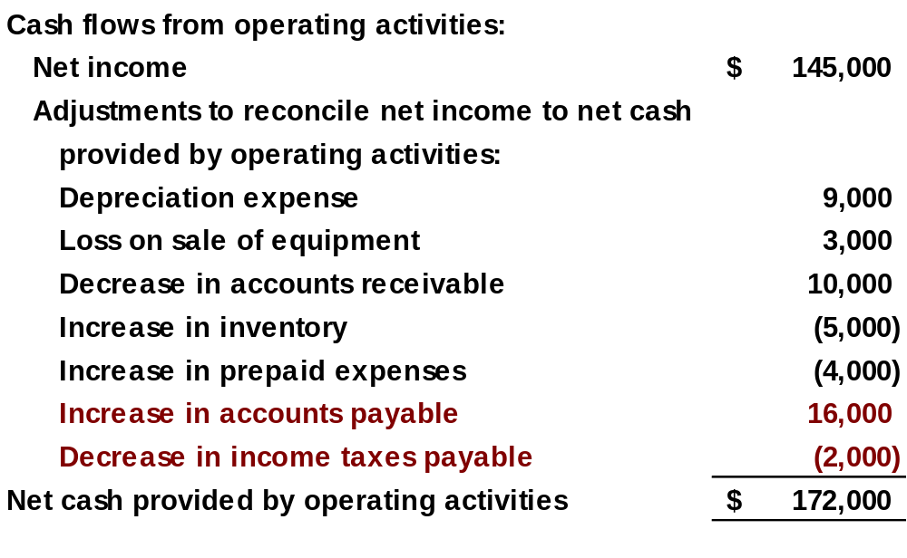
Operating Activities
Changes to Noncash Current Liability Accounts
Illustration 12-11
SO 4

Slide 36
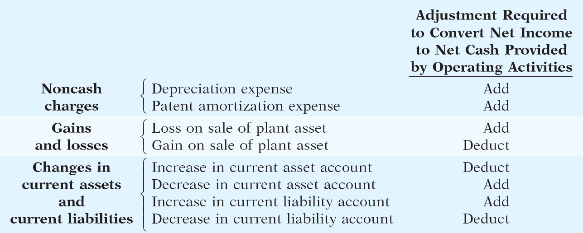
Operating Activities
Summary of Conversion to Net Cash Provided by Operating Activities—Indirect Method
SO 4 Prepare a statement of cash flows using the indirect method.

Slide 37
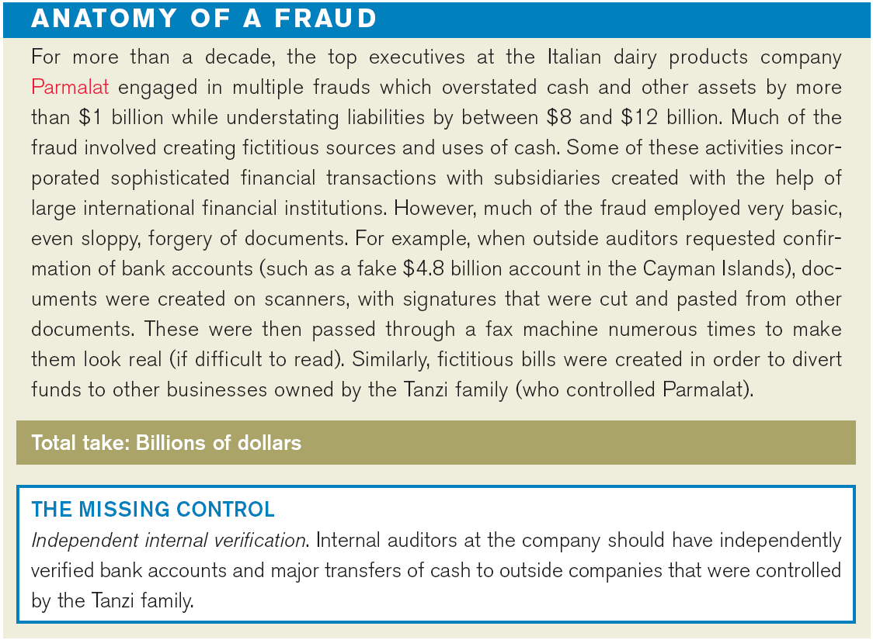

Slide 38
Step 2: Investing and Financing Activities
Company purchased land of $110,000 by issuing long-term bonds. This is a significant noncash investing and financing activity that merits disclosure in a separate schedule.
Land
1/1/12 Balance 20,000
Issued bonds 110,000
12/31/12 Balance 130,000
Bonds Payable
1/1/12 Balance 20,000
For land 110,000
12/31/12 Balance 130,000
SO 4 Prepare a statement of cash flows using the indirect method.

Slide 39
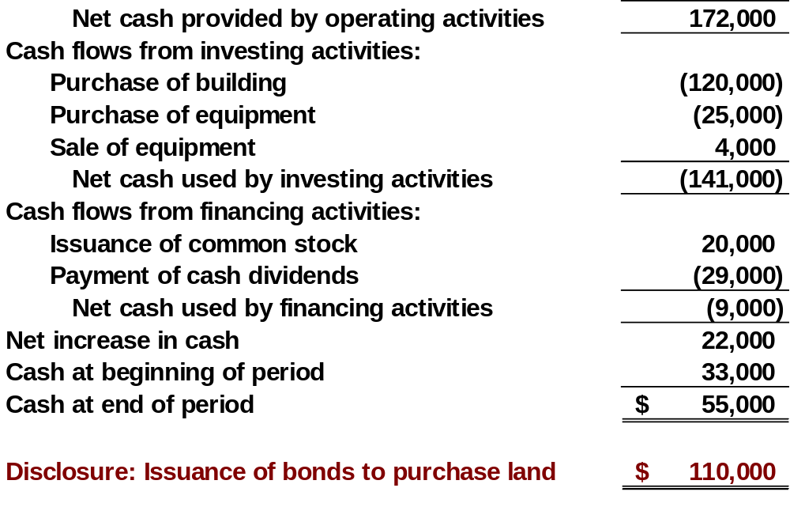
Investing and Financing Activities
Partial statement
Illustration 12-14
SO 4

Slide 40
Investing and Financing Activities
From the additional information, the company acquired an office building for $120,000 cash. This is a cash outflow reported in the investing section.
Building
1/1/12 Balance 40,000
Office building 120,000
12/31/12 Balance 160,000
SO 4 Prepare a statement of cash flows using the indirect method.

Slide 41
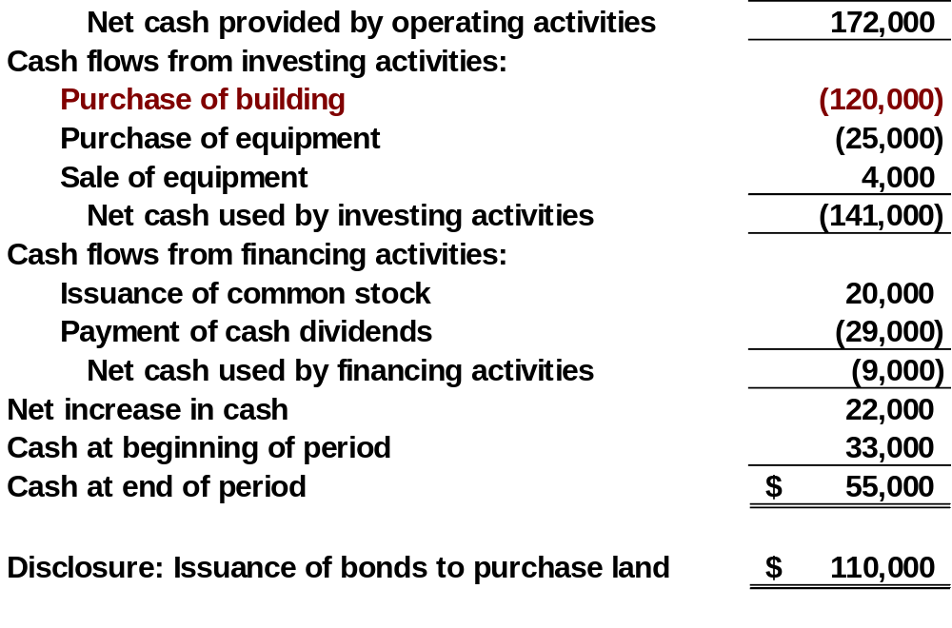
Investing and Financing Activities
Partial statement
Illustration 12-14
SO 4

Slide 42
Investing and Financing Activities
The additional information explains that the equipment increase resulted from two transactions: (1) a purchase of equipment of $25,000, and (2) the sale for $4,000 of equipment costing $8,000.
Equipment
1/1/12 Balance 10,000
Equipment sold 8,000
Purchase 25,000
12/31/12 Balance 27,000
Cash 4,000
Accumulated depreciation 1,000
Loss on sale of equipment 3,000
Equipment 8,000
Journal Entry
SO 4 Prepare a statement of cash flows using the indirect method.

Slide 43
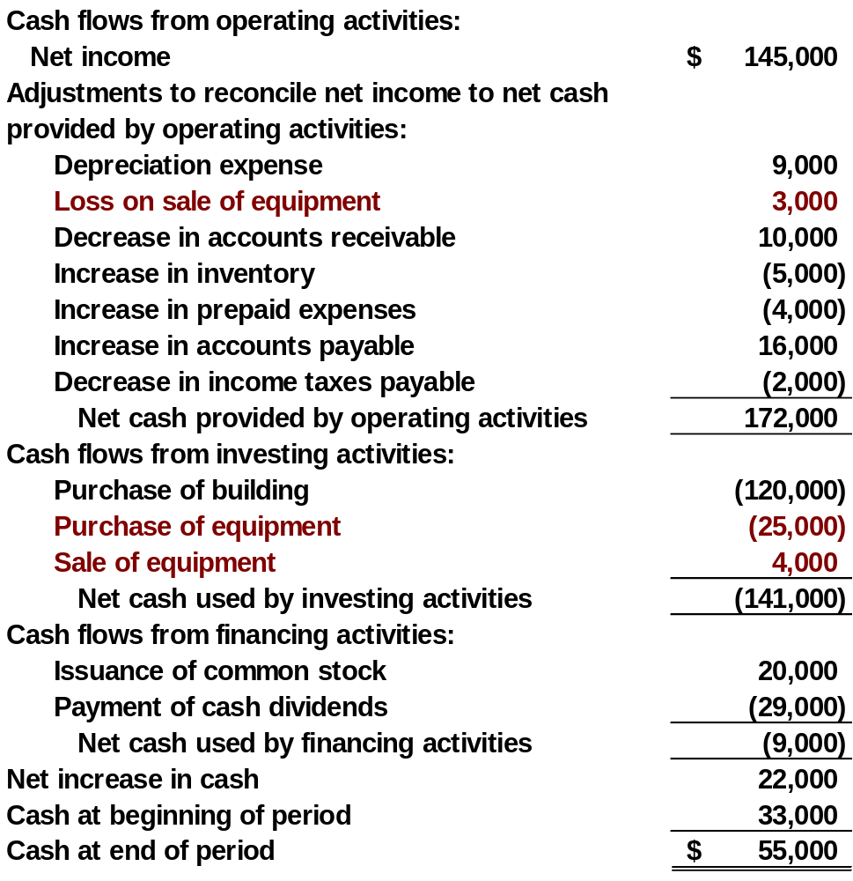
Statement of Cash Flows
Illustration 12-14
Indirect Method
SO 4

Slide 44
Investing and Financing Activities
The increase in common stock resulted from the issuance of new shares.
Common Stock
1/1/12 Balance 50,000
Shares sold 20,000
12/31/12 Balance 70,000
SO 4 Prepare a statement of cash flows using the indirect method.

Slide 45
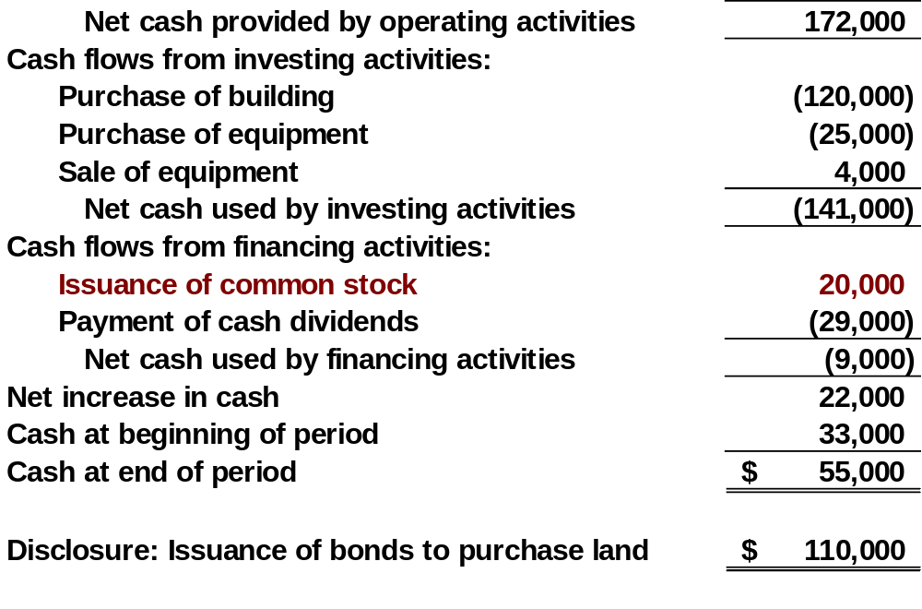
Investing and Financing Activities
Partial statement
Illustration 12-14
SO 4

Slide 46
Investing and Financing Activities
Retained earnings increased $116,000 during the year. This increase can be explained by two factors: (1) Net income of $145,000 increased retained earnings, and (2) Dividends of $29,000 decreased retained earnings.
Retained Earnings
1/1/12 Balance 48,000
Dividends 29,000
Net income 145,000
12/31/12 Balance 164,000
SO 4 Prepare a statement of cash flows using the indirect method.

Slide 47
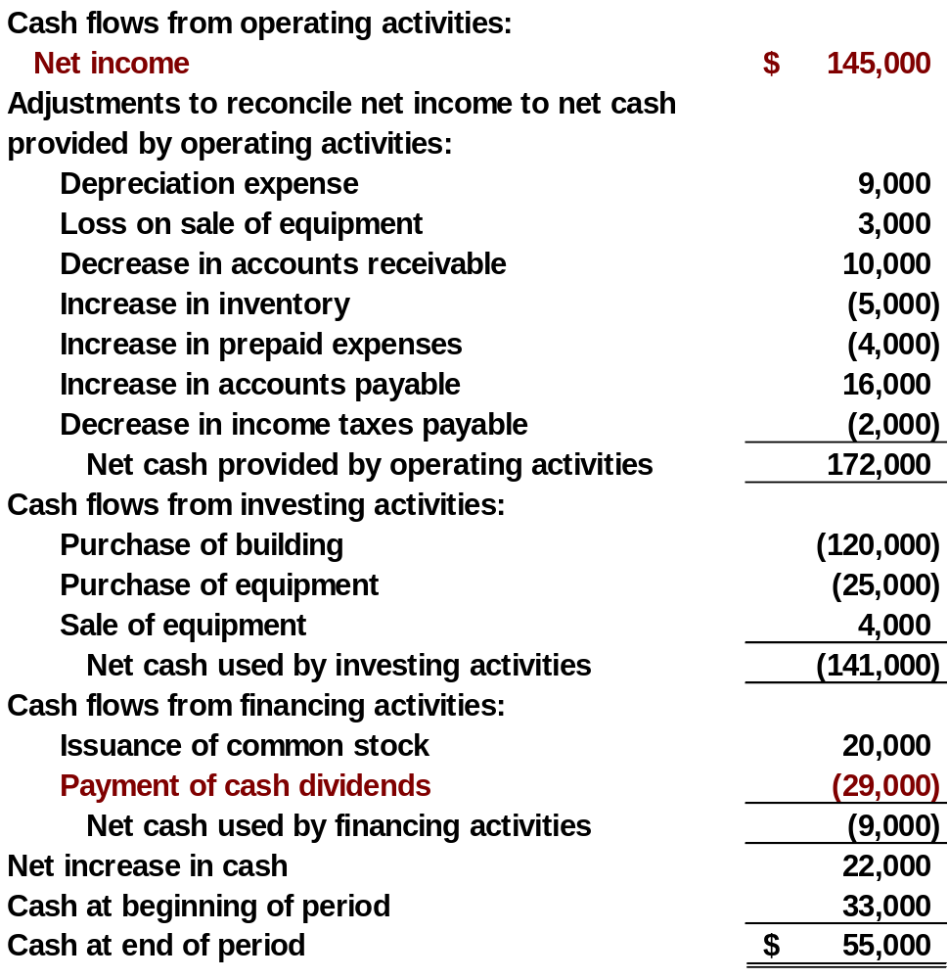
Statement of Cash Flows
Illustration 12-14
Indirect Method
SO 4

Slide 48
Step 3: Net Change in Cash
Compare the net change in cash on the Statement of Cash Flows with the change in the cash account reported on the Balance Sheet to make sure the amounts agree.
SO 4 Prepare a statement of cash flows using the indirect method.

Slide 49
Investing and Financing Activities
Review Question
Which is an example of a cash flow from an investing activity?
  Receipt of cash from the issuance of bonds payable.
  Payment of cash to repurchase outstanding capital stock.
  Receipt of cash from the sale of equipment.
  Payment of cash to suppliers for inventory.
SO 4 Prepare a statement of cash flows using the indirect method.

Slide 50
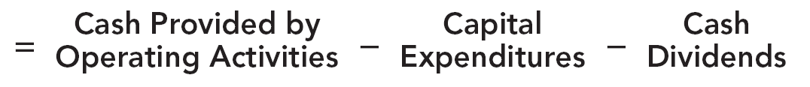
Using Cash Flows to Evaluate a Company
Free Cash Flow
Illustration 12-15
Free cash flow describes the cash remaining from operations after adjustment for capital expenditures and dividends.
SO 5 Use the statement of cash flows to evaluate a company.

Slide 51
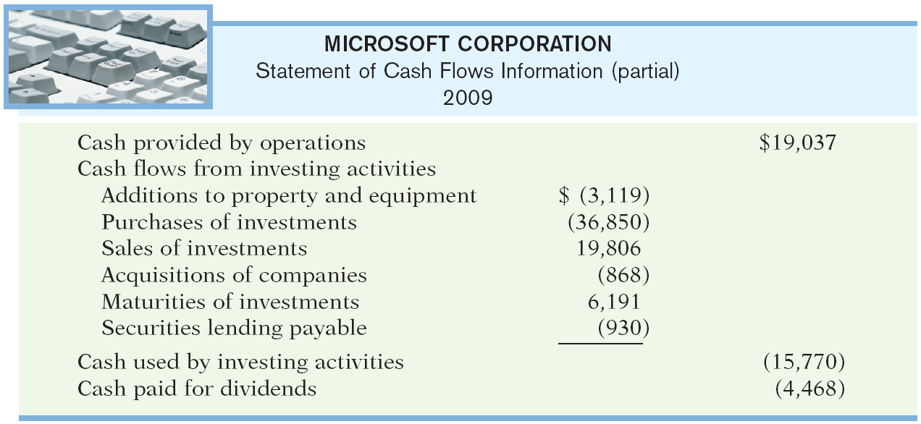
Using Cash Flows to Evaluate a Company
Illustration
Illustration 12-16
Required: Calculate Microsoft’s free cash flow.
Cash provided by operating activities $19,037
Less: Expenditures on property, plant, and equipment 3,119
Dividends paid 4,468
Free cash flow $11,450
SO 5 Use the statement of cash flows to evaluate a company.

Slide 52
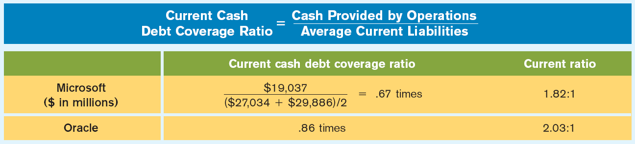
Using Cash Flows to Evaluate a Company
Assessing Liquidity and Solvency
Liquidity is the ability to pay obligations expected to become due within the next year.
Illustration 12-18
A value below .40 times is cause for additional investigation.
SO 5 Use the statement of cash flows to evaluate a company.

Slide 53
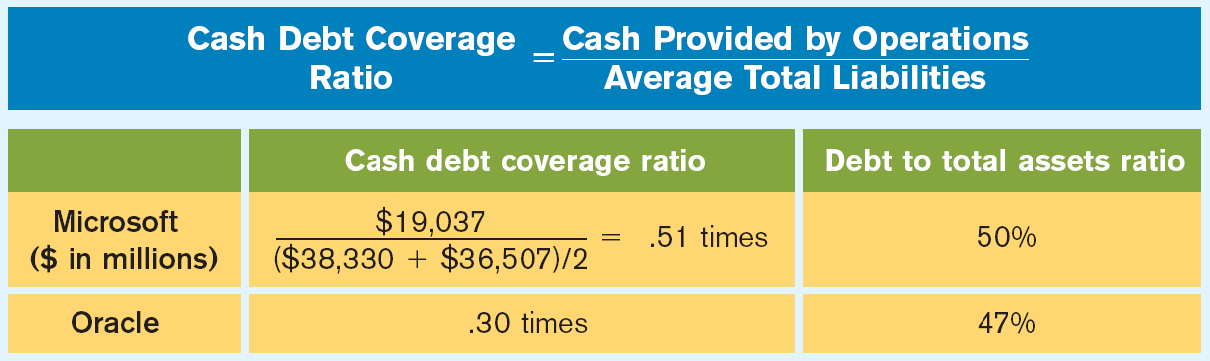
Using Cash Flows to Evaluate a Company
Assessing Liquidity and Solvency
Solvency is the ability of a company to survive over the long term.
Illustration 12-19
A ratio below .20 times is cause for additional investigation.
SO 5 Use the statement of cash flows to evaluate a company.

Slide 54
Direct Method
appendix 12A
Compute net cash provided by operating activities by adjusting each item in the income statement from the accrual basis to the cash basis.
Companies report only major classes of operating cash receipts and cash payments.
For these major classes, the difference between cash receipts and cash payments is the net cash provided by operating activities.
SO 6 Prepare a statement of cash flows using the direct method.

Slide 55
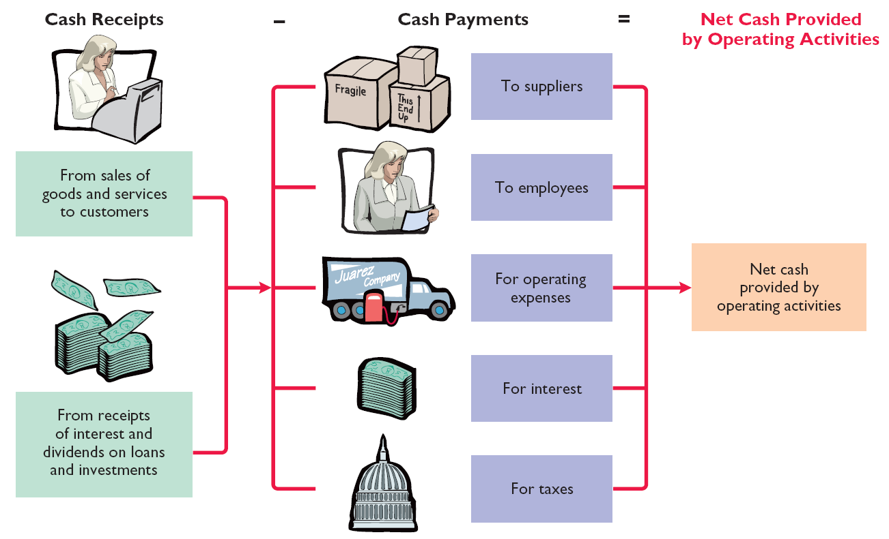
Direct Method
appendix 12A
Step 1: Operating Activities
Illustration 12A-2
SO 6

Slide 56
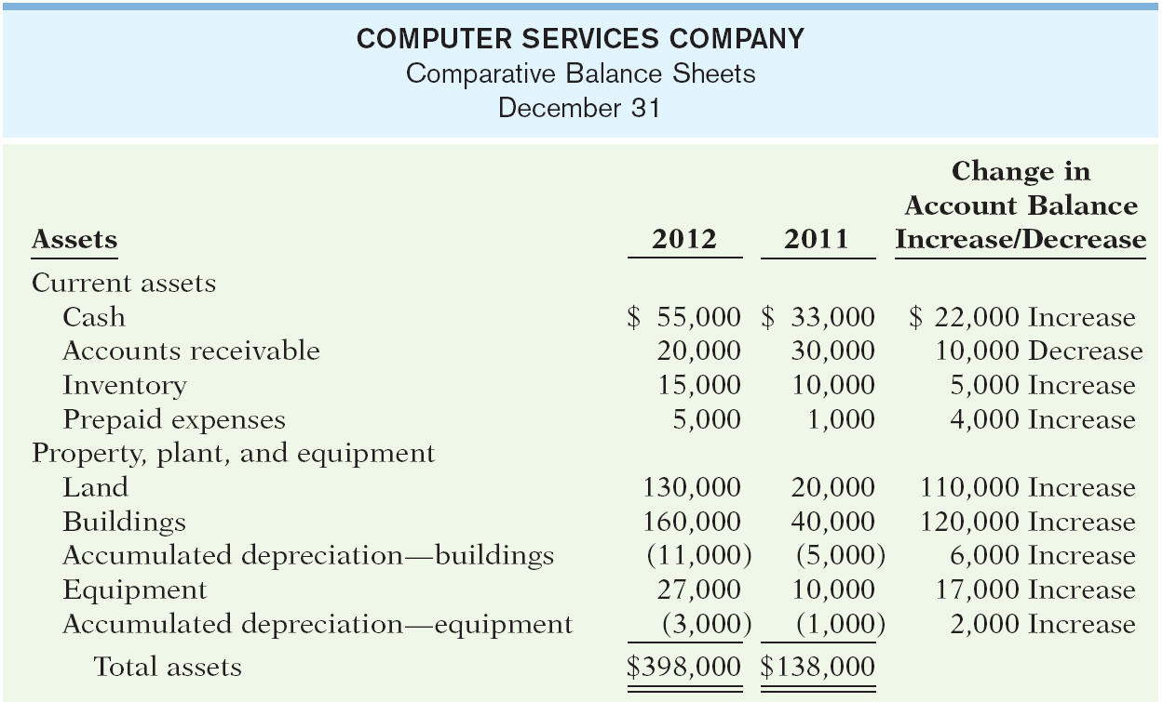
Direct Method
appendix 12A
Illustration 12A-1
SO 6 Prepare a statement of cash flows using the direct method.

Slide 57

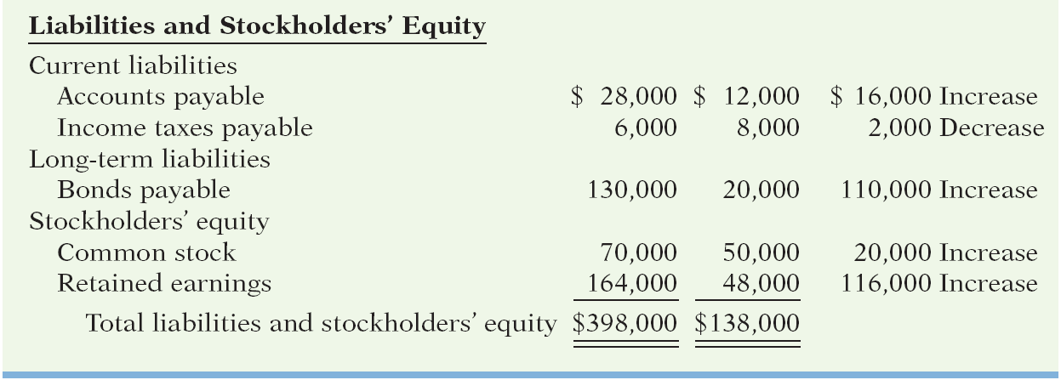
Direct Method
appendix 12A
Illustration 12A-1
SO 6 Prepare a statement of cash flows using the direct method.

Slide 58
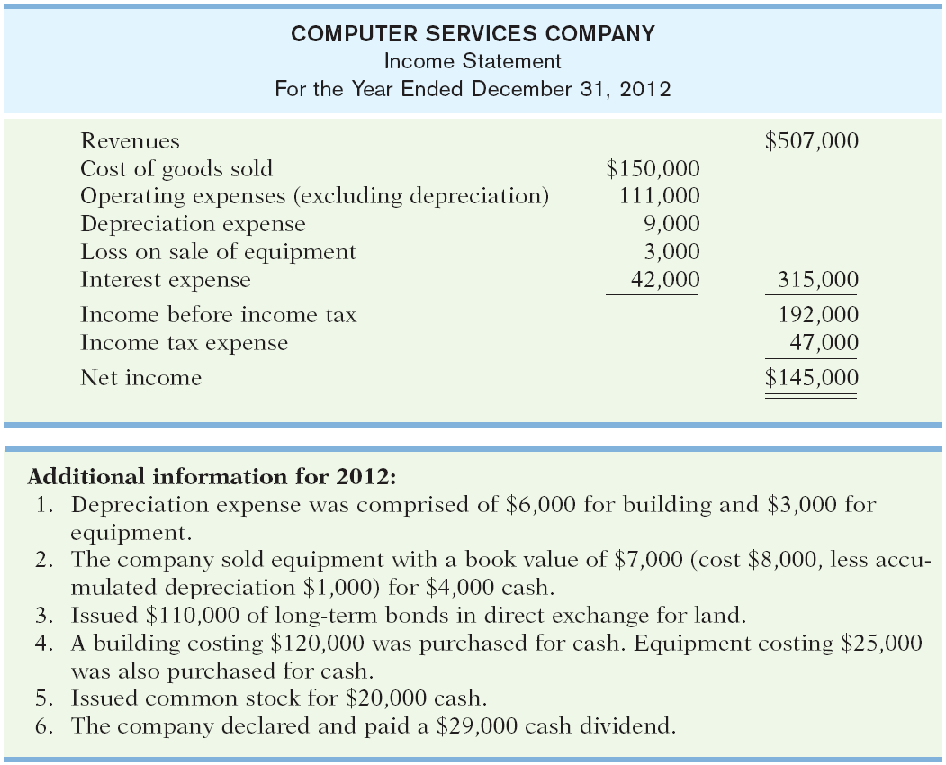
appendix 12A
Illustration 12A-1

Slide 59
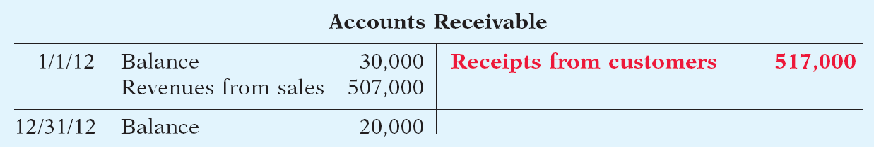
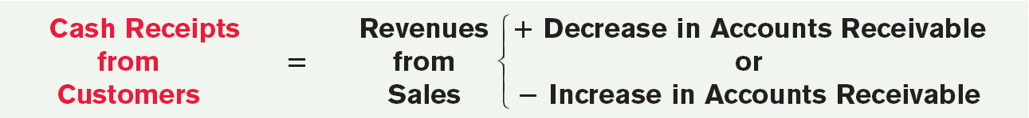
Direct Method
appendix 12A
Cash Receipts from Customers
For Computer Services, accounts receivable decreased $10,000.
Illustration 12A-4
Illustration 12A-5
SO 6 Prepare a statement of cash flows using the direct method.

Slide 60
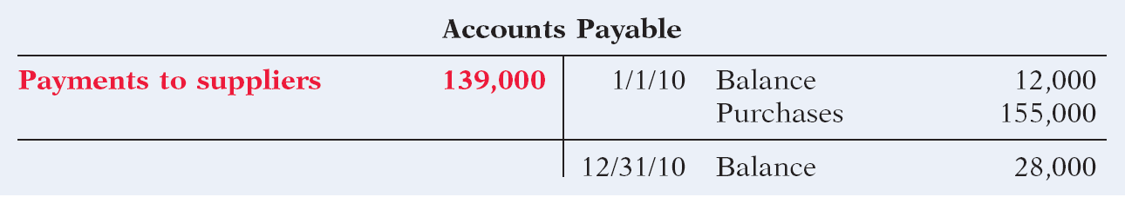
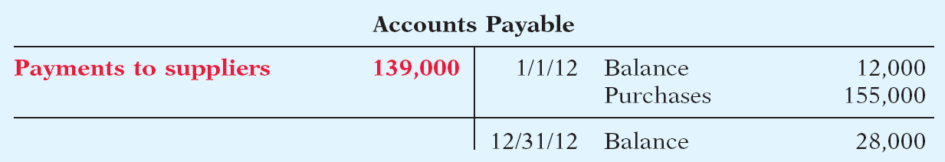
Direct Method
appendix 12A
Cash Payments to Suppliers
In 2012, Computer Services’ inventory increased $5,000.
Inventory
1/1/12 Balance 10,000
Purchases 155,000
Cost of goods sold 150,000
12/31/12 Balance 15,000
Illustration 12A-8
Payments to suppliers 139,000
Purchases 155,000
SO 6 Prepare a statement of cash flows using the direct method.

Slide 61
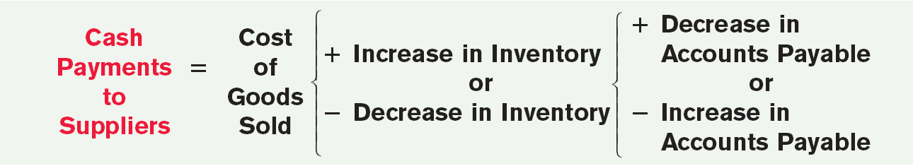
Direct Method
appendix 12A
Cash Payments to Suppliers
In 2012, Computer Services’ inventory increased $5,000.
Illustration 12A-9
SO 6 Prepare a statement of cash flows using the direct method.

Slide 62
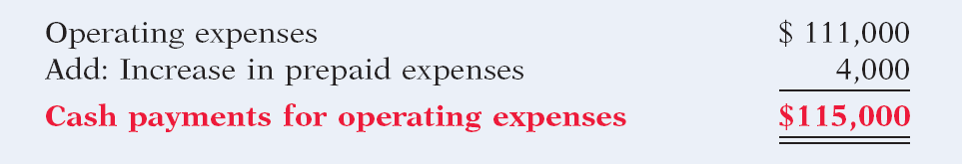
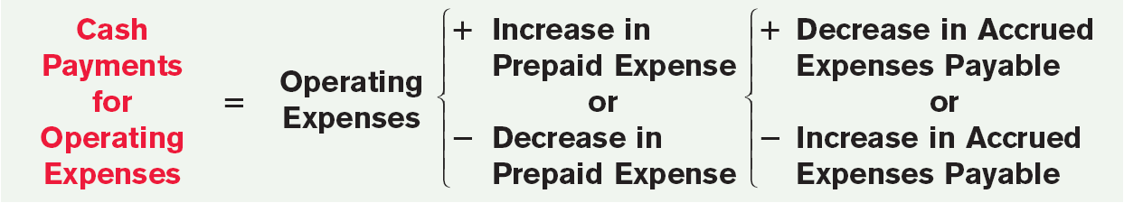
Direct Method
appendix 12A
Cash Payments for Operating Expenses
Cash payments for operating expenses were $111,000.
Illustration 12A-10
Illustration 12A-11
SO 6 Prepare a statement of cash flows using the direct method.

Slide 63
Direct Method
appendix 12A
Cash Payments for Interest
In 2012, Computer Services’ had interest expense of $42,000.
Interest Payable
Cash paid for interest 42,000
1/1/12 Balance 0
Interest expense 42,000
12/31/12 Balance 0
SO 6 Prepare a statement of cash flows using the direct method.

Slide 64
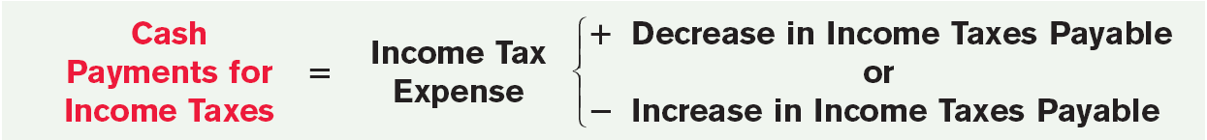
Direct Method
appendix 12A
Cash Payments for Income Taxes
Cash payments for income taxes were $49,000.
Income Tax Payable
Cash paid for taxes 49,000
1/1/12 Balance 8,000
Income tax expense 47,000
12/31/10 Balance 6,000
Illustration 12A-13
SO 6 Prepare a statement of cash flows using the direct method.

Slide 65
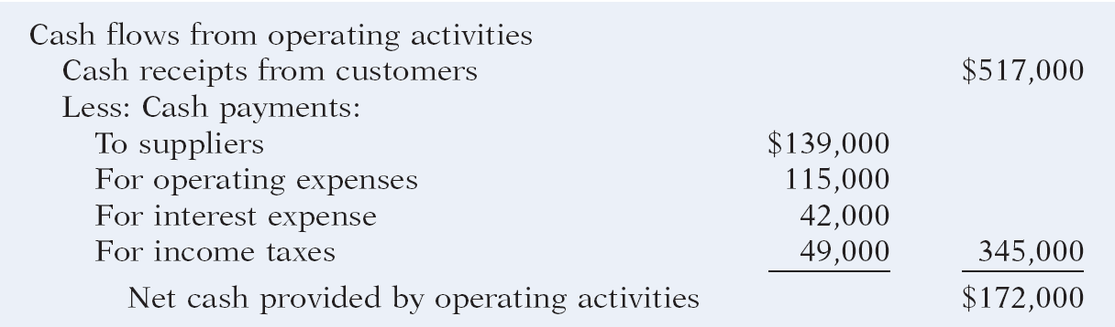
Direct Method
appendix 12A
Illustration 12A-14
Operating activities section
of the statement of cash flows
SO 6 Prepare a statement of cash flows using the direct method.

Slide 66
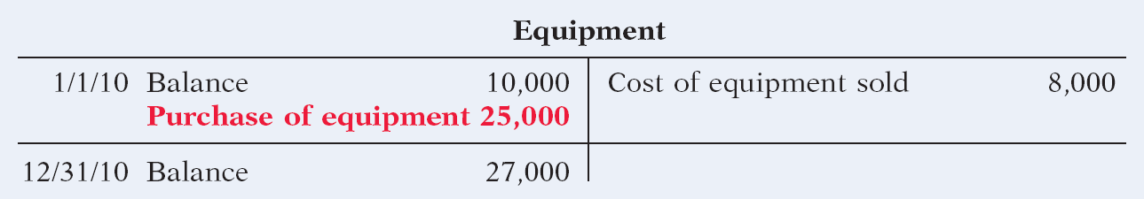
Direct Method
appendix 12A
Step 2: Investing and Financing Activities
Increase in Equipment. (1) Equipment purchased for $25,000, and (2) sale for $4,000 of equipment $8,000.
Illustration 12A-15
Accumulated Depreciation
Equipment sold 1,000
1/1/12 Balance 1,000
Depreciation expense 3,000
12/31/12 Balance 3,000
SO 6 Prepare a statement of cash flows using the direct method.

Slide 67
Direct Method
appendix 12A
Step 2: Investing and Financing Activities
Increase in Equipment. (1) Equipment purchased for $25,000, and (2) sale for $4,000 of equipment $8,000.
Cash 4,000
Accumulated depreciation 1,000
Loss on sale of equipment 3,000
Equipment 8,000
SO 6 Prepare a statement of cash flows using the direct method.

Slide 68
Direct Method
appendix 12A
Step 2: Investing and Financing Activities
Increase in Land. Land increased $110,000. The additional information section indicates that the company exchanged bonds for land.
Significant noncash
investing and financing transaction.
Increase in Building. Acquired building for $120,000 cash.
Investing transaction.
Increase in Bonds Payable. Bonds Payable increased $110,000. The company acquired land by exchanging bonds for land.
Significant noncash
investing and financing transaction.
SO 6 Prepare a statement of cash flows using the direct method.

Slide 69
Direct Method
appendix 12A
Step 2: Investing and Financing Activities
Increase in Common Stock. Increase in Common Stock of $20,000. Increase resulted from the issuance of new shares of stock.
Financing transaction.
Increase in Retained Earnings. The $116,000 net increase in Retained Earnings resulted from net income of $145,000 and the declaration and payment of a cash dividend
of $29,000.
Financing transaction (cash dividend).
SO 6 Prepare a statement of cash flows using the direct method.

Slide 70
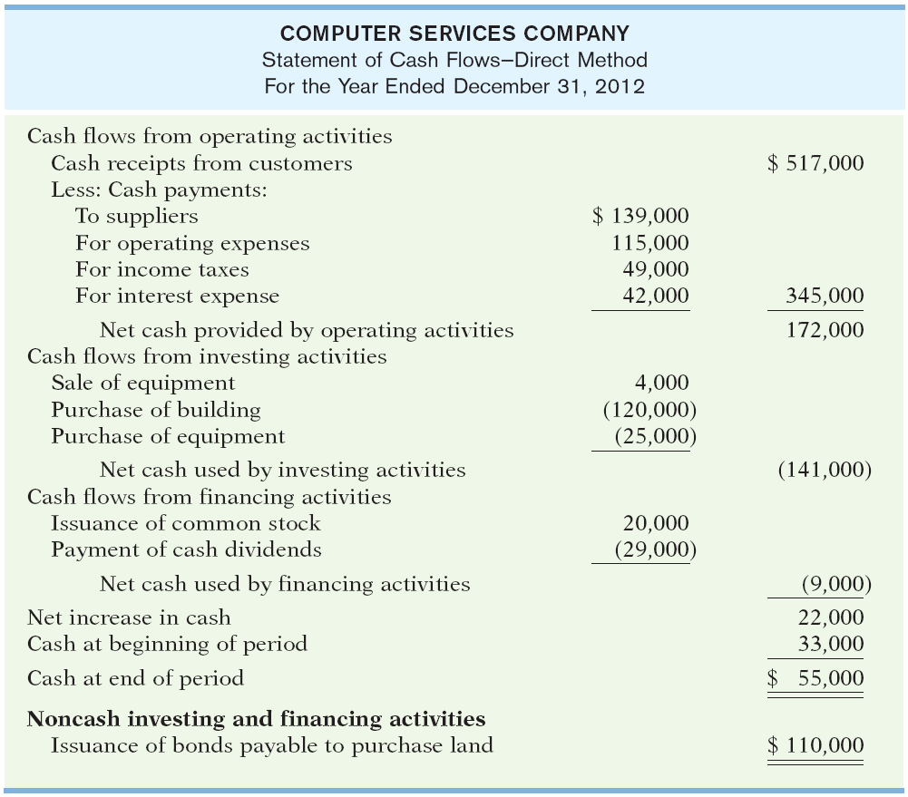
Direct Method
appendix 12A
Step 2: Investing and Financing Activities
Illustration 12A-16
Statement of cash flows, 2012—direct method

Slide 71
Direct Method
appendix 12A
Compare the net change in cash on the Statement of Cash Flows with the change in the cash account reported on the Balance Sheet to make sure the amounts agree.
SO 6 Prepare a statement of cash flows using the direct method.

Slide 72

Key Points
  Companies preparing financial statements under IFRS must prepare a statement of cash flows as an integral part of the financial statements.
  Both IFRS and GAAP require that the statement of cash flows should have three major sections—operating, investing, and financing—along with changes in cash and cash equivalents.
  Similar to GAAP, the cash flow statement can be prepared using either the indirect or direct method under IFRS. In both U.S. and international settings, companies choose for the most part to use the indirect method for reporting net cash flows from operating activities.

Slide 73
Key Points
  The definition of cash equivalents used in IFRS is similar to that used in GAAP. A major difference is that in certain situations, bank overdrafts are considered part of cash and cash equivalents under IFRS (which is not the case in GAAP). Under GAAP, bank overdrafts are classified as financing activities in the statement of cash flows and are reported as liabilities on the balance sheet.

Slide 74
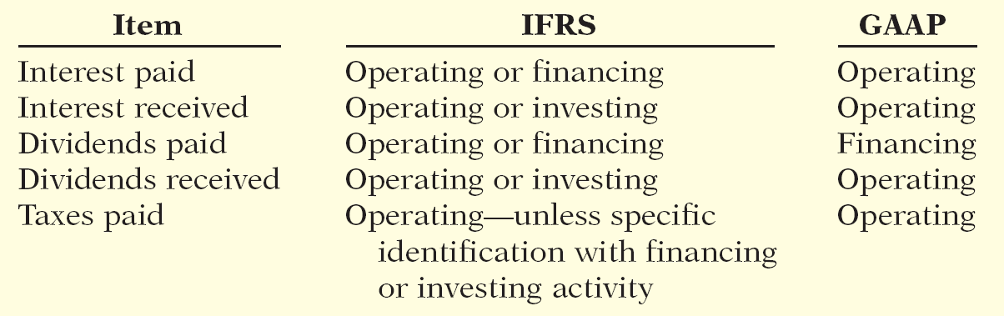
Key Points
  One area where there can be substantial differences between IFRS and GAAP relates to the classification of interest, dividends, and taxes. The following table indicates the differences between the two approaches.

Slide 75
Key Points
  Under IFRS, some companies present the operating section in a single line item, with a full reconciliation provided in the notes to the financial statements. This presentation is not seen under GAAP.
  Similar to GAAP, under IFRS companies must disclose the amount of taxes and interest paid. Under GAAP, companies disclose this in the notes to the financial statements. Under IFRS, some companies disclose this information in the notes, but others provide individual line items on the face of the statement.

Slide 76
Looking into the Future
FASB and the IASB are involved in a joint project on the presentation and organization of information in the financial statements. One possible approach is that the income statement and balance sheet would adopt headings similar to those of the statement of cash flows. That is, the income statement and balance sheet would be broken into operating, investing, and financing sections. In addition, the FASB favors presentation of operating cash flows using the direct method only. However, the majority of IASB members express a preference for not requiring use of the direct method of reporting operating cash flows. The two Boards will have to resolve their differences in this area in order to issue a converged standard for the statement of cash flows.

Slide 77
Under IFRS, interest paid can be reported as:
  only a financing element.
  a financing element or an investing element.
  a financing element or an operating element.
  only an operating element.

Slide 78
IFRS requires that noncash items:
  be reported in the section to which they relate, that is, a noncash investing activity would be reported in the investing section.
  be disclosed in the notes to the financial statements.
  do not need to be reported.
  be treated in a fashion similar to cash equivalents.

Slide 79
In the future, it appears likely that:
  the income statement and balance sheet will have headings of operating, investing, and financing, much like the statement of cash flows.
  cash and cash equivalents will be combined in a single line item.
  the IASB will not allow companies to use the direct approach to the statement of cash flows.
  None of the above.

Slide 80
Copyright
“Copyright © 2011 John Wiley & Sons, Inc. All rights reserved. Reproduction or translation of this work beyond that permitted in Section 117 of the 1976 United States Copyright Act without the express written permission of the copyright owner is unlawful. Request for further information should be addressed to the Permissions Department, John Wiley & Sons, Inc. The purchaser may make back-up copies for his/her own use only and not for distribution or resale. The Publisher assumes no responsibility for errors, omissions, or damages, caused by the use of these programs or from the use of the information contained herein.”

