Slide 1
Bitcoin and Blockchain Technologies
Introduction to FinTech
Prof. Xiaoyu (Joanna Wang)
Peking University

Slide 2
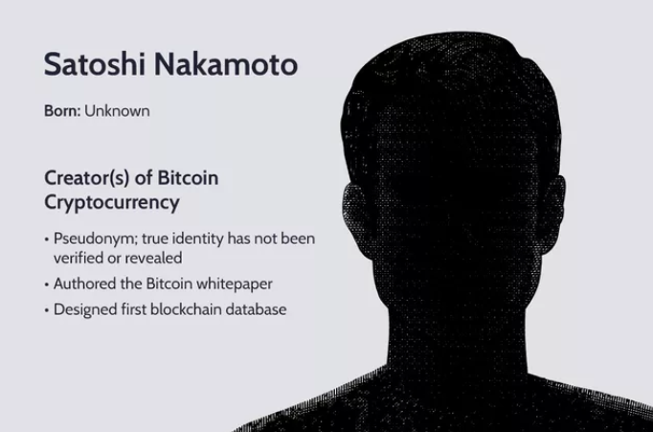
History of Bitcoin
Unlike paper currency, cryptocurrency could be spent more than once. This was known as "double-spending," and Nakamoto solved it by proposing a peer-to-peer distributed timestamp server.

Slide 3
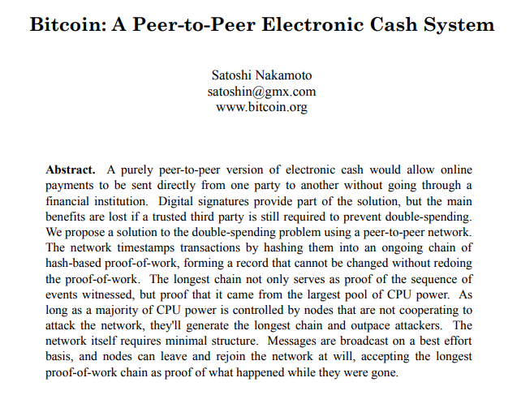
History of Bitcoin
Released in October 2008
Anonymous
Notes:
Blockchain
Anonymous
No-reverse and No third-party
Require computation power
Decentralized

Slide 4
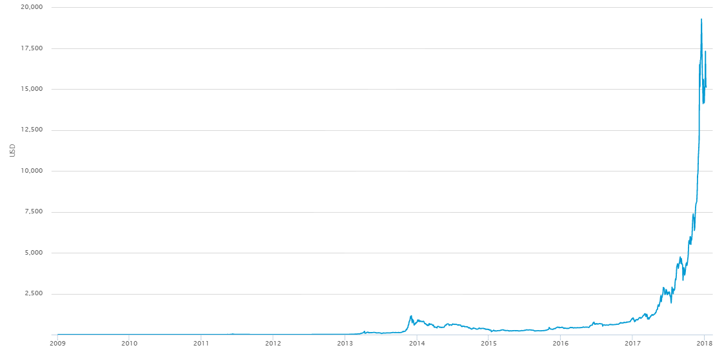
Bitcoin Price

Slide 5
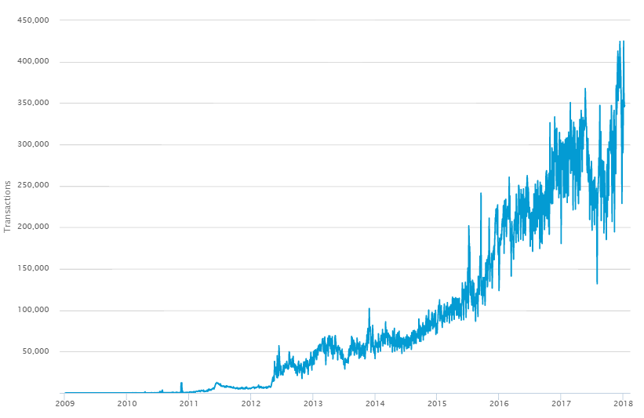
Bitcoin Transactions (Daily)

Slide 6
Desired Features of Digital Currencies
Security
One cannot forge the currency
Only the owner of the money can spend it
The owner maintains (some amount of) anonymity
No double-spending: one cannot spend the same money twice
Convenience
Divisible and Fungible
Easy to use
Fast transactions
Network should be resilient: decentralized network

Slide 7
Security of Ownership
How to ensure security of ownership and veracity of transaction records in a decentralized network?
Answer: Cryptography
Cryptography allows tamper-evident storage of data
Cryptography allows one to prove ownership by an electronic signature
One uses a private key to generate the electronic signature to authorize a transaction
Without knowing the private key, electronic signatures cannot be forged for other transactions

Slide 8
Cryptography and Applications to Blockchain Technology

Slide 9
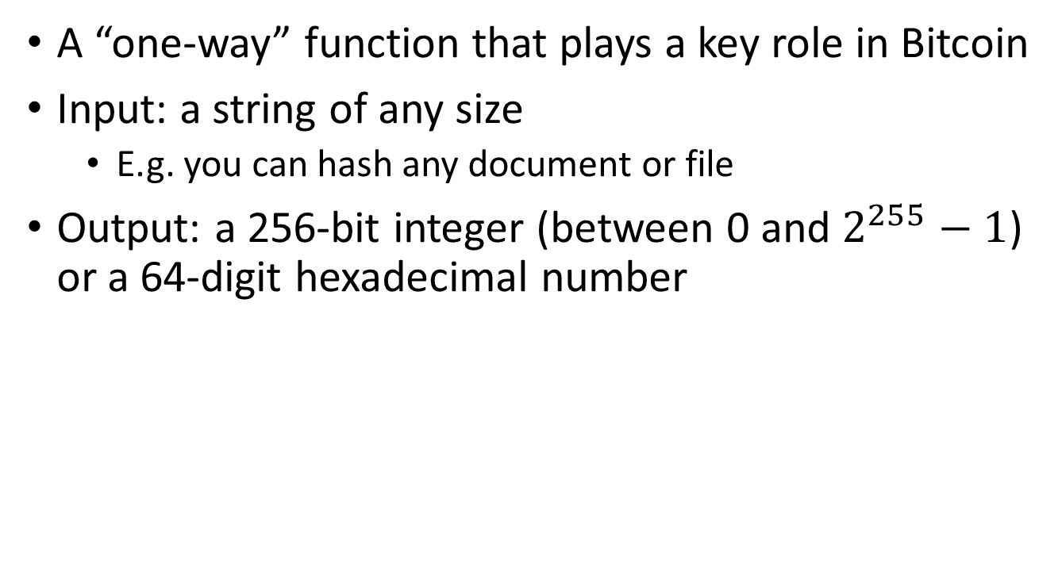
The SHA-256 Hash Function
A “one-way” function that plays a key role in Bitcoin
Input: a string of any size
E.g. you can hash any document or file
Output: a 256-bit integer (between 0 and $2^{255}−1$) or a 64-digit hexadecimal number
Alice sent Bob 2.5 bitcoins
SHA-256
b711226415fd343dc413cf7302725e2a964bd40f638eb1a77f4abf2b56e665c6

Slide 10
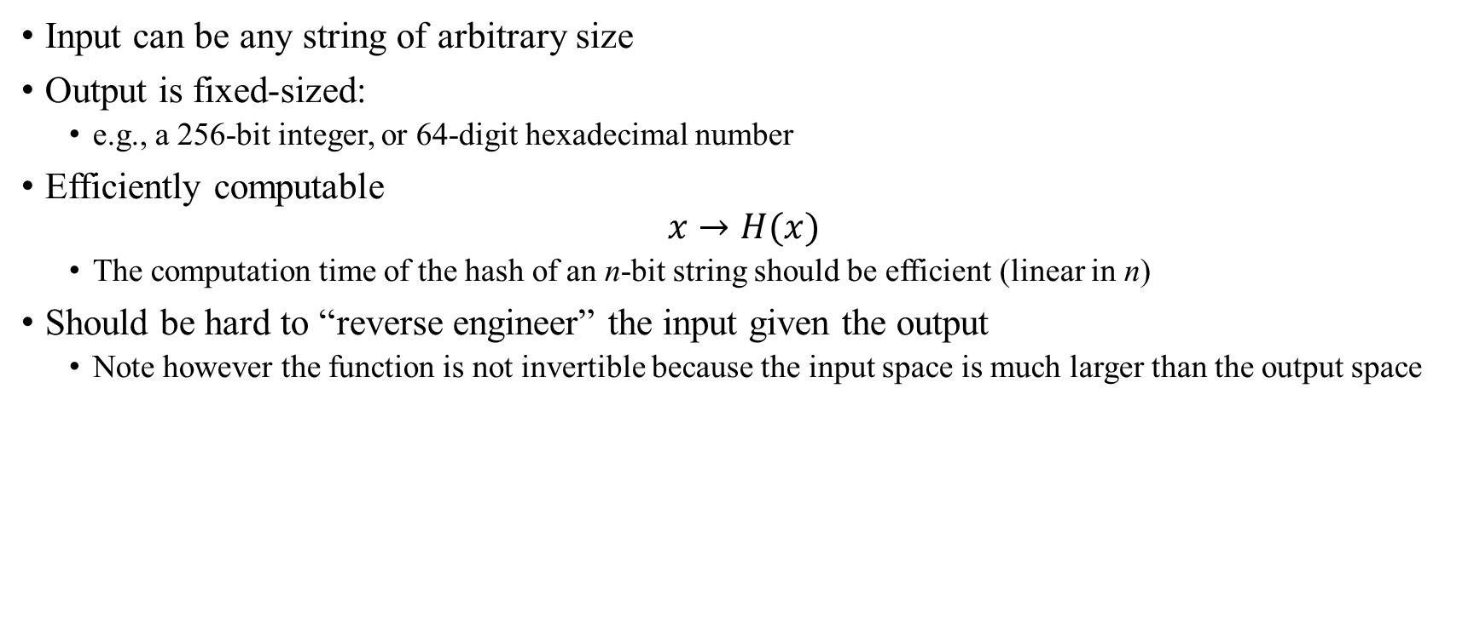
Cryptographic Hash Function
Input can be any string of arbitrary size
Output is fixed-sized:
e.g., a 256-bit integer, or 64-digit hexadecimal number
Efficiently computable
$$x→H(x)$$
The computation time of the hash of an n-bit string should be efficient (linear in n)
Should be hard to “reverse engineer” the input given the output
Note however the function is not invertible because the input space is much larger than the output space

Slide 11

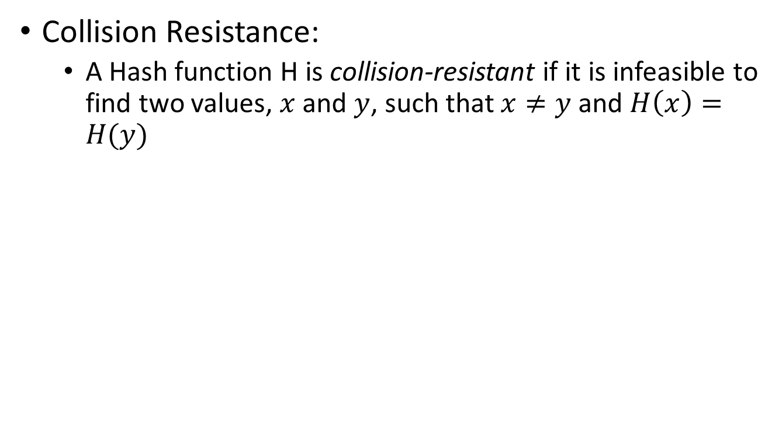


Cryptographic Hash Function
Collision Resistance:
A Hash function H is collision-resistant if it is infeasible to find two values, $x$ and $y$, such that $x≠y$ and $H\left(x\right)=H(y)$
$$x$$
$$H\left(x\right)=H(y)$$
$$y$$

Slide 12
Collision Resistance of SHA-256
SHA-256 is a deterministic but complicated algorithm
Very small change to input leads to large changes in the output
Try it at an online SHA-256 calculator, e.g. www.xorbin.com/tools/sha256-hash-calculator
Alice sent Bob 2.5 bitcoins → b711226415fd343dc413cf7302725e2a964bd40f638eb1a77f4abf2b56e665c6
Alice sent Bob 2.5 bitcoins. → c0b1b093d80e88c3ac836f0d25de6747d2a83a458213f4227cd819f25a7530ba
Alice sent Bob 2.51 bitcoins → 053e74934a04d0d0fe09a3f5d10eb7afdfd18fb8f554676b40d5507ee98e780a

Slide 13
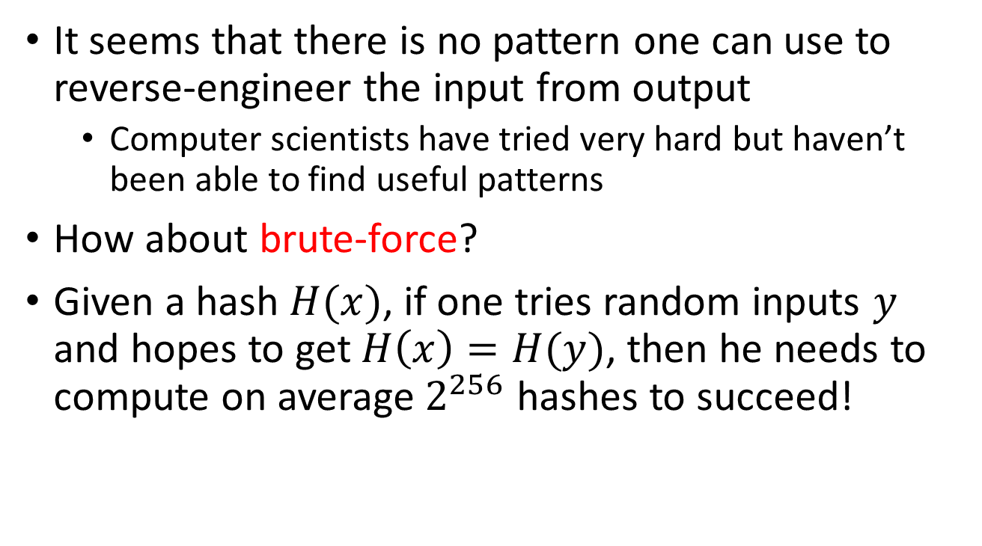
Collision Resistance of SHA-256
It seems that there is no pattern one can use to reverse-engineer the input from output
Computer scientists have tried very hard but haven’t been able to find useful patterns
How about brute-force?
Given a hash $H(x)$, if one tries random inputs $y$ and hopes to get $H\left(x\right)=H(y)$, then he needs to compute on average $2^{256}$ hashes to succeed!

Slide 14
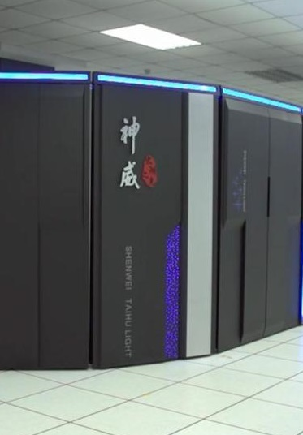
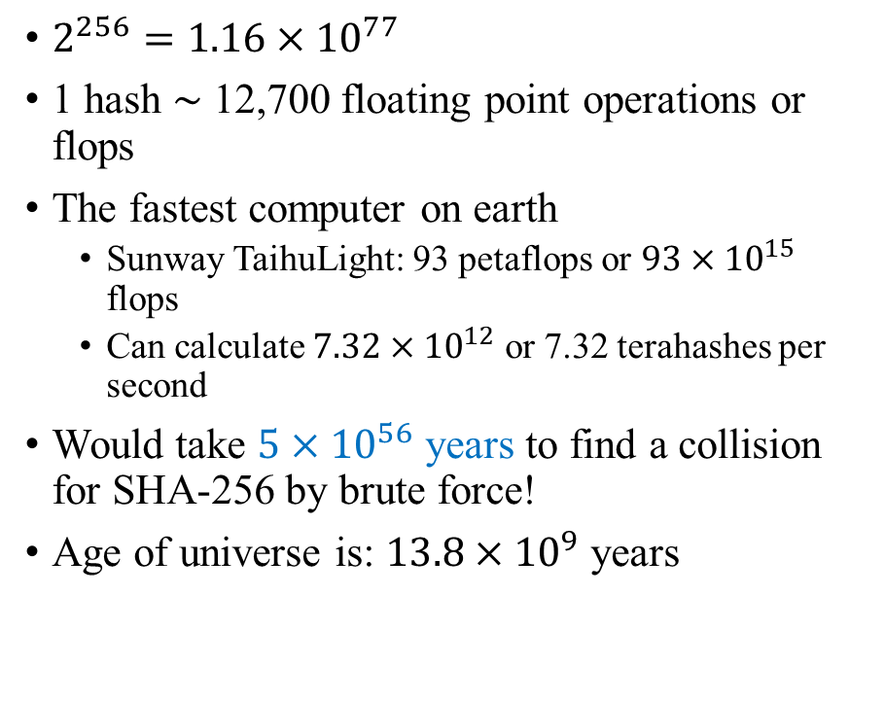
Collision Resistance of SHA-256
$2^{256}=1.16×{10}^{77}$
1 hash $\sim$ 12,700 floating point operations or flops
The fastest computer on earth
Sunway TaihuLight: 93 petaflops or ${93×10}^{15}$ flops
Can calculate $7.32×{10}^{12}$ or 7.32 terahashes per second
Would take $5×{10}^{56}$ years to find a collision for SHA-256 by brute force!
Age of universe is: $13.8×{10}^{9}$ years

Slide 15
Cryptographic Hash Functions
There are many known cryptographic hash functions
Many published by US government
MD5: 128-bit output
Collisions have been found since 2005
SHA-1: 160-bit output
In 2017, CWI Amsterdam and Google announced they had performed a collision attack against SHA-1 by obtaining two dissimilar PDF files which produced the same SHA-1 hash
SHA-2 family
SHA-256, SHA-384, SHA-512, etc.
Still considered safe to collision attacks
SHA-3 family
published in 2015 by NIST as potential alternatives to SHA-2
Notes:
National Institute of Standards and Technology (NIST)

Slide 16
Applications of Cryptographic Hash Functions
Commitments
Alice and Bob are both trying to get the answer to a mathematical problem
Alice got her answer first but she does not want to reveal it to Bob because Bob can then claim that he got the same answer
She also needs to commit to her answer at this time because otherwise Bob can claim she copies his answer later
She can give the hash of her answer to Bob (with timestamp)
After Bob solved it or gave up, Alice can reveal her answer and Bob can hash the answer and check that she indeed got the answer before him

Slide 17
Applications of Cryptographic Hash Functions
Document Integrity
When you download a file from a website, the website can also provide the SHA-256 hash of the file
After you download the file, you can compute the SHA-256 hash and compare with the one published on the website
If the two hashes match, the file has not been comprised
This is called the checksum procedure

Slide 18
Applications of Cryptographic Hash Functions
Password Storage
Websites often store passwords of clients in hashed forms
When a customer enters a password, its hash will be compared with the stored hash for verification
Benefit: passwords will not be easily compromised
Passwords stored this way cannot be recovered and has to be changed if lost

Slide 19
Blockchain
Blockchain is a linked series of blocks (linked list)
Each block contains data, the hash of the previous block, and a pointer to the previous block
Prev: H( )
Prev: H( )
Prev: H( )
H( )
Data
Data
Data

Slide 20
Blockchain is tamper-evident
If someone changes any part of a blockchain, then it is infeasible to make the chain consistent without changing the head pointer
One only need to check the head pointer to detect the tampering
Prev: H( )
Prev: H( )
Prev: H( )
Prev: H( )
H( )
Data
Data
Data
Data

Slide 21
Blockchain
Blockchain is the underlying data structure for Bitcoin and most other cyptocurrencies
Data on blockchains typically contain the history of transactions
The temper-evident nature of blockchains ensure that transaction histories cannot be changed

Slide 22
Merkle Tree
A Merkle Tree is a binary tree with hash pointers
The top of the tree is also called the Merkle root
Tamper-evident
H( )
H( ) H( )
H( ) H( )
H( ) H( )
Data
Data
Data
Data

Slide 23
Merkle Tree
Merkle trees are typically used to store transactions in each block
It is easy to verify whether any transaction has been modified by checking the root

Slide 24
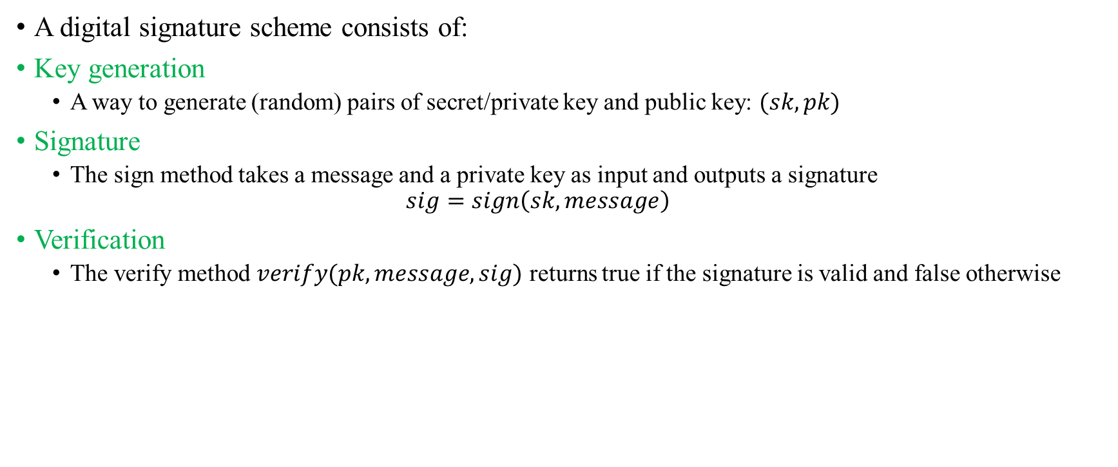
Digital Signatures
A digital signature scheme consists of:
Key generation
A way to generate (random) pairs of secret/private key and public key: $(sk, pk)$
Signature
The sign method takes a message and a private key as input and outputs a signature
$$sig=sign\left(sk, message\right)$$
Verification
The verify method $verify(pk, message, sig)$ returns true if the signature is valid and false otherwise

Slide 25
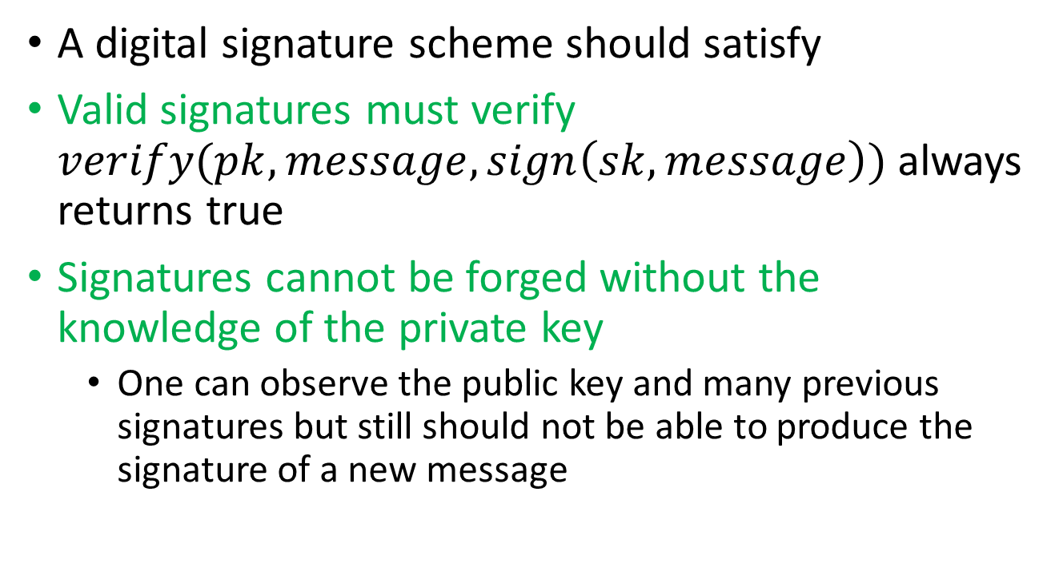
Digital Signatures
A digital signature scheme should satisfy
Valid signatures must verify $verify(pk, message, sign\left(sk, message\right))$ always returns true
Signatures cannot be forged without the knowledge of the private key
One can observe the public key and many previous signatures but still should not be able to produce the signature of a new message

Slide 26
Digital Signatures
A digital signature scheme can be used to achieve secure ownership of digital assets
The owner claims a digital asset by a public key/private key pair
The public key can be shared with anyone
The owner can sign a transaction message to prove that the transaction is authorized
Such signatures can be easily verified (using the public key) but cannot be forged by others
It is important to safeguard the private key!

Slide 27
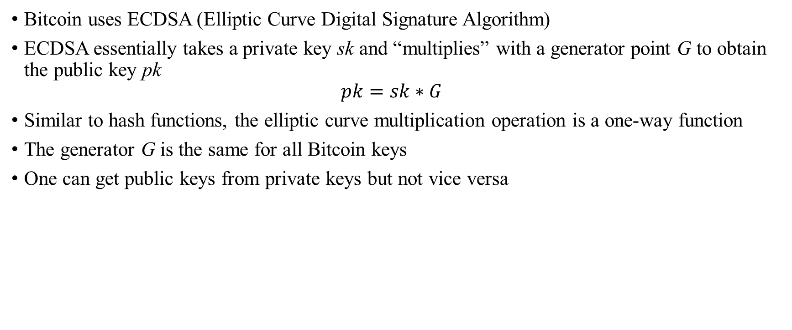
Digital Signature
Bitcoin uses ECDSA (Elliptic Curve Digital Signature Algorithm)
ECDSA essentially takes a private key sk and “multiplies” with a generator point G to obtain the public key pk $pk=sk∗G$
Similar to hash functions, the elliptic curve multiplication operation is a one-way function
The generator G is the same for all Bitcoin keys
One can get public keys from private keys but not vice versa

Slide 28
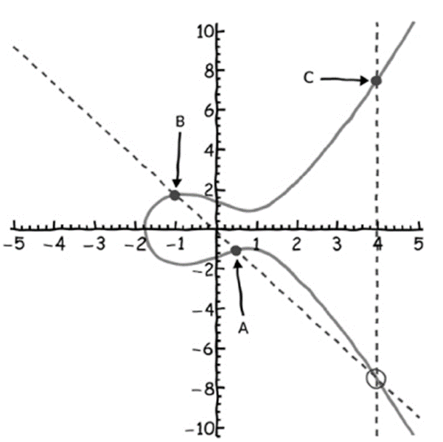
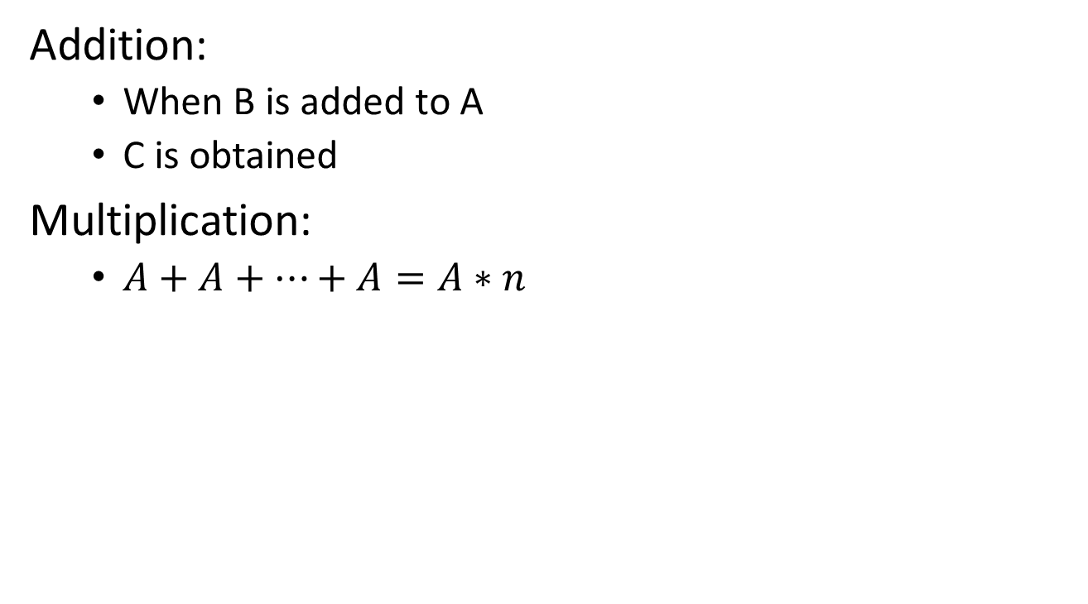

Digital Signature: ECDSA
Addition:
When B is added to A
C is obtained
Multiplication:
$A+A+…+A=A∗n$
n copies of A
$$y^{2}=x^{3}+a (mod p)$$
Source: Mastering Bitcoin, Antonopoulos

Slide 29
Digital Signature: ECDSA
ECDSA
Private key: 256 bits
Public key: 512 bits
Message to be signed: 256 bits
Signature: 512 bits
Messages are hashed before signature so messages of any length can be signed
It is important to generate the private key with a good source of randomness

Slide 30
Example
Private Key: 20de0bec7e51b4cbdd4b6baeedef3de15491db94f83c3f883400b75dc950dcc3
Public Key:
023e64db4d25308c4fa930d320b46268e6e2d16d1582a126fb825a8eae3ddd8e68
Address:
mi8Bx79yfdWD27uSrtfVc4PCAB2HifyoKR

Slide 31
Example- Create your own Bitcoin keys
Try generating new Private Key, Public Key and Addresses online (do not use for real transactions):
Online RSA Key Generator
https://travistidwell.com/jsencrypt/demo/
Open Source JavaScript Client-Side Bitcoin Wallet Generator
bitaddress.org

Slide 32
Mechanics of Bitcoin

Slide 33
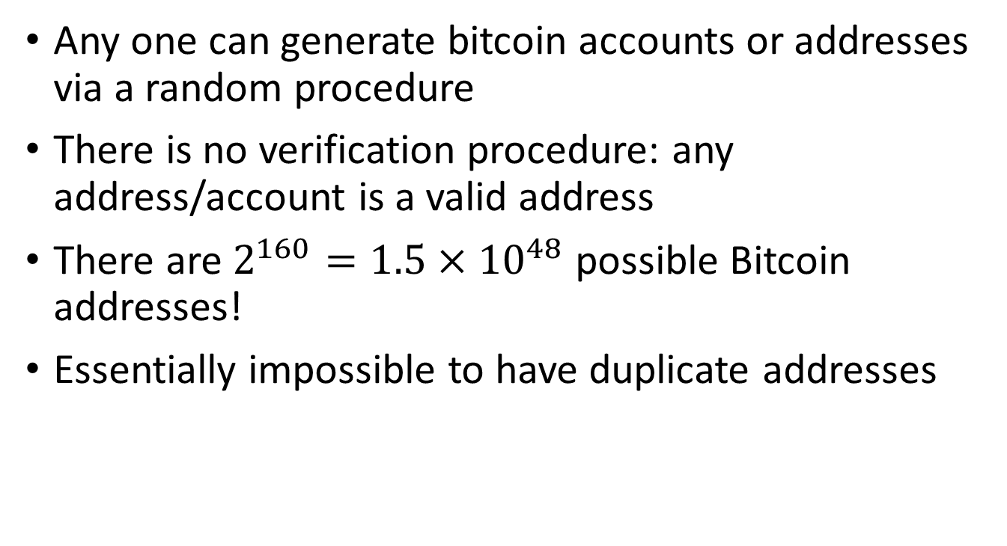
Bitcoin Addresses
Any one can generate bitcoin accounts or addresses via a random procedure
There is no verification procedure: any address/account is a valid address
There are $2^{160}=1.5×{10}^{48}$ possible Bitcoin addresses!
Essentially impossible to have duplicate addresses

Slide 34
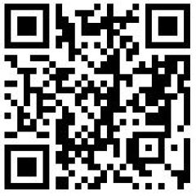
Bitcoin Addresses
To generate an address, first generate a private key and public key pair
Each address is a base-58 number transformed from a 160-digit hash of the public key
Can also be represented by QR-code
The address that receives the first bitcoins
1A1zP1eP5QGefi2DMPTfTL5SLmv7DivfNa

Slide 35
Bitcoin Wallets
Typically use wallet software to store bitcoins and the keys
Accounts at bitcoin exchanges, such as Coinbase, Bitstamp, etc.
Local Wallets
Desktop Computer or Mobile Device
Hardware Wallet
https://bitcoin.org/en/wallets/desktop/windows/
https://blockchain.info/wallet/#/

Slide 36
Bitcoin Wallets
Hot storage vs. Cold storage
Hot storage: easily accessible, but also risky
Online accounts
Wallets on computers or phones
Multi-factor verification can increase security
Cold storage: offline, more secure, less convenient
Hardware Wallets
Paper Wallets

Slide 37
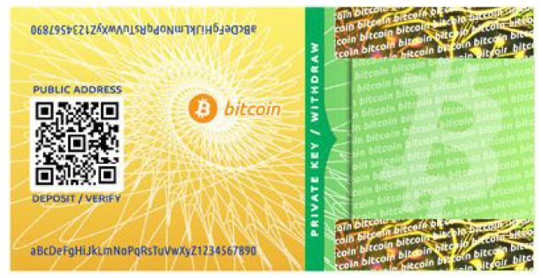
A Bitcoin paper wallet
Source: Narayanan et al (2016)

Slide 38
Bitcoin Transactions
Any one can send bitcoins to a public address
You need the private key associated with an address to send money out of the address
Transactions are irreversible

Slide 39

Bitcoin Transactions
Example: Alice buys some goods from the merchant Bob and sends one bitcoin to Bob
Alice
Bob
1 BTC

Slide 40
Bitcoin Transactions
Bob gives Alice his public bitcoin address by sending the string, or scanning the QR-code
Alice inputs the address and the amount in a transaction and signs it with her private key
Alice then broadcasts the transaction to the Bitcoin network
Alice
Bob
1 BTC

Slide 41
Bitcoin Transactions
The Bitcoin blockchain is a distributed ledger
Each transaction will be broadcast to the network
Each node (miner) will check whether the transaction is valid
Account has sufficient balance
No double-spending
If a transaction is valid, it will be put in a block on the ledger

Slide 42
What’s in a bitcoin transaction?
Input(s)
Each input refers to a previous transaction (hash)
There can be multiple inputs and amounts
Each input needs to be signed by the sender, who is the owner of the output of the previous transaction
Output(s)
There can be multiple output addresses and amounts
Sum of inputs should be greater than or equal to the sum of outputs
Any excess will be paid as transaction fees to the “coinbase” address, or the miner who mine the block

Slide 43
What’s in a bitcoin transaction?
Bitcoin script: the output contains a script that gives instructions on how to execute the transaction
Script is a programming language
Not Turing-complete
Complete reference: https://en.bitcoin.it/wiki/Script
Most common: pay to public address
OP_DUP OP_HASH160 <address> OP_EQUALVERIFY OP_CHECKSIG

Slide 44
What’s in a bitcoin transaction?
Multisig transactions
Needs M out of N signatures to spend the amount
Can be used in Escrow transactions
Buyer, seller, and a third party (platform, intermediary)
Impose a 2 out of 3 requirement on the transaction
Null transactions: used to store data on blockchain
A script that cannot be redeemed
Can burn a small amount of Bitcoin and write arbitrary data in the script field (up to 80 bytes)
These are simple examples of smart contracts

Slide 45
Bitcoin Transactions
The Bitcoin ledger or blockchain keeps track of all transactions
Ownership is tracked via transaction outputs
Carol
Alice
Bob
1 BTC
0.8 BTC
David
0.2 BTC

Slide 46
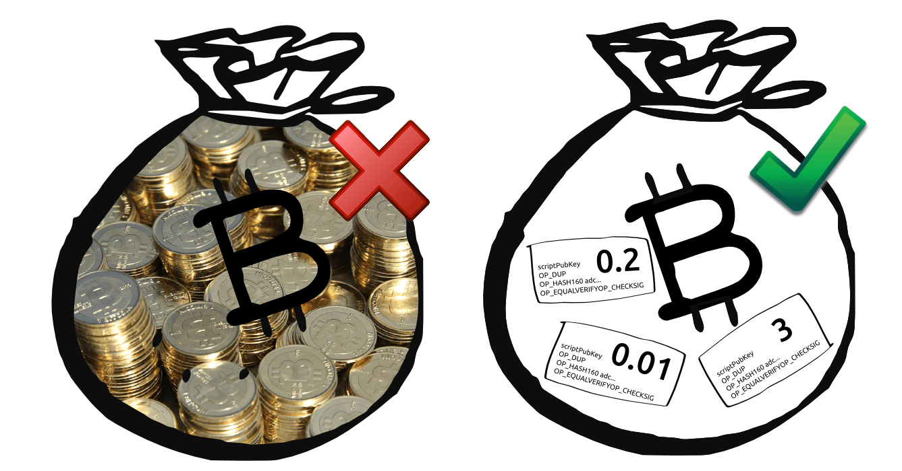
Bitcoin balance
The balances in a bitcoin address are tracked to inputs and to outputs of different transactions and not mixed up
https://www.cryptocoinsnews.com/bitcoin‐transaction‐really‐works/

Slide 47
Bitcoin Transactions
https://www.cryptocoinsnews.com/bitcoin‐transaction‐really‐works/

Slide 48
Bitcoin Transactions
https://www.cryptocoinsnews.com/bitcoin‐transaction‐really‐works/

Slide 49
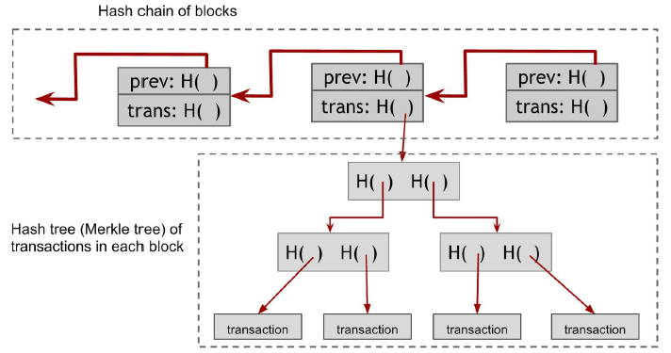
Bitcoin Blocks
Source: Narayanan et al. (2016)

Slide 50
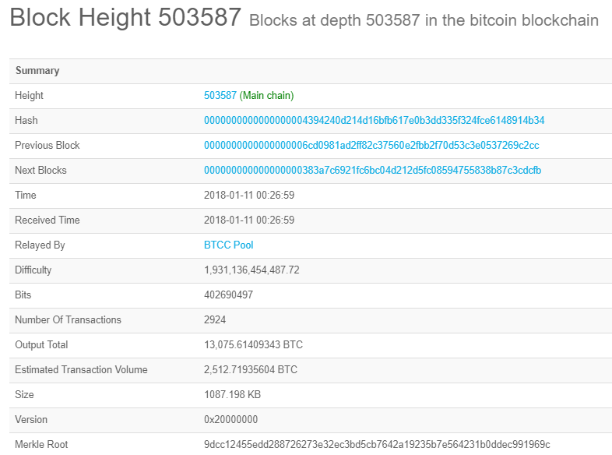
Example: Bitcoin block
Source: blockchain.info

Slide 51
Information
http:/coinmarketcap.com
https://bitinfocharts.com/
http:/blockchain.info/
https://live.blockcypher.com/

Slide 52
Mining
Bitcoin is a distributed ledger
Who maintains the ledger of transactions?
Who determines which transactions are valid?
Who creates new bitcoins?
Answer:
The miners

Slide 53
Mining
Miners keep the entire history of Bitcoin transactions and maintain the ledger
When Alice sends Bitcoins to Bob
She broadcasts the transaction to the miners on the network
Miners verify that the transaction is valid
Alice has the amount to spend
No double-spending
Miners seal the transaction onto the ledger by completing a computational task (“mining”)

Slide 54
Mining
Key to Bitcoin’s success as a cryptocurrency is mechanism of mining and the economic incentives to the miners
Miners’ rewards
Block rewards
For each new block, the miner who seals the block onto the blockchain receives new bitcoins as rewards
As in 2017, the block rewards are 12.5 bitcoins
Transaction fees
Miners also collect small fees for each transaction
Higher transaction fees ensure faster execution

Slide 55
Mining
Mining reward halve around every 4 years, starting with 50 bitcoins/block in 2009
Block rewards will stop at around year 2140
Total number of bitcoins capped at 21 million

Slide 56
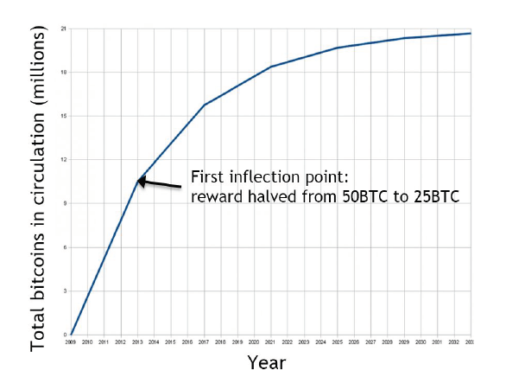
Mining
Reward is 12.5 BTC in 2017
Source: Narayanan et al (2016)

Slide 57
Mining and Proof of Work
Sybil attack
In a decentralized network, all nodes are equal
An adversary can set up a large number of nodes on the network and try to change the blockchain in their favor
To prevent such attacks, mining should consume some kind of resources so that Sybil attack is very costly
Proof of work: mining consumes computing power
Miners need to solve a mathematical puzzle to get the block reward and write to the blockchain

Slide 58
Proof of Work
The miners compute the hash of block in progress together with a nonce, a fixed-length number
Source: King, Williams and Yanofsky (2013)

Slide 59
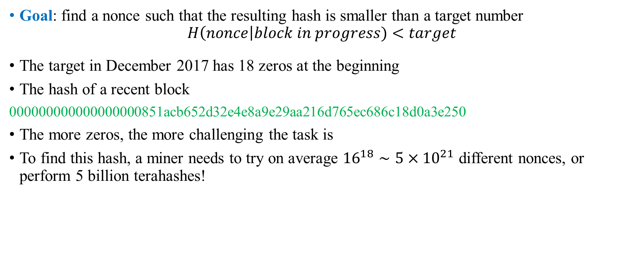
Proof of Work
Goal: find a nonce such that the resulting hash is smaller than a target number
$$H\left(nonce\right|block in progress)<target$$
The target in December 2017 has 18 zeros at the beginning
The hash of a recent block
000000000000000000851acb652d32e4e8a9e29aa216d765ec686c18d0a3e250
The more zeros, the more challenging the task is
To find this hash, a miner needs to try on average ${16}^{18}∼5×{10}^{21}$ different nonces, or perform 5 billion terahashes!

Slide 60
Proof of Work
Example: Find a nonce so that there are three leading zeros in the SHA-256 hash
“Hello World!0” → e59f8bdf1305e382a4919ccefd613d3eebae612aa4c443f3af2d65663de3b075
“Hello World!1” → 9e2be792bcd092bd5ab7bdac7bda1ae5d0db9f6d052a3c819615900c7c06e9be
“Hello World!2” → cacb96bf2e7873afedc96859081e535f44588be761a6169bed0623d1e5dd18c8
…
“Hello World!460”→ 0007ff56bd7816cff5a889f831a27c48198ad2943e6b662dfbc240b291556994

Slide 61
Sample Python Code
import hashlib
initstr = 'Hello World!'
for nonce in range(0, 2000):
hash_object = hashlib.sha256((initstr+str(nonce)).encode())
hex_dig = hash_object.hexdigest()
if hex_dig[0:3] == '000':
print('Found nonce: ' + str(nonce))
print('String: ' + initstr+str(nonce))
print('Hash: '+ hex_dig)
break

Slide 62
Homework
Find a nonce so that “Hello, <your name>!<nonce>” yields a hash with 5 leading zeros
Report the nonce, the string, and the hash
Bonus: Record the time to find the first nonce with a hash with 1, 2, 3, 4, 5 leading zeros.

Slide 63
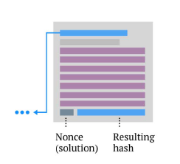
Proof of Work
When a miner finds a nonce that solves the problem, he/she wins the block and broadcasts the solution to the network

Slide 64
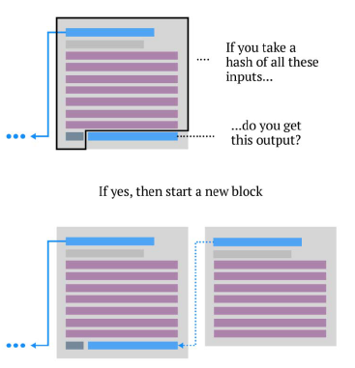
Proof of Work
If one miner receives a solution from a “winner”, he/she will verify it, and add the block to the blockchain
Although the mining puzzle can be very difficult, it is very easy to verify a solution
Only needs one hash

Slide 65
Proof of Work
What if two miners solve the puzzle at around the same time?
Different miners may accept different solutions from the two miners, depending on their proximity to them in the network
A “fork” of the chain will happen – more on this later

Slide 66
Proof of Work
Every two weeks, the mining difficulty or the target is reset so that a block will be mined in about 10 minutes
The difficulty thus depends on the total computing power, or hashrate, of the Bitcoin network

Slide 67
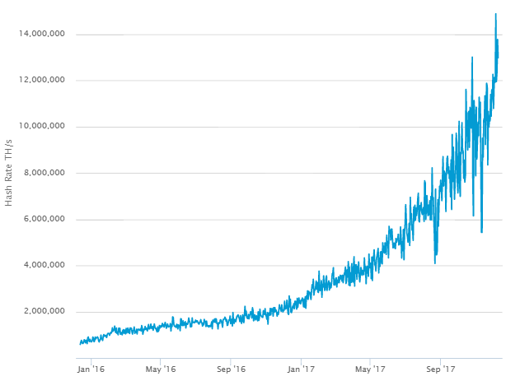
Hashrate Trends
Hashrate: a measure of the computational power of a blockchain network, group, or individual.
Hash rate is determined by how many guesses are made per second.
The overall hash rate helps determine the mining difficulty of a blockchain network.
Source: Blockchain.info

Slide 68

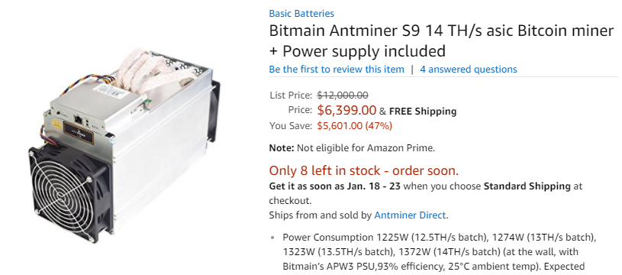
Evolution of Mining Hardware: Faster and More Specialized
More than the hash power of a general-purpose supercomputer!
CPU
GPU
FGPA
ASIC

Slide 69
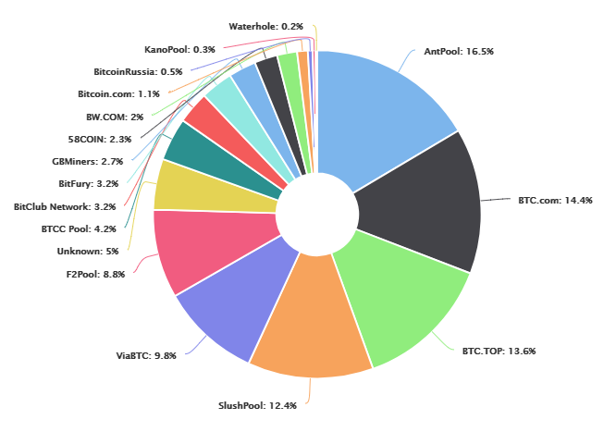
Hashrate Distribution: December 2017
Source: blockchain.info/pools

Slide 70

Excel Mining of Bitcoin

Slide 71
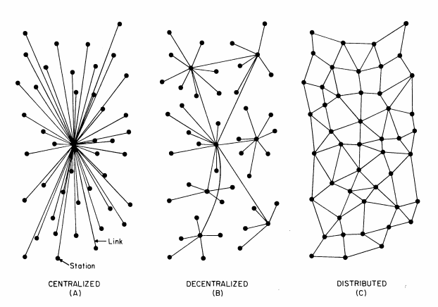
Blockchain – Distributed Ledger

Slide 72
Distributed Consensus
Bitcoin network is a distributed network
All nodes are equivalent
There are latencies in network and there is no globally defined “time”
It is impossible for all nodes to “meet” together and agree on the next block
The nodes can only communicate by messages
Some nodes may be malicious, e.g., running a modified bitcoin core and submitting invalid transactions

Slide 73
Distributed Consensus
Byzantine Generals Problem
A group of Byzantine generals with their troops encircle a city
Each general must decide whether to attack or retreat
Attack with fewer than half of the generals lead to losses
Generals can only communicate their decisions via bilateral messages
There are some traitorous generals who can sabotage the plan (e.g. they can send different messages to different parties)
Impossibility result: it is impossible for the generals to decide on a good plan if one-third or more of the generals are traitorous
Byzantine Fault Tolerance (BFT) consensus: consensus in a distributed network that are tolerant of faulty nodes
Usually involves a trade-off between confidence and time

Slide 74
Distributed Consensus
Bitcoin uses a Proof-of-Work mechanism and a blockchain to solve the Byzantine Generals Problem.
If any member of the network attempts to broadcast false information, all nodes on the network will immediately recognize it as objectively invalid and ignore it.
Because each node can verify all information on the Bitcoin network itself, there is no need to trust other members of the network, making Bitcoin a trustless system.

Slide 75
Bitcoin Consensus
Miners complete to seal the next block
Each miner could be solving a different problem since they may have received different transactions in different order
The first one who succeeds in finding a solution seals a new block onto the chain and broadcasts the solution to the network
If two miners solve the problem at about the same time, a fork may occur
The miners will keep working on their branches until the tie is broken
The protocol for miners is to always work on the longest chain

Slide 76
Forks in the blockchain
Orphaned Blocks
Prev: H( )
Prev: H( )
Data
Data
Prev: H( )
Data
Prev: H( )
Prev: H( )
Prev: H( )
Data
Data
Data

Slide 77
How does Bitcoin avoid Double-Spending?
Suppose Alice spends the same bitcoin twice
The two transactions may be put into different blocks by different miners
However, the two transactions are incompatible with each other and cannot appear on the same branch
In the end, only one transaction will appear in the longest chain and the other will be rejected by the consensus
To be very sure that double-spending won’t happen, one usually need to wait for a number of “confirmations”, or blocks that continue after the transaction
Typically, 6 confirmations are considered safe for the bitcoin network

Slide 78
Double-Spending
Prev: H( )
Prev: H( )
Alice: Transaction 1
….
Data
Prev: H( )
Data
Prev: H( )
Prev: H( )
Prev: H( )
Alice: Transaction 2
….
Data
Data
Confirmations

Slide 79
51 percent attack
If one party obtains more than half of the mining power of the network (a “51 percent attacker”), then it can basically seal only the blocks it wants to include in the blockchain
If any other party seals a block on the chain, the 51 percent attacker can simply work on a fork and make it longer
The 51 percent attacker can essentially get all the block rewards and control which transactions to be included
However, it cannot steal bitcoins from other people since the digital signatures are not broken
Costs: billions of dollars in hardware investment
Benefits: Not clear – unless to destroy confidence in Bitcoin

Slide 80
Updating Protocol
How to introduce new features into the Bitcoin Protocol?
More complicated than just releasing a new version of the software
It is difficult to ensure that all nodes will update the software in time
Sometimes it is not clear that all nodes will even agree with the update, or update the software
A fork will happen whenever there are some nodes running the new version and others running the old version
Nodes on the chain have no incentives to improve (Key challenge of blockchain application on corporate governance).

Slide 81
Soft forks
Soft forks
New features are added that make the validation rules stricter
Old version of the software will accept all new blocks
New version might reject some of the blocks accepted by the old version
If the majority of nodes update to the new software, they will help to enforce the new rules
Old miners might mine invalid blocks if they don’t update their software

Slide 82
Hard Forks
Introduce features that are previously considered invalid
The new and old chains are not compatible
The chain will split into two chains
Whether both will survive in the long run will depend on the community, especially the miners
Example: Bitcoin Cash hard fork on August 1, 2017: increases the block size up to 8MB
Bitcoin splits into two cryptocurrencies after then
The original cryptocurrency, Bitcoin Cash, remained in place and continued to follow its previous protocols. At the same time, a second currency, Bitcoin SV, emerged.

Slide 83
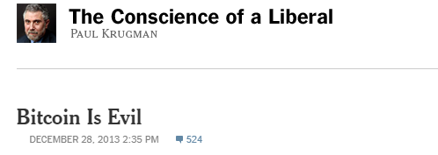
Controversies over Bitcoin

Slide 84

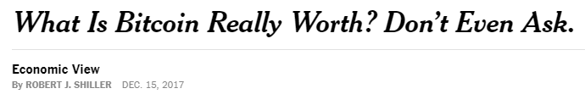

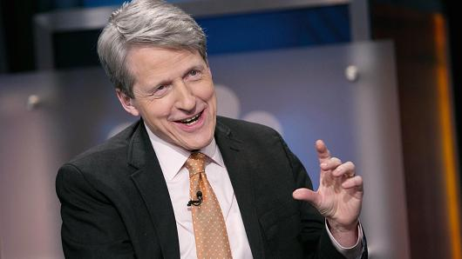
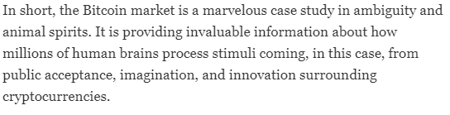
Controversies over Bitcoin

Slide 85

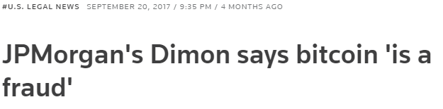
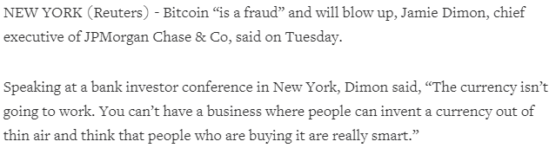

Controversies over Bitcoin

Slide 86

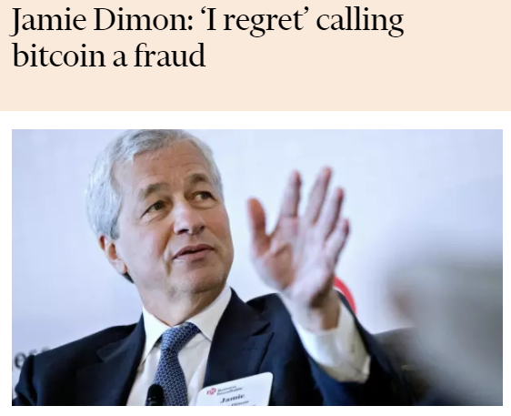
Controversies over Bitcoin

Slide 87

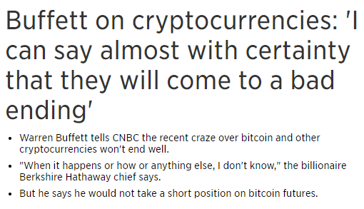

Controversies over Bitcoin

Slide 88
Controversies over Bitcoin
Cons
Bitcoin is not backed by any collateral or entity
USD is implicitly backed by the US government
Gold has practical uses
Bitcoin’s value only derives from its acceptance
Bitcoin prices are very volatile, making it less suitable as a currency

Slide 89
Controversies over Bitcoin
Cons
Bitcoin uses a large amount of energy
It is estimated that Bitcoin mining consumes as much energy as Denmark does!
Bitcoin also leads to the construction of Application Specific Integrated Circuits (ASICs) and has dedicated mining operations

Slide 90
Controversies over Bitcoin
Cons
Can be used for illegal purposes such as money laundering
Governments (US, Korea, etc.) have started to demand real names and ids for bitcoin transactions

Slide 91
Controversies over Bitcoin
Cons
Cannot replace credit cards as so far there is no credit service based on bitcoin
Scalability: only allows about 7 transactions per second, compared to about 2,000 transactions per second for Visa/Mastercard

Slide 92
Controversies over Bitcoin
Pros
Not controlled by any government, not subject to inflationary monetary policies
Does not require intermediaries such as central banks and banks
Easy and fast international transactions
Transactions irreversible: no chargebacks
Security and robustness of distributed ledger system
The network is robust even if many nodes go down
Prevents double-spending
Extremely costly to take over the bitcoin network

Slide 93
Controversies over Bitcoin
Pros
Value of bitcoin may derive from
The cost savings it offers as a transaction medium
The cost of mining or the security of the network

Slide 94
Controversies over Bitcoin
Pros
Bitcoin’s innovation: reduces the cost of verifying and transferring ownership
Is Bitcoin equivalent to the initial application of internet, i.e., Email?
The technology behind Bitcoin, Blockchain technology, can have very wide applications

Slide 95
References
Narayanan et. al, Bitcoin and Cryptocurrency Technologies: A Comprehensive Introduction
Diedrich, Ethereum: Blockchains, Digital Assets, Smart Contracts, Decentralized Autonomous Organizations
Cryptofinace, Campbell Harvey

