Slide 1
Applications of Blockchain Technologies in Financial Industry
Introduction to FinTech
Prof. Xiaoyu (Joanna) Wang
Peking University

Slide 2
Blockchain
Blockchain is a digital, decentralized, distributed ledger that provides a way for information to be recorded, shared, and maintained by a community (private or public)
Allows everyone to keep an eye on what is going on, without giving a single person control over the system

Slide 3
Components of Blockchains and Distributed Ledgers
Cryptography
P2P network
Consensus mechanism
Ledger
Access and Validation

Slide 4
Features of Blockchain
Digital
Transparent
Reliable
Real-time
Irreversible
Immutable

Slide 5
Three Levels of Blockchain Usage
Storage of digital records
Exchange of digital assets
Recording and executing smart contracts

Slide 6
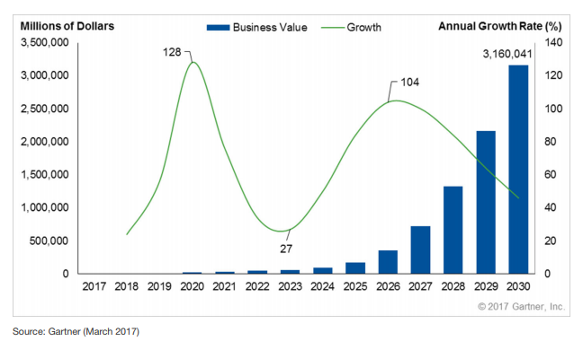
Blockchain Business Value 2017-2030

Slide 7
Industrial Revolutions in Human History
1st Industrial revolution: Steam Engine
2nd: Electricity
3rd: Information technology
4th: Blockchain?

Slide 8
Trust and Intermediation
Internet revolutionized communication
It hasn’t transformed business and commerce in terms of trust
Establishing identity and transacting value online still requires a trusted third party such as banks, governments, big tech companies
Intermediaries serve important roles but also add frictions
Charge fees
Monetize on information
Exclusion of a population

Slide 9
Key Takeaway from Blockchain Studies
A key takeaway across these applications is that blockchain is not just about disintermediating the middleman
In some cases, blockchain could disrupt markets and existing participants
Promises to help drive cost savings by reducing labor-intensive processes and eliminating duplicate effort
Can create new markets by exposing previously untapped sources of supply
The common thread is that by enabling a fundamentally new type of database technology that can be distributed across organizations, blockchain creates the foundation for solving problems or seizing opportunities that have eluded current systems
Blockchain's unique characteristics give it the potential not only to streamline existing markets, but also to redistribute markets and create new ones

Slide 10
Challenges to Blockchains
Still needs “killer” applications that are impactful
Bitcoin and Ethereum are the most successful ones and both face scalability issues
Applications in business are still mostly on test stages
The limits of open governance
Open and decentralized governance does not automatically lead to fair and equitable decisions
Decentralized market structures are untested
Are they more preferable than “trust taxes”?
Would they introduce new sources of risk to the global economy?

Slide 11
Challenges to Blockchains: What could go wrong?
Standards
Many special-purpose permissioned blockchains to be created for a wide variety of applications
Technical standards will be needed to ensure similar technical implementations across industries
Multiple blockchains need to interoperate with each other.
Commercial conflicts and business process differences
A blockchain database is only as good as the data and business process that underlie it
Failure to reach a consensus among counterparties because of business process or commercial conflicts could significantly slow or even halt blockchain’s adoption.
Privacy
Applying a distributed database to commercial transactions raises the question of whether organizations want to share information about counterparties.
Similarly, the idea of “reputation management” could raise concerns about the ability to permanently impact reputations. Users will need to carefully weigh these factors.
Speed and performance
Any distributed database is inherently slower than a centralized one, raising the question of whether blockchain is appropriate for highspeed, high-volume applications

Slide 12
Public vs Permissioned Blockchains

Slide 13
Public vs Private Blockchains
Public blockchains
Anyone can serve the role of miner/validator
All records are open to everyone
Consensus mechanism: Proof-of-Work or Proof-of-State
Permissioned blockchains
Only permissioned parties can serve the role of validators
The records may or may not be accessible to the public
Consensus mechanism: often majority voting
Private blockchains
Only a single party can write to the blockchain
Records may be open to selected parties or the public

Slide 14
Public vs Permissioned Blockchains
Internet vs Intranet
Permissioned/Private Blockchain
Better performance
More secure
Faster innovation/change
Public Blockchain
Accessible by everyone in the world
Allows decentralized cooperation with equal status

Slide 15
Hybrid/Consortium Blockchains
A mix of public and private blockchains
Rights to read and write can be extended to a number of parties based on need
Can be used by groups of organizations that collaborate while possibly competing with each other
Example: Risk Block developed by Risk Institutes a Consortium of insurance companies

Slide 16
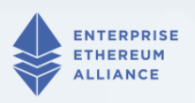
Consortiums and Platforms
Ethereum Enterprise Alliance
Started by 30 companies, including blockchain startups, Fortune 500 companies, and research groups in March 2017
Studying enterprise applications based on Ethereum
Now has more than 250 members, including Microsoft, JP Morgan, Deloitte, Mastercard, etc.
JP Morgan developed quorum, a permissioned blockchain platform based on Ethereum

Slide 17

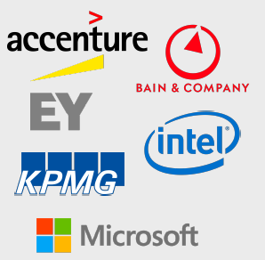
Consortiums and Platforms
R3
Started in 2015 by a group of banks and technology companies
A consortium working on a common blockchain platform focused on financial services applications
Developed Corda, an open-source distributed ledger platform. Available on Amazon AWS
Big banks such as Goldman Sachs, J.P. Morgan have exited R3

Slide 18

Consortiums and Platforms
Hyperledger
An open source collaborative effort created to advance cross-industry blockchain technologies
Hosted by The Linux Foundation
100+ Members include leaders in finance, banking, Internet of Things, supply chains, manufacturing and Technology, e.g., IBM, Intel, Accenture, Baidu, American Express, JP Morgan
Many different products
IBM developed Hyperledger Fabric
Hyperledger Sawtooth was started by Intel
Hyperledger Quilt: interledger protocol

Slide 19
Applications in Retail and Supply Chain

Slide 20
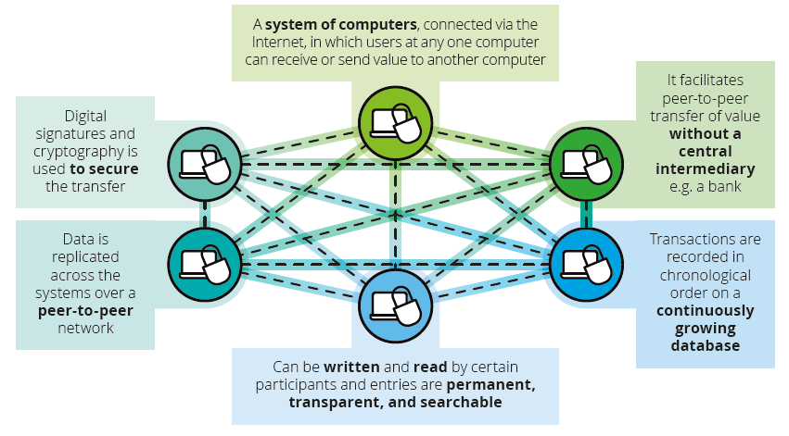
Overview of Blockchain
Source: Deloitte (2017)

Slide 21
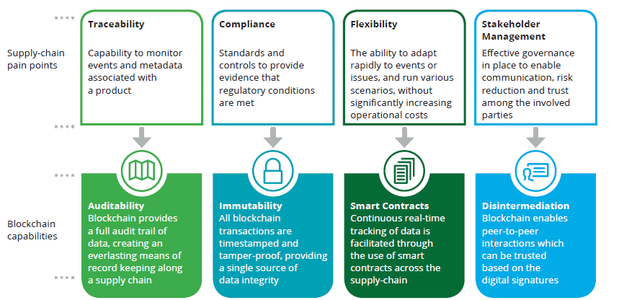
Blockchain and Supply chain

Slide 22
Use Cases: Consumer
Smart loyalty programs
Consumer Participation
Locate Stolen Products
Connected Devices
Targeted Recall
Sharing Economy

Slide 23
Use cases: Supply chain
Connected Supply Chain
Authenticity and provenance
Delivery
Know your customer
Connected store
Fraudulent transactions

Slide 24
Use cases: Payments and Contracts
Consumer Payments
B2B Payments
Digital Advertising
Consumer Protection

Slide 25
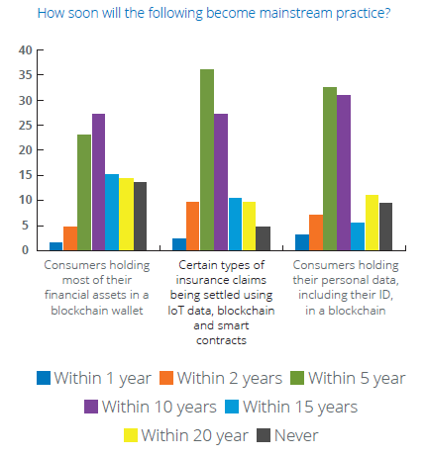

Slide 26
Applications to Government

Slide 27
Role of Government
Catalyze an Ecosystem for Growth and Collaboration
Blockchains and DLTs are nascent technologies
Governments can play a role in catalyzing its maturity as a technology by supporting grassroots developer innovation and encouraging collaboration among enterprises, countries and entrepreneurs.
Regulation and Governance in a Distributed Economy
Effective governance in a distributed economy will require legislative agility beyond what rules and regulations can provide
Modern governance will need to carefully balance a combination of broad policy principles, technology standards and “code”
Understand the benefits and risks brought by the new technology
A Hyperconnected and Highly Efficient Government
A “hyperconnected” government enables unprecedented integration and efficiency, where services are tailored to each individual’s needs
Blockchains will be used to connect disparate entities within and across regional, municipal, and state entities around citizens, businesses and assets

Slide 28
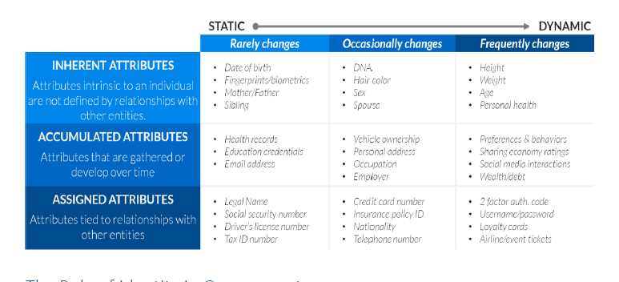
Use Case: Digital Identity
Source: Illinois Blockchain Report

Slide 29
Public Key Infrastructure (PKI)
A set of requirements that allow for the creation of digital signatures
Through PKI, each digital signature transaction includes a pair of cryptographic keys: a private key and a public key
The private key, is not shared and is used only by the signer to electronically sign documents
The public key is openly available and used by those who need to validate the signer’s electronic signature
PKI enforces additional requirements, such as the Certificate Authority (CA), a digital certificate, end-user enrollment software, and tools for managing, renewing, and revoking keys and certificates

Slide 30
Government PKI
The State of Illinois received certification as a self-signed Public Key Infrastructure (PKI) Certificate Authority (CA) and Registration Authority (RA) following an independent audit
Currently the Department of Innovation and Technology (DoIT), by legislative directive, is the sole source of digital certificates for State of Illinois agencies, boards, commissions, universities, municipal governments and business partners.

Slide 31
Why Decentralized Identity Management?
Decentralized Identity Management
Decentralized identifiers (DIDs)
DID documents and verifiable claims
Blockchain/distributed ledgers
Decentralized Resilience
Does not rely on any single Certificate Authority to check for validity of public keys and use globally available blockchain ledger for verification
Reduce Man in the Middle (MITM) attacks and the risk of a single Certificate Authority being a single point of failure
Embedding PKI in Each Transaction
Blockchains can make public key infrastructure more usable. Blockchains by nature require a built-in public key infrastructure mechanism, which if “wrapped” in a well-designed user experience, can be invisible to the end user
Pseudonymous: supplemental information, such as name, contact information or professional credentials can be associated with unique public-private key pair, merging on-chain and off-chain identity

Slide 32
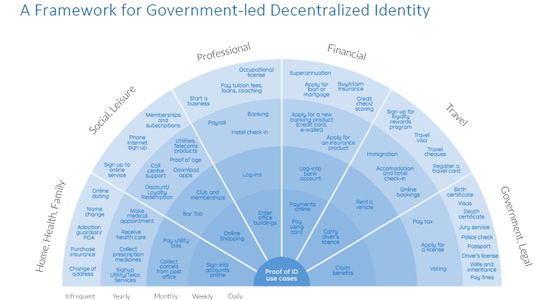

Slide 33
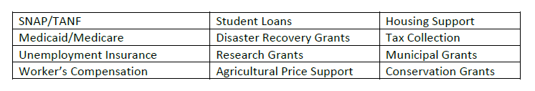
Potential Government Programs that Can Benefit from Blockchains

Slide 34
Social Benefits and Incentive Program Distribution
Blockchain can simplify Eligibility and Grant Process
Many government grants and incentives programs are eligibility based, where a grant is either approved or denied based on the meeting of certain requirements
Difficulty: data being held within disparate government and private entities, making the eligibility process time consuming and resource intensive to get right
Rolling up all of these systems into one distributed ledger simplifies the eligibility process
Upon eligibility, a smart-contract can trigger a grant payment to the recipient instantly.
Example: Medicaid
In this scenario, the State maintains a distributed roster (ledger) of eligible Medicaid members
Data is fed into this ledger from various sources, including the member’s employer or former employer and records from the federal and state government
This allows the eligibility status of a member to stay in constant sync
Should a member fall out of coverage once they find a stable job, a smart-contract would automatically terminate their enrollment in the program

Slide 35
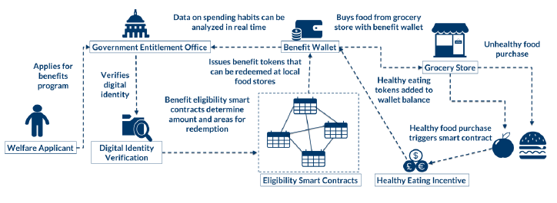
Use Case: Entitlement Digital Currencies

Slide 36
Use Case: Registration of Land Titles
Worldwide “dead capital” – when people do not have legal title to their houses, cars, and other assets – is estimated to be $20 trillion
Global crisis of confidence in institutions
The Republic of Georgia and Bitfury initiative
Register land titles via a private blockchain
Provide verification functions on bitcoin’s public blockchain
Future Extensions
Purchases and sales of land titles
Mortgages and rentals
Notary services
Offer smartphone Apps
Other pilot projects: Sweden, Honduras, Cook County

Slide 37
More Case Studies

Slide 38
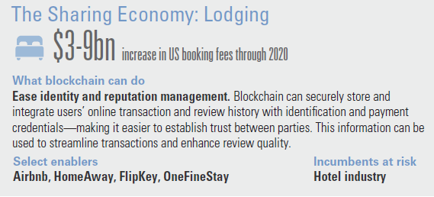
Case Study: Accelerating the Sharing Economy in Lodging

Slide 39
Case Study: Accelerating the Sharing Economy in Lodging
Opportunity
Problems
Significant time and communication needed before selection
Difficulty in assessing quality of host, guest, and property
Payment surety and speed

Slide 40
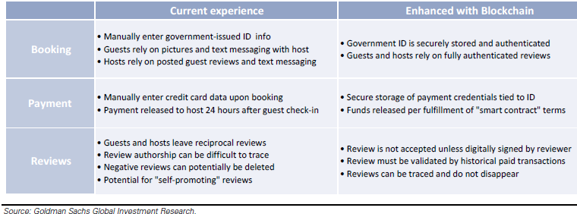
How Can Blockchain Help?

Slide 41
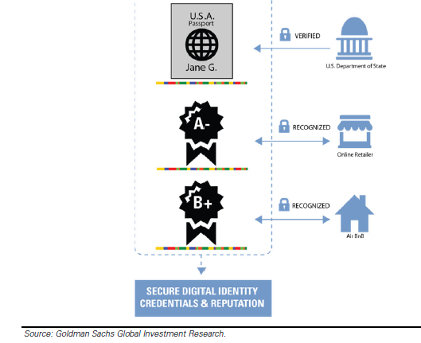
Blockchain Verification of Credentials and Reputation

Slide 42
Benefits of Blockchain in P2P lodging
Security: Enhancing verified ID with blockchain
Increasing trust in the booking process
Secure payment credentials and automating the release of funds upon contract satisfaction
Smart contracts can be used for payment release
Elevating the review system with blockchain-based authentication

Slide 43
Challenges to Adoption
Privacy concerns
Perception of loss of consumer privacy
Blockchain-based system aggregates user’s ID, payment information, reputation, past transactions, and reviews
Strong level of underlying security with a blockchain-based solution will mitigate such objections over time

Slide 44
Case Study: Capital Markets: US cash equities
The US cash equities market trades an average of 7 billion shares, or approximately $277 bn of notional value, per day in 2015
A number of intermediaries are needed
Stock exchanges, brokers/dealers, custody banks, Deposit Trust Company (DTC)
Post-trade settlement remains complex and expensive
Requires manual affirmation
Takes 2-3 days
Ties up capital and liquidity

Slide 45
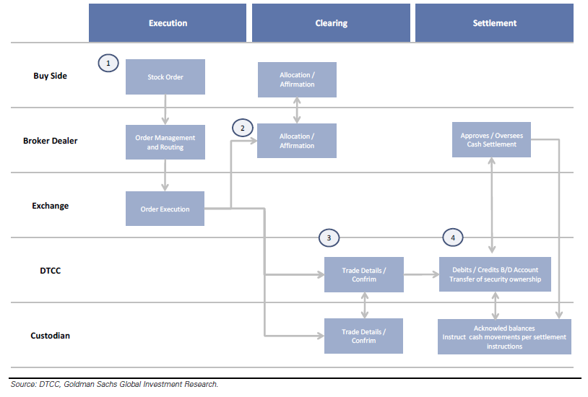
How US Equities are Traded Today

Slide 46
How Blockchains Can Help
Reduce/Eliminate Trade Errors
About 10% trades contain errors, leading to costly manual confirmation
Streamline back-office functions
Reduced manual labor and fewer platforms
Shortening settlement times
Near real-time settlement
Estimated Savings ~ $2 bn per year
Reduced back-office costs
Reduced capital requirements

Slide 47
Who will be disrupted?
Stock exchanges
Minimal
Custody banks
Reduced costs and back-office head counts
Clearing houses
Likely still necessary for netting and regulatory reasons
Overall, blockchain’s effects are more streamlining than disrupting

Slide 48
Challenges to Adoption
Universal adoption
Competitors have to collaborate with each other to achieve a network effect
Standardization
There need to be a standard for account information, trading records, order information, etc.
Scalability
Capital investment in infrastructure and processing power is needed to ensure scalability and speed
Legal and regulatory approval
Coordination among global regulators are needed
Changes to existing rules may be necessary
Challenges of technical transition
Given the stakes, transition will need to be thoroughly tested

Slide 49
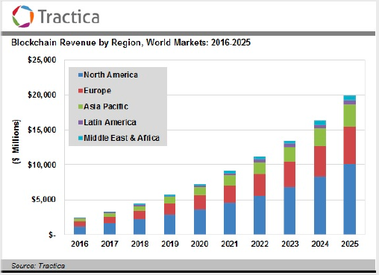
Blockchain Enterprise Applications: Projected Growth
Annual Revenue for Enterprise Blockchain Applications is projected to grow from $2.5 Billion in 2016 to $20 Billion in 2025

Slide 50
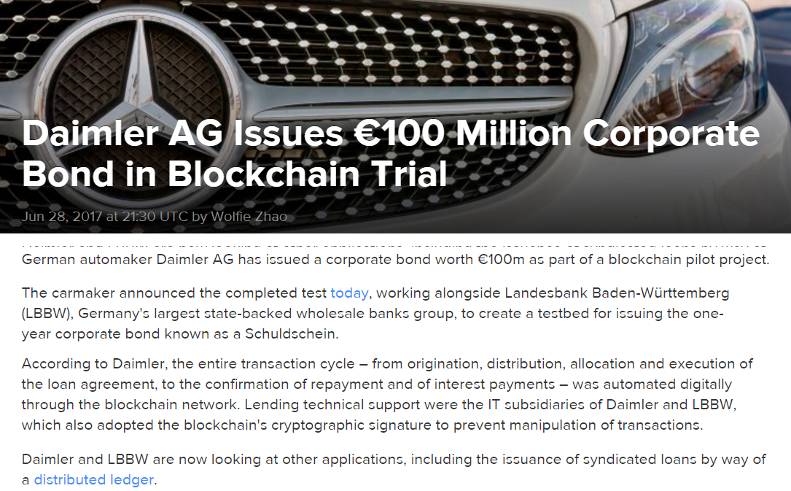
Daimler’s Bond Issue on Blockchain

Slide 51
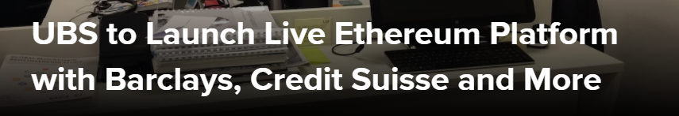
UBS Initiative: December 2017
The project led by Swiss banking giant UBS, with help from Barclays, Credit Suisse, KBC, SIX and Thomson Reuters, is designed to make it easier for banks to reconcile a wide range of data about their counterparties
Instead of each company checking the information independently, and reconciling the results periodically, the blockchain smart contracts will ensure accuracy in almost real-time

Slide 52

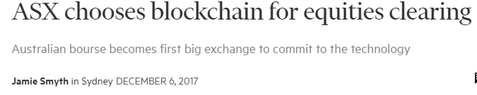
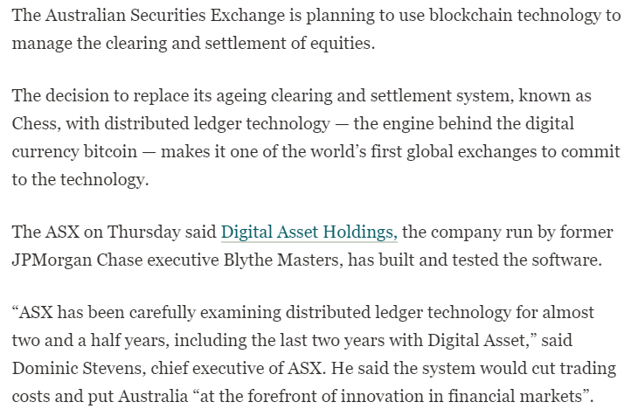
Australian Stock Exchange: December 2017

Slide 53
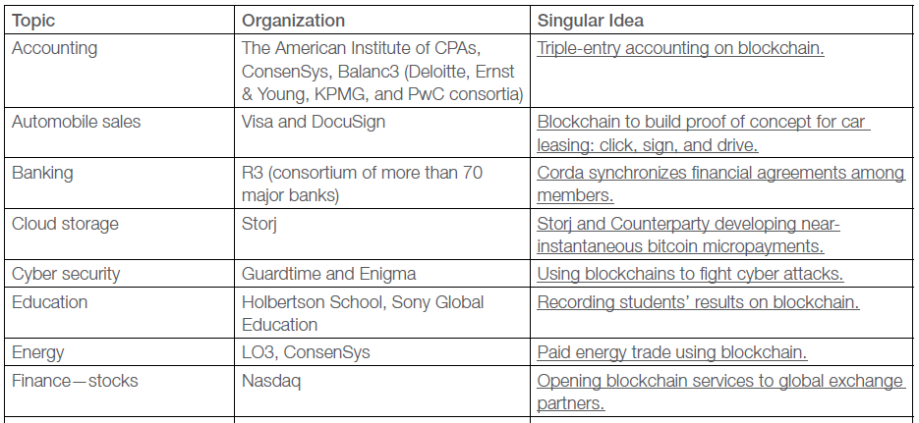
Blockchain Applications
Source: Risk Block

Slide 54
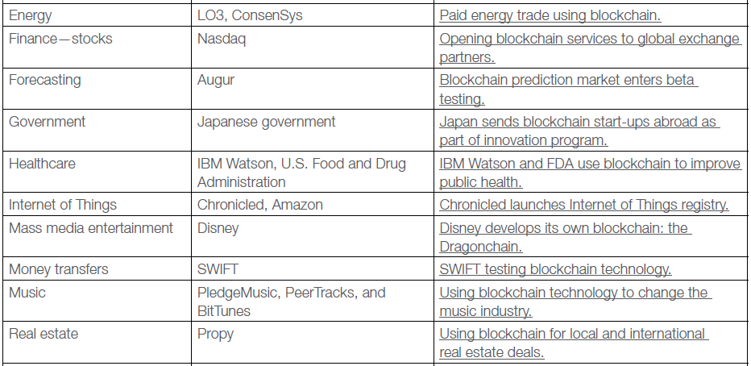
Blockchain Applications
Source: Risk Block

Slide 55
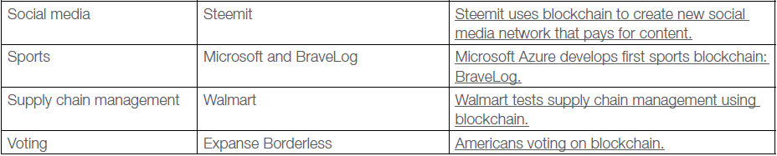
Blockchain Applications
Source: Risk Block

Slide 56
References
Accenture, 2013, Strategy in the Age of Devastating Innovation -- Big Bang Disruption
Chen, Mark, Qinxi Wu, and Baozhong Yang, 2018, How Valuable is FinTech Innovation?
Christensen, Clayton M., Michael E. Raynor, and Rory McDonald, 2015, What is Disruptive Innovation, Harvard Business Review
Deloitte, 2018, New Tech on the Block
Goldman Sachs, 2016, Blockchain: Putting Theory into Practice
Illinois Blockchain Report, 2017

