Slide 1
Cryptocurrencies and ICOs
Introduction to FinTech
Prof. Xiaoyu (Joanna) Wang
Peking University

Slide 2
Cryptocurrencies

Slide 3
Top 15 Cryptocurrencies by Market Capitalization (Nov. 2017)
 | Name | Market Cap (MM $) | Price | Circulating Supply
1 | Bitcoin | 109,024.35 | 6,537.07 | 16,677,862 BTC
2 | Ethereum | 30,250.40 | 316.08 | 95,705,475 ETH
3 | Bitcoin Cash | 22,884.88 | 1,362.17 | 16,800,313 BCH
4 | Ripple | 7,785.10 | 0.20 | 38,531,538,922 XRP
5 | Litecoin | 3,255.70 | 60.50 | 53,813,632 LTC
6 | Dash | 3,235.86 | 420.98 | 7,686,486 DASH
7 | Monero | 1,870.17 | 121.87 | 15,345,839 XMR
8 | NEO | 1,777.62 | 27.35 | 65,000,000 NEO
9 | NEM | 1,661.83 | 0.18 | 8,999,999,999 XEM
10 | IOTA | 1,627.61 | 0.59 | 2,779,530,283 MIOTA
11 | Ethereum Classic | 1,521.94 | 15.62 | 97,408,715 ETC
12 | Qtum | 827.08 | 11.23 | 73,658,652 QTUM
13 | OmiseGO | 736.69 | 7.22 | 102,042,552 OMG
14 | Lisk | 685.89 | 5.97 | 114,828,235 LSK
15 | Zcash | 684.03 | 261.82 | 2,612,581 ZEC

Slide 4
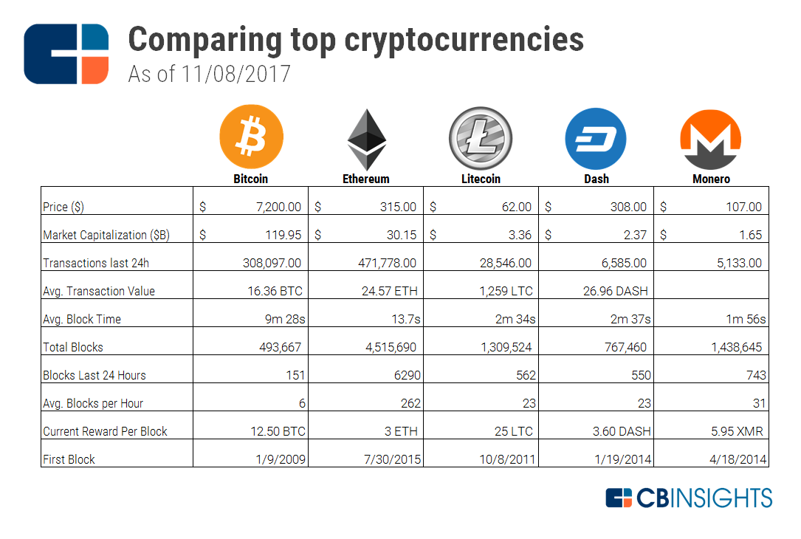

Slide 5
Bitcoin
Oldest cryptocurrency with largest market cap
Most widely used cryptocurrency
Over 100,000 merchants accept Bitcoin as payments
Chicago Mercantile Exchange (CME) and CBOE launched Bitcoin Futures in December 2017
Issues:
Scalability: Used to be 2 or 3 transactions; Currently 7 transactions
High transaction costs: currently a few dollars, was as high as $20-30 at peak price

Slide 6

Ethereum
Founded by Vitalik Buterin in 2014
Cryptocurrency (Ether) and smart contract platform
Allows Turing-complete programs
Base platform for hundreds of ICO’s
DAO Attack: a hacker stole $60 million using a loop hole in the codes
Led to a hard fork of the blockchain
Ethereum split into two chains: Ethereum and Ethereum Classic
More details on Ethereum later

Slide 7
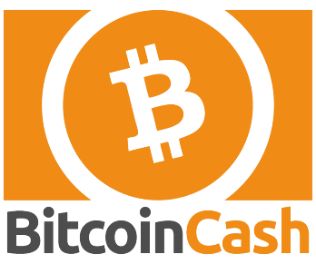
Bitcoin Cash
Bitcoin scalability is a big concern
Bitcoin Improvement Proposal (BIP) 91, or Segregated Witness (SegWit), activated on July 20, 2017
SegWit effectively increases blocksize slightly (1MB to 1.8MB) and would allow Lightning Network in the future
A group of developers and miners are not satisfied and proposed another solution: increasing blocksize to 8MB
Bitcoin Cash
Hard fork from Bitcoin on August 1, 2017

Slide 8
Bitcoin Cash
Blocksize
the size of a block in data storage and file systems.
Segregated Witness (SegWit)
a Bitcoin transaction change that separates transaction signatures and scripts (witness data) from inputs and outputs data.
By separating the witness data, SegWit allows for more transactions to fit in a Bitcoin block, increasing throughput and reducing fees for users on the network.
Lightning Network
uses smart contracts to establish off-blockchain payment channels between pairs of users. Once these payment channels are established, funds can be transferred between them almost instantly. Cleverly, the network doesn't need to create pairs between all users.

Slide 9

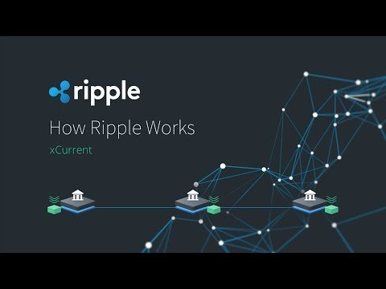
Ripple

Slide 10
Ripple
The Ripple transaction protocol (RTXP)
"secure, instantly and nearly free global financial transactions of any size with no chargebacks.“
The Ripple protocol support exchanges among fiat currencies, cryptocurrency, or any other units of value
Ripple has collaborated with a large number of banks in using the Ripple Network for international money transfers
Competition with SWIFT
Ripple network uses a list of validated nodes for verifying transactions
No mining is needed
Can be very fast (a few seconds)
Transactions are public but payment amounts are not

Slide 11
Ripple
The native cryptocurrency on the Ripple network is also called Ripple (XRP)
Not necessary for transactions in the protocol except for transaction fees
Most banks are not yet using XRP for their transactions
Easy to use for payment/transfer, but subject to greater volatility than fiat currencies
XRP is pre-mined (No miners needed)
There are 100 billion XRPs in total supply

Slide 12
Ripple
Validators decide the evolution of the XRP Ledger, so any business that uses or depends on the XRP Ledger has an inherent incentive to ensure the reliability, and stability of the network. Validators also earn the respect and goodwill of the community by contributing this way.
Validators get rewarded in XRP for being part of the consensus mechanism, receiving newly created XRP and transaction fees from blocks they propose and validate.

Slide 13

Litecoin
Started on October 7, 2011 by Charlie Lee
Very similar to Bitcoin except aimed more at achieving faster transactions
Block time is 2.5 minutes
Adopted SegWit earlier than Bitcoin
Lightning Network under tests
Use scrypt in its proof-of-work algorithm, a memory-hard function
Scrypt is a password-based key derivation function created by Colin Percival. The algorithm was specifically designed to make it costly to perform large-scale custom hardware attacks by requiring large amounts of memory (e.g., FPGA or ASIC for mining).
Mining setups — known colloquially as rigs — can vary in price, size, scale, performance, and efficiency. For example, a mining rig can be a central processing unit (CPU), graphics processing unit (GPU), field-programmable gate array (FPGA), or application-specific integrated circuit (ASIC).
ASICs are still being made now

Slide 14

Dash
Dash: “Digital+Cash”
Started in January 2014 (previously named Xcoin and Darkcoin). Codes forked from Litecoin
Unlike Bitcoin's single-tier network of miners, Dash utilizes a two-tier network with miners and masternodes
Masternodes require 1000 Dash as collateral to prevent Sybil attacks
Mining rewards: 45% go to miners, 45% go to masternodes, 10% go to a treasury system for development
Masternodes also vote on proposals
PrivateSend: mixing coin addresses so that transactions are untraceable. Only available for fixed denominations.
InstantSend: allows for near-instant transaction. Inputs are locked and verified by a consensus of masternodes

Slide 15
Proof of Work vs. Proof of Stake
Proof of work (PoW)
Decentralized consensus mechanism that requires network members to expend effort in solving an encryption puzzle.
Proof of work is also called mining, in reference to receiving a reward for work done.
Commonly called a consensus mechanism:
1. miner creates a temporary file (a block), if wins the competition to solve for a winning hash, will be stored on the blockchain.
2. miner broadcasts to the network that the block it confirmed is valid.
3. New blocks use the previous block's header hash, creating a chain of proof, which leads to network consensus.

Slide 16
Proof of Work vs. Proof of Stake
Proof of Stake
The validators offer their coins as collateral—called staking—for the chance to validate blocks and earn rewards.
Validators are selected randomly to confirm transactions and validate block information. This system randomizes who gets to collect fees rather than using a competitive rewards-based mechanism like proof-of-work.
Blocks are validated by multiple validators, and when a specific number of validators verify that the block is accurate, it is finalized and closed.
Compared to PoW, the PoS mechanism effectively substitute staking for computational power. Thus, there will be a drastic reduction in energy consumption since miners can no longer rely on massive farms of single-purpose hardware to gain an advantage.

Slide 17
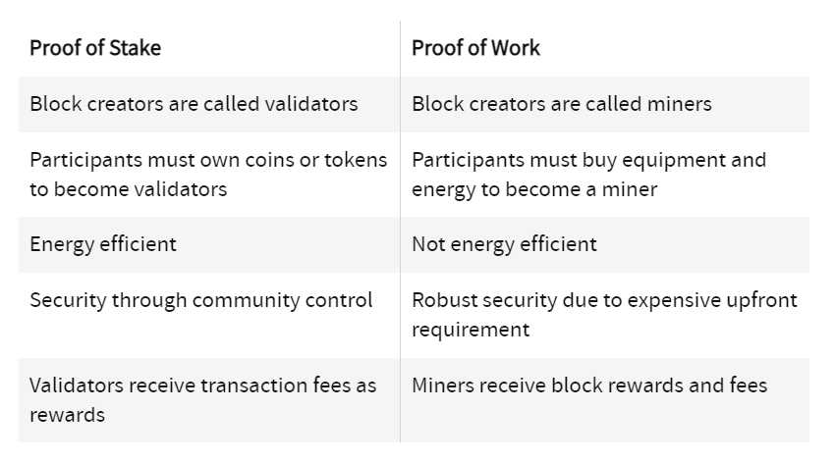
Proof of Work vs. Proof of Stake

Slide 18
Proof-of-stake (POS) Consensus
The creator of the next block on the blockchain is selected by various combinations of randomization, and wealth and age (the stake)
Peer coin
Coin age is the product of number of coins and the number of days the coin has been held
Coins that have been unspent for at least 30 days can sign for the next block. Greater coin ages lead to a greater probability of signing the next block
One stake of coins is used to sign a block, their holding period is reset to zero
Dash
Masternodes perform PoS consensus
Very high entry threshold for masternodes
Proof-of-stake does not require expensive computations and energy expenditures as in proof-of-work

Slide 19
Issues of Proof of Stake
“Stake” referred to the tokens that validators (aka PoS miners) had they were allowed to propose and validate blocks.
If you owned a PoS network’s token, you had an interest in the success of that network. The more of the token you owned, the more you had “at stake” if the network was attacked.
Two concerns:
It costs a validator nothing to validate transactions on multiple forks!
validators are expected to build on every fork because it is theorized that it is in their financial self-interest to do so.
If validators mine on both (or more) chains, they will collect transaction fees on whichever fork ends up winning.
If validators stake on every fork, this will be disruptive to consensus at minimum and could leave the network more vulnerable to double spend attacks.

Slide 20
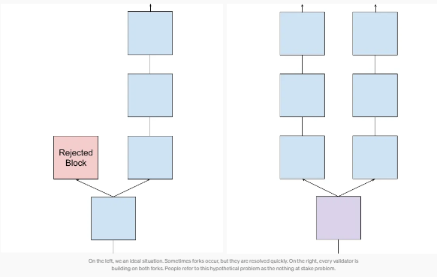
Proof-of-stake consensus
Nothing-at-stake problem:

Slide 21
Proof-of-stake consensus
Nothing-at-stake problem: a node can try to endorse multiple blockchain histories and thus help to double-spend
One possible solution: Casper (proposed PoS solution of Ethereum)
If a validator acts in a malicious manner and tries to do a “nothing at stake”, they will immediately be reprimanded, and all of their stake will be slashed
Casper also has other incentives such as punishing validators that go offchain

Slide 22
Delegated Proof-of-Stake (DPOS)
Example: BitShares (a platform)
Under DPOS, the stakeholders can elect any number of witnesses to generate blocks
Each account is allowed one vote per share per witness, a process known as approval voting
The top N witnesses by total approval are selected
The number (N) of witnesses is defined such that at least 50% of voting stakeholders believe there is sufficient decentralization
When stakeholders expresses their desired number of witnesses, they must also vote for at least that many witnesses.
Each time witnesses produce a block, they are paid for their services. If a witness fails to produce a block, then they are not paid, and may be voted out in the future.
The slate of active witnesses is updated once every maintenance interval (1 day) when the votes are tallied. The witnesses are then shuffled, and each witness is given a turn to produce a block at a fixed schedule of one block every 2 seconds

Slide 23

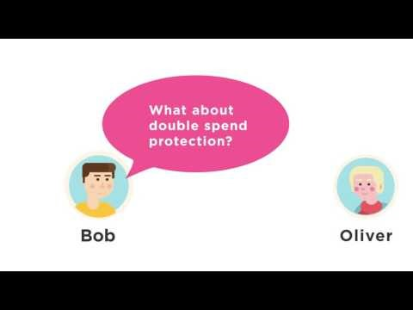
Monero

Slide 24
Monero
Introduced on April 18, 2014
Unlike bitcoin, transactions of Monero can be optionally non-traceable
Ring signatures: mix spenders’ address with a group of others
Destination addresses and amount can also be hidden
Use CryptoNote hash algorithm
Designed to be resistant to application-specific integrated circuit (ASIC) mining
Concern: can be used for illicit purposes
WannaCry operators convert their proceeds to Monero

Slide 25

NEO
Blockchain platform and cryptocurrency
Founded in 2014 in China by a private company Onchain
Delegated Byzantine Fault Tolerance (dBFT) consensus algorithm
Up to 10,000 transactions per second
Smart contracts can be developed with a number of programming languages
.Net, Java/Kotlin
Testing: Go, JavaScript, Python

Slide 26

NEM

Slide 27

NEM
Launched on March 31, 2015
NEM Client is open source but the server based component is closed source
Allows development of smart assets and contracts through API
Proof of Importance (POI) algorithm
A user’s importance is determined by the number of coins they have and the number of transactions made
Allows multisignature and encrypted messaging
Examples of applications: financial payments, mobile payments, equity trade settlement, escrow, notarization, coin creation, etc
In the Coincheck hack, more than $500 million of NEM was stolen due to the exchange’s security problems

Slide 28
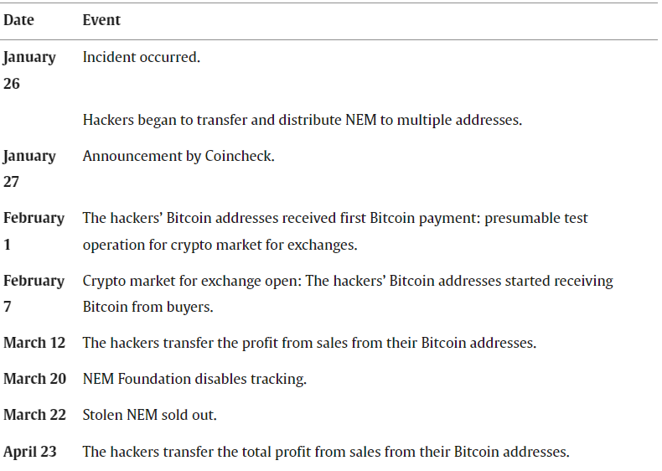
Coincheck hack

Slide 29

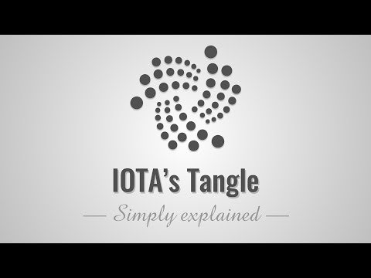
IOTA

Slide 30
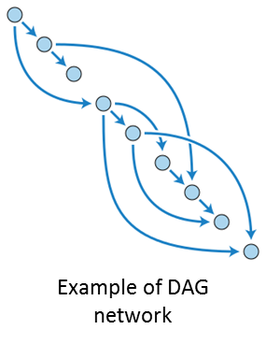
IOTA
Founded in 2015 by Serguei Popov and others
Intended to be the cryptocurrency for Internet of Things (IoT)
Open-source distributed ledger system focused on providing secure communications and payments among machines
IOTA uses tangle, based on Directed Acyclic Graph (DAG), not the traditional blockchain
Each participant is responsible for validating two previous transactions before their own can be approved.
This concept, known as “tip selection,” ensures that every participant has an active role in the consensus process.
Fast transactions
Low or no transaction fees

Slide 31

Ethereum Classic
After the security breach with DAO ICO, a hard fork was performed to reverse the hack transactions
A group of supporters believe blockchains should be immutable and continue to support the original blockchain, which becomes Ethereum Classic

Slide 32

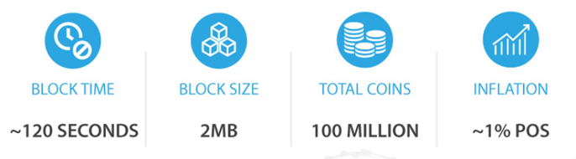
Qtum
Pronounced as “Quantum”
Designed to facilitate interoperability of major cryptocurrencies and allow smart contracts
A hybrid blockchain application platform that combines a modified bitcoin core and a modified Ethereum Virtual Machine (EVM)
Proof-of-Stake consensus algorithm

Slide 33

Omisego
Online payment platform and decentralized exchange built on Ethereum
Public and permissionless
Allow transactions of fiat money and digitial currencies
Low cost, fast transactions
“Unbank the banked”
Provide financial services to everyone
Omise is a venture-backed payments company based in Thailand
Has expanded to many Asia-Pacific countries
Backed by founders of Ethereum: Vitalik Buterin and Gavin Wood
ICO raised over $20 million

Slide 34

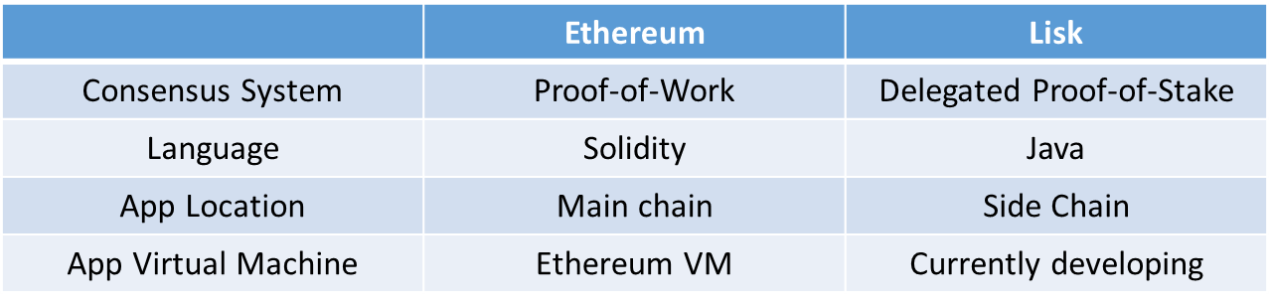
Lisk
Public blockchain platform that provides decentralized blockchain applications
Founded in May 2016
Goal is similar to Ethereum:

Slide 35
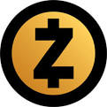
Zcash
Zcash is a cryptocurrency that grew out of the Zerocoin project, aimed at improving anonymity for Bitcoin users in October 2016
Zcash payments are published on a public blockchain, but users can use an optional privacy feature to conceal the sender, recipient, and amount being transacted
Use zero-knowledge proof signatures
Like Bitcoin, Zcash has a fixed total supply of 21 million units
Zcash also provides the option of "selective disclosure", allowing a user to prove payment for auditing purposes
Compliance with anti-money laundering or tax regulations

Slide 36

Classifications of Cyptocurrencies based on Hash Type and Consensus Algorithm
TYPE | COIN
SHA-256-based | Bitcoin, Bitcoin Cash, Namecoin, Peercoin, NuBits
Scrypt-based | Auroracoin, Dogecoin, Litecoin, PotCoin
Zerocoin-based | Zcash, Zcoin, ZeroVert
CryptoNote-based | Bytecoin, Monero, DigitalNote, Boolberry
Ethash-based | Ethereum, Ethereum Classic, Ubiq
Other proof-of-work | Dash, DigiByte, Primecoin, Zerocash
Non proof-of-work | BlackCoin, Burstcoin, Counterparty, Gridcoin, Lisk, NEM, Ardor, Nxt, Waves Platform, Ripple, Stellar, Shadow

Slide 37
Regulation of Cryptocurrencies
It is legal to hold and transact bitcoins in most countries
Australia
Bitcoin is regarded a currency
Japan
legal method of payment
US
IRS: cryptocurrencies are properties
CFTC: allows Bitcoin futures
Europe: still lacks a clear regulatory framework
China
banned exchanges between cryptocurrencies and fiat money
Korea
planned to ban exchanges but pulled back at protests

Slide 38
Regulation: New York’s BitLicense
Businesses in the State of New York or operated by a New York resident conduct virtual currency business activities need to obtain a BitLicense from the New York State Department of Financial Services
Virtual currency business activity includes one of the following types of activities:
receiving virtual currency for Transmission or Transmitting virtual Currency, except where the transaction is undertaken for non-financial purposes and does not involve the transfer of more than a nominal amount of virtual currency;
storing, holding, or maintaining custody or control of virtual currency on behalf of others
buying and selling virtual currency as a customer business
performing Exchange Services as a customer business
controlling, administering, or issuing a virtual currency
The following two activities are excluded from the definition of virtual currency business activity
development and dissemination of software in and of itself
merchants and consumers that utilize virtual currency solely for the purchase or sale of goods or services or for investment purposes

Slide 39
Initial Coin Offerings

Slide 40
Initial Coin Offering
Initial coin offering (ICO) is a means of crowdfunding for startup companies via the use of cryptocurrency and tokens
In an ICO, a percentage of the newly issued cryptocurrency or token is sold to investors typically in exchange for cryptocurrencies such as Bitcoin and Ethereum
Typically gives investors access to the features of a particular project starting at a later date
ICOs may also sell a right of ownership or royalties to a project
Companies usually post a “white paper” together with team and project information online before ICOs

Slide 41
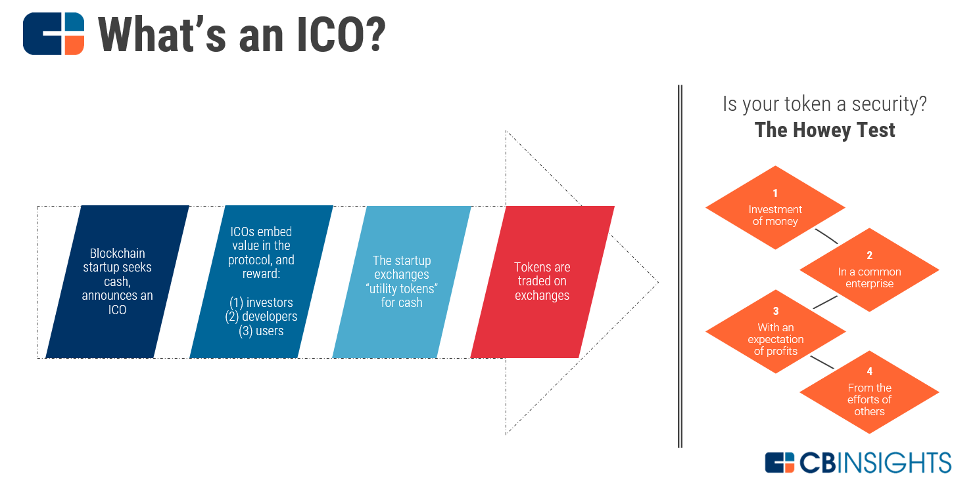

Slide 42
Returns of ICOs as of 2017 June

Slide 43
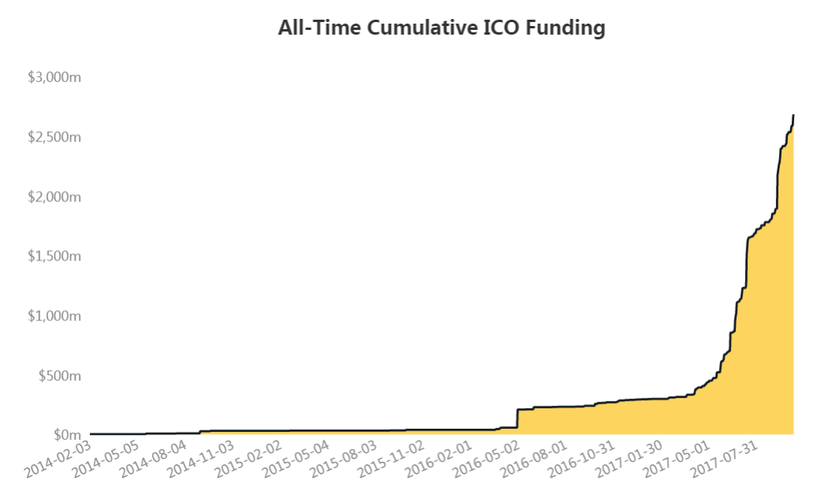
Data source: Coindesk website.

Slide 44
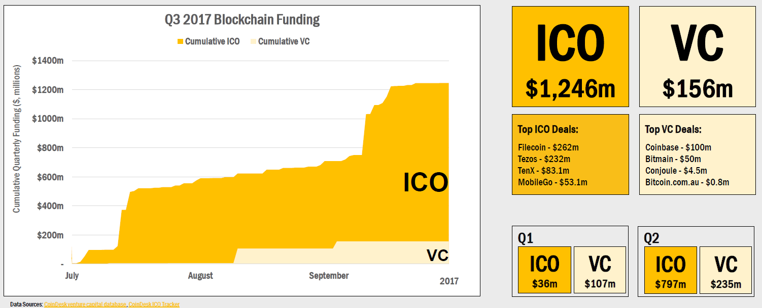
ICO funding far exceeds VC funding for blockchain companies in 2017

Slide 45
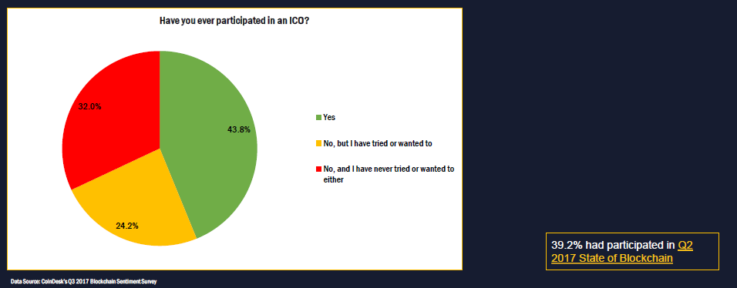
Participation in the ICO

Slide 46
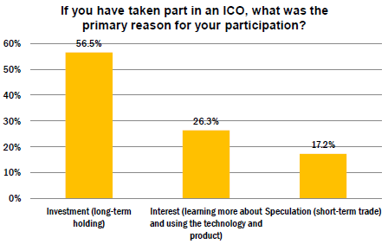
Reasons for ICOs
Source: CoinDesk

Slide 47
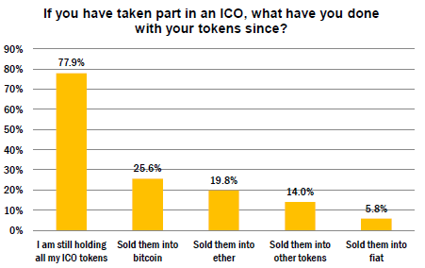

What to do with the tokens?

Slide 48
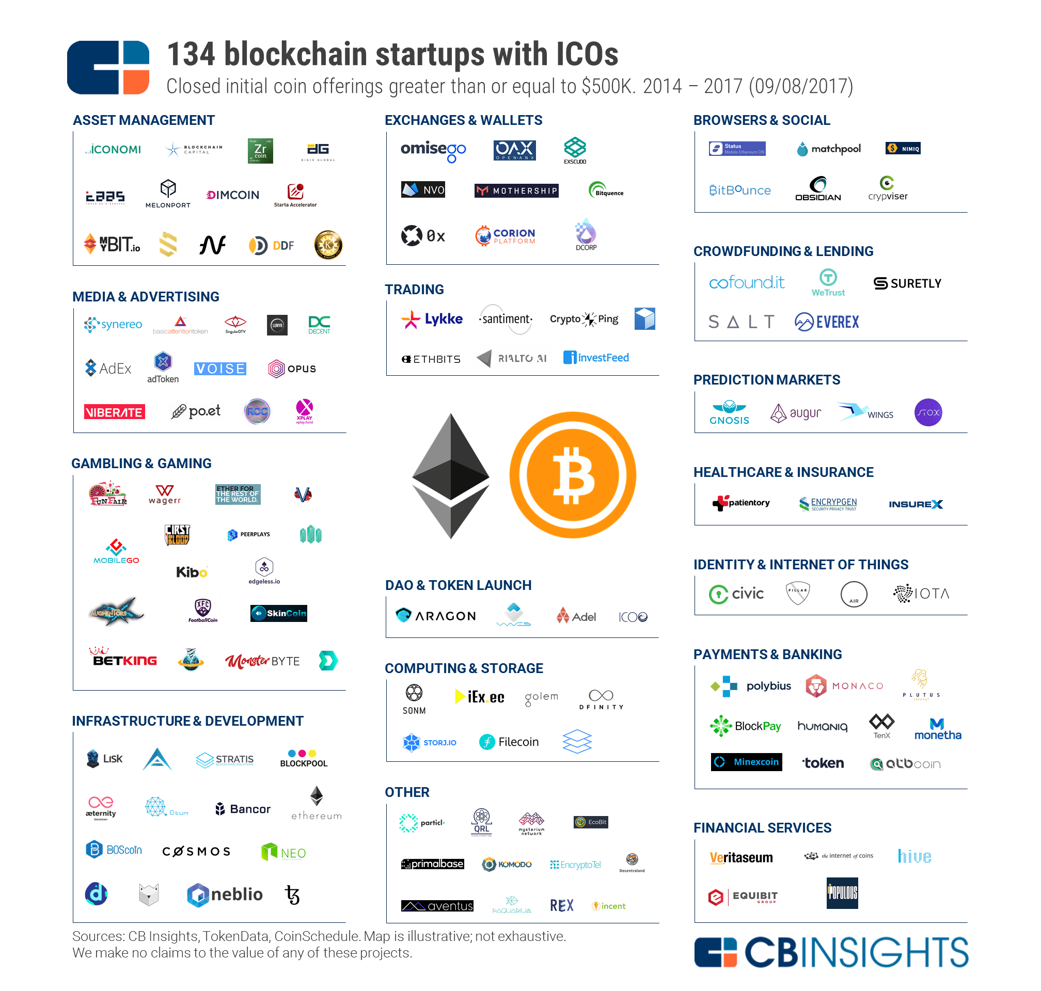

Slide 49
Ethereum was the first ICO
July 22, 2014
Raised $18.4 million in Bitcoin
Source: Ethereum.org

Slide 50

BAT
The fastest ICO
Brave Browser – Basic Attention Token (BAT):
Brave is a fast, open source, privacy-focused browser that blocks malvertisements, trackers, and contains a ledger system that anonymously captures user attention to accurately reward publishers.
On May 31st of 2017, Brave Browser launched its new digital currency, named the BAT. The ICO raised $36m via a token offering on the Ethereum Network. The offering raised 156,250 Ether in a mere 24 seconds!
The token can be used to obtain a variety of advertising and attention-based services on the Brave platform. The utility of the token is based on user attention, which simply means a person’s focused mental engagement
Notes:
https://basicattentiontoken.org/

Slide 51
Decentralized Autonomous Organization (DAO)
The most “tragic” ICO
The DAO was the first decentralized venture fund. It was initiated on the Ethereum blockchain and raised $152m. However a bug in the smart contract underlying The DAO was exploited to drain $60 million
It was a blow not only for the fund, its founders and investors but for the whole community and a hard fork was used to freeze all DAO tokens and send them to a new smart contract address
The DAO was delisted from trading on major exchanges in late 2016
In July 2017, the SEC concluded that DAO tokens sold on the Ethereum blockchain were securities and therefore possible violations of U.S. securities laws.

Slide 52

Milkcoin
MilkCoin – an ICO in 2017 November
The first and biggest agricultural ICO
The ICO starts at Nov. 15, 2017, and ends at Dec. 15, 2017
Token symbol: MLCN
The company is a milk production complex for 2400 diary cows/ cultivated areas of 3500 hectares of land, based in Voronezh Region in Russia
Backers invest in milk production complex, the company pays annual dividends and can buy back MilkCoin at 20% higher prices
Bonus periods: 1st period $0.1, 2nd period - $0.4, 3rd period - $0.6, 4th period - $0.8, 5th period - $1
Project passed all government approval stages
Business plan and financial model
"Priority Project" adopted by the Government

Slide 53

BetBox
BetBox is an AI-driven Hedge Fund, bringing the power of Machine Learning and Deep Neural Networks to turn sports betting into an alternative asset class. The fund is raising money to register under the AIFMD Regulation in European Union (Gibraltar) and to help with the R&D, operation of the fund.
Token: BetBoxTokens (BETX). BetBox aims to raise a total capital of $25 million during ICO in 2017
The fund aims to provide capital growth by investing in sports betting markets through algo-trading and systematic approach and will not invest more than 10% of its AUM into each BetBox algo-trading model.
The fund will have a 3% yearly management fee plus a 30% performance fee. The BetBox hedge fund's performance fees are uncapped, so there is no maximum fee charged.
ICO investors will receive 20% of the net transaction revenue earned by BetBox, which is the difference between performance fee charged by BetBox less direct costs associated with the transaction.

Slide 54
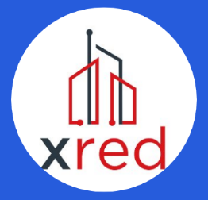
XRED
The "X Real Estate Development" project (XRED) aims to develop a technological and organizational model for the real estate development market based on blockchain technology
Allow interested parties to enter into projects for the purchase and construction of new real estate projects with high speed and unsurpassed security
The technological solution of the XRED project allows removal of unnecessary chains of links in real estate transactions, therefore having a significant impact on the final value of transactions
With the XRED Foundation anyone can invest in the first cryptocurrency fund for real estate and participate in developing UK & Central London Real Estate (initial step)
All investors will have their own ICO-wallet and will be able to control and transact XRED tokens securely and quickly
The XRED Foundation uses the crowdfunding process to secure the best sites for developing projects thereby creating capital to make a profit for participants

Slide 55

Rega
Rega risk sharing is a crowdsurance platform that will allow people cover and manage the variety of risks without excessive and inefficient chain of intermediaries
Peers may finally get the opportunity to manage their own risks at their own price without intermediary risk carriers receiving all upside of risk premiums. The platform just takes a flat fee for providing the technological solution to the market, peers receive all the benefits and prolonged risk coverage
REGA Risk Sharing platform will use smart tokens basing on Bancor protocol
REGA Tokens can be used as an contribution in pools for crowdsurance products, and means of payment for REGA services
Those tokens will also be used as REGA expert license to manage the parameters of the REGA risk models and to process some difficult cases.

Slide 56

BBOD
Blockchain Board of Derivatives (BBOD) is world’s first decentralized platform to trade cryptocurrency options, futures and exchange digital coins and tokens
BBD utility tokens are used solely to pay for the platform’s trade execution fees. All BBD tokens that BBOD collects from fees, after paying Exchange Operator and Partners, will be burned and taken out of circulation, ceasing to exist, forever.
“Please note, we do not recommend buying BBD tokens for speculative investment purposes”

Slide 57
ICO Platforms
Ethereum is the predominant platform
Over 500 ICOs
Typically use the ERC-20 token standard
ERC-20 token is a standard smart contract that can be modified
Once launched, an ERC20 token’s rules cannot be changed, and its supply cannot be increased
Highest liquidity and transaction volume
Due to the wide applications, the Ethereum network can sometimes get congested, transaction fees can also be higher than other platforms
Other platforms: Bitshares, NEM, Neo, Nxt, Omni, Qtum, Stellar, Waves, etc

Slide 58
ICO Rounds
ICO financing is commonly staged, similar to angel investor and VC rounds
Example: Telegram, a messaging app, is planning to raise a staggering $1.2 billion in an ICO to build and support a payment system on its platform
Telegram, similar to a number of the stronger companies to stage ICOs, plans a $20 million “pre-sale” in which numerous venture firms are poised to participate, including Sequoia Capital, Benchmark, and Kleiner Perkins

Slide 59
Is ICO a security?
Howey Test of whether an investment is a security:
It is an investment of money
There is an expectation of profits from the investment
The investment of money is in a common enterprise
Profit from the efforts of a promoter or third party

Slide 60
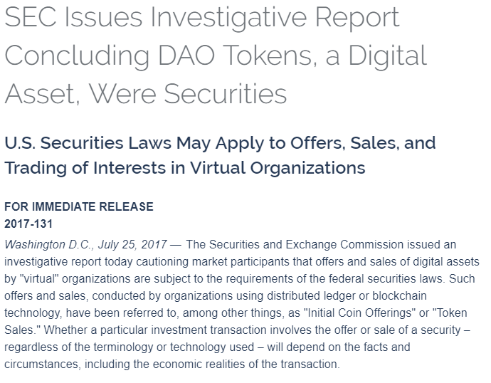
SEC Investigation of DAO

Slide 61
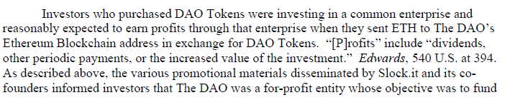
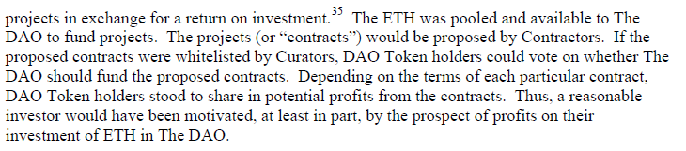
SEC Investigation of DAO

Slide 62
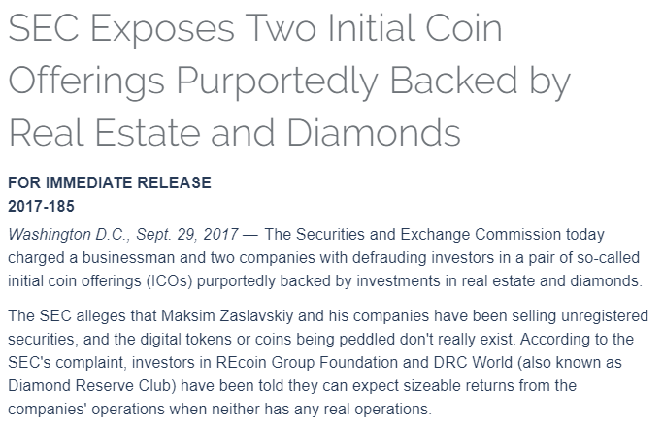
SEC Regulation of ICO

Slide 63
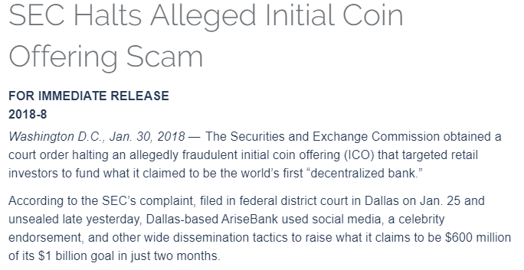
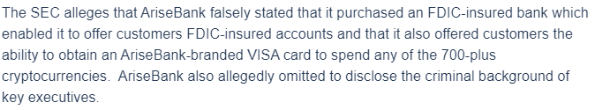
Another SEC Case

Slide 64

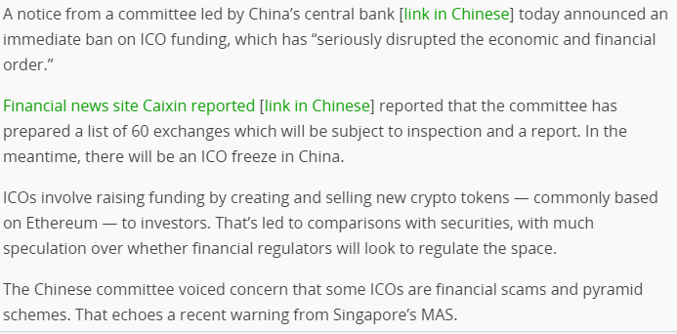
International Regulation of ICOs
Source: Ted Crunch

Slide 65

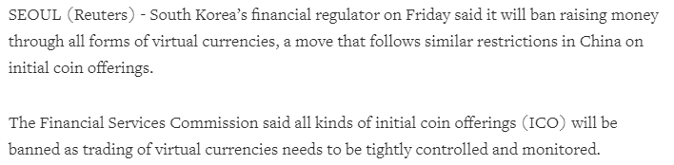
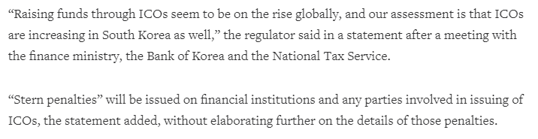
International Regulation of ICOs

Slide 66
References
https://www.icoalert.com/
https://icowatchlist.com/finished
https://www.coindesk.com/
https://www.smithandcrown.com/icos/
https://topicolist.com/
http://www.wikipedia.com/
http://www.Investopia.com/
https://coinmarketcap.com/tokens/views/all/

Slide 67
Central Banks and Digital Currency

Slide 68
Classical Central Bank Roles
Issue and replace coins and paper currency
Conduct monetary policy by changing money supply and interest rates
The Federal Reserve buy or sell treasury bonds in open market operations to change money supply
When money supply increases, interest rates decrease and economy is stimulated
When the Fed wants to fight inflation or overheated economy, it decreases money supply and increase interest rates
The effectiveness of monetary policy also depends on the banking system
When the central bank increases money supply, how much of it will be loaned out to businesses and other borrowers and boost the economy?

Slide 69
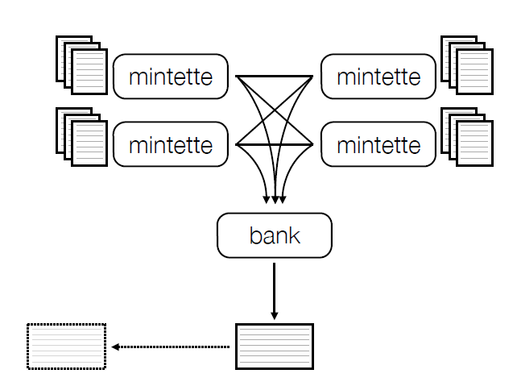
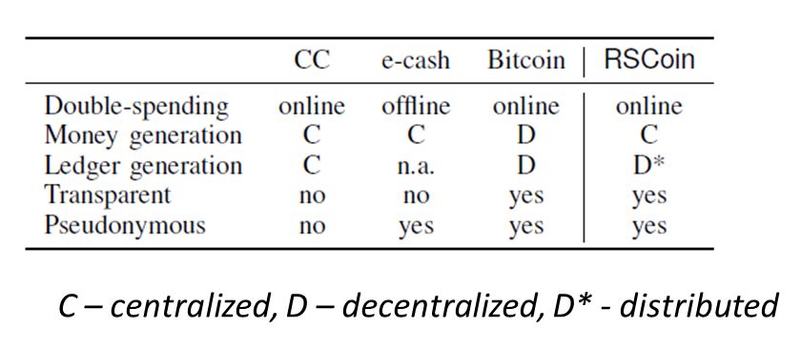
Rscoin - a framework for central bank issued cryptocurrency
Other banks
Low-level blocks
Central bank
High-level blocks
Banks (mintettes) are authorized by central bank to add transactions to valid (low-level) blocks
Mintettes can exchange transaction blocks with other valid mintettes
Low-level blocks are gathered and sent to central bank; central bank creates high-level blocks that are auditable
Source: Centrally Banked Cyptocurrencies, UCL Research paper

Slide 70
Central Bank Digital Currency: Benefits
“…we find that CBDC issuance of 30% of GDP, against government bonds, could permanently raise GDP by as much as 3%, due to reductions in real interest rates, distortionary taxes, and monetary transaction costs.”
Bank of England Research Paper

Slide 71
Considerations for Central-Bank Digital Currencies
Structural issues:
Retail deposits (you and me!) may switch to central banks
Bank deposit rates go down, as banks will depend on wholesale deposits (B2B)/debt capital/other avenues
Central banks can conduct open market operations directly
Intense competition for deposit and payment services
Reduction in cost of settlement and collateral requirements (elimination of liquidity and credit risk) – This is huge!
Settlement around the clock – 24 X 7
Price and output stability issues:
Reduction in taxes
Reduction in govt. interest expenses, therefore interest rates
Financial stability issues:
Transition – how to retrain staff, architect & fund new infrastructure?
Bank balance sheet shrinkage
Partial removal of too-big-to-fail concerns
Macro economics of central bank issued digital currencies, Bank of England staff working paper

Slide 72
Central banks adopting digital currency
Tunisia
In 2015, boost its eDinar digital currency using the blockchain, with the help of a universal contracting platform, Monetas
Ecuador
The South American country banned Bitcoin and cryptocurrencies in 2014
Issued a national cryptocurrency, Dinero Electrónico, in 2015
The Dinero Electrónico tokens are backed by the assets of Ecuador’s central bank, Banco Central del Equador, and pegged one-to-one to the US dollar, which is Ecuador’s national currency
Senegal
Sweden, China, Japan, Russia, Venezuela, and others are considering digital currencies

Slide 73
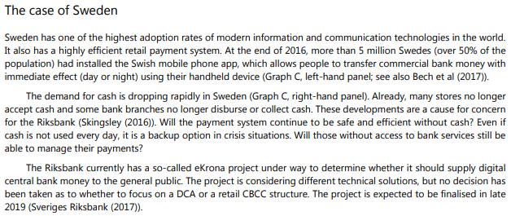
Sweden considering Central Bank Cryptocurrency
Source: Bech and Garratt, Bank of International Settlements

Slide 74
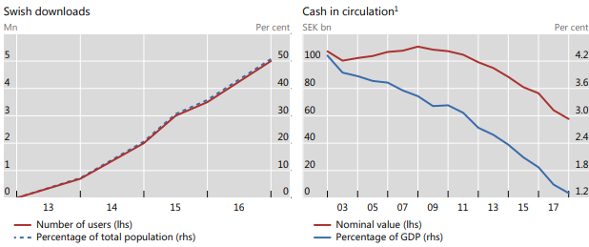
Sweden considering Central Bank Cryptocurrency
Source: Bech and Garratt, Bank of International Settlements

Slide 75

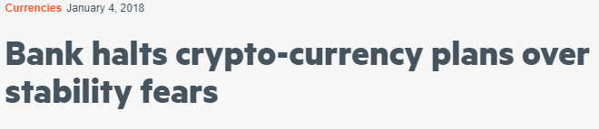
Bank of England halts plans for cryptocurrency
Concerns:
Consumers would stop using commercial banks and directly use accounts with the central bank
The central bank may find its monetary policy less effective
Demand for traditional form of money has been relatively elastic to changes in interest rates
Uncertain whether it will remain so for digital currency
Bank of England is still conducting studies and does not think other crypto-currencies pose a threat to financial stability

Slide 76
Basecoin: “Algorithmic central bank”
The cryptocurrency will be pegged to the US dollar
Includes programmed “monetary policies”
When coin price is traded at less than $1, a monetary contraction will be performed
The blockchain offers coin holders a chance to buy bonds, that pays interests and principal in the future
When bonds are purchased, coins are destroyed and money supply shrinks
When coin price is traded at more than $1
The blockchain will issue new coins and pay bond holders
If bonds are all paid off, it will issue coins to shareholders who hold tokens that have claims to new coin issues
In the long run, the currency can be pegged to the Consumer Price Index
Not launched yet, backed by venture capitals such as Andreessen Horowitz, Bain Capital Ventures, Libertus Capital, PolyChain Capital, Pantera Capital, Digital Currency Group

Slide 77
Central Bank Cryptocurrency in China
The Digital Yuan currency has a state-formed centralized structure. Multiple assets control existing cryptocurrencies, while the activities of the digital Yuan are strictly supervised and controlled by the Chinese government.
Another difference between a standard cryptocurrency and a digital yuan is anonymity. While existing cryptocurrencies can be anonymous to varying degrees depending on the coin, the Chinese government will monitor the use of the currency moving in its economy.
Benefits:
This has great meanings of anti money laundering.
It will help position the Renminbi to international reserve status. US dollar has an 88.3% stake in the international economic network, while the Chinese currency renminbi only has a 4% share.
It will increase financial inclusion. The unbanked population will participate in the economy.

