Slide 1




1. Dataset
2. Model
3. Experiment
Download Raw Dataset
From Website
Build Up the
Torch Required Dataset
Start
Train & Validation
Data Preprocess
Buil Up the
Multi-CNN
Adjust Model Structure
And Hyperparameters
Well-Orgnized
Dataset
Built Up a Reasonable Set of Hyperparameters
Analyse
Experiment Result

Slide 2
1. Dataset
2. Model
3. Experiment
Download Raw Dataset
From Website
Start
Train & Validation
Buil Up the
Multi-CNN
Data Preprocess
Adjust Model Structure
And Hyperparameters
Well-Orgnized
Dataset
Analyse
Experiment Result

Slide 3
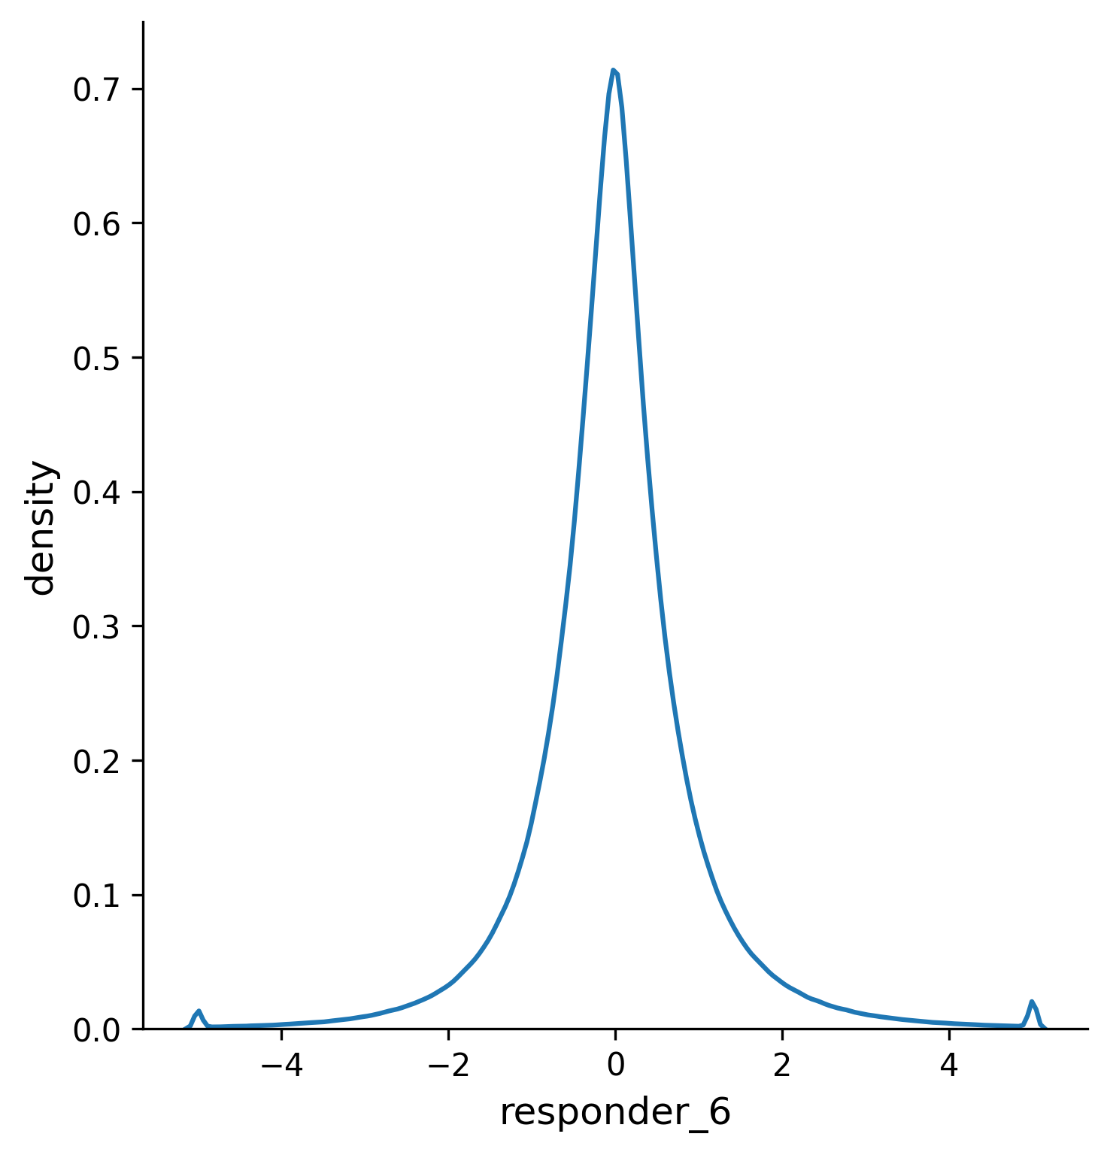

Slide 4

Dataset Description
Downloaded from Jane Street Real-Time Market Data Forecasting.
10 PARTS
12.3 GB
4 PARTS
3.0 GB
select parts
680 days, 11,802,114 lines, 29 symbols, 79 features, 9 responders
Data Preprocess
Preprocess the Raw Data to Restructure.
Step 1: Reduce Data Memory. Select 1 responder & Change data type.
Step 2: Nan Operation.
Drop first 500 days data; Feature ffill and drop; Feature mid-fill. => No Nan !
180 days, 9,274,909 lines, 29 symbols, 64 features, 1 responder
Step 3: Normalization & Set Noise Label.
Use global z-score to do the feature normalization & Set the noise label based on the feature bias. => add 1 is_noise label.
Step 4: Data Restructure.
Lag 3 time steps, reshape features to (3, 8, 8) “image-like” array. Split to Train (160 days, 3,760,163 samples) & Valid (20 days, 491,678 samples).

Slide 5
symbol id number

Slide 6

symbol
grouped
ffill
 | Max | Min | Median | Nan Num | NaN Percentage %
feature_21 | 2.20 | -0.56 | -0.19 | 662220 | 0.15574475
feature_26 | 4.63 | -2.32 | 0.22 | 662220 | 0.15574475
feature_27 | 2.46 | -3.32 | -0.82 | 662220 | 0.15574475
feature_31 | 2.26 | -0.50 | -0.19 | 662220 | 0.15574475
feature_39 | 4.03 | -4.04 | 0.02 | 1973 | 0.00046402
feature_42 | 3.90 | -4.29 | -0.09 | 1973 | 0.00046402
feature_50 | 4.05 | -4.26 | 0.10 | 1972 | 0.00046379
feature_53 | 5.71 | -4.07 | -0.13 | 1972 | 0.00046379
feature_15 | 111.06 | -1.46 | -0.31 | 696 | 0.00016369
feature_41 | 4.00 | -4.07 | -0.02 | 523 | 0.000123
feature_44 | 4.03 | -4.18 | -0.02 | 523 | 0.000123
feature_52 | 4.29 | -4.21 | 0.07 | 522 | 0.00012277
feature_55 | 4.95 | -4.32 | -0.07 | 522 | 0.00012277
feature_32 | 4.18 | -4.15 | 0.54 | 290 | 6.82E-05
feature_33 | 4.15 | -4.12 | 0.03 | 290 | 6.82E-05
feature_58 | 42.31 | -29.91 | 0.00 | 290 | 6.82E-05
feature_73 | 98.31 | -4.46 | -0.26 | 290 | 6.82E-05
feature_74 | 92.81 | -4.80 | -0.24 | 290 | 6.82E-05
feature_62 | 28.52 | -0.82 | -0.18 | 136 | 3.20E-05
feature_17 | 91.25 | -1.61 | -0.31 | 116 | 2.73E-05
feature_64 | 70.31 | -0.85 | -0.18 | 31 | 7.29E-06
feature_45 | 4.13 | -3.96 | 0.04 | 30 | 7.06E-06
feature_46 | 4.08 | -4.44 | -0.12 | 30 | 7.06E-06
feature_65 | 5.44 | -5.22 | -0.03 | 30 | 7.06E-06
feature_66 | 5.08 | -5.25 | -0.05 | 30 | 7.06E-06
feature_63 | 114.63 | -0.83 | -0.20 | 10 | 2.35E-06
feature_40 | 4.42 | -4.08 | -0.05 | 1 | 2.35E-07
feature_43 | 4.03 | -4.05 | 0.01 | 1 | 2.35E-07
Final Nan Operated Data:
No Nan !
64 Features
symbol
grouped
mid fill
drop 15
features

Slide 7


Multi-Scale Conv Encoding
Squeeze-and-Excitation Module
Multi-Task Prediction
responder label
3x3 small-scale
Conv
MSE Loss
(16, 1, 1)
responder prediction
(8, 8, 8)
Futher Conv
+
Global Average Pooling
(32, 1, 1)
is_noise prediction
input: (3, 8, 8)
(16, 8, 8)
(16, 8, 8)
CE Loss
5x5 large-scale
Conv
is_noise label
(8, 8, 8)

Slide 8
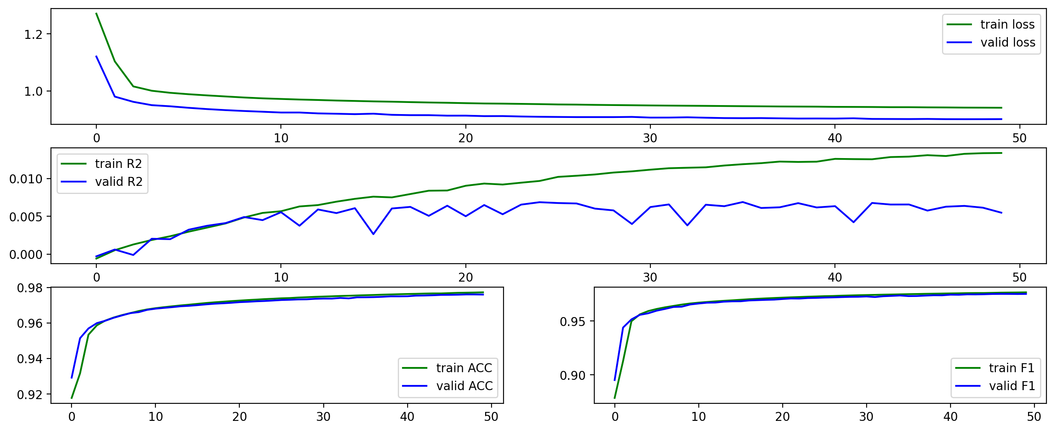

Slide 9
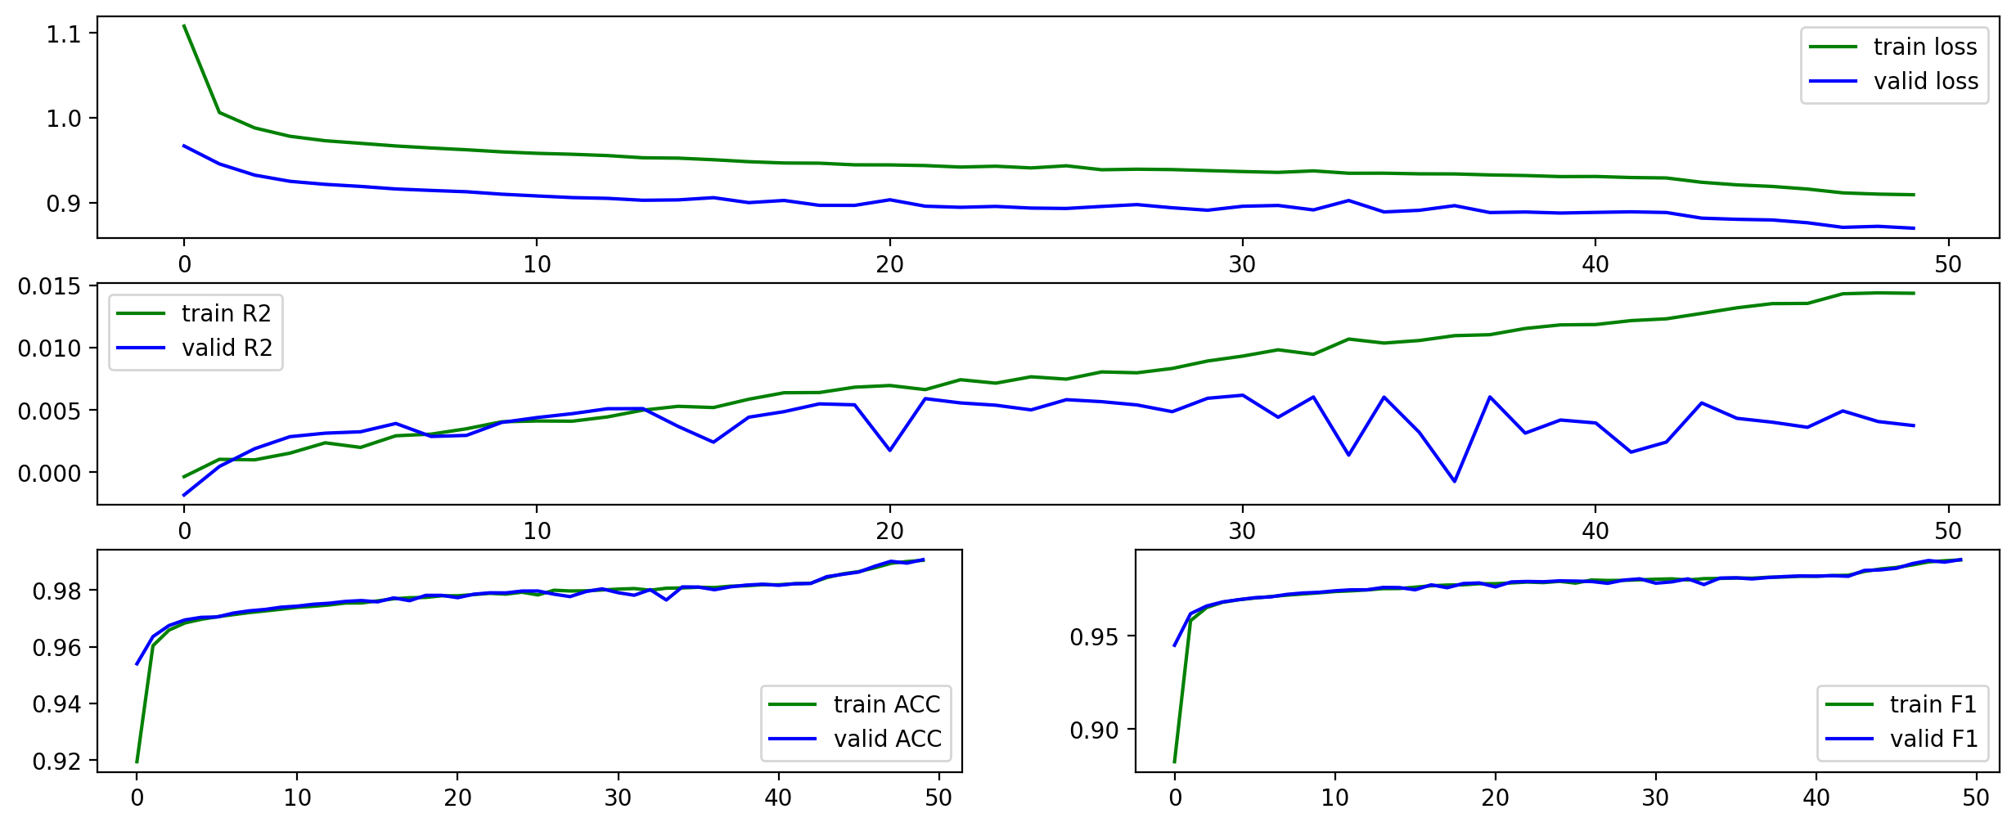
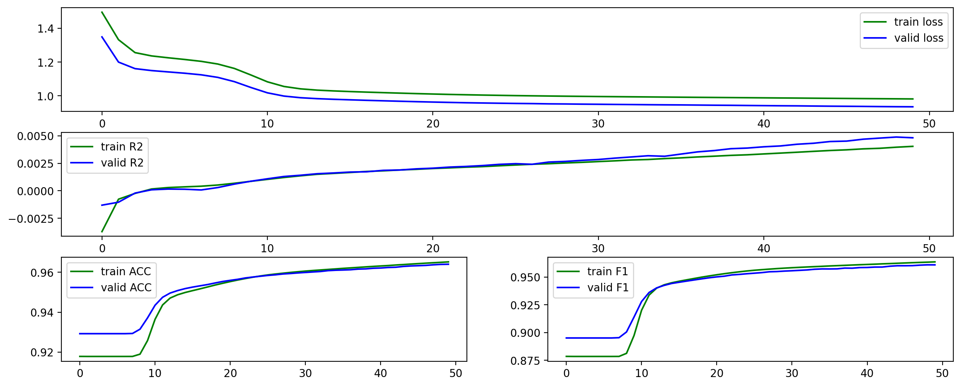
LR Change (lr=1e-2)
LR Change (lr=1e-4)

Slide 10
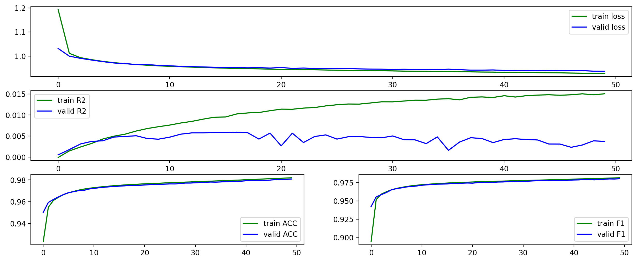
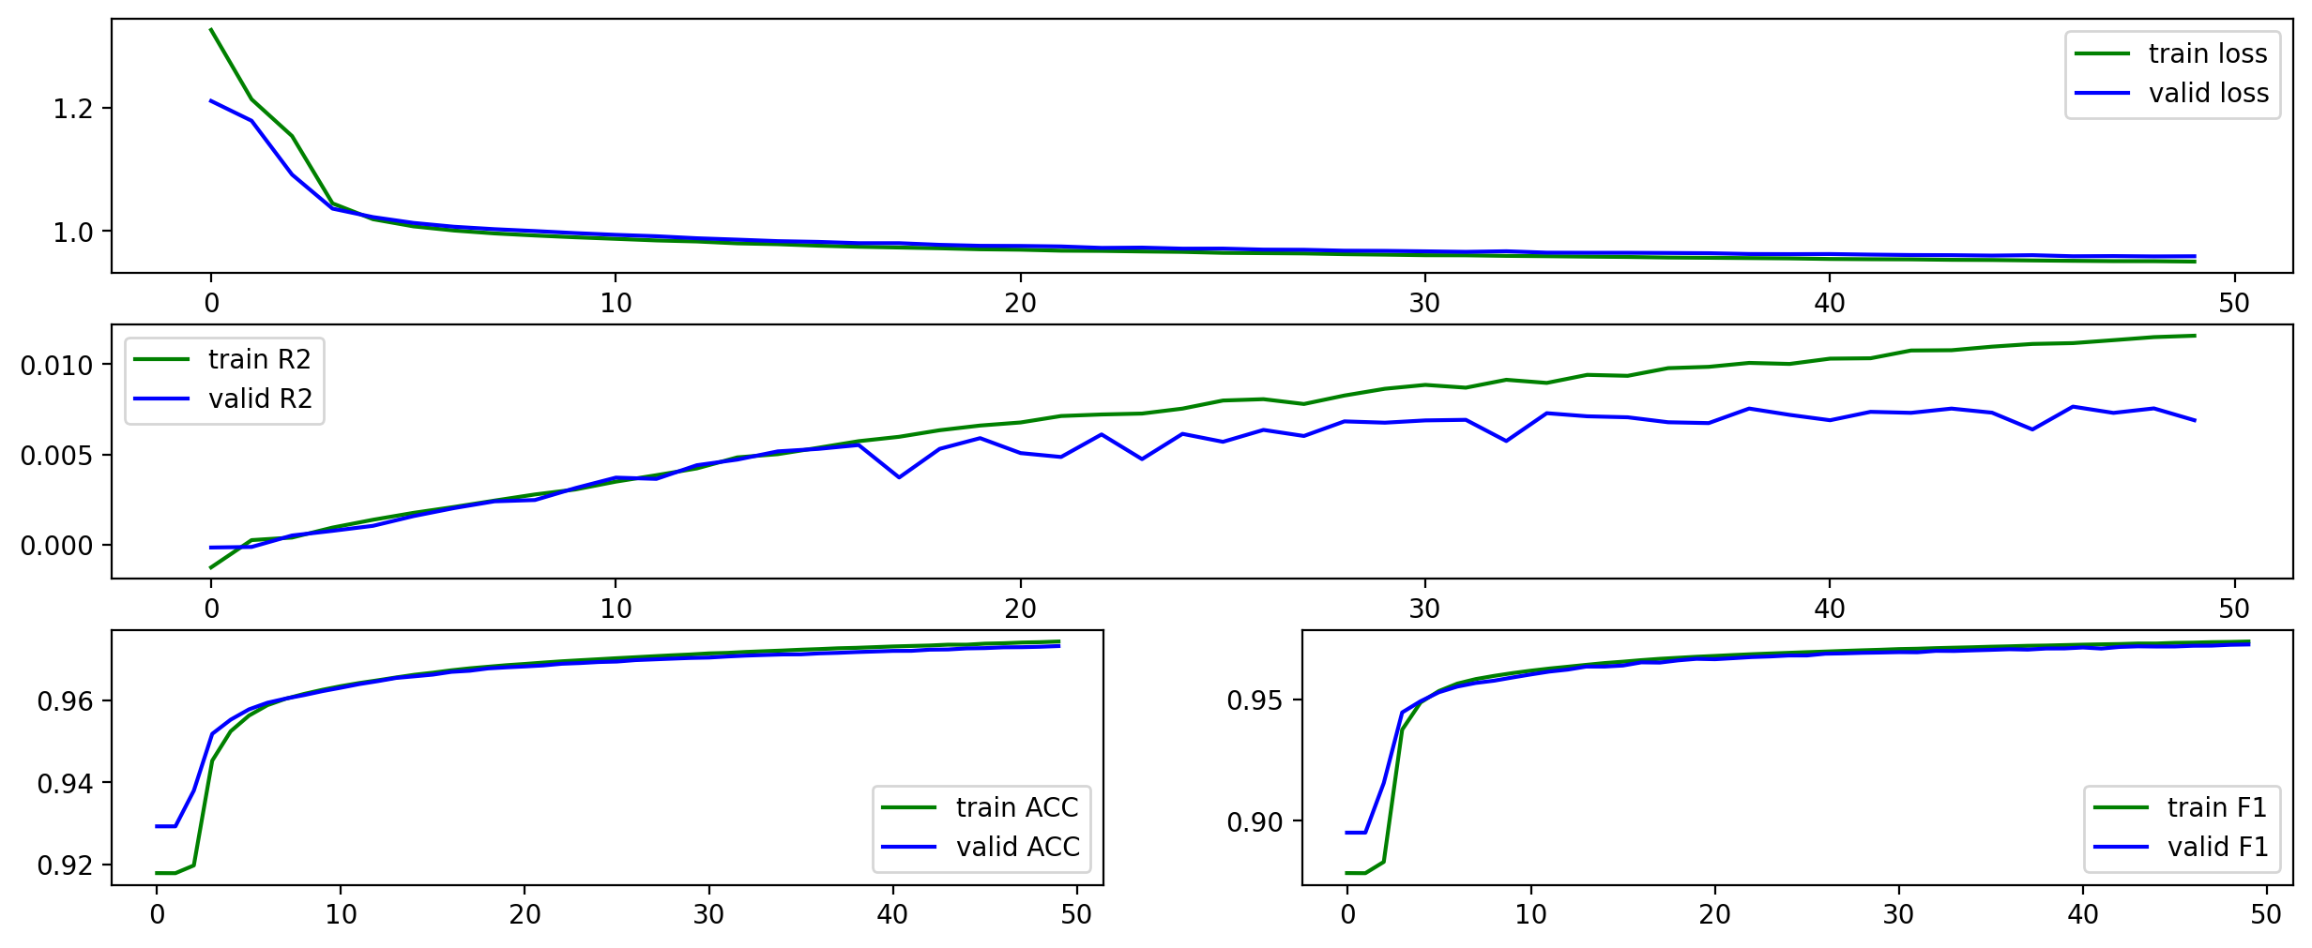
BS Change (bs/=2)
BS Change (bs*=2)

Slide 11
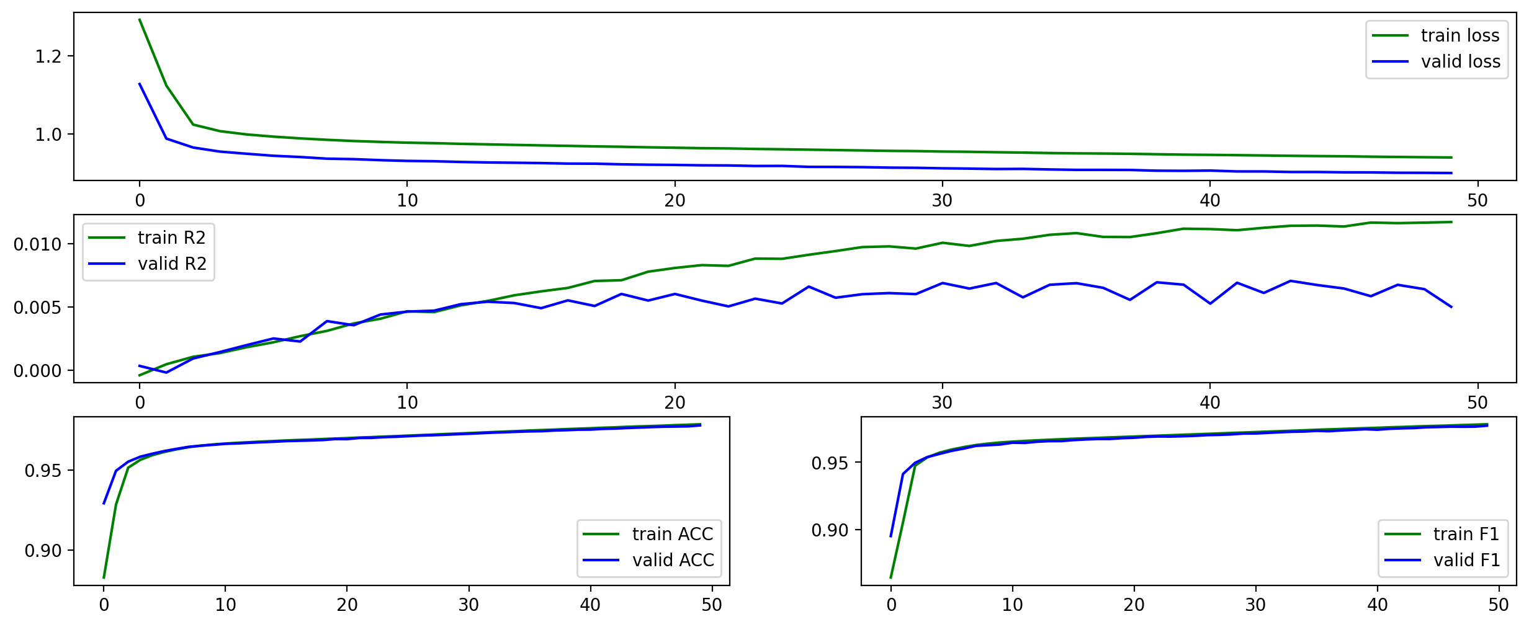
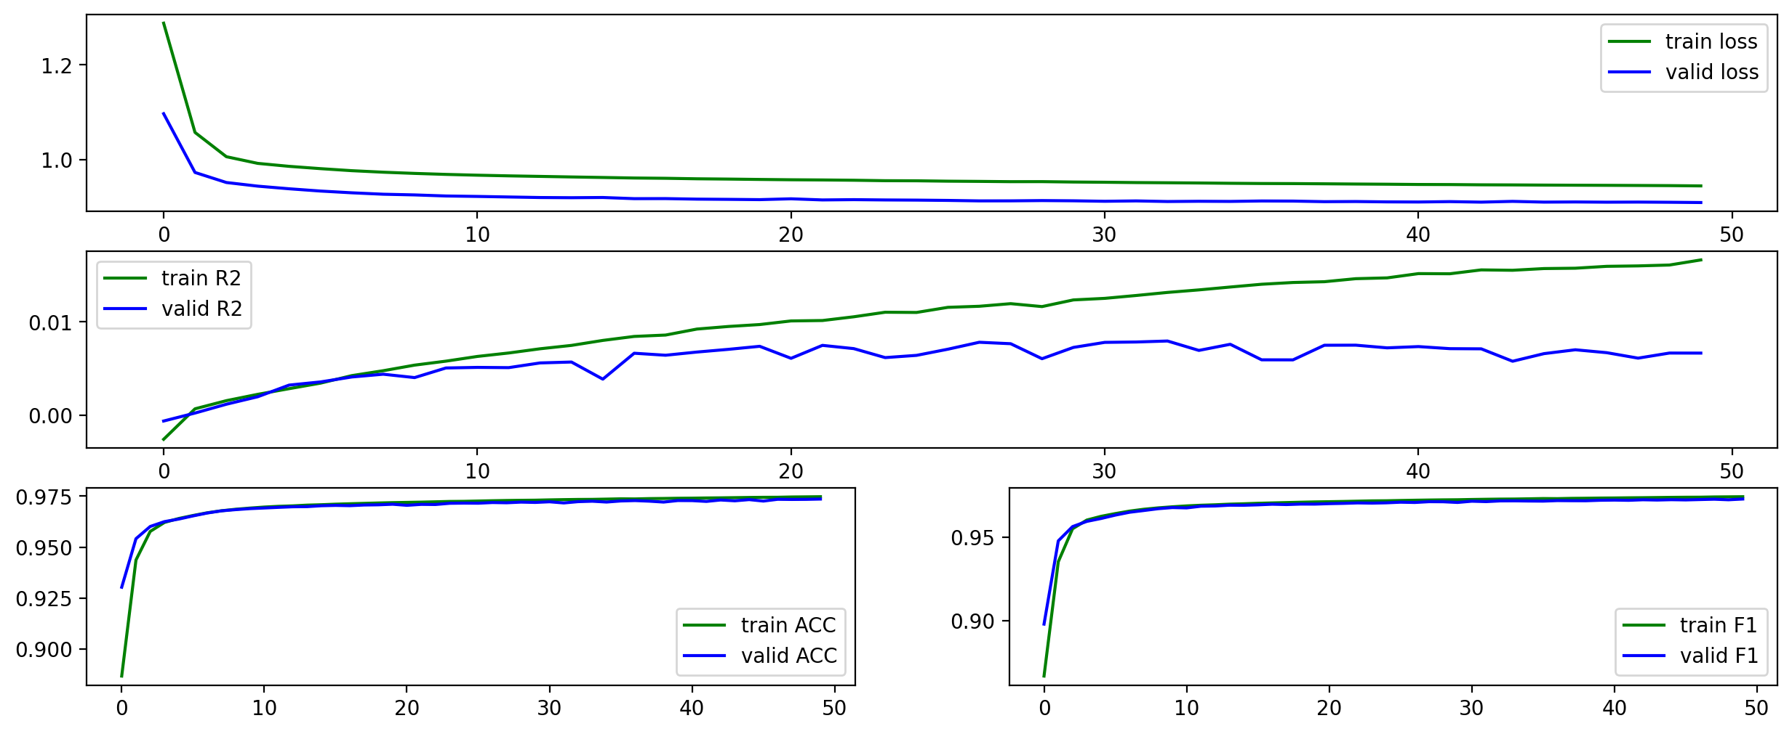
Conv Change (both 3x3)
Conv Change (both 5x5)

Slide 12
