Slide 1
Finance Transformer

Slide 2
What is Cross-Section Feature ?
S
1
S
2
S
3
S
4
S
n
···
···
S
1
S
2
S
3
S
4
S
n
Time
···
S
1
S
2
S
3
S
4
S
n
···
Cross-Section Feature

Slide 3

Finance Transformer (FiT)
MLP
Head
Attention Score
shape=(n+1,n+1)
$$\hat{y}$$
Transformer Encoder
Mask
TTFTTF
 |  | 1e6 |  |  | 1e6
 |  | 1e6 |  |  | 1e6
 |  | 1e6 |  |  | 1e6
 |  | 1e6 |  |  | 1e6
 |  | 1e6 |  |  | 1e6
 |  | 1e6 |  |  | 1e6
Extra Learnable
[fin] token
Random Init
No PE
Masked Attention Score
shape=(n+1,n+1)
*
S
1
S
2
S
3
S
4
S
n
···
Linear Projection of Raw Feature
softmax()
 |  | 0 |  |  | 0
 |  | 0 |  |  | 0
 |  | 0 |  |  | 0
 |  | 0 |  |  | 0
 |  | 0 |  |  | 0
 |  | 0 |  |  | 0
S
1
S
2
S
3
S
4
···
S
n
Cross-Section Feature
Attention Weight
shape=(n+1,n+1)
Mask
T
T
F
T
T
···
F

Slide 4

Parameters Analyzing
X N
Transformer Encoder
S
1
···
S
n
Add & Norm
···
Linear Projection
Feed Forward
MLP Head
Linear(hidden_dim, dim)
LayerNorm(input_size)
Linear(dim, hidden_dim)
GELU()
Linear(dim, 1)
Linear(input_size, dim)
Add & Norm
$$\hat{y}$$
LayerNorm(dim)
MultiHeadAttention
There are learnable params
*
S
1
S
n
w_o(dim, dim)
···
Dropout()
Masked Attention
Dropout()
w_q(dim, dim)
w_k(dim, dim)
w_v(dim, dim)

Slide 5
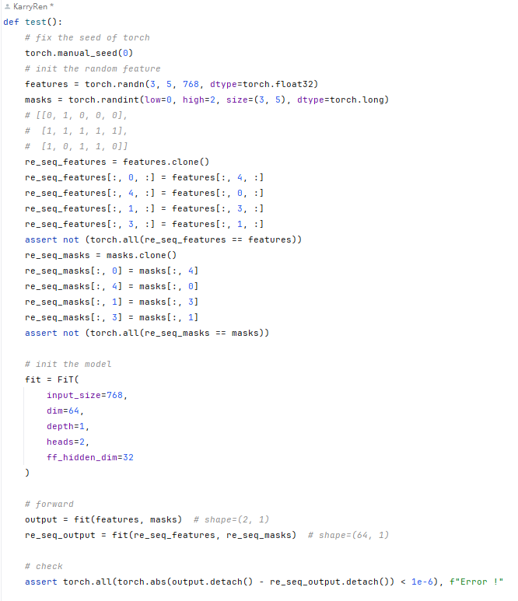
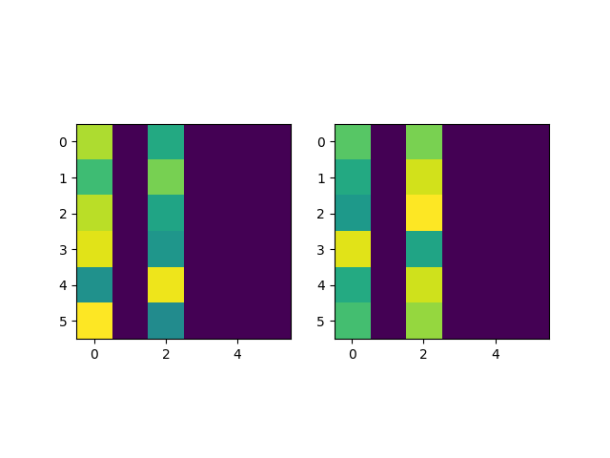
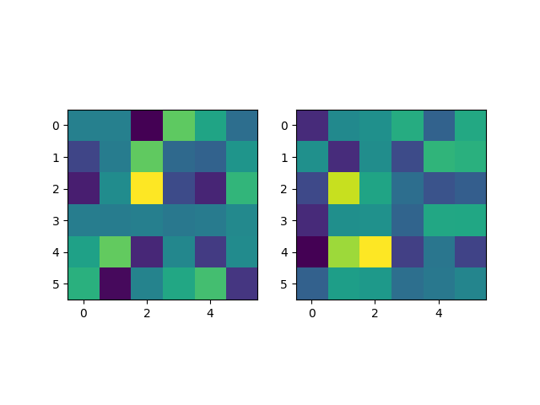
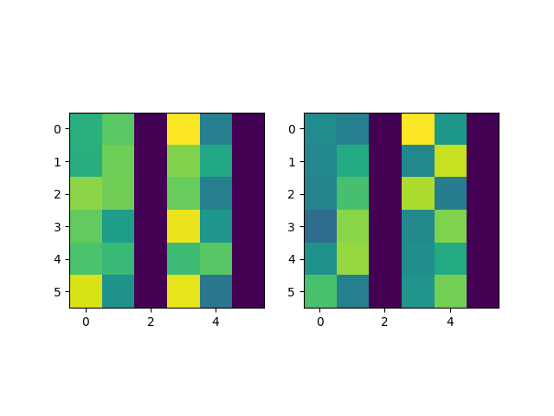
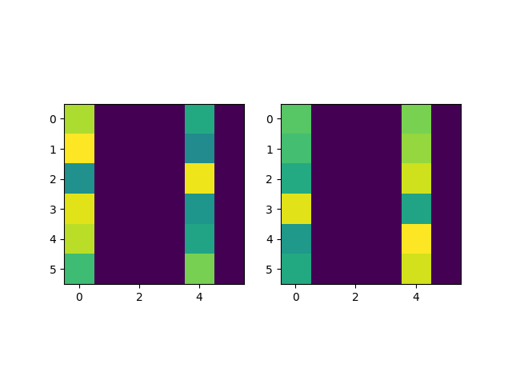
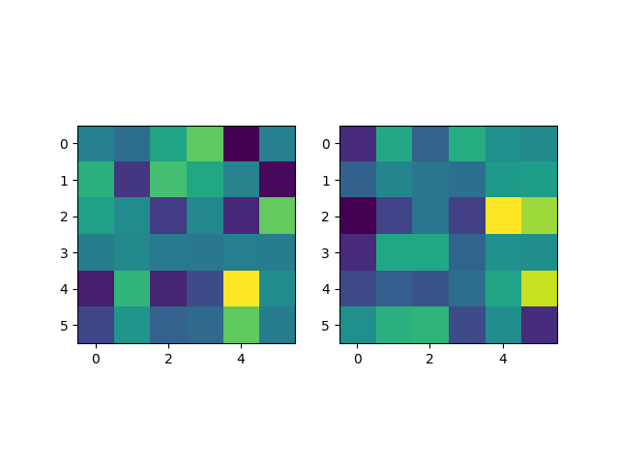
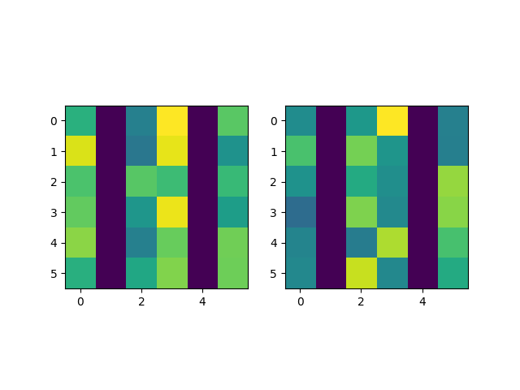
Demo
bs=0
bs=1
bs=2
Attention Weight
bs=0
bs=1
bs=2
Re-Seq Attention Weight

