Slide 1
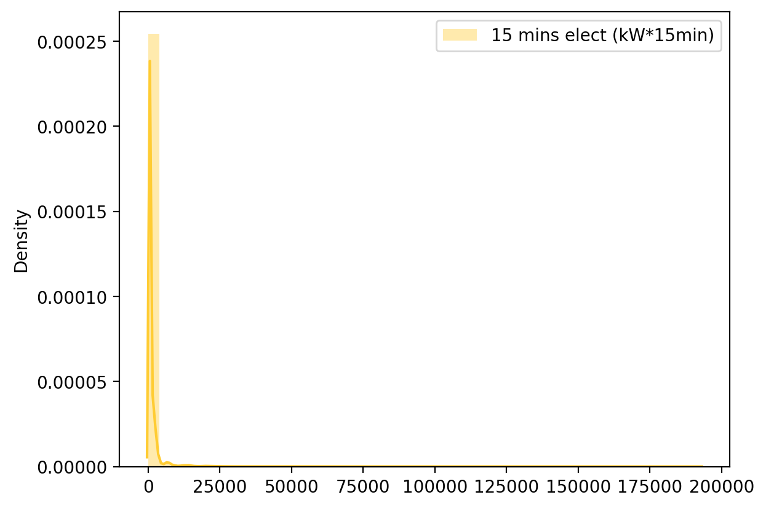
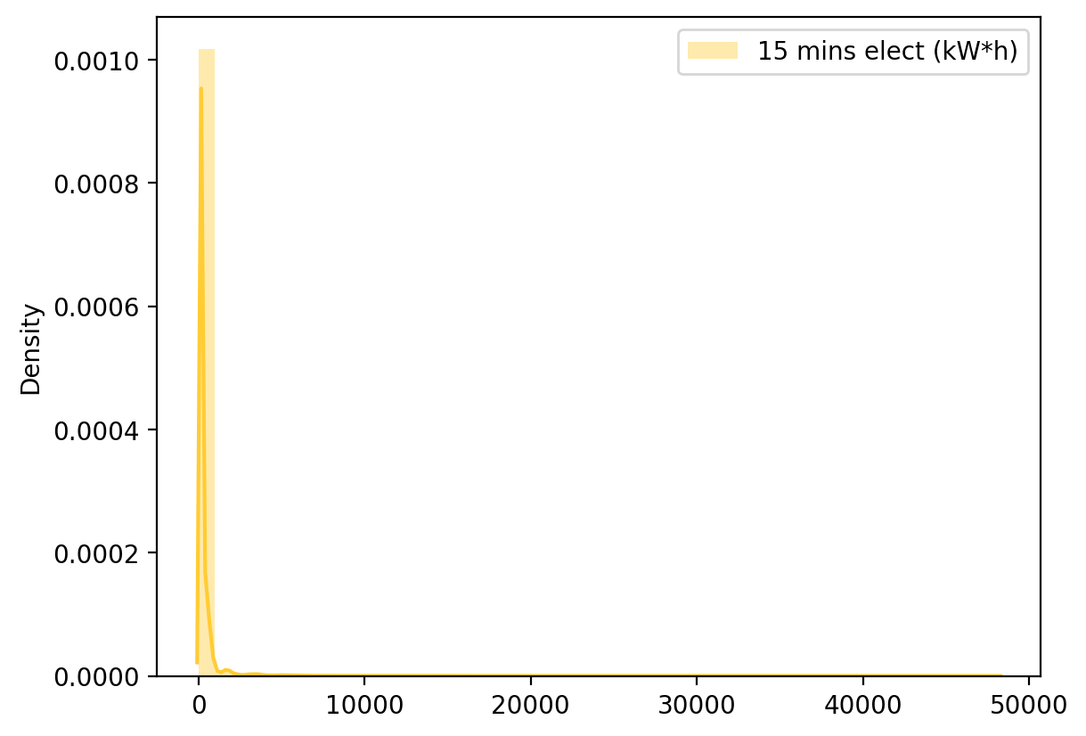
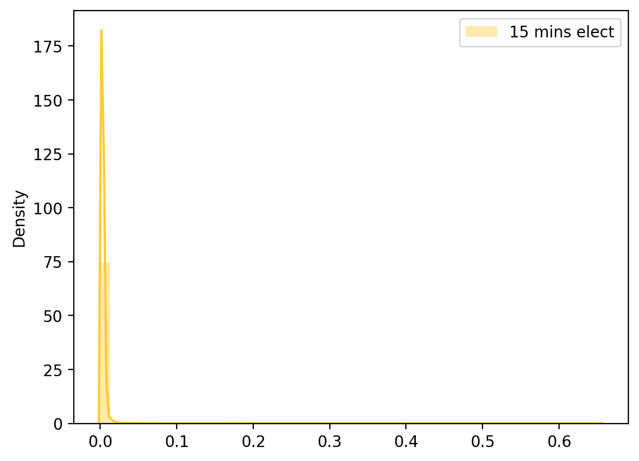
ELECT DATA DISTRIBUTION
Raw elect distribution (kW*15min)
Raw elect distribution (kW*h)
Adj elect distribution

