Slide 1

Why did PDD take off ?
A platform economics-based perspective.
Mar 7th, 2025
Group Members: Kai Ren, PeiHua Ji, JunWen Luo, FeiFan Xu, Lei Cheng, Chang Li

Slide 2
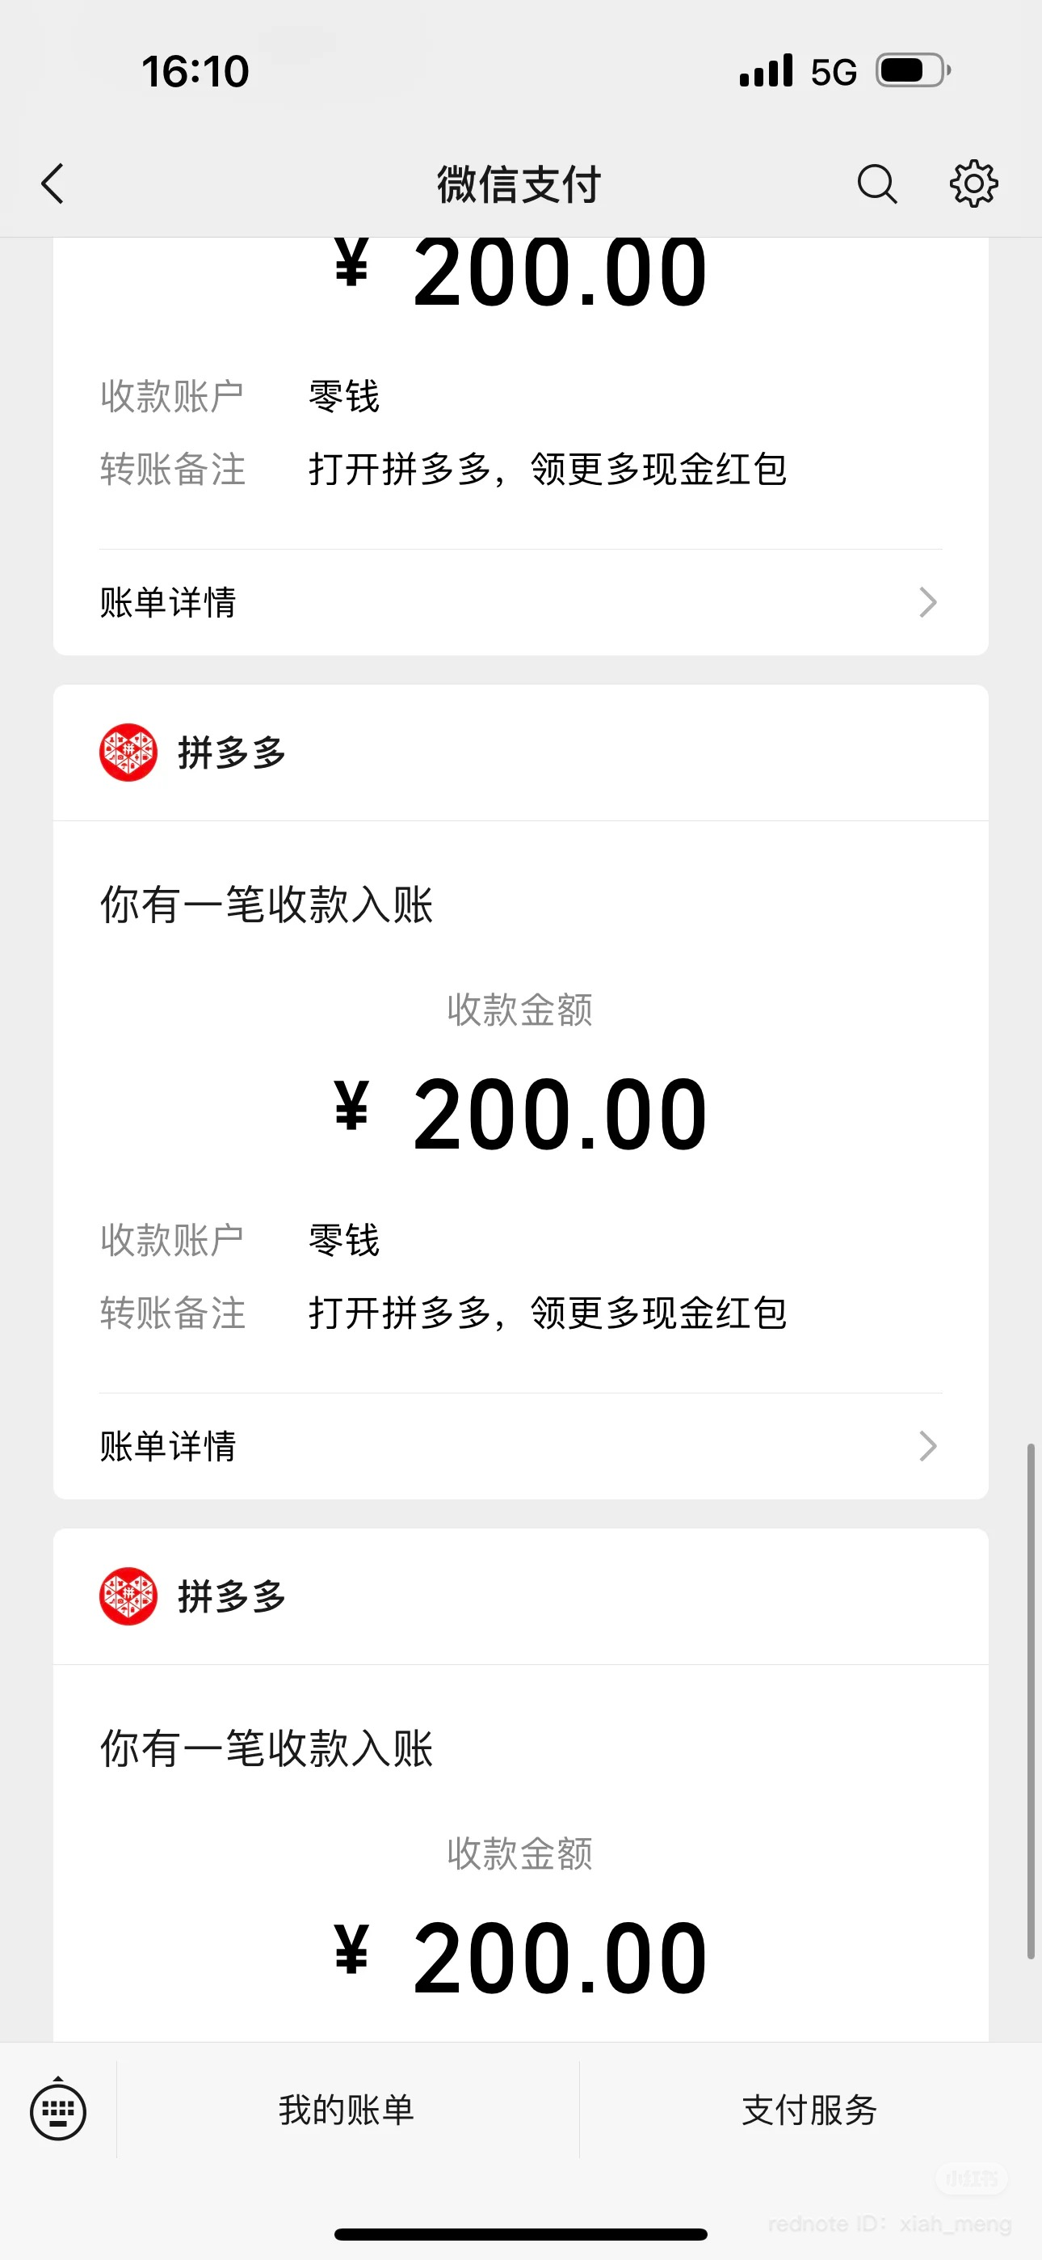
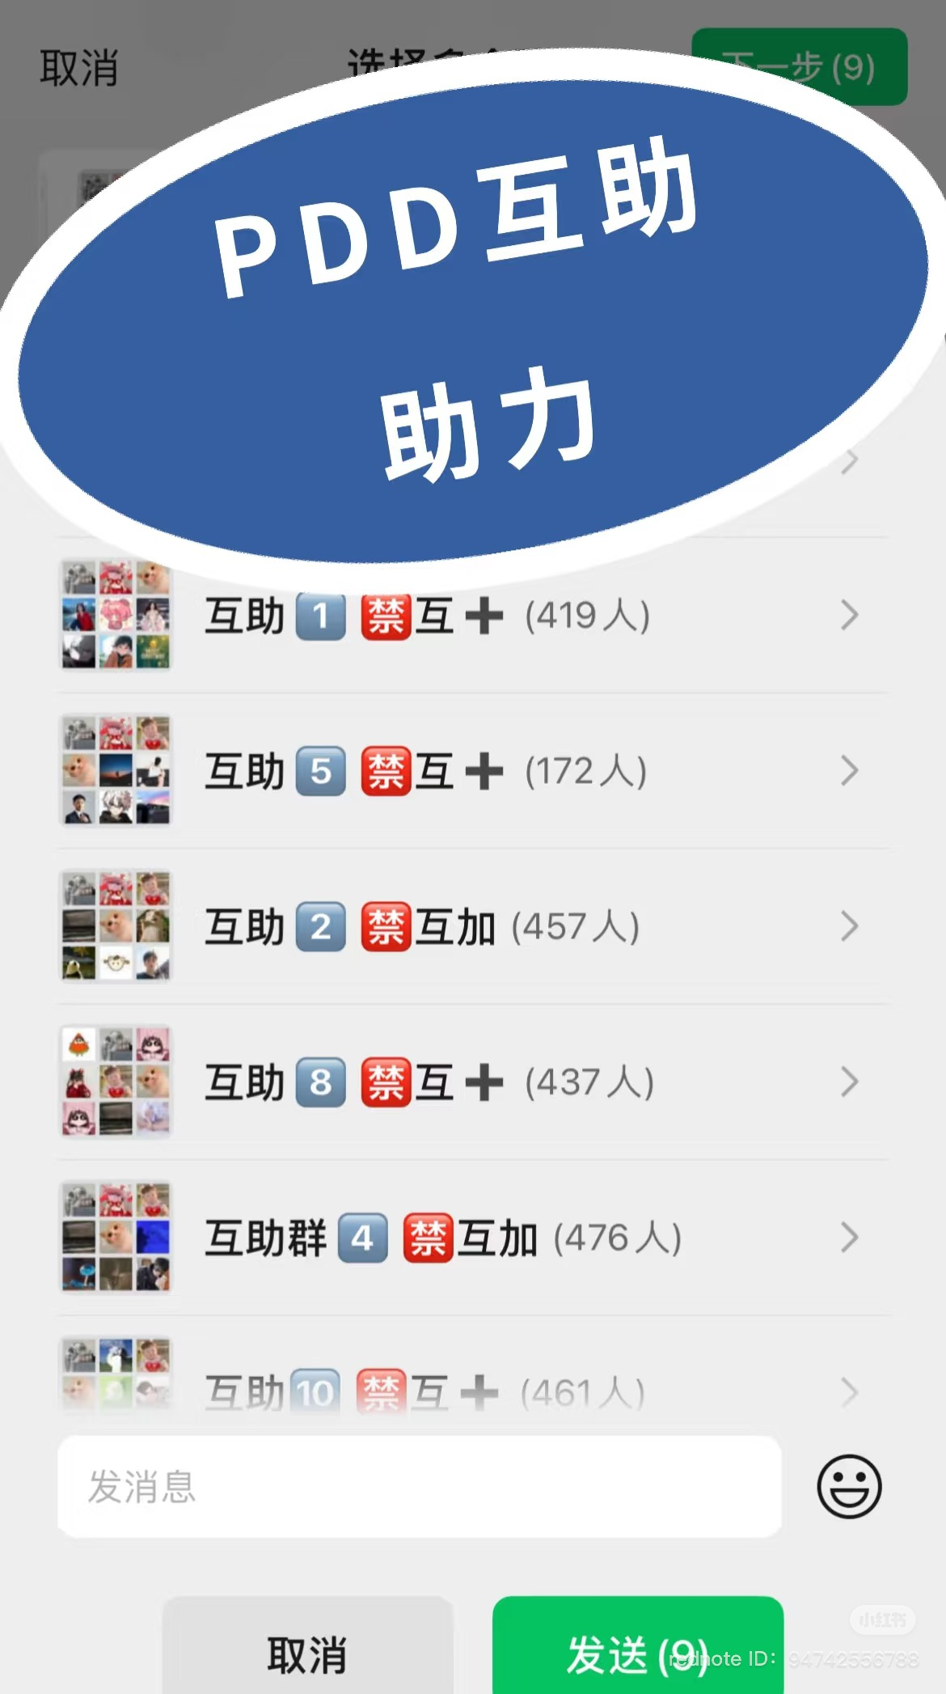
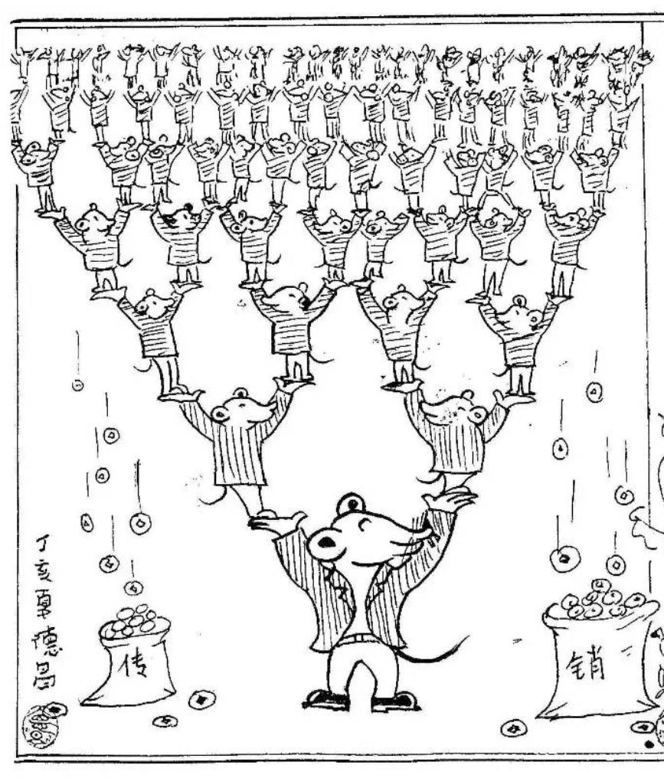
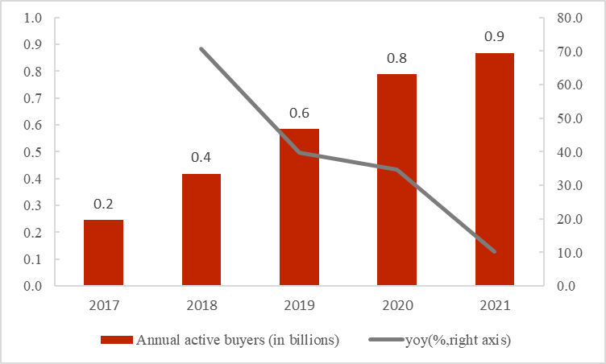
Let’s do a survey about PDD !
Have you ever been asked to “砍一刀” ?
Did you succeed ? (I did it in 1st, Oct. 2019)
When you “砍一刀”, it grows like “传销”. The only difference is that it doesn‘t cheat you out of money but your time !
Is PDD a tool for Using Money or Making Money ?

Slide 3
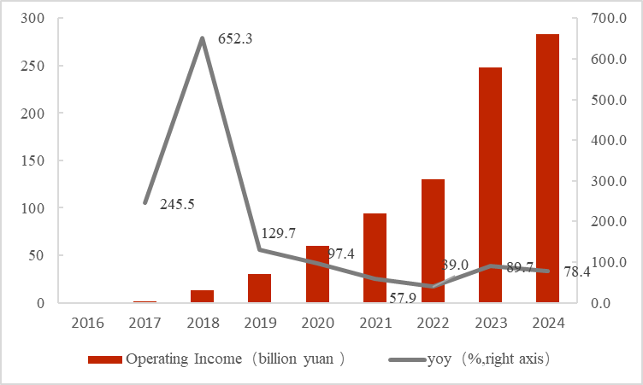
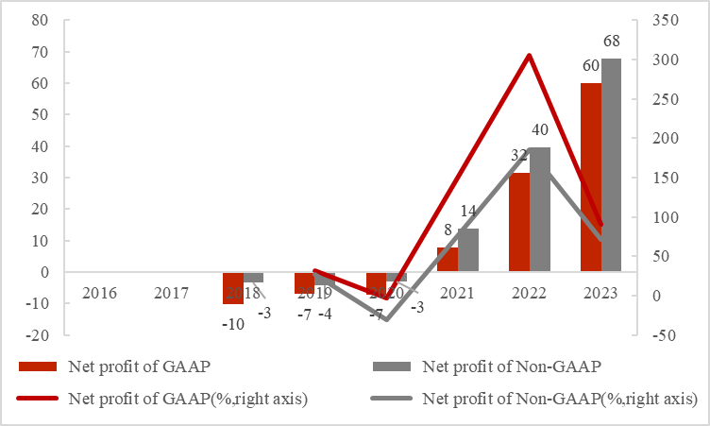
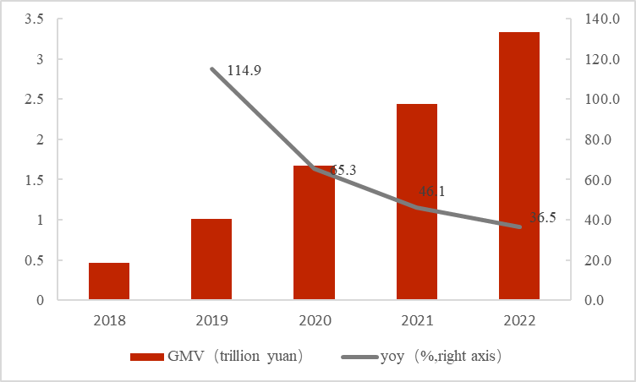
PDD was Taking Off ✈️ !
Fig 1. Income and growth rate of PDD.
Fig 2. GAAP/Non-GAAP profit and profit rate
Fig 3. GMV and growth rate.
Fig 4. Annual active domestic buyers.
Figure out “WHY did PDD take off ?”
Think about “HOW to continue the legend of PDD !”

Slide 4



Analyze based on platform economics.
People
Network Effects
Pricing
Dynamic Pricing
Trick
Gamified Operations
By positively connecting users on both the supply and demand sides, its social viral model (like “砍一刀“ and “拼团“) leverages WeChat to reach users at low cost in lower-tier markets.
It attracts merchants to join, forming a virtuous cycle of user growth and product supply.
By adjusting product prices and data traffic through algorithms, dynamic pricing optimizes resource matching efficiency which demonstrates how platforms leverage data-driven approaches to precisely align supply and demand.
By leveraging principles of behavioral economics, gamified operations incentivize user par-ticipation and extend platform engagement time.
This design aligns with platform economics' strategies for captur-ing and retaining user attention.
Based on the theory and model of platform economics, we will analyze the underlying logic of PDD operations, and summarize the theoretical framework of take-off.

Slide 5
Why did PDD take off ?
Feedback & Suggestions Welcome!
Mar 7th, 2025
Group Members: Kai Ren, PeiHua Ji, JunWen Luo, FeiFan Xu, Lei Cheng, Chang Li

