Slide 1
Decidability
Turing Machines Coded as Binary Strings
Diagonalizing over Turing Machines
Problems as Languages
Undecidable Problems
Notes:
Now, we are ready to show some particular problems not to have algorithms. The central ideas for this lecture are first, that Turing machines can be enumerated, so we can talk about the i-th Turing machine. That lets us diagonalize over Turing machines the way we diagonalized over languages – showing a particular language that cannot be the language of any Turing machine.
Then, we establish the principle that a “problem” is really a language, and we show certain specific problems not to have Turing machines.

Slide 2
Binary-Strings from TM’s
We shall restrict ourselves to TM’s with input alphabet {0, 1}.
Assign positive integers to the three classes of elements involved in moves:
  States: q₁(start state), q₂ (final state), q₃, …
  Symbols X₁ (0), X₂ (1), X₃ (blank), X₄, …
  Directions D₁ (L) and D₂ (R).
Notes:
To enumerate Turing machines, we are going to develop a specific representation of Turing machines as binary strings.
Click 1
It is sufficient to provide a code for Turing machines whose input alphabet is {0,1}, although we could encode others if we wanted to. The reason it is sufficient to assume only 0 and 1 are inputs, is that the Turing-machine codes themselves will be binary strings, so we can focus on Turing machines with input alphabet {0,1} as inputs to other Turing machines with the same input alphabet.
Click 2
The first thing we need to do is assign integer codes to the components of a Turing machine.
Click 3
We’ll give integers 1, 2, 3, and so on to the states. We’ll assume that q_1 is always the start state. We’ll also assume that q_2 is always the one final state of the Turing machine. Notice that once a Turing machine enters a final state, nothing further matters, so we can always merge all the final states into 1. Thus, we can restict our attention to Turing machines with a single final state and know that we can still define any recursively enumerable language. The other states are numbered 3, 4, and so on.
Click 4
The tape symbols are also numbered starting at 1. We’ll assume X_1 is always the input symbol 0 and X_2 is always the input symbol 1. X_3 is always the blank, and any other tape symbols are numbered 4 and above.
Click 5
There are two directions, but we need to number them. D_1 is left and D_2 is right.

Slide 3
Binary Strings from TM’s – (2)
Suppose δ(q_{i}, X_{j}) = (q_{k}, X_{l}, D_{m}).
Represent this rule by string 0^{i}10^{j}10^{k}10^{l}10^{m}.
Key point: since integers i, j, … are all > 0, there cannot be two consecutive 1’s in these strings.
Notes:
Click 1
Consider a rule, expressed using the integer numbering of the components. That is, in state q_i, scanning symbol X_j, suppose the Turing machine goes to state q_k, writes symbol X_ell, and moves in direction D_m.
Click 2
Represent this rule by blocks of i, j, k, ell, and m 0’s, separated by single 1’s.
Click 3
Notice that all the integers are positive, so the representation for a rule never has consecutive 1’s.

Slide 4
Binary Strings from TM’s – (2)
Represent a TM by concatenating the codes for each of its moves, separated by 11 as punctuation.
  That is: Code₁11Code₂11Code₃11 …
Notes:
We then represent an entire Turing machine by all its rules, concatenated and separated by pairs of 1’s.

Slide 5
Enumerating TM’s and Binary Strings
Recall we can convert binary strings to integers by prepending a 1 and treating the resulting string as a base-2 integer.
Thus, it makes sense to talk about “the i-th binary string” and about “the i-th Turing machine.”
Note: if i makes no sense as a TM, assume the i-th TM accepts nothing.
Notes:
Click 1
Once we have Turing machines represented by binary strings, we can convert these strings to unique integers, using the trick we explained a while ago. Put a 1 in front of a binary string, and treat the result as a binary integer.
Click 2
Thus, we can talk about the i-th Turing machine. And of course we earlier learned we could talk about the i-th binary string.
Click 3
A small matter is that some binary strings represent flawed Turing machines. For example, it might have a pair of double 1’s with other than four single 1’s between them. That would not represent five blocks of 0’s and therefore would not represent any move of a Turing machine. However, let’s assume any binary string that is flawed represents a Turing machine that accepts the empty language. Likewise, if i is the integer we get from such a string, then the i-th Turing machine accepts the empty language.

Slide 6
Table of Acceptance
String j
1 2 3 4 5 6 . . .
1
2
3
4
5
6
.
.
.
TM
i
x
x = 0 means
the i-th TM does
not accept the
j-th string; 1
means it does.
Notes:
So here’s a table relating Turing machines to the strings they accept.
Click 1
The value in row i and column j is 1 if the i-th Turing machine accepts the j-th string, and 0 if it does not. Notice that if the i-th Turing machine is one of the flawed ones, then its row is all 0’s.

Slide 7
Diagonalization Again
Whenever we have a table like the one on the previous slide, we can diagonalize it.
  That is, construct a sequence D by complementing each bit along the major diagonal.
Formally, D = a₁a₂…, where a_{i} = 0 if the (i, i) table entry is 1, and vice-versa.
Notes:
Any matrix of 0’s and 1’s with rows and columns corresponding to all the integers can be diagonalized over. That is, we can construct an infinite sequence of 0’s and 1’s, call it D, such that the i-th bit of D is the complement of the bit in position (i,i) along the diagonal.

Slide 8
The Diagonalization Argument
Could D be a row (representing the language accepted by a TM) of the table?
Suppose it were the j-th row.
But D disagrees with the j-th row at the j-th column.
Thus D is not a row.
Notes:
Click 1
We can argue that D is not a row of the matrix, and therefore does not represent the language accepted by any Turing machine.
Click 2
D can’t be row j,
Click 3
Because it disagrees with the j-th row in their j-th entries.
Click 4
Thus, D cannot be a row, and therefore the language it describes – the language that contains the i-th string if and only if the i-th bit of D is 1, is not the language of any Turing machine. Notice that this language can be described as the set that contains the i-th string if and only if the i-th Turing machine does NOT accept the i-th string.

Slide 9
Diagonalization – (2)
Consider the diagonalization language L_{d} = {w | w is the i-th string, and the i-th TM does not accept w}.
We have shown that L_{d} is not a recursively enumerable language; i.e., it has no TM.
Notes:
Click 1
Let’s give a name to this language: L_d, or the diagonalization language. Again, L_d is the set of binary strings w such that w is the i-th string for some i, and the i-th Turing machine does not accept w.
Click 2
We just argued that L_d is not a recursively enumerable language – it has no Turing machine.
We earlier proved that there are more languages than integers, and since there are no more Turing machines than integers, we already knew that there were languages with no Turing machine. But now we are much better off. We have a particular language L_d, and a description for this language, such that L_d is one of the languages without Turing machines.
Note, however, that L_d is a delicate language. We know what it is, but we can’t for example, always tell whether a given binary string w is in L_d. To do so, we can figure out the i such that w is the i-th string – that’s the easy part. Then we can write down the code for the i-th Turing machine. In fact, that code is w. If w is the code for a flawed Turing machine, we know it doesn’t accept w. But some w’s give good codes for Turing machines, and in fact every Turing machine with input alphabet {0,1} has some code w. We can’t always figure out whether a Turing machine is going to accept or run forever without accepting, so for at least some w’s we can never learn whether or not it is in L_d.

Slide 10
Problems
Informally, a “problem” is a yes/no question about an infinite set of possible instances.
Example: “Does graph G have a Hamilton cycle (cycle that touches each node exactly once)?
  Each undirected graph is an instance of the “Hamilton-cycle problem.”
Notes:
Click 1
Let us introduce the formal concept of a problem. Informally, a problem is a yes/no question about an infinite number of possible instances of the problem.
Click 2
Here’s an example of a problem that is actually quite famous – we’ll see why soon. The instances of the “Hamilton-cycle problem” are undirected graphs. There are an infinite number of graphs, of course. The answer to the question implied by the Hamilton-cycle problem is “yes” if there is a Hamilton cycle in the graph, that is, a cycle that passes through each node exactly once (DRAW a cycle with some chords) in the upper right.

Slide 11
Problems – (2)
Formally, a problem is a language.
Each string encodes some instance.
The string is in the language if and only if the answer to this instance of the problem is “yes.”
Notes:
Click 1
Formally, a problem is simply a language over some alphabet Sigma.
Click 2
Each string in Sigma-star can be viewed as an instance of the problem, once we decide on an encoding for instances as strings. We’ll see a number of examples of these encodings, but we already saw one, where we encoded Turing machines as binary strings. It should not be hard for you to devise an encoding for graphs in a similar spirit.
Click 3
Then the language associated with the problem is the set of strings that code instances for which the answer is “yes.” Typically, as we did for Turing machines, our coding allows certain strings that are flawed – they don’t represent an instance. We’ll always assume that flawed encodings represent instances for which the answer is “no.”

Slide 12
Example: A Problem About Turing Machines
We can think of the language L_{d} as a problem.
“Does this TM not accept its own code?”
Notes:
For example, as a problem, the language L_d can be stated “does this TM not accept its own code.”

Slide 13
Decidable Problems
A problem is decidable if there is an algorithm to answer it.
  Recall: An “algorithm,” formally, is a TM that halts on all inputs, accepted or not.
  Put another way, “decidable problem” = “recursive language.”
Otherwise, the problem is undecidable.
Notes:
Click 1
When we talk about problems, we use the term “decidable.” it means that there is an algorithm to answer its question – that is, a Turing machine that accepts the encoded instances of the problem for which the answer is “yes,” and halts without accepting the other instances.
So a decidable problem is really the same thing as a recursive language, if we think of the language as encoding a problem.
Click 2
The opposite of decidable is undecidable.

Slide 14

Bullseye Picture
Not recursively
enumerable
languages
Decidable
problems =
Recursive
languages
L_{d}
Recursively
enumerable
languages
Are there
any languages
here?
Notes:
Here’s what we know about languages so far. In the center we see the recursive languages, or as problems, the decidable problems.
Click 1
Then there is a superset of the recursive languages, called the recursively enumerable languages. These, recall, are the languages accepted by Turing machines with no guarantee they will halt on inputs they never accept.
Click 2
And then there is outer space. The uncountably many languages that are not recursively enumerable – they have no Turing machine at all. So far, we have one example of a language. L_d, that lives in this region.
Remember that the undecidable problems are all those in either the second ring – the recursively enumerable but not recursive languages, or in outer space. That is, everything that is not yellow in this diagram.
Click 3
And a big question need to answer: are there any languages in the second ring – those that are recursively enumerable but not recursive.

Slide 15
From the Abstract to the Real
While the fact that L_{d} is undecidable is interesting intellectually, it doesn’t impact the real world directly.
We first shall develop some TM-related problems that are undecidable, but our goal is to use the theory to show some real problems are undecidable.
Notes:
And remember the real goal of our plan is to show some real problems that are undecidable. The fact that L_d is undecidable, and in fact –super-undecidable because it is not even recursively enumerable, is interesting, but it doesn’t, by itself, tell us anything about the real world.

Slide 16
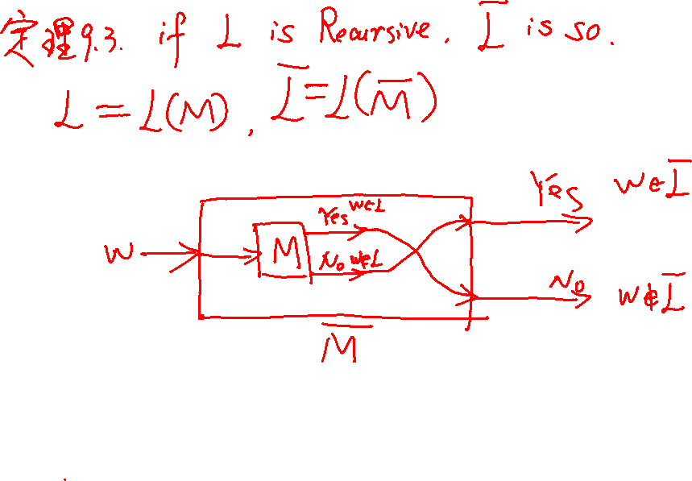

Slide 17
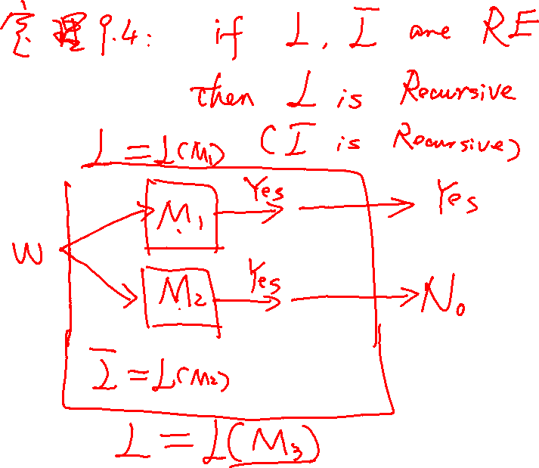

Slide 18
Examples: Undecidable Problems
Can a particular line of code in a program ever be executed?
Is a given context-free grammar ambiguous?
Do two given CFG’s generate the same language?
Notes:
Here are some examples of real problems that are undecidable.
Click 1
Will a program ever reach a particular line of code?
Click 2
Is a given context-free grammar ambiguous?
Click 3
Are two given grammars equivalent, in the sense that they generate the same language?

Slide 19
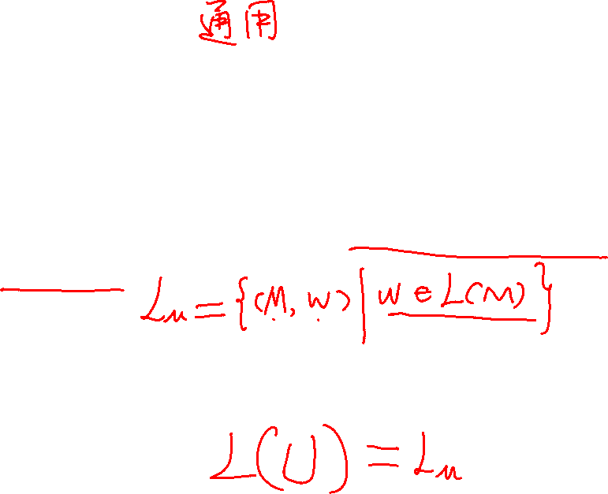
The Universal Language
An example of a recursively enumerable, but not recursive language is the language L_{u} of a universal Turing machine.
That is, the UTM takes as input the code for some TM M and some binary string w and accepts if and only if M accepts w.
Notes:
Click 1
Still staying in the world of Turing machines rather than the real world, but a necessary way-station on our trek to the real world, is to show a particular language to be recursively enumerable but not recursive. This is the language we call L_u, the universal Turing machine language.
Click 2
In more detail, the universal Turing machine takes as input a binary string consisting of the code for some Turing machine M and some input w for M. The universal Turing machine accepts the coded M and w if and only if tM accepts w.
The idea of a universal Turing machine should not seem strange, if you have ever contemplated a Java virtual machine. The JVM takes a coded Java program and an input for that program, and executes the program on the input. In fact, the JVM is more general in capability than a Turing machine, which can only make a single accept output. The JVM can cause whatever output the program calls for to be made.

Slide 20
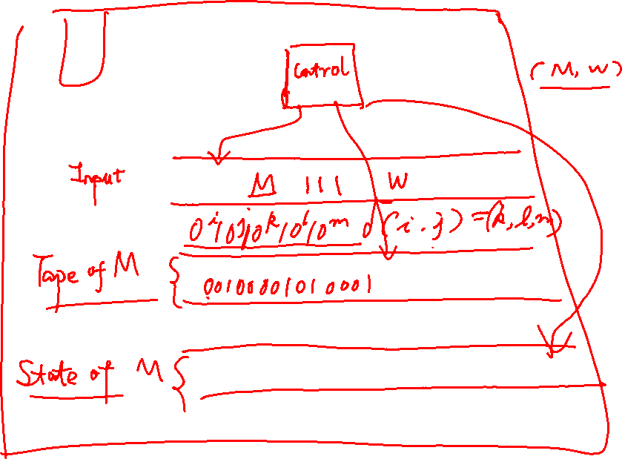

Slide 21
Designing the UTM
Inputs are of the form:
Code for M 111 w
Note: A valid TM code never has 111, so we can split M from w.
The UTM must accept its input if and only if M is a valid TM code and that TM accepts w.
Notes:
So let us see how to build a universal Turing machine.
Click 1
First of all, inputs to the universal Turing machine are of the form a code for machine M, three 1’s, and then the binary string w.
Click 2
Since a valid code for M can never have three consecutive 1’s, it is never ambiguous what part of the input to the universal Turing machine is M and what part is w.
Click 3
The universal Turing machine accepts its input if and only if that input has a valid code for some Turing machine, and that Turing machine accepts w. So, for example, the universal machine never accepts a string that doesn’t have three consecutive 1’s.

Slide 22
The UTM – (2)
The UTM will have several tapes.
Tape 1 holds the input M111w
Tape 2 holds the tape of M.
Tape 3 holds the state of M.
Notes:
Click 1
We’ll design the universal Turing machine as a multitape machine.
Click 2
The first tape will hold the input, and we never change that.
Click 3
The second tape is used to represent the current tape of M during the simulation of M with input w. We’ll discuss this representation shortly.
Click 4
The third tape of the universal machine simply represents the state of M.

Slide 23
The UTM – (3)
Step 1: The UTM checks that M is a valid code for a TM.
  E.g., all moves have five components, no two moves have the same state/symbol as first two components.
If M is not valid, its language is empty, so the UTM immediately halts without accepting.
Notes:
the first thing the universal machine needs to to is examine its input, and particularly that portion that represents M. It has to check that between consecutive double 1’s there are always five blocks of 0’s. It also has to check that a block of three 1’s appears somewhere on its input, and it regards this as the end of the rules for M. Finally, since M is assumed deterministic, the universal machine needs to check that there are never two rules that agree on the first two components.
All this checking will require running back and fourth on the input quite a bit. It can be facilitated by copying blocks of 0’s onto one of the other tapes and comparing these with the rest of the representation for M.
Click 2
If any flaws are found with the code for M, or the 111 is not found, then M is regarded as a Turing machine that accepts nothing, so the universal Turing machine immediately halts and rejects its input.

Slide 24
The UTM – (4)
Step 2: The UTM examines M to see how many of its own tape squares it needs to represent one symbol of M.
Step 3: Initialize Tape 2 to represent the tape of M with input w, and initialize Tape 3 to hold the start state.
Notes:
Click 1
Assuming the code for M is valid, the universal machine next examines the code for M to determine how many squares of its own tape it needs to represent one symbol of M’s tape. That is we discover the longest block of 0’s representing a tape symbol, and add one to that for a marker between symbols of M’s tape. Thus, if, say, X_7 is the highest numbered symbol, then we’ll use eight squares to represent one symbol of M. Symbol X_i will be represented by i 0’s and 7-i blanks, followed by a marker pound sign. For example, here’s how we’d represent X_5. (DRAW 00000BB#)
Click 2
Now, initialize tape 2 to represent the input w. Remember 0’s are X_1 and 1’s are X_2. The blanks on the second tape of the universal machine all represent X_3, the blank of M, but we won’t initialize those squares until we need to.
Finally, we initialize Tape 3 to hold the start state. That state is always q_1, so it is represented by a single 0.

Slide 25
The UTM – (5)
Step 4: Simulate M.
  Look for a move on Tape 1 that matches the state on Tape 3 and the tape symbol under the head on Tape 2.
  If found, change the symbol and move the head marker on Tape 2 and change the State on Tape 3.
  If M accepts, the UTM also accepts.
Notes:
Click 1
Now, we are ready to simulate M.
Click 2
We have the current state on tape 3, and the tape of M represented on tape 2. We scan the moves of M on tape 1 until we find a move that matches both this state and this tape symbol. If we can’t find one, then apparently M halts without accepting w, so the universal machine does as well.
Click 3
But if we find a match, we find right after that on tape 1 the new state, which we install on tape 3, replacing the old state. We also find a new tape symbol with which to replace the old tape symbol under the head on tape 2. We also move the tape head one simulated square of M’s tape, left or right, whichever the move says.
Click 4
And most important, if M enters an accepting state, then the universal machine stops simulating and accepts its own input, which remember is the pair machine M plus input string w.

Slide 26

Proof That L_{u} is Recursively Enumerable, but not Recursive
We designed a TM for L_{u}, so it is surely RE.
Suppose it were recursive; that is, we could design a UTM U that always halted.
Then we could also design an algorithm for L_{d}, as follows.
Notes:
We claim that the language L_u is recursively enumerable but not recursive.
Click 1
We just showed that there is a Turing machine for the language L_u, so surely L_u is recursively enumerable.
Click 2
But suppose L_u were recursive. That means there is a Turing machine that always halts and whose language is L_u.
Click 3
If that were the case, then L_d, the diagonalization language would also be recursive – we’re going to explain why on the next slide. But we already know that L_d isn’t recursively enumerable, let alone recursive.

Slide 27
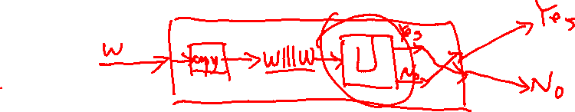
Proof – (2)
Given input w, we can decide if it is in L_{d} by the following steps.
  Check that w is a valid TM code.
    If not, then its language is empty, so w is in L_{d}.
  If valid, use the hypothetical algorithm to decide whether w111w is in L_{u}.
  If so, then w is not in L_{d}; else it is.
Notes:
So let’s assume that L_u is recursive. We construct an algorithm for L_d as follows.
Click 1
We’re given an input w. Let’s suppose w is the i-th string. The first thing to do is check whether or not w is a valid code for a Turing machine, for example, that it doesn’t have three consecutive 1’s. If the code is NOT valid, then the i-thTuring machine defines the empty language. That means w, the i-th string, is not in the language of the i-th Turing machine. Therefore, w IS in L_d.
Click 2
Now suppose w is a valid code for a Turing machine. Then simulate the hypothetical algorithm for L_u on the input w111w. That bit string represents the i-th Turing machine processing the input that is the i-th string. Eventually, this algorithm will halt and tell us whether or not the i-th machine accepts the i-th string.
Click 3
If the algorithm says “yes,” the i-th machine accepts the i-th string, then we say “no,” because that means w is not in L_d. However, if the hypothetical algorithm says “no,” then we accept w, because w IS in L_d.

Slide 28
Proof – (3)
But we already know there is no algorithm for L_{d}.
Thus, our assumption that there was an algorithm for L_{u} is wrong.
L_{u} is RE, but not recursive.
Notes:
Click 1
We proved that there is no algorithm – or any kind of Turing machine – for L_d.
Click 2
Therefore we must blame our assumption. The only thing we assumed without proof was that there is an algorithm for L_u. That means there really IS NO algorithm for L_u.
Click 3
Put those facts together, and we conclude that L_u is recursively enumerable but not recursive.

Slide 29
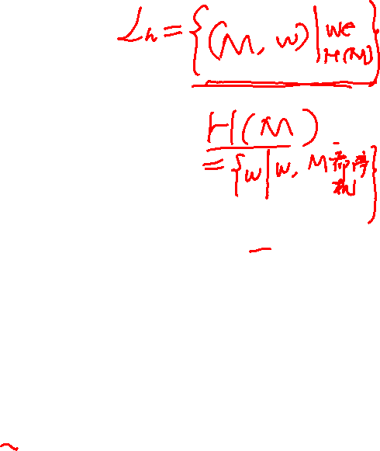
Bullseye Picture
Not recursively
enumerable
languages
Decidable
problems =
Recursive
languages
L_{d}
Recursively
enumerable
languages
All these are
undecidable
L_{u}
Notes:
So here is our improved version of the universe of languages. We still have the decidable problems, or equivalently recursive languages in the center. Outside that are two kinds of undecidable problems. The second ring is the languages that are recursively enumerable but not recursive. We now have a concrete example of such a problem: L_u, the universal language Turing machine language. And beyond that is the not-recursively enumerable languages, of which we have a concrete example L_d.

Slide 30
