Slide 1
More Undecidable Problems
Reduction
Rice’s Theorem
Post’s Correspondence Problem
Some Real Problems
Notes:
Now we are going to see more undecidable problems. We begin with Rice’s theorem, which tells us that almost every question we can ask about the recursively enumerable languages is undecidable. We then introduce a problem called Post’s Correspondence problem, which we show undecidable. Post’s problem does not appear to have anything to do with Turing machines, so the fact we can show it is undecidable is a valuable step on our road toward showing “real” problems undecidable. However, Post’s problem is still just a game. But we can use Post’s problem to show some real problems – for example questions about grammars, to be undecidable.

Slide 2
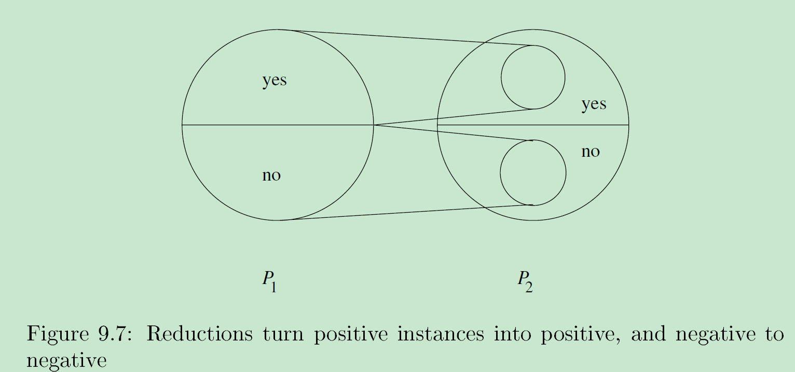
Reductions
A reduction from language L to language L’ is an algorithm (TM that always halts) that takes a string w and converts it to a string x, with the property that:
x is in L’ if and only if w is in L.
Notes:
An important part of the proof of Rice’s theorem, which we’ll be working on for a while, is the idea of a reduction. There are actually several different notions of “reduction” – we’ll come back to that point later. But the simplest one, and the one we need for Rice’s theorem, is an algorithm that takes an input string w for one language or problem L and converts it to another string x that is an input to another language or problem L’, with the property that x is in L’ if and only if w is in L.
The value of having such a reduction is that it tells us L is no harder than L’, at least as far as decidability is concerned. If I know L’ is recursively enumerable, then I also have a Turing machine program for L. If I know L’ is recursive, then I also have an algorithm for L. In either case, the solution for L is to take the input w, convert it to x, see what the Turing machine for L’ does, and take its output to be the answer for w.

Slide 3
TM’s as Transducers
We have regarded TM’s as acceptors of strings.
But we could just as well visualize TM’s as having an output tape, where a string is written prior to the TM halting.
Notes:
Click 1
The thing that turns a string w into x is called a transducer. So far, we have only talked about a Turing machine whose only output is the “yes” or “no” that is implied by accepting or by halting without accepting, respectively.
Click 2
But we can get other kinds of output from a multitape Turing machine if we designate one of its tapes to be the “output tape,” and regard what is written there when the machine halts as its output. We could, for example, imagine such a transducer that takes w on its input tape and writes x on its output tape and then halts.

Slide 4
Reductions – (2)
If we reduce L to L’, and L’ is decidable, then the algorithm for L’ + the algorithm of the reduction shows that L is also decidable.
yes
Transducer
Algorithm
for L’
w
x
no
Algorithm for L
Notes:
So if we reduce language L to L’ using such a transducer, and L’ is decidable --- that is, there is an algorithm that tests membership in L’, then there is also an algorithm for L
Click 1
That is, we start by applying the transducer to input w, producing output x.
Click 2
We apply the algorithm for L’ to input x, and decide whether or not x is in L’. Either way, the algorithm renders a decision, either yes or no.
Click 3
And these two steps form an algorithm for L. The whole thing takes input w and tells use whether or not w is in L.

Slide 5
Reductions – (3)
Normally used in the contrapositive.
If we know L is not decidable, then L’ cannot be decidable.
Notes:
We sometimes see a reduction used to discover an algorithm for L. But the more important use of the idea is in the contrapositive. If we already know that there is no algorithm for L, then there cannot be any algorithm for L’. That’s how we’re going to use reductions. We’ll take one problem, that we may not be interested in but that we know is undecidable, and reduce it to another problem that we are really interested in, but whose status we don’t yet know, and we’ll conclude that the second problem is also undecidable.
Moreover, when we get to intractability, or the “theory of NP-completeness,” we’ll be using reductions that are fast to argue that a problem like L’ can’t be solved faster than the problem L.

Slide 6
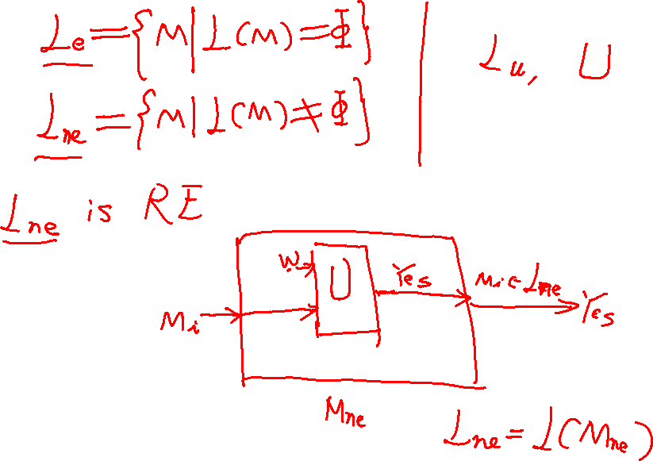

Slide 7
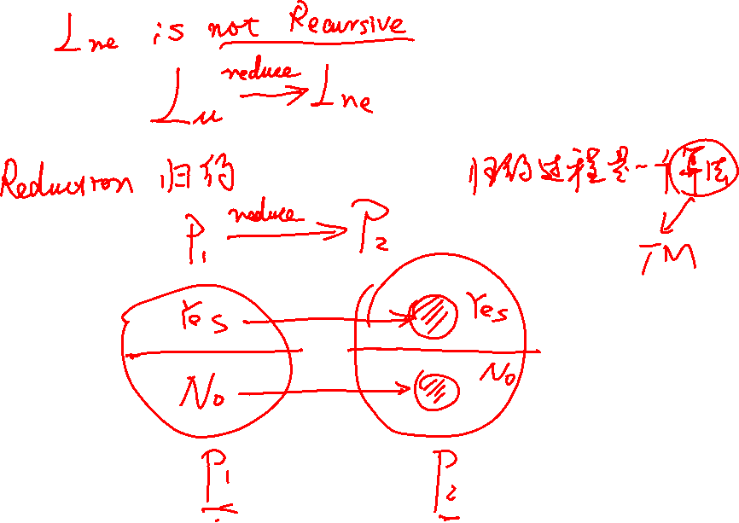

Slide 8
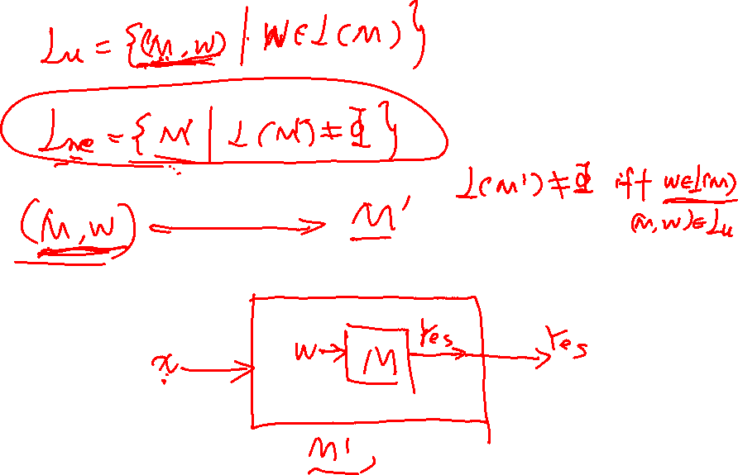

Slide 9
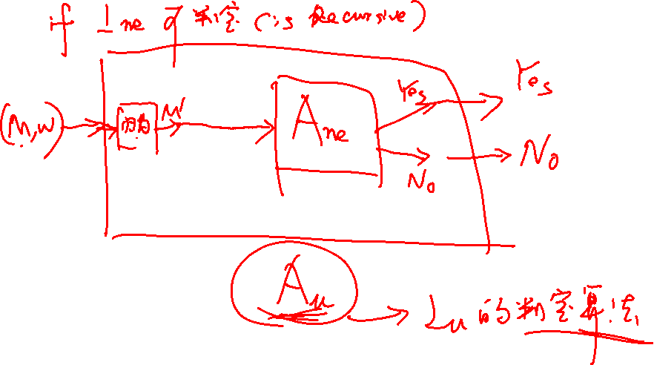

Slide 11
Properties of Languages
Any set of languages is a property of languages.
Example: The infiniteness property is the set of infinite languages.
In what follows, we’ll focus on properties of RE languages, because we can’t represent other languages by TM’s.
Notes:
We’ll first see Rice’s Theorem. That theorem involves “properties” of languages. Formally, a property of languages is any set of languages – the languages that we say have that property. For example, the property of being infinite is the set of infinite languages. The property of being empty is the set containing only the empty language.
While properties like being infinite apply to any language, even not recursively enumerable ones, we need to represent languages, and the Turing machine is the most powerful tool we have for representing languages, so we’ll talk about properties of recursively enumerable languages.

Slide 12
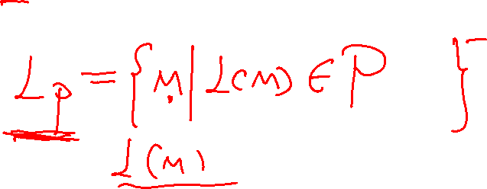
Properties of Langauges – (2)
Thus, we shall think of a property as a problem about Turing machines.
Let L_{P} be the set of binary TM codes for TM’s M such that L(M) has property P.
Notes:
Click 1
So we shall consider a property to be a problem about Turing machines – given a code for a Turing machine, does it define a language with the property.
Click 2
So for any property P, we can define a language L_P, the set of binary strings that represent a Turing machine whose language has the property P. So for example, L_infinite (DRAW) is the set of codes of Turing machines that define an infinite language.

Slide 13

Trivial Properties
There are two (trivial ) properties P for which L_{P} is decidable.
  The always-false property, which contains no RE languages.
  The always-true property, which contains every RE language.
Rice’s Theorem: For every other property P, L_{P} is undecidable.
Notes:
Click 1
There are two properties we call “trivial” for reasons that will be obvious. For these two properties P, L_P is decidable.
Click 2
One of these trivial properties is the always-false property that contains no recursively enumerable languages. We could think of this property as “is NOT a recursively enumerable language.” This property is actually true of some languages, but those are outside the recursively enumerable class, obviously, and we are talking about properties only as applied to the recursively enumerable languages.
How do we decide this property? Given an input w, we ignore it and say “no.” Notice that even if w represents an invalid Turing-machine code, we have agreed to take all those strings as representing a Turing machine that accepts the empty language. But the empty language IS a recursively enumerable language, so we are correct in saying that w’s Turing machine does not have the property.
Click 3
The second trivial property is the always-true property. We could express the property as “is a recursively enumerable language.” The algorithm for this property is to ignore the input and say “yes.”
Click 4
And Rice’s theorem is that for every property P except for the two trivial ones, L_P is undecidable.

Slide 14
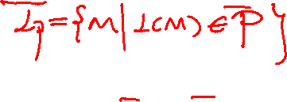
Proof of Rice’s Theorem
We shall show that for every nontrivial property P of the RE languages, L_{P} is undecidable.
We show how to reduce L_{u} to L_{P}.
Since we know L_{u} is undecidable, it follows that L_{P} is also undecidable.
Notes:
We’re now ready to prove Rice’s theorem. The idea is that we can reduce L_u to L_P for any nontrivial property P. Then, since we know L_u is undecidable, it follows that L_P is undecidable.

Slide 15
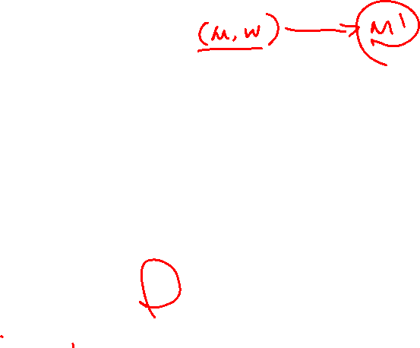
The Reduction
Our reduction algorithm must take M and w and produce a TM M’.
L(M’) has property P if and only if M accepts w.
M’ has two tapes, used for:
  Simulates another TM M_{L} on the input to M’.
  Simulates M on w.
    Note: neither M, M_{L}, nor w is input to M’.
Notes:
Click 1
Here’s how we reduce L_u to L_P. The input to L_u is a Turing machine M and an input w for M. The output will be the code for a Turing machine M’. That is at least of the right form, since L_P is a set of Turing-machine codes – those for which the language of the machine has property P.
Click 2
Of course for the transduction from M and w to M’ to work, we must arrange that M’ has property P if and only if M accepts w. That is, M’ is in L_P if and only if M and w is in L_u.
Click 3
We’ll design M’ to be a two-tape machine.
Click 4
On the first tape, M’ simulates another particular Turing machine we’ll call M_L on its own input, say x.
Click 5
On the second tape M’ simulates M on w. It is important to understand that M’ has only its own input x, which the transducer does not deal with or see. The transducer knows about M_L – it is built into the design of the transducer. The transducer gets to see the code for M and the string w – that is on its own input. Thus, the transducer can build both the moves of M and the input w into the transition function of the machine M’ that is its own output. None of M, M_L or w is input to M’.

Slide 16

The Reduction – (2)
Assume that ∅ does not have property P.
  If it does, consider the complement of P, which would also be decidable if P were, because the recursive languages are closed under complementation.
Let L be any language with property P, and let M_{L} be a TM that accepts L.
Notes:
Click 1
We’re going to assume that the empty language does not have property P. If that is not the case, then consider the complement of P, say Q. Surely the empty language then has property Q. But if we could prove that Q were undecidable, then P also must be undecidable. That is, if L_P were a recursive language, then so would be L_Q, since the class of recursive languages is closed under complementation.
Click 2
Let L be any language with property P. We know L exists, because P is not trivial. Also, let M_L be a Turing machine that accepts L.

Slide 17

Design of M’
On the second tape, write w and then simulate M on w.
If M accepts w, then simulate M_{L} on the input x to M’, which appears initially on the first tape.
M’ accepts its input x if and only if M_{L} accepts x.
Notes:
Here’s how M’ behaves.
Click 1
To begin, M’ writes w on its second tape. It can do that because the transducer, seeing w, generates a sequence of states that write w one bit at a time. M’, from its start state, enters each of these states in turn. Then, M’ moves the tape head for tape 1 to the left end, goes to the start state of M and simulates M on input w. Again, M’ can do that because the transducer sees both M and w and makes the transition function of M part of the transition function of M’.
Click 2
Suppose during this simulation of M on w, M enters an accepting state. Then M’ goes to the start state of M_L and simulates M_L on the input x to M’, which has been just sitting there on tape 1, being ignored so far. Where does M’ get the transition function for M_L? M_L is a particular Turing machine, one that accepts a language L with property P. Thus, the transducer itself can be designed so that it writes the transitions of M_L out as part of the transition function of M’.
Click 3
If M_L accepts the input x, then M’ enters an accepting state. If M_L never accepts x, neither does M’. Thus, if M’ ever gets to the stage where it simulates M_L, then M’ accepts the same language as M_L, that is, L. But if M does not accept w, then M’ never gets to the stages where it simulates M_L, and therefore M’ accepts nothing.

Slide 18

Action of M’ if M Accepts w
On accept
Simulate M
on input w
Simulate M_{L}
on input x
x
Accept
iff x is
in L.
Notes:
Here’s a picture to help us remember what M’ does. It first simulates M on input w. So far, M’ ‘s own input x is ignored.
Click 1
But if M accepts w, then M’ simulates M_L on its own input x.
Click 2
And M’ accepts x if and only if x is in L.

Slide 19
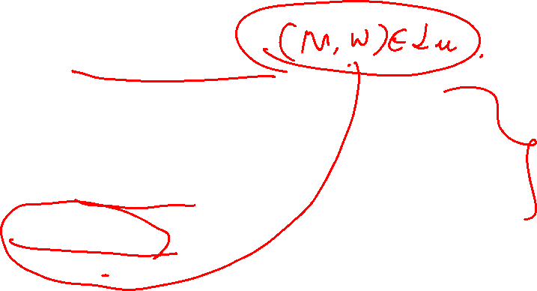
Design of M’ – (2)
Suppose M accepts w.
Then M’ simulates M_{L} and therefore accepts x if and only if x is in L.
That is, L(M’) = L, L(M’) has property P, and M’ is in L_{P}.
Notes:
Click 1
So to summarize what we know about M’: first suppose M accepts w.
Click 2
Then M’ simulates M_L on x and accepts x if and only if x is in L.
Click 3
That is, if M accepts w, then the language of M’ is L. We know L has property P, so M’ is in L_P.

Slide 20

Design of M’ – (3)
Suppose M does not accept w.
Then M’ never starts the simulation of M_{L}, and never accepts its input x.
Thus, L(M’) = ∅, and L(M’) does not have property P.
That is, M’ is not in L_{P}.
Notes:
Click 1
Now look at the opposite case, where M does not accept w.
Click 2
Then M’ never even starts the simulation of M_L, and therefore M’ cannot accept its input x.
Click 3
That is, in this case the language of M’ is the empty language. We know the empty language does not have property P.
Click 4
Thus, if M does not accept w, M’ is not in the language L_P.

Slide 21
Design of M’ – Conclusion
Thus, the algorithm that converts M and w to M’ is a reduction of L_{u} to L_{P}.
Thus, L_{P} is undecidable.
Notes:
We conclude that the algorithm we described for converting M and w to M’ is a reduction of L_u to L_P, and therefore that L_P is undecidable.

Slide 22

Picture of the Reduction
Accept
iff M
accepts w
A real
reduction
algorithm
Hypothetical
algorithm for
property P
M, w
M’
Otherwise
halt without
accepting
This would be an algorithm
for L_{u}, which doesn’t exist
Notes:
This is a picture that reviews the argument for why the existence of the reduction from L_u to L_P proves L_P is undecidable. We have a real reduction algorithm. I hope you are convinced that you could program this algorithm if you were paid enough. We then contradict the hypothesis that L_P has an algorithm by supposing that algorithm existed.
Click 1
Then you could put the reduction plus the hypothetical algorithm together and build an algorithm for L_u. Since we already proved there is no such thing, we have to look at what of this story hasn’t been proved. The finger points at the hypothetical algorithm for L_P, since we didn’t prove it exists – we just assumed it did. Thus, this assumption must be responsible for the false conclusion, and we can conclude instead that there is no algorithm for property P.

Slide 23

Applications of Rice’s Theorem
We now have any number of undecidable questions about TM’s:
  Is L(M) a regular language?
  Is L(M) a CFL?
  Does L(M) include any palindromes?
  Is L(M) empty?
  Does L(M) contain more than 1000 strings?
  Etc., etc.
Notes:
Click 1
Thanks to Rice’s theorem, we suddenly have an infinite collection of undecidable problems about the languages defined by Turing machines. Here is just a tiny sample of the questions that are undecidable about Turing machines M.
Click 2
Is M’s language regular?
Click 3
Is it context free?
Click 4
Does this language include at least one string that is a palindrome – that is a string that is the same as its reversal.
Click 5
Is the language empty; that is, does M accept any string at all?
Click 6
Does the language contain at least 1000 strings?
Click 7
But Rice’s theorem also applies to programs, since you can write a program to simulate a Turing machine. That tells us that any nontrivial question about what a program does will also be undecidable. I want to emphasize “about what a program does.” There are lots of questions about what a program *looks like* that are decidable, for example, I can tell whether a program uses more than 20 variable names. But that’s not a question about what a program does.
An example of a question about what a program does is “does the program eventually halt on any input?” That is undecidable. Or “does the program correctly sort its input.” That is undecidable. Or “does this line of code ever get executed?” That’s undecidable.

Slide 24
Post’s Correspondence Problem
Post’s Correspondence Problem (PCP) is an example of a problem that does not mention TM’s in its statement, yet is undecidable.
From PCP, we can prove many other non-TM problems undecidable.
Notes:
We’re now going to take up Post’s correspondence problem, afffectionately known as PCP.
Click 1
PCP is the first example of a problem that is undecidable, yet doesn’t involve Turing machines, or programs, which is really the same thing.
Click 2
PCP is not really important by itself, since it is just a made-up problem, but it leads us to proofs that many other problems are undecidable. These problems are unrelated to Turing machines but are related to matters like context-free languages that were not developed for the purpose of exposing undecidable problems. That is, we studied grammars for their use in matters like describing the structure of programming languages. We had no intent to describe problems that turn out to be undecidable – it just turned out that there were undecidable problems lurking in the theory of context-free grammars.

Slide 25
PCP Instances
An instance of PCP is a list of pairs of nonempty strings over some alphabet Σ.
  Say (w₁, x₁), (w₂, x₂), …, (w_{n}, x_{n}).
The answer to this instance of PCP is “yes” if and only if there exists a nonempty sequence of indices i₁,…,i_{n}, such that w_{i1}…w_{in} = x_{i1}…x_{in}.
Notes:
Click 1
An instance of PCP is a list of “corresponding” strings, that is. a list of pairs of strings over some particular alphabet Sigma. That is, the instance has some number of pairs n. The first pair is w1,x1, the second w2,x2, and so on. . None of these strings can be the empty string
Click 2
The PCP question is, given a list of corresponding pairs, whether we can find a list of one or more integers, i1 through i-k that we can treat as the sequence of pairs we choose. There can be repetitions in this list. The property of the list that makes the answer to this instance of PCP be “yes” is that when we take the first component from each pair on the list (POINT and explain that w_i1 and so on is really the w from the pair i_1, and so on), we get the same string as if we take the second string from the same list of pairs (POINT to x’s). Such a list is called a SOLUTION to the instance of PCP.

Slide 26
Example: PCP
Let the alphabet be {0, 1}.
Let the PCP instance consist of the two pairs (0, 01) and (100, 001).
We claim there is no solution.
You can’t start with (100, 001), because the first characters don’t match.
Notes:
Here’s a simple example instance of PCP.
Click 1
The alphabet will be 0 and 1.
Click 2
There are two pairs. The first pair is 0 and 01 (POINT). Every time there is a 1 in the list of pair indexes, this the the pair referred to. The second pair is 100 and 001 (POINT). This pair is referred to by index 2 in lists.
Click 3
In this case, there is no solution to the instance of PCP.
Click 4
The analysis of this simple instance is not so easy. The easy part is that no solution can start with the second pair. The reason is that if we choose 2 as the first integer in the list, then the first string, made from the w’s that are the first components, begins with a 1. But the second string, the one made from the corresponding x’s that are the second components, begins with 0. I don’t care how you continue. A string that begins with 1 can never equal a string that begins with 0.

Slide 27
Example: PCP – (2)
Recall: pairs are (0, 01) and (100, 001)
0
01
100
001
100
001
But we can never make
the first string as long
as the second.
Must start
with first
pair
Can add the
second pair
for a match
As many
times as
we like
Notes:
However, it is possible that the solution list begins with index 1, because for pair 1 the two strings are not inconsistent. That is, one is a prefix of the other.
Click 1
So let’s see if we can build a solution starting with the first pair.
Click 2
Since the two strings are not equal, we have to add another pair. We can’t choose pair 1, because the first string would then begin 00, and the second string would begin 01. That could never lead to a solution. So the second index in the solution must be 2. Now, both strings begin 0100, and the second string has an additional 1.
Click 3
We’re back were we were at the previous choice. We can’t pick 1 as the third index. We can pick 2, and we get a match up to a point, but with the second string having an additional 1.
Click 4
If you think about it, you can never make the two strings be the same, because to do so we’d eventually have to use a pair whose second string was shorter than the first. But there is no such pair in this instance. We conclude that this instance has answer “no.”

Slide 28
Example: PCP – (3)
Suppose we add a third pair, so the instance becomes: 1 = (0, 01); 2 = (100, 001); 3 = (110, 10).
Now 1,3 is a solution; both strings are 0110.
In fact, any sequence of indexes in 12*3 is a solution.
Notes:
Click 1
On the other hand, let’s change the instance a little by adding a third pair 110 and 10 (POINT).
Click 2
Now, the list of indexes 1,3 is a solution. From the first strings of the pairs we get 0 followed by 110 (POINT), which is 0110. From the corresponding second strings, we get 01 followed by 10 (POINT), which is also 0110.
Click 3
In fact, there is an infinity of solutions for this instance – any string of indexes in the language of regular expression 12*3. That is, after the 1, we can use pair 2 any number of times, and finally use the pair 3.

Slide 29
Proving PCP is Undecidable
We’ll introduce the modified PCP (MPCP) problem.
  Same as PCP, but the solution must start with the first pair in the list.
We reduce L_{u} to MPCP.
But first, we’ll reduce MPCP to PCP.
Notes:
Here is the plan for proving that PCP is undecidable.
Click 1
We start by introducing a modified version of the problem, called MPCP – the modified Post Correspondence Problem. The modification is that a solution to MPCP must begin with the first pair; otherwise the modified and original PCP are the same.
Click 2
We’ll show how to reduce L_u, the universal Turing machine language to MPCP.
Click 3
And we’ll show how to reduce MPCP to PCP. This part is easier so we’ll do it first.

Slide 30
Example: MPCP
The list of pairs (0, 01), (100, 001), (110, 10), as an instance of MPCP, has a solution as we saw.
However, if we reorder the pairs, say (110, 10), (0, 01), (100, 001) there is no solution.
  No string 110… can ever equal a string 10… .
Notes:
Click 1
Just to get the distinction between PCP and MPCP clear, observe that if we treat the list of three pairs from our previous example of PCP as an instance of MPCP, then the answer is “yes.” The reason is that there is a sequence of indexes, beginning with 1, say 1-3, that produces equal strings from the first and second components of the pairs.
Click 2
But we can reorder the pairs, say putting 110 and 10 first (POINT). As an instance of PCP, order of the pairs doesn’t matter. There is still a solution. But as an instance of MPCP, there is now no solution. Any solution would have to begin with index 1. But then the first of the two strings would begin 110, and the second would begin 10. No matter how we extend these strings, they disagree in their second positions so they are not equal.

Slide 31
Representing PCP or MPCP Instances
Since the alphabet can be arbitrarily large, we need to code symbols.
Say the i-th symbol will be coded by “a” followed by i in binary.
Commas and parentheses can represent themselves.
Notes:
Before we can talk about reductions, we need to express PCP and MPCP as languages. The instances of these problems can have any alphabet, so it is not immediately obvious how to express the set of all PCP instances with a solution. Again, the problem is that there is no finite alphabet for this set, and languages need a finite alphabet.
Click 1
So we need to code symbols in a finite alphabet.
Click 2
We’ll represent the i-th symbol of an alphabet by the symbol “a” followed by i in binary. Thus we only need three symbols to represent any number of symbols. The order of symbols of the alphabet is not important. For example. if we have an instance over alphabet {A,…Z} (DRAW at bottom), we could represent A by a1, B by a10, and so on (DRAW). But we could also represent Z by a1, Y by a10, and so on. It should be clear that the particular symbols used for the alphabet of a PCP instance does not affect the outcome.
Click 3
And the only other symbols we need to represent instances is the comma, and left and right parentheses. Thus, the alphabet for the language of PCP instances will have an alphabet of six symbols: “a”, 0, 1, comma, left paren, and right paren.

Slide 32
Representing Instances – (2)
Thus, we have a finite alphabet in which all instances of PCP or MPCP can be represented.
Let L_{PCP} and L_{MPCP} be the languages of coded instances of PCP or MPCP, respectively, that have a solution.
Notes:
Now that we have a finite alphabet for coding instances, we can define two languages. L_PCP is the language of coded instances of PCP that have a solution, and L_MPCP is the same for the modified problem.

Slide 33
Reducing L_{MPCP} to L_{PCP}
Take an instance of L_{MPCP} and do the following, using new symbols * and $.
  For the first string of each pair, add * after every character.
  For the second string of each pair, add * before every character.
  Add pair ($, *$).
  Make another copy of the first pair, with *’s and an extra * prepended to the first string.
Notes:
Now, we can do the reduction of MPCP to PCP. We’ll describe the transformation only, but you should be able to visualize the process being performed by a Turing-machine transducer.
Click 1
Our input is an instance of MPCP. The output instance of PCP will use the same alphabet as the input instance, plus two new symbols * and $. Of course all symbols, the new ones and the symbols in the input instance of MPCP will be coded using “a”’s 0’s, and 1’s as we just described.
Click 2
For each pair (w,x) in the input instance, there is a pair in the output instance based on w and x. For the first string w of the pair, we add * after every symbol. So for example, 01 becomes 0*1* (DRAW in line).
Click 3
And for x, the second string of the pair, we instead add a * before every character. So for example, 11 becomes *1*1 (DRAW).
Click 4
The output instance also has a new pair, unrelated to any input pair. This pair is ($, *$).
Click 5
And the output also has a second pair based on the first input pair. This pair has *’s placed after symbols of the first string and before symbols of the second string, just like in rules (1) and (2) on the slide. But the first string also has a * at the beginning. So for example, the pair (01,0) (DRAW at bottom) would become (*0*1*, *0).

Slide 34
Example: L_{MPCP} to L_{PCP}
MPCP instance,
in order:
(110, 10)
(0, 01)
(100, 001)
PCP instance:
(1*1*0*, *1*0)
(0*, *0*1)
(1*0*0*, *0*0*1)
($, *$)
Ender
(*1*1*0*, *1*0)
Special pair version of
first MPCP choice – only
possible start for a PCP
solution.
Notes:
Here is an example. On the left is the instance of MPCP that is input to the transducer. On the right are these pairs with the added stars. Notice that for each pair, the *’s come after the symbols in the first pair and before the symbols in the second pair.
Click 1
And we always add this pair, which will serve to make strings of the PCP instance match when there is a solution to the MPCP instance. It’s job is to add the missing star to the second string.
Click 2
And this pair also comes from the first pair. It is just like the first pair of the PCP instance (POINT), except for this star at the beginning of the first string (POINT). Notice that this is the only pair in the entire PCP instance where both strings start with the same symbol. For example, this pair (POINT to the second pair on the right) has 0 beginning the first string and star beginning the second. All these pairs have second strings that begin with * and a first string that begins with 0 or 1.

Slide 35
L_{MPCP} to L_{PCP} – (2)
If the MPCP instance has a solution string w, then padding with stars fore and aft, followed by a $ is a solution string for the PCP instance.
  Use same sequence of indexes, but the special pair to start.
  Add ender pair as the last index.
Notes:
Click 1
Suppose the MPCP instance has a solution – a sequence of indexes that yield string w when we use the first strings in the pairs and the same string w when we use the second strings. Then we can get a solution to the constructed PCP instance. In this case, the solution string will be w padded with *’s before each symbol of w and also at the end, followed by the $.
For example, if w is 101 (DRAW at bottom), then the PCP instance’s solution is *1*0*1*$ (DRAW at bottom).
Click 2
To get the PCP solution, we use the same sequence of indexes as in the solution to the MPCP instance. with two exceptions. First, we use the index of the special pair as the first index. Recall this pair was constructed from the first pair of the MPCP instance with the extra star.
Click 3
And also add to the solution the index of the ender pair (*$, $) at the end of the list of indexes.

Slide 36
L_{MPCP} to L_{PCP} – (3)
Conversely, the indexes of a PCP solution give us a MPCP solution.
  First index must be special pair – replace by first pair.
  Remove ender.
Notes:
Thus, a solution to the input MPCP instance means that the output PCP index also has a solution.
Click 1
But the other direction also holds. If the PCP instance has a solution, we can modify it to get a solution for the input MPCP index.
Click 2
The first index in the PCP solution must be the special pair, because that is the only pair of the PCP instance where both strings start with the same symbol. Change this index to 1, the index of the first pair of the MPCP index.
Click 3
Leave all the other indexes unchanged, but remove from the PCP solution the last index, which must be the index of the ender pair. Why? That’s the only pair where both strings END with the same symbol.
Thus, we have shown that the answer to the questions “does the input MPCP instance have a solution?” and “does the output PCP instance have a solution?” are the same. That means we have a valid reduction from MPCP to PCP. If we can prove MPCP is undecidable – which we’ll do next – then we have a proof that PCP is also undecidable.

Slide 38
Reducing L_{u} to L_{MPCP}
We use MPCP to simulate the sequence of ID’s that M executes with input w.
Suppose q₀w⊦I₁⊦I₂⊦ … is the sequence of ID’s of M with input w.
Then any solution to the MPCP instance we can construct will begin with this sequence of ID’s, separated by #’s.
Notes:
Our next task is to show how to reduce L_u to MPCP.
Click 1
Given an instance (M,w) of L_u, we’ll convert this to an instance of MPCP whose only possible solutions yield strings that represent the sequence of ID”s that M enters when its input is w.
Click 2
More precisely, suppose this (POINT) is the sequence of ID’s that M enters, starting with the initial ID with input w.
Click 3
Then any solution to the constructed MPCP instance will yield a pair of strings that begin with this sequence of ID’s separated by pound signs.

Slide 39
Reducing L_{u} to L_{MPCP} – (2)
But until M reaches an accepting state, the string formed by concatenating the second components of the chosen pairs will always be a full ID ahead of the string from the first pairs.
If M accepts, we can even out the difference and solve the MPCP instance.
Notes:
However, until M enters an accepting state, when we look at the two strings of the partial solution – one formed from the first strings of the indexed pairs and the second from the second strings of the same pairs, the second string will always be a full ID ahead of the first string.
Only if M accepts will we be able to choose pairs that make the first string grow faster than the second and eventually make the two strings become identical.

Slide 40
Reducing L_{u} to L_{MPCP} – (3)
Key assumption: M has a semi-infinite tape; it never moves left from its initial head position.
Alphabet of MPCP instance: state and tape symbols of M (assumed disjoint) plus special symbol # (assumed not a state or tape symbol).
Notes:
Click 1
We’re going to assume, as we can, that the Turing machine M from the input to L_u has a semiinfinite tape and never moves left from the initial head position. That is, given the actual binary string representing M, we can modify the represented machine to mark its left end of tape, as we did when we described the construction of a Turing machine with a semiinfinite tape from one that had a two-way infinite tape. Then, we can perform the reduction on the new Turing machine that we know does the same as M, rather than on M itself.
However, in what follows, we will continue to refer to the input machine as “M.”
Click 2
The MPCP instance we construct will have an alphabet that consists of all the states and tape symbols of M (or rather the modified M), plus the special marker #. We assume that the symbols used for states and tape symbols are disjoint so we can tell one from the other in an ID.

Slide 41
Reducing L_{u} to L_{MPCP} – (4)
First MPCP pair: (#, #q₀w#).
  We start out with the second string having the initial ID and a full ID ahead of the first.
(#, #).
  We can add ID-enders to both strings.
(X, X) for all tape symbols X of M.
  We can copy a tape symbol from one ID to the next.
Notes:
Here’s the beginning of the construction of the MPCP instance from M and w.
Click 1
The first pair has a first string that is just a pound-sign, but a second string that is the entire first ID with input w, surrounded by #’s. Note that the transducer gets to see w on its input, so it can generate this pair.
Click 2
Add the pair (#,#). It lets us add a marker to the end of one ID in the first string at the same time we add a # to the following ID in the second string.
Click 3
Add pair (X,X) for every tape symbol X. This pair lets us add an X to the ID we are forming in the first string at the same time we add an X to the next ID, which is being formed in the second string. Of course in order to make sure the strings match, it must be the case that an X appears as the first unmatched symbol of the second string. Recall the second string is one ID ahead, so these pairs in effect let us copy the tape of one ID to the next ID, but prevents us from making changes that are not justified by a move of M.

Slide 42
Example: Copying Symbols
Suppose we have chosen MPCP pairs to simulate some number of steps of M, and the partial strings from these pairs look like:
. . . #
. . . #ABqCD#
A
B
A
B
Notes:
Here’s a picture of copying ID’s. Suppose we have just reached a point in the sequence of indexes where the second string has a complete ID more than the first string, but otherwise, the strings match.
Click 1
We can add to the solution we are constructing the pair (A.A). That has the effect of putting the first symbol of the new ID at the end of the first string, and also extending the second string by the same symbol. That’s what we want, since there is no way this A could change in the next ID.
Click 2
We can also then add the index of the pair (B,B) to the solution, extending the new ID one symbol further. This might or might not be the right thing to do. The problem is that if the move of M in state q with symbol C is to move left, then the second symbol of the new ID is the new state, and B will be the third symbol. But just because we can choose the pair (B,B) doesn’t mean we have to. If M is going to move left, there will be another choice of next index that simulates the move correctly, and the sequence where (B,B) is chosen instead will fail to yield a solution to the MPCP instance we are constructing.

Slide 43
Reducing L_{u} to L_{MPCP} – (5)
For every state q of M and tape symbol X, there are pairs:
  (qX, Yp) if δ(q, X) = (p, Y, R).
  (ZqX, pZY) if δ(q, X) = (p, Y, L) [any Z].
Also, if X is the blank, # can substitute.
  (q#, Yp#) if δ(q, B) = (p, Y, R).
  (Zq#, pZY#) if δ(q, X) = (p, Y, L) [any Z].
Notes:
Now, we need to add the pairs that reflect the moves of M.
Clicks 1 and 2
For every state q and tape symbol X, if the move of M is to the right, say (p,Y,R) (POINT), we have a par in which q to the left of X (POINT) can be replaced by p to the right of Y (POINT). That correctly reflects the change in ID that occurs in a rightward move.
Click 3
And if the move is to the left, then we have a family of pairs, one for each symbol Z that could appear to the left of the state. Note that we arranged that M can never move left from its initial position, so there is no possibility that the state is at the left end of the ID if M moves left.
So if the leftward move has state q and symbol X replaced by state p and symbol Y, then for every Z, there is a rule that puts p to the left of the Z and replaces X by Y (POINT).
Click 4, 5, 6
One other possibility is that in the current ID, the state is at the right end of the ID, scanning a blank we have never visited before. If so, the state will actually be to the left of a pound sign (POINT in item 1). The pairs are almost the same, but when constructing the second string, we should imagine an extra blank in front of the #. The blank is replaced by the new symbol Y, of course. (POINT to item 1 again).

Slide 44
Example: Copying Symbols – (2)
Continuing the previous example, if δ(q, C) = (p, E, R), then:
. . . #AB
. . . #ABqCD#AB
If M moves left, we should not have copied B if we wanted a solution.
qC
D
#
Ep
D
#
Notes:
Following on our previous example, suppose that in state q, scanning C, M does indeed move right, going to state p and writing E in place of C. Had M moved left in that situation, this sequence of pair choices would be dead in the water, unable to continue. However, in that case, we could have chosen not to use the pair (B,B), but instead use a pair that incorporated the leftward move and handled the B properly.
Click 1
In this case, we have a pair with qC as the first string, so we can match the string on the bottom. It also extends the bottom string with Ep, reflecting a move of M.
Click 2
Once the move has been handled, we can just match symbol against symbol. Here, the pair (D,D) is used.
Click 3
And once we are at the end of the ID, we use the pair of pound signs to separate the ID”s, and we are now ready to continue the sequence of pair choices to copy the new ID ABEpD (POINT), changed by another move of M.

Slide 45
Reducing L_{u} to L_{MPCP} – (6)
If M reaches final state f, then f “eats” the neighboring tape symbols, one or two at a time, to enable M to reach an “ID” that is essentially empty.
The MPCP instance has pairs (XfY, f), (fY, f), and (Xf, f) for all tape symbols X and Y.
To even up the strings and solve: (f##, #).
Notes:
Click 1
But we need some more pairs in the MPCP instance, so that in case M accepts, we can find a solution. Note that if M never accepts, then only the rules given so far can ever be used, and these can never lead to a solution, because the second string is always one ID longer than the first.
However, if M enters final state f, then it is possible for the f to “eat” the neighboring symbols of an ID. We no longer have real ID’s of M, but it doesn’t matter. We’ve simulated M enough to know that M accepts w, and therefore our only concern is to make sure there is a solution to the MPCP instance based on M and w.
Click 2
Thus, we add to the instance of MPCP pairs (XfY,f), (fY,f), and (Xf,f) (POINT) for all X and Y. Using these pairs, together with pairs of the form (X,X) to copy parts of ID’s as we have done, we eventually get to an ID that is only the state f. Of course that isn’t an actual ID of M, but it doesn’t matter any more.
Click 3
And one more pair, (f##,#) will end the two strings being formed, making them the same and yielding a solution to the MPCP instance.

Slide 46
Example: Cleaning Up After Acceptance
… #
... #ABfCDE#
A
BfC
D
E
#
AfD
E
#
f E
#
f##
A
f
D
E
#
f
E
#
f
#
#
Notes:
Here’s an example, where M has entered the final state f, and a sequence of choices, each either copying a symbol or allowing f to eat the adjacent symbol or symbols eventually leads to identical strings
Click 12 times, ending with f##, #.

Slide 47
CFG’s from PCP
We are going to prove that the ambiguity problem (is a given CFG ambiguous?) is undecidable.
As with PCP instances, CFG instances must be coded to have a finite alphabet.
Let a followed by a binary integer i represent the i-th terminal.
Notes:
Click 1
We’re going to reduce PCP to the problem “is a context-free grammar ambiguous?” Then, for the first time we’ll have an undecidable problem that arose naturally – that is, not because we were looking for undecidable problems.
Click 2
Before we can talk about any problem involving grammars, we need to find a code for grammars using a finite alphabet, just as we did for PCP.
Click 3
So to start that encoding of grammars, let’s represent the i-th terminal by symbol “a” followed by i in binary. That may look like we’re thus forgetting what the actual terminal symbols are, but since we are interested in ambiguity, we can rename the terminals any way we like, as long as we don’t name two terminals the same, and the ambiguity or unambiguity of the grammar will not change.

Slide 48
CFG’s from PCP – (2)
Let A followed by a binary integer i represent the i-th variable.
Let A1 be the start symbol.
Symbols ->, comma, and ε represent themselves.
Example: S -> 0S1 | A, A -> c is represented by A1->a1A1a10,A1->A10,A10->a11
Notes:
Click 1
Then we’ll represent the i-th variable by capital A followed by i in binary.
Click 2
We’ll assume that A1 is always the start symbol.
Click 3
The right arrow between the head and body of a production will be represented by itself.. Likewise, the comma separating productions and the symbol epsilon will represent themselves.
Click 4
For example, this grammar is represented by this string (POINT). The bar connecting alternative bodies for S has been expanded, so there are two separate productions. This (POINT) represents S->0S1, and this (POINT) represents S->A. Finally, this (POINT) represents A->c.

Slide 49
CFG’s from PCP – (3)
Consider a PCP instance with k pairs.
  i-th pair is (w_{i}, x_{i}).
Assume index symbols a₁,…, a_{k} are not in the alphabet of the PCP instance.
The list language for w₁,…, w_{k} has a CFG with productions A -> w_{i}Aa_{i} and A -> w_{i}a_{i} for all i = 1, 2,…, k.
Notes:
Click 1
Suppose we have a PCP instance with k pairs, and let the i-th pair be (wi, xi).
Click 2
We need k index symbols to represent the numbers of the pairs. We’ll use a1 through ak, which we may choose to be symbols that do not appear in the PCP instance. Notice that we’re going to talk about reducing an uncoded instance of PCP, so it can have any alphabet, to an uncoded grammar, which also can have any symbols. However, the process we describe really takes place with all the symbols coded in the manner we have described. It is easier to follow the construction in the uncoded form, so that is what we do.
Click 3
The *list language* for the first half of each pair, the strings w1 through wk, has a context-free grammar with productions A goes to wi A little ai, for each i (POINT). It also has the same sort of production for each i, but with A omitted from the body. These productions are used to end derivations.
All the strings in this language are some sequence of the wi’s, with repetitions allowed, and in any order, with the corresponding index symbols following, but in reverse. (DRAW an example, A => w1Aa1 => w1w2a2a1) Notice the sequence of a’s is the reverse of the sequence of w’s.

Slide 50
List Languages
Similarly, from the second components of each pair, we can construct a list language with productions B -> x_{i}Ba_{i} and B -> x_{i}a_{i} for all i = 1, 2,…, k.
These languages each consist of the concatenation of strings from the first or second components of pairs, followed by the reverse of their indexes.
Notes:
And we can do the same thing with the second string from each pair. We’ll use variable B, and xi’s in place of wi’s, but the idea is the same.
The language of strings generated from A and B each consist of a concatenation of strings, either from the w’s or the x’s – the first or second components of the pairs – followed by the reverse of the sequence of indexes of the pairs from which the strings came.

Slide 51
Example: List Languages
Consider PCP instance (a,ab), (baa,aab), (bba,ba).
Use 1, 2, 3 as the index symbols for these pairs in order.
A -> aA1 | baaA2 | bbaA3 | a1 | baa2 | bba3
B -> abB1 | aabB2 | baB3 | ab1 | aab2 | ba3
Notes:
click 1
Here’s an example of a PCP instance over alphabet {a,b}.
Click 2
We’ll use 1, 2, and 3 as the index symbols.
Click 3
The grammar with start symbol A is this, For example, the second pair, whose first string is baa, gives rise to these two productions (POINT).
Click 4
And here’s the grammar for the second strings in the pairs, with start symbol B.
As an example (DRAW), if we choose the three pairs is order 1, 2, 3, then there is a derivation from A of A => aA1, abaaA21 => abaabaa321

Slide 52
Reduction of PCP to the Ambiguity Problem
Given a PCP instance, construct grammars for the two list languages, with variables A and B.
Add productions S -> A | B.
The resulting grammar is ambiguous if and only if there is a solution to the PCP instance.
Notes:
We’re now ready to show how to reduce PCP to the ambiguity problem.
Click 1
Given the PCP instance, construct the two list languages, with variable A for the first strings in the pairs and B for the second strings in the pairs.
Click 2
Then add productions S -> A and S-> B. Of course S is the start symbol of the new grammar.
Click 3
We’ll show the resulting grammar is ambiguous if and only if there is a solution to this instance of PCP.

Slide 53
Example: Reduction to Ambiguity
A -> aA1 | baaA2 | bbaA3 | a1 | baa2 | bba3
B -> abB1 | aabB2 | baB3 | ab1 | aab2 | ba3
S -> A | B
There is a solution 1, 3.
Note abba31 has leftmost derivations:
S => A => aA1 => abba31
S => B => abB1 => abba31
Notes:
But first let’s look at an example, that should actually expose how the proof in general works.
Clicks 1, 2, 3
Here is the grammar constructed from the PCP instance we saw earlier. It is the sets of A-productions and B-productions we saw, plus the two productions for S.
Click 4
Notice there is a solution, 1,3. That is, the first pair was (a,ab) and the third pair was (baa,ba) (DRAW next to S-productions). When we take the first strings of each pair we get abba, and if we take the second strings from these pairs we get the same.
Click 5
And this common string, followed by the index string in reverse (POINT) will have two leftmost derivations, one starting with A and the other with B.
Click 6
Here’s the derivation starting with A.
Click 7
And here’s the derivation starting with B.

Slide 54
Proof the Reduction Works
In one direction, if a₁,…, a_{k} is a solution, then w₁…w_{k}a_{k}…a₁ equals x₁…x_{k}a_{k}…a₁ and has two derivations, one starting S -> A, the other starting S -> B.
Conversely, there can only be two leftmost derivations of the same terminal string if they begin with different first productions. Why? Next slide.
Notes:
Click 1
So here’s the proof this construction is a correct reduction from PCP to ambiguity. First, suppose the PCP instance has a solution, say represented by the sequence of index symbols a_1 through a_k. Note there can be repeats in this sequence. Then w1 through wk is the same string as x1 through xk – that’s what it means for this index sequence to be a solution. Then there are two leftmost derivations of the string that is w1 through wk (or equivalently x1 through xk, followed by ak down to a1. One starts S->A and the other starts S->B.
Click 2
For the converse, we are going to show that if there are two leftmost derivations of a string of terminals, then one must begin S->A and the other S->B.

Slide 55
Proof – Continued
If the two derivations begin with the same first step, say S -> A, then the sequence of index symbols uniquely determines which productions are used.
  Each except the last would be the one with A in the middle and that index symbol at the end.
  The last is the same, but no A in the middle.
Notes:
Click 1
Suppose there are two leftmost derivations that begin with S->A. Then we can look at the sequence of index symbols in the resulting terminal string, in reverse, and learn exactly the sequence of productions used.
Click 2
Except for the last production used, each would be the unique A production that generates that index symbol and has an A in the body.
Click 3
and the final production would be the one with the last – that is leftmost – index symbol, and no A in the body.
The same idea works for derivations that start with S->B. There can be only one with a given sequence of index symbols.

Slide 56
Example: S =>A=>*…2321
S
A
w₁
1
A
w₂
2
A
w₃
3
A
w₂
2
Notes:
Here’s an example. If the derivation starts with S->A and it produces a terminal string with index sequence 2321, then here is what the derivation or parse tree has to look like.
Click 1
We start with A.
Click 2
The first production used must generate the 1 at the right end, and we need to keep the A, so this is the only choice.
KEEP clicking until A dsappears.

Slide 57
More “Real” Undecidable Problems
To show things like CFL-equivalence to be undecidable, it helps to know that the complement of a list language is also a CFL.
We’ll construct a deterministic PDA for the complement langauge.
Notes:
We can prove many things about context-free grammars to be undecidable as well. To do so, we need to show that the complement of a list language is also context-free. Remember that the complement of a context-free language need not be context-free, but fortunately, these are.
For the proof, we find it easier to construct a PDA, in fact a deterministic PDA, for the complement.

Slide 58
DPDA for the Complement of a List Language
Start with a bottom-of-stack marker.
While PCP symbols arrive at the input, push them onto the stack.
After the first index symbol arrives, start checking the stack for the reverse of the corresponding string.
Notes:
Click 1
The PDA we construct will start with a bottom-marker on its stack.
Click 2
At first, some symbols from the PCP instance – not index symbols – will appear. The PDA simply pushes them onto its stack.
Click 3
After the first index symbol arrives, start checking that the proper strings appear on the stack. That is, if we see index symbol ai, then check that the proper wi appears on the stack, with the right end of wi at the top. The PDA pops all the symbols of wi, if so. Note that we’re assuming this is the complement of the list language based on first components. If it is for second components, check that xi appears on top of the stack, again with the right end at the top.

Slide 59
Complement DPDA – (2)
The DPDA accepts after every input, with one exception.
If the input has consisted so far of only PCP symbols and then index symbols, and the bottom-of-stack marker is exposed after reading an index symbol, do not accept.
Notes:
What we seem to be doing is accepting the list language itself, rather than the complement. But I didn’t tell you when the PDA accepts.
Click 1
It accepts every input, with only the exception of when it has found a string in the list language.
Click 2
That is, if the input so far was some sequence of PCP symbols followed by some sequence of index symbols, and these sequences are not empty, and the bottom of stack marker is now exposed, then the PDA does NOT accept this string. If will accept any other string that follows, which cannot also be a solution to the PCP instance.

Slide 60
Using the Complements
For a given PCP instance, let L_{A} and L_{B} be the list languages for the first and second components of pairs.
Let L_{A}^{c} and L_{B}^{c} be their complements.
All these languages are CFL’s.
Notes:
Now we can use the complement languages.
Click 1
Let LA and LB be the list languages for the first and second components of an instance of PCP.
Click 2
And let LA-complement and LB-complement be their complements.
Click 3
All four of these languages are context-free languages.

Slide 61
Using the Complements
Consider L_{A}^{c} ∪ L_{B}^{c}.
Also a CFL.
= Σ* if and only if the PCP instance has no solution.
Why? a solution a₁,…, a_{n} implies w₁…w_{n}a_{n}…a₁ is not in L_{A}^{c}, and the equal x₁…x_{n}a_{n}…a₁ is not in L_{B}^{c}.
Conversely, anything missing is a solution.
Notes:
Click 1
Let’s consider the union of the complement languages.
Click 2
This is also a context-free language, by the fact that context-free languages are closed under union.
Click 3
I claim that the union equals Sigma-star, where Sigma is the alphabet consisting of all the symbols used by the languages involved, if and only if there is NO solution to the PCP instance.
Click 4
Suppose there were a solution, say represented by index symbols a1 through a_n. Then this string (POINT) is not in the complement of LA. and this (POINT) is not in the complement of LB. Thus, if there is a solution, there is a string missing from the union.
Click 5
Conversely, suppose string ya_n…a_1 (DRAW) is missing from the union. That means y is the string you get by using indexes a1 through a_n and taking the first strings from the indexed pairs, and it is also the string you get by doing the same with the second pairs. That means a1 through a_n is a solution to the PCP instance.

Slide 62
Undecidability of “= Σ*”
We have reduced PCP to the problem is a given CFL equal to all strings over its terminal alphabet?
Notes:
We have now reduced PCP to the question is a given context free language equal to all strings over its terminal alphabet. Thus. this problem is undecidable.

Slide 63
Undecidablility of “CFL is Regular”
Also undecidable: is a CFL a regular language?
Same reduction from PCP.
Proof: One direction: If L_{A}^{c} ∪ L_{B}^{c} = Σ*, then it surely is regular.
Notes:
Click 1
Here’s another undecidable question about context-free languages: is the language also a regular language?
Click 2
We do exactly the same reduction from PCP.
Click 3
One direction is easy. If there is no solution, then the union of the complement languages is Sigma*, and that’s surely a regular language.

Slide 64
“= Regular” – (2)
Conversely, we can show that if L = L_{A}^{c} ∪ L_{B}^{c} is not Σ*, then it can’t be regular.
Proof: Suppose wx is a solution to PCP, where x is the indices.
Define homomorphism h(0) = w and h(1) = x.
Notes:
Click 1
But we also need to show the converse: that if L, the union of the complement languages, is something other than Sigma*, then it is NOT a regular language.
Click 2
Suppose we have a solution to the PCP instance, and in particular, let x be the index symbols, in reverse, that gives you the solution, and let w be the string you get by using the first string from each of the indexed pairs, in order. Since it is a solution, w is also what you get by using the second pairs.
Click 3
Now, let h be the homomorphism defined by h(0) = w and h(1) = x.

Slide 65
“= Regular” – (3)
h(0^{n}1^{n}) is not in L, because the repetition of any solution is also a solution.
However, h(y) is in L for any other y in {0,1}*.
If L were regular, so would be h^{–1}(L), and so would be its complement = {0^{n}1^{n} |n > 1}.
Notes:
Click 1
Remember L is the union of the complements – the strings that are NOT solutions to the given instance of PCP. We claim that h(0^n1^n) is not in L for any n, because if we repeat a solution to a PCP instance any number of times, we also get solutions to that instance.
Click 2
However, h(y) IS in L for any other y. That is, h(y) is not a solution. This point requires a little thought. First, if y isn’t 0’s followed by 1’s, then h(y) isn’t of the right form to be a solution to PCP. That is, it will not consist of PCP-instance symbols followed by index symbols.
But if y consists of n 1’s preceded by a different number of 0’s, then it can’t possibly represent a solution. h applied to the n 1’s gives a particular sequence of index symbols. But we know the PCP-instance symbols that this sequence of index symbols corresponds to is h applied to n 0’s. Therefore, it couldn’t also be h applied to a different number of 0’s.
Click 3
So if L, the union of complements, were regular, then h-inverse(L) would also be regular, because regular languages are closed under inverse homomorphism. And the complement of h-inverse(L) would be regular, because regular languages are closed under complementation. But this language, we just argued, is the set of 0^n1^n such that n >= 1, a language we know very well not to be regular.

