Slide 1
Intractable Problems
Time-Bounded Turing Machines
Classes P and NP
Polynomial-Time Reductions
Notes:
We now take up the last major topic in this course. The subject is intractable problems. These problems are decidable, but colloquially they are said to be problems that take at least exponential time, as a function of their input size. The reality is a bit different. They are problems for which there is an overwhelming amount of empirical evidence that these problems take exponential time, but no solid proof of that belief.
If a problem does take time that is exponential in its input size, then that means it can, in practice, only be solved for small instances. Suppose, to be concrete, that the time it takes to solve an instance of size n is 2^n. Then doubling the speed of machines makes essentially no difference in how large an instance you can solve: it adds 1 to the size n you can solve in a fixed amount of time. Using a thousand machines instead of 1 has the effect of adding 10 to the size n. Using a million machines, each 1000 times faster than today’s machines, adds 30 to n. You never get to really big sizes of problem instances that you can solve.
As a result, it is generally accepted that in order for a solution to a problem to be considered usable in practice, it has to run in less than exponential time, and in particular in polynomial time for some large polynomial. While an algorithm that runs in some large polynomial time, like n^1000 is no more practical than one that runs in time 2^n, we find in practice that if a problem has a polynomial algoirithm at all, then it has an algorithm that runs in some low-degree polynomal, like n^2 or n^3 at the most.
In this lecture, we introduce several important preliminary concepts. We introduce the idea of a Turing machine that is time-bounded – it can only run for a time that is a known function of its input size before it has to stop and tell us whether it accepts or rejects.
We introduce the class P of problems or languages that can be solved by a Turing machine that runs in polynomial time, as a function of its input size. We also meet the class NP, which is problems that can be solved by a Turing machine that is nondeterministic, but has a polynomial time bound along each branch.
Finally, we’ll learn about polynomial-time reductions, which are reductions where the transducer runs in time that is polynomial in its input size. These are used to show one problem intractable, by reducing a known intractable problem to it.

Slide 2
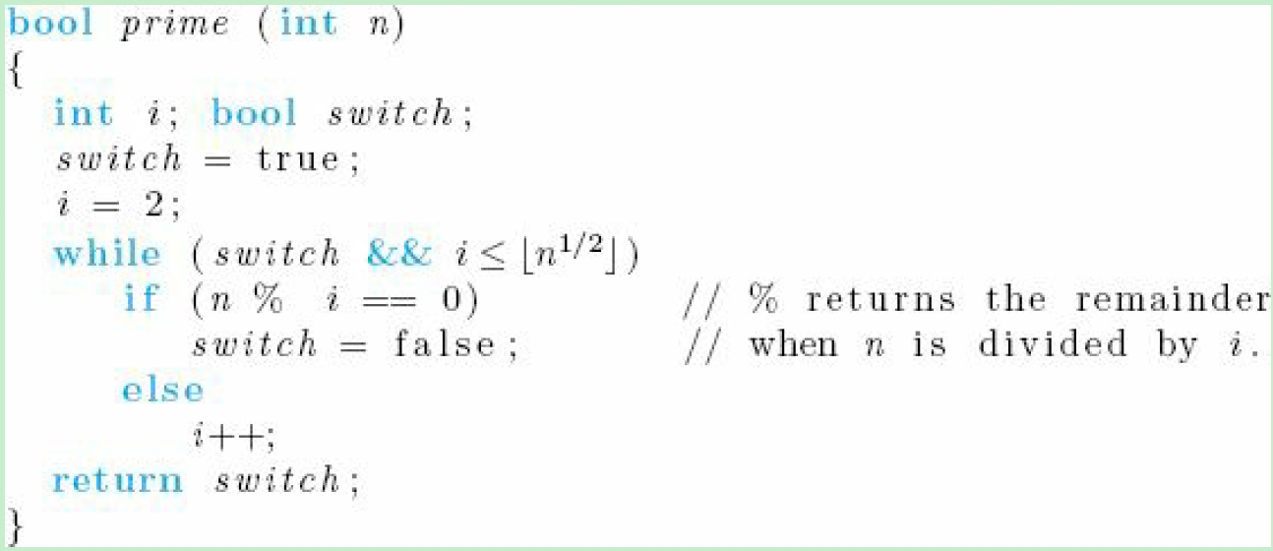

Slide 3
Time-Bounded TM’s
A Turing machine that, given an input of length n, always halts within T(n) moves is said to be T(n)-time bounded.
  The TM can be multitape.
  Sometimes, it can be nondeterministic.
Notes:
Click 1
We say a Turing machine is T(n) time bounded, where T(n) is some function of n, like n^2 or 2^n, if given an input of length n, the machine always halts in at most T(n) steps.
Click 2
We allow the machine to have several tapes.
Click 3
In some circumstances we allow the Turing machine to be nondeterministic, although in that case we will specify that is a T(n) time-bounded nondeterministic Turing machine. Also, in that case, we mean that any of the sequences of moves of the nondeterministic machine is no longer than T(n).
Click 2
In practice, a deterministic multitape Turing machine is close to the idea of an algorithm that runs in time proportional to T(n), or big-oh of T(n). That is, while some algorithms take longer on a Turing machine, even multitape, than on a real computer, these are rare. Moreover, when there is a difference, the difference tends to be small.

Slide 4
The class P
If a DTM M is T(n)-time bounded for some polynomial T(n), then we say M is polynomial-time (“polytime ”) bounded.
And L(M) is said to be in the class P.
Important point: when we talk of P, it doesn’t matter whether we mean “by a computer” or “by a TM” (next slide).
Notes:
A Turing machine M is said to be polynomial-time bounded if it is time bounded by any polynomial. It could be linear, or quadratic, or cubic, or n^1000, as long as it is some polynomial.
The languages that are accepted by polynomial-time bounded Turing machines form the class P.
Now P is defined formally in terms of Turing machines. But it could just as well have been stated as polynomial time on a real computer. The reason, which we address on the next slide, is that if an algorithm runs in some polynomial time on a computer, then it will run in polynomial time on a multitape Turing machine – or even a one-tape Turing machine, although the degree of the polynomial may be higher in some cases.

Slide 5
Polynomial Equivalence of Computers and TM’s
A multitape TM can simulate a computer that runs for time O(T(n)) in at most O(T²(n)) of its own steps.
If T(n) is a polynomial, so is T²(n).
Notes:
That is, we saw a way to simulate a name-value store by a computer. That is the part of a real computer that takes the most time when simulated by a Turing machine. But if a computer runs for on the order of T(n) steps, then it can’t store or retrieve more than T(n) items in its memory. A Turing machine can simulate one lookup or insert into a name-value store in a number of its steps that is proportional to the length of the tape that holds the store. But that length is proportional, at most, to the number of steps the computer has taken, which is T(n). Thus, the Turing machine takes at most T^2(n) of its own steps.
If T(n) is a polynomial, so is T^2(n). The exponent grows, of course. A cubic algorithm on a computer might take time proportional to n^6 on a Turing machine, but it’s no worse than that. And since we are trying to divide the world of problems into those that have polynomial algorithms and those that don’t we can think Turing machine or computer, whichever is more convenient. As you might expect, when simulating a program, it’s best to simulate a Turing machine, but when devising an algorithm, it’s best to think about a computer program.

Slide 6
Examples of Problems in P
Is w in L(G), for a given CFG G?
  Input = w.
  Use CYK algorithm, which is O(n³).
Is there a path from node x to node y in graph G?
  Input = x, y, and G.
  Use depth-first search, which is O(n) on a graph of n nodes and arcs.
Notes:
Here are two examples of problems, or languages, which is the same thing, in the class P.
Click 1
For each context-free grammar G, there is an algorithm – CYK -- that takes an input string w and tells whether w is in the language. The running time of this algorithm is O(n^3).
Click 2
Finding a path in a graph. Here, we are given a directed graph, that is, a list of its nodes and arcs. We are also given one node as the source node x and another as the sink node y. The answer is “yes” if there is a path in the graph from the source to the sink.
Graphs must be coded in a finite alphabet, which should not be hard to see. Represent the i-th node by N followed by i in binary. Represent an arc by a pair of nodes, the tail and head of the arc. Use two special symbols to indicate the source and the sink nodes. Note that if there are m nodes, it takes O(log m) space to represent one node, so n, the input length, is actually somewhat greater than the number of nodes and arcs, but the difference is unimportant since we are only worrying about polynomial versus not-polynomial.
Depth-first search answers this question in time that is linear in the number of nodes and arcs. On a Turing machine, you might need O(n^2) steps, since for one step of the dpeth-first search you have to locate on the input the arcs with a given node as the head. That could require that you run all along the tape just to simulate one computer step. But n^2 is still a polynomial, so as far as membership in P is concerned, n^2 is just fine.

Slide 7
Running Times Between Polynomials
You might worry that something like O(n log n) is not a polynomial.
However, to be in P, a problem only needs an algorithm that runs in time less than some polynomial.
Surely O(n log n) is less than the polynomial O(n²).
Notes:
Just to make sure, when we talk about polynomial time, we include every running time that is less than some polynomial. That is, the definition of P only requires that the language be accepted by some Turing machine whose running time is bounded above by some polynomial.
For example, there are many algorithms that run in times like O(n log n). But that is less than O(n^2), so the problems solved by algorithms like this are surely in P.

Slide 8
A Tricky Case: Knapsack
The Knapsack Problem is: given positive integers i₁, i₂ ,…, i_{n}, can we divide them into two sets with equal sums?
Perhaps we can solve this problem in polytime by a dynamic-programming algorithm:
  Maintain a table of all the differences we can achieve by partitioning the first j integers.
Notes:
Before proceeding, I want to examine in detail a problem that seems to be in P, but really isn’t, and I want you to see why.
Click 1
The problem, called knapsack is this. We are given a list of n positive integers. The answer to this instance of knapsack is “yes” if and only if we can partition the integers into two groups whose sums are equal. For example, if the integers are 1, 2, 3, and 4 (DRAW), I can partition them {1,4} and {2,3} (DRAW).
Incidentally, the problem is called knapsack because of the view that the integers are weights of items, and two hikers want to divide the items between their two knapsacks so each carries equal weight.
Click 2
At first glance, we can solve the knapsack problem by a polynomial-time dynamic-programming algorithm. That is, we maintain a table of all the differences in sums we can achieve by partitioning the first j integers. When we incorporate the j-th integer, we take each possible difference and both add and subtract the j-th integer, thus getting two new possible differences. After looking at all integers, we see if 0 is a possible difference.

Slide 9
Knapsack – (2)
Basis: j = 0. Initially, the table has “true” for 0 and “false” for all other differences.
Induction: To consider i_{j}, start with a new table, initially all false.
Then, if the entry for m is “true” in the old table set the entries for m+i_{j} and m-i_{j} to “true” in the new table.
Notes:
Click 1
To be more precise, for the basis we consider none of the integers. Then the table has “true” for 0 difference and “false” for other differences.
Click 2
For the induction, suppose we have the table for the first j-1 integers. We build a new table to reflect the partitions of the first j integers. Initially, each entry in the new table is “false.”
Click 3
Suppose the j-th integer is i_j. For each difference m that was “true” in the old table, set the entries for m+i_j amd m-i_j to “true” in the new table.

Slide 10
Knapsack – (3)
Suppose we measure running time in terms of the sum of the integers, say s.
Each table needs only space O(s) to represent all the positive and negative differences we could achieve.
Each table can be constructed in time O(s).
Notes:
Click 1
Let’s compute the running time of this algorithm as a function of the sum of the integers. Say that sum is s.
Click 2
We need space O(s) to construct the table for one value of j, since the differences must be in the range –s to +s.
Click 3
And it only takes O(s) time to construct each table from the previous one, using a real computer. Maybe it is O(s^2) on a Turing machine, because we have to move the head a long distance to write each entry. But again, when designing algorithms and worrying only about whether something is polynomial-time or not, a real computer is the right model to think about, because the programming details are generally easier.

Slide 11
Knapsack – (4)
Since n < s, we can build the final table in O(s²) time.
From that table, we can see if 0 is achievable and solve the problem.
Notes:
Note that n <= s, since the integers are each positive. That is, the sum of the integers is at least equal to the number of integers in the list.
Thus, we can build the table for all the integers in O(s^2) time. We then look in this table and see if 0 is “true.” If so, the answer to the knapsack instance is “yes” and otherwise it is “no.”

Slide 12
Subtlety: Measuring Input Size
“Input size” has a specific meaning: the length of the representation of the problem instance as it is input to a TM.
For the Knapsack Problem, you cannot always write the input in a number of characters that is polynomial in the sum of the integers.
Notes:
However, that conclusion is actually deceptive. Although it is true that we just described an algorithm that runs in time no more than the square of the sum of the integers, and that algorithm really does solve the knapsack problem, it doesn’t tell us that the knapsack problem is in P, and in fact it is almost surely NOT in P, as we shall see later.
Click 1
The reason is this algorithm doesn’t show knapsack to be in P is that membership in P requires the algorithm runs in time polynomial in the input size. But we can’t just define “input size” to be “sum of the integers in the input.” The input size is always the number of cells it takes to write the input on a Turing machine tape.
Click 2
For the knapsack problem, this input length is not necessarily polynomial in the sum of the integers, as we shall see on the next slide.

Slide 13
Knapsack – Bad Case
Suppose we have n integers, each of which is around 2^{n}.
We can write integers in binary, so the input takes O(n²) space to write down.
But the tables require space O(n2^{n}).
All n tables in time O(n²2^{n}).
  Or, since we like to use n as the input size, input of length n requires O(n2^{sqrt(n)}) time.
Notes:
Click 1
The longest input length occurs if we have n integers, each of whose values is about 2^n.
Click 2
If we write integers in binary, the input to the Turing machine is O(n^2) in length.
Click 3
But a table then requires about n2^n entries and at least that much space to write down. That is, the sum of all n integers can be around n2^n.
Click 4
We can’t construct one table in time less than its length, so the total time of the algorithm is O(n^22^n). But the input size is n^2, and n^22^n is NOT a polynomial function of the input length.
We usually like to have n be the actual input size for the Turing machine. So if we substitute n for n^2, we can say the input of size n leads to an algorithm that takes time proportional to n times 2 to the square root of n. That is still not a polynomial.
Thus, the dynamic-programming algorithm we described, while it really is a good algorithm when the integers are of limited size, does not show the Knapsack problem to be in the class P.

Slide 14
Redefining Knapsack
We are free to describe another problem, call it Pseudo-Knapsack, where integers are represented in unary.
Pseudo-Knapsack is in P.
Notes:
There is another problem, which we can call Psuedo-Knapsack. The question is the same, but the integers are represented in unary, not binary. That is, integer i is represented by i 1’s followed by some marker symbol to separate integers. This problem is in P, and the dynamic programming algorithm proves that.

Slide 15
The Class NP
The running time of a nondeterministic TM is the maximum number of steps taken along any branch.
If that time bound is polynomial, the NTM is said to be polynomial-time bounded.
And its language/problem is said to be in the class NP.
Notes:
The second important class of languages for our story is NP, the nondeterministic polynomial class.
Click 1
NP is defined in terms of nondeterministic Turing machines. The running time of a nondeterministic Turing machine is the maximum number of moves it takes along any branch, that is making any sequence of choices.
Click 2
If there is a polynomial bound on that time, then the nondeterministic machine is said to be polynomial time-bounded.
Click 3
And the language or problem it accepts is said to be in the class NP.

Slide 16
Example: NP
The Knapsack Problem is definitely in NP, even using the conventional binary representation of integers.
Use nondeterminism to guess a partition of the input into two subsets.
Sum the two subsets and compare.
Notes:
Click 1
For example the standard version of Knapsack, where integers are represented in binary, is in NP.
Click 2
The nondeterministic polynomial-time Turing machine that solves this problem is fairly simple. First, it uses its nondeterminism to guess a partition of the integers into two subsets. This can be done in time that is linear in the input length, using two extra tapes for the two subsets.
Click 3
Then, sum the subsets and compare. Say “yes” if this partition yields two equal sums. This part can surely be done in time that is quadratic in the input size, and can be done in linear time if you are clever and use a few extra tapes. Thus, standard Knapsack is in NP. Note that this fact doesn’t suggest a deterministic polynomial time algorithm, since it may take exponential time to simulate the nondeterminism of the Turing machine.

Slide 17
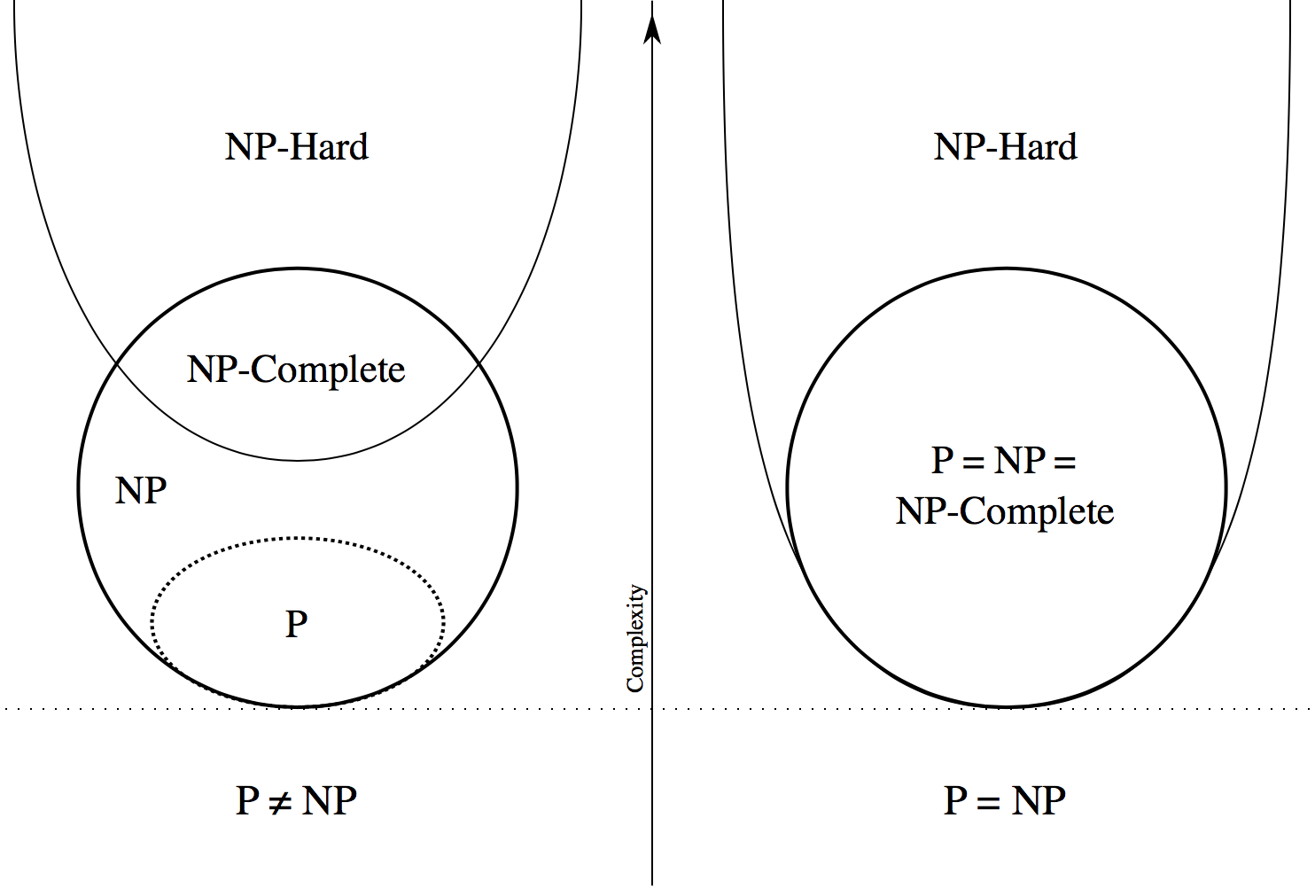

Slide 18
P Versus NP
Originally a curiosity of Computer Science, mathematicians now recognize as one of the most important open problems the question P = NP?
There are thousands of problems that are in NP but appear not to be in P.
But no proof that they aren’t really in P.
Notes:
Are P and NP are really the same class of languages? That is, can any problem that is solved by a nondeterministic Turing machine in polynomial time also solved by some deterministic Turing machine in polynomial time, even if the degree of the polynomial was higher? This question was posed by Steve Cook in 1970. At first, it didn’t seem all that hard or unlikely. After all, nondeterministic finite automata can be simulated by deterministic finite automata, even though the number of states might grow. And deterministic Turing machines can simulate nondeterministic ones.
Click 1
But the problem has proven to be very very difficult, and mathematicians, who once sneered at the question and assumed it was easy because computer scientists had thought it up, now recognize it as one of the most important mathematical questions – perhaps THE most important unsolved question.
Click 2
However, there are thousands of problems that are in NP, but for which no algorithm in P has been found.
Click 3
And unfortunately, neither is there a proof that these problems are NOT in P. What we do have is linkage of a large class of problems, called NP-complete problems, which we discuss on the next slide. What we do know is that either all these problems are in P or none of them are. So they mutually re-enforce the notion that none of them are, since many have been worked on for decades and no polynomial-time algorithms for any of them have been found.

Slide 19
Complete Problems
One way to address the P = NP question is to identify complete problems for NP.
An NP-complete problem has the property that it is in NP, and if it is in P, then every problem in NP is also in P.
Defined formally via “polytime reductions.”
Notes:
Click 1
So we’re going to address the question of whether P=NP by identifying complete problems for NP.
Click 2
Say a problem in NP is NP-complete if the following is true about the problem. If the problem is in P, then P=NP. That is, every problem in NP is also in P. It turns out that almost every problem that is known to be in NP but is not known to be in P is NP-complete.
There is only one well-known exception: graph isomorphism – given two graphs, is there a 1-1 matching of nodes between the two graphs that makes the graphs identical. This problem is known to be in NP (just guess the matching of the nodes in the two graphs and check the right edges exist). But there is no polynomial-time algorithm known, and neither is there a proof that graph isomorphism is NP-complete. But graph isomorphism is an exception to what appears to be almost a general rule: If it’s in NP, and it isn’t known to be in P, then it is NP-complete.
Click 3
While the definition of NP-completeness merely states that there has to be some way of proving P-NP from the assumption that the problem is in P, there is a standard way of making such proofs, and it appears to be sufficient for all the NP-complete problems that we know about. This method involves reductions, of the type we talked about for Turing machines in general, but with the condition that the transducer run in polynomial time as a function of its input size.

Slide 20
Complete Problems – Intuition
A complete problem for a class embodies every problem in the class, even if it does not appear so.
Compare: PCP embodies every TM computation, even though it does not appear to do so.
Strange but true: Knapsack embodies every polytime NTM computation.
Notes:
Click 1
Intuitively, a complete problem for a class embodies, in some sense, every problem in the class.
Click 2
For example, the Post’s Correspondence problem embodies every Turing-machine even though it is hard to see PCP as involving computation -- it seems to be about concatenating strings in constrained ways.
Click 3
So it might surprise you to know that each NP-complete problem, such as Knapsack, embodies all nondeterministic, polynomial-time computation, even though the Knapsack problem seems to be about anything but computation.

Slide 21
Polytime Reductions
Goal: find a way to show problem L to be NP-complete by reducing every language/problem in NP to L in such a way that if we had a deterministic polytime algorithm for L, then we could construct a deterministic polytime algorithm for any problem in NP.
Notes:
So, in order to show a problem L to be NP-complete, we have to show that every problem in NP is somehow embedded in L. We need a transformation from every problem in NP to L, and this transformation has to be sufficiently fast that if we had a deterministic polynomial time algorithm for L, then we could use it to build a deterministic polynomial time algorithm for each problem in NP.

Slide 22
Polytime Reductions – (2)
We need the notion of a polytime transducer – a TM that:
  Takes an input of length n.
  Operates deterministically for some polynomial time p(n).
  Produces an output on a separate output tape.
Note: output length is at most p(n).
Notes:
We are going to define a polynomial-time transducer. Notice that people frequently shorten polynomial-time to “polytime,” and we’ll start doing that too. So a polytime transducer is a deterministic Turing machine that
Click 2
Takes an input whose length is n.
Click 3
Runs for some polynomial number of steps p(n).
Click 4
And produces an output on an output-tape.
Click 5
It is important to observe that, although we do not restrict the output length, since the Turing machine only runs for p(n) steps, it could not write more than p(n) symbols. Thus, the length of the output of a polytime transducer is always polynomial in the length of its input.

Slide 23
Polytime Transducer
state
input
n
scratch
tapes
output
< p(n)
Notes:
Here’s a picture of a polytime transducer. It can have any fixed number of tapes, one is the input tape and one is the output tape. We argued on the last slide that the output length must be polynomial in the length of the input, but the real constraint on the polytime transducer is on how long it runs. It is not acceptable to have it run for time that is exponential in its input length, even if the output is short.

Slide 24
Polytime Reductions – (3)
Let L and M be langauges.
Say L is polytime reducible to M if there is a polytime transducer T such that for every input w to T, the output x = T(w) is in M if and only if w is in L.
Notes:
Consider two languages or problems, say L and M. We say L is polytime-reducible to M if there is a polytime transducer T that takes an input w that is an instance of L, produces output x that is an instance of M, and the answer to L on w is the same as the answer to M on x. That is, w is in L if and only if x is in M.

Slide 25
Picture of Polytime Reduction
in L
not
in L
in M
T
not in M
Notes:
Here’s a picture to help us remember what a polytime reduction does. On the left is the set of strings over the alphabet of L, divided into those that are in L and those that are not in L. On the right is the set of strings over the alphabet of M, also divided between M and its complement. In the middle is the polytime transducer T.
Click 1
Every string in L is transformed by T into a string that is in M. There can be strings in M that are not the target of any string in L.
Click 2
And every string not in L, but over the alphabet of L, is transformed by T into a string that is over the alphabet of M but is not in M. Again, there can be strings in the complement of M that are not the target of any string in the complement of L.

Slide 26
NP-Complete Problems
A problem/language M is said to be NP-complete if it is in NP, and for every language L in NP, there is a polytime reduction from L to M.
Fundamental property: if M has a polytime algorithm, then so does L.
  I.e., if M is in P, then every L in NP is also in P, or “P = NP.”
Notes:
Click 1
Formally, we say a problem or language M is NP-complete if, first of all, it is in NP, and for every language L in NP, there is a polytime reduction from L to M.
Click 2
An important consequence of the fact that M is NP-complete is that if M has a polytime algorithm, then so does every L in NP. That is, the class of languages P and NP are the same, or P=NP.
Notice that earlier, we suggested that the definition of NP-completeness was simply that the language had this property (POINT). Steve Cook’s original definition of NP-completeness was exactly that, and it is often referred to as “Cook completeness.” Cook concentrated on showing one particular problem – the question of whether an expression of proposeitional logic was satisfiable, that is, made true by some assignment of truth values to the propositional variables.
But shortly after Cook wrote his original paper on NP-completeness, Dick Karp wrote another paper that showed many of the classical problems that had been puzzling mathematicians, sometimes for centuries, were NP-complete. Karp used only polytime reductions to the problem Cook had proved NP-complete. Since then, it is generally accepted that the preferred definition of NP-completeness is the one we gave here – the existence of polytime reductions. To make the distinction, this notion of NP-completeness is often called Karp-completeness.

Slide 27
The Plan
All of NP polytime
reduces to SAT, which
is therefore NP-complete
SAT polytime
reduces to
3-SAT
NP
SAT
3-
SAT
3-SAT polytime reduces
to many other problems;
they’re all NP-complete
Notes:
So here’s the plan for proving certain problems to be NP-complete. Here’s all of NP.
Click 1
SAT – the satisfiability problem for propositional logic that we just discussed is one problem in NP.
Click 2
Cook’s theorem is that every problem in NP reduces in polytime to SAT, so SAT is the first known NP-complete problem.
Click 3
Cook also proved a restricted form of SAT, called 3-SAT, is NP-complete by reducing SAT to 3SAT. We’ll learn what the 3SAT restriction is shortly, but in brief, it is SAT restricted to expressions that are the AND of clauses with three literals per term. A literal is a variable or a negated variable, and a clause is the OR of literals.
Click 4
Then from 3SAT, we do polytime reductions to many other problems, either directly or indirectly. Each problem we can reach from SAT by a chain of polytime reductions is thus proved NP-complete.

Slide 28
Proof That Polytime Reductions “Work”
Suppose M has an algorithm of polynomial time q(n).
Let L have a polytime transducer T to M, taking polynomial time p(n).
The output of T, given an input of length n, is at most of length p(n).
The algorithm for M on the output of T takes time at most q(p(n)).
Notes:
But before we embark on this quest, let’s make sure that polytime reductions work, in the sense that they let us draw the desired conclusion about all of NP reducing to the target problem.
Click 1
So suppose M has a polytime algorithm, say running in time q(n) for some polynomial q.
Click 2
Let there be a polytime transducer T from some problem L to M, and let the time taken by T be p(n), for some polynimal p.
Click 3
The output of T, given an input of length n, is at most of length p(n).
Click 4
So when we run the algorithm for M on this input of length p(n), the algorithm takes time q(p(n)). Note that a polynomial of a polynomial is a polynomial. The degrees of the polynomial are multiplied, but it’s still a polynomial.

Slide 29
Proof – (2)
We now have a polytime algorithm for L:
  Given w of length n, use T to produce x of length < p(n), taking time < p(n).
  Use the algorithm for M to tell if x is in M in time < q(p(n)).
  Answer for w is whatever the answer for x is.
Total time < p(n) + q(p(n)) = a polynomial.
Notes:
Click 1
We claim there is a polytime algorithm for L.
Click 2
Given an input w of length n for L, apply the transducer T to w. The result is an output x of length at most p(n). And more importantly, T takes time only p(n) to produce this output.
Click 3
Apply to x the algorithm to tell whether it is in M. As we observed on the previous slide, this part takes time q(p(n)).
Click 4
Return as the answer for w whatever the M-algorithm says about x.
Click 5
The total time of this algorithm is p(n) + q(p(n)), which is polynomial if p and q are. It is a correct algorithm because the fact that T is a polytime transducer from L to M says that the answers to input w and output x are the same.

