Slide 1
Functions of Several Variables

Slide 2

Set of Points

Slide 3
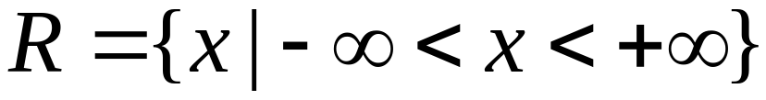
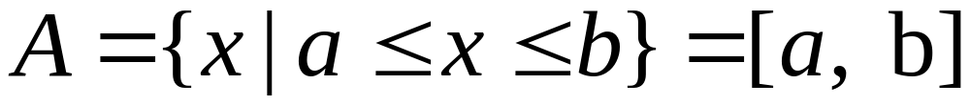


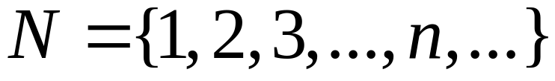
直线 R 中的点集
实数集，一维空间
区间
自然数集

Slide 4
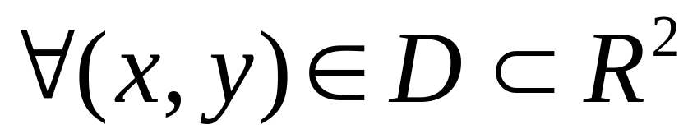
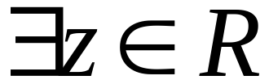
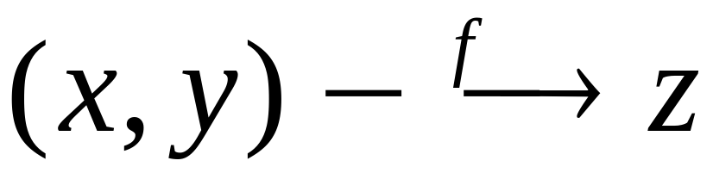
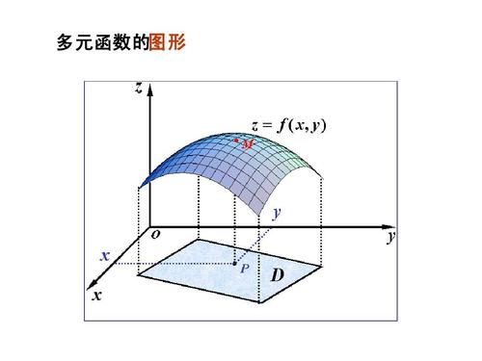
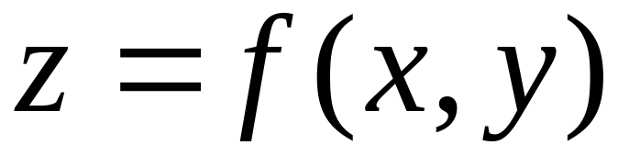
Definition
D：domain
f：rule

Slide 5
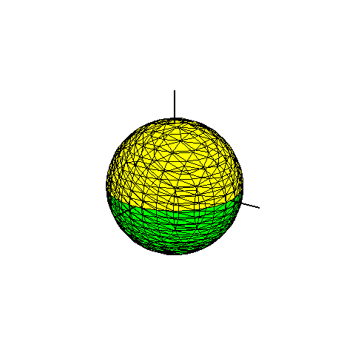
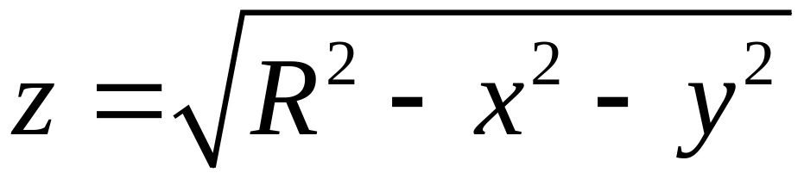
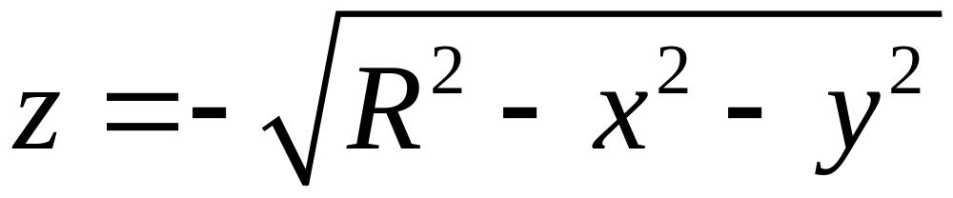
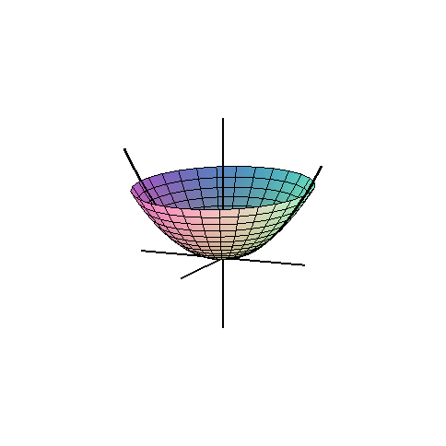
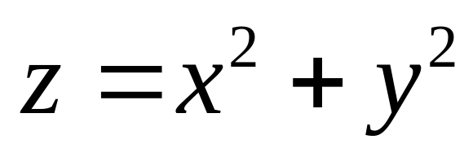

Slide 6
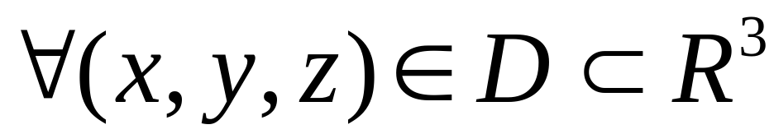
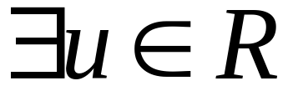
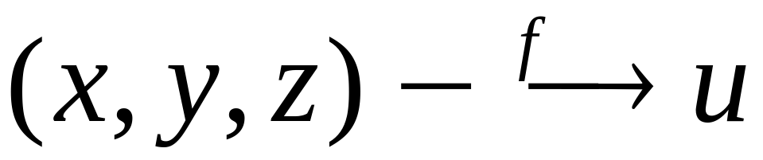
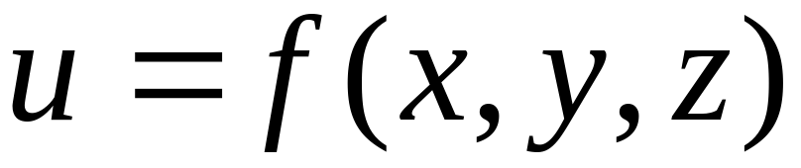
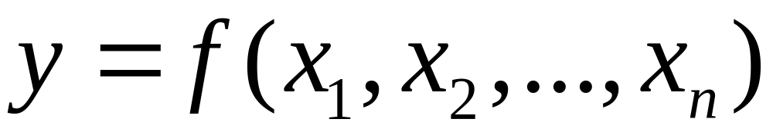
Definition
Functions of n variable

Slide 7
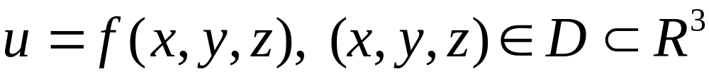
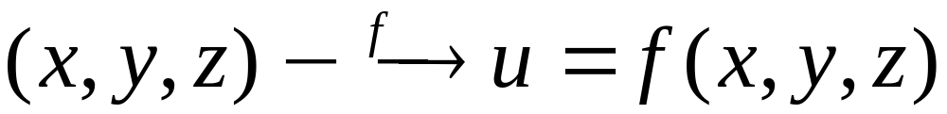
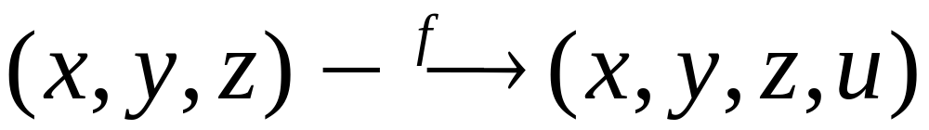
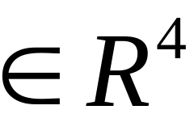
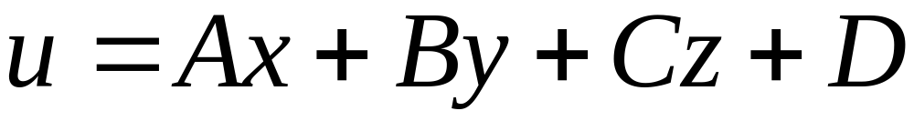
Graphs of functions of 3 variables?
In 4 dimension space！
我们用肉眼是看不见的

Slide 8
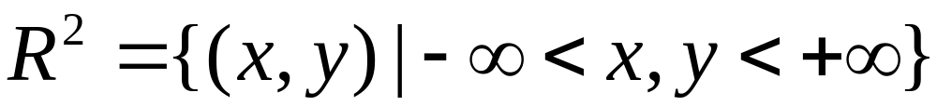
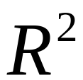
平面中的点集
实平面，二维空间

Slide 9
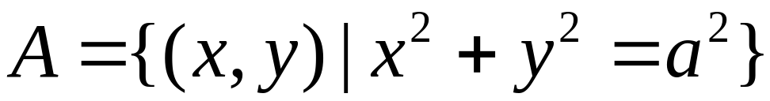

平面中的点集
A Circle

Slide 10
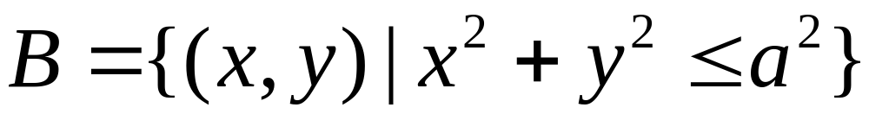

圆域

Slide 11
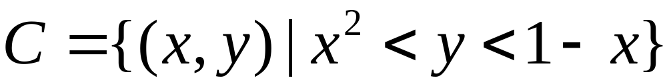
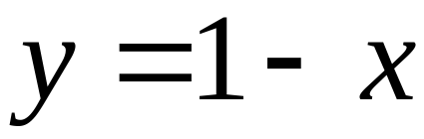
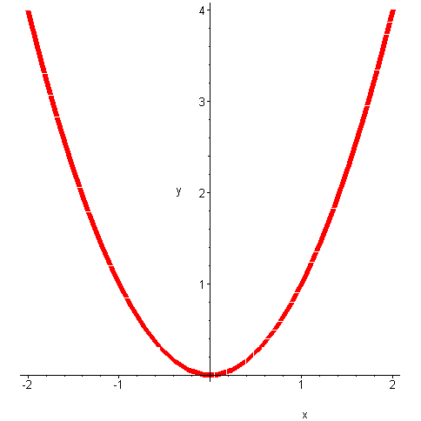
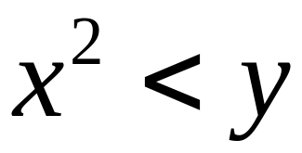
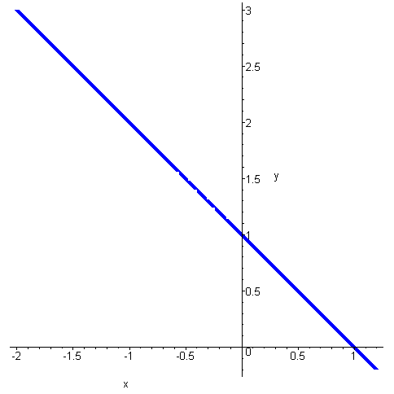
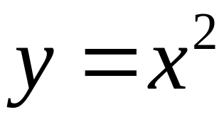
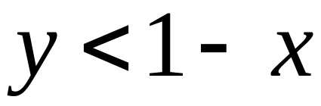
with(student):with(plots):
quxian:=implicitplot(y=x^2,x=-2..2,y=-0.2..4):
zhixian:=implicitplot(y=1-x,x=-2..2,y=-0.2..4,color=blue):
display(quxian,zhixian,scaling=constrained,thickness=6);

Slide 12
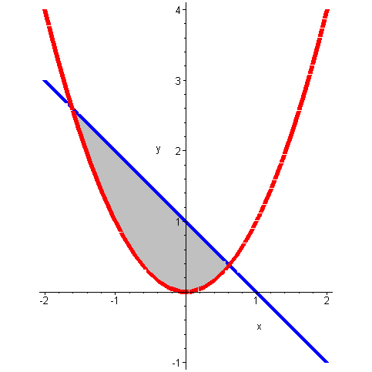

with(student):with(plots):
quxian:=implicitplot(y=x^2,x=-2..2,y=-0.2..4):
zhixian:=implicitplot(y=1-x,x=-2..2,y=x^2..1-x,color=blue):
region:=implicitplot(y=1-x,x=-(sqrt(5)+1)/2..(sqrt(5)-1)/2,y=x^2..1-x,color=grey,filled=true):
display(quxian,zhixian,region,scaling=constrained,thickness=6);

Slide 13
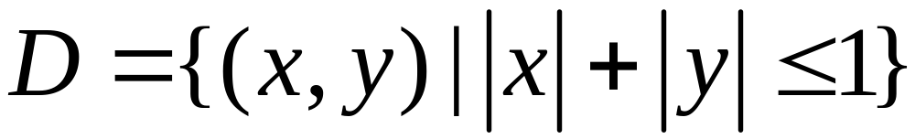
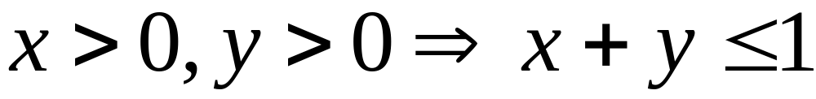
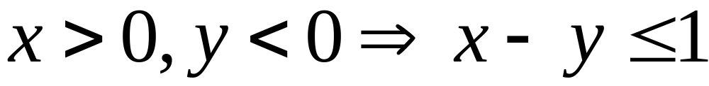
with(student):with(plots):
quxian:=implicitplot(y=x^2,x=-2..2,y=-0.2..4):
zhixian:=implicitplot(y=1-x,x=-2..2,y=-0.2..4,color=blue):
display(quxian,zhixian,scaling=constrained,thickness=6);

Slide 14
with(student):with(plots):
quxian:=implicitplot(y=x^2,x=-2..2,y=-0.2..4):
zhixian:=implicitplot(y=1-x,x=-2..2,y=-0.2..4,color=blue):
display(quxian,zhixian,scaling=constrained,thickness=6);

Slide 15
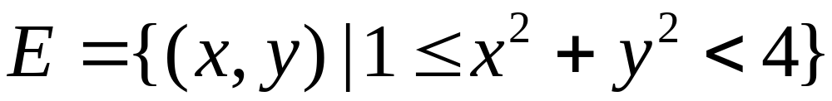
圆环域

Slide 16
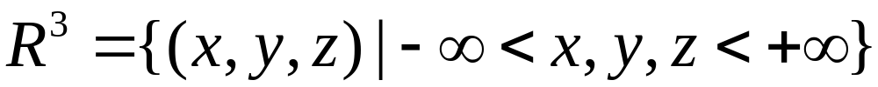
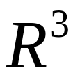
空间中的点集
实空间，三维空间

Slide 17
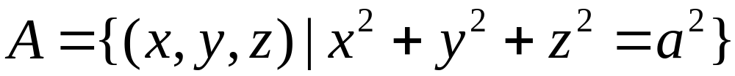
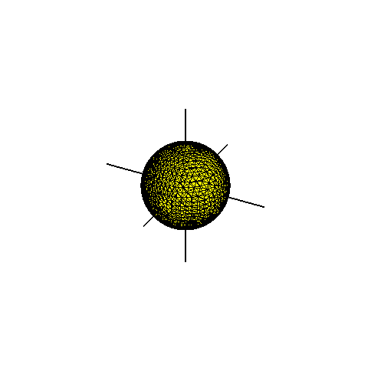
球面
with(plots):
qiumian:=implicitplot3d(x^2+y^2+z^2=1,x=-1..1,y=-1..1,z=-1..1,color=yellow,grid=[20,20,20]):
x_axis:=plot3d([u,0,0],u=-2..2,v=0..0.01,thickness=2):
y_axis:=plot3d([0,u,0],u=-2..2,v=0..0.01,thickness=2):
z_axis:=plot3d([0,0,u],u=-2..2,v=0..0.01,thickness=2):
display(qiumian,x_axis,y_axis, z_axis,orientation=[23,66],scaling=constrained);

Slide 18
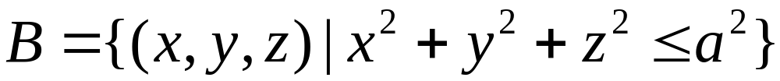
球体
with(plots):
qiumian:=implicitplot3d(x^2+y^2+z^2=1,x=-1..1,y=-1..1,z=-1..1,color=yellow,grid=[20,20,20]):
x_axis:=plot3d([u,0,0],u=-2..2,v=0..0.01,thickness=2):
y_axis:=plot3d([0,u,0],u=-2..2,v=0..0.01,thickness=2):
z_axis:=plot3d([0,0,u],u=-2..2,v=0..0.01,thickness=2):
display(qiumian,x_axis,y_axis, z_axis,orientation=[23,66],scaling=constrained);

Slide 19
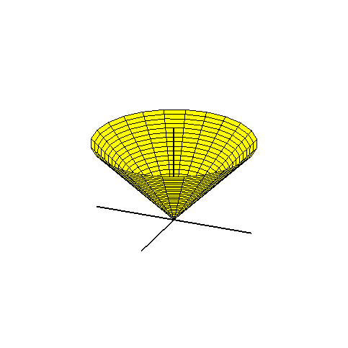
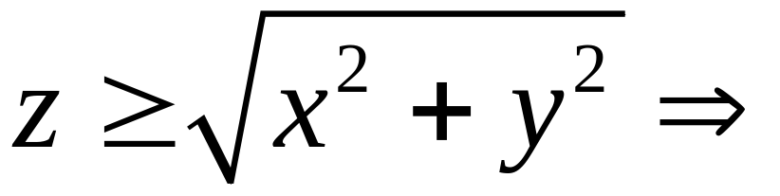
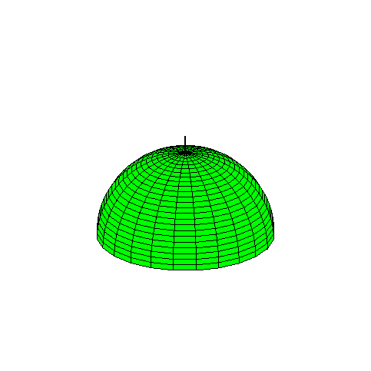
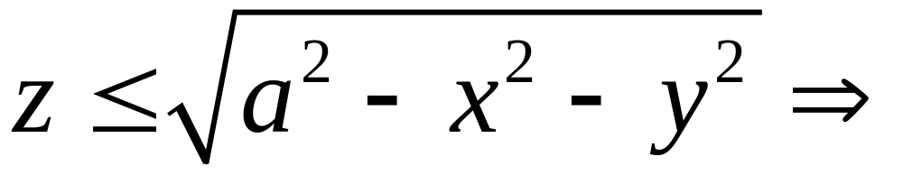
with(plots):
zuimian:=plot3d([r*cos(t),r*sin(t),r],t=0..2*Pi,r=0..1.2,color=yellow):
qiumian:=plot3d([sin(s)*cos(t),sin(s)*sin(t),cos(s)],s=0..Pi/2,t=0..2*Pi,color=green):
x_axis:=plot3d([u,0,0],u=-1.2..1.2,v=0..0.01,thickness=2):
y_axis:=plot3d([0,u,0],u=-1.2..1.2,v=0..0.01,thickness=2):
z_axis:=plot3d([0,0,u],u=0..1.2,v=0..0.01,thickness=2):
display(zuimian,qiumian,x_axis,y_axis, z_axis,orientation=[23,66],scaling=constrained);

Slide 20
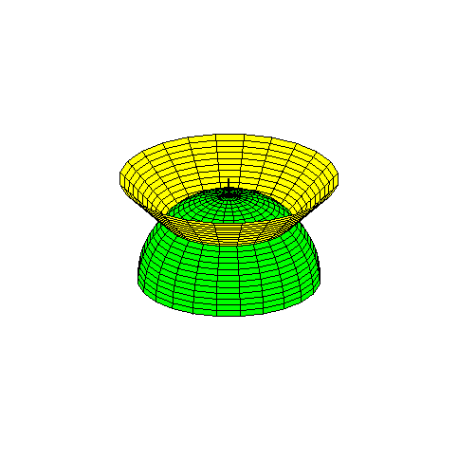
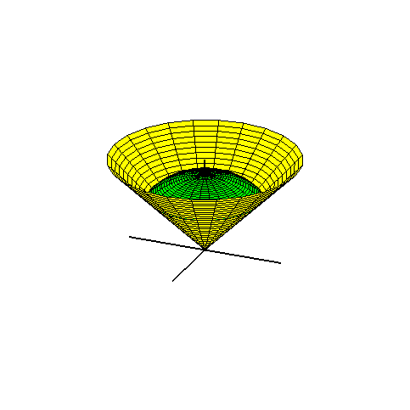


球顶锥体
蛋卷冰淇淋
with(plots):
qiumian:=plot3d([r*cos(t),r*sin(t),r],t=0..2*Pi,r=0..1/sqrt(2),color=yellow):
zuimian:=plot3d([sin(s)*cos(t),sin(s)*sin(t),cos(s)],s=0..Pi/4,t=0..2*Pi,color=green):
x_axis:=plot3d([u,0,0],u=-1..1,v=0..0.01,thickness=2):
y_axis:=plot3d([0,u,0],u=-1..1,v=0..0.01,thickness=2):
z_axis:=plot3d([0,0,u],u=0..1.2,v=0..0.01,thickness=2):
display(qiumian,zuimian,x_axis,y_axis, z_axis,orientation=[23,66],scaling=constrained);

Slide 21







邻域（neighborhood）
回忆： R 中的邻域：

Slide 22




平面中的邻域
点 的 邻域：
开圆域

Slide 23


空间中的邻域
点 的 邻域：
开球体

Slide 24



内点（interior point)
点 是点集 V 的一个内点，如果存在
使
V 的内点属于V

Slide 25

外点（exterior point)
点 是点集 V 的一个外点，如果存在
使
V 的外点不属于V

Slide 26



边界点（boundary point)
点 是点集 V 的一个边界点，如果对任何
都有
V 的边界点可以属于V，
也可以不属于V

Slide 27

开集（open set）
点集 D 是开集是指它的每一个点都是其内点。
开集不包含它的任何边界点

Slide 28

开集的例子
开区间是 R 中的开集

Slide 29

开集的例子
开圆域是 R² 中的开集

Slide 30

闭集（closed set)
点集 D 是闭集是指它包含了它的每一个边界点。

Slide 31
闭集的例子
闭区间是R中的闭集
[a, b] 的边界点是 a 和 b

Slide 32

闭集的例子
闭圆域是R²中的闭集
D 的边界是圆周

Slide 33

既不开，也不闭的集合
半开半闭区间
(a, b] 的边界点是 a 和 b

Slide 34

既不开，也不闭的集合
内开外闭的圆环
D 的边界是 两个圆周

Slide 35




连通集（connected set)
点集 是 中的连通集，如果对D中任意的两点P，Q，都可以由D中的直线或折线连接起来。

Slide 36
连通集
同胚的

Slide 37
非连通集

Slide 38





R 中的区间 [a, b] 是连通集
但 不连通

Slide 39
开区域（open region)：连通的开集
闭区域（closed region)：连通的闭集

Slide 40

有界点集（bounded set）
D是 中的有界点集，如果存在 k > 0,使得
否则称 D是 中的无界点集

Slide 41
D是 中的有界点集当且仅当D可以被包围在一个圆内。

Slide 42
D是无界点集当且仅当D不能被包围在任何一个圆内。

Slide 43

例子
有界开区域：有界、开、连通

Slide 44

有界闭区域：有界、闭、连通

Slide 45

无界开区域：无界、开、连通

Slide 46


Recall: functions of a single variable

Slide 47







Example of function of several variables
Area of a rectangle as a function of its width and height
Volume of a cuboid as a function of its length, width and height

Slide 48


Slide 49


Slide 50
Definition
D：domain
f：rule

Slide 51
Definition
Functions of n variable

Slide 52


Find its domain
Example
Closed disk

Slide 53




Example

Slide 54





Example

Slide 55


Piecewise defined function
The real plane

Slide 56
Graphs of functions of two variables

Slide 57

Functions of one variable

Slide 58




y=f(x) Graph

Slide 59



Functions of two variables

Slide 60


z=f(x, y) Graph

Slide 61



Example
Paraboloid of revolution
> plot(x^2,x=-1.5..1.5,thickness=5,scaling=constrained,axes=none);
with(plots):
qumian:=implicitplot3d(y^2+x^2=z,x=-1.5..1.5,y=-1.5..1.5,z=0..2,scaling=constrained,color=green):
x_axis:=plot3d([u,0,0],u=-2..2,v=0..0.01,thickness=3):
y_axis:=plot3d([0,u,0],u=-2..2,v=0..0.01,thickness=3):
z_axis:=plot3d([0,0,u],u=0..4,v=0..0.01,thickness=3):
display(qumian,x_axis,y_axis,z_axis);

Slide 62


the upper hemisphere
with(plots):
qiumian:=plot3d([sin(s)*cos(t),sin(s)*sin(t),cos(s)],s=0..Pi/2,t=0..2*Pi):
x_axis:=plot3d([u,0,0],u=-1.2..1.2,v=0..0.01,thickness=2):
y_axis:=plot3d([0,u,0],u=-1.2..1.2,v=0..0.01,thickness=2):
z_axis:=plot3d([0,0,u],u=0..1.2,v=0..0.01,thickness=2):
display(qiumian,x_axis,y_axis, z_axis,orientation=[23,66],scaling=constrained);

Slide 63


Circular cone
with(plots):
zuimian:=plot3d([r*cos(t),r*sin(t),r],t=0..2*Pi,r=0..1.2,color=yellow):
x_axis:=plot3d([u,0,0],u=-1.2..1.2,v=0..0.01,thickness=2):
y_axis:=plot3d([0,u,0],u=-1.2..1.2,v=0..0.01,thickness=2):
z_axis:=plot3d([0,0,u],u=0..1.2,v=0..0.01,thickness=2):
display(zuimian,x_axis,y_axis, z_axis,orientation=[23,66],scaling=constrained);

Slide 64


Upper circular cylinder
with(plots):
qumian:=implicitplot3d(z^2+x^2=1,x=-1.1..1.1,y=-1.1..1.1,z=0..1,scaling=constrained):
x_axis:=plot3d([u,0,0],u=-2..2,v=0..0.01,thickness=3):
y_axis:=plot3d([0,u,0],u=-2..2,v=0..0.01,thickness=3):
z_axis:=plot3d([0,0,u],u=0..2,v=0..0.01,thickness=3):
display(qumian,x_axis,y_axis,z_axis);

Slide 65

plane

Slide 66



More Examples
with(plots):
qumian:=implicitplot3d(sin(x)+sin(y)=z,x=-5..5,y=-5..5,z=-2..2,scaling=constrained,color=green,numpoints=10000):
x_axis:=plot3d([u,0,0],u=-6..6,v=0..0.01,thickness=3):
y_axis:=plot3d([0,u,0],u=-6..6,v=0..0.01,thickness=3):
z_axis:=plot3d([0,0,u],u=0..3,v=0..0.01,thickness=3):
display(qumian);

Slide 67


with(plots):
qumian:=implicitplot3d(sin(x)+sin(y)=z,x=-5..5,y=-5..5,z=-2..2,scaling=constrained,color=green,numpoints=10000):
x_axis:=plot3d([u,0,0],u=-6..6,v=0..0.01,thickness=3):
y_axis:=plot3d([0,u,0],u=-6..6,v=0..0.01,thickness=3):
z_axis:=plot3d([0,0,u],u=0..3,v=0..0.01,thickness=3):
display(qumian);

Slide 68


with(plots):
qumian:=plot3d(sin(x)*sin(y)/(x*y),x=-10..10,y=-10..10):
display(qumian);

Slide 69



with(plots):
qumian:=plot3d(x*y*exp(-x^2-y^2),x=-3..3,y=-3..3,numpoints=2000,color=green):
display(qumian,orientation=[5,70]);

Slide 70




Implicitly defined function
with(plots):
zuimian1:=plot3d([y*cos(t),y*sin(t),y],y=0..3,t=0..2*Pi,color=yellow):
zuimian2:=plot3d([y*cos(t),y*sin(t),y],y=-3..0,t=0..2*Pi,color=green):
x_axis:=plot3d([u,0,0],u=-3..3,v=0..0.01,thickness=2):
y_axis:=plot3d([0,u,0],u=-3..3,v=0..0.01,thickness=2):
z_axis:=plot3d([0,0,u],u=-3..3,v=0..0.01,thickness=2):
display(zuimian1,zuimian2,x_axis,y_axis, z_axis,orientation=[23,66],scaling=constrained);

Slide 71



with(plots):
qiumian:=implicitplot3d(x^2+y^2+z^2=1,x=-1..1,y=-1..1,z=0..1,color=yellow):
qiumian1:=implicitplot3d(x^2+y^2+z^2=1,x=-1..1,y=-1..1,z=-1..0,color=green):
x_axis:=plot3d([u,0,0],u=-1..1.5,v=0..0.01,thickness=2):
y_axis:=plot3d([0,u,0],u=-1..1.5,v=0..0.01,thickness=2):
z_axis:=plot3d([0,0,u],u=-1..1.5,v=0..0.01,thickness=2):
display(qiumian,qiumian1,x_axis,y_axis,z_axis,orientation=[23,66],scaling=constrained);

Slide 72








Evaluating functions of two several variables
Example
Solution

Slide 73







More examples
Example
Solution

